Slide 1




College Success Forum-Robert Morris University
Horizon Scholars Program: Supporting Youth
with Foster Care Experience
Presenters
Micah J. Reed, M.A.
Rosie Hogan, MSW
Anika Jones, M. Ed
Notes:
Micah intro

Slide 2
Learning Goals, Outcomes, & Objectives
Goals
Objectives
Outcomes
Gain a deeper understanding of how students who have experienced foster care are supported through the University of Pittsburgh.
During the presentation participates will be able to.....
  Examine statistics and facts on the challenges youth with foster care experience when navigating higher education
  Analyze how institutional departments, local organizations, and social services help to expand the program’s reach.
As a results of viewing the presentation participates will be able to.....
  List 3 barriers to higher education for youth in foster care.
  Identify 3 challenges that youth who have experienced foster care face when applying to college.
  Compare and Contrast how your current role supports the youth who have experienced foster care.
  Discuss gaps of support for youth who have experienced foster care.
Notes:
Micah

Slide 3



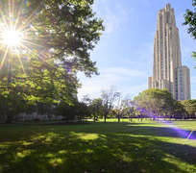

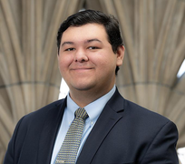






GET TO KNOW THE EOC TEAM
Lena Dowdell
Associate Director
Anika Jones
Manager of Pathway Development
Lydia Pettis
Administrative Assistant
Micah Reed
Manager of Access and
Student Success
Dominick Daniels
Coordinator of Access and
Student Success
Alec Barlock
Pathway Development &
Outreach Coordinator
Rosie Hogan
Pathway Development &
Outreach Coordinator
Student Workers
Program Assistants, Academic Mentors, Social Media Intern
Shelby Woodard
Social Work Intern

Slide 4


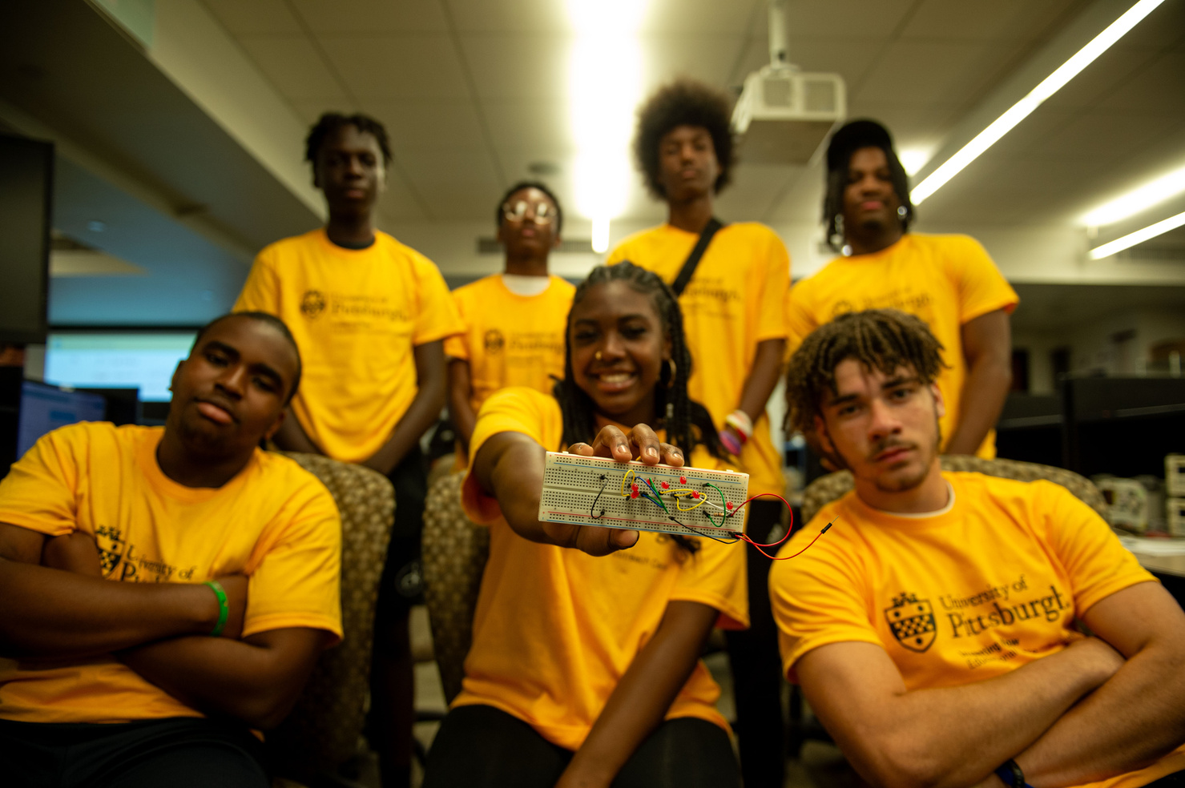




Who is the EOC?
Vision Statement
"The University EOC is dedicated to building more equitable pathways for all students to gain the potential to enroll at the University of Pittsburgh or other selective colleges and universities" (Cudd, 2022)
Mission Statement
The mission of the University Educational Outreach Center (EOC) is to serve as the epicenter for all University of Pittsburgh academic outreach efforts. The Center maintains an infrastructure that operationalizes collaborations and leverages the assets of the university and external communities to enhance college admissions from matriculation through graduation for underserved and underrepresented students
Notes:
Anika

Slide 5





Who is the EOC?
Values
Synergy
Equity
Strengths-Based
Culturally Sustaining
Reciprocity
Notes:
Rosie
The values of EOC are the deeply held beliefs that drive the behaviors of the Educational Outreach Center and the people who support it. These highly esteemed beliefs are:
Equity – “The proportional distribution of desirable outcomes across groups. Sometimes confused with equality, equity refers to outcomes while equality connotes equal treatment. More directly, equity is when an individual’s race, gender, socio-economic status, sexual orientation, etc. do not determine their educational, economic, social, or political opportunities” (Diversity.pitt.edu)3.
Strengths-based – “Emphasizes identifying and enhancing natural supports, networks and assets” ​ (Briscoe, Keller, McClain, & Best, 2009)​4
Synergy – “The advantage that partnerships gain by involving diverse people and organizations in the community” (Lasker & Weiss, 2003)5.
Reciprocity – “A continuous and intentional practice of valuing and drawing on the various forms of knowledge, resources and other assets that each person, contributes to the shared activity and outcomes to a degree that the experience is felt by all to be equitable” (Janke & Clayton, 2012; Dostilio et al., 2012 as cited in Janke, Medlin, Norris, & Shelton, 2019)6
Culturally sustaining – “Understanding youths’ familial and community backgrounds, ways of understanding and engaging the world, needs, and networks”​ (Delale-O'Connor, et al., 2021)​7, which “center youths’ interests, experiences, and understandings in their learning”​ (Briscoe, Keller, McClain, & Best, 2009)​8.

Slide 6


What Percentage of Youth with foster care experience ages 17-18 say they want to go to college?
84%
(Legal Center for Foster Care & Education, 2022)
Notes:
Micah

Slide 7


What percentage of youth with foster care experience earn a college Degree?
3-11%
38% is the national average
(Legal Center for Foster Care & Education, 2022)
Notes:
Anika

Slide 8











Challenges and Barriers
Housing Instability
Housing Instability
Graduation Rates
Educational Instability
Inconsistent educational support, academic opportunities, and documentation
Unexpected changes, Housing Required During Breaks
Financial
Limited Resources, Unexpected Financial Hardships/Obligations, Support Navigating Process
Resource Navigation
Familial & Social Support
Limited Communication, Transparency, and Access to an Informed Resource
College Exploration & Readiness Support
Different levels of emotional and academic guidance
Inconsistent educational support, Informed Resources, and Opportunities
Notes:
Micah
According to a 2023 report from the Pennsylvania Department of Human Services (DHS), the graduation rate for foster youth remains substantially lower than their peers. In Pennsylvania, only 50-60% of youth in foster care graduate high school, compared to the state’s overall high school graduation rate of around 88%.
2023 Pennsylvania Foster Youth Education Data Report reveals that approximately 70% of foster youth who age out of the system do not have the financial resources needed to pay for higher education, resulting in significant barriers to enrollment and retention.
In 2023, a Pennsylvania Youth Advocacy Board report highlighted that 1 in 5 foster youth in the state experiences homelessness or housing instability after aging out of the system, which severely impacts their ability to succeed in higher education. Many students struggle to secure stable housing during their college years, and those without supportive housing options often have to drop out or take time off to find a place to live.
A 2023 report by FosterClub indicated that only 30% of foster youth in Pennsylvania reported being fully aware of all the resources available to them on campus, leaving many to miss out on critical support.

Slide 9


PA Policy & Support Initiatives
Fostering Independence Tuition Wavier
The Chafee Education and Training Grant Program
Campus Support Programs
PA Youth Advisory Board and Foster Youth Coalition
Notes:
Anika
According to a 2023 report from the Pennsylvania Department of Human Services (DHS), the graduation rate for foster youth remains substantially lower than their peers. In Pennsylvania, only 50-60% of youth in foster care graduate high school, compared to the state’s overall high school graduation rate of around 88%.
2023 Pennsylvania Foster Youth Education Data Report reveals that approximately 70% of foster youth who age out of the system do not have the financial resources needed to pay for higher education, resulting in significant barriers to enrollment and retention.
In 2023, a Pennsylvania Youth Advocacy Board report highlighted that 1 in 5 foster youth in the state experiences homelessness or housing instability after aging out of the system, which severely impacts their ability to succeed in higher education. Many students struggle to secure stable housing during their college years, and those without supportive housing options often have to drop out or take time off to find a place to live.
A 2023 report by FosterClub indicated that only 30% of foster youth in Pennsylvania reported being fully aware of all the resources available to them on campus, leaving many to miss out on critical support.

Slide 10


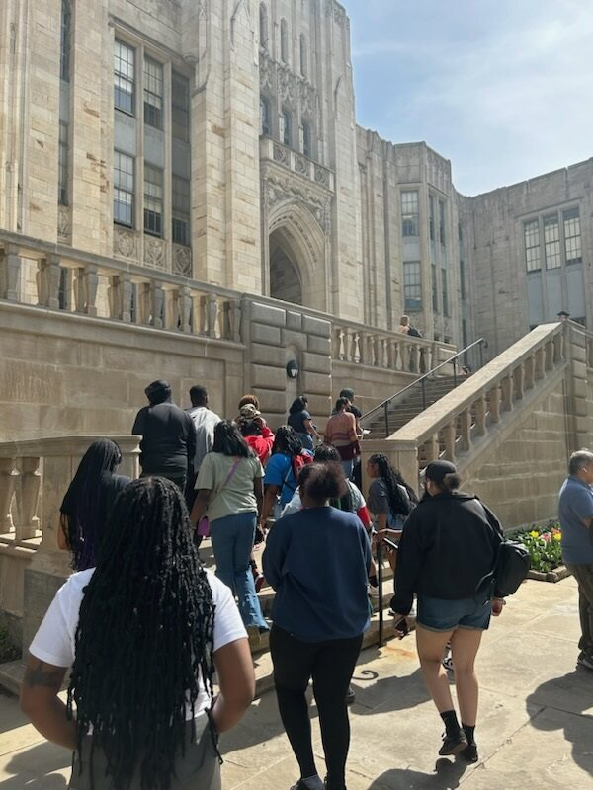
Initiative designed to provide comprehensive support to prospective and current Pitt Panthers who have experienced the child welfare system, guiding them to and through their educational journey.
This collaborative effort is led by the Educational Outreach Center and the Office of the Provost, in partnership with the School of Social Work, School of Public Health, the Office of Admissions and Financial Aid, and other units across Pitt.
This Campus Support Program aims to tackle the distinctive challenges faced by Horizon Scholars that impede persistence, retention, and graduation.
Notes:
Rosie

Slide 11


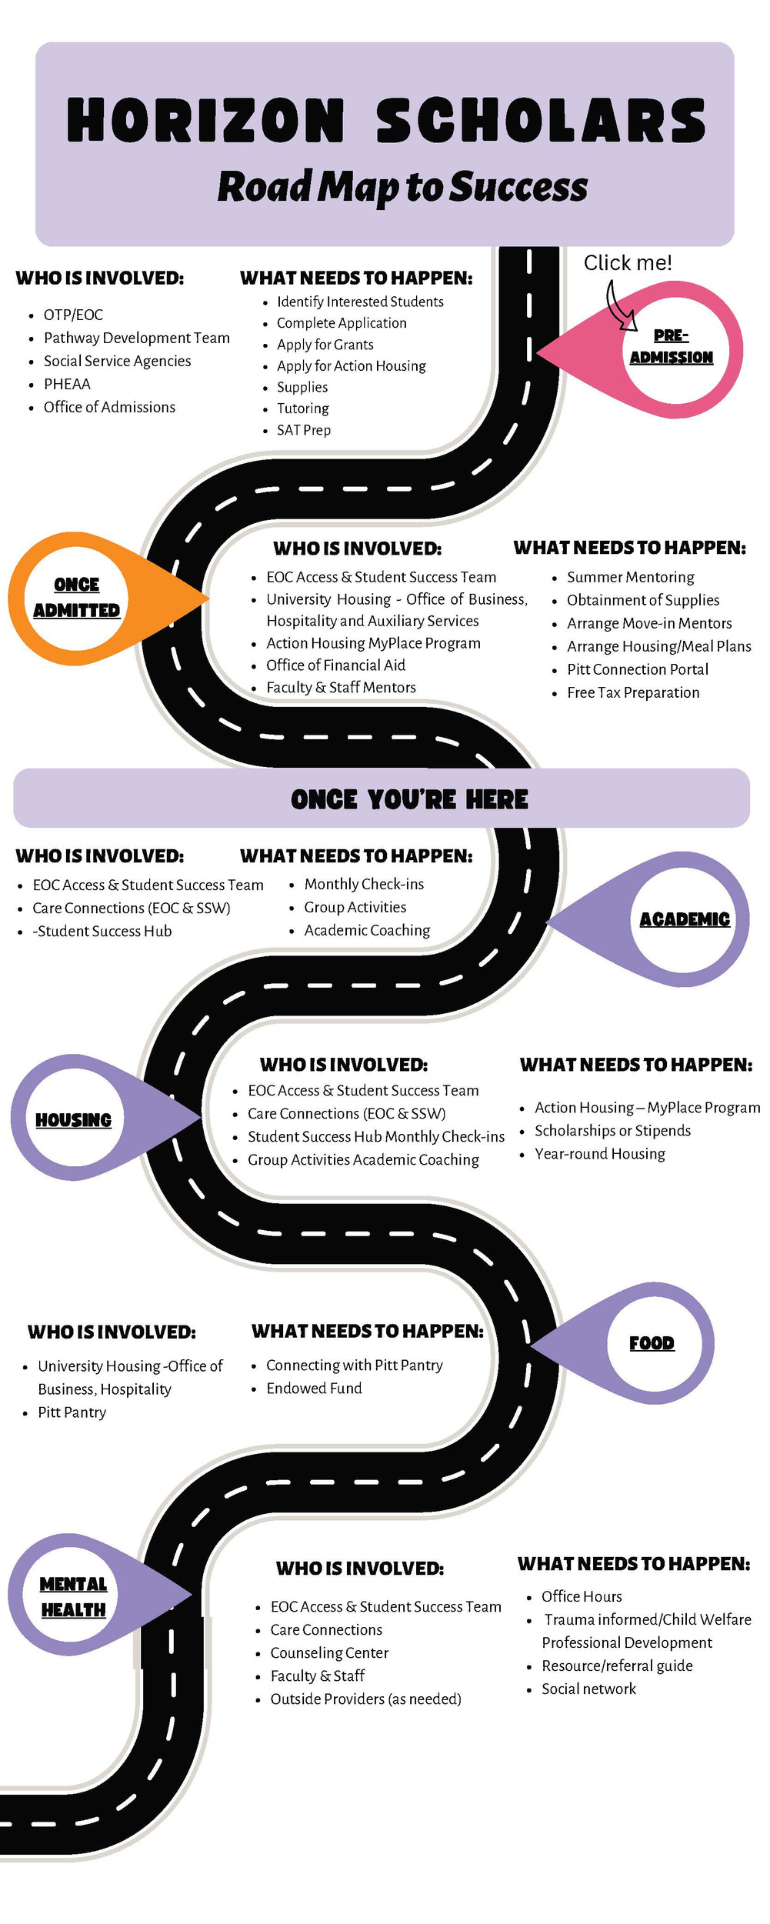

Notes:
Anika

Slide 12





Pitt Connection Portal
The Pitt Connection Portal initiative will provide a “warm” hand off between the Pathway Development Subunit and the Access & Student Success Subunit, ensuring that students interested in matriculating to Pitt will be supported during transition points.
Pathway Development Programs Subunit
Access and Student Success Subunit
Notes:
Anika

Slide 13

Pre-College Support
College Readiness
Academic Support
Guidance on college navigation, application processes, and financial aid
Access to Academic Support Resources: Tutoring, PSAT/SAT Prep, etc.
Career Exploration
Exposure to variety of career pathways and guidance through the exploration process
Notes:
Rosie

Slide 14

Campus Support
Resource Navigation
Mentorship
Trusted campus resource and professional to navigate academic and personal challenges
Assistance with housing, financial aid, academic, and other campus resources
Community
Study Abroad
Opportunities to connect with professionals and other students to develop sense of belonging
Support students in broadening their cultural experiences
Notes:
Micah

Slide 15




Current Horizon Scholar Testimonial
Meet Xavier LIttlejohn
Class Rank-Junior
Major-Social Work
Aspiring Social Worker, plans to work with Youth in Foster Care.
Notes:
Micah

Slide 16



It Takes a Village:
Campus Advisory Committee of Action
Admission & Financial Aid, Office of Inclusion & Belonging, University Counseling Center, Office of Business and Auxiliary Services, Care and Resource Support, Student Success Initiatives, School of Social Work, School of Public Health, School of Health and Rehabilitation Sciences, Student Health Center, and a Horizon Scholar.
Representatives from Pitt Bradford, Johnstown & Greensburg.
Notes:
Anika

Slide 17









Building a stable support network with the Pittsburgh Community and Beyond
Community Organizations Working with Population
PA Youth Advisory Boards
Ex: Homeless Youth Education Fund, Youth Enrichment Services
PA Campus Support Programs
Foster Care to College - The Field Center at Penn
Foster & Kinship Care Placement Agencies
Community Resources
Caseworkers & Educational Liaisons
Ex: Action Housing MyPlace Youth Programs, The 412 Youth Zone
Ex: A Second Chance, Inc.
Allegheny County Office of Children, Youth and Families
Notes:
Rosie

Slide 18





Small Group Discussion
What are resources does your institution/organization currently have to support this population?
How does your current role impact this population?
What are support and resource gaps at your institution/organization?
Notes:
Anika
Discussion- 9 minutes for groups (3 minutes per question.)
5 minutes share out

Slide 19





Call to Action
What are ways educators can support students with foster care experience?
  Professional development for faculty and staff to better understand the needs of youth and how to support them.
    Conferences
    College and University Site Visits
    Trainings
  College and Resource Navigation
How Institutions Can Provide Long-Term Support
  Creating institutional policies that prioritize youth with experience with the child welfare and foster care .
  Expanding scholarships, financial aid, and housing programs specifically for students with foster care backgrounds.
    Housing Scholarships
Notes:
Rosie

Slide 20
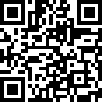

Pre-College Horizon Scholar
Career Panel
The hybrid panel will feature professionals who have lived experience in the child welfare/foster care system sharing their professional journeys and experiences of resilience.
March 5th, 2025
4:30 - 6:00 PM
RSVP here!

Slide 21
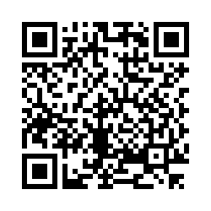
What questions do you have for us?
Use this QR Code to submit questions and feedback
Notes:
Micah

Slide 22







Follow us on social media!
Contact Information
@PittEOC
Manager of Pathway Development, Anika Jones
Email: agj16@pitt.edu
Phone: 412-383-3741
Manager of Access & Student Success, Micah Reed
Email: mjr266@pitt.edu
Phone: 412-624-3607
@pitteducationaloutreach

