Slide 1
Welcome to Speed Dating with your Business Partners
You may know who your business partners work for, but do you know much more about them?
This session is to break down those barriers, increase communication and have a little fun by learning just a bit more about who they are!
College Ave Student Loans
Sallie Mae
SoFi
Cognition Financial
Inceptia
PHEAA
CampusLogic
McClintock & Associates
Citizens
Credible
PNC Student Lending
Ocelot
IHELP Private Student Loans
Earnest
The NHHEAF Network
Edamerica
KHEAA
Ascendium Education Solutions
Nelnet Student Loans
Ascent Funding
ELM Resources
Discover
HESAA

Slide 2
Kat Delgrosso, College Ave

Slide 3
Sallie Mae
Keri and Melony have worked together for nearly 9 years AND combined have 46 years of higher education experience.
Did you know….
Keri and her husband started a non-profit youth sports organization in 2014 and it’s going strong. They welcome more than 900 participants each year, provide community service for local high school students and their children now coach in the league at the ages of 16 and 17!
Melony is the “proud momma” of one daughter every FAO would love to clone to be their students because she…….
Checks her university email account every day; and actually, opens and reads emails from her school!
Always completed the FAFSA’s “student section” on her own. (Well, maybe with a little help the first time)!
Texted the other day - “How great it is not to have the FAFSA to complete this October.”
Is in her final year of the Doctor of Physical Therapy program at Regis University in Denver, CO.
And they do enjoy sharing a frozen cocktail from time to time

Slide 4
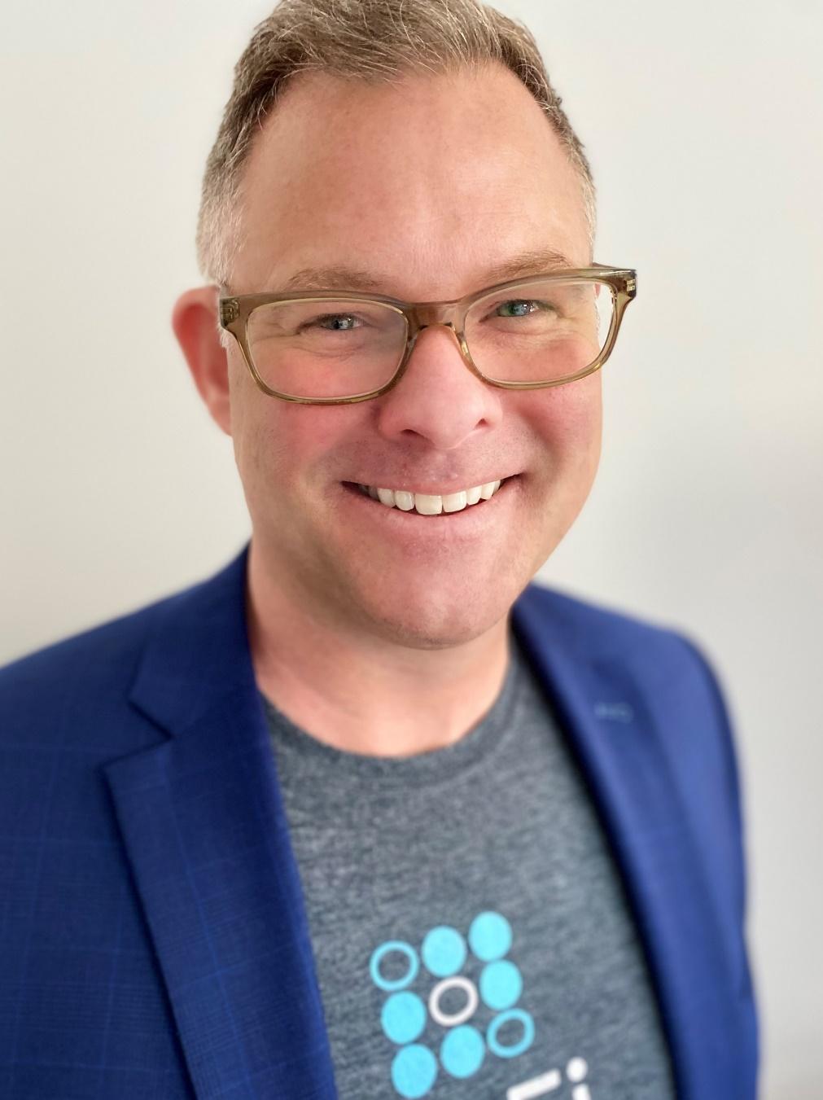
Mark Riggs : SoFi Student Lending
Mark joined SoFi in January of 2019 to launch the In-School Student Loan program and works with Colleges and Universities across PA, OH, and DE. Prior to joining SoFi Mark spend his previous 8 years with Citizens Bank, 5 of which in Student Lending. His career started in Banking with Wachovia and Wells Fargo. Growing up in DE he graduated from the University of Delaware 01’ with a B.A. in Marketing then completed his M.B.A. at Goldey-Beacom School of Business 06’. He lives in Philadelphia with his wife Erin, they purchased a new home during the Pandemic in June of 2020, and they are both looking to soon adopting a Doodle.
Fun Fact:
Mark won a scratch-off ticket and competed on the game show ‘Millionaire Monopoly’ in Las Vegas. Obviously did not win the grand prize and is still happily working.
After college, Mark spent 2 years living on the island of St. Croix in the USVI’s selling wine for a purveyor.
For fun, Mark and his wife started a Pickling company called Passyunk Pickles, distributing to small grocers and a handful of restaurants.

Slide 5
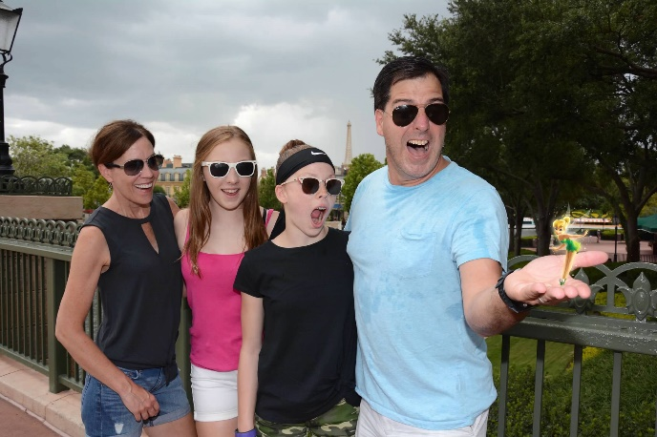
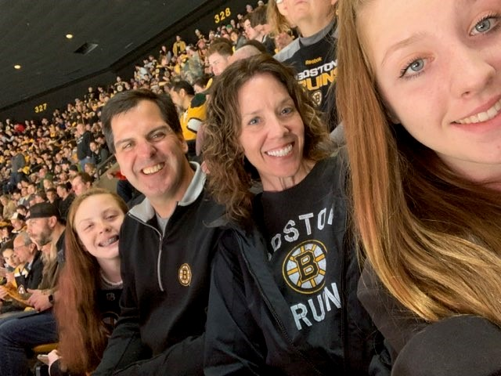
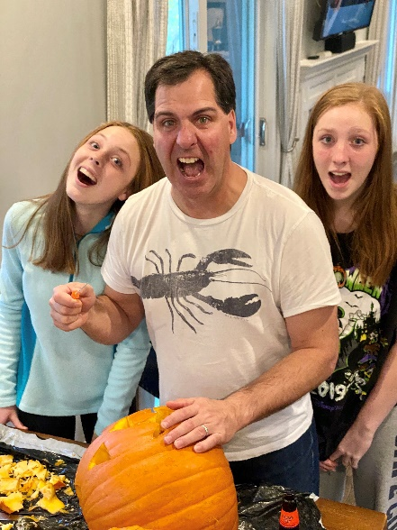
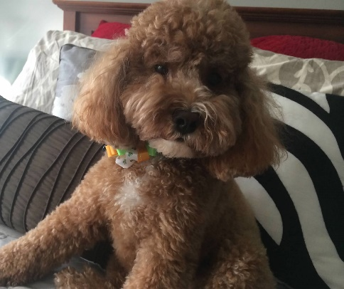
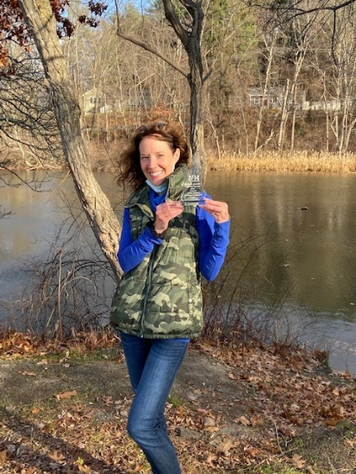
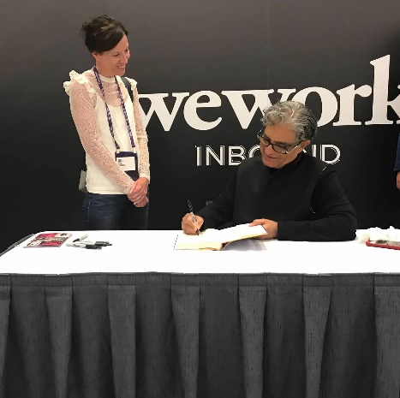
Cognition Financial: Julie Lawton AAA Advantage, Custom Choice & UFSPL

Slide 6
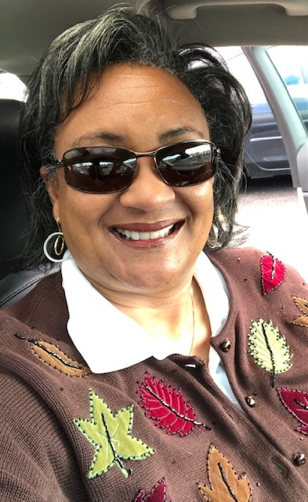
Tami Gilbeaux AVP Business Development Inceptia
Syracuse, New York is home
Southerner by heart
Hand Paint Furniture
Gardening
Play “at” Golf
Beach Time

Slide 7
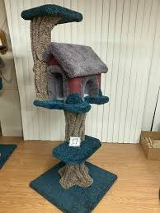
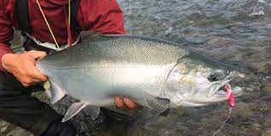
PHEAA: PAForward, Access Partners, Grants, Training and more
PHEAA has many people from different backgrounds and areas across the State that interact with you who have interesting and fun personal hobbies and activities – stop by and chat!
Dan Wray has a menagerie of animals to include mini-donkeys and is a former internationally certified Ice Pilot for shipboard operations in the Arctic and Antarctic
Ron Felder is a popular DJ at Phila nightclubs
Linda Pacewicz has a creative hobby at craft fairs – The Kitty Tree House
Daniel Weigle is a girls softball coach and has a new family hobby: raising chickens
Kathleen Smith enjoys bouncing on the ground and flying through the air as a rebound fitness instructor and enjoys trapeze
Will Lindsey grew up and spent 16 years in France – and is bilingual
Amy Sawdey was born in Las Vegas, NV!
Michael Burke loves being outdoors especially hiking, walking and going to the beach. Took a transatlantic crossing on the Cunard Queen Elizabeth II and was having so much fun abroad missed the ship coming home to the U.S.A.
Robin Walker – Loves Camping and Fishing for Salmon in NY State, but her favorite place to be is at the beach!
Diona Brown – was two months pre-mature and only weighed 1 pound 7 ounces when she was born!
Ashley Ruth - comes from a really large family! On her father’s side alone, she is one of 50 Grandchildren and there are 80 Great grandchildren and 22 Great great grandchildren!

Slide 8
CampusLogic: Matt Young
Hi PASFAA Colleagues!
Born and raised in Grand Rapids
Graduated from Grand Valley State University where I also played tennis
Love to play golf in the summer and ski in the winter
Enjoy coaching my daughter and son in soccer and t-ball
I’ve spent over 17 years in Educational Technology
Visit me at the CampusLogic booth!

Slide 9
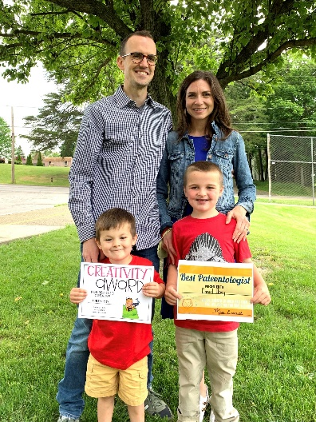
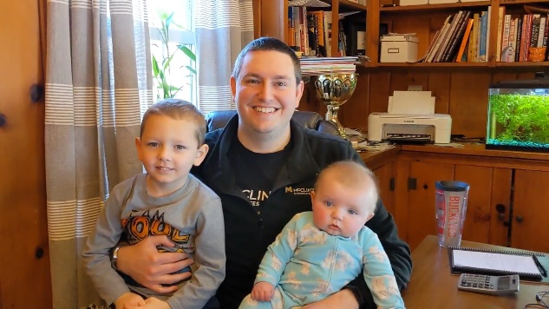
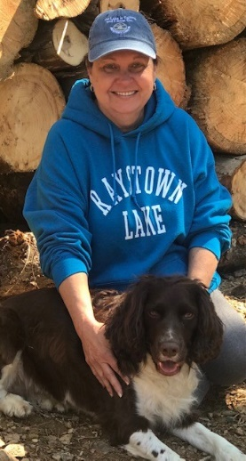
I majored in music at Geneva College.
My wife and I are certified foster parents (have fostered 5 kids, adopted 2).
Luke Hoey
Creates floral bouquets using wood flowers.
Enjoys the planning/shopping for craft supplies more than making them.
Kim Cravotta
I’m a hockey goalie.
I coach youth soccer.
Parker Charlton
Cathy Demchak
The lake is my happy place.
I enjoy stand-up paddle boarding and kayaking.

Slide 10
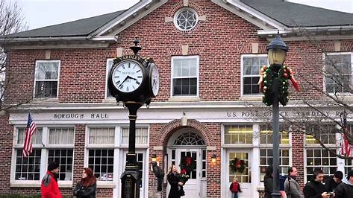
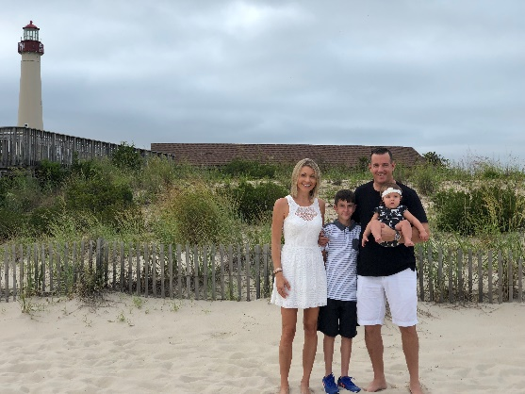
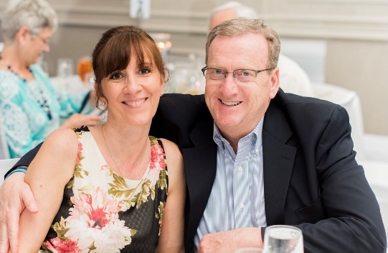
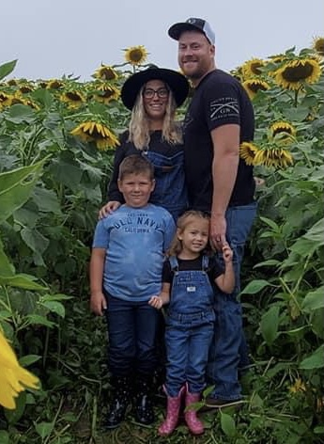
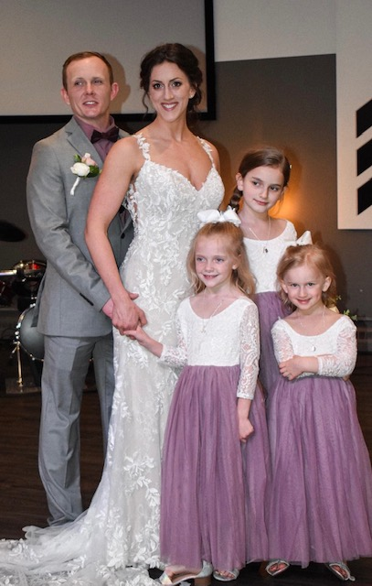
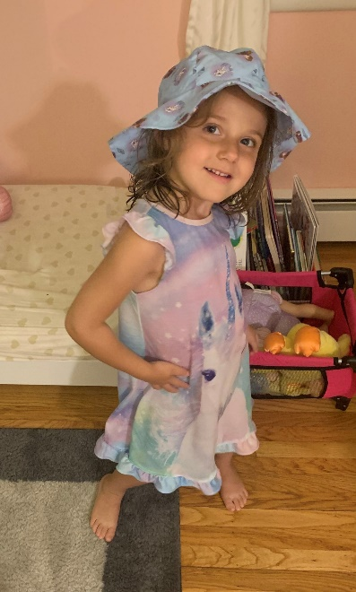
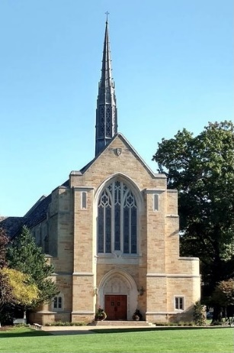
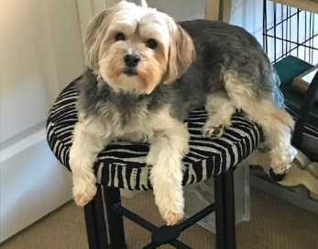
Erin Stevens & Patty Peterson
Hi, I’m Erin Stevens!
Hi, I’m Patty Peterson!
Notes:
Erin Notes: I have been with Citizens for 15 years, and in higher ed/fin aid for over 20 years and started in college when I had a work study job
Currently live in Yardley in Bucks County, PA – originally from CT and I have actually lived in 5 states
Favorite place to vacation is Cabo, San Lucas and I actually got married there in 2015
Basketball is my favorite sport. I started playing when I was in middle school and played through college.
Family photo
Patty Notes: My husband, Paul, began our 38 years together at Grove City College and GCC is also where I began my financial aid career over 20 years ago. We are in the midst of moving from the Lancaster area to Harmony, PA, 30 miles north of Pittsburgh and going through the excitement of 3 months of temporary housing until our home is ready! We have 3 children, 5 grandchildren with our daughter expecting our 6th in February. And our story isn’t complete without sharing a picture of our our Morkie, Amos Jethro who is our constant companion.

Slide 11
Credible Caroline Menendez, Regional Lead School Partnerships
Hello PASFAA,
A little about me is that I have been in Higher Education for over 25 years working in Financial Aid Office’s and with American Student Assistance (ASA).
I live in Massachusetts with my husband, daughter, son and our two rescue dogs and am an avid sports fan. I enjoy playing soccer, running and having great conversations.
Fun fact: When EASFAA was held in Hershey I put myself into a sugar coma with the make your own sundae bar and the chocolate martini’s!
I look forward to seeing you all at the Credible booth,
Caroline

Slide 12
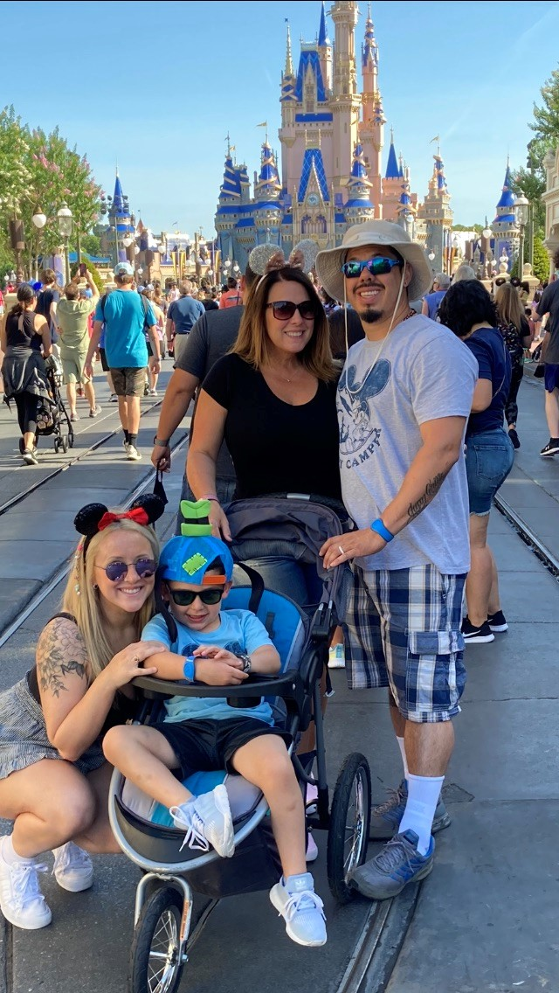
Heather Ledezma, PNC Student Lending
Hello Colleagues!
I am the Campus Relations Manager for PNC Student Lending supporting Pennsylvania and Northern CA. I’ve worked at PNC for 16 years and live in Southeast PA.
Fun fact: My children are 17 years apart ☺ My daughter is 22 and graduated this year from IUP. My son is 5 and just started Kindergarten.
Favorite Hobby/Pastime: Camping! We considers ourselves “weekend warriors” with our RV. In 2021, we have 14 trips planned including Fort Wilderness, Disney World (longer than a weekend).
I look forward to seeing you at the PNC booth!

Slide 13
Laura Helmich, Business Development Officer
Live in Canonsburg PA – Home of Sarris Candy
Have over 30 years of experience in the Student Loan Industry
Huge fan of the Steelers with a bucket list including seeing a Steeler game in every NFL stadium.
Enjoying the “empty nest” part of my life. But, will catch me every once in awhile looking for a puppy but then you will see me talking myself out of it ☺

Slide 14
Timothy Jones – The NHHEAF Network
I am a Pennsylvania native and enjoy my quiet slice of the world on a mountain with my two cats. I have been in the student loan industry for the past 19 years.
My favorite vacation destination is Puerto Rico which I hope to call home someday. My feet in the sand and relaxing under a palm tree is ideal for me.
My biggest fear is sharks. So you may see me on the beach however; you will not find me in the ocean. I do not invite sharks into my home so I will not go into theirs (with or without an invitation).

Slide 15
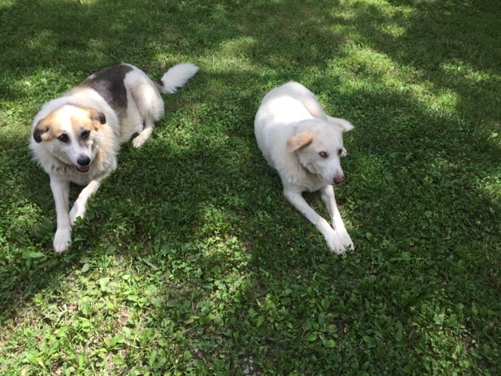
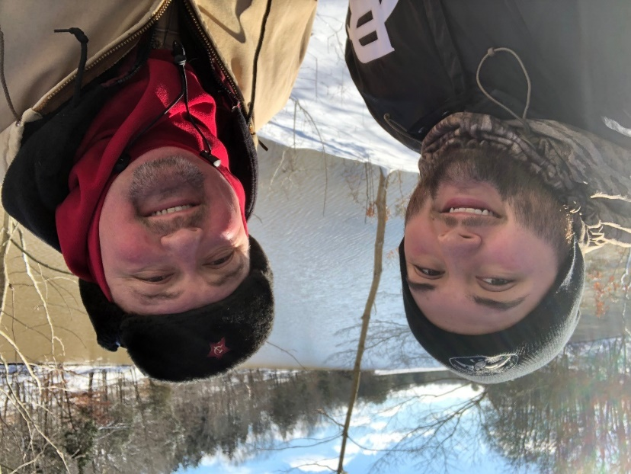
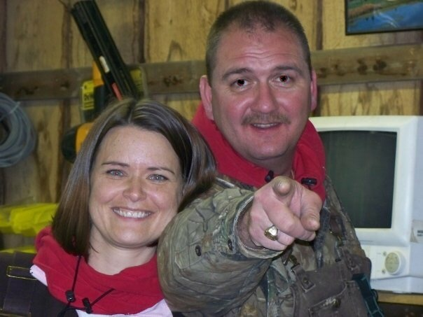
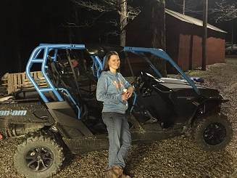
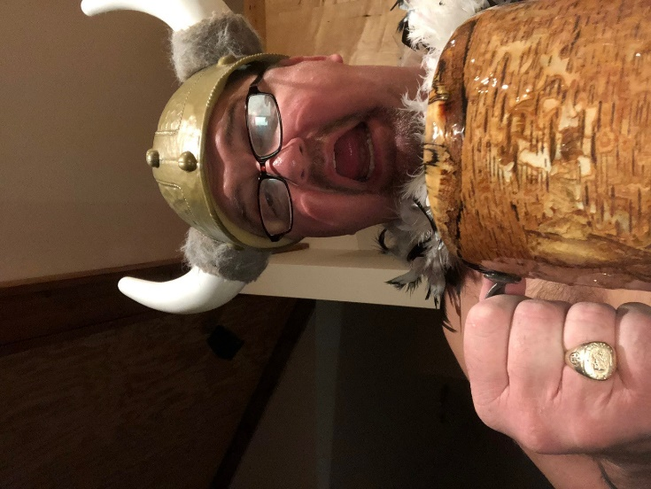
Hello, I’m Chester Priest

Slide 16
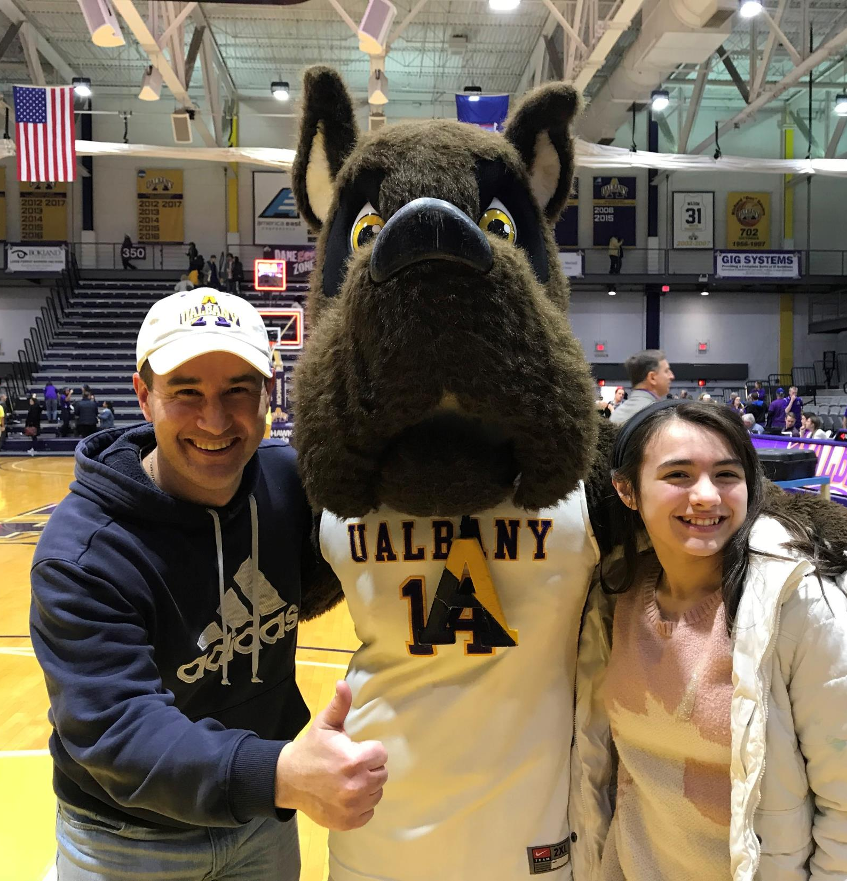
Patrick Ziegler, Regional Director for Attigo
A lifelong New Yorker, I moved from the shadow of New York City to the quieter suburbs of the Capital Region in 1998;
I am married with three kids, a dog and a house with the picket fence!
We love day tripping as a family to some of the amazing places we are blessed to have in the area—Cooperstown, Lake Placid, Hudson Valley, Adirondack Mountains…
My wife and I met at UAlbany where my oldest son is now a junior and we are regulars at football and basketball games;
I am back where I started after leaving financial aid and working with some of the best people in the business. Stop by the booth to learn more!!

Slide 17
Nelnet Student Loans: Joseph Jovell

Slide 18
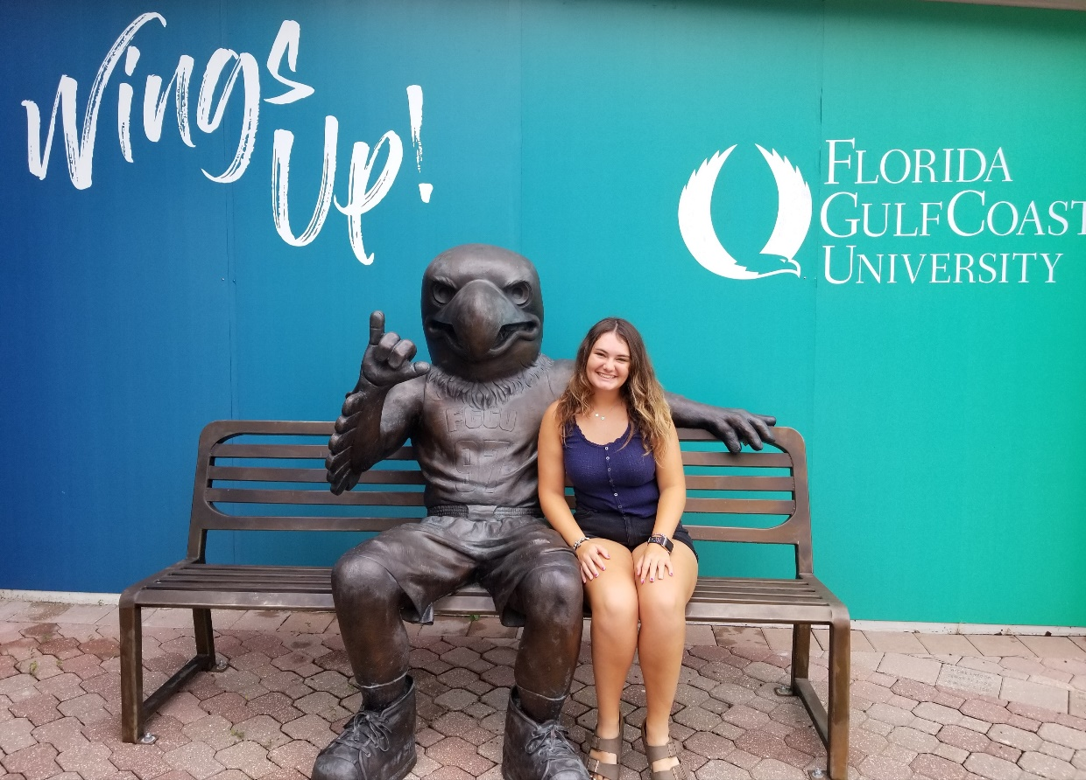
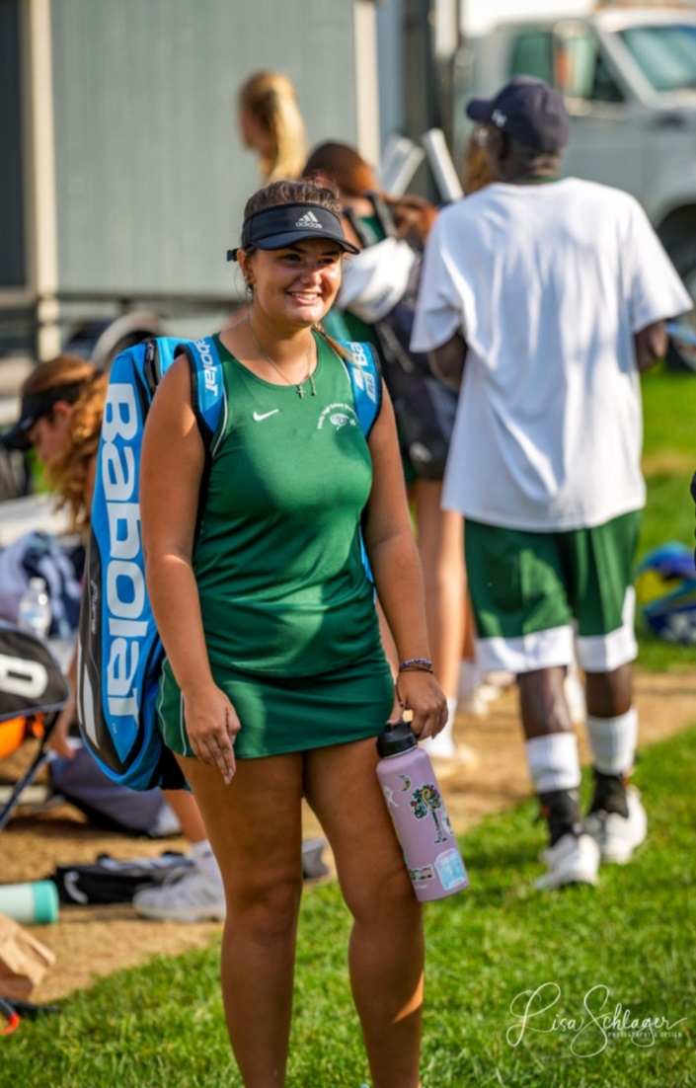
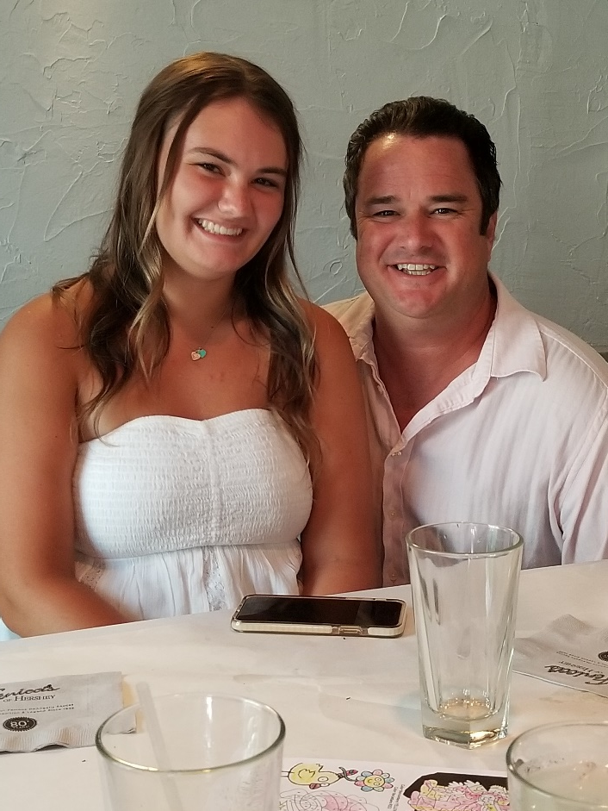
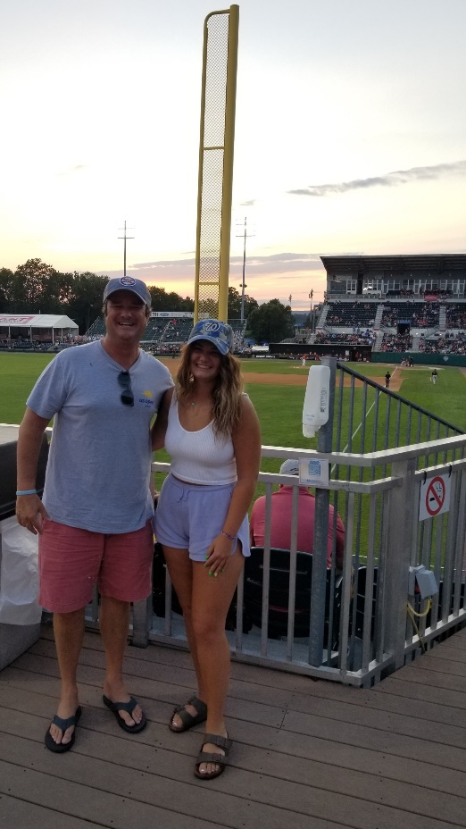

Slide 19
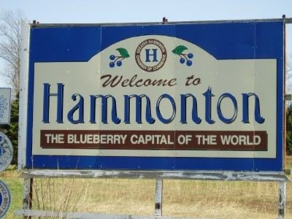
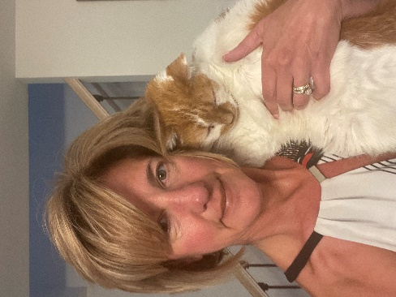
NJCLASS: Sharon Austin Sr. Marketing Manager
Hello Pennsylvania!
I’m a Jersey Girl!!!! My town is the Blueberry Capital of the World!
I am happily married with 2 kids (adults). I am an “empty nester!”
We have downsized the house and bought a boat. Boating is my favorite pastime!
I spend as much time on the water as possible.
Favorite foods are…
Mexican and Sushi!!
I have a Manx cat named Stumpy because he has a stumpy tail.
I’m a bit of a Genius
Come by and say Hello!!

Slide 20
Thanks for joining!
So now you know a little more about the people who are helping your students obtain their educations – and helping you assist them in those efforts.
Hope it’s been as much fun for you, as it’s been for us
Stop by the booths and share YOUR experiences, hobbies, etc – along with learning more about the companies that each of us represent!

