Slide 1
Embracing Equity in Higher Education on the College Campus and beyond
Evelyn Disla-Hernandez, DeSales University
Tammi Hussey, Seton Hall University
Nu’Rodney Prad, Temple University
Darwin Morency, Sallie Mae
Keri Neidig, Sallie Mae
Melony Ohalek, Sallie Mae
Notes:
Introduce panelists
Evelyn Disla-Hernandez, Associate Director of Financial Aid for Compliance & Reconciliation, DeSales University
Tammi Hussey, Associate Director of Financial Aid, Seton Hall University; Chair of the NJASFAA Diversity and Inclusion Committee
Nu'Rodney Prad, Director - Student Engagement, for Temple's Institutional Diversity, Equity, Advocacy and Leadership (IDEAL) office

Slide 2
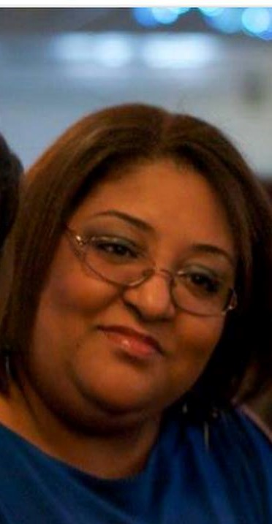
Evelyn Disla-Hernandez, Associate Director of Financial Aid for Compliance & Reconciliation, DeSales University
Evelyn began her career in financial aid 25 years ago in New York State where she served as a Bilingual Counselor for Erie Community College, as Assistant Director at Daemen College and Associate Director at Marymount Manhattan College. Evelyn earned her M.S. in higher education administration from Buffalo State College and is a certified financial aid administrator
She is the staff representative on the Human Resources Advisory Committee and a member of the CARE team. The CARE team is made of various student life and academic support professionals who monitor and assist students who appear to be struggling socially and/or academically.
Outside of DeSales, Evelyn is a member of the Executive Board of the Latino Leadership Alliance of the Lehigh Valley where she serves as the treasurer and is a member of the Education and Leadership committee
In her free time, she enjoys spending time with her family and friends and reading
Notes:
She is a passionate supporter of both groups and is particularly sensitive to the needs of those who are marginalized and underrepresented.

Slide 3
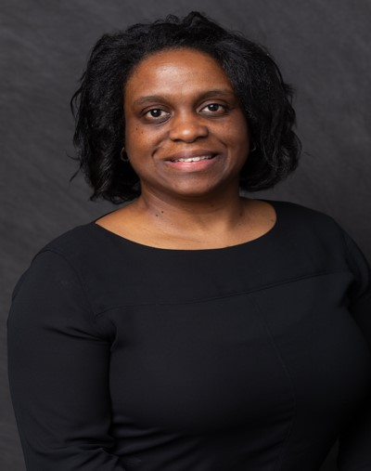
Tammi Hussey, Associate Director of Financial Aid at Seton Hall University; NJASFAA Co-chair of the Training and Professional Development and Diversity and Inclusion Committees
Tammi began her career in financial aid as a counselor at Montclair State University. Before the start of her career, she was a student employee in the financial aid office at MSU where she also completed a Bachelor’s degree in Biology and a Master’s degree in Counseling.
Prior to her current position at Seton Hall University, Tammi was employed by the Higher Education Student Assistance Authority in the Client Services Unit.
Tammi is a Past President of NJASFAA
When she isn’t working, Tammi loves spending time with her husband and children, is the Leader of a Girl Scout troop and is an active participant on the PTA Boards of her children’s schools.
Notes:
Tammi Hussey began her career in Financial Aid as a counselor at Montclair State University (MSU). Before the start of her career, Tammi was a student employee in the Financial Aid Office at MSU where she also completed a Bachelor’s Degree in Biology and a Master’s Degree in Counseling.
Prior to her current position at Seton Hall University, Tammi was employed by the Higher Education Student Assistance Authority in the Client Services Unit.
Tammi is a Past President of NJASFAA.
Tammi previously served as Vice President, Member-At-Large, co-chair of the Novice Training Committee and other roles. She has thoroughly enjoyed her service to the NJASFAA organization as it has encouraged some outstanding networking opportunities and has assisted in her overall professional growth.
When she is not working, Tammi loves spending time with her with husband and children, is the Leader of a Girl Scout troop and is an active participant on the PTA Boards of her children’s schools.

Slide 4
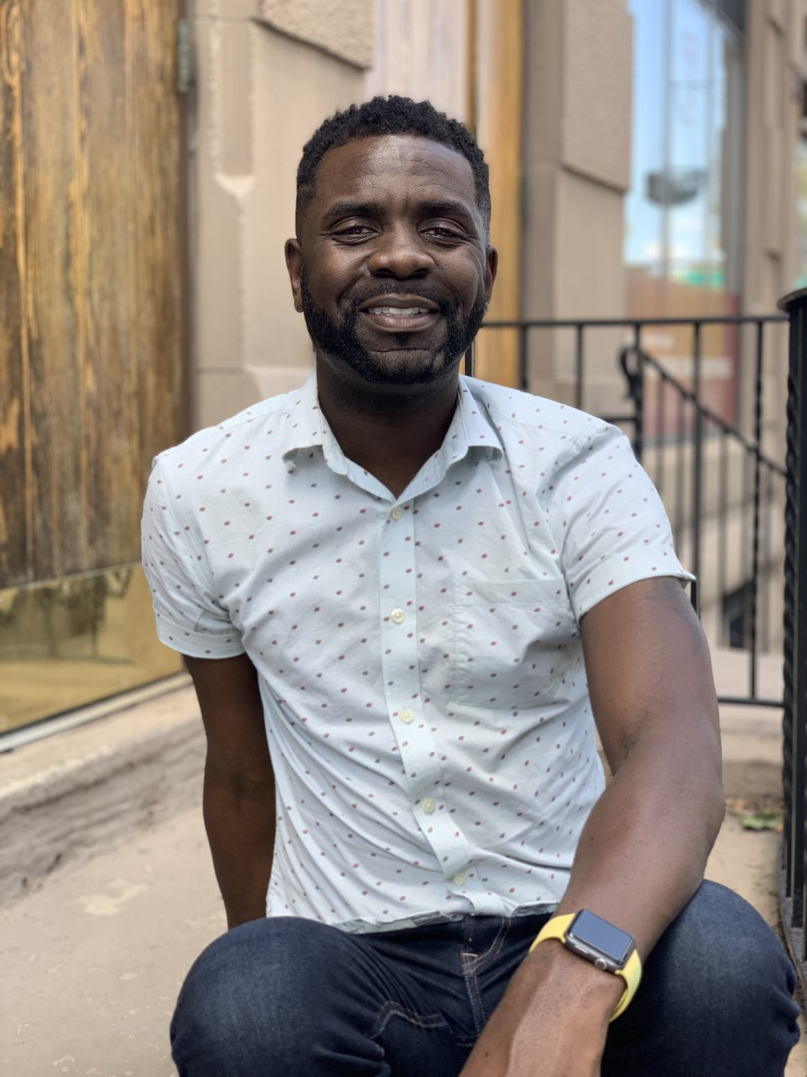
Nu'Rodney Prad, Director - Student Engagement, for Temple's Institutional Diversity, Equity, Advocacy and Leadership (IDEAL) office
Nu'Rodney is a native of Montgomery, AL and earned his bachelors degree in political science and a master's of science in college student personnel administration from The University of Central Arkansas.
He has over 10 years of experience in working with diversity and Social Justice initiatives and facilitating difficult dialogues
In 2009, Nu'Rodney collaborated with a colleague to introduce National Coming Out Week (NCOW) to Temple's campus.
He is a member of NASPA, a NASPA Undergraduate Fellows Program Board member, and a recurring presenter at the National Conference on Race & Ethnicity.

Slide 5
Contact us!
Evelyn Disla-Hernandez, Evelyn.Disla-Hernandez@desales.edu
Tammi Hussey, Tammi.Hussey@shu.edu
Nu'Rodney Prad, Nprad@temple.edu
Darwin Morency, Darwin.Morency@salliemae.com
Keri Neidig, Keri.Neidig@salliemae.com
Melony Ohalek, Melony.Ohalek@salliemae.com

