Slide 1
Managing Student Debt:
An Overview of Consolidation and Refinancing Options
PASFAA Spring Training March 13th and 15th.
Tom May, Vice President
Citizens Bank Student Lending
Citizens Bank Legal Disclaimer
The information presented in these materials are intended and written to be educational only. This presentation is not intended or written to be relied on for tax or legal advice. We are not in the business of providing tax or legal advice. Please seek advice based on your particular situation from an independent tax or legal advisor.
Member FDIC. Equal Housing Lender. Citizens Bank® is a brand name of Citizens Bank, N.A. (NMLS ID #433960) and Citizens Bank of Pennsylvania (NMLS #522615).

Slide 2
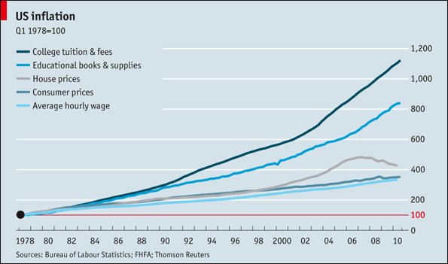
Student Debt – The Impact
• 400B 7.5% or higher • 40% of U.S. Households
1.4T
Home Ownership
75% said student loan debt affected decision or ability to purchase a home
Children
43% said student loans are delaying their decision to start a family
Retirement
73% said they have put off saving for retirement or other investments

Slide 3
Student Debt - Sources
Federal Loans represent 93% of outstanding student debt.
Subsidized Stafford
Unsubsidized Stafford
Federal Perkins Loan
Grad PLUS/Parent PLUS
Direct Consolidation Loan
Private Loans are typically used once the above listed options have been exhausted. They are based on income and credit, and may require a co-signer.

Slide 4
Options for Student Loan Consolidation & Refinancing
Federal Debt
The Federal Direct Consolidation Loan Program currently offers borrowers the opportunity to consolidate only existing Federal loans.
This program is not credit based, and continues to offer the federal loan benefits.
Private Debt
Private Debt can be consolidated with a number of banks, local credit unions, peer lending networks and by utilizing collateral such as a Home Equity loan.
Applications are typically credit based and may offer more attractive rates for well qualified borrowers.
Federal and Private
Ability to refinance BOTH federal and private debt, to reduce interest rate, lower payment, decrease or extend payment period.

Slide 5
Federal Loan Consolidation vs Private Loan Refinance
Federal Student Loan Consolidation
Can only consolidate Federal student loans
Fixed interest rate calculated using the weighted average of consolidated loans rounded up to the next 1/8%
10 – 30 year repayment
Adjusted and income based repayment options
Deferment & Forgiveness options
No credit approval needed
Private Student Loan Refinance
Credit approval required
Choice of fixed or variable interest rates (varies by lender)
Change terms (extend or shorten repayment)
Option for multiple loans – both private student loans and federal loans
Change in interest rate and/or loan term can lower the overall cost of loan
*Federal Loan Consolidation information can be found at www.studentloans.gov

Slide 6
Private Bank Education Refinance Loan
Existing Private and Federal Student Loans
Bar Study or Residency Loan
Prior Education Loan Consolidation
One Education Refinance Loan
Borrowers can combine multiple existing private and federal student loans into a single new private student loan
Usually as many as fifteen loans or as few as one loan (depends on lender)
Can include bar study and residency loans
Cannot include
Any other non-student loan debt (even if it was used to pay for school, such as credit card or home equity
Typically, borrowers may choose to apply alone or with a cosigner

Slide 7
Possible Education Refinance Loan Eligibility Requirements
Cannot be currently enrolled in school
Eligible applicants with Graduate Degree or above can refinance at any time after graduation
Eligible applicants with a Bachelor’s Degree or less must be in repayment on their student loan(s)
Applicants with a bachelor’s degree may be eligible to refinance their student loan(s) upon making 3 consecutive, on-time monthly payments
Applicants without a bachelor’s degree may be eligible to refinance their student loan(s) upon making 12 consecutive, on-time monthly payments
Parent Applicants may have the opportunity to refinance loans they have cosigned, or Parent PLUS loans while the student the loan was taken for is still in school.

Slide 8
Possible Education Refinance Loan Eligibility Requirements
Borrower or cosigner, if applicable, with a graduate degree or above, must demonstrate current minimum income
Borrower or cosigner, if applicable, with a bachelor’s degree or less, must demonstrate 12 consecutive months of recent earnings history
Borrower and Co-signer (if applicable) must be U.S. citizen, permanent resident or resident alien with a valid U.S. Social Security Number residing in the United States
Borrower must meet the age of majority
Meet all credit requirements

Slide 9
Loan Limits (varies by lender)
Minimum loan amount (such as $10,000)
Maximum loan amounts based on degree attained:
As an example: | Maximum Debt to Refinance
Bachelor’s Degree or less | $90K
Graduate or Doctoral Degree, including MBA | $225K
Law Degree | $300K
Professional Degree such as Medical or Dental | $350K

Slide 10
Private Education Refinance Loan Borrower Benefits
Interest Rate Reductions (varies by lender)
Existing bank customers (borrower or co-signer) receive an immediate percentage point interest rate reduction
Automatic Payment Discount: Borrowers receive a 0.25 percentage point interest rate reduction for auto payments from any bank
Cosigner Release (varies by lender)
Lenders may provide an option for the cosigner to be released after the borrower makes 36 months of consecutive on-time payments provided that the borrower meets credit criteria
Loan Forgiveness (varies by lender)
In the unfortunate event of the student’s death or permanent and total disability – regardless of the presence of a cosigner
Please contact your lender for full eligibility requirements for any borrower benefits.

Slide 11
How to Prepare for Private Loan Refinance
Compare your current student loan terms with available options
Determine which loans you would like to consolidate
Research and select the lender that best meets your needs
Gather necessary documentation:
Social Security Number
Gross monthly income (2 pay stubs or other documentation) -
Employer name, phone number and length of employment
Monthly rent or mortgage payment
Current statements & information from your existing loans, including lender, account number, payment, existing balance.
Self employment is more involved & requires tax returns. Income is determined by your take home and any business losses as well.
Continue making payments until the loans are consolidated as it can take up to 2 billing cycles before the process is complete

Slide 12
The Private Lender Refinance Process
Apply
1
Credit Decision
1
Customer selects loan options
Verification of Income and billing statements
3
Sign Promissory Note/Approval Disclosure
1
Funds are sent via check to current loan servicer(s)*
Right of rescission period*
7
Having the right documents is key:
Proof of citizenship or resident alien status (a Social Security Number or government ID)
Personal information, including proof of employment and monthly housing payments.
Proof of income (such as paystubs).
Billing statements for your federal and private loans.
Orange = action by Customer / Green = action by Lender| The numbers may vary between lender’s service levels for each step.
*After signing the promissory note there is a 3day right of rescission
*Customer is to continue paying current loan servicers until confirmation is receive that the loans have been paid off

Slide 13
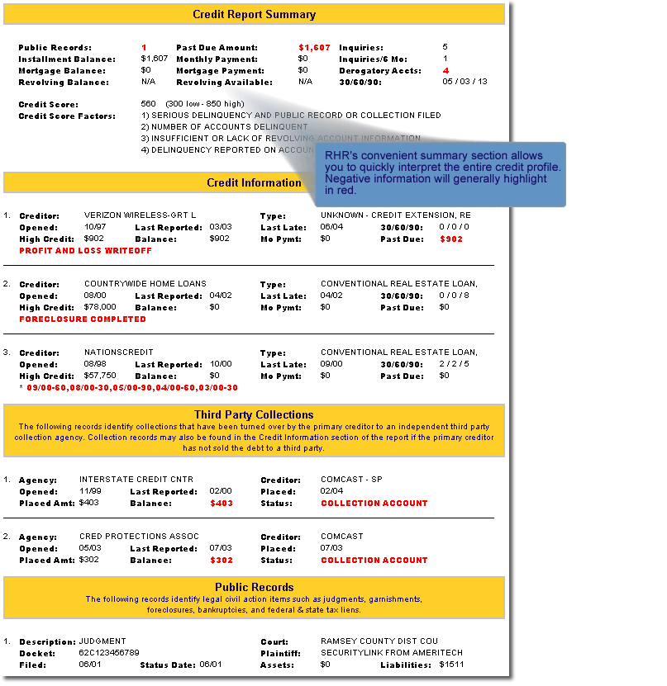
Loan Approval Factors
Credit Score – acts like a minimum threshold for approvals and/or tiered interest rates.
Credit History – lenders may look at both the usage and length of credit history as well as derogatory items
Trade lines – individual credit accounts (installment loans – this includes student loans, credit cards); balance, account status, date opened, credit limit, delinquencies, etc.
Credit inquiries – a list of everyone who has accessed your credit in the last two years, both voluntarily and involuntarily
Public record items – collection accounts, liens, judgments, bankruptcies and wage garnishments
Debt-to-income - Proof of income may also be required to verify debt-to-income ratio.

Slide 14
Your Credit Score – The Impact on Your Rate
Read the fine print when pulling a credit score – many consumer sites (such as credit monitoring companies) offer a credit score. This is not necessarily a FICO score.
Some companies create scoring models with different factors/percentages. The score you are given may not be the FICO score the lenders are seeing.
Websites such as www.myfico.com provide a FICO score for a charge.
www.annualcreditreport.com free copy of your credit report from each of the 3 bureaus.
Denied credit? You may request a copy of your credit report.

Slide 15
Maximizing the Power of Your Credit Score
85%
of consumers are aware that they have access to their credit score
60%
have checked their credit report in the past year
Source: ABA, 2015
and yet…
20%
of consumers have an error in at least one of their three credit reports
5%
of consumers have errors in their credit reports that could result in less favorable loan terms
Source: Federal Trade Commission, 2013
ABA survey: www.aba.com/Press/Pages/012115CreditReports.aspx
FTC report: www.ftc.gov/news-events/press-releases/2013/02/ftc-study-five-percent-consumers-had-errors-their-credit-reports

Slide 16
What Should You Do With Your Credit Report?
Review your credit report regularly.
If you see errors, fill out the dispute forms at the credit reporting agencies websites and contact the company or lender involved.
You cannot "fix" your credit score, but over time, you can improve it.
Why Does Your Credit Score Matter?
It helps lenders evaluate your credit risk
It is viewed any time you apply for a credit card or any type of loan linked to your social security number
It impacts the following life events:
Getting a mortgage
Renting a home
Buying or leasing a car
Securing a credit card
Applying for a job
Refinancing debt

Slide 17
What Is a Good Score?
The national average score is 695. Scores range from 300-850.
A higher score demonstrates lower credit risk, while a lower score demonstrates higher credit risk.
What’s considered a “good” score varies by lender. For example, one lender may offer its lowest interest rates to people with scores above 730, while another lender only offers its lowest interest rates to 760+.
Source: www.valuepenguin.com/average-credit-score
Notes:
http://www.myfico.com/Downloads/Files/myFICO_UYFS_Booklet.pdf
1. CEB TowerGroup. (May 2015). Analyst report. © 2015 The Corporate Executive Board Company.
All rights reserved

Slide 18
The Higher Your Credit Score, the Lower Your Loan Payments
30-year fixed mortgage Loan amount $300,000
Credit score | Annual percentage rate (national average) | Monthly payment
760-850 | 3.080% | $1,278
700-759 | 3.302% | $1,314
680-699 | 3.479% | $1,344
660-679 | 3.693% | $1,380
640-659 | 4.123% | $1,454
620-639 | 4.669% | $1,550
Source: myfico.com – Mortgage rates as of August 23, 2016; for illustrative purposes only
Notes:
http://www.myfico.com/loancenter/mortgage/

Slide 19
Refinancing Student Loans – Quick Review
Advantages
Convenience & Simplification – one monthly payment
Lower interest rate and overall lower cost of borrowing
Lower monthly payment as a result of a longer repayment term
Move from variable rate to fixed rate
No application, origination, or disbursement fees (based on lender)
No prepayment penalties (based on lender)
Select your own repayment terms (based on lender)
Borrower Benefits (rate reductions, based on lender)
Deferment & Forbearance Options (based on lender)
In-School, Residency/Internship, Military, Hardship
Cosigner Release (based on lender)
Loan Forgiveness (based on lender)
Disadvantages
Longer repayment term could mean higher total cost
Loss of borrower benefits from original loan (if applicable)
Possible loss of subsidy or forgiveness

Slide 20
Managing Student Loan Debt - Helpful Resources
Federal Resources
Federal Student Aid Information: www.studentaid.ed.gov
Federal Student Aid, Account Management: https://studentloans.gov/myDirectLoan/index.action
National Student Loan Data System (NSLDS): https://www.nslds.ed.gov/nslds_SA/
Federal Loan Consolidation Information: www.studentloans.gov
Loan Consolidation/Repay Information: https://studentaid.ed.gov/sa/repay-loans
Federal Public Service Loan Forgiveness: www.studentaid.gov/publicservice
Credit Score Resources
AnnualCreditReport.com or 1-877-322-8228
Equifax.com or 1-800-846-5279
Experian.com or 1-888-EXPERIAN (397-3742)
TransUnion.com or 1-800-888-4213
myFICO.com

