Slide 1
Leading Beyond Differences
Dwight Horsey, Executive Director of Financial Aid
Amanda Flurry, Director of Student Accounts
Millersville University of Pennsylvania

Slide 2
Understanding Our Teams
Student Accounts and Financial Aid both utilize generic email accounts
Past practice has been anonymous response
Numerous events necessitated the addition of an identifying signature in the response
Both offices were instructed to make the change…

Slide 3
Leading Beyond Differences
Relationships between Financial Aid and Student Accounts offices
Combining into Student Financial Services

Slide 4
Financial Aid & Student Accounts
Other Institutions
Millersville University
Shared space
Separation and adaptation
Vision for the future
Physical space
Relationships

Slide 5
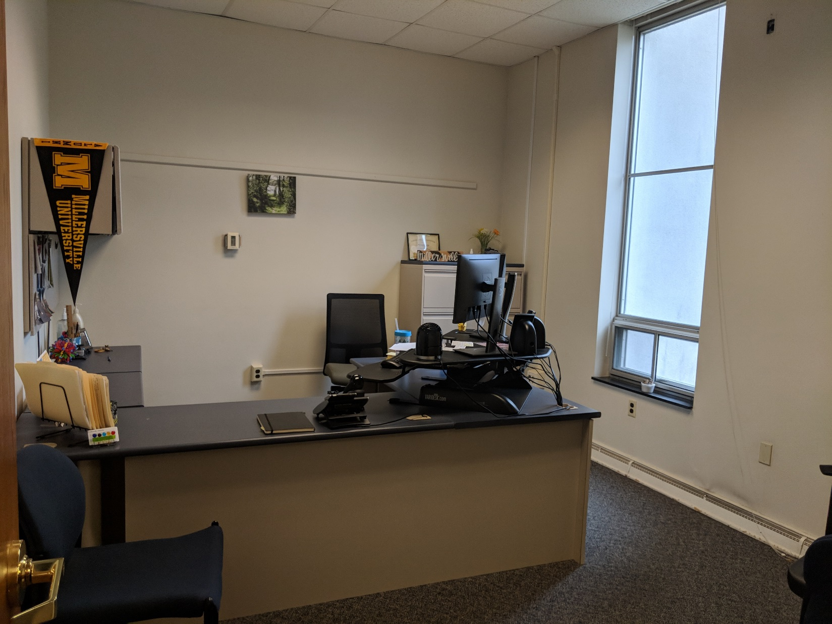
Physical Space

Slide 6
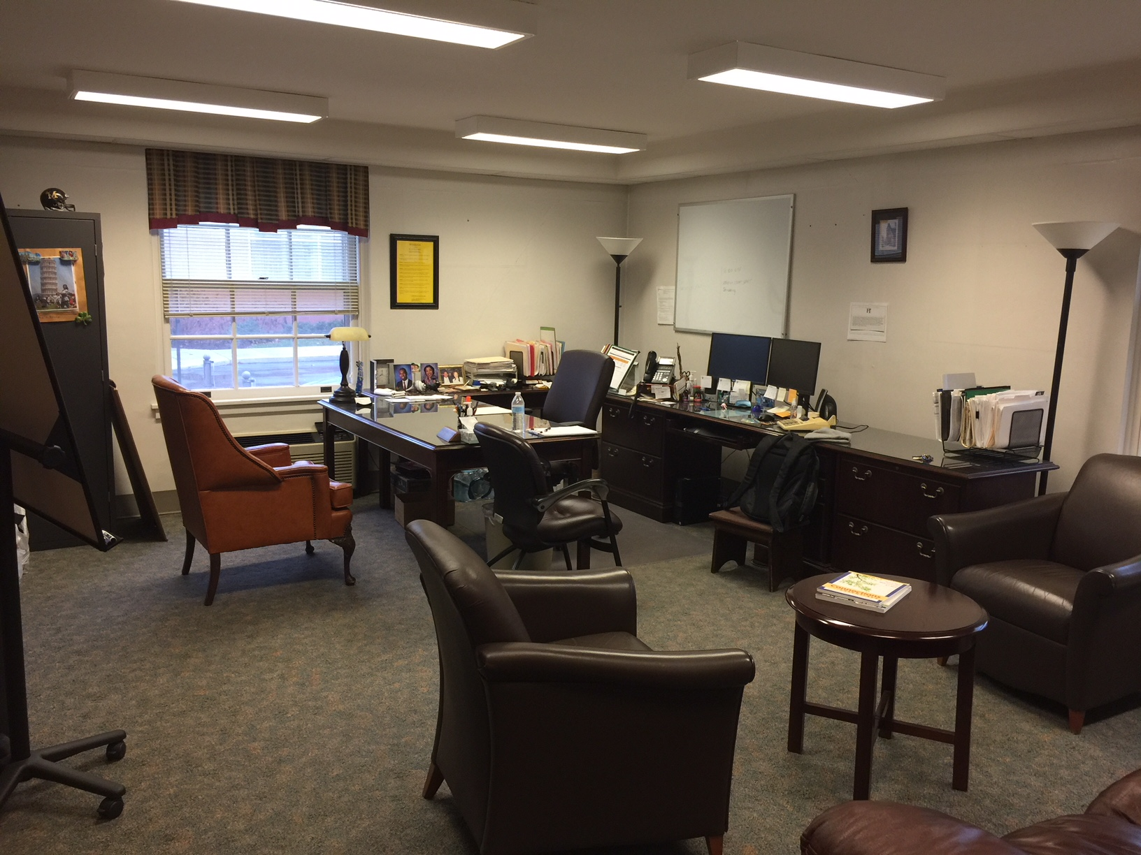
Physical Space

Slide 7
How do you describe…
A financial aid counselor?
A student accounts administrator?

Slide 8
Our Teams
Financial Aid
10 student workers
9 employees
Mostly millennial staff
Mostly women
Ethnically diverse
Hired by Executive Director
Student Accounts
No student workers
Team of six professional staff
Baby Boomers and Generation X
Minimal ethnic diversity
All women
Mostly hired by previous director

Slide 9
Reaction to Change
Our teams reacted very differently!
Our teams are different. We need to know them as people, separate from labels, and tailor our approaches to be effective.

Slide 10
Leadership - Differences
Age
Gender
Ethnicity
Role in the University

Slide 11
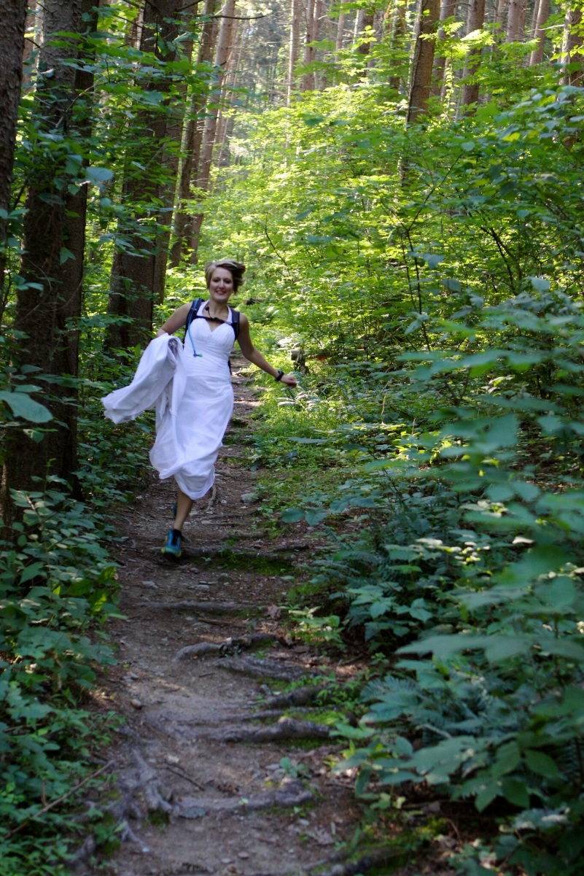
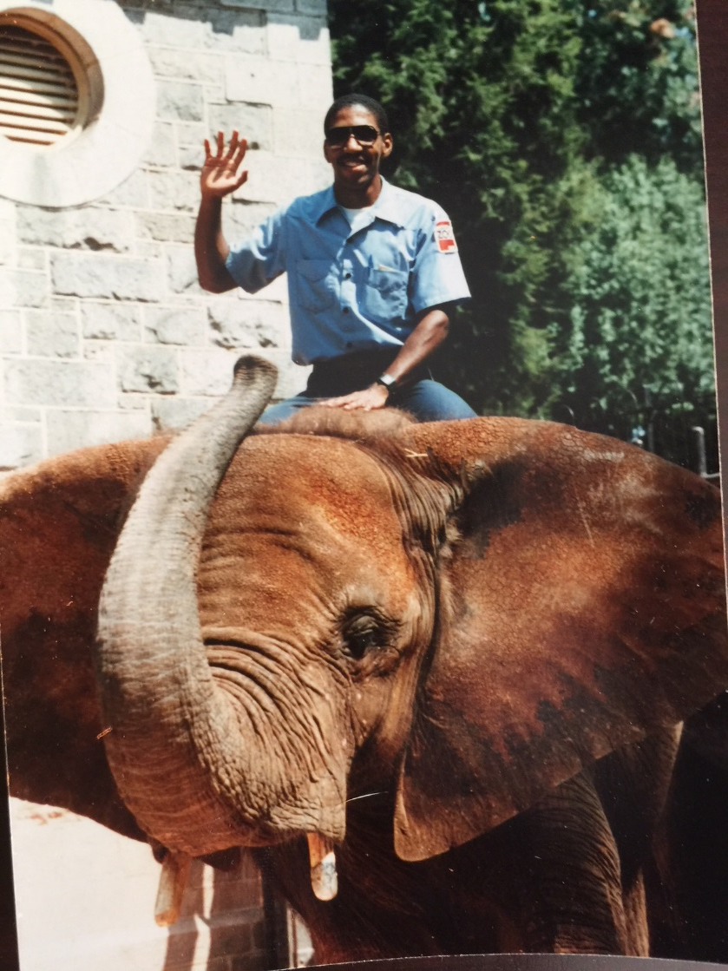
Here is what you did not see…

Slide 12
Do these differences matter in how we are perceived?

Slide 13
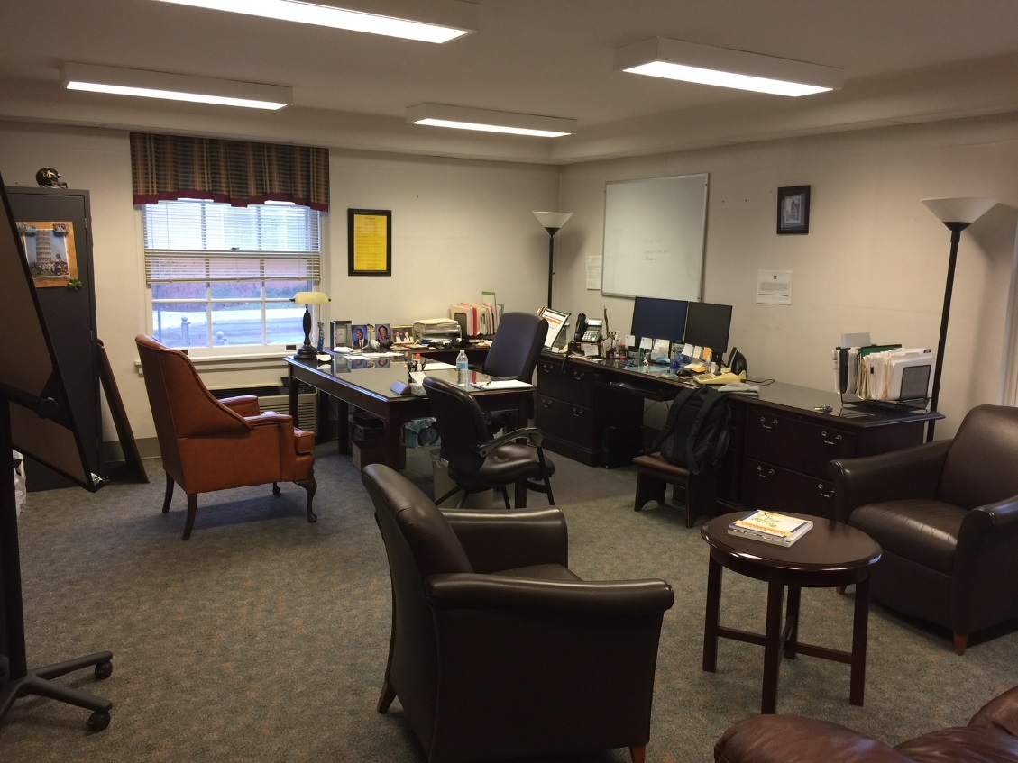
Who belongs where?

Slide 14
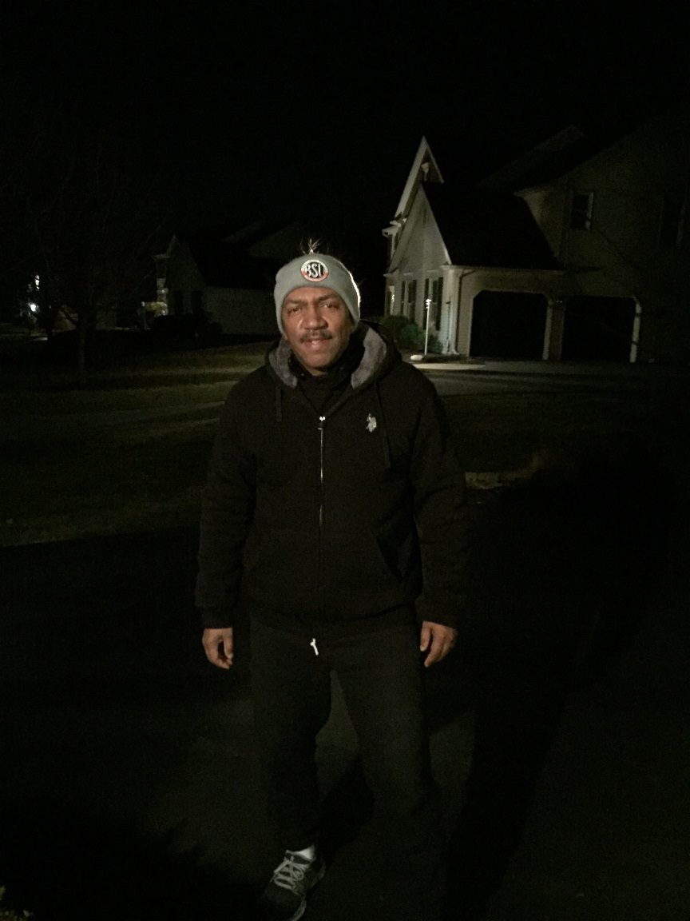
How do we lead beyond differences?
Core values and similarities!

Slide 15
How do we lead beyond differences for our teams?
Set the precedent in leadership
Assume best intentions and accuracy
Provide shared experiences
Demonstrate smooth transition
Value the student experience above our individual preferences

Slide 16
Changes that we’ve made
First (in years) retreat
Regular joint training opportunities
Shared access to meeting minutes
Biweekly meetings with office leadership
United front to other offices

Slide 17
Changes that we’re making
Combined authorization process
Shared space
Increased space to counsel students together
Combined social space – lunch room
Two directors on one floor

Slide 18
Student Financial Services
Our similarities are bigger than our differences
Must adapt to the staff, students, colleagues with whom we are working
Success requires that we see beyond our differences!

