Slide 1
Collegiate Food Insecurity and Collegiate Basic Needs
Erika Ninos, Sustainability Program Coordinator
University of Pittsburgh, Office of PittServes

Slide 2
Defining Food Insecurity
Food insecurity is the limited or uncertain availability of nutritionally adequate and safe foods or the ability to acquire such foods in a socially acceptable manner (USDA).
“Low food security” describes households where quality, variety, and desirability are negatively impacted, but quantity is not.
“Very low food security” indicates decreases in all areas (quality, variety, desirability, quantity) as well as disrupted eating patterns due to inability to access adequate food.
Notes:
Key components are nutritionally adequate and socially acceptable
-Adequacy comes in in difference between low and very low
-Socially Acceptable: without resorting to emergency food supplies, scavenging, stealing, or other coping strategies

Slide 3
Scenarios
During the winter, a student skips breakfast and lunch to save money for increased heating bills. They drink coffee to stay awake during their morning class but are sometimes unable to focus on the material because they feel hungry.
Notes:
Are they food insecure? (Ask audience to raise hands for yes/no)

Slide 4
Scenarios
In order to save money for a required textbook, a student eats ramen noodles for two of their meals every day. They seek out free food, like pizza and pastries, across campus. They don’t feel hungry, but notice they have less energy than usual.
Notes:
Are they food insecure? (ask audience to raise hands for yes/no)
Example of low food security where amount of food is unaffected

Slide 5
Collegiate Food Insecurity:
48% of respondents reported food insecurity in the previous 30 days, including 22% with very low levels of food security that qualify them as hungry.
Notes:
Hunger on Campus- 2016
Hunger in America - 2014

Slide 6
National Trends: 2016 Hunger on Campus Report
Did you ever cut the size of your meals or skip meals because there wasn’t enough money for food?
44%
Did you ever eat less than you felt you should because there wasn’t enough money for food?
43%
Were you ever hungry but didn’t eat because there wasn’t enough money for food?
35%
Did you ever not eat for a whole day because there wasn’t enough money for food?
20%
Notes:
Follow up to USDA food security questions in the same Hunger on Campus Study

Slide 7
National Trends: 2014 Hunger in America Report
“According to Feeding America roughly 10% of its 46.5 million adult clients are college students.
This amounts to two million full-time college students.
Of those surveyed by the emergency food services network, roughly 30.5% of students reported that they were forced to choose between food and educational expenses at some point over the last year.”
Notes:
The Allegheny County Food Insecurity rate: 14.2% = 2014

Slide 8
At Risk Populations:
Food insecurity was more prevalent among students of color~ 57% of Black or African American students reported food insecurity, compared to 40% of non-Hispanic white students
56% of first-generation students were food insecure, compared to 45% of students who had at least one parent who attended college
Other At Risk Groups~
Low-income
Non-traditional
International*
LGBTQIA+
Notes:
Hunger on Campus report 2016

Slide 9
Food Insecurity at Pitt: What We Know
Ohio State University Study on Collegiate Financial Wellness, Spring 2017
 | Pitt | Average of 4-Year Public Institutions
High or Marginal Food Security | 64.10% | 62.30%
Low Food Security | 17.70% | 18.80%
Very Low Food Security | 18.20% | 18.90%
Notes:
Random Selection Method
654 Total Responses for Pitt, 11,007 for average
Just below average, still at ~36%
Segue - Would like to give you an idea of what that looks like

Slide 10
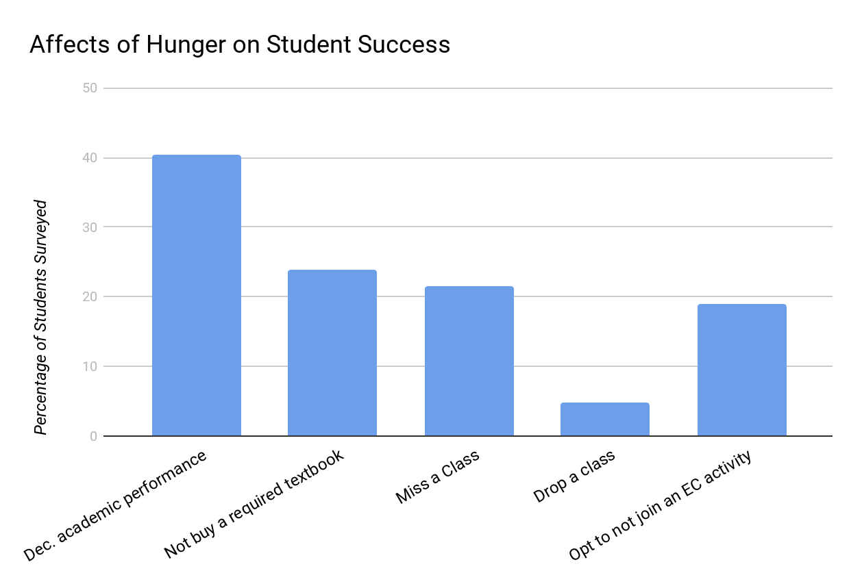
Food Insecurity at Pitt: What We Know (cont.)
Campus Cupboard Study (OCD/GPCFB 2017)
Students were asked, “How often have hunger problems caused these things to happen?”
Figure indicates the percentage of students affected in each area at least once.
Notes:
92 Responses

Slide 11
Campus Cupboard Study (OCD/GPCFB 2017)
Most food insecurity among participants in this study was related to limited quality of affordable food. Problems accessing a sufficient quantity of food were less frequently cited than problems accessing sufficiently high-quality food.
Students experiencing food insecurity relied more heavily on federal student loans to finance their educations.
70% of students experiencing food insecurity reported they would use a food pantry if one were available
Results of this study were consistent with the results of previous national studies
Notes:
11 colleges and universities Fayette, Allegheny Westmoreland and Beaver

Slide 12
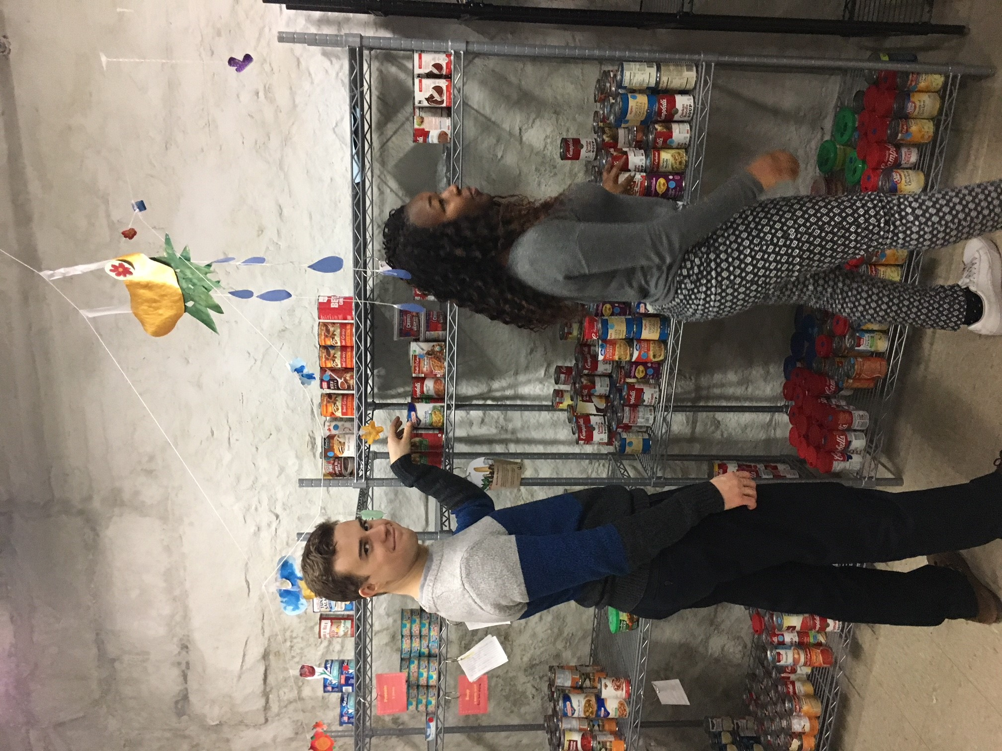
The Pitt Pantry
Eligibility Requirements
Shop-Through Model
Programs: Food Recovery, Resource Fairs, Workshops, Cooking Classes
Spring 2018 Hours:
Wednesdays 1-4pm
Thursdays 5-8pm
Fridays 2-5 pm
pantry@pitt.edu
Notes:
Eligibility - $18,090 for one, $24,360 for two

Slide 13
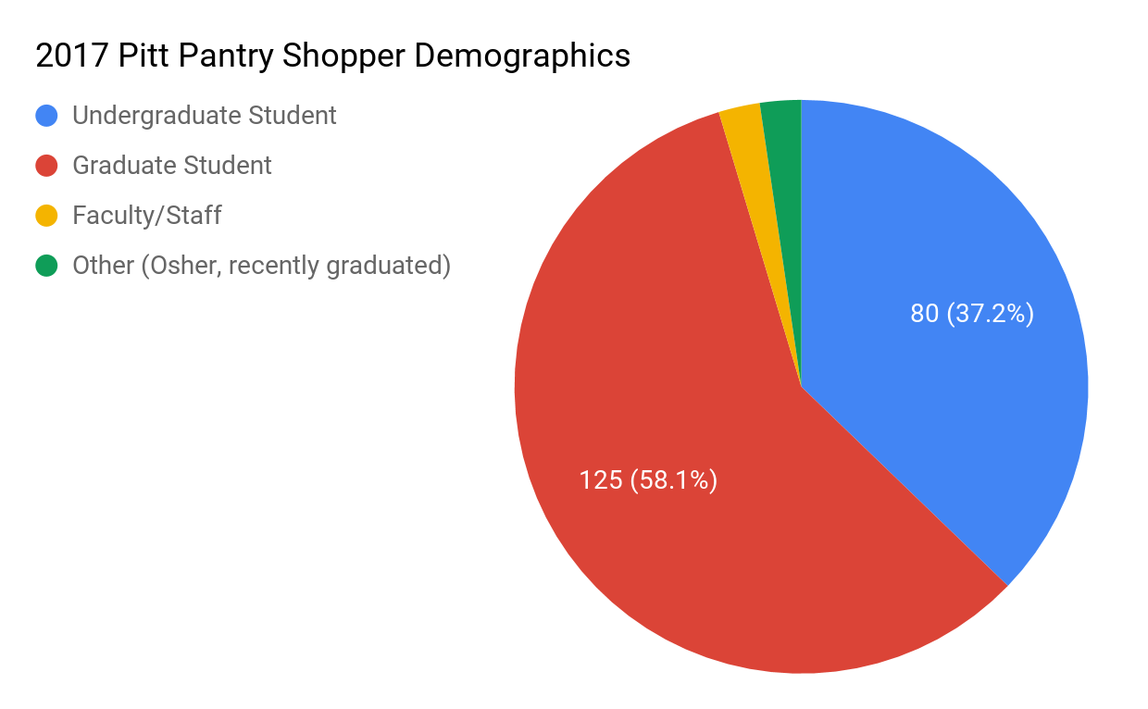
Demographics
Average shoppers age 18-34
3% were veterans/military
30% of graduate students were international
Notes:
227 total shoppers

Slide 14
Moving Forward: A Basic Needs Approach
Basic Needs Approach: A holistic, proactive system designed to identify and meet the varied and unique needs of students
Food Security
Housing Security
Health (Physical and Mental)
Safety
Accessibility
Financial Literacy

Slide 15
A Basic Needs Approach (Cont.)
Source: UC Berkeley Basic Needs Training
Berkeley Basic Needs Website
Source: UC Berkeley Basic Needs Training
Notes:
UC Berkeley one of first universities in the US to bring basic needs into the spotlight
Diagram taken from BN training by Ruben Canedo
Proactive component - trying to get away from the “know about it when you need it” mindset
Focus on education & prevention, long term
Emergency relief at bottom -- less likely to occur with other programs in place
Show website if time

Slide 16
Future Plans for Pitt
Conduct a campus-wide basic needs assessment.
Establish a campus wide basic needs working group.
Ensure all key departments are familiar with the resources that are available and how to refer students to them.
Resource guide
Incorporate and normalize basic needs approach in our institution as a foundation for student success.
TRANPARENCY.

Slide 17
Questions?
Erika Ninos, Sustainability Program Coordinator
erika.ninos@pitt.edu
(412)648-1293
Ciara Stehley, AmeriCorps VISTA
pantry@pitt.edu
(412) 648-1295

