Slide 1
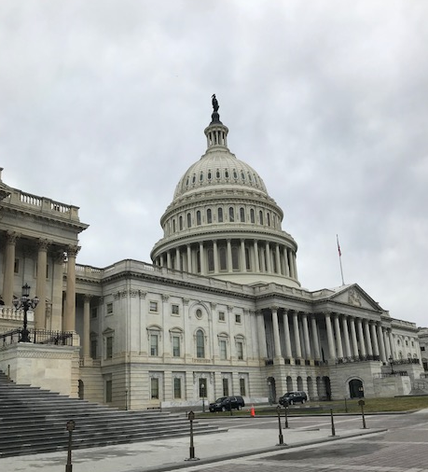
Advocacy Can Be Easy
...and Fun!
Alyssa Dobson
Kimberly McCurdy

Slide 2
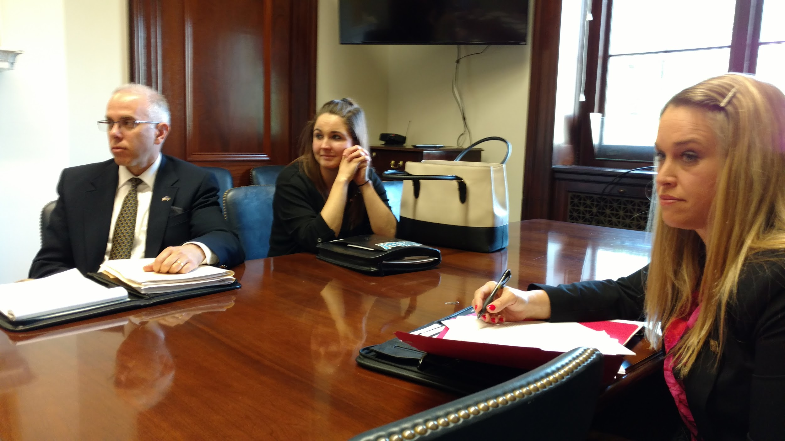
Agenda
What does advocacy look like?
What’s your reason?
Issues pertinent to PASFAA?
PROSPER Act
Suggestions to begin
Consider this...

Slide 3
What does advocacy look like?
Action alerts
Personal emails
Hand-written notes
Personal phone calls
Professional organizations
Walk-the-Hill
In Harrisburg or DC
Local legislative drop-ins or appointments
Volunteering
Presenting at an event or sitting at a resource table
Rallying students to advocate
Notes:
Ask the question first and see what the group has to say about advocacy. Then click and the answers fly in.

Slide 4
What does advocacy look like?
Starting point = educate yourself (there’s no financial aid for that though)
https://www.senate.gov/reference/reference_index_subjects/Directories_vrd.htm (Federal)
https://www.house.gov/representatives/find-your-representative (Federal)
http://www.legis.state.pa.us/cfdocs/legis/home/findyourlegislator/ (State)
Each of these folks will have information on their important topics other relevant information.

Slide 5
What does advocacy look like?
Following bills that pertain to you:
https://www.legis.state.pa.us/login/Form.cfm (State legislature)
https://edworkforce.house.gov/prosper/ (Prosper Act Specific)
http://www.help.senate.gov/ (Federal senate HELP committee)

Slide 6
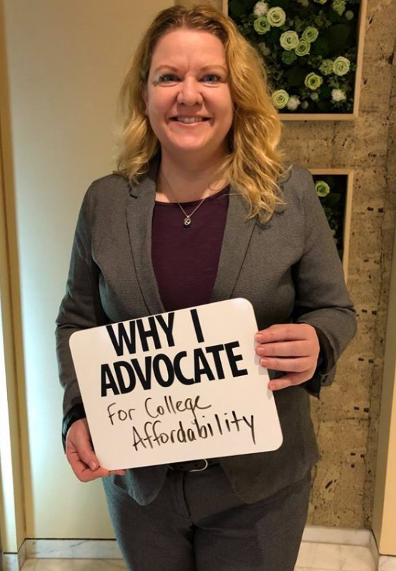
What’s your reason?
Your agenda (locally)
Your school’s agenda
Students
PASFAA’s agenda
Educate the legislators
What they don’t know can
hurt YOU!

Slide 7
What’s your reason?
Laws are the statutory basis for ALL of our regulations that impact our work and our students
Created by folks who are not working in our field
Lack an understanding of the impact
Fueled by political motives
If you want to have better/beneficial rules and regulations then you must advocate

Slide 8
PASFAA Advocacy
College affordability
PA State Grant funding
PASSHE and State-Related funding
Financial literacy for students
Preserve the Pell well!
FAFSA simplification
PROSPER Act
Where are my PLUS loans!?!?!?!
Origination fees

Slide 9
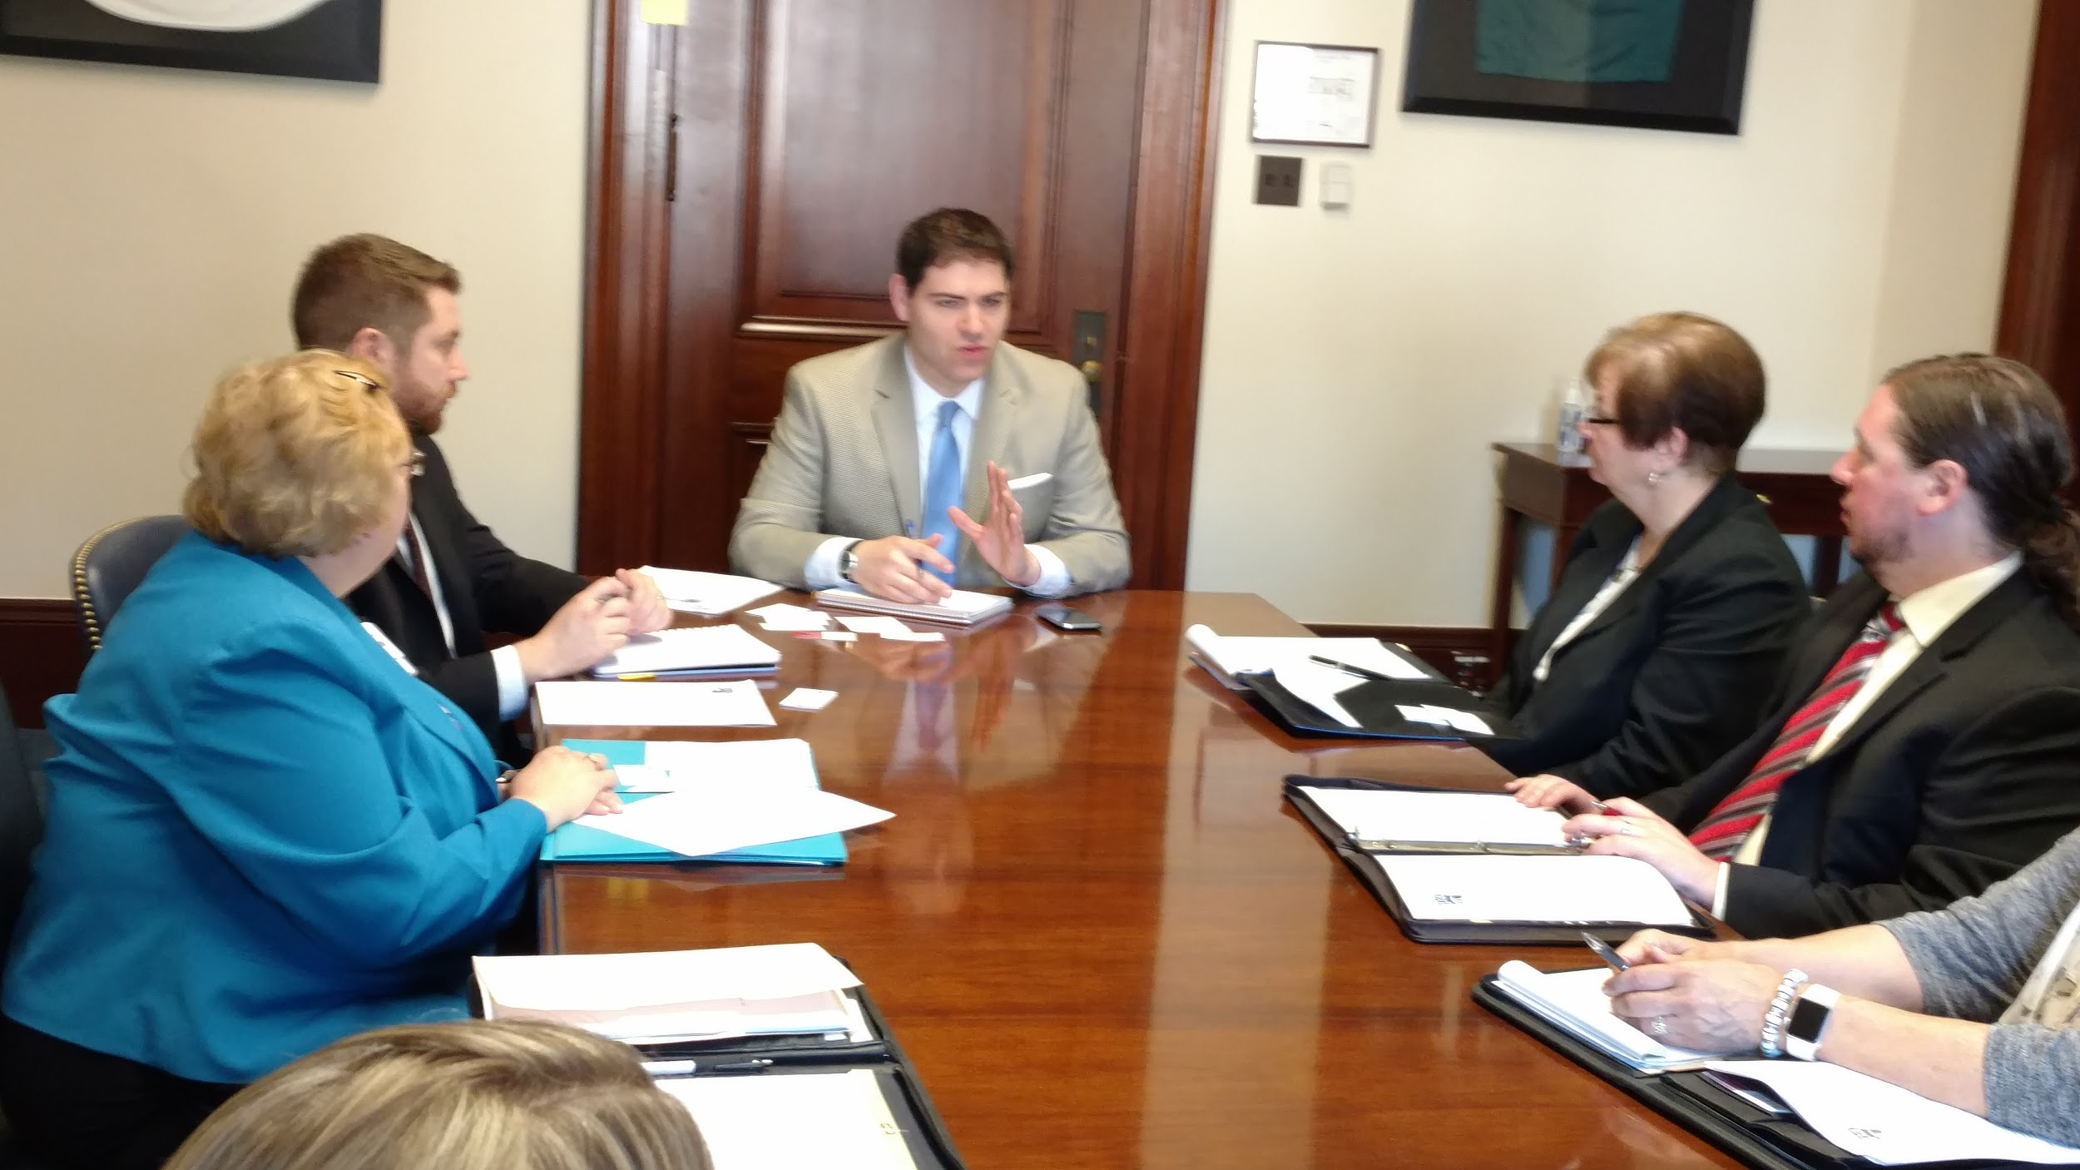
PASFAA Advocacy
We represent all school types and sectors
We must advocate responsibly to ensure all interests are represented
Diverse representation on the GRC
Access and affordability!

Slide 10
PROSPER Act
Reauthorization of the Higher Education Act of 1965
4 years or so overdue
Some good, some bad
Pell bonus
FWS retained (but it’s the only campus based fund)
No origination fees
Higher annual and overall aggregates
LOSS of the graduate PLUS program
New parent PLUS annual and aggregate limits

Slide 11
PROSPER Act
New loan limits
Parent annual limit $12,500
Parent aggregate $56,250
Freshmen annual limit $7,500
Total for first year $20,000
Even PASSHE is unaffordable under this rule for students who don’t qualify for anything else!!!
Graduate annual $28,500
No PLUS loan here - more private loans!

Slide 12
Where do I begin?
Education
Get involved in Government Relations Committee
Practice your pitch
Know what legislation has been sent out of committee
Sign up for notifications
Websites
Get to know your legislators
Who are the champions for education?
Find personal, relatable stories

Slide 13
Where do I begin?
Gather student testimonials (with permission to share) where possible.
Create a “one pager”
Easy to read
Charts are good
Quick talking points
Be memorable! Offer to be a resource on an area of expertise
Comment on an NPRM!
And comment and comment and encourage comment!

Slide 14
Consider This...
Become a member of an advocacy group
Run for local office
Help with a campaign for someone running on an educational platform
Start a student organization that advocates for higher education on your campus

Slide 15
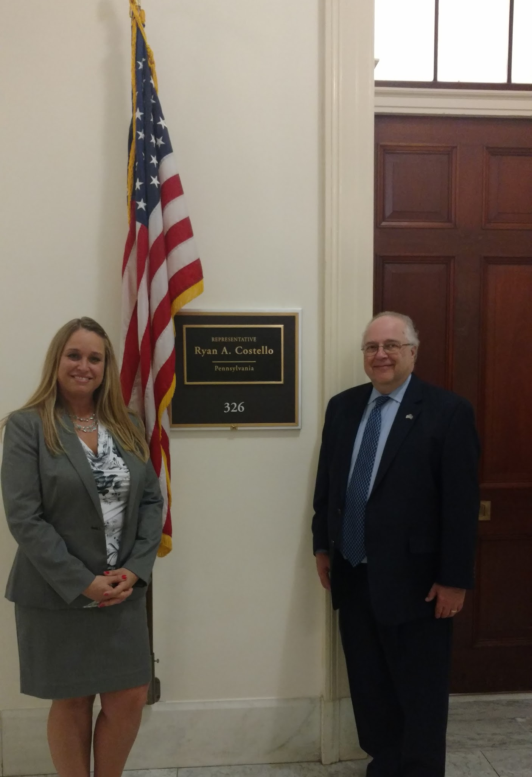
Consider This…
Negotiated Rulemaking
Can be nominated by NASFAA or
PASFAA
Can nominate yourself
ED makes final selection
School pays for the expense
Time intensive

Slide 16
Contact Information
Alyssa Dobson - Director of Financial Aid,
Slippery Rock University
alyssa.dobson@sru.edu
Kimberly McCurdy - Higher Education Access Partner,
PHEAA
kmccurdy@pheaa.org
This is totally Ruth Bader Ginsburg, the notorious RBG if you will - you never know who you’ll see in DC!

