Slide 1

Return of Title IV
Pasfaa Spring Training 2015
Presented by:
Janet McLaughlin (west)
And linda Ross (East)

Slide 2

R2T4
Modules and Leaves,
and
Clock (Credit) Hours…OH
MY!!

Slide 3

Understanding the Basics
Principles
Terminology
Top Finding
Errors

Slide 4

Principles
Complete the Entire Period
Attendance
Calculation
Withdrawals

Slide 5

Terminology
Return of Title IV
Funds
Post-Withdrawal Disbursement
Unearned Funds
Title IV Recipient

Slide 6

* Semesters * Payment period
* Trimesters * Period of Enrollment
* Quarters * Non-term
* Modules * Non-Standard term
* Standard term
* Clock-Hour
Credit-Hour
Terminology

Slide 7

Return to Title IV requirements apply to a Title IV grant or loan recipient who does not complete the term.
Title IV aid programs subject to the R2T4 funds calculation include:
Federal Pell Grant
Iraq & Afghanistan Service Grant (ISAG)
Teach Grant
Federal SEOG
Federal Perkins
Federal Direct Student Loans
Federal work-study funds earned are not counted

Slide 8

Formula Descriptions
Days attended
* * Credit – hour program Days in period
=Percentage completed
* Clock– hour program Scheduled hours at withdrawal
Hours in period
=Percentage completed

Slide 9

Modules
How to determine whether a student withdrew
Ask the following questions:
1.) After beginning attendance in the payment period or period of enrollment, did the student cease to attend or fail to begin attendance in a course he or she was scheduled to attend?
2.) When the student ceased to attend or failed to begin attendance in a course he or she was scheduled to attend, was the student still attending any other courses?
3.) Did the student confirm attendance in a course in a module beginning later in the period (for non-term and nonstandard-term programs, this must be no later than 45 calendar days after the end of the module the student ceased attending)?

Slide 10

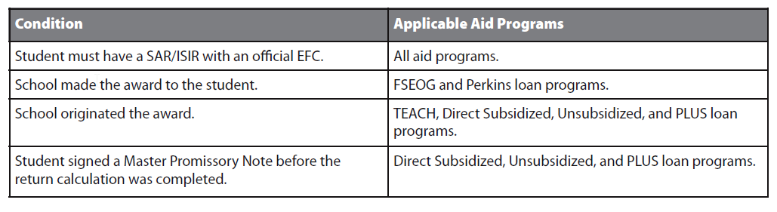
Title IV Aid Disbursed –vs-Aid That Could Have Been Disbursed

Slide 11

Understanding the
Title IV Funds Return Form
1. Student’s Title IV Aid Information
Amount Disbursed
Could Have been Disbursed
2.Percentage of Title IV Aid Earned.
3. Amount of Title IV Aid Earned by the student.
4. Title IV Aid to be disbursed or Returned.
5. Amount of Unearned Title IV Aid Due from the School.
6. Return of Finds by School
7. Initial Amount of Unearned Title IV Aid Due From the Student.
8. Repayment of the Student’s Loans
9. Grant Funds to be Returned
10. Return of Grant Funds by the Student

Slide 12
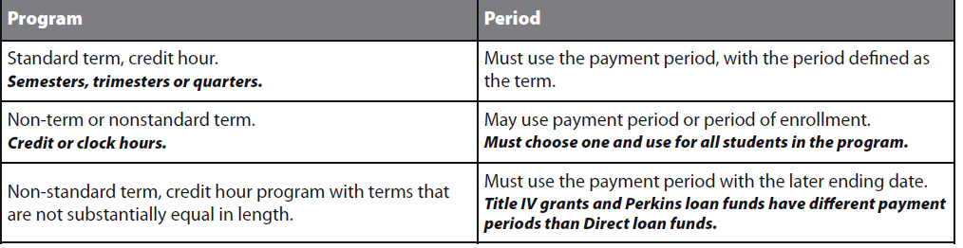
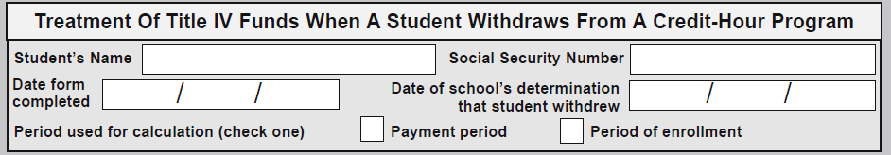

Worksheet – Step by Step

Slide 13
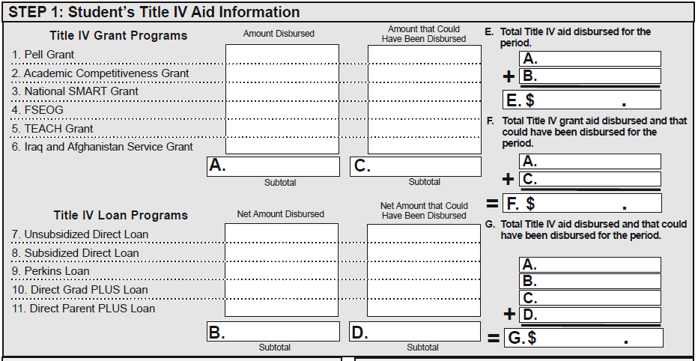

Account for the Federal Aid – Step 1

Slide 14
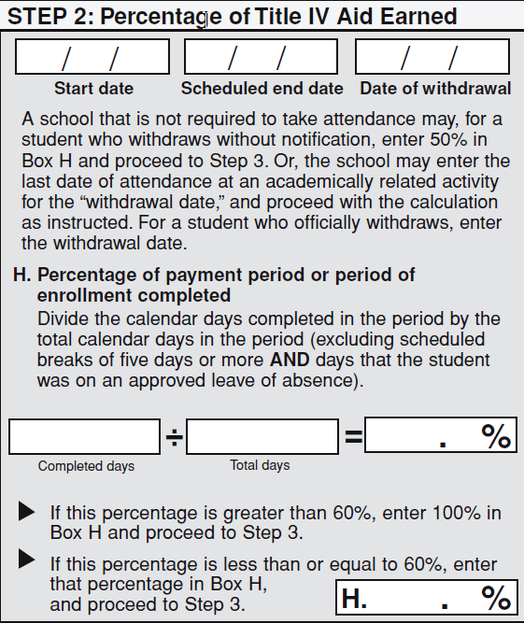
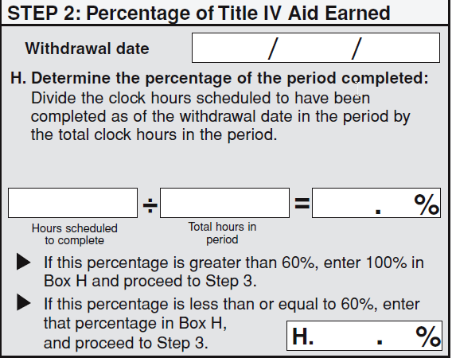
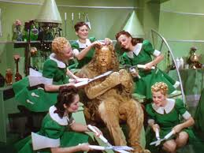
Clock hour –Step 2 - Credit hours/Clock hours (credit / clock) side by side

Slide 15
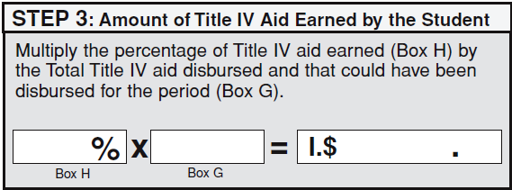

Step Three – amount earned by the student

Slide 16
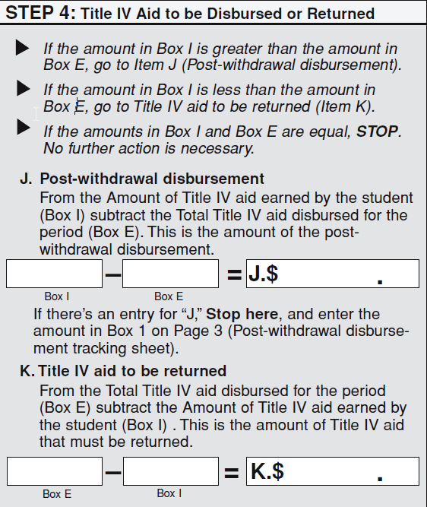
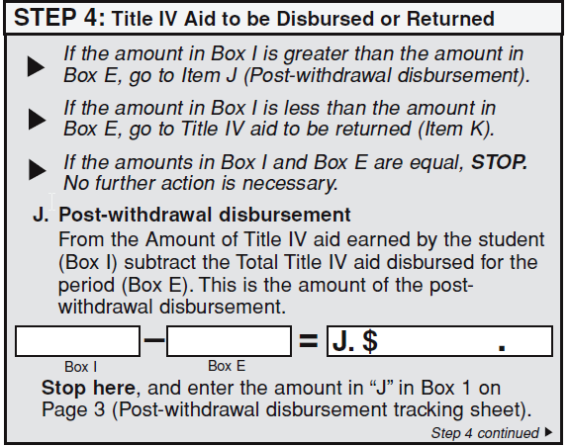
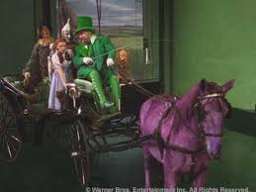
Step Four - – Credit hour / Clock hour

Slide 17
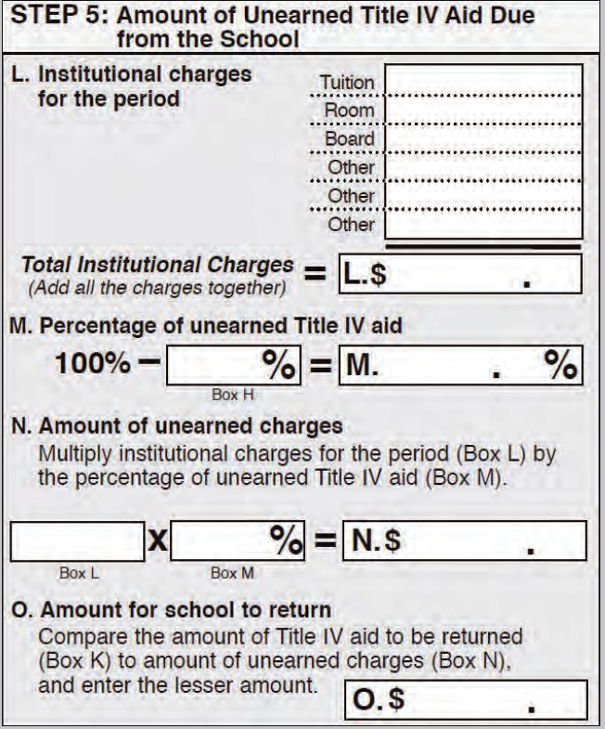
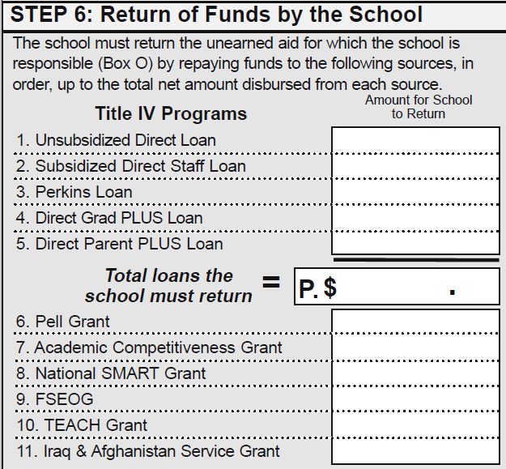
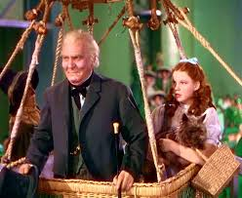
Almost done!!!

Slide 18
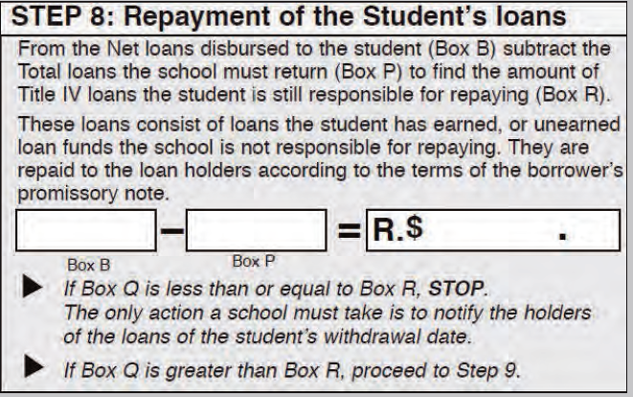
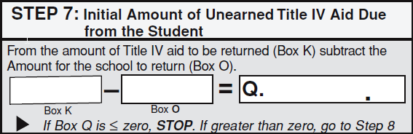

Student

Slide 19
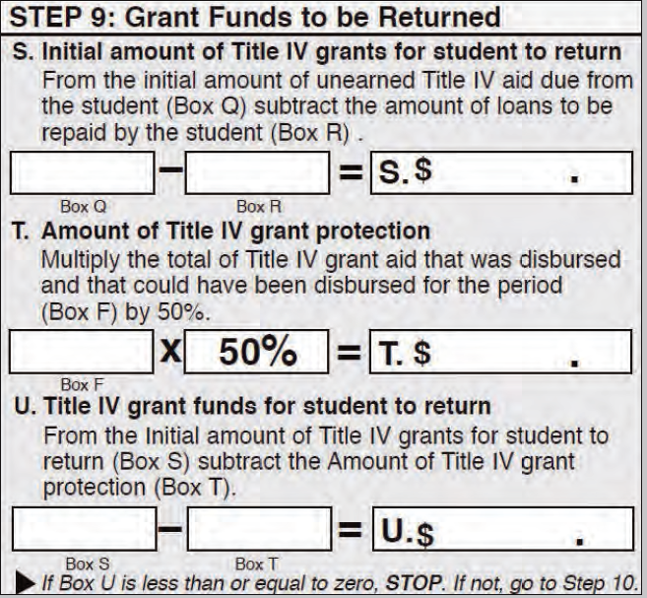
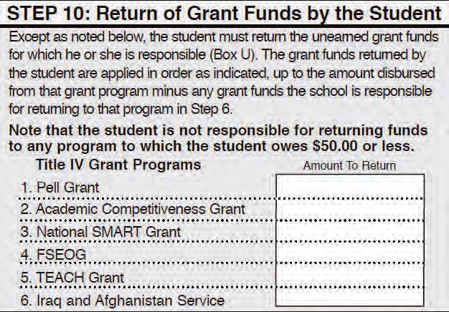
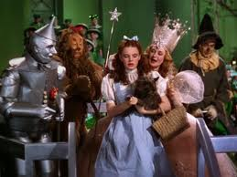
Grant Funds…

Slide 20

Top Finding Errors
Late R2T4
Incorrect Numbers
Late Disbursements
Grant Overpayment
Withdrawal Date
Math Errors
Policy and Procedures
Unofficial withdraw

Slide 21

Don’t get trapped by the “oddities”
These are examples of things that can and do happen:
1) Snow days ?
2) Exceptions by the academic advisors
3) The Programmer/Consultants who incorrectly program your calendar.
4) Make sure you have Return to Title IV Funds Policies and Procedures on record!
5) Make certain you have ALL of you consumer information accessible to your students. (withdrawal policy, refund policy, requirements, etc.)

Slide 22


Questions ????????
FINANCIAL AID

Slide 23

By Linda Ross and
Janet McLaughlin
(Reading Hospital School of Health Sciences and University of Pittsburgh )
References
- USA Funds University
Federal Student Aid Handbook
NASFAA –National Association of Student Financial aid Administrators

