Slide 1
Motivating / Marketing Techniques to Engage Students
Shannon adam, assistant director of financial aid, moravian college
Melissa labrie, associate director of financial aid, moravian college
Charles M. Scheetz, Director of Student Financial Aid, Mansfield University

Slide 2
Presence on Campus
Do your students know where your office is located?
Set deadline expectations early
Incoming freshman should know deadlines asap
Use of institutional programming efforts
College magazine/newspaper
TV advertisements
Posters
Emails
Video Messaging

Slide 3
SOCIAL MEDIA
FaceBook
Twitter
Moravian College had zero Financial Aid presence on social media prior to January 2014
Almost at 106 likes for the Facebook page
Collaborate with other offices for promotional efforts
Make sure to promote the pages you are using on your website and in your publications.

Slide 4
SOCIAL MEDIA Continued…
FaceBook
Share others photos and status updates

Slide 5
SOCIAL MEDIA Continued…
FaceBook
Make it fun!

Slide 6
SOCIAL MEDIA Continued…
Twitter
Follow and retweet

Slide 7
SOCIAL MEDIA Continued…
Twitter
Giveaways

Slide 8
Collaborate
Collaborate with admissions office
We work with admissions office to use mail chimp to be able to send mass emails communications
Admissions office uses mail chimp and texting
If students text back it goes to the Google Hangout rather than personal cell phone

Slide 9
Video Messaging
Mansfield has created a How-To section of videos on their website
Each video is a few minutes in length
The videos detail the important information
Both audio and video
It is used by several departments on-campus
Student Registration and Financial Services
Admissions
A collaborative effort

Slide 10
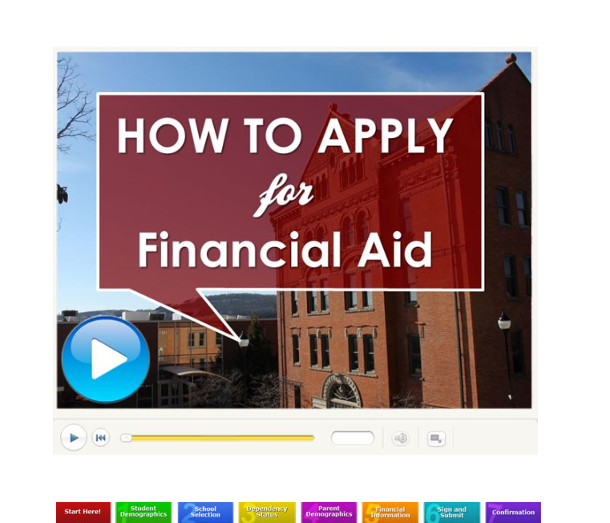
Video Messaging

Slide 11
BB Connect
Mansfield uses BB Connect
A mass marketing tool
Sends out emails and voice messages to a select group of students
Used for the following:
FAFSA reminders
Payment Due Dates
Loan Documents
Events
We receive a large number of calls for a few days following the announcements being sent
Students and parents are both notified

Slide 12
Promote
Use social media as a stepping stone, do not rely on it
Email reminders
Reminder phone calls
Text Messaging
Face to face contact
Use layering - there is nothing wrong with using several systems to “announce” the same message
Even if your students read it several times from the various systems, you have increased your percentage of success

Slide 13
Collaborate
Work closely with Admissions Office to promote your office
If school is large enough, can have a designated social media coordinator for entire campus
Works closely with offices on campus to get proper text
They are the creative backbone

Slide 14
Financial Literacy
Use of vendor programs or homegrown
Not just Financial Aid info
Collaborate with Introduction to College Life Courses
April: Financial Literacy Month
Have a presence on campus

Slide 15
Questions or Suggestions?

Slide 16
Contact Information
Shannon Adam, Assistant Director of Financial Aid, Moravian College
Email: adams@moravian.edu Phone: 610-861-1330
Melissa Labrie, Associate Director of Financial Aid, Moravian College
Email: labriem@moravian.edu Phone: 610-861-1330
Charles M. Scheetz, Director of Student Financial Aid, Mansfield University
Email: cscheetz@mansfield.edu Phone: 570-662-4854

