Slide 1
Graduate School Concerns
Spring 2015

Slide 2
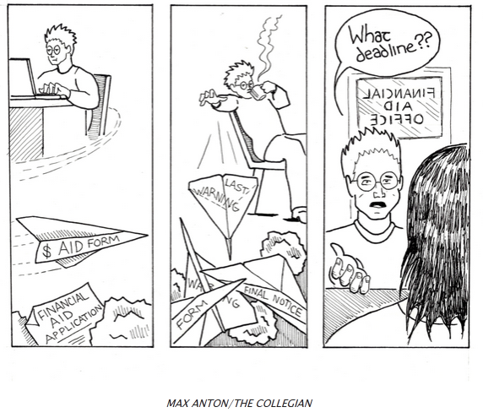
Graduate School Concerns
New - FSA ID
New - Direct Loan Consolidation
New – FAST Act
Financial Literacy
Consumer Disclosure Requirements
Shopping Sheet
Hybrid/Online Programs
Wind-down of the Federal Perkins Loan Program
Resources

Slide 3
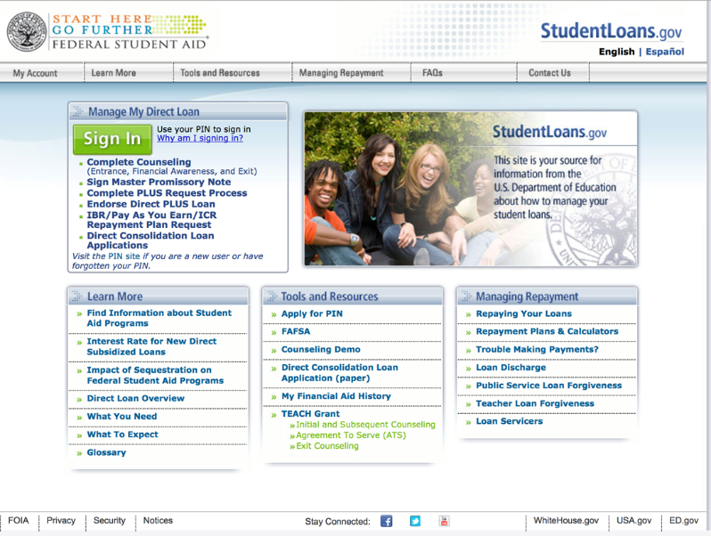
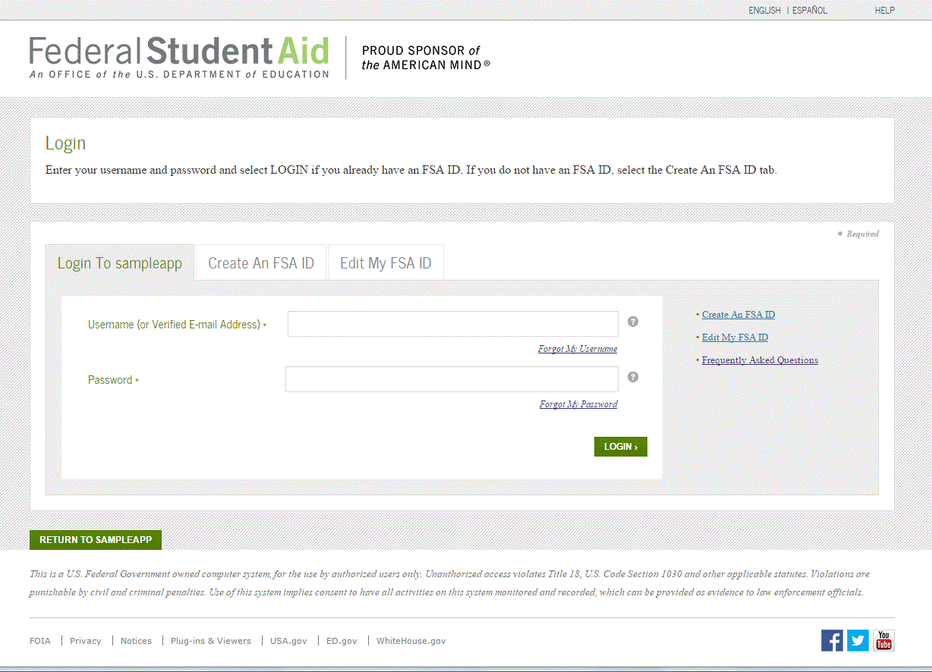
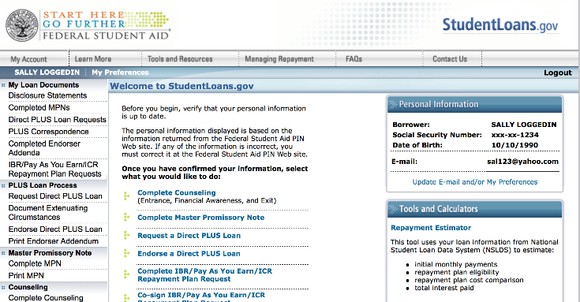
Introducing the FSA ID
Users still click the Sign In button. This directs them to the
FSA ID login page. Once they enter their FSA ID,
they are directed back to the website landing page
Retrieved from 2014 FSA Conference Session 57

Slide 4
Direct Loan Consolidation
The New Loan Consolidation Process was implemented in 2014.
All borrowers can use www.StudentLoans.gov to apply for a consolidation loan
The electronic application consists of five steps:
Choose Loans & Servicer
Repayment Plan Selection
Terms & Conditions
Borrower & Reference Information
Review & Sign

Slide 5
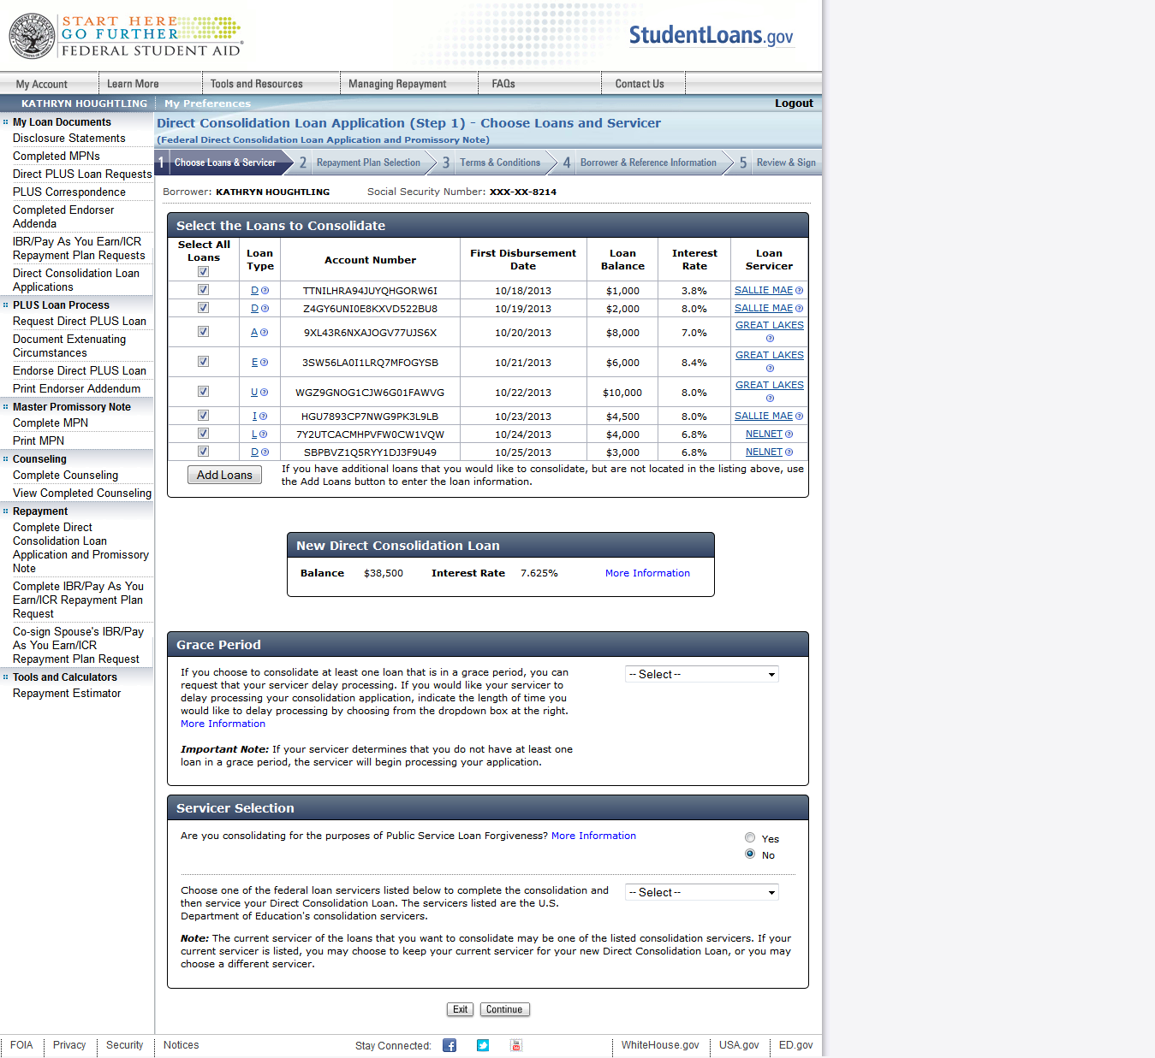
Step 1 – Choose Loans & Servicer
By using the user’s authenticated PIN data to retrieve the user’s loan information from NSLDS, borrowers are able to select or deselect pre-populated loans.
Users are also capable of adding additional loans.
Retrieved from 2014 FSA Conference Session 44

Slide 6
Step 1 – Choose Loans & Servicer
Under “Servicer Selection” the user can select if they are consolidating for the purposes of Public Service Loan Forgiveness (PSLF)
The user can click the “More Information” link for additional information about PSLF
If the user is consolidating for the purposes of PSLF, their servicer options will be restricted to the PSLF servicer
If the user is not consolidating for the purposes of PSLF, the user will select his/her consolidating servicer from a randomized list of servicers
Retrieved from 2014 FSA Conference Session 44

Slide 7
Step 2 – Repayment Plan Selection
This conditional page appears when a user selects an Income- Driven Repayment Plan (IBR/Pay As You Earn/ICR).
By selecting one of the spouse options, the user has the ability to have his/her spouse be a co-signer on the IDR request that will subsequently pay off the consolidation loan (the spouse is not a co-signer on the consolidation loan).
A “Link” is provided to access IRS Tax Return Information, essential to processing an IDR request.
Retrieved from 2014 FSA Conference Session 44

Slide 8
Step 3 – Terms & Conditions
The Terms and Conditions will consist of legal conditions and information relating to borrower rights, responsibilities, and understandings. The user is required to read through the LC Terms and Conditions in its entirety and click the checkbox with an associated message that states that the user has read and understands the LC Terms and Conditions. The user must mark the checkbox in order to continue to the next page of the flow.
Retrieved from 2014 FSA Conference Session 44

Slide 9
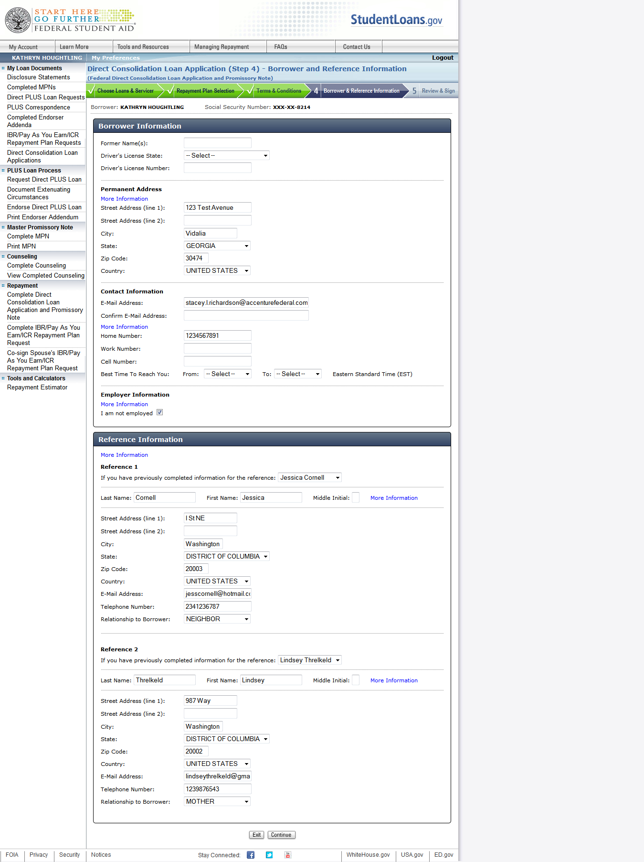
Step 4 – Borrower & Reference Information
The user will be required to submit personal information along with information for two references.
Note: If a user has previously submitted ‘Reference’ information in a StudentLoans.gov application (i.e. – PLUS Application, Exit Counseling), that information appears in a dropdown and can be selected. Otherwise, the user may supply a new reference.
Retrieved from 2014 FSA Conference Session 44

Slide 10
Step 5 – Review & Sign
The “Review & Sign” page for the LC flow will display a summary of the following information provided by the user.
Loans the borrower elected to consolidate
Consolidated Balance and Interest Rate
Length of time for servicer to hold application due to “In Grace” loan (if applicable)
Selected servicer
Selected repayment plan
Transferred IRS tax information (if applicable)
Family size (if applicable)
Spouse Information (if applicable)
Personal information
References
Retrieved from 2014 FSA Conference Session 44

Slide 11
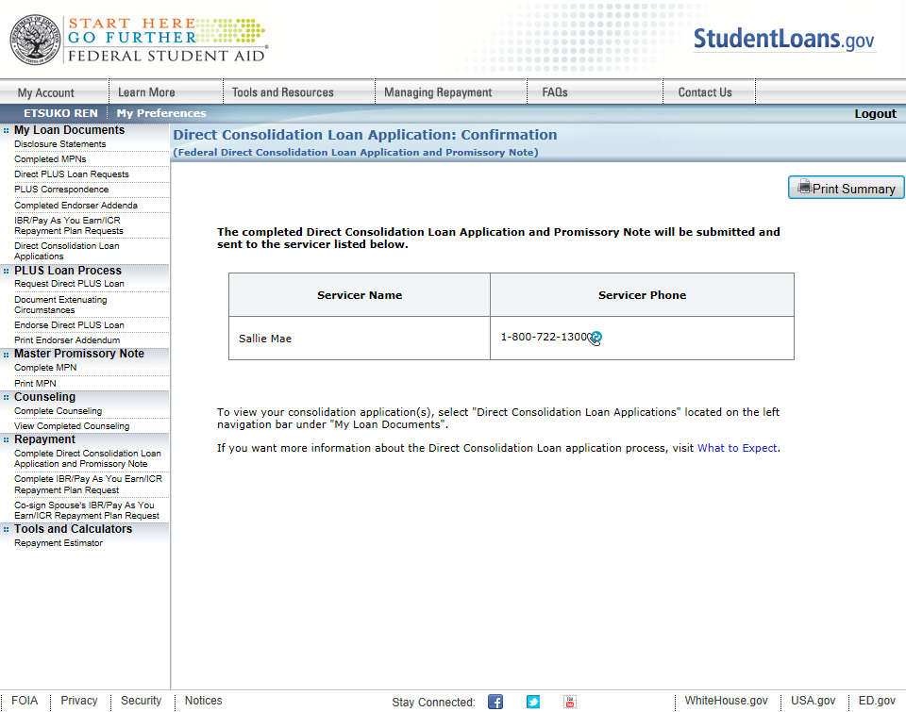
It’s Complete – Loan Application Confirmation
A confirmation page will be displayed to the user upon submission.
Retrieved from 2014 FSA Conference Session 44

Slide 12
FAST Act
Financial Aid Simplification and Transparency Act of 2015
Establishes a new financial aid form that only asks two questions
Replaces the FAFSA
Streamlines the federal financial aid system into one grant and one loan
If this eliminates the Graduate PLUS loan, will this compel graduate students to explore private lending options?
Simplifies repayment programs
Establishes two repayment options
Standard 10 year repayment plan
Income based repayment plan where a borrower would pay no more than 10% of their income for 20 years and forgives any remaining balance

Slide 13
What is Financial Literacy?
“The ability to use knowledge and skills to manage financial resources effectively for a lifetime of financial well being.”
2008 Annual Report, President’s Advisory Council on Financial Capability

Slide 14
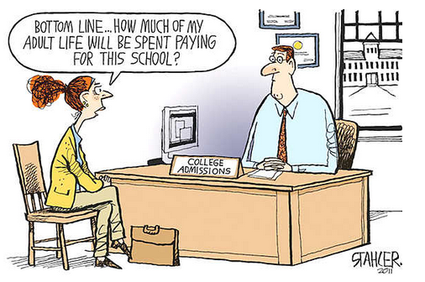
Basics for Student Loan Borrowers
Budgeting
Borrowing
Repayment Strategies

Slide 15
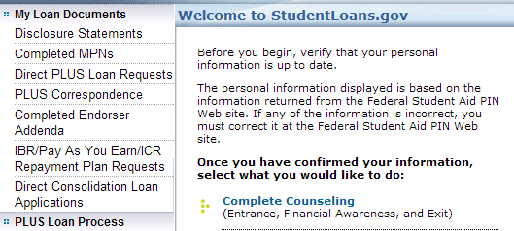
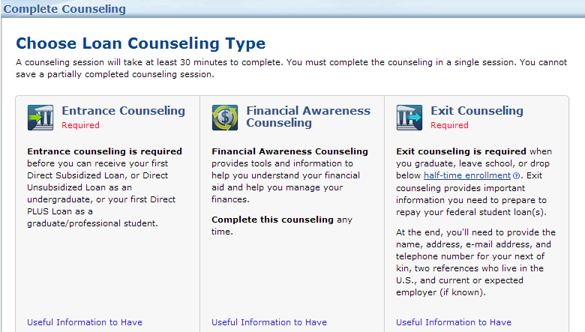
Financial Awareness Counseling Tool
The Financial Awareness Counseling Tool (FACT) is on Studentloans.gov
Retrieved from 2014 FSA Conference Session 37

Slide 16
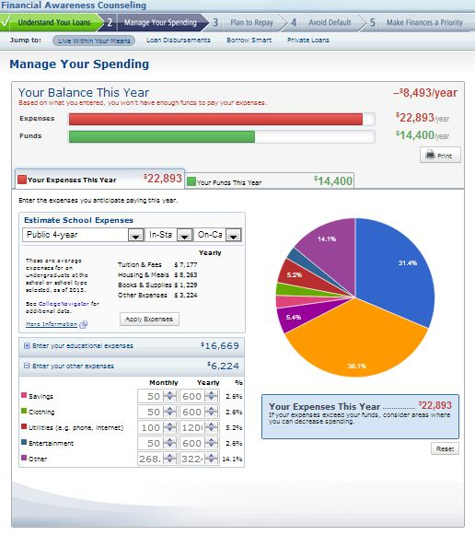
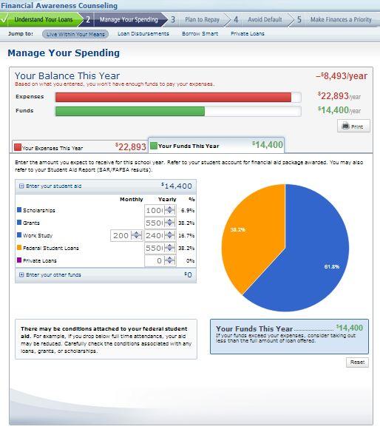
Financial Awareness Counseling Tool
Expenses
Funds
The Financial Awareness Counseling Tool (FACT) is on Studentloans.gov
Retrieved from 2014 FSA Conference Session 37

Slide 17
How Schools Are Using FACT
Incorporating FACT into the financial aid process
Encourage completion of FACT before disbursement of any loan
Direct students to FACT after completing promissory note
Utilizing FACT as a resource
Include as part of annual loan counseling on default aversion
Direct link on financial aid office home page

Slide 18
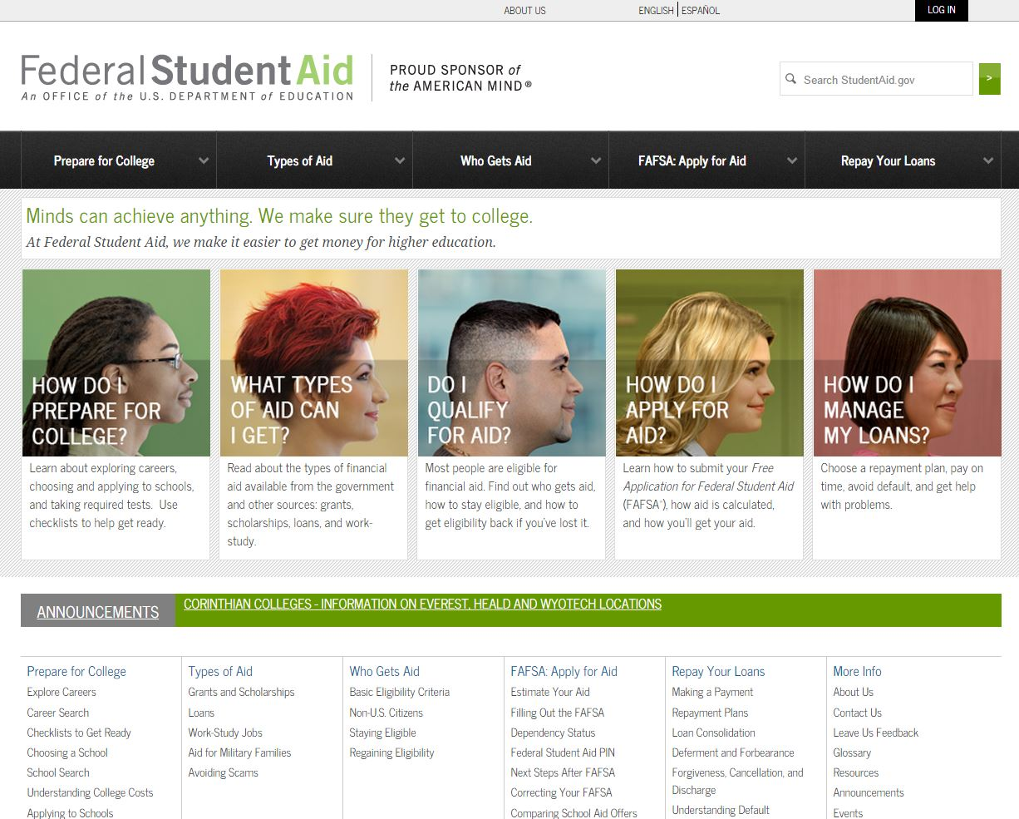
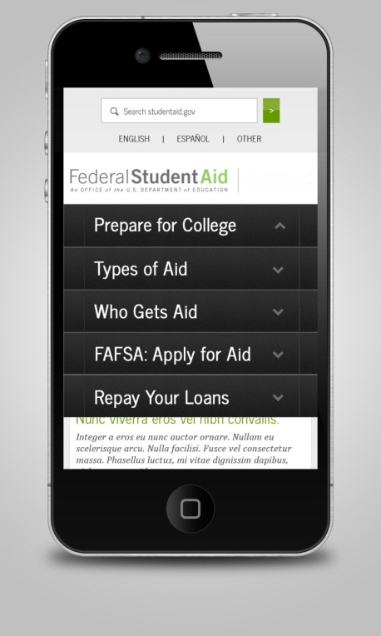
Financial Literacy
NEW
My Federal Student Aid
Retrieved from 2014 FSA Conference Session 37

Slide 19
Videos
Retrieved from 2014 FSA Conference Session 37

Slide 20
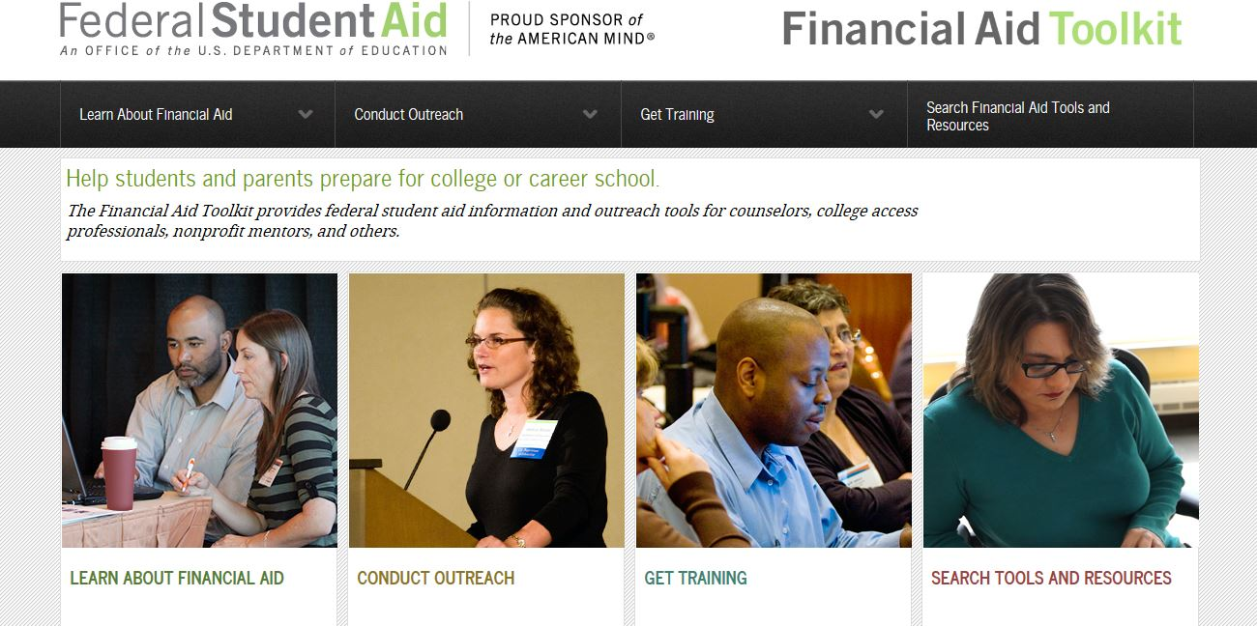
Financial Aid Toolkit
Retrieved from 2014 FSA Conference Session 37

Slide 21
Consumer Disclosure Requirements
HEA requires you to disclose certain information as part of Title IV participation
Disclosures often require information from offices across the institution, not just the financial aid office
Schools may face penalties for noncompliance

Slide 22
Shopping Sheet
Single sheet, standardized format
Can use as cover sheet with aid offer notification or as standalone notice of aid awards
Value as a consumer comparison tool
Designed for undergrads and may be modified for graduate students
Transparency and consistency in providing information to all students
Use is voluntary but strongly encouraged
Fulfills information requirements for key pieces of Executive Order 13607

Slide 23
Shopping Sheet for 2014-15
Student information
School information
Information supplied by DOE
Graduation Rate
Loan Default Rate
Median Borrowing

Slide 24
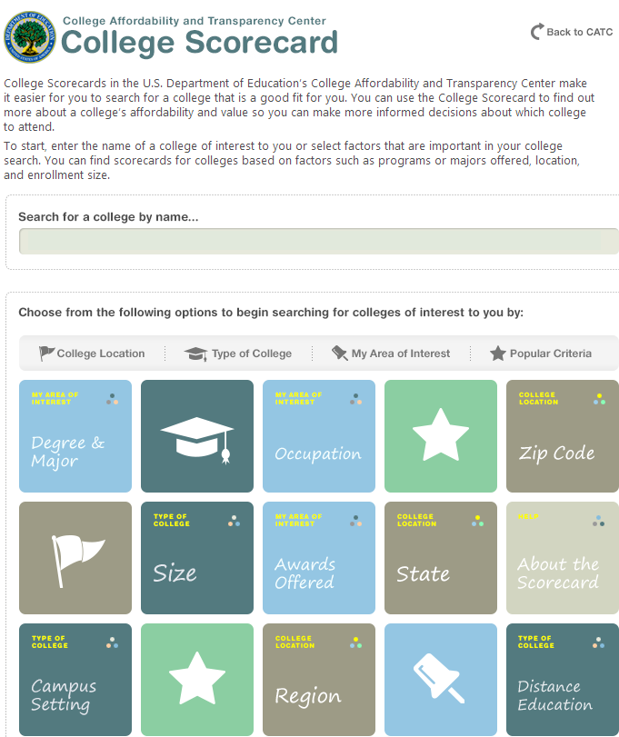
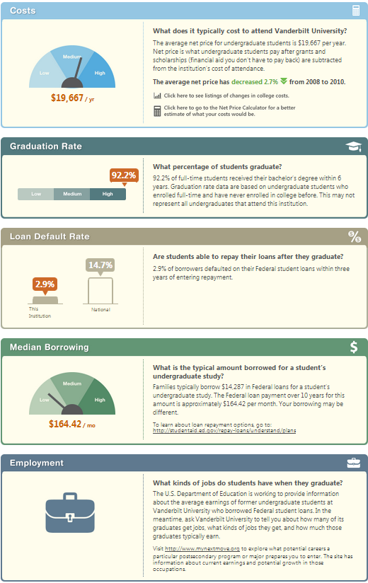
College Scorecard

Slide 25
Hybrid/Online Programs
Cost of Attendance
Does your online program include modules?
R2T4 for online programs, any best practices to share?
BBAY vs. SAY

Slide 26
Perkins Loan Program
Limited authority to award after September 30, 2015
Grandfathering provision
What will you do?

Slide 27
Additional Thoughts?

Slide 28
Resources
FSA Conference Presentations http://fsaconferences.ed.gov/index.html
Manage Student Loans www.studentloans.gov
FAST Act http://www.help.senate.gov/imo/media/doc/final_Draft%20_FAST%20Bill%20summary.pdf https://www.govtrack.us/congress/bills/114/s108
Federal Student Aid www.StudentAid.gov
May 20, 2014: Phase Two of Transition Implemented on May 18, 2014 http://ifap.ed.gov/eannouncements/052014NewDirectConsolLoanProcessInfoPhaseTwoTransImplMay182014.html
Financial Aid Toolkit www.financialaidtoolkit.ed.gov
Consumer Information http://ifap.ed.gov/qahome/qaassessments/consumerinformation.html
Shopping Sheet Template https://www.ifap.ed.gov/eannouncements/attachments/ShoppingSheetTemplate20152016.pdf
College Scorecard http://www.whitehouse.gov/issues/education/higher-education/college-score-card
Perkins Loan Wind-down http://ifap.ed.gov/dpcletters/GEN1503.html

