Slide 1

2015-2016 Verification
Tonya R. Hsiung,
Franklin & Marshall College

Slide 2
Regulations define…
Whose application MUST be verified
FAFSA information to be verified (varying collected information began in 2013-2014)
Documentation used to verify data elements
Regardless of whether a student is selected for verification or not, you MUST always resolve discrepancies and conflicting information.

Slide 3
Who Must Be Verified?
You must verify applications, selected by CPS, of students who will receive (or have received) SUBSIDIZED student financial assistance - Title IV programs for which eligibility is determined by the EFC:
  Federal Pell grant
  FSEOG
  Federal Work Study
  Federal Perkins Loan
  Direct Subsidized Loan Program
Verification is not required if the student will only receive UNSUBSIDIZED student financial assistance – Title IV programs for which eligibility is NOT based on the EFC:
  TEACH Grant
  Direct Unsubsidized Loan Program
  Direct PLUS Loan Program
  Iraq and Afghanistan Service Grant (this is a non-need based grant and not subject to verification)

Slide 4
Customized Verification
(started in 2013-2014)
The FAFSA information that must be verified:
  Will vary between applicants
  May be information that is not used in calculating the applicant’s EFC
  May differ between award years

Slide 5
DOMA and DCL GEN 13-25
DOMA repealed on 6/26/13 – effective 25 days later
Internal Revenue Service (IRS) now allows legally married same-sex couples to file as “married”
A student can be considered independent for purposes of FAFSA completion and EFC calculation if the student is legally married, without regard to whether the student is in a same-sex or opposite-sex marriage.
…“responses to the FAFSA marital status questions must be ‘married’ if the student or parent was legally married in one of the 50 states, the District of Columbia, a U.S. territory, or a foreign country, without regard to whether the marriage was between persons of the same sex or opposite sex or where the couple resides or where the student will be attending school.”
  Considered married if student or parent was legally married in any domestic or foreign jurisdiction that recognizes the relationship as a valid marriage, regardless of where the couple resides.
ED has confirmed that schools are not required to verify or otherwise document a legally recognized same-sex marriage.
  2 websites for more information about same-sex marriage, if interested:
    www.freedomtomarry.org/states
    www.cnn.com/interactive/us/map-same-sex-marriage/

Slide 6
Impact of DCL GEN-13-12 and
Defense of Marriage Act (DOMA)
Dependent Student’s Parents’ Household Comprised of: | Data from 1 or 2 Parents Collected? | Data from 1 or 2 Parents Collected?
 | 2013-2014 and Prior | 2014-2015 and Forward
Single legal parent | 1 Parent | 1 Parent
Two legal parents who are husband and wife | 2 Parents | 2 Parents
Legal parent and stepparent | 2 Parents | 2 Parents
Two legal parents who are unmarried and live together (regardless of gender), or who are of the same sex and are married, as recognized by a state or foreign country | 1 Parent | 2 Parents

Slide 7
Verification Tracking Groups
V1 – Standard
V2 – Reserved – NOT USED IN 2015-2016
V3 – Child Support Paid
V4 – Custom
V5 – Aggregate
V6 – Household Resources

Slide 8

Items To Be Verified – Tax Filer
Adjusted Gross Income
US Income Tax Paid
Untaxed Portions of IRA distributions (exclude Rollovers)
Untaxed Portions of Pensions (exclude rollovers)
Tax-Exempt Interest Income
Education Credits
Number of Household Members
Number in College
Supplemental Nutrition Assistance Program (SNAP – Food Stamps)
Child Support Paid
Other Untaxed Income
  Payments to Tax-Deferred Pension and Savings
  Child Support Received
  Housing, food, and other living allowances paid to members of the military, clergy, and others
  Veterans Non-education Benefits
  Other untaxed income
  Money received or paid on the applicant’s behalf

Slide 9
Items To Be Verified – Tax Filer
 | VERIFICATION GROUP
Verification Data Item | Standard | NOT USED in 2015-2016 | Child Support Paid | Custom | Aggregate | Household Resources
 | V1 | V2 | V3 | V4 | V5 | V6
Adjusted Gross Income | X |  |  |  | X | X
US income tax paid | X |  |  |  | X | X
Untaxed portions of IRA distributions | X |  |  |  | X | X
Untaxed portions of pensions | X |  |  |  | X | X
IRA deductions and payments | X |  |  |  | X | X
Tax-exempt interest income | X |  |  |  | X | X
Education credits | X |  |  |  | X | X
Other Untaxed Income |  |  |  |  |  | X
Household Size | X |  |  |  | X | X
Number in College | X |  |  |  | X | X
SNAP benefits | X |  |  | X | X | X
Child Support Paid | X |  | X | X | X | X
High School Completion |  |  |  | X | X
Identity/Educational Purpose |  |  |  | X | X

Slide 10

Items To Be Verified – Non-Tax Filer
Income Earned from Work
Number of Household Members
Number in College
Supplemental Nutrition Assistance
Program (SNAP – Food Stamps)
Child Support Paid
Other Untaxed Income*
  Payments to Tax-Deferred Pension and Savings
  Child Support Received
  Housing, food, and other living allowances paid to members of the military, clergy, and others
  Veterans Non-education Benefits
  Other untaxed income
  Money received or paid on the applicant’s behalf*

Slide 11
Items To Be Verified – Non-Tax Filer
 | VERIFICATION GROUP
Verification Data Item | Standard | NOT USED in 2015-2016 | Child Support Paid | Custom | Aggregate | Household Resources
 | V1 | V2 | V3 | V4 | V5 | V6
Income earned from work | X |  |  |  | X | X
Household Size | X |  |  |  | X | X
Number in College | X |  |  |  | X | X
SNAP benefits | X |  |  | X | X | X
Child Support Paid | X |  | X | X | X | X
High School Completion |  |  |  | X | X
Identity/Educational Purpose |  |  |  | X | X
Other Untaxed Income |  |  |  |  |  | X

Slide 12
Untaxed Income
For the 2015-2016 award year, certain applicants (V6 Verification Group) will be required to verify the untaxed income information they provided on the FAFSA for the student and for the dependent student’s parents
If the financial aid administrator determines that the amounts provided and verified from the untaxed income question and from income information (e.g. AGI, income earned from work, untaxed income not included on the FAFSA) do not appear to provide sufficient financial support for the number of household family members reported, the applicant and, if appropriate, the applicant’s parents or spouse must explain how the family was financially supported during the 2013 calendar year.
  You could use the poverty Guidelines as a guide if
  additional information is needed: http://aspe.hhs.gov/poverty/index.cfm (see handout)

Slide 13
Required Documentation
For taxable income, base year tax information (i.e. for 2015-2016, need 2014)
For untaxed income and benefits, examples include:
  Verification Worksheet
  Official agency documentation
  Signed statement

Slide 14
Tax Documents
IRS tax data can be obtained using one of two methods:
  IRS Data Retrieval Tool (through the FAFSA)
    This is the BEST METHOD!
    Transferred information, which is unaltered is acceptable (code of 02)
  IRS Tax RETURN Transcript (from the IRS)
    Via web, IRS Form 4506T-EZ

Slide 15
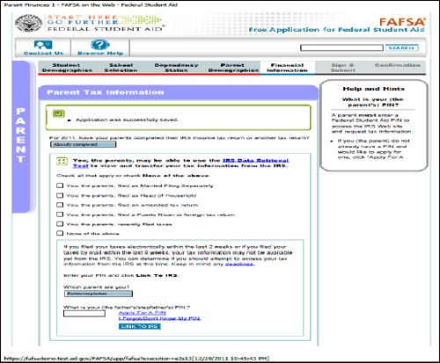
IRS Data Retrieval Tool

Slide 16
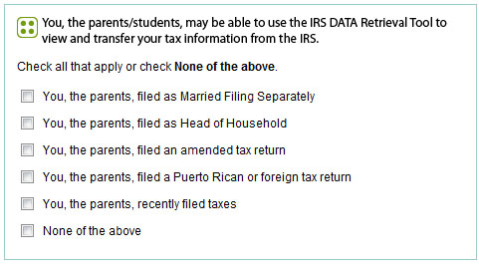
IRS Data Retrieval Tool

Slide 17
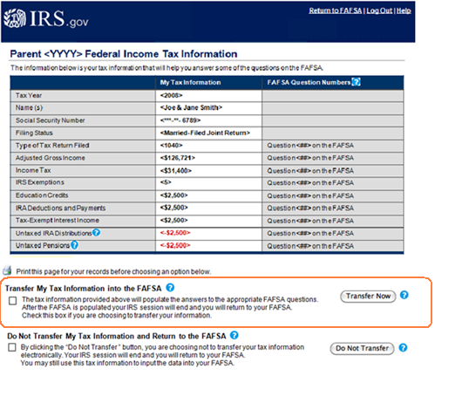
IRS Data Retrieval Tool

Slide 18
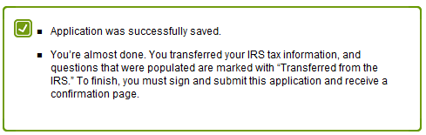
Updating the FAFSA with the IRS DRT
If the IRS DRT is not initially used when completing the FAFSA, students/parents can go back and make corrections to use the IRS DRT.
When the information is transferred from the IRS, they will get the following message:
Additionally – an email will be sent to students who have saved corrections after seven days of inactivity, encouraging them to return to the FAFSA on the Web to submit the corrections.

Slide 19
IRS Display Flags – Parent –
You will see these flags regarding IRS DRT
Blank = IRS DRT not available
A (if student is dependent) = Dependent student has special circumstances – IRS DRT was not displayed
A (if student is independent) = Independent student skipped the parent questions – IRS DRT was not displayed
B = IRS DRT was displayed to parent
C = Tax return status not equal to “Already completed” – IRS DRT was not displayed
D = Marital status date greater than or equal to January 2014 – IRS DRT was not displayed
E = First three digits of SSN are 666 – IRS DRT was not displayed
F = Non-married parent or both married parents entered all zeroes in SSN – IRS DRT was not displayed
G = Neither married parent entered a valid SSN – IRS DRT was not displayed
H = Parent amended his/her tax return – IRS DRT was not displayed
J = Parent filed a Puerto Rican or Foreign tax return – IRS DRT was not displayed
K = Parents are married and tax return filing status is Married Filed Separate Return – IRS DRT was not displayed
L = Parents are married and tax return filing status is Head of Household – IRS DRT was not displayed
M = Conflict between the parents’ marital status and tax return filing status – IRS DRT was not displayed
N = Parents’ marital status is “Unmarried and both parents living together” – IRS DRT was not displayed

Slide 20
IRS Display Flags – Student –
You will see these flags regarding IRS DRT
Blank = IRS DRT not available
A = Dependent student skipped the income and asset questions – IRS DRT was not
displayed
B = IRS DRT was displayed to student
C = Tax return status not equal to “Already completed” – IRS DRT was not displayed
D = Marital status date greater than or equal to January 2014 – IRS DRT was not
displayed
E = First three digits of SSN are 666 – IRS DRT was not displayed
H = Student amended his/her tax return – IRS DRT was not displayed
J = Student filed a Puerto Rican or Foreign tax return – IRS DRT was not displayed
K = Student is married and tax return filing status is Married Filed Separate Return –
IRS DRT was not displayed
L = Student is married and tax return filing status is Head of Household – IRS DRT was
not displayed
M = Conflict between the student’s marital status and tax return filing status – IRS
DRT was not displayed

Slide 21
IRS Tax Return Transcript via www.irs.gov/Individuals/Get-Transcript
Click on Get Transcript Online
Create an Account with the IRS (if you already have one, skip this step)
Once an account has been created, log in
Indicate the reason for requesting the transcript is “Higher Education/Student Aid”
The Return Transcript will be boxed and highlighted – select year “2014”
Be sure to disable the pop-up blocker in order to receive the PDF version of your Tax Return Transcript

Slide 22


Get Transcript
www.irs.gov/Individuals/Get-Transcript
Get Transcript
Get a record of your past tax returns, also referred to as transcripts. IRS transcripts are often used to validate income and tax filing status for mortgage applications, student and small business loan applications, and during tax preparation.
You can download and print your transcript immediately, or request the transcript be mailed to your address on record.
View and print your transcript immediately. Choose among Tax Return, Tax Account, Record of Account, or Wage and Income transcripts or a Verification of Nonfiling Letter. Need help? More information about Get Transcript Online. |  | Transcripts arrive in 5 to 10 business days. Choose from either a Tax Return or Tax Account. Transcript by Mail is available en Español.

Slide 23
IRS Tax Return Transcript via www.irs.gov/Individuals/Get-Transcript
Go to http://www.irs.gov/Individuals/Get-Transcript
Click on Get Transcript by Mail
Enter your SSN, Date of Birth, Street Address, and Zip Code
Click Continue
Select Return Transcript for Tax Year (i.e. 2014)
Click Continue

Slide 24
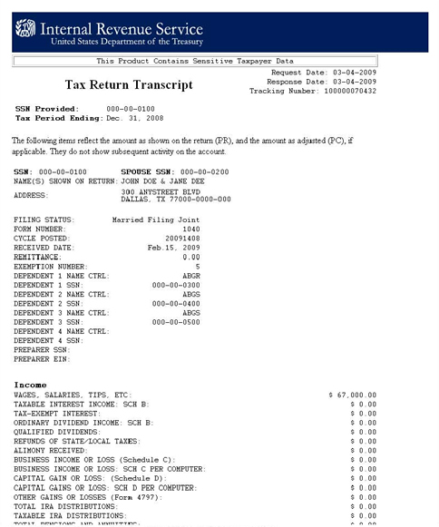
IRS Tax Return Transcript
CORRECT

Slide 25
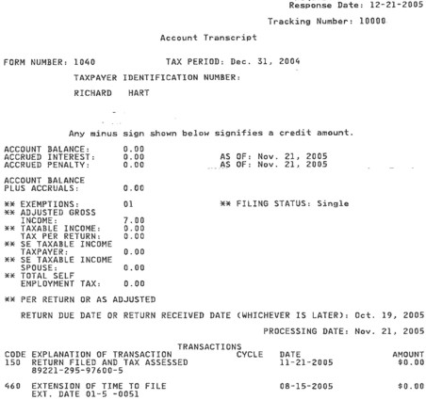
IRS Tax Return Transcript
INCORRECT

Slide 26
Reasons the IRS DRT cannot be used
The person did not indicate on the FAFSA that the tax return has been completed (indicated “will complete” or “not required to file”)
The marriage date is January 2015 or later
The first three digits of the SSN are 666
The tax return was amended
The person filed a Puerto Rican or foreign tax return
The person is married and filed the tax return as Head of Household (HOH) or Married, filing Separately (MFS)
Neither married parent entered a valid SSN
A non-married parent or both parents entered all zeroes for the SSN

Slide 27
IRS Tax Transcript Required
When the applicant or parent did not use the IRS DRT – either at initial FAFSA filing or through the FOTW correction process.
When information obtained by using the IRS DRT was changed before or after submission of the FAFSA or the FAFSA correction.
When a married independent applicant and spouse filed separate returns.
When the married parents of a dependent student filed separate returns
In all instances, when the dependent student’s legal parents are unmarried and living together.

Slide 28
IRS Tax Transcript Required
When an applicant or applicant’s parents had a change in marital status after the end of the 2014 IRS tax year on December 31, 2014.
When the applicant or parent or spouse file an amended tax return. Under this condition, the institution must obtain the documents below to complete verification:
  A signed copy of the original tax return that was filed with IRS, an IRS Tax Return Transcript, or any IRS tax transcript that includes all of the income and tax information required to be verified, and
  A signed copy of the IRS Form 1040X that was filed with the IRS.
    In order to be complete, it should include the updated 1040, 1040A, or 1040EZ, along with the 1040X.

Slide 29
Availability of IRS Transcripts
Electronically filed Tax Returns
  $0 balance/refund returns: Generally available 2-3 weeks after the return has been accepted by IRS
  Balance due/partial pay returns: Generally available by end of June or 3-4 weeks after the IRS receives the full/final payment
Paper Tax Returns
  $0 balance/refund returns: Generally available 8-11 weeks after the IRS receives the return
  Balance due/partial pay returns: Generally available by end of July
Amended Returns
  Must be filed as a paper return
  Generally available 12 weeks after the IRS receives the amended return
ID Theft Cases
  Must be filed as a paper return
  Generally available 8-11 weeks after the IRS receives the duplicate return

Slide 30

IRS DRT or Tax Transcript Items
Adjusted Gross Income
US Income Tax Paid
Untaxed Portions of IRA distributions*
Untaxed Portions of Pensions*
IRA Deductions and Payments
Tax-Exempt Interest Income
Education Credits
*IRS DRT & Tax Return Transcript cannot identify rollovers – may need 1099-R to verify if IRA or Pension distribution is a rollover

Slide 31
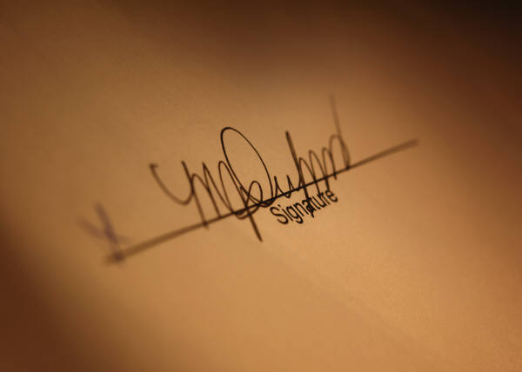
Other Information Regarding Taxes
IRS Tax Return Transcripts submitted to the institution for verification do not need to be signed by the tax filer, unless the institution has reason to doubt the authenticity of the document.
Paper Tax Returns – in very limited circumstances, an institution may accept a signed paper copy of a 2014 income tax return for verification purposes through guidance provided by the US Department of Education and must document the limited circumstances that allowed the applicant to submit a copy of the income tax return

Slide 32
Other Information Regarding Taxes
On 8/21/12, the US Department of Education issued guidance in an Electronic Announcement on the limited circumstances when a signed copy of an income tax return or other documentation is acceptable for completing verification for individuals who:
  Filed an amended IRS income tax return
  Were victims of IRS identity theft (more on next slide)
  File non-IRS income tax returns
  This guidance continues to be in effect for the 2015-2016 award year and subsequent award years until further notice.
If you listened to the Jim Briggs Webinar in January, he mentioned about not accepting a statement of non-filing status that was dated after June 15 to be valid – what he was speaking of was the IRS “Verification of Nonfiling Letter” – you only need that if you question the student or parent in their status of not being required to file a tax return.

Slide 33
Other Information Regarding Taxes
Who is required to file taxes?
Single dependents. Were you either age 65 or older or blind?
No. You must file a return if any of the following apply.
Your unearned income was over $1,000.
Your earned income was over $6,100.
Your gross income was more than the larger of—
  $1,000, or
  Your earned income (up to $5,750) plus $350.
Other Situations When You Must File
You had net earnings from self-employment of at least $400.

Slide 34
Tax Extensions
If a student or parent has been granted a tax filing extension, you MUST accept the following to complete verification:
  A copy of IRS Form 4868 – Application for Automatic Extension of Time to File U.S. Individual Income Tax Return
  Copies of all W-2 forms and/or
  If self-employed, a signed statement with the amount of their AGI and their U.S. income taxes paid.
Once the tax return has been filed, you MAY request they use the IRS DRT or submit a copy of the tax return transcript. However, if you do that, you MUST re-verify the income information.

Slide 35
Identity Theft
    At the FSA Conference, Department of Ed officials indicated that students or parents who are victims of identity theft could contact 1-800-908-4490 and a transcript would be mailed to those individuals.
    To Complete Verification – if they cannot obtain the tax return transcript:
      Send in a copy of the signed IRS income tax return AND
      One of the following:
        IRS Form 14039, “Identity Theft Affidavit”
        Signed, dated statement indicating victim of identity them and IRS is investigating
        Copy of the police report filed by the tax filer

Slide 36
Documents to Verify
Untaxed Income and Benefits
The US Department of Education no longer has a Verification Form for school use. They have a example forms in the Federal Student Aid Handbook with suggested or required text. Each institution will need to create a form or forms to verify information, based on the customized verification groups.
  If one form is used, you will need to determine
  how you will notify the student of what
  sections to complete based on their
  verification selection group.
  All text is suggested with the exception of the
  Statement of Educational Purpose – the text
  provided is the exact language that must be used.

Slide 37
Verifying SNAP Benefits & Child Support Paid
SNAP Benefits
  If the ISIR shows that someone in the parents’ or student’s household received SNAP benefits in 2013 or 2014, the student must provide a signed statement indicating receipt of the benefit (this can be done on your customized verification form)
Child Support Paid
  If the ISIR shows that the student or parent paid child support in 2014, the student must provide a statement signed by him/her or,
  if she is dependent, either parent and giving the annual amount
  of the support, the names of those who paid it and whom it was
  paid to, and the name(s) of the child(ren) for whom it was paid
  (this can be done on your customized verification form)
You may request documentation to verify receipt of SNAP or Child Support Paid if you believe the information to be inaccurate.

Slide 38
Verifying High School Completion
Acceptable Documentation
A copy of high school diploma
A copy of final, official high school transcript that shows the date when the diploma was awarded
A copy of a General Education Development (GED) certificate or GED transcript
An academic transcript that indicates the student successfully completed at least a two-year program that is acceptable for full credit toward a bachelor’s degree
A copy of a secondary school completion credential for homeschool (other than a high school diploma or its recognized equivalent) if state law requires homeschooled students to obtain that credential
A transcript or the equivalent, signed by the parent or guardian of a homeschooled student, that lists the secondary school courses the student completed and documents the successful completion of a secondary school education in a homeschool setting.
If your school has already received one of the documents above as
part of the admission process, you do not need to ask for another.
Students who are unable to get one of these documents must
contact your financial aid office.

Slide 39

Verifying Identity and Statement of Educational Purpose
Students must appear IN PERSON at the school and present a valid, government-issued photo identification (ID) such as a passport, drivers license, etc.
You must maintain an annotated copy of the ID. The annotation must include the date it was received and the name of the person your school authorized to receive it.
Students must also sign a statement of educational purpose (you create the form, but must use the Department of Education’s wording on the form).
If they are unable to appear in person, they must sign and submit the statement of educational purpose and must submit a copy of his/her ID with the statement signed by a notary public confirming that the student appeared before him/her and presented the ID confirming his/her identity.

Slide 40
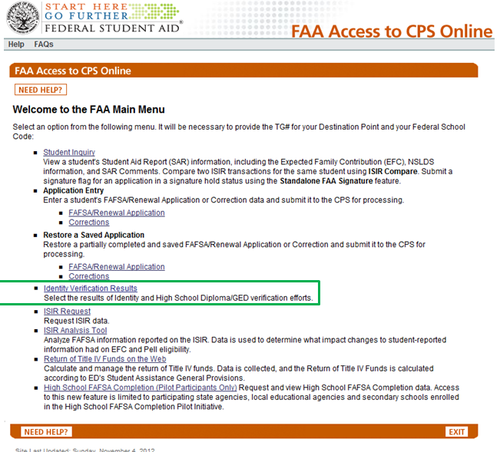
FAA Access 2015-2016

Slide 41
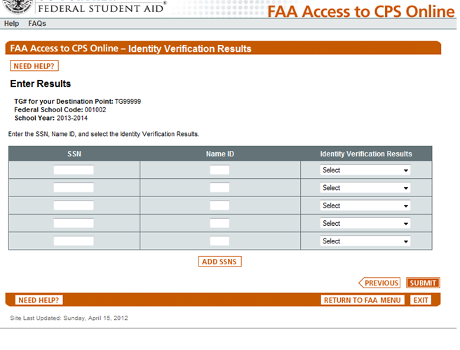
FAA Access 2015-2016
FAAs are able to enter SSNs/Name ID/ Verification Results from a dropdown menu on this page
Click “Add SSNs” and enter additional ones

Slide 42
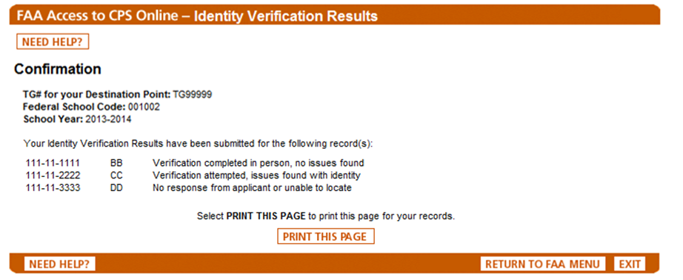
FAA Access 2015-2016
Dropdown options are
  Verification completed in person, no issues found
  Verification completed remotely, no issues found
  Verification attempted, issues found with identity
  Verification attempted, issues found with HS completion
  No response from applicant or unable to locate
  You must only report on students from whom you attempt to collect or request documentation
FAAs will get a confirmation page with the results submitted. FAAs can print the page for their records.

Slide 43
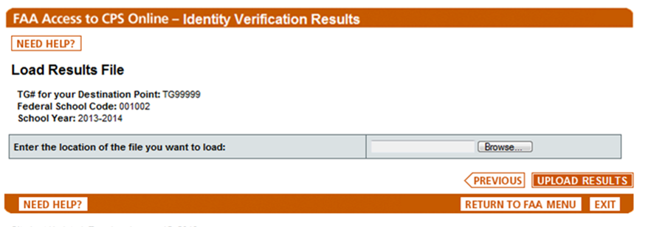
FAA Access 2015-2016
FAAs can create and upload a flat file to report required results.
FAAs will get a confirmation page with the results submitted. FAAs can print the page for their records.

Slide 44
Updating Information
Generally, a student cannot update information on the FAFSA because it is considered a “snapshot” of the family’s financial situation as of the date it was signed.
Only certain items can be updated under the following conditions:
  All applicants whose dependency status changes must update that status and the associated FAFSA information throughout the award year except when the update is caused by a change in the student’s marital status.
  All applicants selected by the Department of a school for verification of household size or number in college must update those numbers to be correct as of the date of verification unless the update is due to a change in the student’s marital status.
  At your discretion, you can update either situation even when the update is due to a change in the student’s marital status (if you deem it necessary to address an inequity or to reflect more accurately the applicant’s ability to pay – must be on a case-by-case basis and must be documented).
Documenting household size or number in college is not required
in a subsequent verification in the same year if the information
has not changed.

Slide 45
Correcting Errors
For students who are selected for verification and receiving subsidized student aid, the following changes must be submitted for processing:
  Changes to any non-dollar items
  Changes to any dollar item of $25 or more

Slide 46
Verification Status Codes
V – Verified
You have verified the student. This includes students selected by the CPS and those your school chose to verify based on its own criteria.
W – Without Documentation
The student was selected for verification by the CPS or your school, and you chose to pay a first disbursement of Pell without documentation. You must update this status once verification is complete or COD will reduce the Pell Grant to zero.
S – Selected, But Not Verified
The CPS selected the student for verification, but you did not verify because the student met the criteria to not be verified or because your school participates in the Quality Assurance (QA) Program and the student’s application did not meet your school’s verification criteria.
Blank
Used in verification was not performed because the student was not selected by the CPS or your school or because the student was selected after ceasing enrollment at your school and all disbursements were already made.

Slide 47
Verification Resources
Q&A on Program Integrity website:
  http://www2.ed.gov/policy/highered/reg/hearulemaking/2009/verification.html
2015-2016 Verification – Suggested Text
  http://ifap.ed.gov/eannouncements/112414VerificationSuggestedText1516.html
2014-2015 FAFSA-IRS Tax Return Transcript Matrix
  https://ifap.ed.gov/eannouncements/041714FAFSAVerificationIRSTaxReturnTranscriptMatrix1415.html
  2015-2016 should be available mid-April

Slide 48
Verification Resources
  2014-2015 Application and Verification Guide
    http://www.ifap.ed.gov/fsahandbook/attachments/1415AVG.pdf
  Limited Circumstances When a Signed Copy of a Tax Return or Other Documentation is Acceptable for Completing Verification
    http://www.ifap.ed.gov/eannouncements/082112LimitedCircumstancesWhenSignedCopyofTaxReturnisAcceptable.html
  Dear Colleague Letter GEN 14-11: 2015-2016 Award Year: FAFSA Information to be Verified and Acceptable Documentation
    http://ifap.ed.gov/dpcletters/GEN1411.html

Slide 49
Data Sources
2014-2015 Federal Student Aid Handbook – Application and Verification (AVG) Guide – Chapter 4
2013-2014 NASFAA Core Module 4 – Verification
2014 NASFAA Verification Presentation, July 2014
2014 FSA Conference GS3 – Verification, December 2014
US Department of Education GEN-13-12
US Department of Education GEN-13-25
US Department of Education GEN-14-05
US Department of Education GEN-14-11
IRS Form 1040: http://www.irs.gov/pub/irs-pdf/i1040.pdf

Slide 50
Questions???
Tonya R. Hsiung
Assistant Director of Financial Aid
Franklin & Marshall College
717-291-4395
tonya.hsiung@fandm.edu

