Slide 1
2014-15 Verification
Michelle Jackson, Director of Financial Aid CCAC-Boyce Campus
Kyle Mosley, Director of Financial Aid CCAC-South Campus

Slide 2
2014-15 Verification
Federal Register Notice, published June 13, 2013, Free Application for Federal Student Aid (FAFSA) Information To Be Verified for the 2014-2015 Award Year
Dear Colleague Letter GEN-13-16, Published June 13, 2013, 2014-15 Award Year: FAFSA Information to be Verified and Acceptable Documentation

Slide 3
Changes to 2014-15 Verification
Target verification based upon most error prone data items specific to an applicant
Eliminated SNAP (V2) as a separate verification group
Added household resources group (V6)
Other untaxed income and benefits as a verification item

Slide 4
ISIR Verification Flags
Notes:
Verification Flag
Y = selected for verification
N = not selected for verification
* = selected for verification on a subsequent transaction

Slide 5
2014-15 Verification Tracking Groups
Verification Tracking Flag | Verification Tracking Group | Verification Description
V1 | Standard Verification | Record selected because conditions based on statistical analysis error-prone risk model were met
V2 | Reserved for FSA Use Only | N/A
V3 | Child Support Paid Verification | Record selected for Child Support Paid criteria only
V4 | Custom Verification Group | Record selected for Identity criteria and SNAP/Child Support Paid
V5 | Aggregate Verification Group | Record selected for Identity criteria, “Standard Verification” criteria and SNAP/Child Support Paid
V6 | Household Resources Verification Group | Record selected for Other untaxed income, “Standard Verification” and SNAP/Child Support Paid

Slide 6
V1 – Standard Verification Group (Tax Filers)
Adjusted Gross Income
U.S. Taxes Paid
Untaxed IRA Distributions
Untaxed Pensions
Education Credits
IRA Deductions
Tax-Exempt Interest
Household Size
Number in College
Child Support Paid*
SNAP (Food Stamps)*
*If reported on FAFSA

Slide 7
V1 – Standard Verification Group (Non-Tax Filers)
Household Size
Number in College
Child Support Paid*
SNAP (Food Stamps)*
*If reported on FAFSA
Income Earned from Work

Slide 8
V3 – Child Support Paid Verification Group
Child support paid by the student (or spouse), the student’s parent(s), or both

Slide 9
V4 – Custom Verification Group
Child Support Paid*
SNAP (Food Stamps)*
High School Completion Status
Identity/Statement of Educational Purpose
*If reported on FAFSA

Slide 10
V5 – Aggregate Verification Group
High School Completion Status
Identity/Statement of Educational Purpose
AND
All items in V1 (Standard Verification Group)
Tax Filer
Non-Tax Filer

Slide 11
V6 – Household Resources Verification Group
All items in V1 (Standard Verification Group)
Tax Filer
Non-Tax Filer
AND
Other Untaxed Income
Payments to tax-deferred pension and savings plans
Child support received
Housing, food and other living allowances
Veterans non-education benefits
Additional untaxed income
Money received or paid on student's behalf

Slide 12
Acceptable Documentation

Slide 13
2014-15 Verification
ED will not publish a Verification Worksheet
Suggested text provided in IFAP Electronic Announcement posted November 8, 2013
Must use exact language from Department for Statement of Educational Purpose

Slide 14
Household Size
Signed statement from the applicant (and one parent, if the applicant is dependent) listing the following for each household member:
Name
Age
Relationship to the applicant
A dependent student’s legal parents who live together, regardless of marital status or gender, are required to provide information on the FAFSA and for verification.

Slide 15
Household Size
Not required when:
Dependent student lists 2, and parent is single, divorced, separated or widowed
Dependent student lists 3, and parents are married or unmarried and living together
Independent student lists 1, and student is single, divorced, separated or widowed
Independent student lists 2, and student is married

Slide 16
Number in College
Signed statement from the applicant (and one parent, if the applicant is dependent) listing the following for each household member attending a Title IV-eligible school at least half-time during the 2014-15 award year :
Name
Age
Name(s) of the applicable school(s)
Not required when number in college is 1
Notes:
If the school believes information from the FAFSA or the signed statement is inaccurate, it must obtain a statement from each listed school unless the household member is not yet registered or will attend the applicant’s school.

Slide 17
Tax Filers
Information obtained through IRS data retrieval
IRS Request Flag value: 02
OR
Tax Return Transcript (obtained from IRS)
Record of Account Transcript (obtained from IRS)

Slide 18
2014-15 IRS Request Flags
Code | Description
Blank | IRS Data Retrieval Tool not available in the application method utilized by the student (for example, paper FAFSA, EDE, or FAA Access to CPS Online).
00 | Not eligible to use the IRS Data Retrieval Tool and was therefore not presented with the option to use it in FAFSA on the Web.
01 | Presented with the option to use the IRS Data Retrieval Tool in FAFSA on the Web and elected to use it, but did not transfer IRS data into the FAFSA.
02 | IRS data was transferred from the IRS and was not changed by the user prior to submission of an application or correction.
03 | IRS data was transferred from the IRS and changed by the user prior to submission of an application or correction.
04 | IRS data was transferred from the IRS and then changed by the user on a subsequent transaction.
05 | Presented with the option to use the IRS Data Retrieval Tool in FAFSA on the Web, but did not elect to use it.
06 | IRS data was transferred from the IRS, but a subsequent change made the student or parent ineligible to use the IRS Data Retrieval Tool.

Slide 19
IRS Request Flags

Slide 20
When IRS Data Retrieval CANNOT Be Used
Married independent student and spouse filed separate tax returns
Married parents of dependent student filed separate tax returns
When dependent student’s parents are unmarried and living together
When student or parent had a marital status change after 12/31/13
When student, spouse, or parent filed an amended tax return - 1040

Slide 21
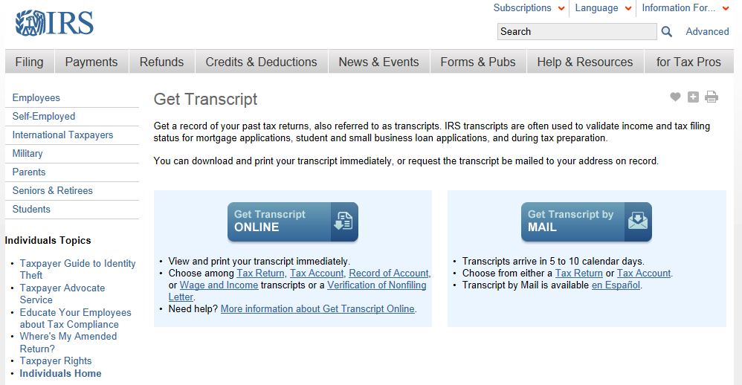
Get IRS Tax Transcript Online
Go to www.irs.gov/transcript

Slide 22
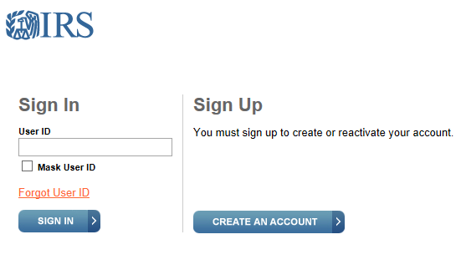
Get IRS Tax Transcript Online
Notes:
Create an account where you can setup a username and password to sign in at a later date
Do not have to create an account, can elect to enter all information each time accessing the website

Slide 23
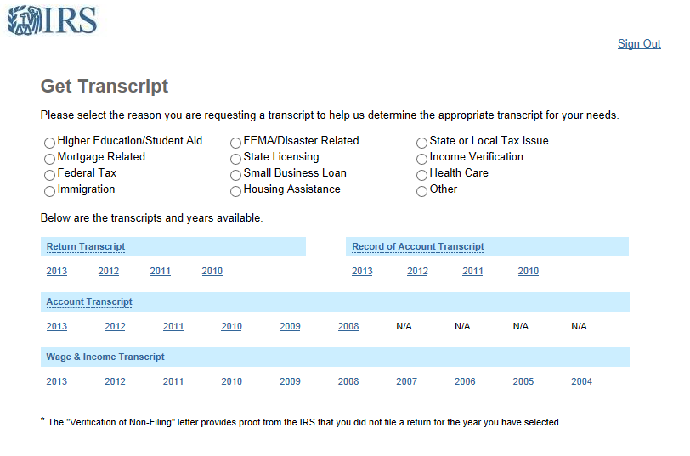
Get IRS Tax Transcript Online

Slide 24
IRA Rollovers
School must collect:
Written statement from tax filer indicating the amount of the distribution that was excluded because it was an IRS authorized rollover
OR
Signed and dated notation indicating “ROLLOVER” on IRS Tax Return Transcript

Slide 25
Paper 2013 Tax Transcripts
It is acceptable to collect a paper 2013 tax return when:
Amended tax return was filed
Victim of IRS identity theft
Filed non-US tax return

Slide 26
Amended Tax Return
An individual who filed an amended return must submit both of the following:
Copy of the tax transcript or signed original IRS Form 1040
Signed copy of the IRS Form 1040X that was filed with the IRS

Slide 27
Identity Theft
Collect a signed copy of the paper 2013 tax return that was filed AND a copy of IRS Form 14039 “Identity Theft Affidavit”
For taxpayer who does not have IRS Form 14039, collect either—
A signed and dated statement indicating tax filer was victim of IRS identity theft and that IRS is investigating.
Must include certification that taxpayer did file IRS Form 14039 and did not keep copy OR was not required to file such form
OR
A copy of a police report related to identity theft filed by the tax filer

Slide 28
Foreign, U.S. Territory or Commonwealth Tax Returns
For Puerto Rico, the Virgin Islands, American Samoa, Guam and the Commonwealth of the Northern Mariana Islands, obtain a signed copy of the tax return.
For the Freely Associated States (Republic of the Marshall Islands, Republic of Palau and the Federated States of Micronesia), obtain a copy of the individual’s Wage and Tax Statement from each employer and a signed statement identifying all income and taxes for the tax year.
For foreign countries where taxes are filed, obtain a signed copy of the foreign tax return or other documentation.
For foreign countries where taxes are not filed, obtain a signed statement identifying all income and taxes paid for the tax year.

Slide 29
Income Earned From Work (Non-Tax Filers)
Copy of a W-2 Form for each source of employment income received in 2013
If the applicant is unable to obtain the required W-2 Form(s) in a timely manner, the school instead may accept a signed statement listing:
Source of income
Amount of income earned from work
Reason the W-2 Form(s) is not available

Slide 30
No Income Earned From Work
Signed statement certifying the applicant has not filed and is not required to file taxes for 2013
NEW for 2014-2015: If the school believes information provided in the signed statement is inaccurate, the applicant must provide to the school a “Verification of Non-Filing” from the IRS. Applicants may request this statement via IRS Form 4506-T, line 7. The IRS will not respond to a paper request until after June 15, 2014, however a letter is available immediately through the IRS Get Transcript online service.
Notes:
Askregs - to help ensure accuracy in the 2014-15 verification process, ED advises schools not to accept a Verification of Nonfiling letter for the 2013 tax year that is dated prior to June 15, 2014.

Slide 31
Child Support Paid
Signed statement from applicant or parent listing:
Name of the individual who paid the support
Name of the child support recipient
Name(s) of the child or children for whom support was paid
Amount of support paid during the calendar year
If the school believes information provided is inaccurate, it must obtain documentation such as a copy of a separation agreement/divorce decree showing the amount to be paid, a statement from the child support recipient showing the amount paid, or copies of cancelled checks, money order receipts or electronic payment records.

Slide 32
SNAP (Food Stamps)
Signed statement from the applicant (or parent, if the applicant is dependent) certifying that the applicant or another household member received Food Stamps in calendar year 2012 and/or 2013.
If the school believes information provided on the signed statement is inaccurate, the applicant must provide the school with documentation from the applicable Food Stamp issuing agency.

Slide 33
High School Completion Status
High school diploma
Copy of high school diploma
Copy of final official high school transcript that shows the date when the diploma was awarded
“Secondary school leaving certificate” (or another similar document) for students who completed secondary education in a foreign country and are unable to obtain a copy of their diploma or official transcript

Slide 34
High School Completion Status
Recognized equivalent
GED
State certificate recognized as an equivalent to a diploma.
Academic transcript showing successful completion of at least a two-year program fully acceptable toward a bachelor’s degree.
Documentation that the student excelled in high school (in accordance with the postsecondary institution’s written policies), if the student did not complete high school and enrolls in at least an associate degree program.

Slide 35
High School Completion Status
Home school credential
Transcript signed by the parent or guardian documenting the successful completion of secondary education, listing the courses completed by the student, or a state-issued home school certification credential

Slide 36
Identity Statement of Educational Purpose
An applicant must provide the following to the school in person:
Government-issued photo identification, such as a driver’s license or passport.
Signed statement of educational purpose for the 2014-2015 award year.
For documentation presented in person, the school must maintain an annotated copy of the ID provided by the applicant, including the following information:
Date the identifying document was received.
Name of the institutionally authorized individual who received the documentation.

Slide 37
Identity Statement of Educational Purpose
If an institution determines that an applicant is unable to provide the information in person, the applicant must provide to the school:
Original notarized statement of educational purpose signed by the applicant for the 2014-2015 award year.
Copy of a government-issued photo identification, such as a driver’s license or passport, that is referenced in the notarized statement.
Notes:
It is against the law to photocopy a military ID. Therefore, a military ID may not be used for this purpose.
After the institution reviews the original identification and signed statements, it may convert the documentation to an electronic record.

Slide 38
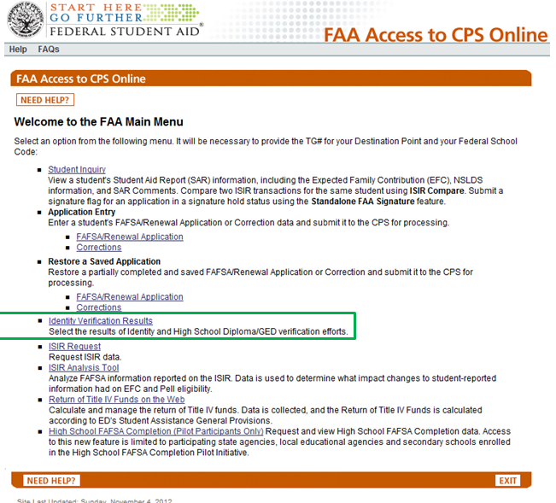
2014-15 FAA Access Updates
Beginning with the 2014-2015 award year, aid administrators will be required to report Identity Verification Results for an applicant assigned to either the V4 or V5 Verification Tracking Group.
Select Identity Verification Results

Slide 39
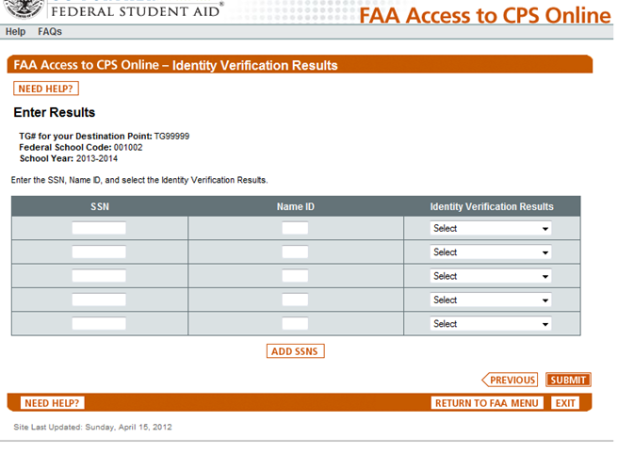
2014-15 FAA Access Updates
FAAs will be able to manually enter SSNs/Name ID/ Verification Results from a dropdown menu on this page.

Slide 40
2014-15 FAA Access Updates
Dropdown options will be
Verification completed in person, no issues found
Verification completed remotely, no issues found
Verification attempted, issues found with identity
Verification attempted, issues found with HS completion
No response from applicant or unable to locate

Slide 41
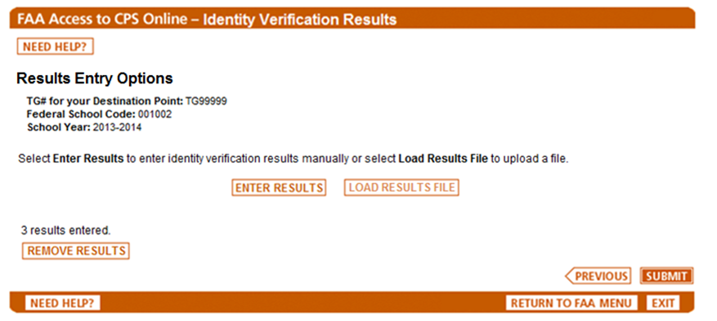
2014-15 FAA Access Updates
Beginning in April, FAAs will be able to select the option to upload a flat file to report required results
Select

Slide 42
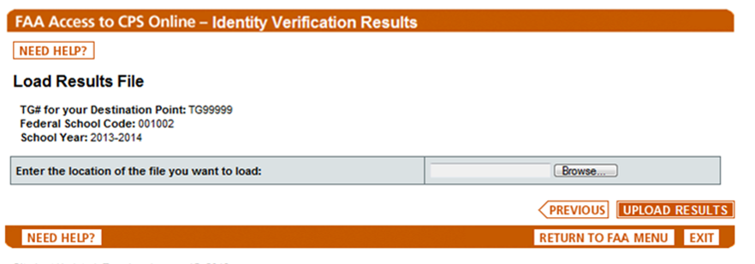
2014-15 FAA Access Updates
Select file from database by browsing
2014-2015

Slide 43
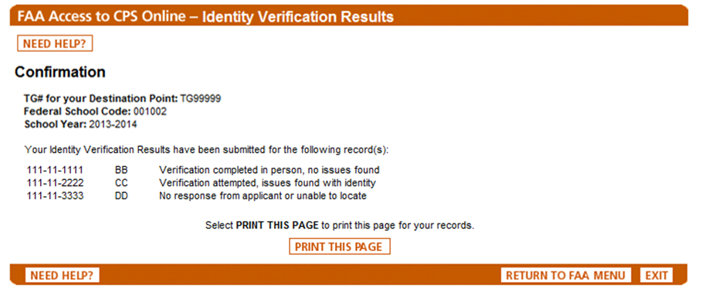
2014-15 FAA Access Updates
FAA will receive a confirmation page with the results submitted that can be printed.

Slide 44
Other Untaxed Income
Signed statement from the applicant (and one parent, if the applicant is dependent) listing the sources of other untaxed income on the 2014-2015 FAFSA:
Payments to tax-deferred pension and savings plans
Child support received
Housing, food and other living allowances paid to members of the military, clergy and others
Veterans non-education benefits
Other untaxed income
Money received or paid on the student’s behalf
Copy of a W-2 Form for each source of employment income received in 2013.
Notes:
If the applicant is unable to obtain the required W-2 Form(s) in a timely manner, the school instead may accept a signed statement listing the source and amount of income earned from work, and the reason the W-2 Form(s) is not available.
If the verified amounts of untaxed income, when combined with other income information, do not appear to provide sufficient financial support for the household size, the school must document how the family was financially supported in 2013.

Slide 45
Updating FAFSA Information
FAFSA is generally considered a snapshot in time
Updates may be required for:
Change in applicant’s marital status

Slide 46
Verification Exclusions
No verification required if:
Student dies
Student receives no Title-IV aid
Student eligible for unsubsidized aid
Transfer student who completed verification at previous school and current school can obtain certification with ISIR transaction number from previous school

Slide 47
Verification Exclusions
Verification of parental information not required
Parents cannot be reached by normal means of communication
Both parents are mentally incapacitated
Verification of student’s spouse’s information is not required
Spouse is deceased
Spouse is mentally incapacitated
Spouse cannot be reached by normal means of communication

Slide 48
Verification & Professional Judgment
If a student was selected for verification (by you or the Department), you must complete verification before exercising professional judgment.
If a student was not selected for verification, not required to complete verification before exercising professional judgment.
Notes:
Was long standing policy at Department

Slide 49
2014-15 Verification Resources
Federal Register Notice, published June 13, 2013
http://ifap.ed.gov/fregisters/attachments/FR061313FAFSAInformationToBeVerifiedforthe20142015AwardYear.pdf
Dear Colleague Letter GEN-13-16
http://ifap.ed.gov/dpcletters/GEN1316.html
Askregs - Should a School Accept an IRS Verification of Nonfiling Letter to Complete 2014-15 Verification Prior to June 15, 2014?
http://askregs.nasfaa.org/link/portal/16113/16151/Article/2158/Should-a-School-Accept-an-IRS-Verification-of-Nonfiling-Letter-to-Complete-2014-15-Verification-Prior-to-June-15-2014

Slide 50
2014-15 Verification Resources
2014-15 Verification Suggested Text
http://ifap.ed.gov/eannouncements/110813VerificationSuggestedText1415EA.html
Reporting Verification Results Using FAA Access to CPS Online
http://ifap.ed.gov/eannouncements/111313FSAOIGEAIdentityVerificationResults.html
2014-15 Application and Verification Guide
http://ifap.ed.gov/fsahandbook/attachments/1314AVG.pdf

Slide 51
PASFAA Resource Share Site

Slide 52
QUESTIONS?

