Slide 1
What is PASFAA? and How Can PASFAA Help YOU? Presenter: Stacy Schenk, Director of Financial Aid, Mt. Aloysius College, President of PASFAA

Slide 2
The Pennsylvania Association of Student Financial Aid Administrators (PASFAA) is a dynamic, service association whose mission is: - To provide for the professional development of members and other constituencies, - To advocate for access to post-secondary education, and - To educate the public on financial aid and funding opportunities.

Slide 3
We Are: an all-volunteer organization comprised of 861 members, affiliated with 224 different institutions
Membership Categories
550 Regular Members
291 Associate Members
2 Retired Members
0 Student Members
18 Life Members
Sector Categories
72 Business, Trade & Technical
59 Inst’l Support Services
17 Nursing
360 Private
94 Public Two-Year
72 PASSHE
147 State Related
10 Graduate School
Notes:
By-law Section 1: There shall be five (5) classifications in this Association … more details in bylaws. Summary:
Regular membership shall be limited to persons employed, by institutions of post-secondary education located within the Commonwealth of Pennsylvania who are responsible for the administration of student financial aid and/or having the authority to award aid.
Associate membership shall include persons employed by organizations affiliated with financial aid matters who do not qualify for Regular membership,
Student membership shall be for and limited to graduate and undergraduate students in post-secondary education
Retired membership shall be limited to persons who were Regular or Associate members in this Association, who are no longer employed in the financial aid profession, and who are not eligible for Regular or Associate membership.
Life membership shall be an honorary membership ….. Refer to bylaws for more

Slide 4
PASFAA Council Our Elected Leadership
http://www.pasfaa.org/docs/committees/ExecutiveCouncil/index.html
President Elect | President | Past President
Vice-President | Secretary | Treasurer
8 Sector Representatives:
Business Trade & Technical | Institutional Support Services | Nursing
Private | Public Two-Year | PASSHE
 | State Related | Graduate
Notes:
Explain that PASfAA council is our elected leadership. Clickk on the URL to show the PASFAA page that has the names, organizations and pictures of PASFAA Council. (Have a backup slide next of a screenshot of the page incase the internet is not working)

Slide 5
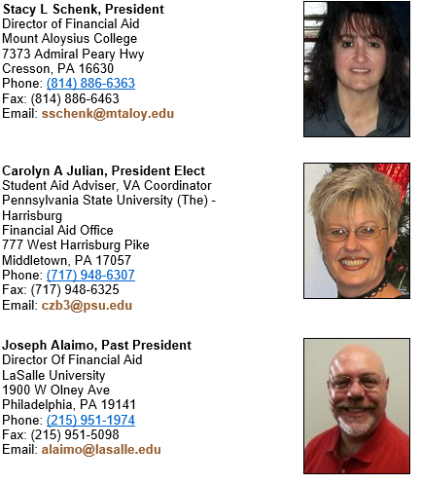
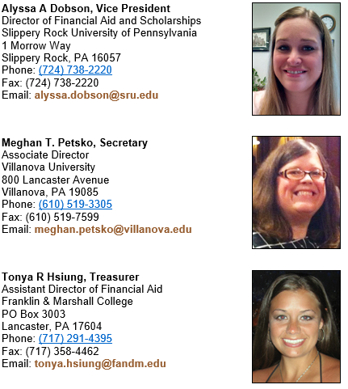
PASFAA Council Our Elected Leadership
Notes:
Explain that PASfAA council is our elected leadership. Clickk on the URL to show the PASFAA page that has the names, organizations and pictures of PASFAA Council. (Have a backup slide next of a screenshot of the page incase the internet is not working)

Slide 6
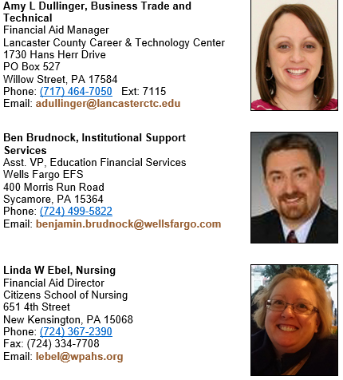
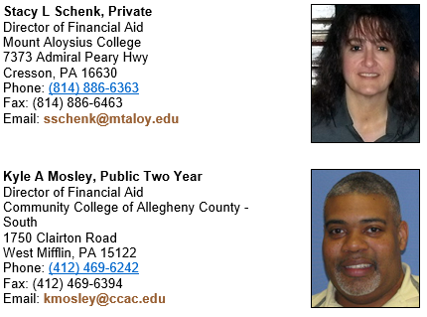
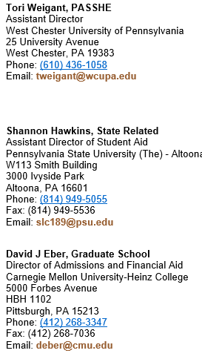
PASFAA Council Our Elected Leadership
Notes:
Explain that PASfAA council is our elected leadership. Clickk on the URL to show the PASFAA page that has the names, organizations and pictures of PASFAA Council. (Have a backup slide next of a screenshot of the page incase the internet is not working)

Slide 7
PASFAA Standing Committees The LifeBlood of PASFAA
http://www.pasfaa.org/docs/toc_finaidadmin.html
Communication * | Conference | Finance & Development
Financial Aid Awareness | Government Relations | PFAT*
Membership & Association Governance | Technology Advisory & Electronic Initiatives | * Reflects committees with sub-committees
Additional committees may be created by Council as needed to address specific needs of the Association, such as Strategic Planning and nextPAGE.
Notes:
Explain the committees’ jobs/work in PASFAA. Talk breifly about each, and refer our audience to the Policy and Procedure’s manual (found in the “ABOUT” link in the toolbar on the homepage) for complete descriptions. Click on the URL to show how they can look at committee membership and who to contact if they have questions.
Have sceenshot on the next page if the internet is not working.

Slide 8
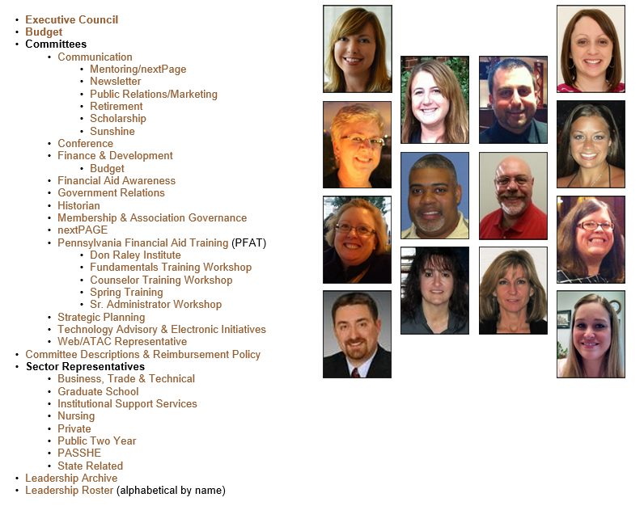
PASFAA Standing Committees The LifeBlood of PASFAA
Notes:
Explain the committees’ jobs/work in PASFAA. Talk breifly about each, and refer our audience to the Policy and Procedure’s manual (found in the “ABOUT” link in the toolbar on the homepage) for complete descriptions. Click on the URL to show how they can look at committee membership and who to contact if they have questions.
Have sceenshot on the next page if the internet is not working.

Slide 9
How Can PASFAA Help You and Your Career?
Leadership Opportunities through Elected Office and Committee Membership, Conferences, Training, Outreach lead to:
Professional Networking
Increased technical expertise
Improved office operations and student service
Development of legislative awareness
Notes:
Discussion page; the next 2 pages are for discussion also

Slide 10
A Sample of Our Stories
A favorite committee experience
Why I chose to run for a PASFAA office
One of my most influential experiences in PASFAA
I didn’t know I could do that; but I did it
A PASFAA colleague who made a difference in my career
A benefit I received through networking with peers
How PASFAA connected me to EASFAA and NASFAA
Notes:
Discussion page. Allow presenters and pasfaa leadership in attendance comment on one or two of the above, based on time.

Slide 11
PASFAA and YOU … What questions can we answer for you about getting more involved?
Notes:
Discussion page.

