Slide 1
This is Why It’s So Interesting to Work in Financial Aid
Session Presenter:
Joan Holleran, Kutztown University

Slide 2

Whether you are officially “in charge” or in a “participant/co-worker” role, below are 2 activities that you can use to help shape your professional career:
Meetings
Performance Evaluations
Where it all begins…….

Slide 3
FERPA
The Family Educational Rights and Privacy Act (FERPA) determines what information is public and what is confidential in a student’s record.
Which of the following individuals have access to a dependent student’s financial aid information?

Slide 4
FERPA
Noncustodial parent
Older sibling
Donors of a scholarship that the student receives
Landlord
None of the above

Slide 5
FERPA
When a student matriculates into postsecondary education, all rights under FERPA transfer from the parent to the student.

Slide 6
FERPA
How would the noncustodial parent, older sibling, scholarship donors, or landlord get permission to have student information?
How and where do you document that permission?
Is there a time limit on release of student info?

Slide 7
Verification
The dependent student V1 verification form is returned. The question says, “List the people in your parents’ household…” The parents with whom the student resides are mother, 49, and stepfather, 52. Which of the following family members should be included?

Slide 8
Verification
Stepfather, 52. Says he’s not paying for college for children that aren’t his
Younger sister, 6, child of mother & bio father, splits time between them, claimed by mother on taxes
Older brother, 26, child of mother & bio father, floats between mother and bio father, works more or less full-time
Grandmother, 77, mother’s mother, in declining health, receives SS and pension

Slide 9
Verification
Must include stepparent if remarried regardless of support they contribute
Deciding factor to determine number in household: If parents/stepparents provide more than half of support for school year being verified
What if the dependent student in this scenario says she moved out when she was 18 because she doesn’t get along with stepfather and supports herself?

Slide 10
Identity Theft
A parent of one of your students tells you he is the victim of IRS tax-related identity theft and cannot provide you with the requested tax information for you to verify the file. Which of the following is true?

Slide 11
Identity Theft
Unable to use IRS Date Retrieval Tool
Cannot request a tax transcript until issue is resolved
Request that IRS Identity Protection Specialized Unit provide “alternate paper tax return transcript” known as Transcript DataBase View (TRDBV)
School must collect signed and dated statement from tax filer indicating they are victim of IRS tax-related identity theft and that IRS has been made aware of tax-related identity theft
All of the above

Slide 12
Identity Theft
School could develop its own form that taxpayer signs and dates acknowledging tax-related identity theft and that IRS has been made aware

Slide 13
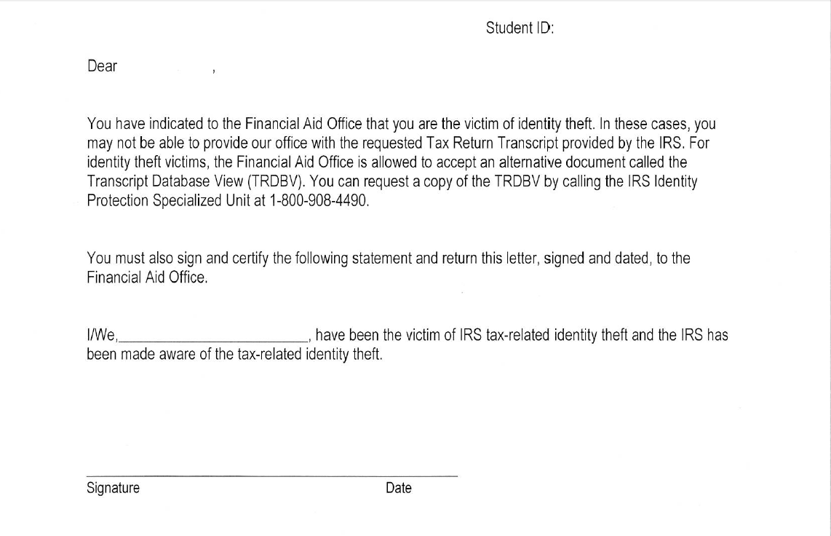
Identity Theft – Sample Form For School Use

Slide 14
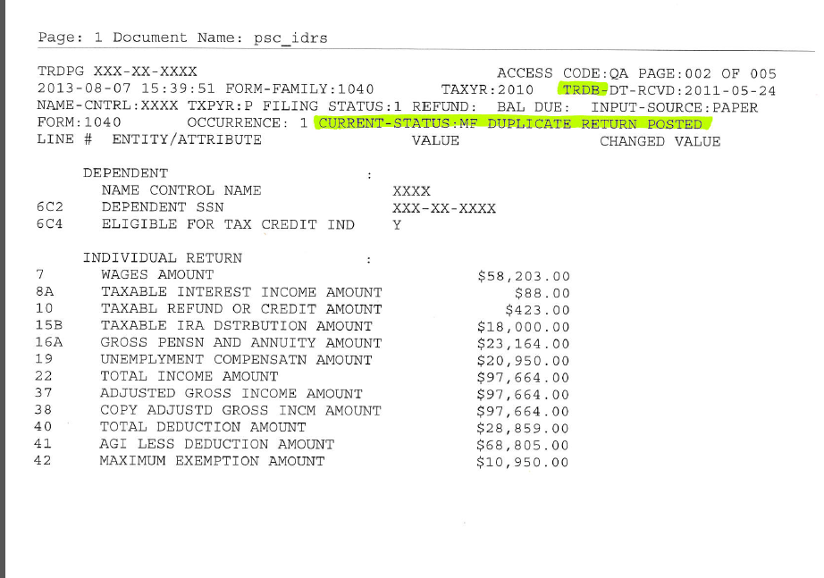
Sample TRDB

Slide 15
C-Flag – Social Security
Luis Montero-Rodriguez applied for financial aid at your school. His FAFSA record comes back with a C-Flag discrepancy, “The name you reported on your FAFSA does not match the name in the Social Security Administration’s (SSA) records for your Social Security Number (SSN). Therefore, you must correct your SSN (Item 8) or name (Items 1 and 2). If you confirm your name, you should also contact the SSA to make sure that they correct it in their records…”
The student tells you there is no error.

Slide 16
C-Flag – Social Security
This is SAR comment code 061. SSN Match Flag = 3 (SSN match, no name match)
Student’s SSN matches but name does not match.
What documentation will you request?

Slide 17
C-Flag – Social Security
Birth certificate
Social Security card
Final high school transcript
A letter from high school guidance office
Driver’s license

Slide 18

C-Flag – Social Security
123-45-6789
LUIS MONTERO RODRIGUEZ
Luis Montero Rodriguez

Slide 19
C-Flag – Social Security
Must match SS card exactly!
Latinos often combine surname of father first and mother second (with or without hyphens but not always)
  Montero Rodriguez
  Montero
  Rodriguez
Another C Flag situation – family adopted a child but child’s SS card is not their legal name – never changed through court system

Slide 20
C-Flag – Selective Service
The student indicates on the FAFSA that their first name is Ryan and DOB is 7/2/94. Student did not answer question, “Are you male or female?” Selective Service match says that student is not registered. You ask the student to come to the office to help them resolve the discrepancy. When the student arrives, she introduces herself as Rachel.
How do you proceed?

Slide 21
C-Flag – Selective Service with Transgender Issue
For Selective Service to be a match, student must list gender on birth certificate.
Females who don’t answer question will be told they must register.
We don’t deal with “preferred” names.
It is not our intention to “out” a student but we need to use their legal name.
You can say, “What pronouns do you identify with?” but if student chooses not to register, we stop there.

Slide 22
C-Flag – Citizenship
Student completed FAFSA but rejects due to failed citizenship match
Undocumented student produces Employment Authorization Card
Is student eligible for federal aid?
How can you assist this student?

Slide 23
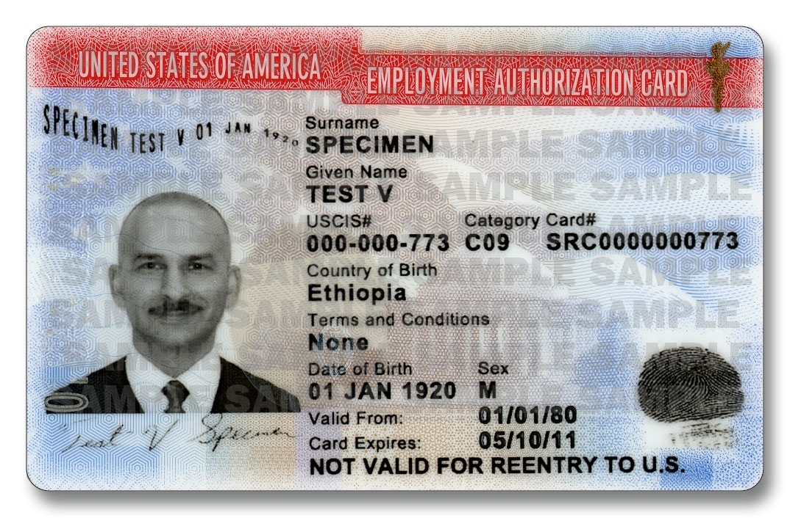
C-Flag – Citizenship

Slide 24

C-Flag – Citizenship

Slide 25
C-Flag – Citizenship
Illegal alien parents bring child to USA
Child attends, graduates from US high school – qualifies for Employment Authorization Card
Child cannot become U.S. citizen or permanent resident – no passport
Social Security number/card for work only
No federal or state aid. Alternative loan with co-signer who is citizen or permanent resident
May qualify for institutional aid

Slide 26
C-Flag – Unusual Enrollment History (UEH)
Sabrina applies for financial aid at your school for 2016-17. Her ISIR comes back with SAR comment code 359 – NSLDS Unusual Enrollment History
She says she attended Blackjack University (2015-16) and Muddy Swamp CC (2014-15) before transferring to your school
What does financial aid have to do?

Slide 27
C-Flag – Unusual Enrollment History (UEH)
Must review student’s enrollment and financial aid records to determine if received Pell Grant (or other federal aid) at your school in 3 most recent prior years
If not, use NSLDS and COD to determine where student received federal aid in 3 most recent prior years.
AND was academic credit earned at each school during the award year?

Slide 28
C-Flag – Unusual Enrollment History (UEH)
What is UEH about?
Alerts FAO to students who go from school to school receiving aid to ensure they are progressing toward a degree.
Student attends 3 different schools and gets federal aid at all 3.
When 4th school’s federal aid award appears, they are flagged as UEH.

Slide 29
C-Flag – Unusual Enrollment History (UEH)
You check with Admissions/Records Office and on NSLDS and COD
Sabrina’s college enrollment and aid history:
  2015-16 - Blackjack Univ - Pell F15, Sp16 - 9cr F15 + 6 cr Sp16 = 15 cr
  2014-15 - Muddy Swamp CC - Pell F14, Sp15 - 12 cr F14 + 12 cr Sp15 = 24 cr
  2013-14 - Neverland CC - Pell F13 - no acad transcript, not reported on your school’s admission app
What action does the FAO need to take?

Slide 30
C-Flag – Unusual Enrollment History (UEH)
Contact student to find out about Neverland CC enrollment
Student says she didn’t earn any credits. Walked away due to “personal issues.”
Since student did not earn credits at Neverland, is the student eligible to have federal aid at your school for the upcoming year?

Slide 31
C-Flag – Unusual Enrollment History (UEH)
No, student not eligible to receive future federal aid since didn’t earn any credits at Neverland CC
Student has right to appeal
If appeal is approved, student will continue to qualify for aid as long as meeting school’s SAP policy

Slide 32
C-Flag – Unusual Enrollment ory (UEH)
Often student owes money and can’t get missing transcript - letter from other school acceptable - did student earn credits?
If student withdrew due to medical reasons, acceptable documentation will permit student to qualify for continued aid

Slide 33

Questions?
Need More Information?

