Slide 1
Verification: Beyond the Basics
Tonya Hsiung
Senior Assistant Director of Financial Aid
Franklin & Marshall College

Slide 2
Documents to Collect
Federal Tax Return – Form 1040, 1040A, 1040EZ
Schedules
  A – Itemized Deductions
  B – Interest and Ordinary Dividends
  C – Business Income (Sole Proprietorship)
  D – Capital Gains and Losses
  E – Supplemental Income and Loss (Rental, Partnership, S-Corporation)
  F – Profit or Loss from Farming
  K-1 for Income from Investments in a Partnership and S-Corporation
W-2 forms
1099 Forms
  1099-MISC – miscellaneous income
  1099-R –Distributions from Pensions, Annuities, Retirement, or Profit-Sharing Plans, IRAs, Insurance Contracts, etc.
  SSA-1099 – Social Security Benefits
Form 8825 – Rental Real Estate – Partnership Form
Form 1065 – Partnership Return
Form 1120S – S- Corporation Return

Slide 3
Tax Filing Status
Single – Line 1
Married, Filing Jointly – Line 2
Married, Filing Separately – Line 3
Head of Household – Line 4
Qualifying Widower with dependent child – Line 5

Slide 4
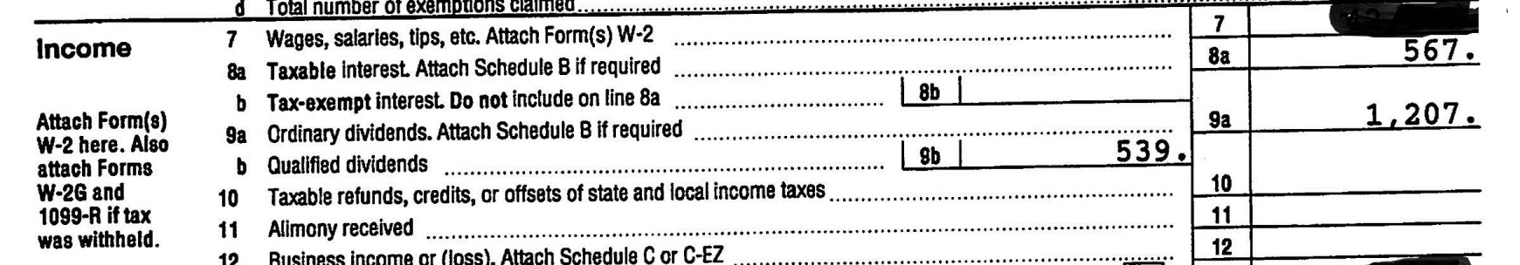
Interest and Dividend Income
Lines 8a, b & 9a, b & Schedules A & B
Did they report assets?
How much in assets did they report?
From where is the interest earned?
From where are the dividends earned?

Slide 5
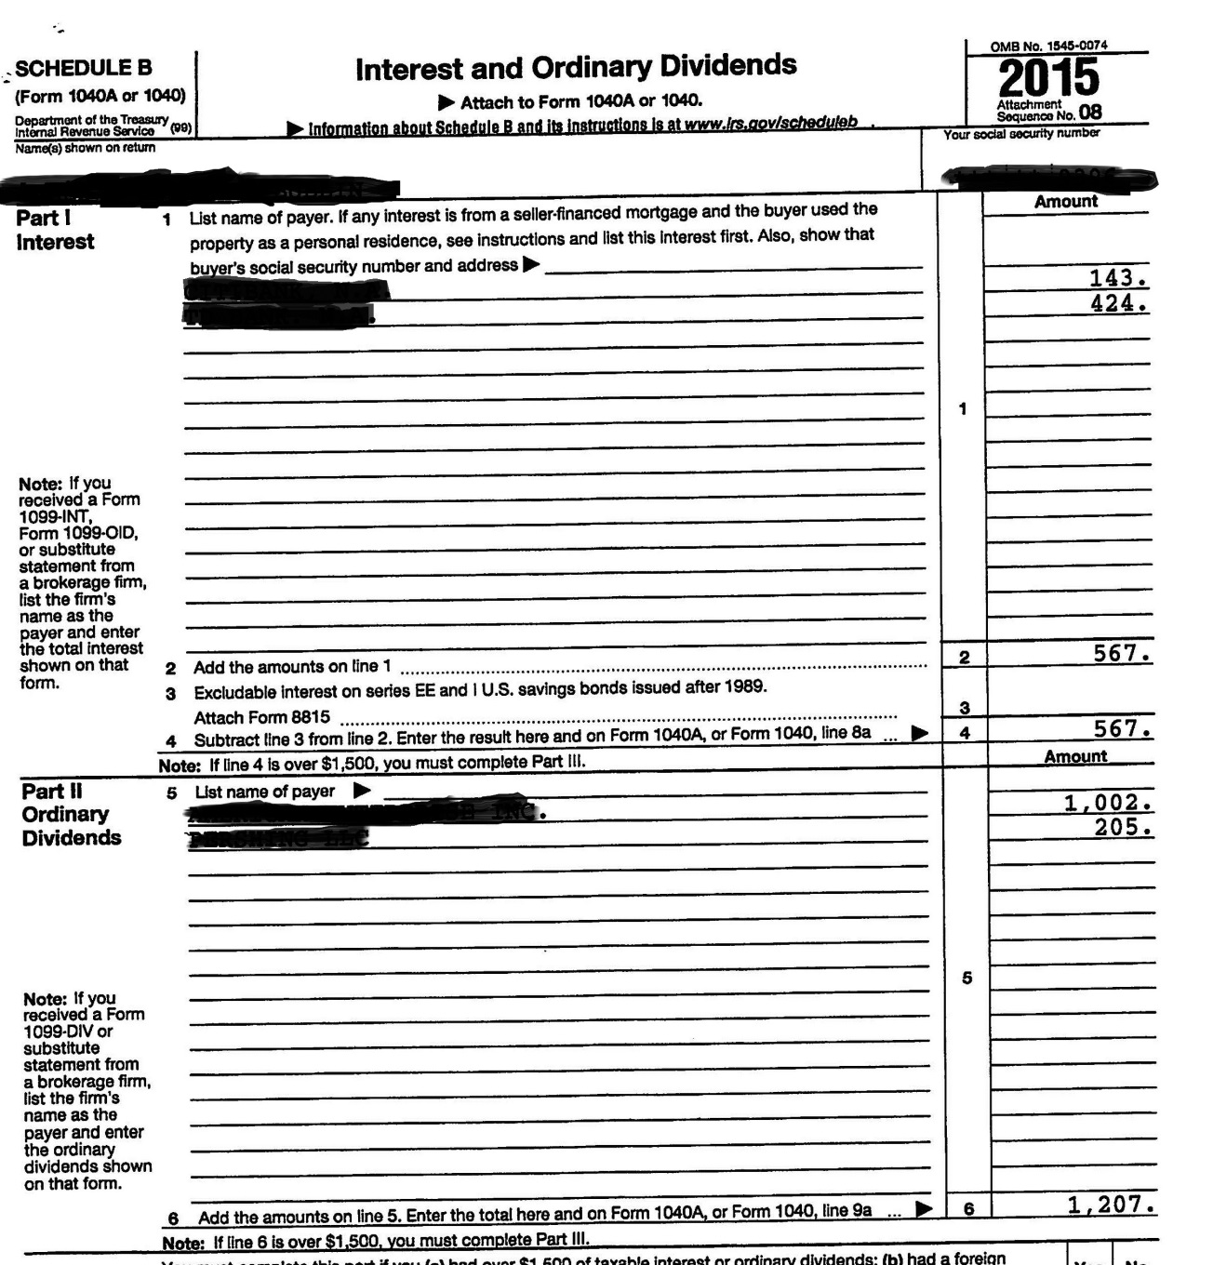
Schedule B
Is the interest earned from Savings Bonds that were cashed in?
Is the interest earned from a family trust?
Are the dividends earned from investments in stocks/bonds?
Are the dividends from their own companies?
Are the dividends from family trusts?

Slide 6
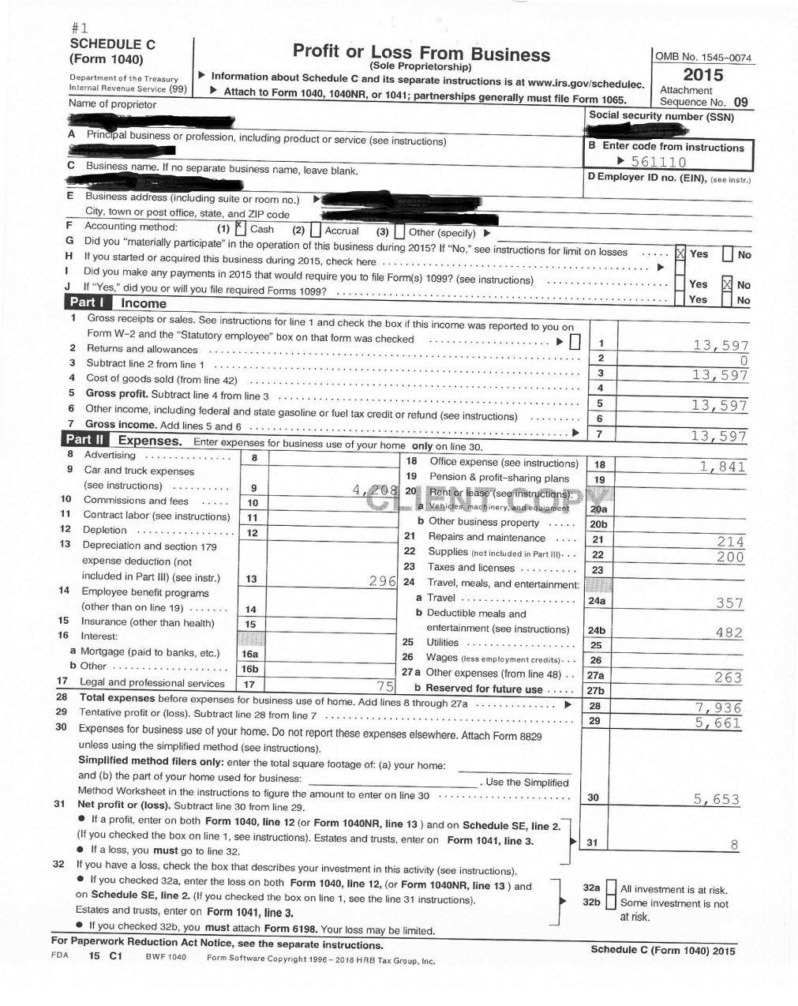
Business Income – Sole Proprietorship
Line 12 & Schedule C
What items do you look for in a business?
  Car/Truck Expenses
  Depreciation
  Meals & Entertainment
  Wages - to family members?

Slide 7
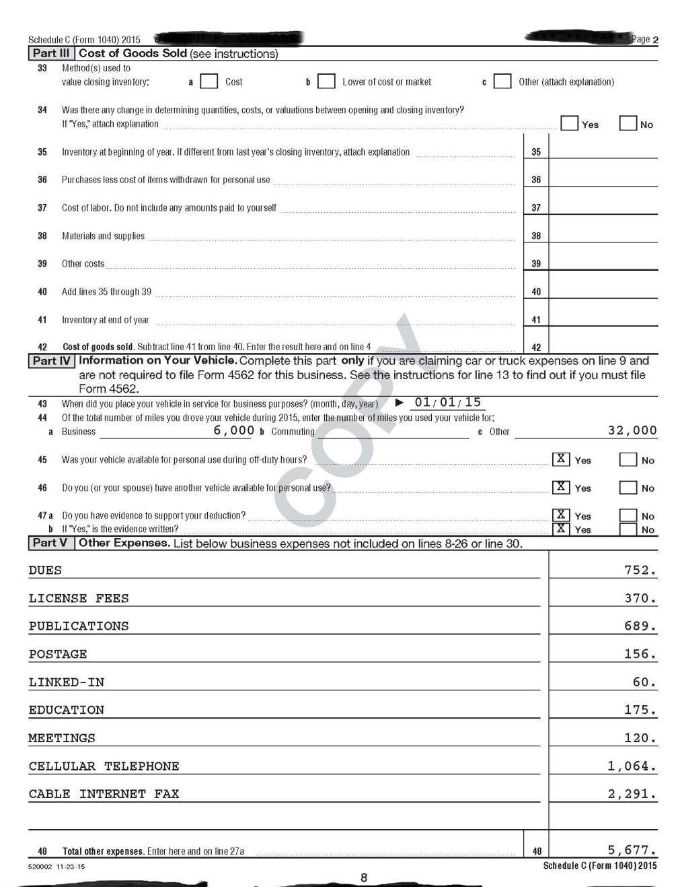
Other Business Write-Offs
Other expenses from Business – do you remove any of these items?

Slide 8
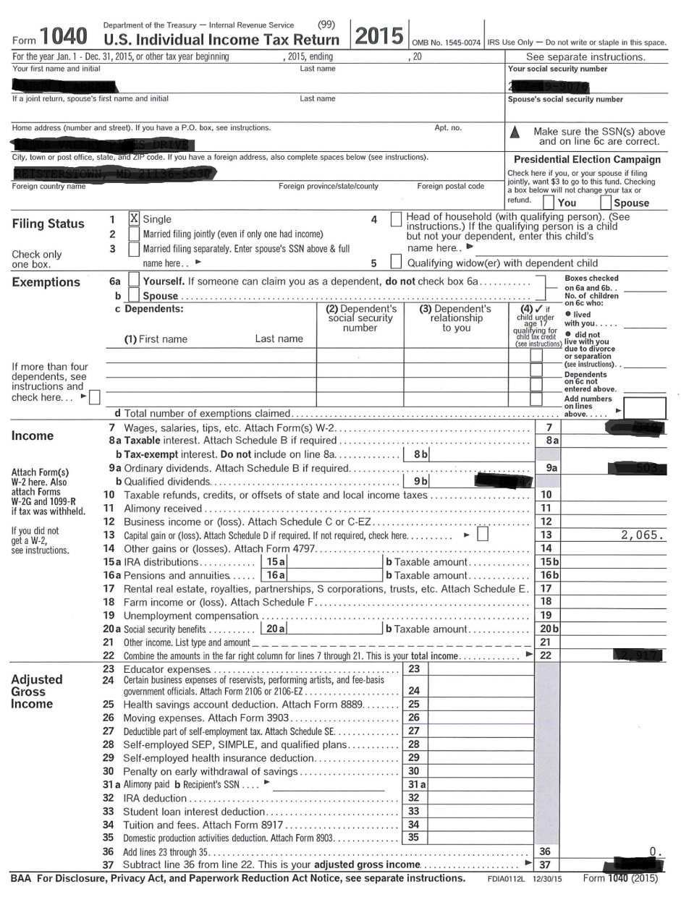
Capital Gains

Slide 9
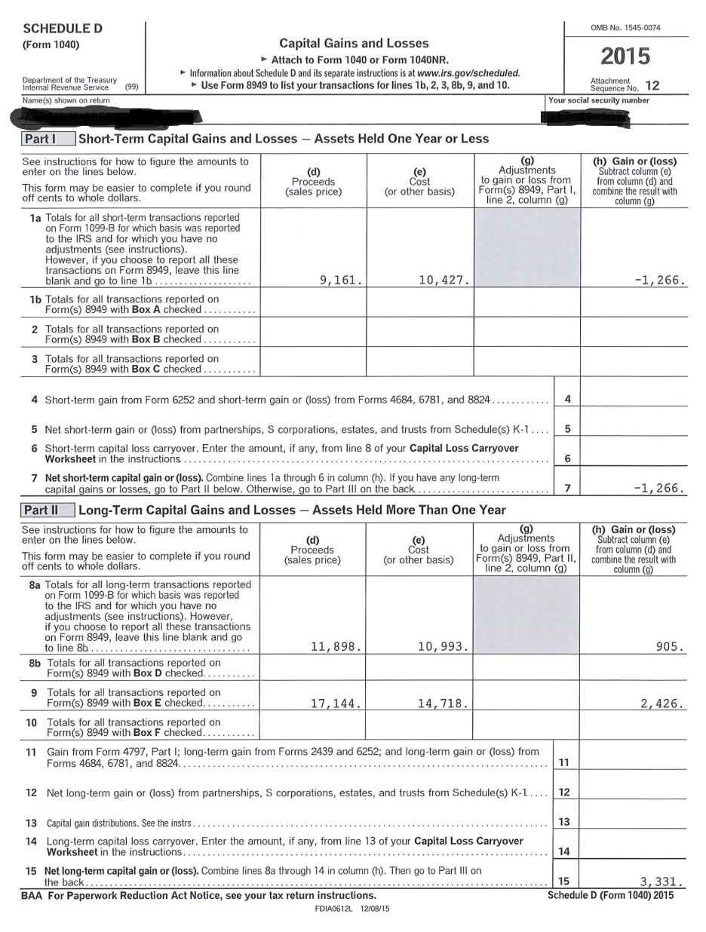
Capital Gains (Losses)
Line 13 & Schedule D
From where is the gain/loss
  Home
  Stocks / investments
  Short term vs. long term
Is this a one-time gain?

Slide 10
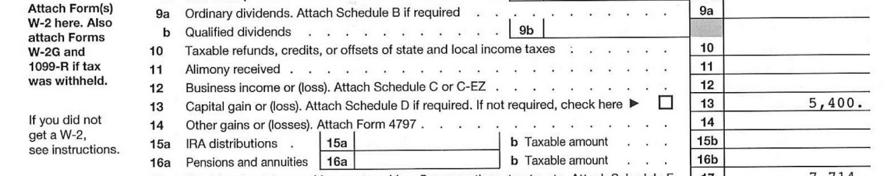
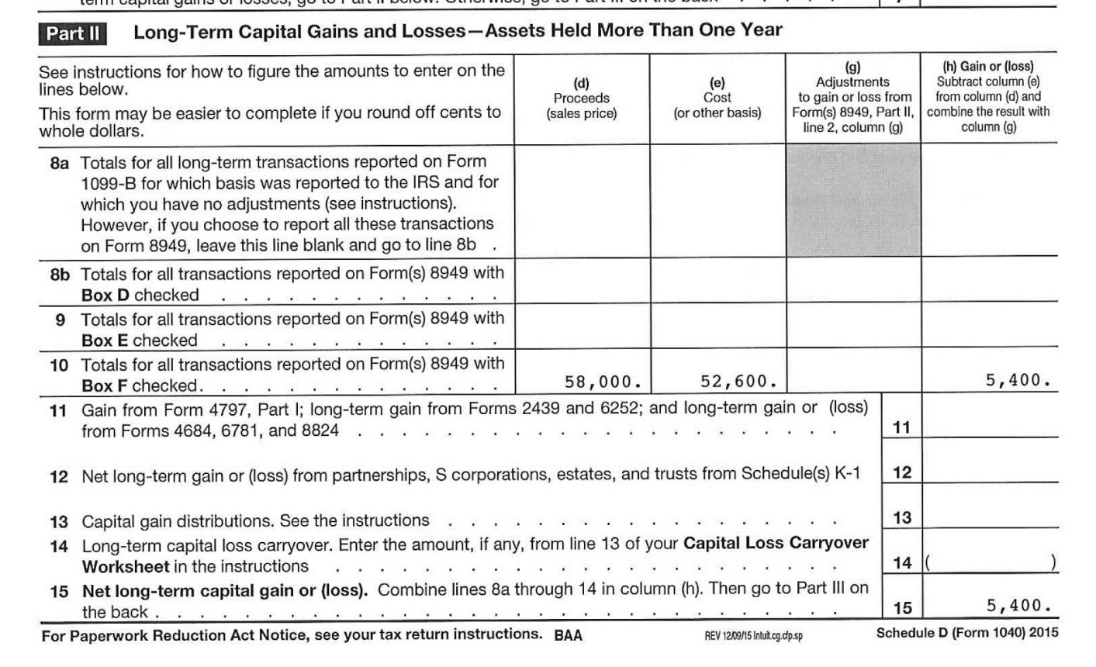
Capital Gains – Professional Judgment
How much were the proceeds?
Where did the proceeds go?
Form 4797 Sales of Business Property may show more information

Slide 11
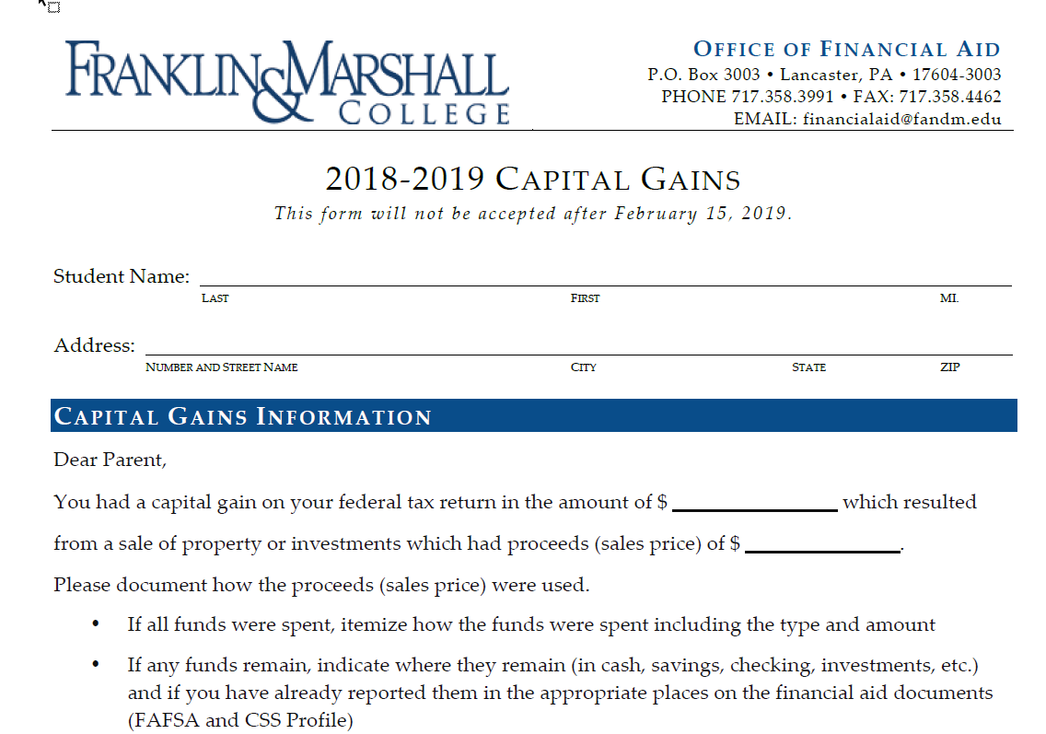
Capital Gains – PJ - Documentation

Slide 12

IRA Distributions and Pension/Annuities
Lines 15a, 15b and 16a, 16b
Questions to ask:
  Where are the figures located – in column “a” or the taxable column “b”?
  Do you have the tax return or just the transcript or IRS DRT?
    Is “ROLLOVER” written on the tax return?
    If you only have the transcript or IRS DRT, you do NOT know if this is a rollover…so you MAY get additional documentation
    (not required, but recommended since this
    could have a large impact on aid eligibility).

Slide 13
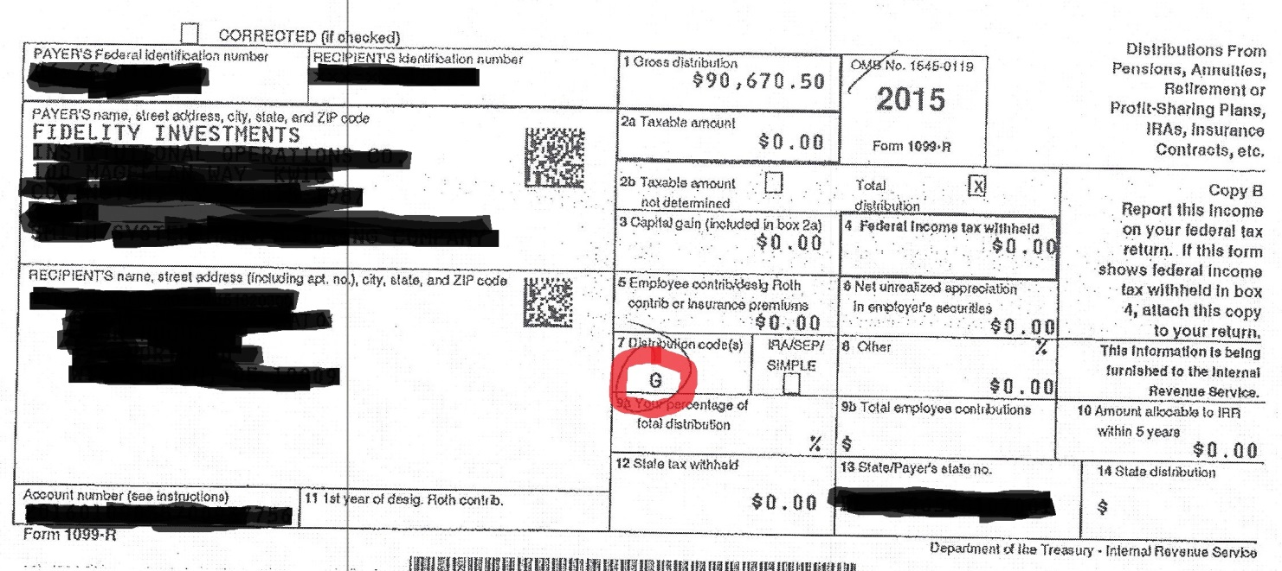
IRA Distributions and Pension/Annuities
ROLLOVER - 1099 - R
Acceptable Codes for Rollover:
6: Section 1035 exchange (a tax-free exchange of life insurance, annuity, qualified long-term care insurance, or endowment contracts)
G: Direct rollover of a distribution to a qualified plan
H: Direct rollover of a designated Roth account

Slide 14
IRA Distribution / Pensions and Annuities – Professional Judgment
  Even if “ROLLOVER” is written on the return – there may be multiple 1099-R forms and not all may be ROLLOVERS. You should collect ALL.
  What were the funds used for?
    Get an itemized list
    Do you pick through the list?
  Is this a one time occurrence?

Slide 15
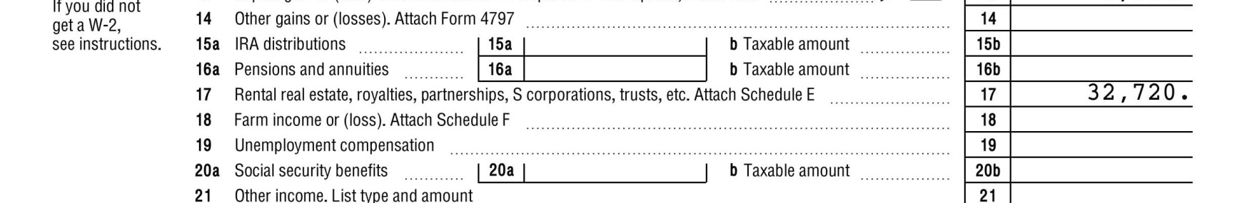
Rental Real Estate and Royalties
Line 17 and Schedule E
Rental Real Estate will show on Line 17 as a gain or (loss)
Collect Schedule E for the detail – page 1
  There may be multiple copies of page 1 if they have more than 3 properties

Slide 16
Schedule E – Rental Real Estate
Can be from:
  Single family residence
  Multi-family residence
  Vacation/short-term rental
  Commercial property
  Land
  Royalties
  Self-rental
  Other

Slide 17
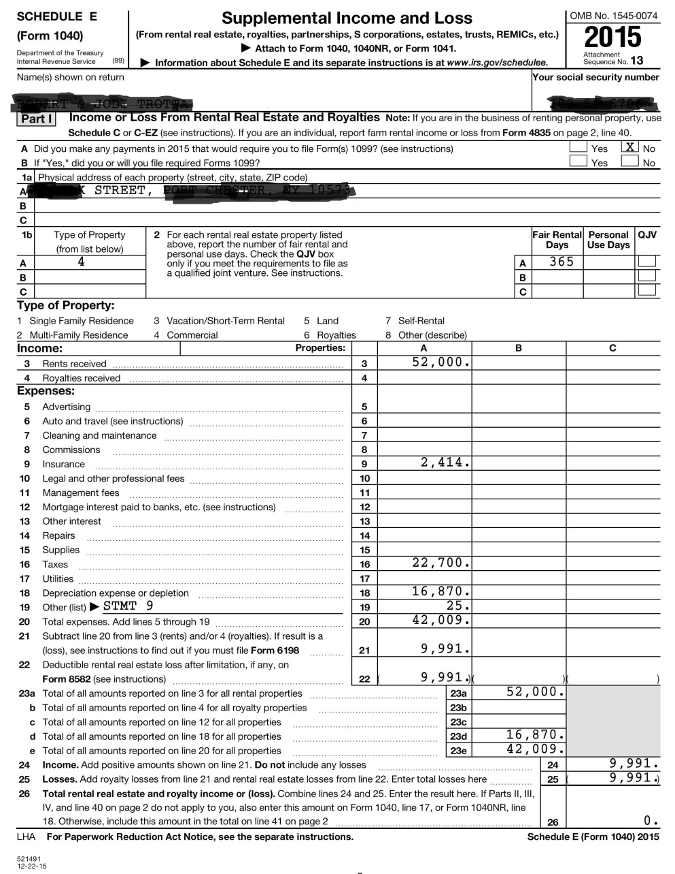
Rental Real Estate
Type of property
Rents received
Mortgage interest –
what is the balance of the loan?
Taxes Paid
Depreciation

Slide 18
Schedule E – Rental Real Estate
Single Family Residence
  I use http://www.zillow.com to value a property
Multi-family residence
  Is it the address in which they reside
  Google Earth helps
  www.zillow.com
    Use Taxes and Line 16 of Schedule E to get percentage
Commercial Properties
  https://keyvon.com/
  Google Earth
Single member Limited Liability Company (LLC) are not treated as a separate entity for federal income tax purposes in most cases. A sole member of a domestic LLC needs to file a Schedule E (or they can elect to treat it as a corporation instead).
  Why is this important? Because we can no longer assume that all properties listed on Schedule E are automatically personally owned. It is possible they
  are owned by a corporation the parents own.

Slide 19
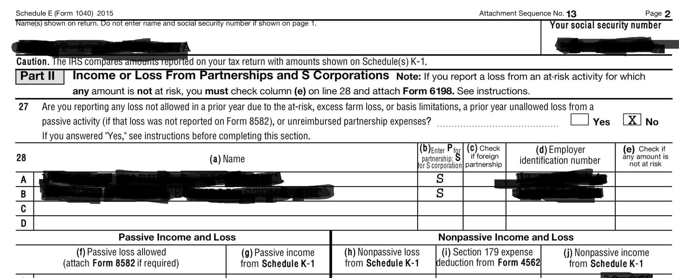
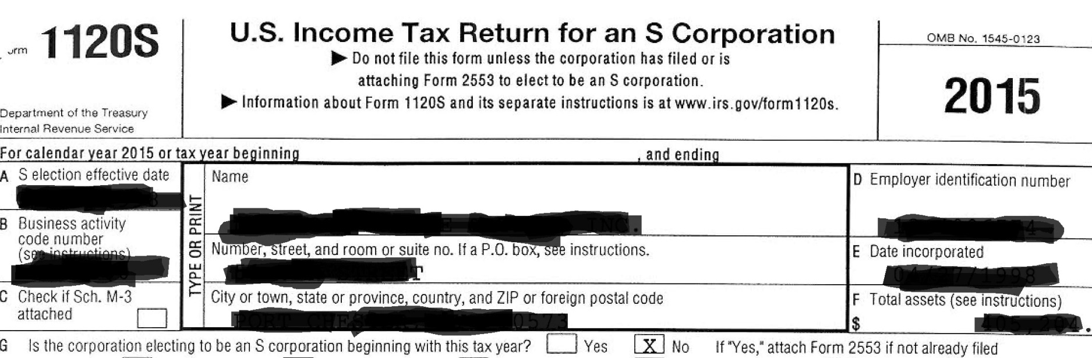
Rental Real Estate is a Corporation?

Slide 20
Commercial Buildings as Assets?
Per NASFAA Ask Regs: Do You Report the Net Worth of a Commercial Building That the Family Owns and the Family Business Rents?
Scenario: We have a situation where the parents are self-employed and own a corporation. They are 100% owners and have less than 100 employees, so the net worth of the business itself does not have to reported on the FAFSA. However, the parents own a commercial building that is in their name. The family corporation pays them rent to lease the building.
Answer: The building rented to the business is real estate owned by the parents individually; therefore, it should be reported as an asset on the FAFSA. Additionally, any income or loss from the rental property should have been reported on the parents' tax return using Schedule E and would be reflected in the adjusted gross income (AGI).
See the sidebar on page AVG-18 of the 2018-19 FSA Handbook regarding rental properties:

Slide 21
Per the FSA Handbook
AVG - 17
Rental properties are an asset. A unit within a family home that has its own entrance, kitchen, and bath (therefore a rented bedroom would not count) and that is rented to someone other than a family member counts as an asset. To calculate its net value, multiply the net value of the entire structure by the fraction the rented space represents. Similarly, if a family owned a 10-unit apartment building and lived in one of the apartments, 9/10 or 90% of the net value of the building would be an asset.
At times a student or parent will claim rental property as a business. Generally, it must be reported as real estate instead. A rental property would have to be part of a formally recognized business to be reported as such, and it usually would provide additional services like regular cleaning, linen, or maid service.

Slide 22

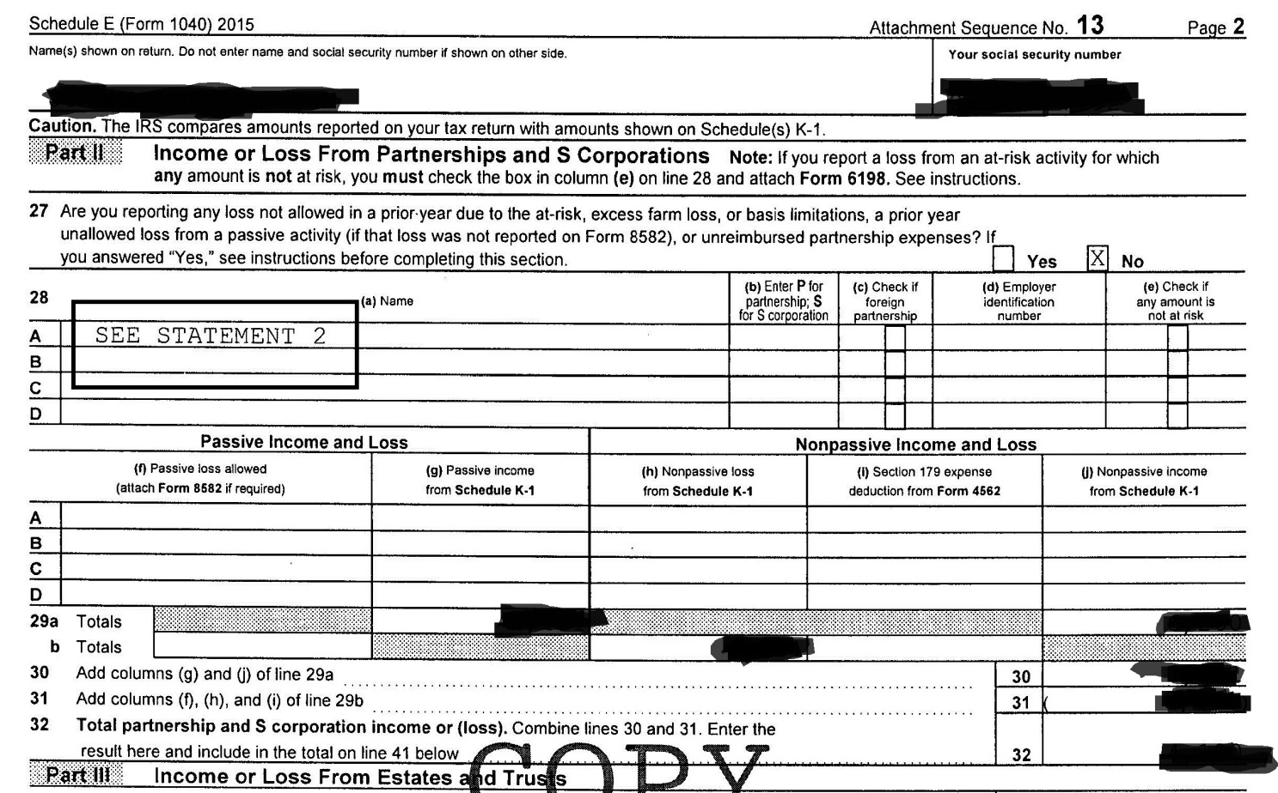
Partnerships
Line 17 & Schedule E – Page 2

Slide 23
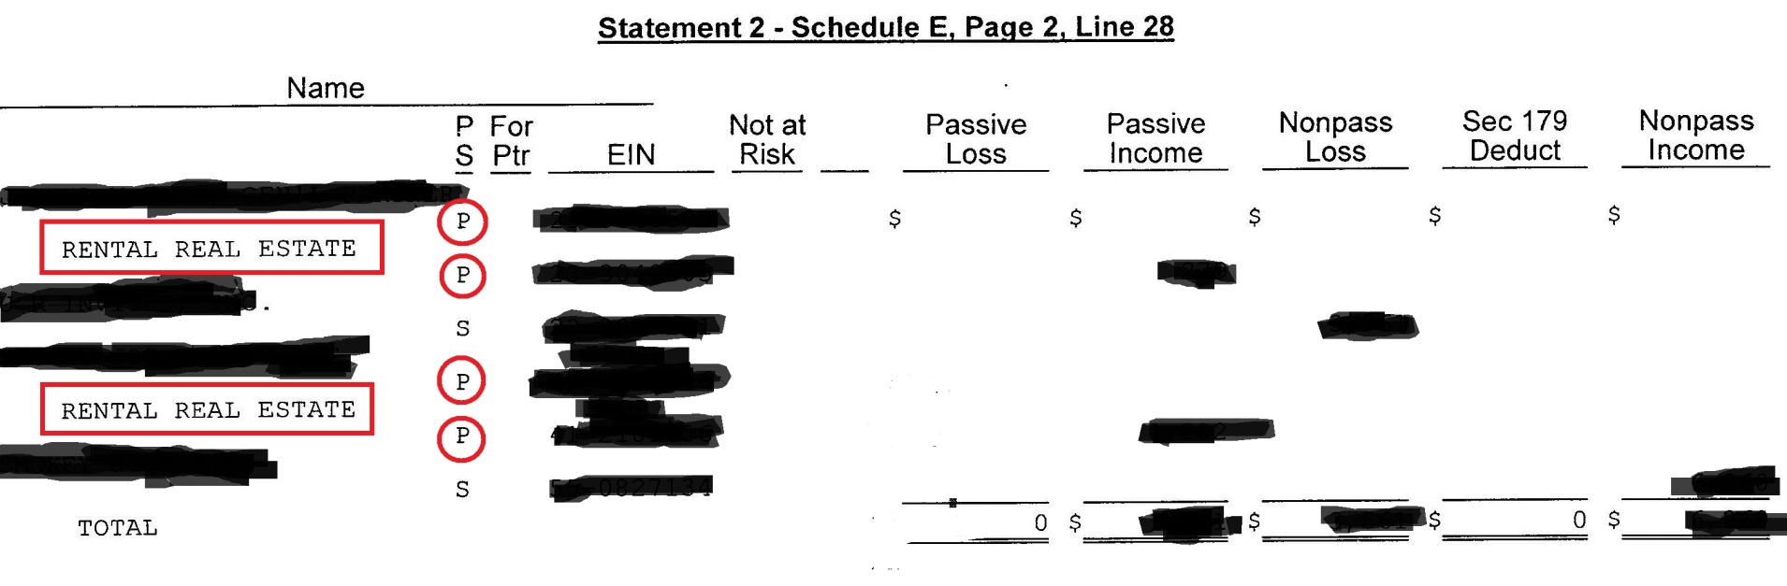
Partnerships
Line 17 & Schedule E – Page 2

Slide 24
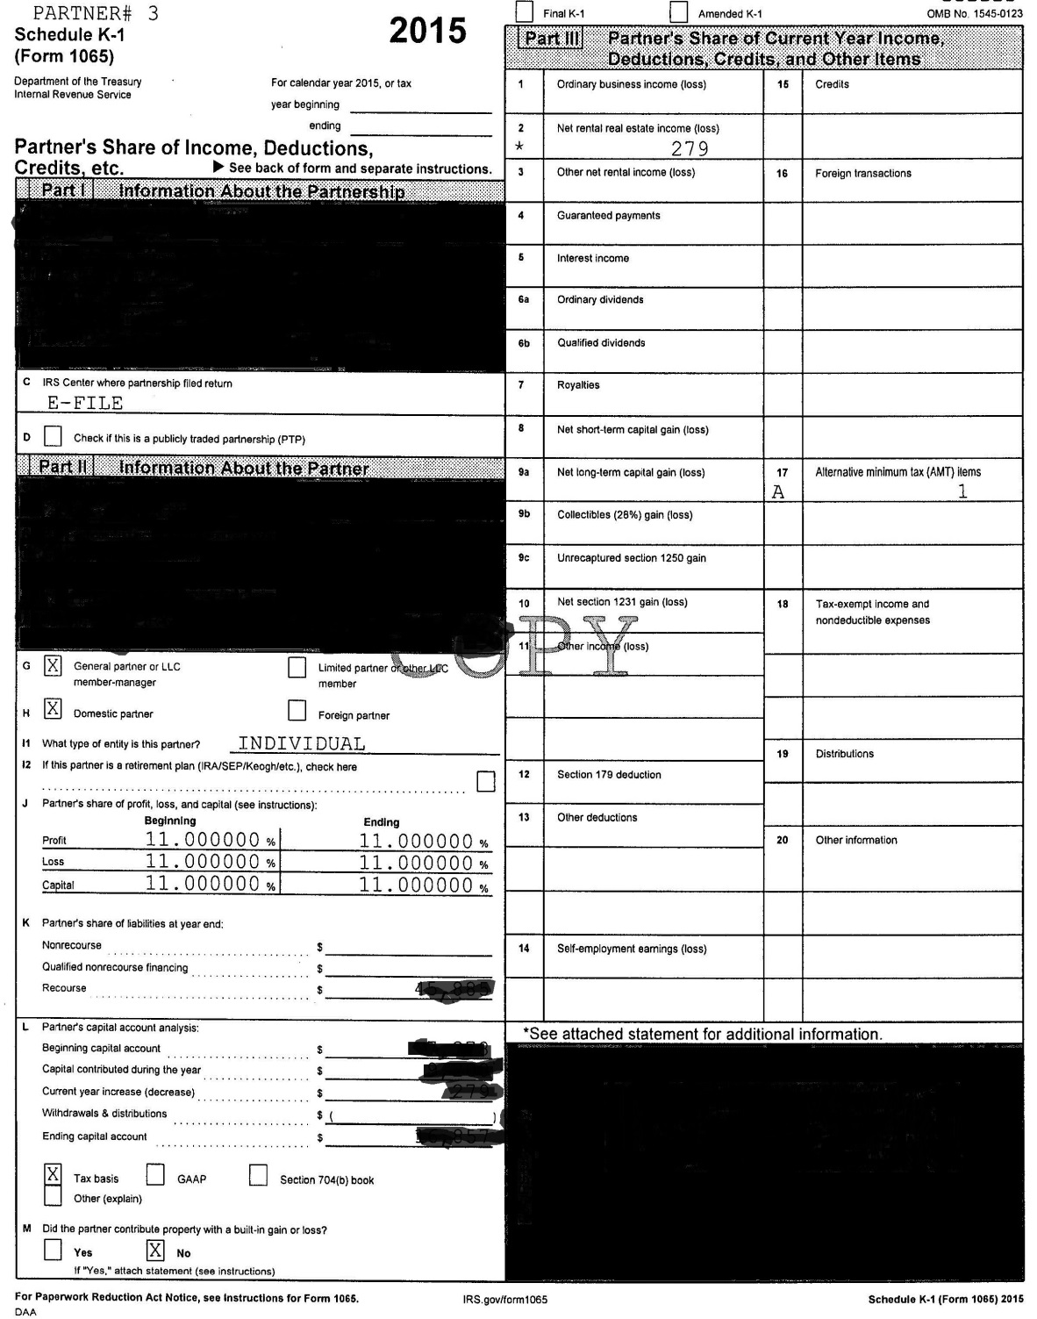
Partnerships
Schedule K-1
Is the Partnership a Business or Rental Real Estate
  Look at the Schedule K-1
    Type of Partnership – Box 2 – net rental real estate income (loss)
    Percentage of ownership – under Capital
    Self-employment earnings (add to wages)

Slide 25
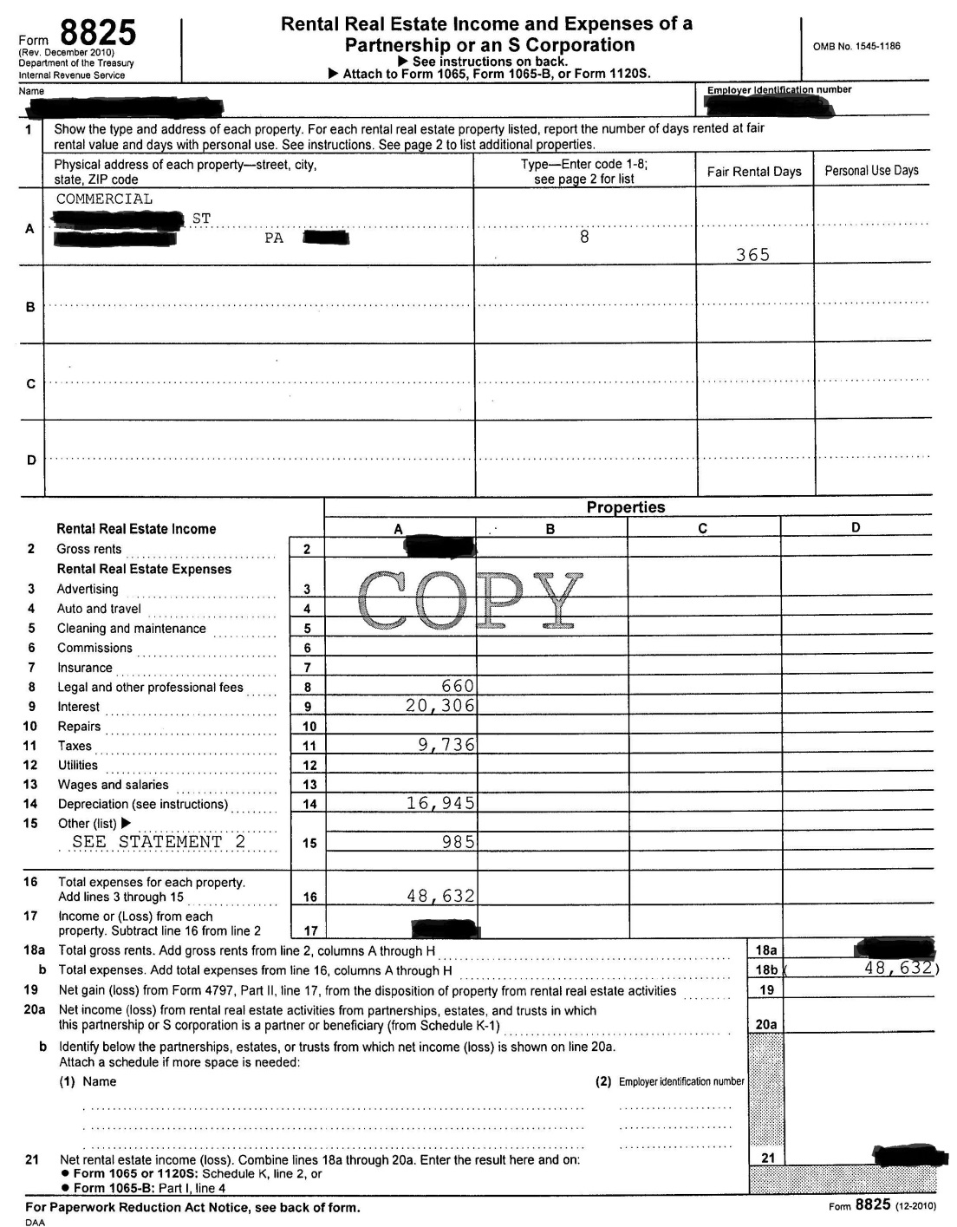
      If there is income (loss) in this box, need Form 8825 for more information
The one major thing we look at for all companies and all real estate is DEPRECIATION
Depreciation is considered a “paper loss” and not a real loss.
Per Investopedia: “Depreciation…does not represent real cash flow. Depreciation is an accounting convention that allows a company to write-off the value of an asset over time, but is considered a non-cash transaction.”

Slide 26
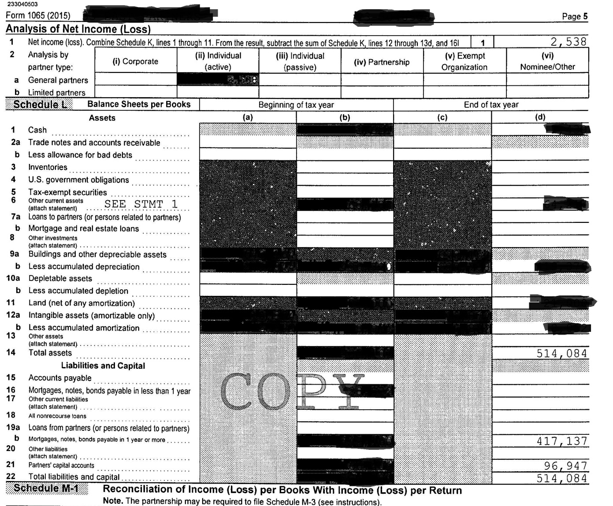
Net Value of Partnerships
Basic Accounting: Assets = Liabilities + Equity
Assets
Liabilities
Equity
Equity
(net value)

Slide 27
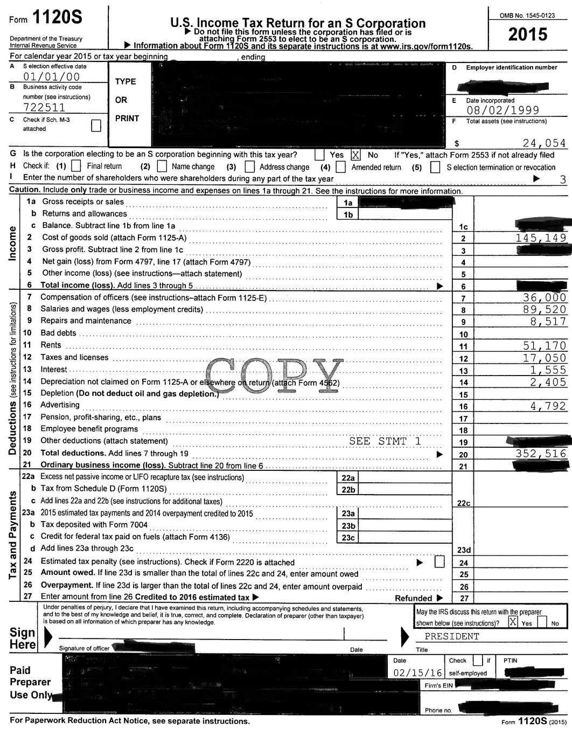
S-Corporations, Trusts
Line 17 & Schedule E
Schedule K-1 and Form 1120-S
Date Incorporated
Final Return?
Number of Shareholders
Compensation of Officers
Rents
Depreciation
Other deductions

Slide 28
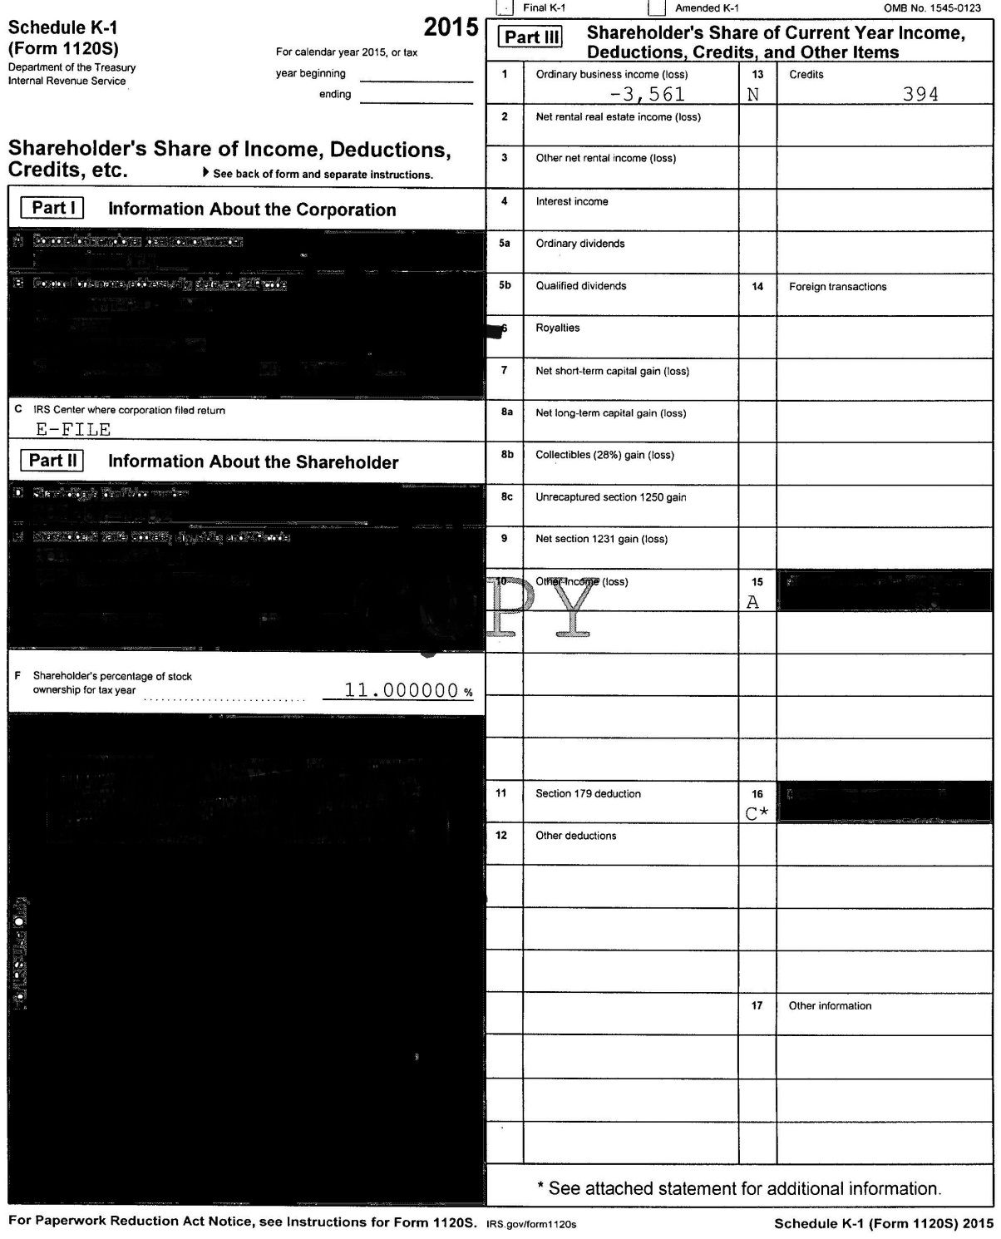
Schedule K-1
Business Income (Loss)
Percentage of Ownership

Slide 29
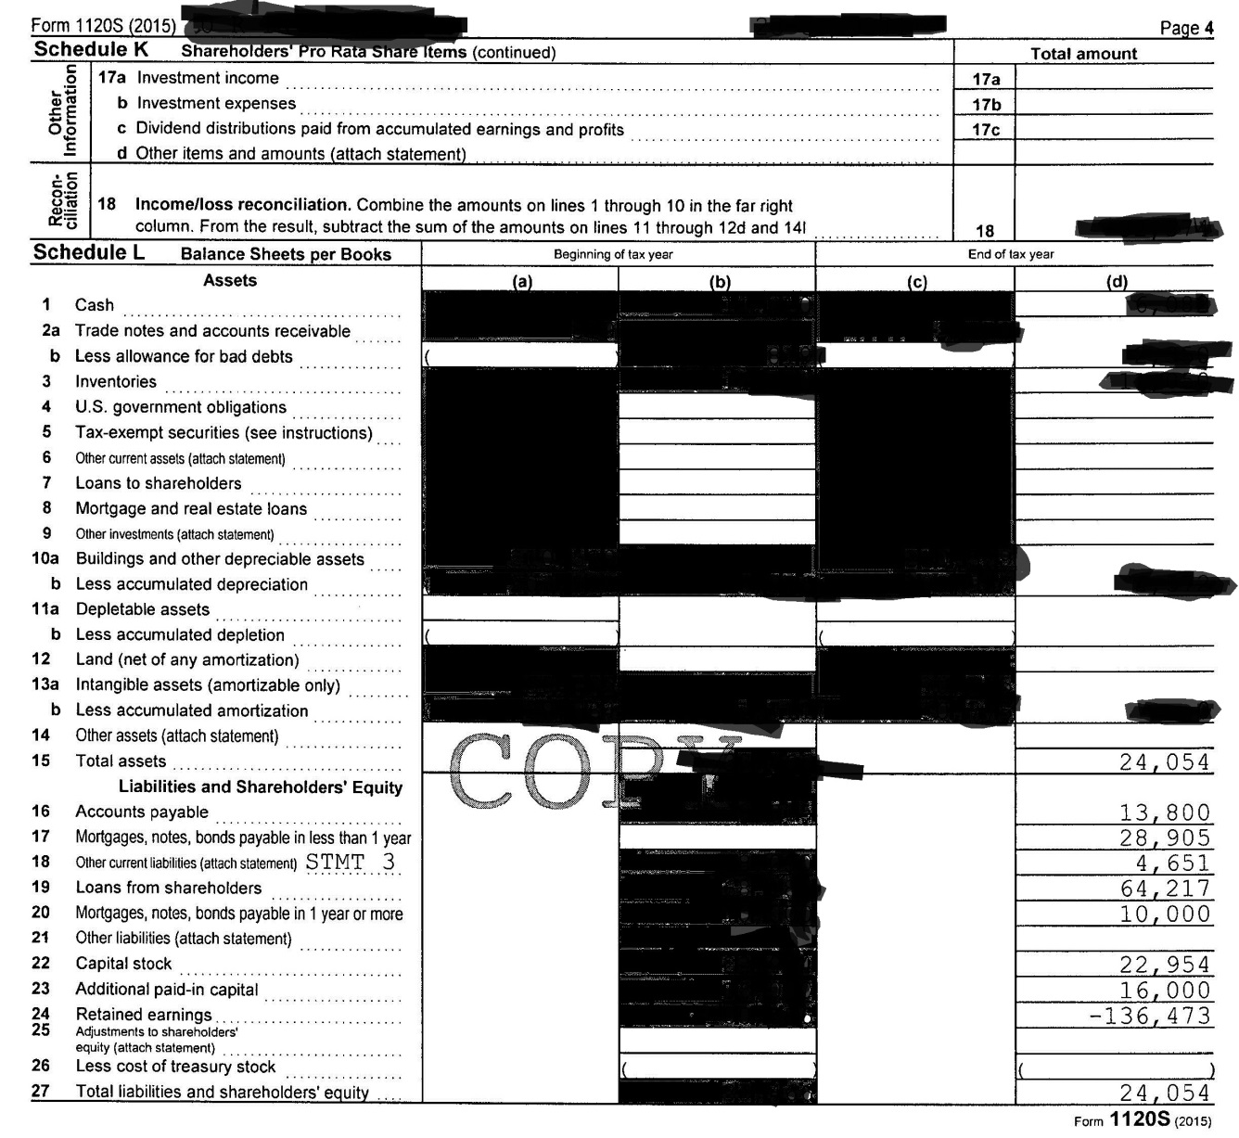
S-Corporation – Form 1120 S
Assets =
Liabilities + Equity
Loans from shareholders

Slide 30

Loans from Shareholders
Recourse / Nonrecourse
Notes:
Recourse vs. Nonrecourse Debt
There are two types of debts: recourse and nonrecourse.
A recourse debt holds the borrower personally liable. All other debt is considered nonrecourse.
In general, recourse debt (loans) allows lenders to collect what is owed for the debt even after they've taken collateral (home, credit cards). Lenders have the right to garnish wages or levy accounts in order to collect what is owed.
A nonrecourse debt (loan) does not allow the lender to pursue anything other than the collateral. For example, if a borrower defaults on a nonrecourse home loan, the bank can only foreclose on the home. The bank generally cannot take further legal action to collect the money owed on the debt. Whether a debt is recourse or nonrecourse may vary from state to state, depending on state law.

Slide 31
Loans from Shareholders
Per NASFAA Ask Regs: If an Applicant is the Sole Shareholder in a Corporation, Should a "Loan from Shareholders" be Reported as an Asset on the FAFSA?
Scenario: A student’s parents own a corporation and are the sole shareholders. The balance sheet of the corporation indicates a $540,000 “loan from shareholders.”
Answer: Yes, the value of the loan should be included in FAFSA Q. 89 as an investment. The FAFSA indicates that investments include (but are not limited to): “…real estate (do not include the home you live in), trust funds, UGMA and UTMA accounts, money markets funds, mutual funds, certificates of deposit, stocks, stock options, bonds, other securities, installment and land sale contracts (including mortgages held, commodities, etc.” Although the parents own the corporation, they have used $540,000.00 of their own money to loan money to a separate entity (their corporation). The fact that the $540,000.00 is a loan implies that the corporation will eventually pay the parents back, further demonstrating that
the parents made an investment into their own company.
The FAFSA Q. 90 would not have a bearing on the answer to FAFSA Q. 89.

Slide 32
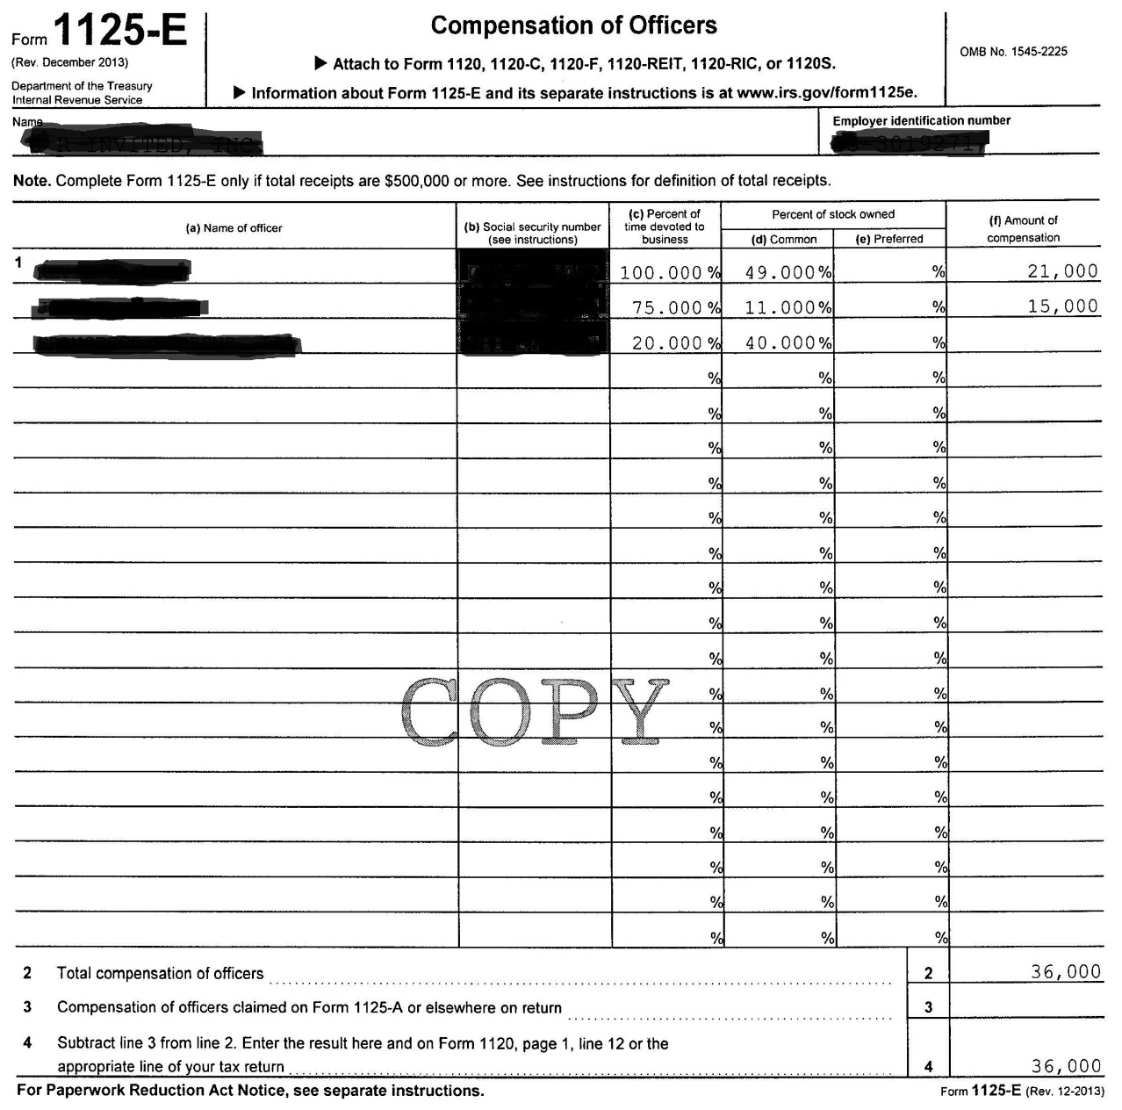
Compensation of Officers
% of time devoted to business vs. % of Stock Owned
Amount of Compensation

Slide 33
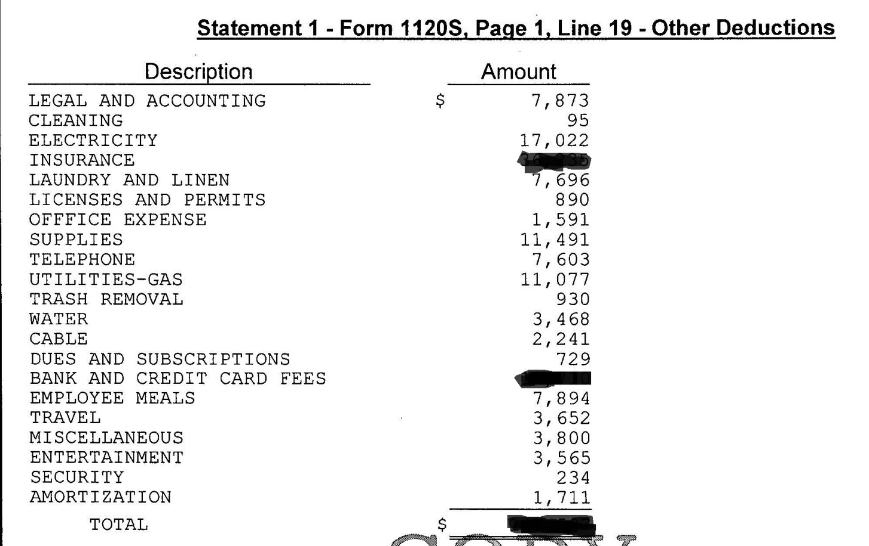
Other Deductions
Meals
Travel
Entertainment
Other?

Slide 34
NEW for 2018 TAX RETURNS!!!!
New Qualified Business Income (QBI) Deduction Introduced
  A 20% deduction on business income that is taxed on the owner’s personal return
  Effectively caps the tax rate on this business income at 29.6%
Will Apply to
  Sole proprietorships (Schedule C)
  Partnerships (Schedule E)
  S-Corporations (Schedule E)
  Real estate properties held in LLCs
  Potentially even some Schedule E rental properties
  Will Reduce AGIs for business owners
Gets complicated for taxpayers with taxable incomes greater than $315,000 (joint filers) or $157,500 (all other statuses)
Information Provided regarding 2018 tax information provided on Webinar 4/11/18 and supplied here with permission:
Robert Weinerman
Director of Training
Iron Bridge Resources
http://www.ironbridgeresources.com/financial-aid-training
617-733-0027

Slide 35
2018 TAX RETURN
The QBI is located on the tax return AFTER the AGI and after the standard/itemized deductions.
What does this mean?
  Does NOT impact the AGI
  WILL impact the taxes paid
  Means the taxes paid will be LOWER if they use the QBI
    Will reduce the EFC

Slide 36
2018 vs. 2017 TAX RETURN
2018 2017
Impact of the new 20% OBI Deduction in 2018

Slide 37
2018 TAX RETURN
It is very important to note at this time that the U.S. Department of Education has not released guidance or a decision on whether or not the QBI will already be added back as untaxed income.
If it is, then this may not as much of an issue.
If it is not, then you may want to consider adding this back as untaxed income.
Watch for guidance from the Department regarding this new line item on the tax return.
Also watch if families indicate once they have filed their 2018 tax return and indicate a lower AGI – it could be due to this allowance for QBI!

Slide 38
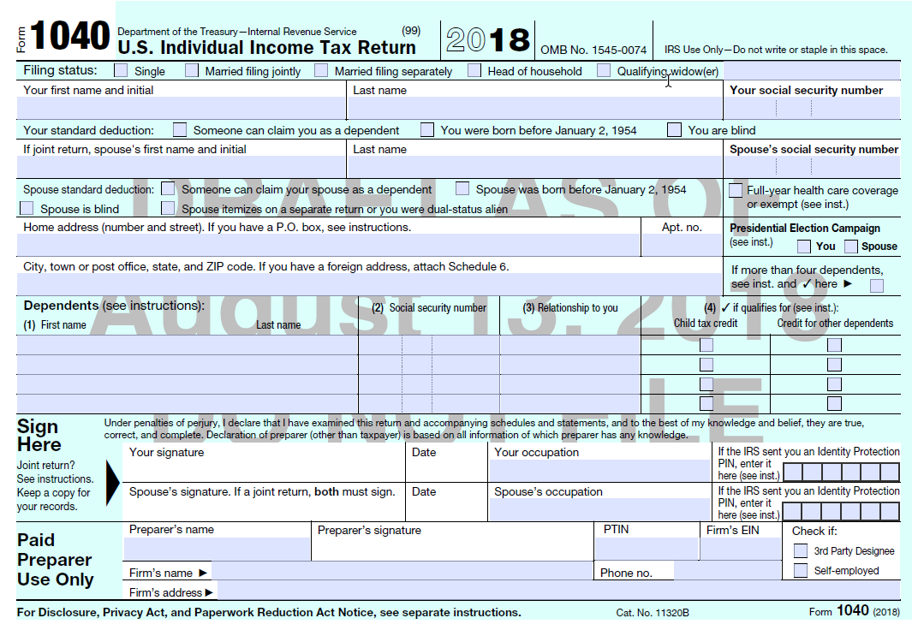
2018 – No more 1040A or 1040EZ
Draft 1040 – Page 1

Slide 39
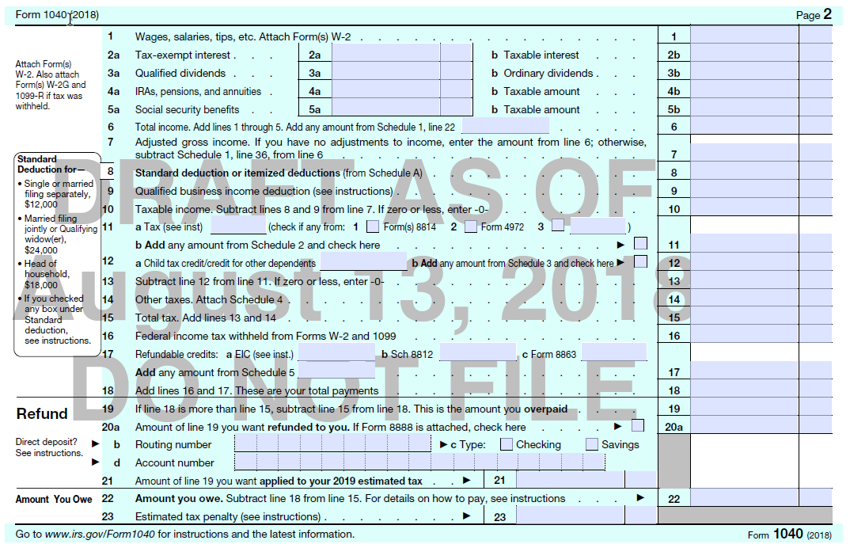
Draft 2018 Page 2
https://www.irs.gov/pub/irs-dft/f1040--dft.pdf

Slide 40
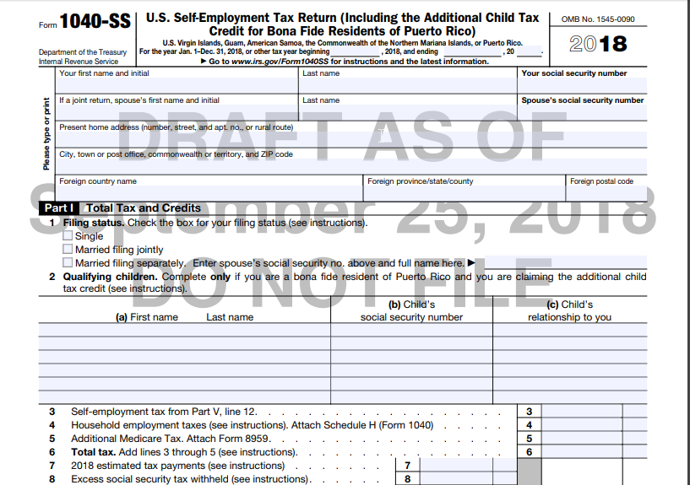
2018 – Self-Employment Tax Form
https://www.irs.gov/pub/irs-dft/f1040ss--dft.pdf

Slide 41
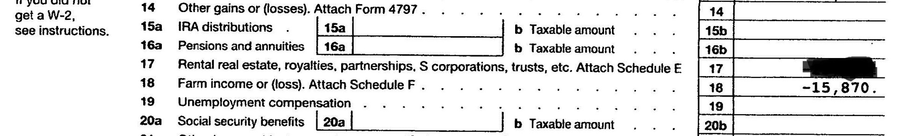
Farm Income (Loss)
Line 18 & Schedule F

Slide 42
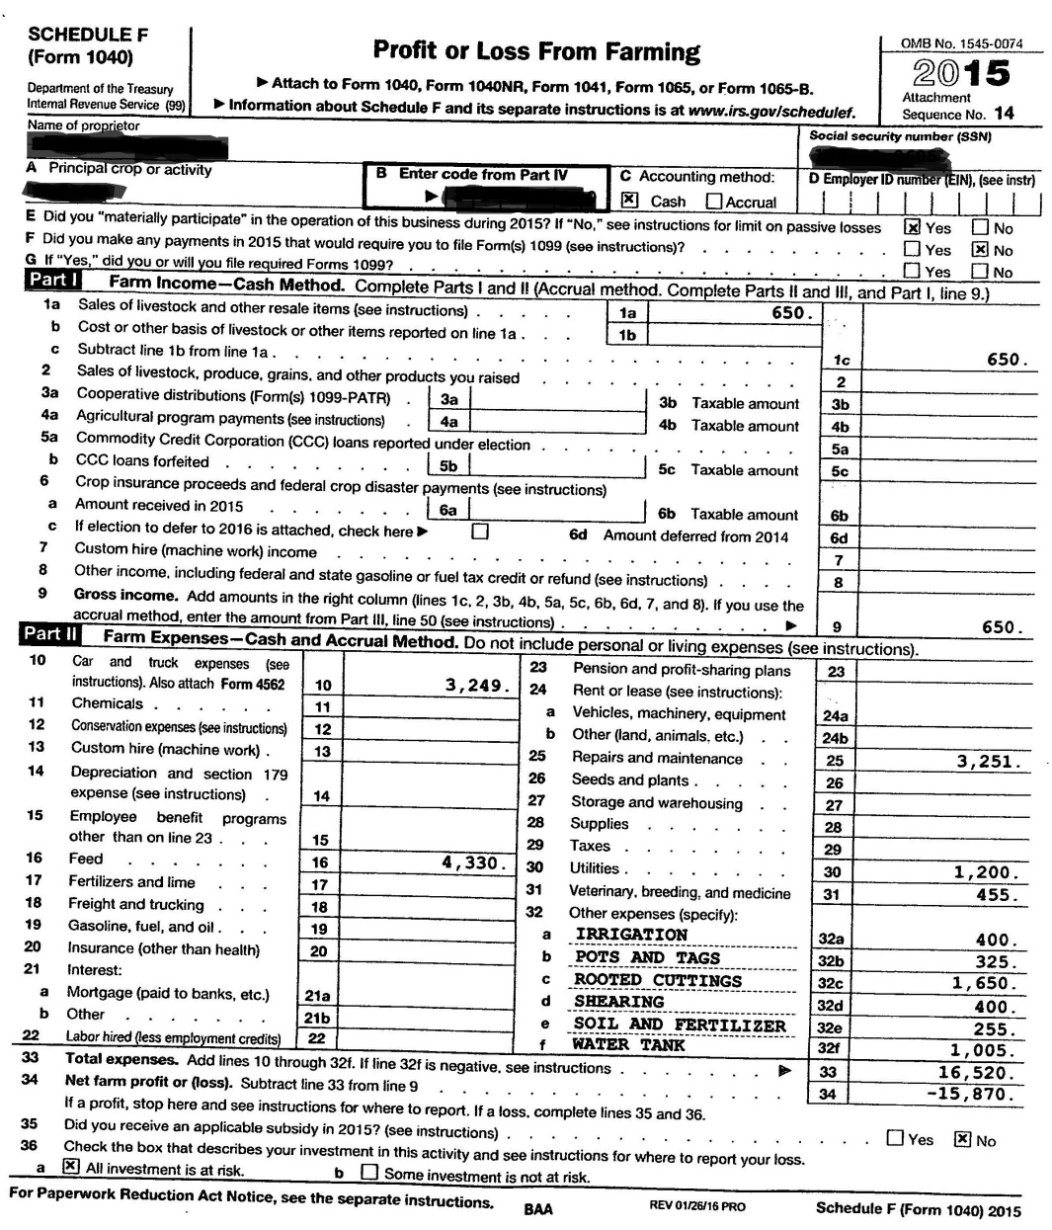
Farm Income (Loss) - Line 18 & Schedule F
Appears to be HOBBY FARM
Sale of livestock and other resale items
Car and truck expenses

Slide 43
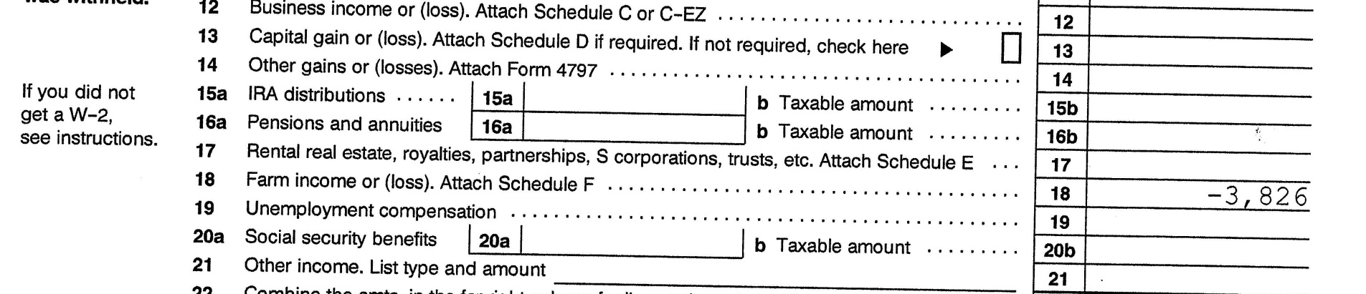
Farm Income (Loss)
Line 18 & Schedule F

Slide 44
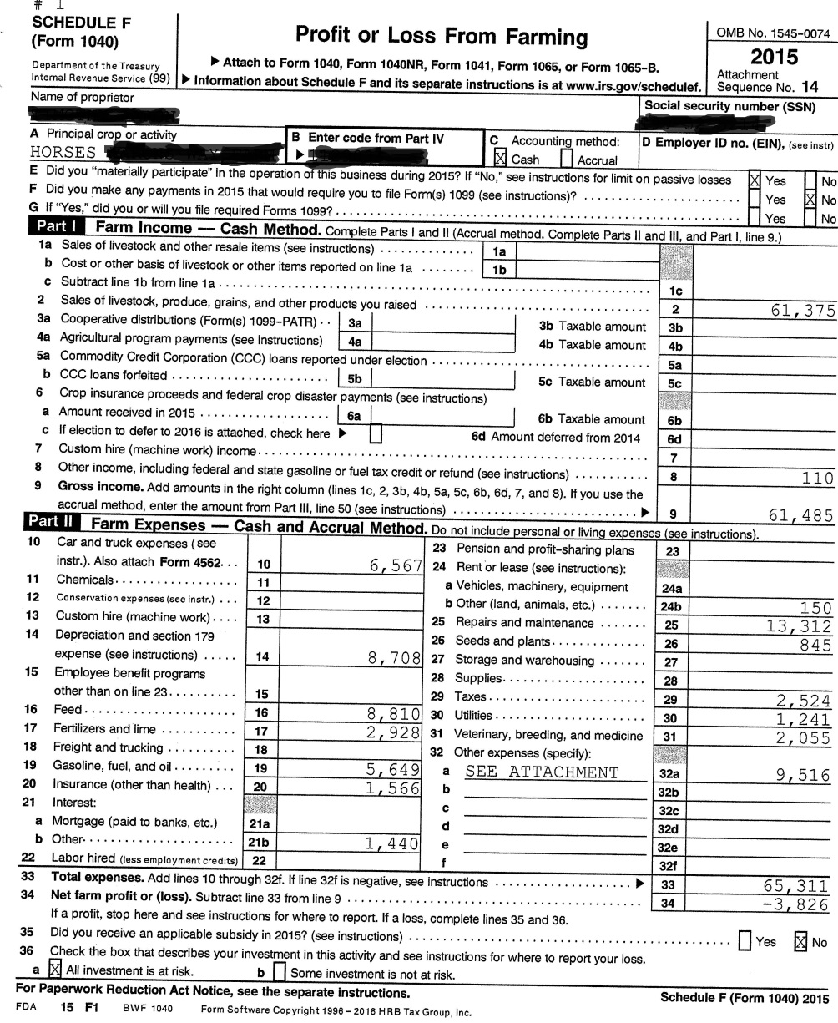
Farm Income (Loss) - Line 18 & Schedule F
Appears to be PRIMARY INCOME FARM
Sale of livestock, produce, grains, and other products YOU raised
Car and truck expenses
DEPRECIATION
OTHER

Slide 45
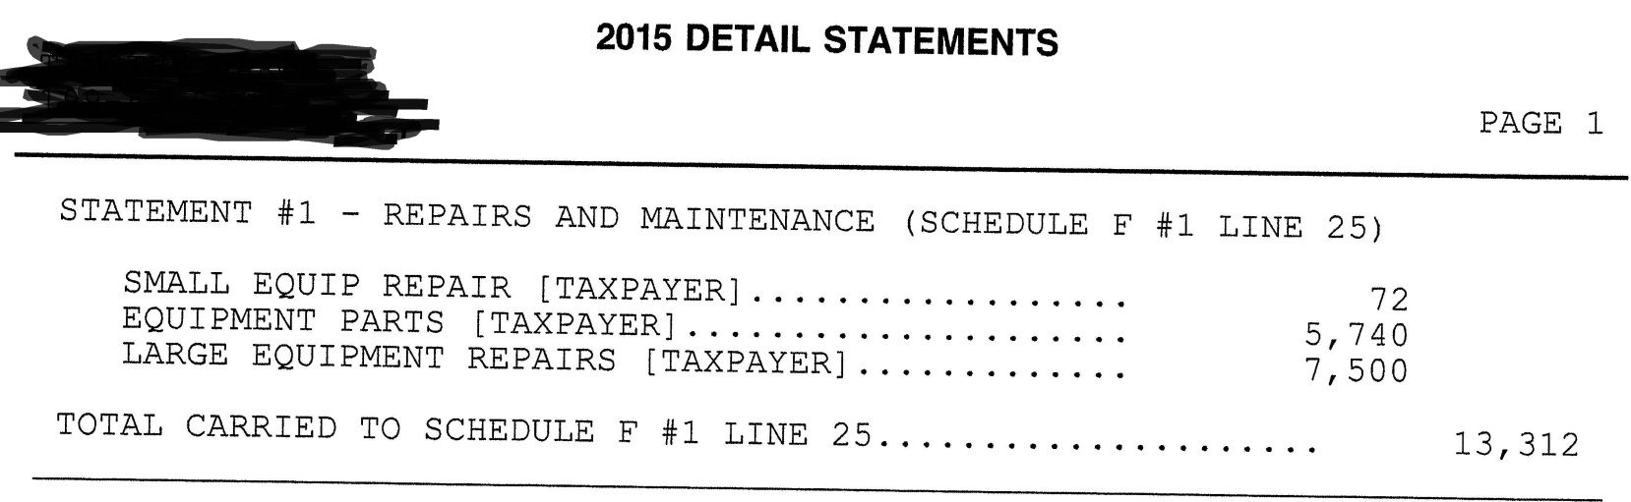
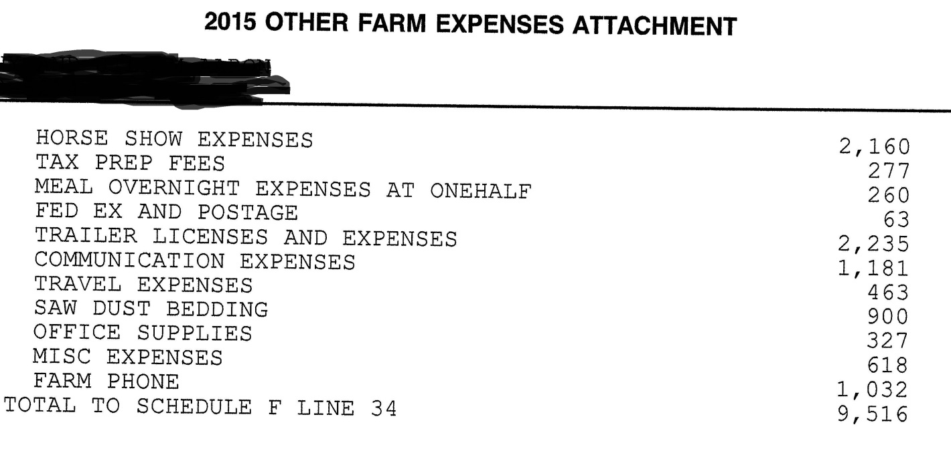
OTHER

Slide 46
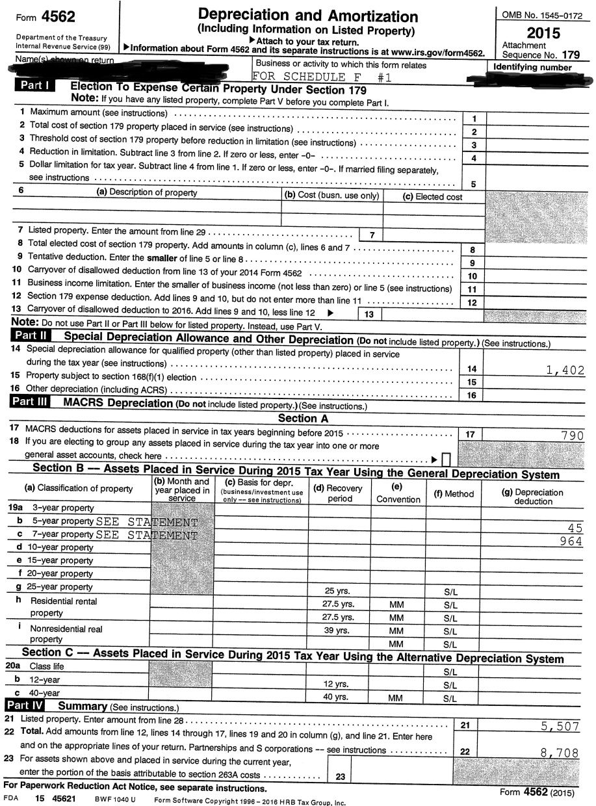
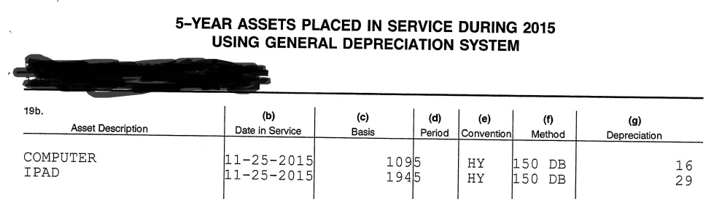
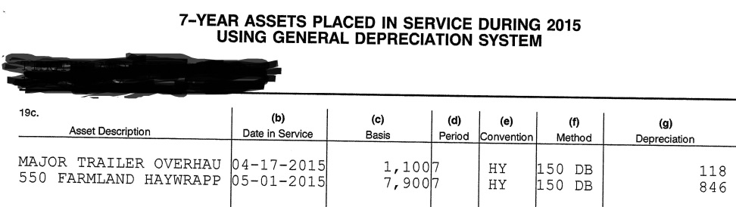
Farm Income (Loss) - Line 18 & Schedule F
DEPRECIATION

Slide 47
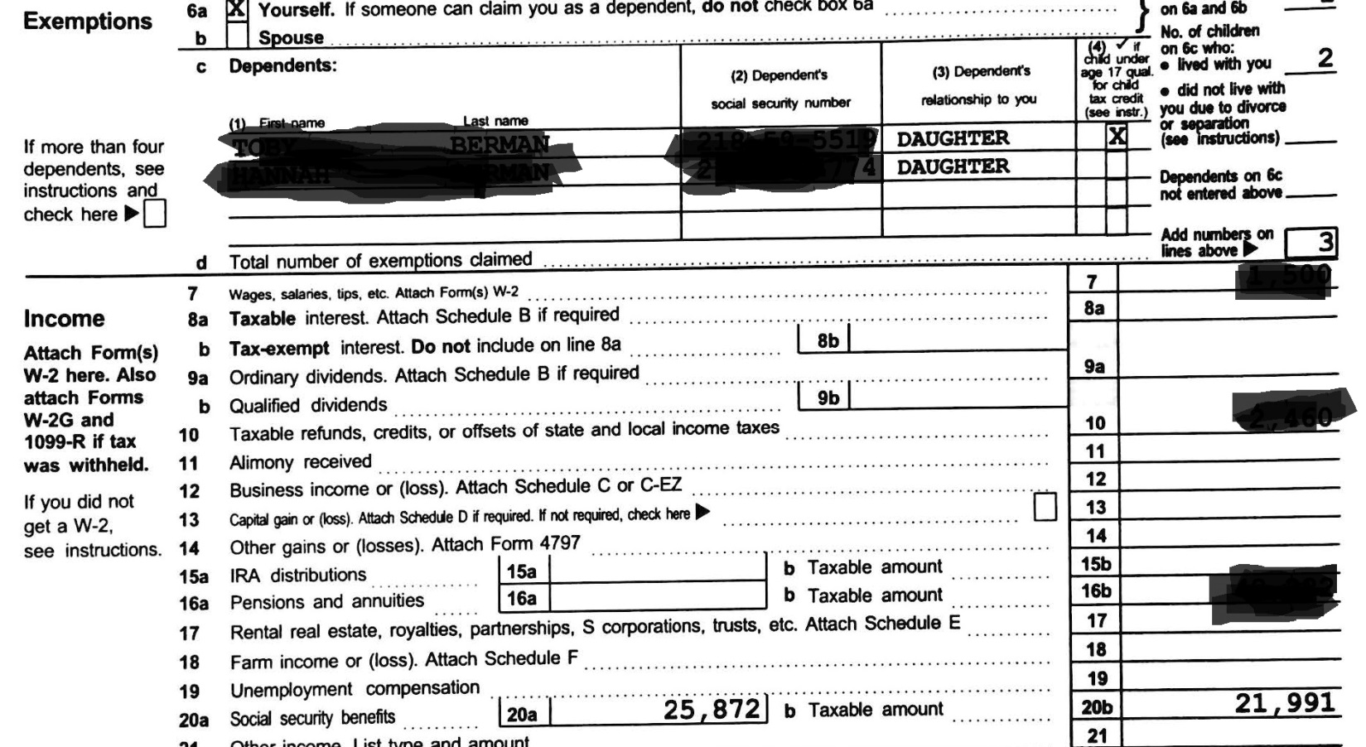
Social Security Benefits
Lines 20a, 20b and Form SSA-1099
  Be sure only to count the untaxed amount since taxable amount is already counted in AGI
Are there younger siblings (under 18)?

Slide 48
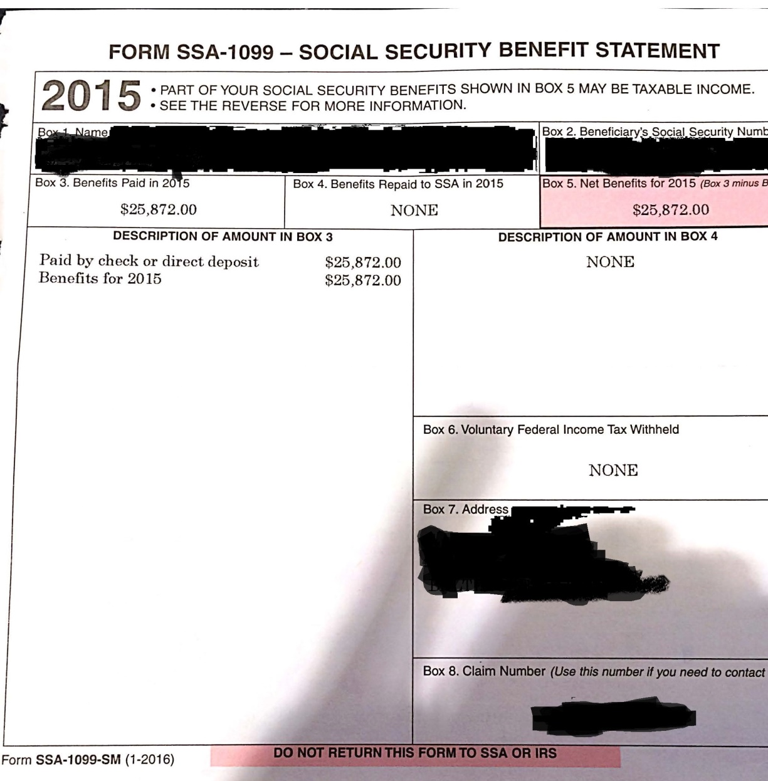
SSA-1099
Only the parents SSA will be taxable on their own tax return – not the children’s SSA-1099

Slide 49
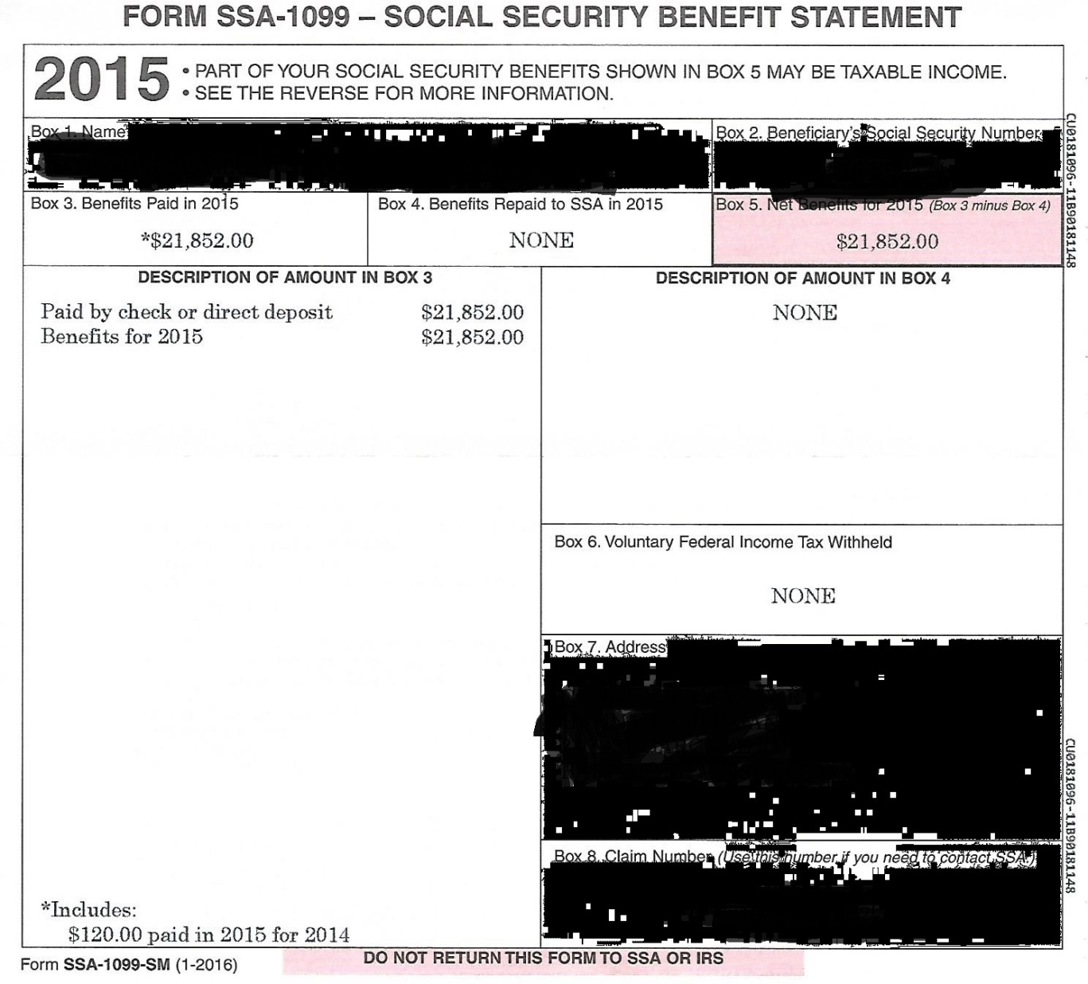
SSA-1099 - student
Watch for previous year payouts
PJ – benefits stop when student turns 18

Slide 50

SSA-1099 - Sibling
Be sure to collect for all siblings
Watch for previous year payouts
PJ – benefits stop when student turns 18 – especially important now with PPY

Slide 51


Questions
No Questions and I’m bored…
Questions are too
hard and I’m stumped…

Slide 52

Contact Information
Tonya R. Hsiung
Senior Assistant Director of Financial Aid
Franklin & Marshall College
717-358-4395
tonya.hsiung@fandm.edu

