Slide 1
Presenters’ Names,
Position Titles,
and Institutions

Slide 2
PASFAA Fall 2018 Conference Presentation: International Students and Graduate Financial Aid
David Eber, Graduate Admissions & Financial Aid
Brian Hill, Student Accounts & Financial Aid
Carnegie Mellon University

Slide 3
Agenda
Introductions
Background on CMU
International Recruitment and Admissions: recruiting abroad and what makes for a successful student.
International Student Need Analysis: How do you evaluate for need?
International Student merit aid: Is there money out there?
International Student Loans: Are there loans?
International Student Employment: work-study options? Internships and post-grad employment (OPT and CPT)?
Other issues that can fall to the financial aid office

Slide 4
Introductions + Background on CMU
Who we are…
Why international students are important to an institution
Recruit the best and brightest
Diversity of thought = better solutions
Diversity of revenue
Global workforce demands broader perspective + cross-cultural communication skills

Slide 5
Carnegie Mellon University Facts
High-select private research university
located in Pittsburgh
5 other locations in the US
13 locations outside the US:
Doha, Qatar
Adelaide, Australia
Multiple cities in Portugal
Kacyiru‐Kigali, Rwanda
Multiple cities in Japan
Connexis, Singapore

Slide 6
Carnegie Mellon Enrollment
12,659 students
6,203 Undergraduates
4,368 Masters
1,922 Doctorates
76 Special
4,461 international students (35.4%)
1,096 Undergraduates (17.7%)
2,323 Masters (53.2%)
1,011 Doctorates (52.6%)
31 Special (40.8%)

Slide 7
International Recruitment and Admissions
Recruitment Tactics
What makes for a successful student?
Fulbright and EdUSA
Travel/ Grad Fairs
Time and $$$
Agents?
Online Advertising
Scholarships
Rankings
Webinars/ Virtual Fairs
English Language Skills
TOEFL or IELTS
Clear goals
Professional experience

Slide 8
International Student Need Analysis: How do you evaluate for need?
CMUQ’s process (IM methodology with College Board tool)

Slide 9
International Student Merit Aid: Is there money out there?
Institutional Discounts (merit-based scholarships)
External Resources Listings (CMU’s FSO)
Scholarship Search Databases
Hosted by schools
General Search Engines (FastWeb)
Google?
PDF’s (Like NYU)
Time intensive
Not best use of technology (b/c of Google)
Employers
Government Partners
Ministries of Education (Turkey, Saudi Arabia)
External Scholarships/ Sponsors
Fulbright
XX-Futuro: Columbia, Guatemala, Honduras
Japan/ World Bank Scholarship

Slide 10
International Student Loans: Are there loans?
Program dependent (STEM, MBA)
Timing of disbursement can be an issue (never early enough)
Can release early?
Campus-based emergency loans
Transition loans
Salary advances for RA’s and TA’s

Slide 11
International Student Employment:
Campus employment options (20 hours / week MAXIMUM)
Summer Internships and CPT
Post-grad employment (OPT)
STEM extension

Slide 12
Other issues that can fall to the financial aid office
Access to campus-based vs. off-campus Housing
Not many options on-campus for grad students at CMU
Signing a lease without an SSN
How to conduct a housing search
Where to look?
When to look?
Price for rent?
Should I get roommate?
Meal plans: Depends on location of your campus!
Other options (Craig Street in Oakland vs. Meadville’s Park Avenue)
In urban settings, does your offer bus pass or other transportation?
Many social and academic events offer free food, but that is NOT sustainable for students.

Slide 13
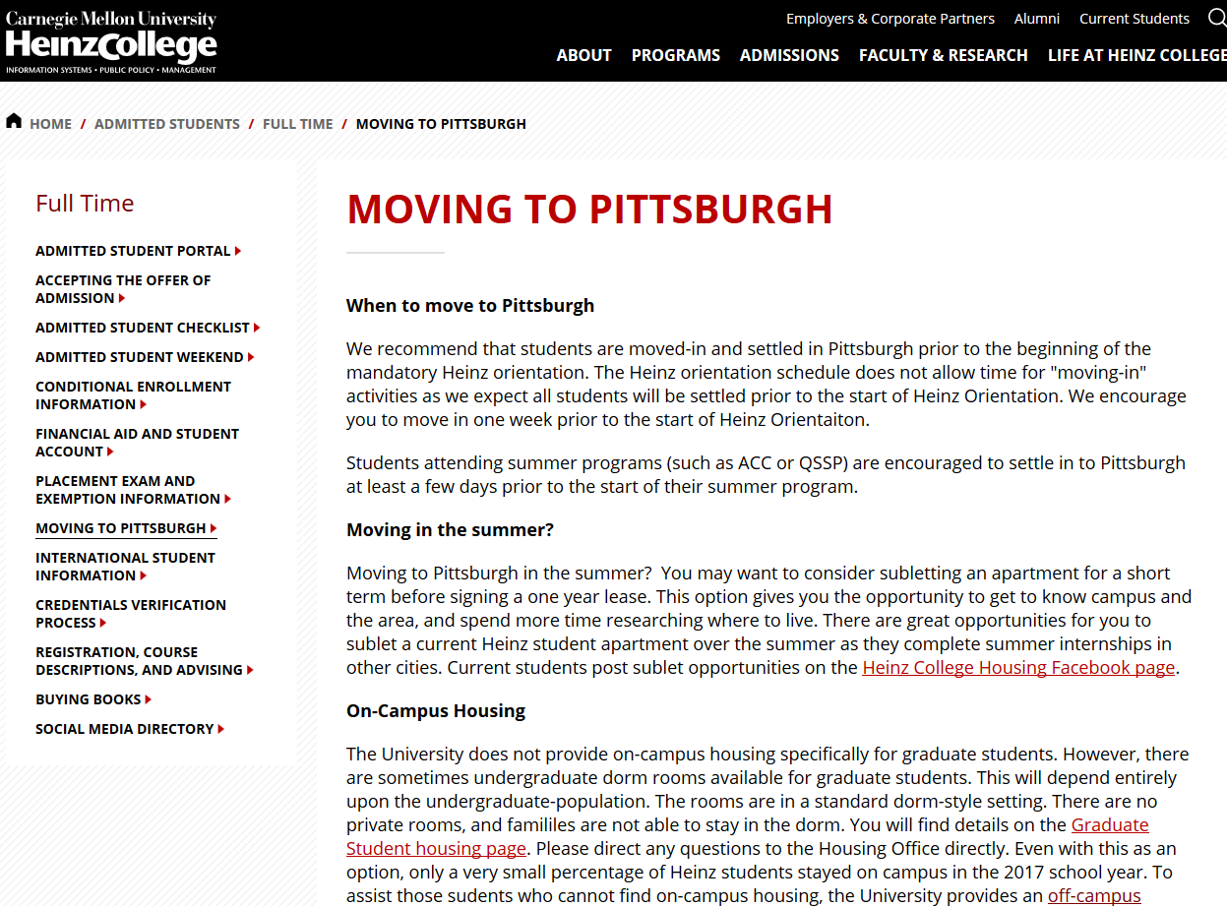
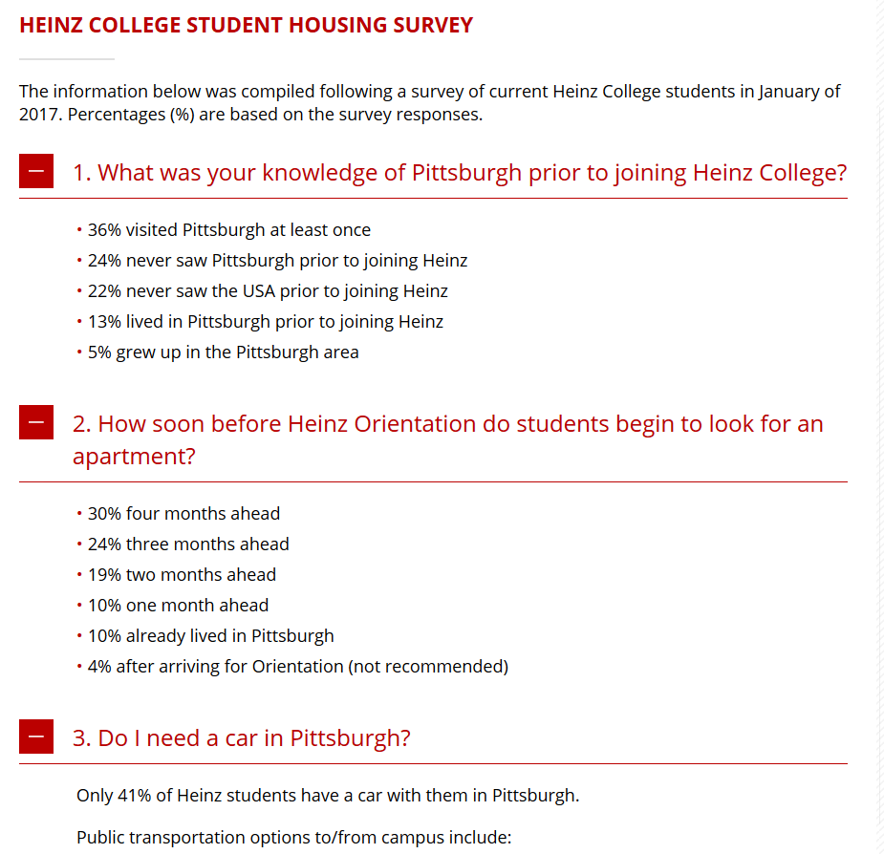
Share Information with the Incoming Students
Website with Resources
Housing Survey Results
Fulbright and EdUSA
Travel/ Grad Fairs
Time and $$$
Agents?
Online Advertising
Scholarships
Rankings
Webinars/ Virtual Fairs

Slide 14
Vendors as a Resource
Recruitment Tactics
What makes for a successful student?
Fulbright and EdUSA
Travel/ Grad Fairs
Time and $$$
Agents?
Online Advertising
Scholarships
Rankings
Webinars/ Virtual Fairs
English Language Skills
TOEFL or IELTS
Clear goals
Professional experience

