Slide 1
REWARD LETTER
FAFSA OR FASFA ?

Slide 2
What Do Our Students Know?
What do we know?
What studies show students know?
How are we trying to communicate with students?
Kathleen Roebuck Donna Wilkoski
FATV Bucks County Community College

Slide 3
Under-Resourced for Success

Slide 4
Repetition

Slide 5
Lack of Student Engagement

Slide 6
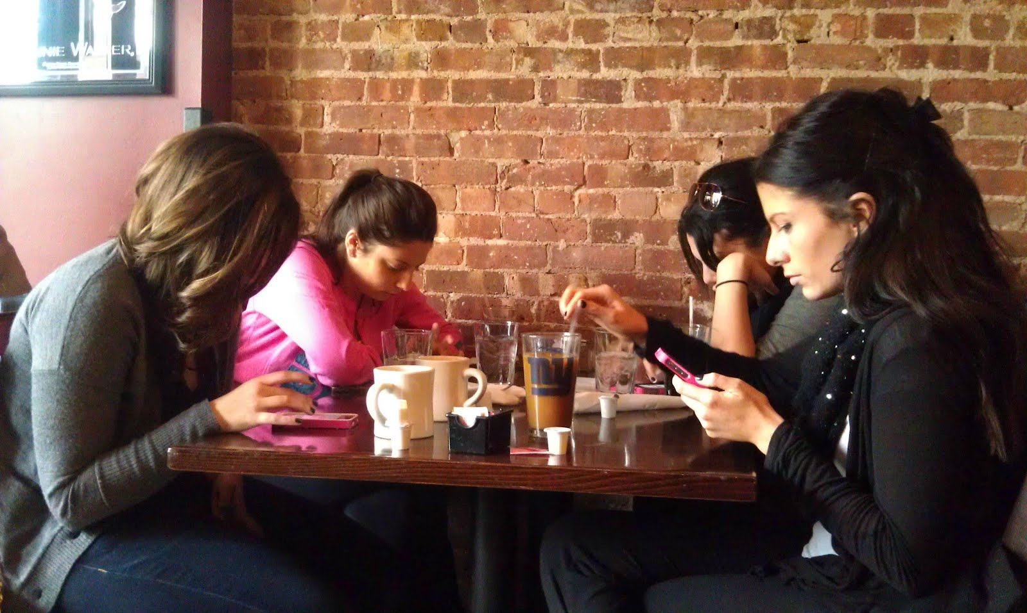
Student Communicate 24.7.365

Slide 7
Pressure of Summer Melt and Dropouts

Slide 8
What Do We Know About Our Students?
THAT STUDENTS STATE “NO ONE TOLD THEM”
IT IS EVERYONE ELSE’S FAULT
THEY WANT IT NOW
THEY DO NOT READ
THEY PROCRASTINATE
THEY WANT IMMEDIATE RESPONSE
THEY ARE LOOKING FOR THE EASY WAY
THEY ARE ELECTRONIC SAVY
WE KNOW THAT WE ARE ALWAYS BEHIND IN COMMUNICATION TOOLS
ANY OTHERS?

Slide 9
What students really know about financial aid
New America/Rachel Fishman: Familiarity with Financial Aid

Slide 10
What students really know about financial aid

Slide 11
What Resources Did Students Use & Were They Helpful
Source: Used BUCKS Very Helpful Helpful
RESULTS
High School Guidance Counselor: 42% 28% 44% 32%
Online Search Engines: 42% DNA 37% 42%
College or University Websites 33% 65% 38% 32%
Brochures or printed materials 24% 28%* 26% 37%
College/University Financial Aid Office 24% DNA 48% 38%
College/University Admission Office 16% DNA 49% 32%
College’s Net Price Calculator 10% DNA 25% 58%
Other websites 10% 15% 35% 18%
Family/Friends 7% 39%
Teachers 1% DNA
Did not look for financial aid info. 8% 20% *
Open House, college events 16%
Registration events 16%
DNA-Bucks Did not ask in survey
*similar question was asked

Slide 12
Common student answers to some basic financial aid questions
NCAN: Financial Aid Eligibility Mindsets Among Low-Income Students

Slide 13
STUDENT RESPONSE to a generic question
When asked, “What have you heard about financial aid? How would you describe it? What’s good about it? What’s not so good? If you haven’t heard anything about financial aid or aren’t sure what it is, please tell me what you think it is,”
“I have not heard much about financial aid.” “I’m not sure about financial aid but isn’t that like support from friends and family to help you in college? Or is that like FASFA [sic] to help get you started?” “I haven’t heard much about financial aid. I think it’s where you get payed [sic] for your college by the government.”

Slide 14
SURVEY WAS CONDUCTED AT BUCKS To all first time students that did not have a FAFSA on file for that term.
Would you like to receive money to help you pay for college? SQ #1
If you had to fill out a questionnaire that has 108 questions in order to get money to attend college, would you do it? SQ #2
Do you know what verification refers to in relation to financial aid? SQ #3
Did you know that you can apply for next year 2019-2020 financial aid starting October 1, 2018? SQ #6
What is an entrance interview used for? SQ #12
How Familiar are you with the Pell Grant? SQ #17
How do you personally get your information about financial aid? Select all that apply. SQ #27

Slide 15
RESULTS WE FOUND
Would you like to receive money to help you pay for college? SQ #1 ( Y 95% N 5%)
If you had to fill out a questionnaire that has 108 questions in order to get money to attend college, would you do it? SQ #2 ( Y 96% N 4%)
Do you know what verification refers to in relation to financial aid? SQ #3 ( Y 44% N 56%)
Did you know that you can apply for next year 2019-2020 financial aid starting October 1, 2018? SQ #6 ( Y 41% N 59%)
What is an entrance interview used for? SQ #12
How Familiar are you with the Pell Grant? SQ #17
How do you personally get your information about financial aid? Select all that apply. SQ #27 (results on chart slide # 11)

Slide 16
What Do We Do?
Personalized Experience - what do I need to do / how do I finalize the process and get my aid?
Removing barriers
Self-service
18-24 year olds vs. non-traditional viewpoints

Slide 17
What Is Your Strategy???
Personalize the experience – make it engaging
Snail Mail
Email
Telephone calls
Videos
Texting
Live Chat
Chatbot/Ai
Call Centers

Slide 18
What is a Artificial Intelligence?
ar·ti·fi·cial in·tel·li·gence
ˌärdəˈfiSHəl inˈteləjəns/
noun
the theory and development of computer systems able to perform tasks that normally require human intelligence, such as visual perception, speech recognition, decision-making, and translation between languages.

Slide 19
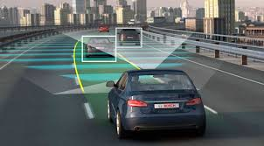
AI Evolution -
From Turing to Today
Big Data
Processing Power
Learning Algorithms

Slide 20
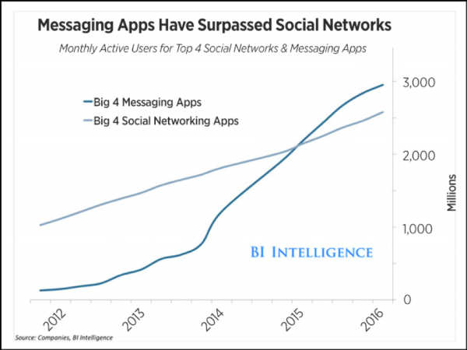
Messaging: 75% of Gen Z prefer texting to talking

Slide 21
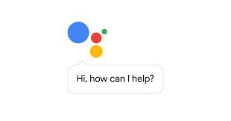
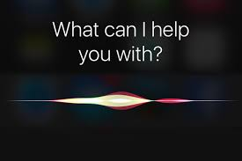
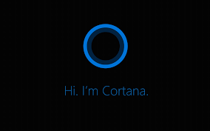
Conversational Interfaces (AI + Messaging)

Slide 22
What is a Chatbot
A bot is a computer program that automates certain tasks by chatting with a user through a conversational interface.
https://www.youtube.com/watch?v=wL7-PoiBiKM

Slide 23
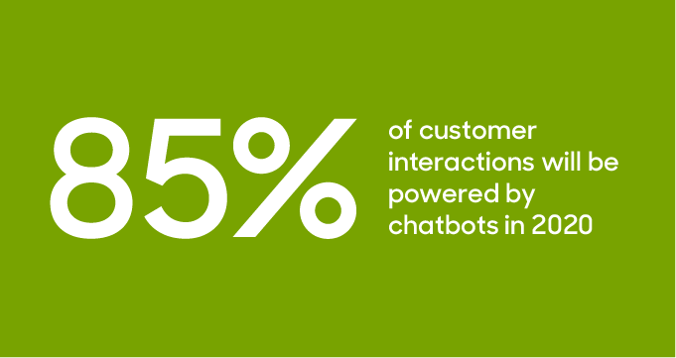
Chatbot Adoption
Source: Gartner

Slide 24
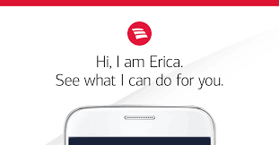
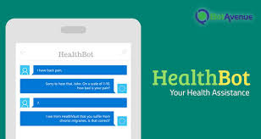
Chatbots in Other Industries
Video: https://www.youtube.com/watch?v=SNQGypLBJys

Slide 25
Benefits & Results
Better experience and engagement
Reduced Burden on Staff
Higher Volume/Enrollment/Satisfaction
24/7/365

Slide 26
What Are They Asking The Bot?
FATV Recently Launched a Chatbot July 2018
For the months of July, August, September, these questions appear in the Top 10 asked questions each month:
How much is tuition?
When will my aid get disbursed/When will I get my refund?
How do I apply for financial aid?
How do I apply for/get scholarships?
Can International students apply for financial aid?

Slide 27
Wrap: How your world could change

Slide 28
Resources
Student FA Surveys/Research: Summarized in slides
https://lendedu.com/blog/financial-aid-awareness-month-survey/
https://www.newamerica.org/education-policy/policy-papers/familiarity-with-financial-aid/
https://educationnorthwest.org/sites/default/files/resources/FAFSA-research%20handout-jan2017.pdf
https://ticas.org/sites/default/files/pub_files/Paving_the_Way.pdf
Communication Strategy: Helpful resources
https://www.businessinsider.com/ap-survey-youtube-tops-teen-social-media-as-facebook-fades-2018-6
https://www.businessinsider.com/generation-z-things-gen-z-are-killing-facebook-ralph-lauren-2018-5
https://www.businessinsider.com/best-and-worst-social-networks-according-to-college-student-2017-1

Slide 29
QUESTIONS?
THANK YOU FOR ATTENDING
DON’T FORGET TO COMPLETE THE SURVEY

