Slide 1
Assisting At Risk Students: An Academic College Initiative
Eric Doberstein and Abigail Mbuvi,
Student Aid Coordinators at Penn State University

Slide 2
The Past: 2005

Slide 3
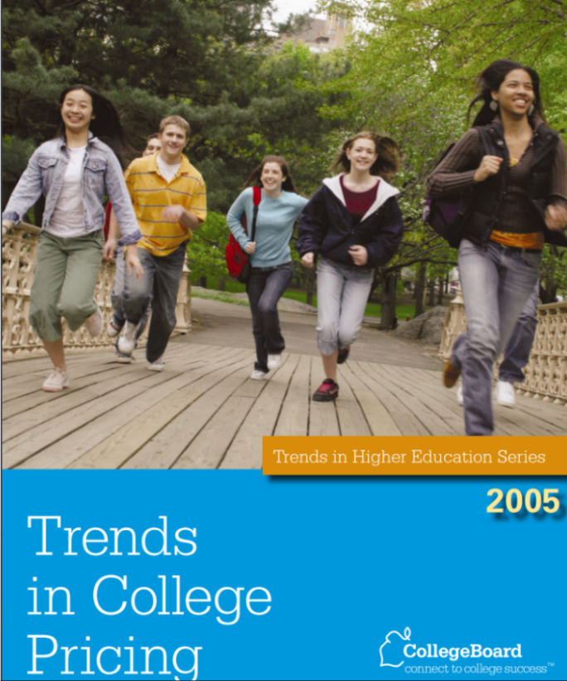
Trends in College Pricing: 2005
Average Tuition and Fees: $5,491
Average Cost (including room and board): $12,2127
Stafford Loan: $2,625
Maximum Pell Grant: $4,050
Remaining unmet need: $5,452
100% of all tuition and fees covered just by Stafford Loan and maximum Pell Grant- “tuition free college”

Slide 4
Trends in College Pricing: 2005
Resident tuition and fees: $11,024
Average Costs (including room and board): $17,554
Stafford Loan: $2,625
Maximum Pell Grant: $4,050
PHEAA Grant: $3,500
Remaining Unmet Need: $7,379
92% of tuition and fees for in state students met by Stafford Loans, Pell and PHEAA Grants.

Slide 5
Trends in College Pricing: Graphs
Before 2006 to 2015, average cost of attendance nationally went from $12,797 to $18,632 (46% increase)
Between 2006 to 2015, in-state cost of attendance at Penn State went from $18,496 to $27,272 (47% increase)

Slide 6
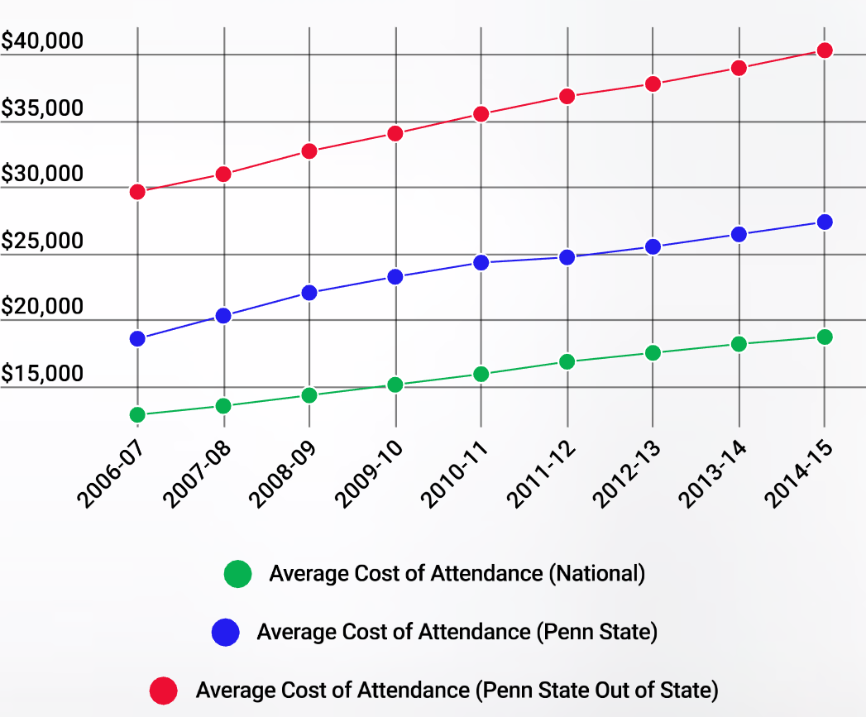
Trends in College Pricing: Graphs
Between 2006 to 2015, out of state cost of attendance jumps from $29,562 to $40,222

Slide 7
Trends in College Pricing: Graphs
In 2007-08 the Stafford Loan goes from $2,625 and $3,500 and in 2008-09 it goes from $3,500 to $5,500
Five out of ten years between 2005 and 2015 the Pell Grant is increased, going from $4,050 yup to $5,730
Between 2005-2015 – unmet need for in state 0 EFC students at Penn State climbs from $7,621 to $12,372 (62% increase)
Between 2005-2015 – average unmet need for 0 EFC (Expected Family Contribution) out of state students reaches $29,000

Slide 8
The Present: 2015

Slide 9
President’s Report to the Board of Trustees
“Family income is the strongest predictor of graduation rates and low-income students are graduating at significantly lower rates.”
Six year graduation rate for families with income greater than $88,000 = 88%
Six year graduation rate for families with income between $34,700 and $55,000 = 80%
Six year graduation rate for families with income less than $18,500 – 71%

Slide 10
Call to Action
Goal: highest quality education at a cost that ensures access for our citizens
“Improve understanding of the cost of an education and long-term consequences of debt; expand/refine existing financial literacy programs and ensure availability at all campuses.”
“Increase Provost Awards from $20M awarded in summer/fall 2014 to $25M in summer/fall 2015; merit and financial need criteria; $4,000 per student (coupled with Raise.Me in five H.S to earn tuition scholarships based on achieving success factors)”
“Increased accessibility at campuses with higher percentages of need-based student – retention, graduation rates, lower loan rates.”

Slide 11
Call to Action
Every office is encouraged to identify and recommend initiatives designed to assist economically at risk students.
The Academic College Initiative Pilot Program is conceptualized – identify the academic colleges that have the highest populations of economically at risk students and embed financial aid coordinators in each of these programs to provide support and pro-active assistance to students whose Expected Family Contribution (EFC) would qualify them for the Pell Grant.
2016-17 – The first coordinator begins working with Division of Undergraduate during high need times (late drop/withdrawal) to provide general support to all students
2017-2018 – Two Coordinators come on board with Health and Human Development and Liberal Arts
Late Spring 2018 – Memo of Understanding drafted between Office of Student Aid (OSA) and the three partner academic colleges

Slide 12
Call to Action: Memorandum of Understanding
Background:
This initiative establishes a dedicated student aid adviser whereby the student aid adviser will spend a portion of their time in the advising center to work with at-risk students and to collaborate with academic advisers on plans for student success and retention of financial aid eligibility
Purpose:
To partner with academic advisers in identifying and serving student aid recipients who are at risk of becoming ineligible for student aid.
To intervene early in a student’s academic career at the first point of an academic decision that has potentially adverse ramifications to the student’s aid eligibility and to successful and timely degree completion
Goals:
To improve graduation rates of Pell Grant recipients. Currently at Penn State, the graduation rate for Pell Grant recipients is 11% below to overall graduation rate
To reduce student loan debt by reducing the time of degree completion

Slide 13
Liberal Arts
About the college
Relationships in the college
Goals for the initiative
Challenges
Overcoming challenges

Slide 14
Division of Undergraduate Studies
About the college
Challenges unique to DUS

Slide 15
The Future: 2025

Slide 16
Information Gathering: Refining what it means to be “At Risk”
Not all EFCs are equal
Professional staff training and development to look beyond the numbers
Moving beyond EFC as the at risk indicator

Slide 17
Workshops and Presentations
Open sessions
Scholarship searching and application
Loan debt/ barrowing smart

Slide 18
Partnership and Collaborations
Financial Literacy
Community resources
Targeted scholarship Use

Slide 19
Starfish and the Red Flag Warnings
Fail first round of exams
Missing a lot of class
Transition to college/ adjustment issues
Special circumstances
What we see as a satisfactory academic progress issue is more complex than just a student with less than 67% completion rate or below a 2.0 GPA

Slide 20
Questions & Answers

