Slide 1
More Than Just Pens and Sticky Notes The Complex World of Lenders Panel Discussion
Amanda Scheler, AVP/Campus Relations Manager, PNC Bank
Keri Neidig, Director, Business Development, Sallie Mae
Bill Ayers, Head of Campus Development, College Ave

Slide 2
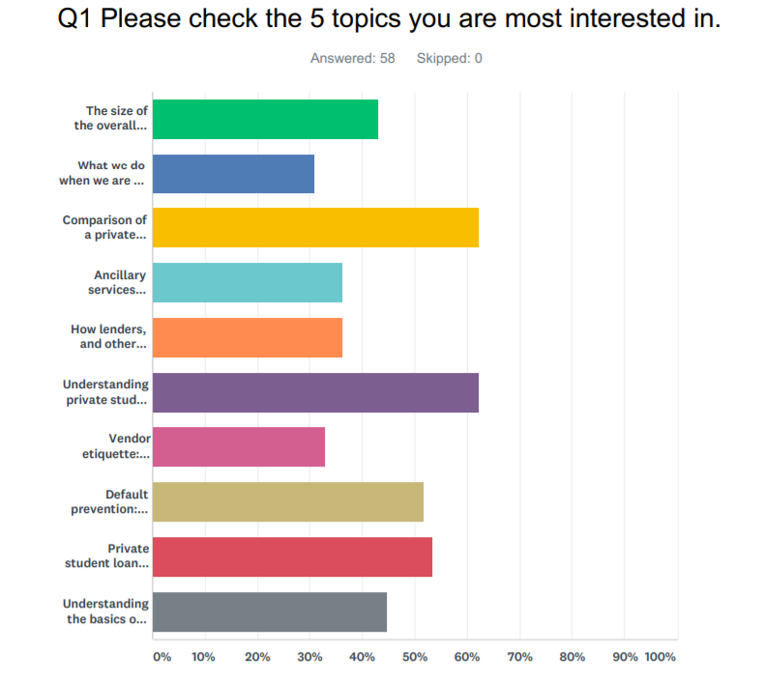
PASFAA member survey (Aug 2018)

Slide 3
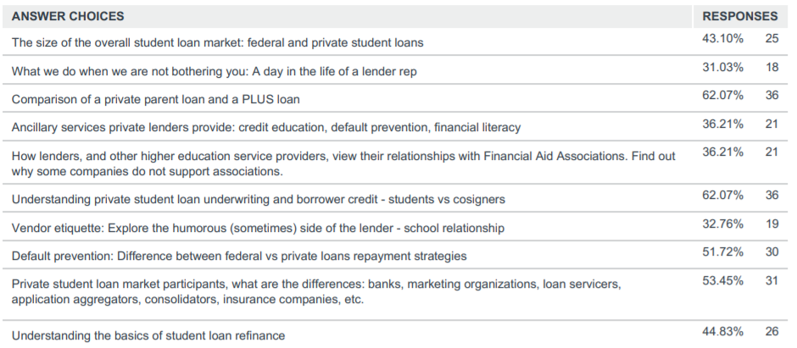
PASFAA member survey (Aug 2018)

Slide 4
The Complex World of Lenders – Agenda
The size of the overall student loan market: federal and private student loans (Keri)
Private student loan market participants (Amanda)
Understanding private student loan underwriting and borrower credit - students vs cosigners (Bill)
Comparison of a private parent loan and a PLUS loan (Keri)
Default prevention: Difference between federal vs private loans repayment strategies (Amanda)
Understanding the basics of student loan refinance (Bill)

Slide 5
1. The size of the overall student loan market: federal and private student loans
Borrowing Trends
Tuition and fees continue to increase
Overall student borrowing is on the decline
Federal loans make up 92% of $1.48 trillion in student debt outstanding
Repayment Success
Federal and private loan default rates are declining
Private loan delinquency / charge off rates are considerably lower than federal loans

Slide 6
2. Private student loan market participants
Who is involved
Application Aggregators
Originator
Lender
Guarantor
Servicer
Consolidators
How they work together
Insurance Companies
Insuring tuition/room/board while in-school
Insuring debt against disability/death after school
Some of these protections MAY be available or included through the lender

Slide 7
2. Private student loan market participants
Insurance Companies
Insuring tuition/room/board while in-school
Insuring debt against disability/death after school
Some of these protections MAY be available or included through the lender

Slide 8
3. Understanding private student loan underwriting and borrower credit
General characteristics:
Student loans are unsecured
Credit based asset
Vast majority of private student loans are credit based
Better credit = better rates
Interest rates based on lender underwriting
90+% of undergraduate loans are cosigned
Annual loan amount limits & lifetime loan aggregate limits
Maximum loan amount is the cost of attendance minus any other financial aid

Slide 9
3. Understanding private student loan underwriting and borrower credit
How private student loans are made:
Loan Eligibility – will lender consider making a loan
Credit Decision – approve or deny based on risk assessment
Underwriting – if approved then determine pricing

Slide 10
3. Understanding private student loan underwriting and borrower credit
Loan Eligibility - will lender consider making a loan
School Eligibility – accreditation, domestic or foreign, type (not-for-profit or for-profit, degree-granting)
Borrower Eligibility – enrollment, citizenship, age of majority, meets credit requirements
Cosigner Eligibility – citizenship, meets credit requirements

Slide 11
3. Understanding private student loan underwriting
“Thin” credit file - Primary challenge for approving students
1 to 4 credit ‘trades” on credit reports
Not enough data to calculate a credit score

Slide 13
4. Comparison of a private parent loan and a PLUS loan
Evaluating and counseling gap financing options
Interest Rates and APR
Payment Flexibility
Repayment Benefits & Loan Features
Providing choice:
One solution does not fit all

Slide 14
5. Default prevention: Difference between federal vs private loans repayment strategies
Most student loan repayment schedules -- whether for federal or private loans -- last 10 years or more.
There are many repayment options available, with federal loans offering plans designed to fit income.
Although private loans may have hardship, academic and military deferment options, federal student loans offer deferment, forbearance and loan forgiveness options that might not be provided by private lenders.
Repayment options include immediate repayment of principal and interest, interest-only payments while enrolled in school, or no payments until after graduation.

Slide 15
Federal Loan Consolidation
Only combine federal loans
New loan rate which is a weighted average of old loans’ rates
Keep federal repayment benefits like Public Service loan forgiveness and income-driven repayment plans.
6. Understanding the basics of student loan refinance
Private Loan Refinancing
Credit based
May combine federal and private loans
New loan rate is based on current credit
Forfeit federal repayment benefits if combining federal and private loans

Slide 16
6. Understanding the basics of student loan refinance
How much money can students save by refinancing their student loans – federal and private?
Critical factors:
– What is the likelihood of using the federal repayment plans?
– Repayment period
– Interest rate
– Monthly payment
– Market conditions (rate environment)
– Changing personal risk profile
– Life management

Slide 17
PASFAA member survey (Aug 2018)

Slide 18
THANK YOU!

