Slide 2
Promoting Diversity and Success for Graduate Students through Financial Aid
Nancy Conneely, Director of Policy
Rachel Patterson, Director, Programs for Diversity
October 23, 2018

Slide 3
Session Agenda
Demographics of law school applicants and matriculants
Federal funding and repayment options, and potential threats to these programs
Trends in federal graduate and professional student borrowing
Examples of state financing options available to graduate and professional students
Distribution of need and merit aid, and the impact on underrepresented students
How need and merit aid could be distributed differently to create greater equity

Slide 4
Law School applicants and matriculants

Slide 5
Diversity by the Numbers
The diversity of our law schools does not reflect the diversity of our society. Based on the 2010 Census, 13% of our population is black and 10% of first-year law students are black.
49% of Black students and 33% of Latino/a students who applied to law school in 2016-17 were not admitted to any law schools.
26% of Asian students who applied to law students were not admitted anywhere.
17% of white students who applied to law school were not admitted anywhere.

Slide 6
The NUMBER OF APPLICATIONS IT TOOK TO YIELD 1000 OFFERS OF ADMISSION IN 2017 (OVERLAID WITH ADMIT RATE)

Slide 7
Diversity and the LSAT
In 2016-17, out of 8400+ applicants, 2 black students had LSAT scores of 175+. 131 black students had LSAT scores of 165+. 382 black students had LSAT scores of 160+.
5221 black applicants have LSAT scores ranging from 135-149.
The median black LSAT score of 142 has not changed in 20+ years.

Slide 8
Federal funding and repayment

Slide 9
Federal Repayment Options
Standard
Graduated
Extended
Income-contingent
Income-sensitive
Income-based (old)
Income-based (new)
Pay as You Earn
Revised Pay as You Earn

Slide 10
Federal Forgiveness Options
Public Service Loan Forgiveness
Repay Direct Loan for at least 10 years.
Must be in the right repayment plan and work for a qualifying employer.
Temporary Expanded PSLF
New in 2018!
Adds the extended and graduated repayment plans.
Teacher Loan Forgiveness
Teach full-time for five years in a low-income school.
Forgiveness of up to $17,500.

Slide 11
Threats
PSLF
Department of Education implementation
Eliminated in Trump budget
Eliminated in PROSPER Act for new borrowers
TEPSLF
Department of Education implementation
Income-driven repayment
Forgiveness effectively eliminated in PROSPER Act

Slide 12
Trends in federal borrowing

Slide 13
Trends in Graduate Debt
Source: U.S. Department of Education, National Postsecondary Student Aid Study (NPSAS), 2000-2016, analysis by Robert Kelchen, “Examining Trends in Graduate Student Debt by Race and Ethnicity”, retrieved from https://robertkelchen.com/2018/05/15/examining-trends-in-graduate-student-debt-by-race-and-ethnicity/

Slide 14
No Debt – By Race/Ethnicity
Source: U.S. Department of Education, National Postsecondary Student Aid Study (NPSAS), 2000-2016, analysis by Robert Kelchen, “Examining Trends in Graduate Student Debt by Race and Ethnicity”, retrieved from https://robertkelchen.com/2018/05/15/examining-trends-in-graduate-student-debt-by-race-and-ethnicity/

Slide 15
Students with $100K in Debt – By Race/Ethnicity
Source: U.S. Department of Education, National Postsecondary Student Aid Study (NPSAS), 2000-2016, analysis by Robert Kelchen, “Examining Trends in Graduate Student Debt by Race and Ethnicity”, retrieved from https://robertkelchen.com/2018/05/15/examining-trends-in-graduate-student-debt-by-race-and-ethnicity/

Slide 16
State financing

Slide 17
Examples of State Financing Options
Maryland | Ohio | New York
Graduate and Professional Scholarship Program | Choose Ohio First | Masters-in-Education Teacher Incentive Scholarship Program
Programs in dentistry, law, medicine, nursing, pharmacy, social work, and veterinary medicine | Enrollment in undergrad or graduate program in Ohio STEMM programs (STEM + medicine) | Enrollment in an education master’s program at a SUNY or CUNY college or university
Awards from $1,000 - $5,000 per year | Scholarships based on need and merit | Full-tuition scholarship

Slide 18
Distribution of need and merit aid

Slide 19
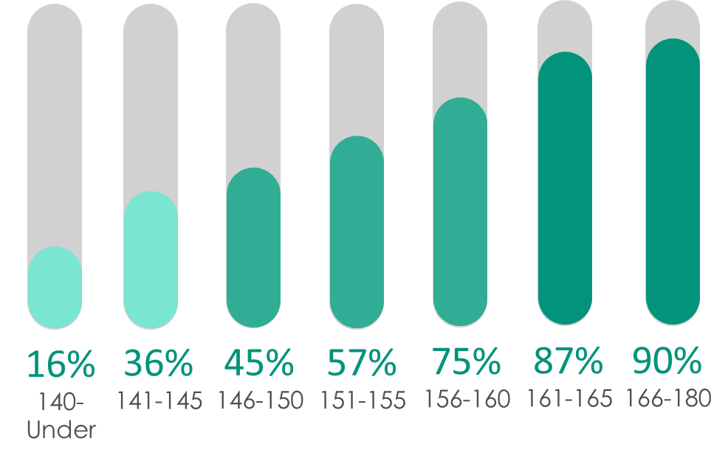
The Role of the LSAT
Ninety percent of respondents with LSAT scores above 165 received merit scholarships, compared to 16% of respondents with scores of 140 or below.

Slide 20
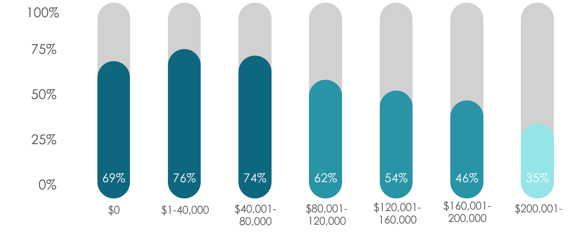
Receipt of a Merit Scholarship was Associated with Lower Levels of Debt
Respondents expecting $80,000 in debt or less were more than twice as likely to have received a merit scholarship than those expecting debt of $200,000 or more.

Slide 21
Law School Debt

Slide 22
Need/Merit Aid Options
How much money at your institution is designated for need-based aid?
How much money is designated at your institution for merit-based aid?
How are do underrepresented students fare with respect to need/merit-based aid?
Do underrepresented students receive merit-based aid at comparable rates as their majority peers?
Are substantially more funds designated for merit aid as opposed to need and if so, what disparate impact does that have on underrepresented students?
Are tuition-discounting practices at your institution ultimately resulting in underrepresented students paying full-price while higher-profile students receive substantial scholarship funds?
Are merit scholarships being determined in significant part based on LSAT scores and to a slightly lesser extent UGPA profiles?

Slide 23
Rethinking need and merit aid

Slide 24
Increase Transparency: Need/Merit Aid
Timing
Types of Aid that are available
Process to request/receive aid

Slide 25
Merit Based vs. Need Based Aid
“A common tension is created when determining allotments of merit versus need-based funding. These allotments are fundamental expressions of priorities, and they provide templates for determining the eventual recipients of scholarship funds.”- LSSSE 2016 Annual Report
Merit scholarship funding makes up the bulk of law school scholarship budgets.
A potential solution is to increase the rates of need-based scholarships

Slide 26
Increase Need Based Aid
LSSSE 2016 Annual Report
A common tension is created when determining allotments of merit versus need-based funding. These allotments are fundamental expressions of priorities, and they provide templates for determining the eventual recipients of scholarship funds.
Merit scholarship funding makes up the bulk of law school scholarship budgets.

Slide 27
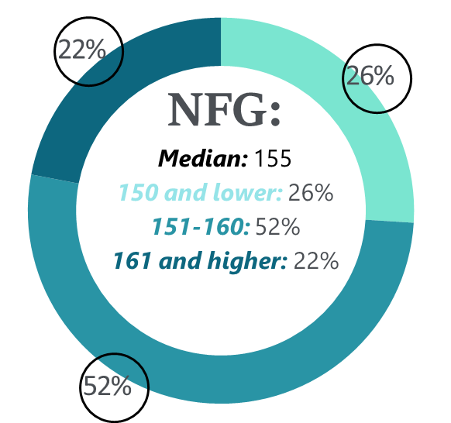
Increase Need Based Aid
10%
12%
43%
FG-HS:
Median: 152
150 and lower: 43%
151-160: 47%
161 and higher: 10%
FG-SC:
Median: 152
150 and lower: 37%
151-160: 51%
161 and higher: 12%
37%
47%
51%
LSAT Score Distribution
By Parental Education

Slide 28
Re-Define Merit
Merit Aid is given most commonly to students with high LSAT scores/UGPA profiles.
2016 LSSSE Report
“Merit scholarships tend to be awarded through equality frameworks, in which similar criteria are applied to all applicants. These criteria most often revolve around standardized test scores and other factors that track closely to non-merit indicators, such as socioeconomic status. In the end, wealth and privilege become proxies for merit, a conflation that results in financial windfalls and further advantages for applicants least in need of such assistance.”

Slide 29
Schultz-Zedeck Factors

Slide 30
Re-Define Merit
Examine the criteria utilized to determine merit.
Incorporate other factors
Leadership skills/opportunities
Networking abilities
Overcoming Adversity
Work ethic
Work Experience

Slide 31
Questions / Comments

Slide 32
Contact Info
Nancy Conneely nconneely@accesslex.org
Rachel Patterson rpatterson@accesslex.org

