Slide 1
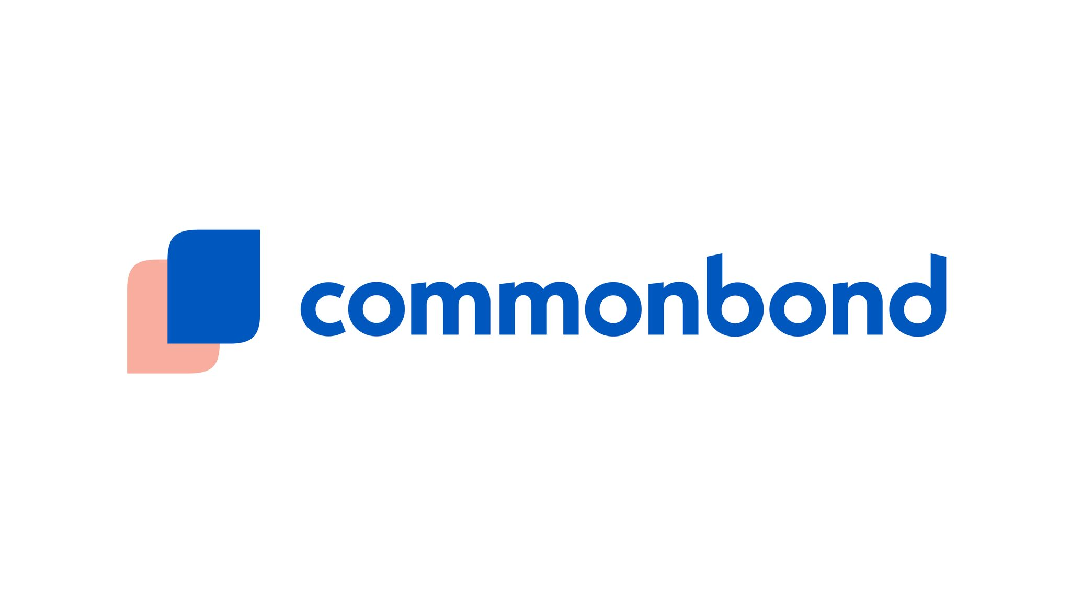
Student Refi 101
A money-saving guide to assisting your students with loan repayment.
Julie Moreno Rehder
Pete Wylie

Slide 3
About CommonBond
Leading technology-enabled lender focused on transforming consumer finance
Key Highlights
More than $1.5B funded to date
$1.5B+ in student loan originations
20,000+ millennial customers
Raised more than $2.5B in committed capital
175+ corporate partners
Lowest defaults in industry
“AAA” rating from S&P & DBRS
1:1 Social Mission: Pencils of Promise
9x Growth

Slide 4
How We Help Students Save
CommonBond Solution
B2C (Refinance and In-School)
Focused on prime credit borrowers
Saving borrowers real money
~$24,000 on refinance loans
~$20,000 on in-school loans
B2B ( )
Platform enables employees to evaluate, manage & reduce student debt
Accelerates origination volumes
Lending (B2C)
Saas Technology (B2B)
Revenue $
Refinance
In-School
Evaluation
Contribution
Origination $

Slide 6
Agenda
Loan repayment options
What is student loan refinancing?
What repayment method is right for students?

Slide 7
The impact of student debt
7 of 10 millennials graduate college with $37,000 in student debt¹

Slide 8
Average student debt by degree
$35k
$57k
$56k
$112k
$176k
$247k
$250K
$200K
$150K
$100K
$50K
$0K
Undergraduate
Graduate
MBA
JD
MD
DDS

Slide 9
Options for Paying off Student Loans

Slide 10
Choice of employer has a large impact on the appropriate method of loan repayment

Slide 11
Working for a non-profit employer
Options for Federal Loans:
Income-driven repayment plans
Public service loan forgiveness
For Private Loans:
Student loan refinancing

Slide 12
Working for a for-profit employer
Options for Federal loans:
Income-driven repayment plans
Standard repayment plans
Student loan refinancing
For Private Loans:
Student loan refinancing

Slide 13
Repayment Options for Federal Loans
Income-driven repayment plans
Your monthly payment is capped at a certain percentage of your income
May be a good plan for those with a lower income who wouldn’t be able to afford standard monthly payments
Pro: Keeps monthly payment low
Con: Increases total cost of the loan
Use these plans if pursuing PSLF

Slide 14
Repayment Options for Federal Loans – Income Driven Plans
 | Revised Pay As You Earn Repayment Plan (REPAYE) | Pay As You Earn Repayment Plan (PAYE) | Income Based Repayment (IBR) | Income Contingent Repayment (ICR)
Eligibility | Direct Loan borrowers | Direct Loan borrowers | Direct Loan and FFEL borrowers | Direct Loan borrowers (only plan for Parent PLUS loans)
Monthly payment | 10% of discretionary income | 10% of discretionary income | 10% of discretionary income if you borrowed on or after 7/1/14, or 15% if older | 20% of discretionary income or what you would pay on a 12 year fixed plan adjusted for income
Repayment period (remaining balance is forgiven after this time) | 20 years for undergrad loans, 25 years for grad or professional loans TAXABLE | 20 years TAXABLE | 20 years if you borrowed on or after 7/1/14, or 25 years if older TAXABLE | 25 years TAXABLE
Income requirement to enter plan | None | Your income must be low compared to your eligible federal student loan debt | Your income must be low compared to your eligible federal student loan debt | None

Slide 15
Repayment Options for Federal Loans
Standard repayment plans
Repay your loan in full in 10-25 years based on type of loan
Pro: Lower overall cost than income-driven plans
Con: Higher monthly payment than income-driven plans

Slide 16
Repayment Options for Federal Loans - Standard repayment plans
 | Standard Repayment | Graduated Repayment | Extended Repayment
Repayment period | Pay off your loan in 10 years | Pay off your loan in 10 years | Pay off your loan in 25 years
Monthly payment | Same payment each month | Payments start low and go up every 2 years | Can be fixed or graduated
Benefits | Save money on interest vs. longer plans | Save now while your income is low and pay more when your income can handle it | Generally lower monthly payments then any other plan
Drawbacks | Highest monthly payments | You’re betting on making more money later | Highest total cost No forgiveness

Slide 17
Repayment Options for Federal Loans
Forbearance
You can put your federal loans in forbearance, which pauses repayment completely
Interest will continue to accrue and will be capitalized at the end of the forbearance period
You can do this for up to 12 months at a time
Increases total cost of the loan

Slide 18
Repayment Options for Federal Loans
The Public Service Loan Forgiveness Program (PSLF) | Forgives the remaining balance on your Direct Loans after you’ve made 120 qualifying monthly payments under a qualifying repayment plan, while working full-time for a qualifying employer.

Slide 19
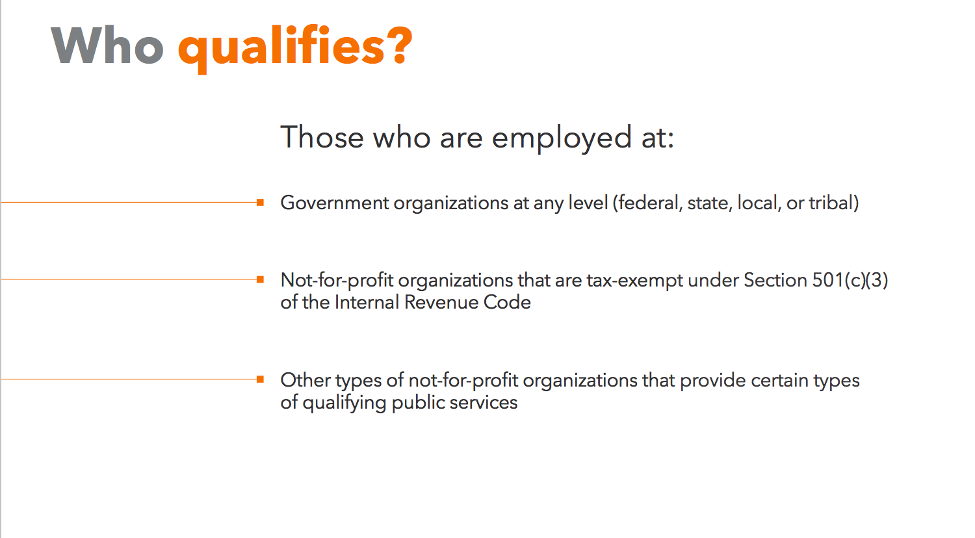
Public Service Loan Forgiveness

Slide 20
What about refinancing those student loans?

Slide 21
What is student loan refinancing?
Refinancing means taking out a new loan to
replace an existing loan
Lenders pay off existing loans, and create a new loan at a lower interest rate
Borrowers can refinance federal, private, Parent Plus and previously consolidated student loans

Slide 22
What are the benefits of refinancing?

Slide 23
Refinancing helps your students save by giving them a tailored interest rate that is often lower than the rate on their existing loans.

Slide 24
Savings
Lower interest over the life of the loan
Ease
One lower
monthly payment
Protections
Borrowers can defer payments if they return to school or lose their job
No Fees

Slide 25
How do I know if refinancing is right
for my students?

Slide 26
When it’s right
When it’s wrong
Student should not be in an existing IBR program due to income or debt load
Student has private loans that aren’t eligible for govt. programs
Student meets refinancing criteria
Student wants to pay off debt quickly and reduce interest costs
Student did not graduate from a 4 year, Title IV school with a Bachelors degree or higher
Student works for non-profit that would be eligible for PSLF
Student has a low income compared to their student loan debt
Student has low interest rate loans

Slide 27
Refinancing criteria
Credit
660+ FICO
No derogatory credit
Cosigner if needed
Income
Strong free cash flow
Solid DTI
School
US Non-profit
4 year undergrad or grad program
Country
US Citizen or perm resident
US SL debt

Slide 28
Refinancing specifics
Terms
5, 7, 10, 15, 20 years
Fixed, Variable, Hybrid
Rates
2.57% - 7.25% (V)
3.20% - 7.25% (F)
Protections
Deferment
Forbearance
Death & disability
Types
Private, Federal or consolidated

Slide 29
Let’s compare
Benefits | Refinancing Benefits | Keeping federal student loans
Save with a lower interest rate | ✓
Consolidate into one monthly payment | ✓ | ✓
Discharge your obligation in the event of death or disability | ✓ | ✓
Add a co-signer to potentially reduce your rate | ✓
Take advantage of income-driven repayment |  | ✓
Use public service loan forgiveness |  | ✓

Slide 30
Illustrative
When it’s right
Erica’s Profile
Profession: Investment Banking Associate
Employer: Goldman Sachs
Loan Amount: $85,000
Annual Income: $250,000
 | APR | Monthly Payment | Overall Payment
Fed Gov’t Grad PLUS 10-Year Loan | 6.84%⁴ | $980⁵ | $117,591
Income-Based Repayment 20-Year Term | Does not qualify.
CommonBond 10-Year Loan | 4.65%⁶ | $887⁷ | $106,450

Slide 31
When it’s wrong
Illustrative
Danny’s Profile
Employer: Robertwood Johnson Hospital
Loan Amount: $300,000
Profession: MD, Infectious Disease Specialist Residency: $55K; Fellowship: $70K; Practicing Physician: $120K
 | APR | Monthly Payment | Total Payment
Fed Gov’t Grad PLUS 10-Year Loan | 6.84%⁴ | $3,459⁸ | $415,028
Income-Based Repayment 20-Year Term | N/A | Residency: $258⁹ Fellowship: $383⁹ Practicing Physician: $800⁹ | $321,574¹⁰
CommonBond 10-Year Loan | 4.65%¹¹ | $3,131¹² | $375,707
IBR total payment based on total paid by borrower over 20 years plus taxes paid on net present value of amount forgiven.
IBR can save Danny $93,454 vs. the Federal Government 10-Year Loan and $54,133 vs. the CommonBond 10-Year Loan.

Slide 32
A note on refinancing Parent Plus Loans
If a parent has received a Bachelors degree or higher and they want to refinance a Parent Plus loan, they can either refinance the Parent Plus loan in their name or transfer it to their graduated child.
If the parent has not received a Bachelors degree or higher and they want to refinance a Parent Plus loan, they can transfer the loan to their graduated child in order to refinance it.

Slide 33
Thank you!
Julie Moreno Rehder
Account Manager, School Relations
Julie.moreno@commonbond.co

