Slide 1
Clock Hour Basics – Administering Title IV Programs
Presented by Robin Hall, Director of Financial Aid and Budget
- Reading Hospital School of Health Sciences

Slide 2
Session Agenda
Program Eligibility
Defining a Clock Hour
Defining an Academic year
Defining/Determining Payment periods
Payment Period Disbursements
Return to Title IV Calculations
Other Considerations
Resources
Q & A

Slide 3
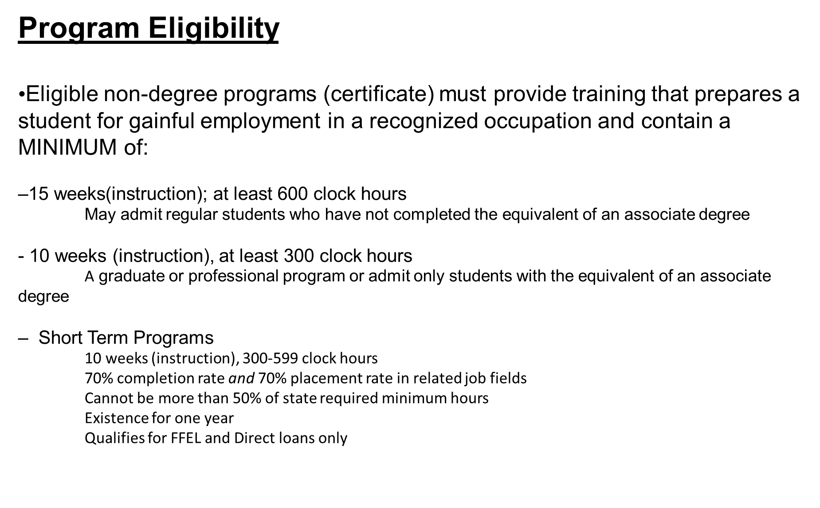

Slide 4
Defining a Clock Hour
A Clock hour is a period of time consisting of –
A 50 to 60-minute class, lecture, or recitation in a 60-minute period;
(2) A 50 to 60-minute faculty supervised laboratory, shop training, or internship in a 60-minute period;
(3) Sixty minutes of preparation in a correspondence course
Note 1: A clock hour is based on an actual hour of attendance, though each hour may include a 10-minute break. Outside work does not count in the number of clock hours.
Note 2: May not schedule several hours of instruction without breaks and then count clock hours in 50 minute increments.

Slide 5
Defining an Academic Year
• Must be defined for each eligible program
• May be the same for all programs
• May be different for some or all programs – credit and clock hour programs will have different academic years
• Must contain at least 900 clock hours and 26 weeks of instructional time
A week of instructional time is any 7 consecutive days in which at least one day of instruction occurs; Need not correspond to a “calendar” week

Slide 6
Defining the Academic Year (cont’d)
• A program may be shorter than, equal to, or longer than the defined academic year
EX. 600-, 900-, and 1300-hour programs could all have an academic year of 900 clock hours/30 weeks, or
1050 clock-hour/35-week program could have an AY definition equal to the program
( Receive one annual Pell and one annual loan for program)
• The Academic year (AY) determines the period of time for which Title IV aid will be awarded and disbursed
• Does NOT always correspond to a school’s scheduled academic calendar

Slide 7
Academic Year examples -
•Program is 1200 clock hours and 40 weeks
– If Academic year is defined as 900 hours and 30 weeks
First AY is 900 hours and 30 weeks
Second AY contains 300 hours and 10 weeks
– If Academic year is defined as 1200 hours and 40 weeks

Slide 8
Defining the Academic Year (Cont’d)
• Full-time for an undergraduate clock-hour program must be at least 24 clock hours a week
• Half-time must be at least 12 clock hours per week
(needed for loan eligibility)
• Reminder: weekly attendance schedule impacts academic year definition
• A student attending 24 hours per week will complete 900 hours in 37.5 weeks
• A student attending 30 hours per week will complete 900 hours in 30 weeks
• A student attending 35 hours per week will complete 900 hours in 26 weeks
6

Slide 9
Defining Payment Periods
• Schools cannot create more payment periods for a program than what is specified in the regulations
For Title IV purposes, there are NO terms for clock hour programs! Clock hour payment periods may not (and most likely won’t ) line up with terms defined for credit hour programs)
Based on the Academic year definition of the program and the defined length of the program, in clock hours and weeks of instructional time; there is a two payment period limit in an academic year or program
There are specific rules/guidelines for:
1. Programs equal to or shorter than an academic year, in either clock hours or weeks
2. Programs longer than an academic year

Slide 10
Defining Payment Periods (cont’d)
1. Programs equal to or shorter than an academic year (900 hours)
• Divide the program/academic year in half
• First payment period equals half the clock hours and half the weeks
• Second payment period equals the other half of the clock hours and weeks
Ex.1: Program of 900 clock hours and 30 weeks will have two payment
periods of 450 clock hours and 15 weeks
Ex.2: Program of 750 clock hours and 24 weeks will have two payment periods of 375 clock hours and 12 weeks

Slide 11
Defining Payment Periods (cont’d)
2. Programs longer than an academic year with remaining period equal to or less than half an academic year
• Use rule for one academic year for each full academic year in the
program
• Final portion is one payment period with remaining clock hours and
weeks
Program: 1230 clock hours/41 weeks; AY 900 hours/30 weeks
PP1: 450 hrs/15 wks
PP2: 450 hrs/15 wks
PP3: 330 hrs/11 wks
Program: 1050 clock hours/42 weeks; AY 900 hours/36 weeks
PP1: 450 hrs/18 wks
PP2: 450 hrs/18 wks
PP3: 150 hrs/6 wks

Slide 12
Defining Payment Periods (cont’d)
2.5. Programs longer than an academic year with remaining period greater than half an academic year
• Use rule for one academic year for each full academic year in the
program
• Remaining portion is divided into two equal payment periods, each with 1/2 the remaining hours/weeks
Program: 1600 clock hours/46 weeks; AY 900 hours/26 weeks
AY 1 PP1: 450 hrs/13 wks
PP2: 450 hrs/13 wks
AY 2 PP3: 350 hrs/10 wks
PP4: 350 hrs/10 wks

Slide 13
Defining Payment Periods (cont’d)
These rules for defining lengths of payment periods do not change based on conditions such as
• Student progress through the program
• The award year in which the payment period falls
However, there are two exceptions…….

Slide 14
Defining Payment Periods (cont’d)
Exception #1: Transfer students
If you accept transfer hours, the hours/weeks remaining for the student to complete the program at your school make up the program length, and payment periods are defined accordingly
Ex. Student transfers 300 hours into an 1170 hour program; this leaves 870 hours remaining. Program will be treated as one shorter than an academic year and will have two payment periods, each with 435 hours and the number of weeks to complete those hours
Exception #2 – Second Year loans
If program is longer than an academic year, the 2nd year loan must be prorated by the hours the student has remaining to complete at the end of the first academic year
Ex. Student enrolled in a 1650 hour program ( AY=900 hrs) and attended more hours than scheduled so at the end of the first AY in weeks, student had actually completed 1000 hours rather than 900. The Year 2 loan would be prorated based on the remaining 650 hours.
- payment periods would be determined according to normal rules, in this case, 325 hour payment periods

Slide 15
Defining Payment Periods (cont’d)
A payment period ends only when an individual student successfully completes the clock hours AND the weeks in the payment period
– “Successfully completes” means the student has attended and passed the coursework associated with the clock hours/weeks in the payment period
– Students may complete payment periods at different times, for instance, due to absences or failing coursework

Slide 16
Payment Period Disbursements Do’s and Don’ts:
As with term-based programs, you may make the first disbursement up to 10 days prior to the first
day of the first payment period
• Subsequent disbursements cannot be made until the student successfully completes the clock
hours and the weeks in the previous payment period
• Cannot choose to have more payment periods than those defined in regulation
• Can make multiple installments of a disbursement within a payment
period to best meet needs of the student; however, does not create
more payment periods, nor does it change amount student is eligible to
receive for the payment period
• Cannot delay making disbursement until the student has completed at least 60% of the payment period in order to avoid having to return funds from an R2T4 calculation

Slide 17
Payment Period Disbursement Do’s and Don’ts:
Student cannot be paid to repeat clock hours in same program
• Student will NEVER be paid Title IV aid for more than the clock hours that make up the official program since the student cannot receive next disbursement until successfully completes the clock hours and weeks in payment period.
• Exceptions:
• If a student completes a program of study and retakes the entire program over again OR if the student withdraws and returns after 180 days into the same program of study. The student is then considered to have begun a new program ( though previous hours earned would still be factored into SAP). The student begins a new payment period upon re-entry or transfer. The remaining portion of program is treated as the length of entire program for awarding Title IV funds.

Slide 18
Payment Period Disbursements - Loans
• Clock hour programs must use borrower-based Academic year (BBAY) for all students
BBAY is usually equal to the academic year, unless
Program is shorter than an academic year
Remaining portion is shorter than an academic year
( Loans must be pro-rated in both cases)
Student must be enrolled at least half-time for loan eligibility ( 12 clock hours/week)
For programs longer than an academic year, the student becomes eligible for Grade level 2 annual loan amounts after successfully completing the first academic year in weeks AND clock hours
Annual loan amount is divided into 2 equal disbursements and disbursed in each payment period
-same criteria as Pell payment periods
- at least one disbursement must be made in each payment period

Slide 19
Payment Period Disbursements - Loans
• Loans must be prorated in two instances:
1. When program is shorter than an academic year –
Annual loan amount is prorated by the lesser of clock hours in program/clock hours in academic year OR weeks in program/weeks in academic year
2. When remaining portion is shorter than an academic year –
Annual loan amount prorated by clock hours remaining/clock hours in academic year; no comparison with weeks is required
Clock hours remaining are those that the student has left to complete at the end of the first academic year.

Slide 20
Payment Period Disbursements - Pell
• Always use Pell Formula 4 for clock-hour/credit-hour non-term programs
Pell Cost of Attendance – always use the cost for a full-time student for a full academic year ( as you define it)
Unlike credit hour programs that have different payment charts based on enrollment status ( FT, HT, etc.), you will ALWAYS use the full-time Pell payment chart for clock hour programs, even if a student is attending on a “part-time” schedule ( ex. night classes) to determine the student’s annual award
The annual award will always equal the scheduled award

Slide 21
Payment Period Disbursements (cont’d)–
Crossover Payment Periods:
• Defined as any payment period that begins prior to July 1 and ends on/after July 1
• Process for defining length of payment periods DOES NOT CHANGE if the program or payment period crosses over award years
• Number and length of payment periods as originally determined remain the same even when payment periods fall into different award years
Must pay the full Pell disbursement from ONE award year; school may assign disbursement to either award year on an individual student basis.

Slide 22
Return to Title IV Calculations
• Aid is awarded under the assumption that the student will attend school for the entire period for which the aid is awarded
For a clock hour program, a student is a withdrawal if the student does not complete all scheduled clock hours/weeks of instructional time. When a student withdraws, the student may not be eligible for the full amount disbursed or scheduled to receive.
The student earns Title IV aid through attendance; R2T4 requirements apply to any recipient who withdraws during a payment period or period of enrollment in which the student began attendance
The percentage of aid earned is equal to the percentage of the payment period or period of enrollment completed; when the student completes more than 60% of the payment period or period of enrollment, the student has earned 100% of the scheduled Title IV funds
If the student never commences attendance for the period, the student is not an eligible Title IV recipient
R2T4 does not apply
All aid must be returned

Slide 23
Return to Title IV Calculations (Cont’d)
• The institution calculates the percentage of the period that the student was scheduled to complete upon withdrawal
Numerator = number of clock hours the student was scheduled to complete in the payment period or period of enrollment as of the student’s LDA ( last date of attendance)
Denominator = total clock hours in the payment period or period of enrollment
The student must actually start a payment period to be considered in that payment period
Schools that are required to measure the clock hours that a student completes in a program are considered to be institutions that are required to take attendance for R2T4 purposes.
Withdrawal Date – determines the percentage of Title IV aid earned; the Withdrawal date is the LDA
Date of Determination – starts the clock ticking for doing the calculation, returning funds, and providing timely notifications to the student; the DOD cannot be more than 14 days after the Withdrawal date (LDA)

Slide 24
Other Considerations -
Excused Absences – (optional)
• Separate from attendance and SAP policies
• Written policy permitting excused absences
• An absence that a student does not have to make up
• Excused absences cannot exceed the lesser of:
• Accrediting agency policy on excused absences
• State licensing agency policy on excused absences OR
• 10% of the clock hours in a payment period
• Example - 45 hours in a 450 clock-hour payment period can be counted as
excused absences (count as completed hours)

Slide 25
Other Considerations -
Approved Leave of Absence (LOA) –
• School must have a formal written LOA policy
• Student must request LOA in writing
• School has a reasonable expectation that student will return
• No additional charges are imposed during or because of the leave
Leaves of Absence cannot exceed 180 days in any 12 month period
Upon completion of leave, student is allowed to complete the coursework started prior to leave
An Approved LOA is NOT considered a withdrawal unless the student fails to return from leave
If the student is a Title IV recipient, the school must explain the effect the failure to return from the LOA has on loan repayment

Slide 26
Other Considerations -
Approved Leave of Absence (LOA) cont’d–
• If the student fails to return from the LOA –
1. the Withdrawal date reverts back to the last date of attendance (LDA) prior to the LOA
2. the student’s loan grace period starts retroactively back to the Withdrawal date
3. an R2T4 calculation must be done

Slide 27
Resources:-
Understanding Clock Hours : “Back to the Basics” from the FASFAA Clock Hour Workshop, 10/25-10/27, 2016 presented by David Bartnicki
Return to Title IV Funds – Clock Hour Programs from the SASFAA Annual Conference, February 2018, presented by David Bartnicki
FSA Handbook - Volumes 3,5
NASFAA ASKREGS Knowledgebase

Slide 28
Q and A
And a sincere thanks for your attention and participation!

