Slide 1
Verification: Beyond the Basics
Tonya Hsiung
Franklin & Marshall College

Slide 2
Non-Tax Filers for 2017-2018
Per GEN 16-07: Confirmation of Nonfiling
Nontax filers and tax filers who received an extension but still have not filed their income tax return must provide confirmation of nonfiling dated on or after October 1, 2016. A confirmation of nonfiling can be obtained from the IRS using Form 4506-T and checking box 7. If appropriate, a similar confirmation from another taxing authority (e.g., a U.S. territory or a foreign government) is also acceptable.
This means that ALL non-tax filers must obtain the Verification of Non-filing Letter from the IRS
ONLINE REQUEST of NON-FILING LETTER: Individuals who can complete the online registration process on the IRS website will receive a PDF page indicating that the IRS has no record of a tax return being filed for 2015: https://www.irs.gov/Individuals/Get-Transcript
REQUESTING A NON-FILING LETTER: Individuals who are not able to successfully register to use the Get Transcript Online Tool will need to request a Verification of Non-filing letter using the IRS FORM 4506-T by completing and checking BOX 7 on the IRS FORM 4506-T which can be found on the IRS website: https://www.irs.gov/uac/about-form-4506t

Slide 3
Documents to Collect
Federal Tax Return – Form 1040, 1040A, 1040EZ
Schedules
A – Itemized Deductions
B – Interest and Ordinary Dividends
C – Business Income (Sole Proprietorship)
D – Capital Gains and Losses
E – Supplemental Income and Loss (Rental, Partnership, S-Corporation)
F – Profit or Loss from Farming
K-1 for Income from Investments in a Partnership and S-Corporation
W-2 forms
1099 Forms
1099-MISC – miscellaneous income
1099-R –Distributions from Pensions, Annuities, Retirement, or Profit-Sharing Plans, IRAs, Insurance Contracts, etc.
SSA-1099 – Social Security Benefits
Form 8825 – Rental Real Estate – Partnership Form
Form 1065 – Partnership Return
Form 1120S – S- Corporation Return

Slide 4
Tax Filing Status
Single – Line 1
Married, Filing Jointly – Line 2
Married, Filing Separately – Line 3
Head of Household – Line 4
Qualifying Widower with dependent child – Line 5

Slide 5
Interest and Dividend Income Lines 8a, b & 9a, b & Schedules A & B
Did they report assets?
How much in assets did they report?
From where is the interest earned?
From where are the dividends earned?

Slide 6
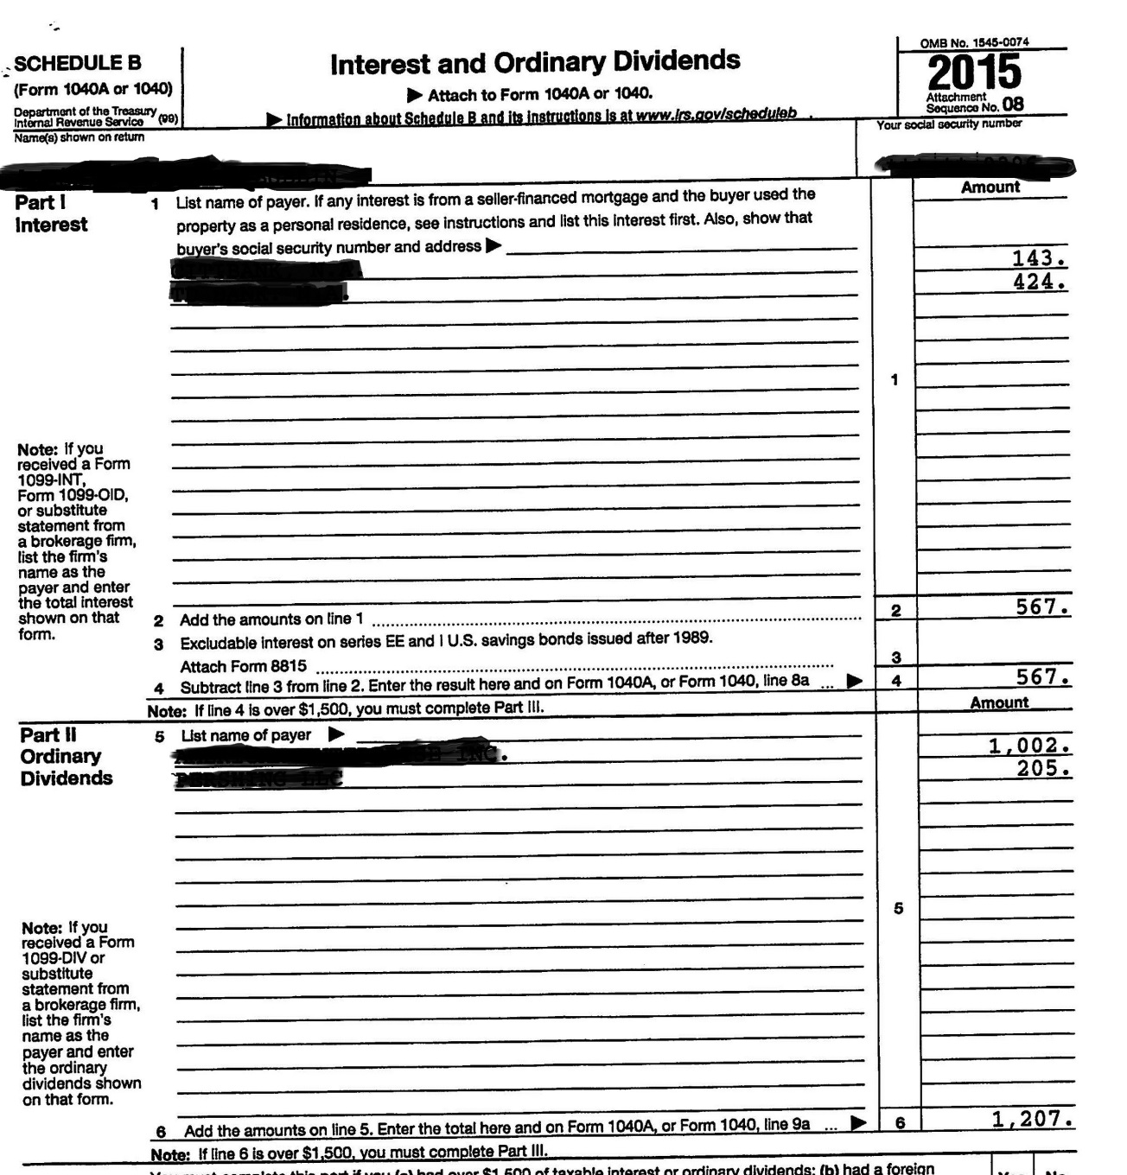
Schedule B
Is the interest earned from Savings Bonds that were cashed in?
Is the interest earned from a family trust?
Are the dividends earned from investments in stocks/bonds?
Are the dividends from their own companies?
Are the dividends from family trusts?

Slide 7
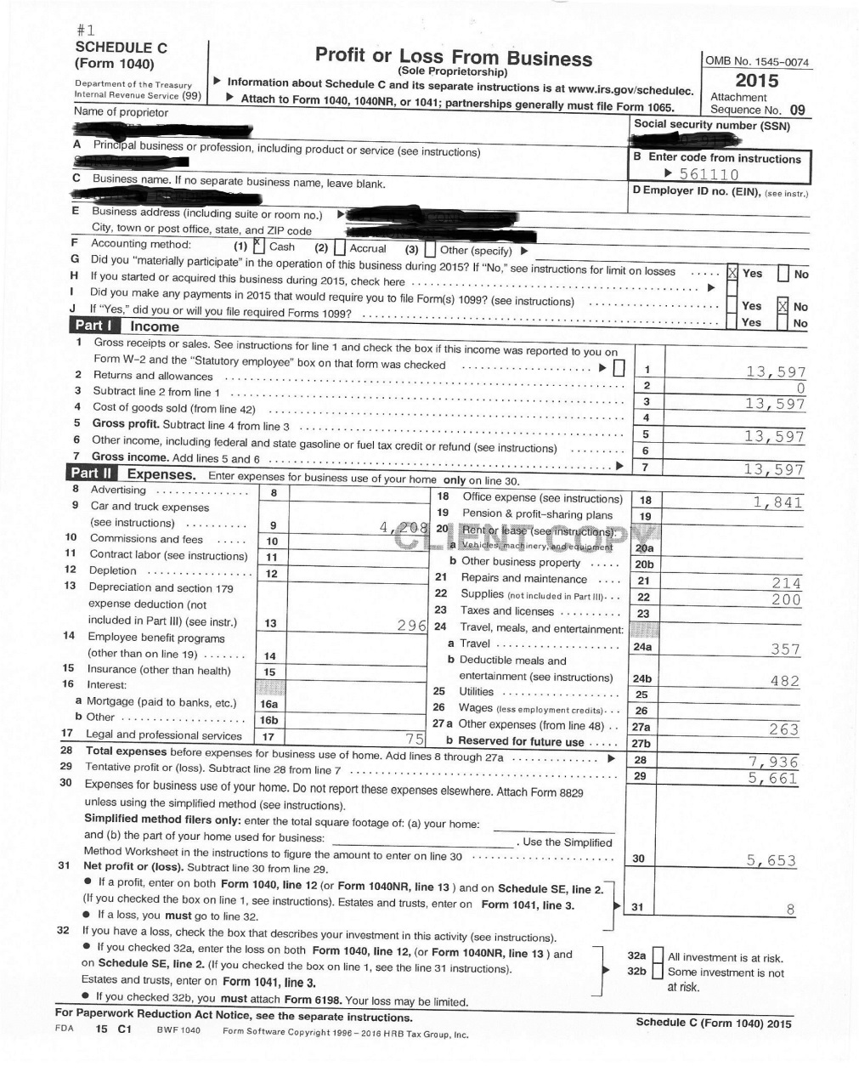
Business Income – Sole Proprietorship Line 12 & Schedule C
What items do you look for in a business?
Car/Truck Expenses
Depreciation
Meals & Entertainment
Wages - to family members?

Slide 8
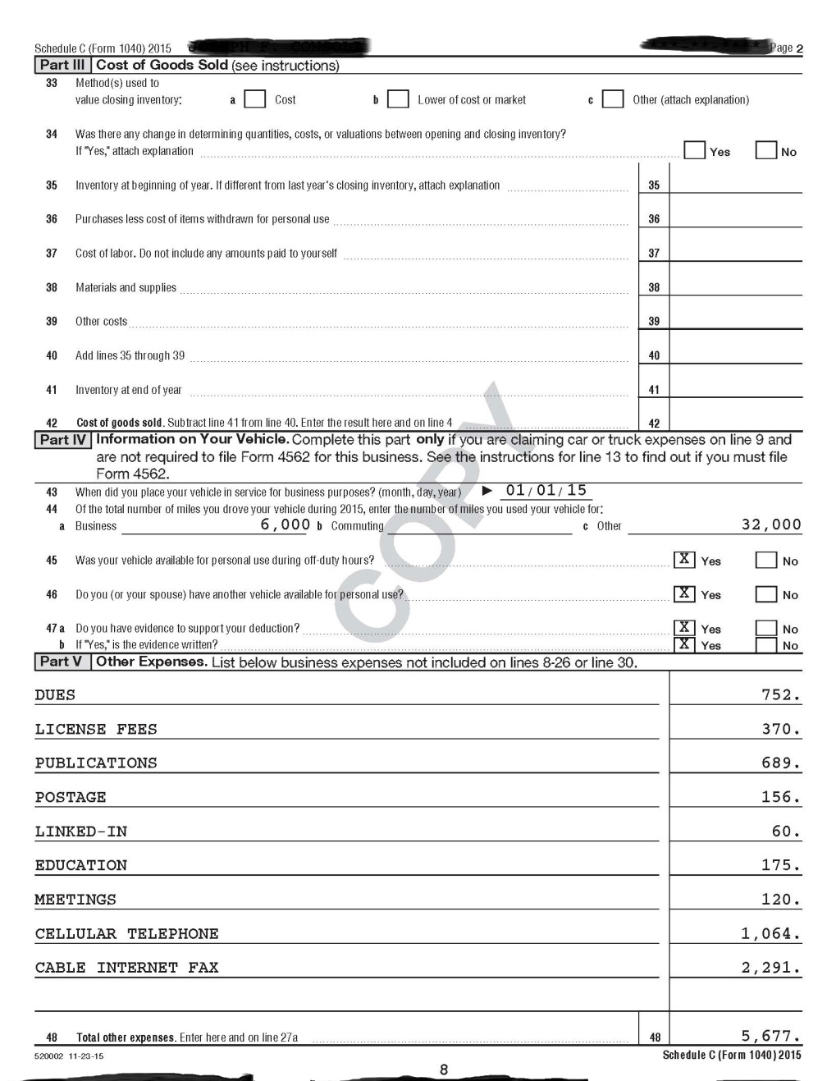
Other Business Write-Offs
Other expenses from Business – do you remove any of these items?

Slide 9
Capital Gains

Slide 10
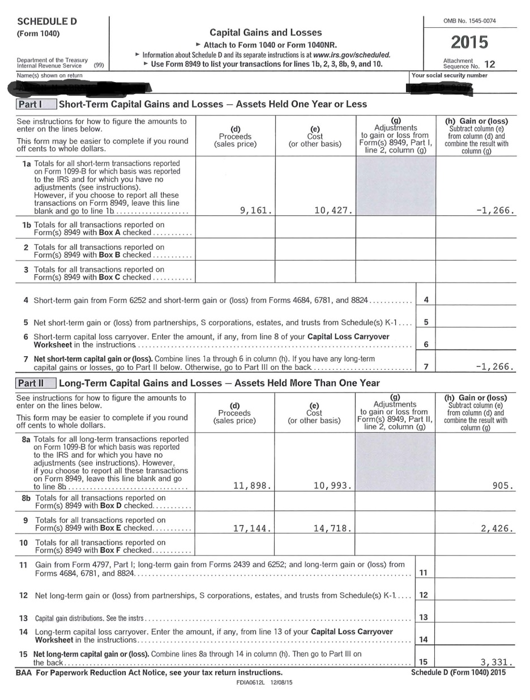
Capital Gains (Losses) Line 13 & Schedule D
From where is the gain/loss
Home
Stocks / investments
Short term vs. long term
Is this a one-time gain?

Slide 11
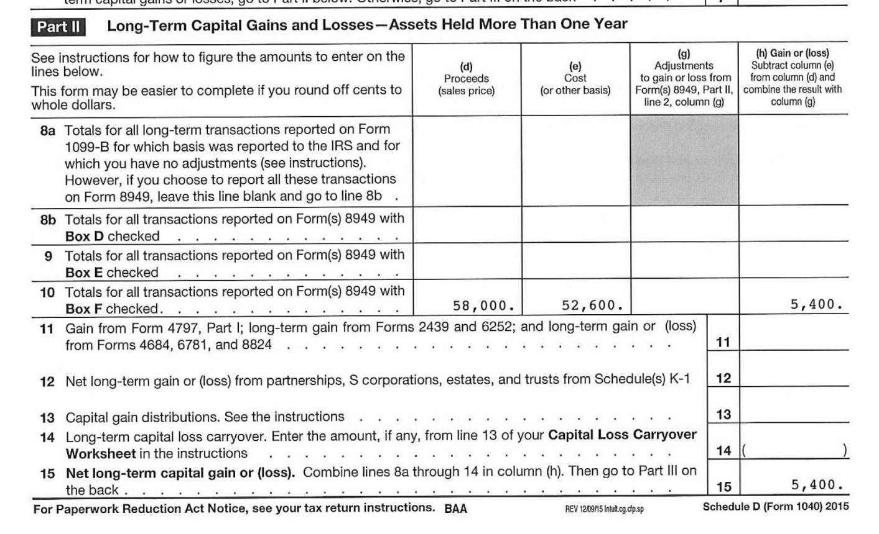
Capital Gains – Professional Judgment
How much were the proceeds?
Where did the proceeds go?
Form 4797 Sales of Business Property may show more information

Slide 12
Capital Gains – PJ - Documentation

Slide 13
IRA Distributions and Pension/Annuities Lines 15a, 15b and 16a, 16b
Questions to ask:
Where are the figures located – in column “a” or the taxable column “b”?
Do you have the tax return or just the transcript or IRS DRT?
Is “ROLLOVER” written on the tax return?
If you only have the transcript or IRS DRT, you do NOT know if this is a rollover…so you MAY get additional documentation (not required, but recommended since this could have a large impact on aid eligibility).

Slide 14
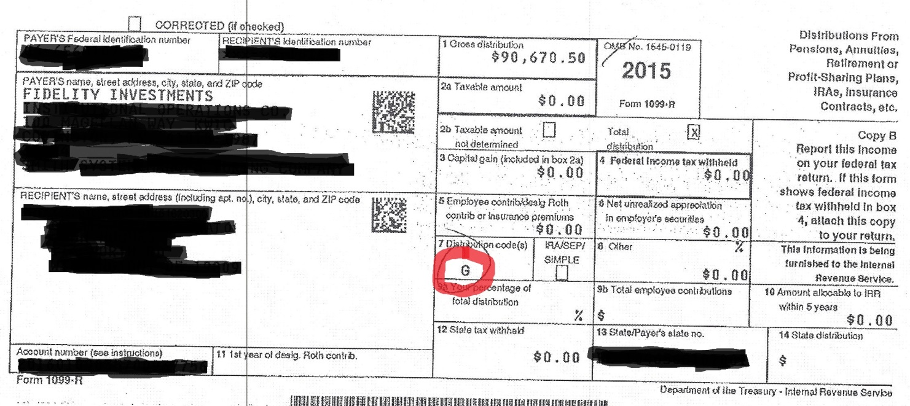
IRA Distributions and Pension/Annuities ROLLOVER - 1099 - R
Acceptable Codes for Rollover:
6: Section 1035 exchange (a tax-free exchange of life insurance, annuity, qualified long-term care insurance, or endowment contracts)
G: Direct rollover of a distribution to a qualified plan H: Direct rollover of a designated Roth account

Slide 15
IRA Distribution / Pensions and Annuities – Professional Judgment
Even if “ROLLOVER” is written on the return – there may be multiple 1099-R forms and not all may be ROLLOVERS. You should collect ALL.
What were the funds used for?
Get an itemized list
Do you pick through the list?
Is this a one time occurrence?

Slide 16
Rental Real Estate and Royalties Line 17 and Schedule E
Rental Real Estate will show on Line 17 as a gain or (loss)
Collect Schedule E for the detail – page 1
There may be multiple copies of page 1 if they have more than 3 properties

Slide 17
Schedule E – Rental Real Estate
Can be from:
Single family residence
Multi-family residence
Vacation/short-term rental
Commercial property
Land
Royalties
Self-rental
Other

Slide 18
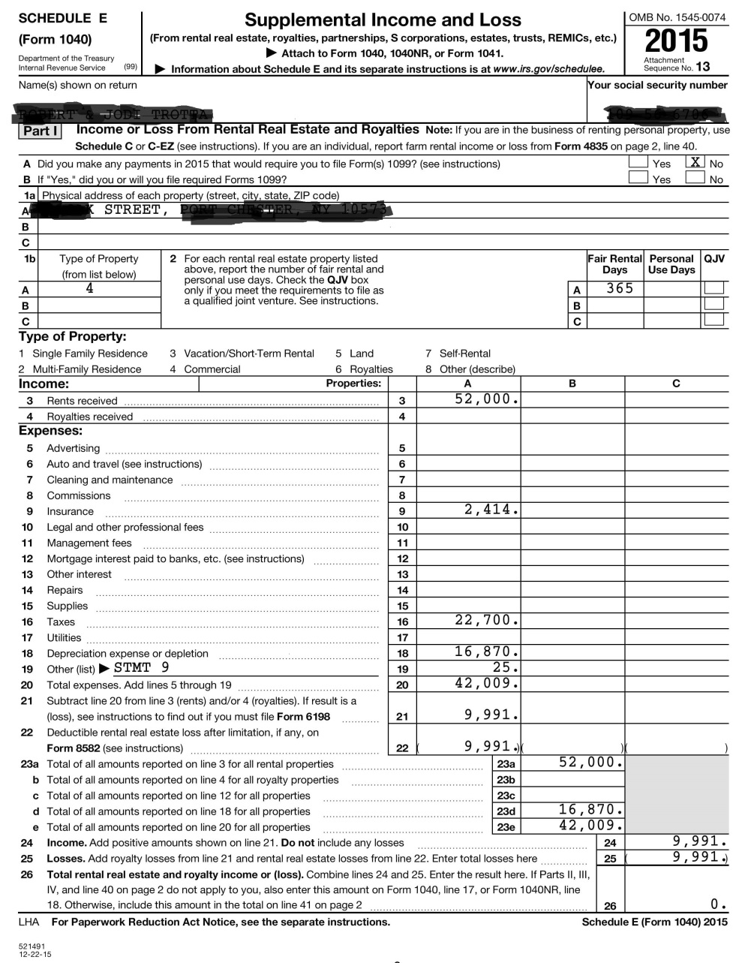
Rental Real Estate
Type of property
Rents received
Mortgage interest – what is the balance of the loan?
Taxes Paid
Depreciation

Slide 19
Schedule E – Rental Real Estate
Single Family Residence
I use http://www.zillow.com to value a property
Multi-family residence
Is it the address in which they reside
Google Earth helps
www.zillow.com
Use Taxes and Line 16 of Schedule E to get percentage
Commercial Properties
http://commercial-real-estate.findthedata.com/
Google Earth
Single member Limited Liability Company (LLC) are not treated as a separate entity for federal income tax purposes in most cases. A sole member of a domestic LLC needs to file a Schedule E (or they can elect to treat it as a corporation instead).
Why is this important? Because we can no longer assume that all properties listed on Schedule E are automatically personally owned. It is possible they are owned by a corporation the parents own.

Slide 20
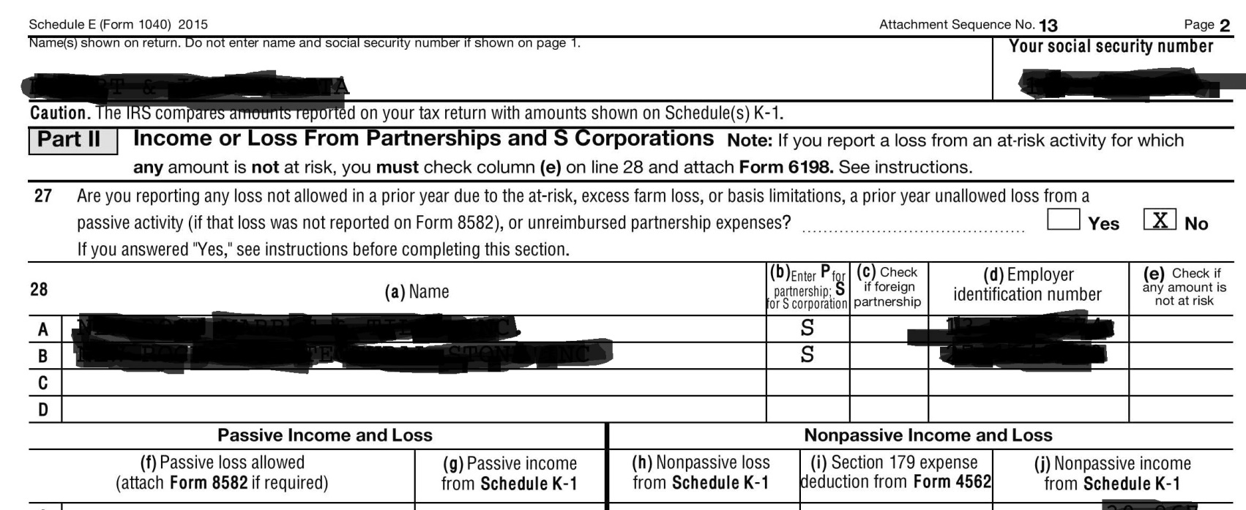
Rental Real Estate is a Corporation?

Slide 21
Commercial Buildings as Assets?
Per NASFAA Ask Regs: Do You Report the Net Worth of a Commercial Building That the Family Owns and the Family Business Rents?
Scenario: We have a situation where the parents are self-employed and own a corporation. They are 100% owners and have less than 100 employees, so the net worth of the business itself does not have to reported on the FAFSA. However, the parents own a commercial building that is in their name. The family corporation pays them rent to lease the building. Answer: The building rented to the business is real estate owned by the parents individually; therefore, it should be reported as an asset on the FAFSA. Additionally, any income or loss from the rental property should have been reported on the parents' tax return using Schedule E and would be reflected in the adjusted gross income (AGI). See the sidebar on page AVG-17 of the 2016-17 FSA Handbook regarding rental properties:

Slide 22
Per the FSA Handbook AVG - 17
Rental properties are an asset. A unit within a family home that has its own entrance, kitchen, and bath (therefore a rented bedroom would not count) and that is rented to someone other than a family member counts as an asset. To calculate its net value, multiply the net value of the entire structure by the fraction the rented space represents. Similarly, if a family owned a 10-unit apartment building and lived in one of the apartments, 9/10 or 90% of the net value of the building would be an asset.
At times a student or parent will claim rental property as a business. Generally, it must be reported as real estate instead. A rental property would have to be part of a formally recognized business to be reported as such, and it usually would provide additional services like regular cleaning, linen, or maid service.

Slide 23
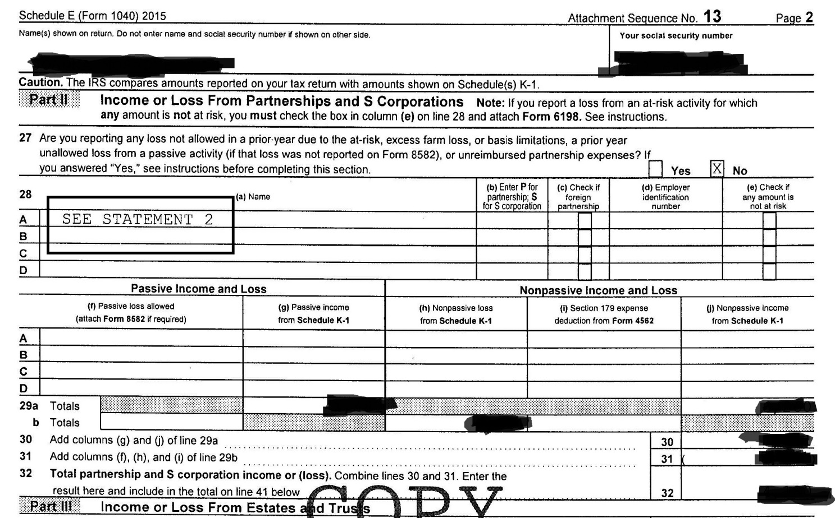
Partnerships Line 17 & Schedule E – Page 2

Slide 24
Partnerships Line 17 & Schedule E – Page 2

Slide 25
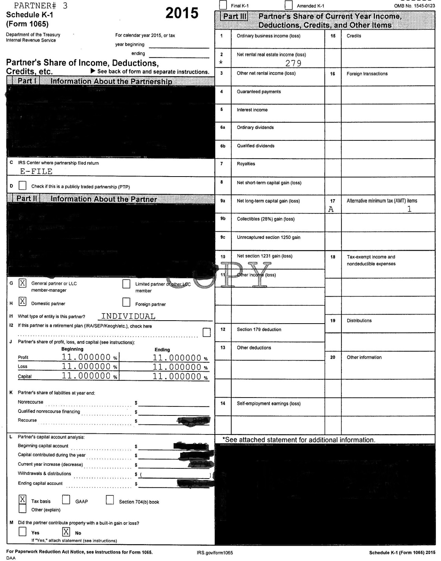
Partnerships Schedule K-1
Is the Partnership a Business or Rental Real Estate
Look at the Schedule K-1
Type of Partnership – Box 2 – net rental real estate income (loss)
Percentage of ownership – under Capital
Self-employment earnings (add to wages)

Slide 26
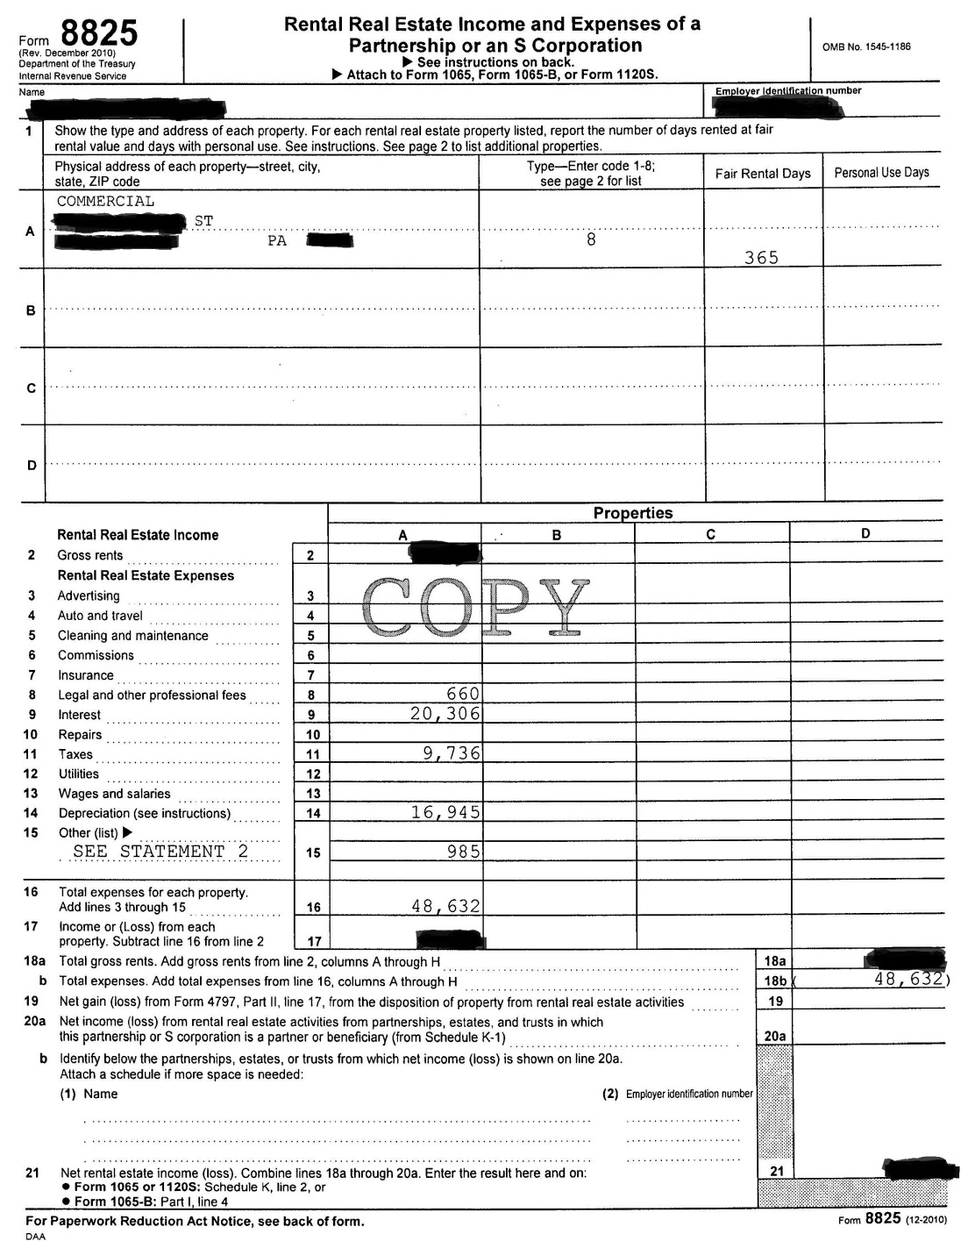
If there is income (loss) in this box, need Form 8825 for more information
The one major thing we look at for all companies and all real estate is DEPRECIATION
Depreciation is considered a “paper loss” and not a real loss.
Per Investopedia: “Depreciation…does not represent real cash flow. Depreciation is an accounting convention that allows a company to write-off the value of an asset over time, but is considered a non-cash transaction.”

Slide 27
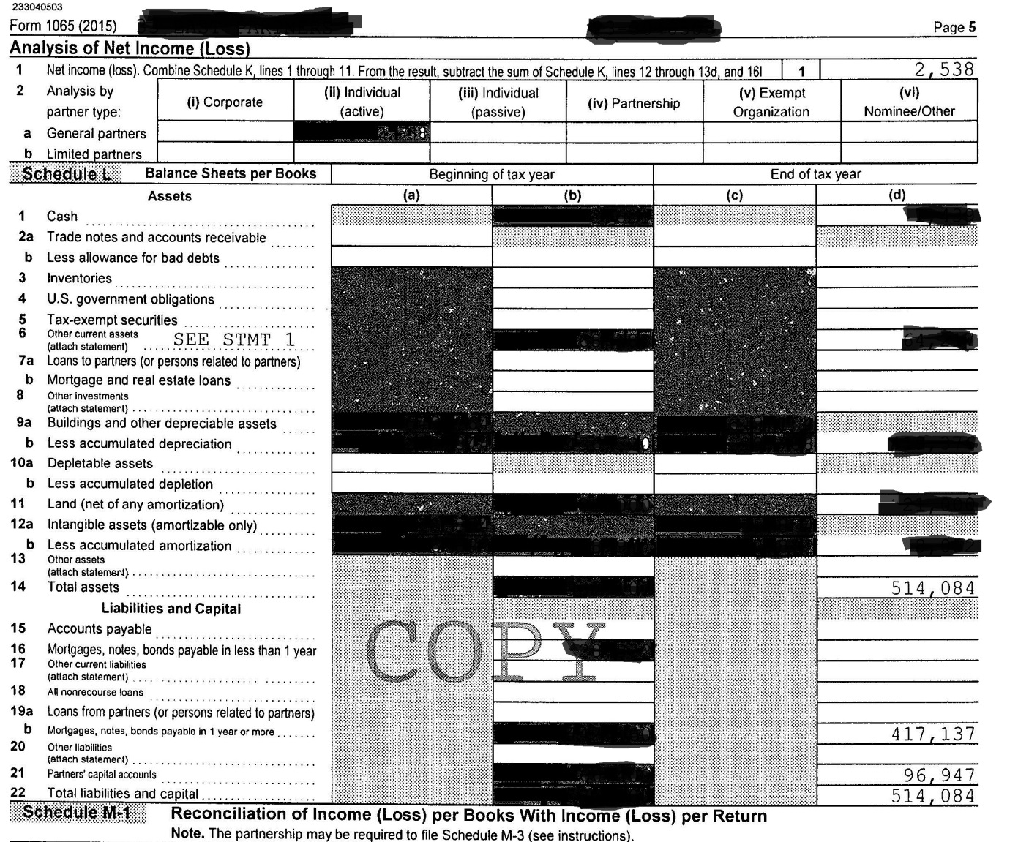
Net Value of Partnerships
Basic Accounting: Assets = Liabilities + Equity
Assets
Liabilities
Equity
Equity (net value)

Slide 28
S-Corporations, Trusts Line 17 & Schedule E Schedule K-1 and Form 1120-S
Date Incorporated
Final Return?
Number of Shareholders
Compensation of Officers
Rents
Depreciation
Other deductions

Slide 29
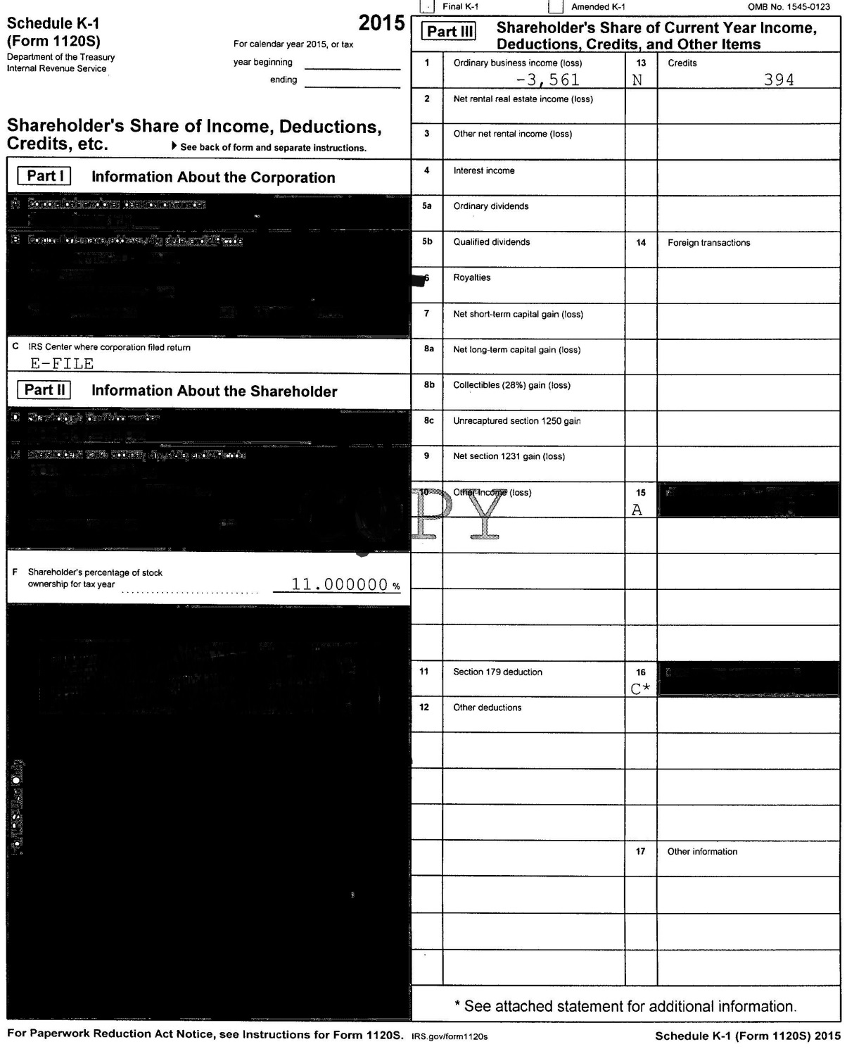
Schedule K-1
Business Income (Loss)
Percentage of Ownership

Slide 30
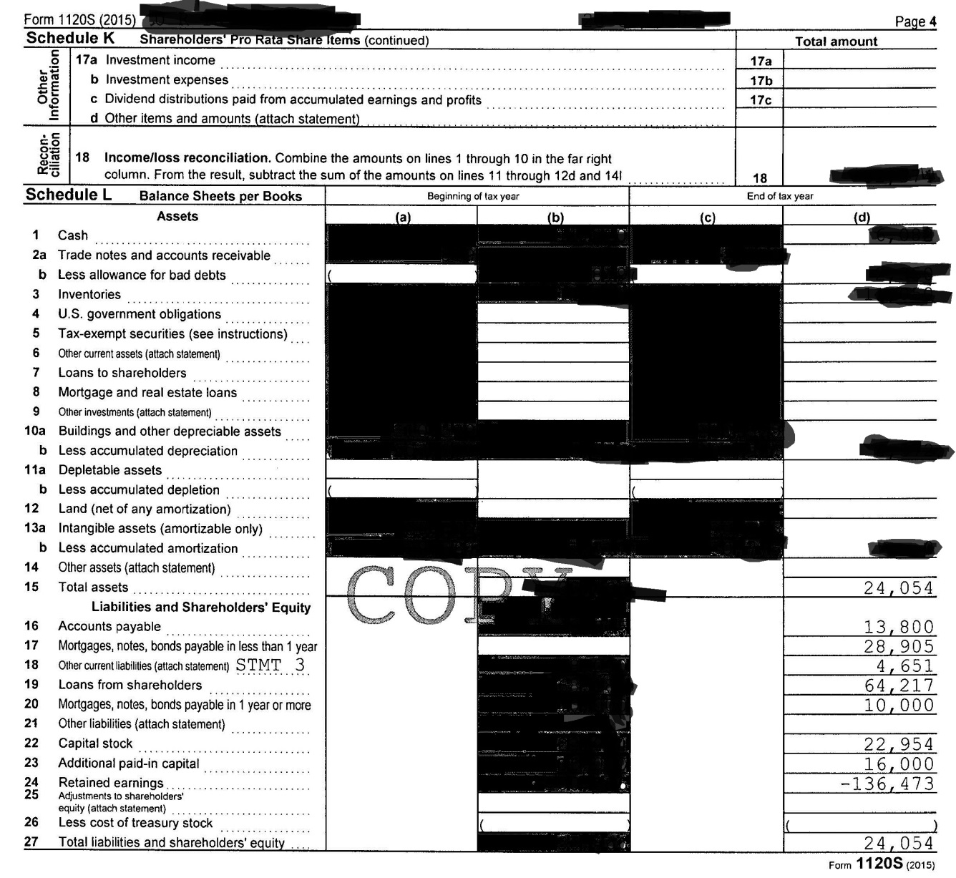
S-Corporation – Form 1120 S
Assets = Liabilities + Equity
Loans from shareholders

Slide 31
Loans from Shareholders
Per NASFAA Ask Regs: If an Applicant is the Sole Shareholder in a Corporation, Should a "Loan from Shareholders" be Reported as an Asset on the FAFSA?
Scenario: A student’s parents own a corporation and are the sole shareholders. The balance sheet of the corporation indicates a $540,000 “loan from shareholders.”
Answer: Yes, the value of the loan should be included in FAFSA Q. 89 as an investment. The FAFSA indicates that investments include (but are not limited to): “…real estate (do not include the home you live in), trust funds, UGMA and UTMA accounts, money markets funds, mutual funds, certificates of deposit, stocks, stock options, bonds, other securities, installment and land sale contracts (including mortgages held, commodities, etc.” Although the parents own the corporation, they have used $540,000.00 of their own money to loan money to a separate entity (their corporation). The fact that the $540,000.00 is a loan implies that the corporation will eventually pay the parents back, further demonstrating that the parents made an investment into their own company.
The FAFSA Q. 90 would not have a bearing on the answer to FAFSA Q. 89.

Slide 32
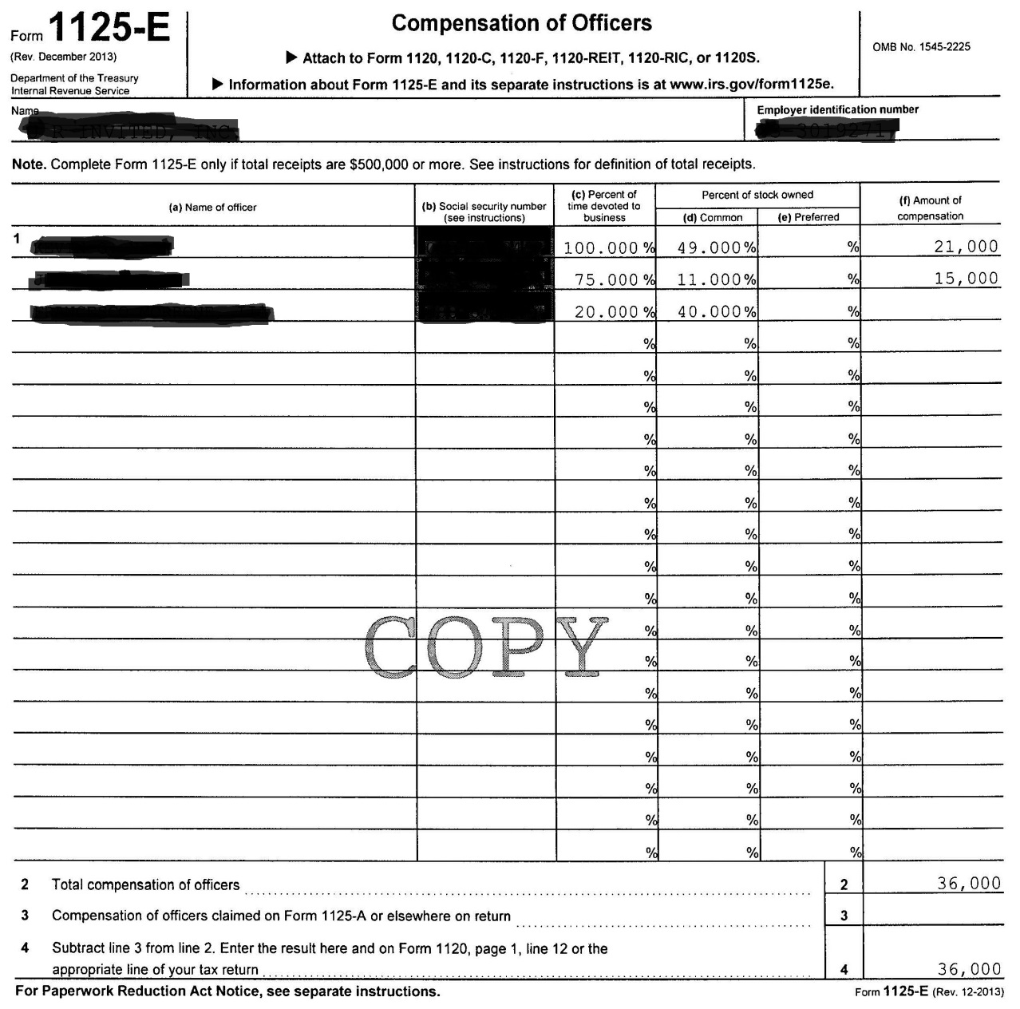
Compensation of Officers
% of time devoted to business vs. % of Stock Owned
Amount of Compensation

Slide 33
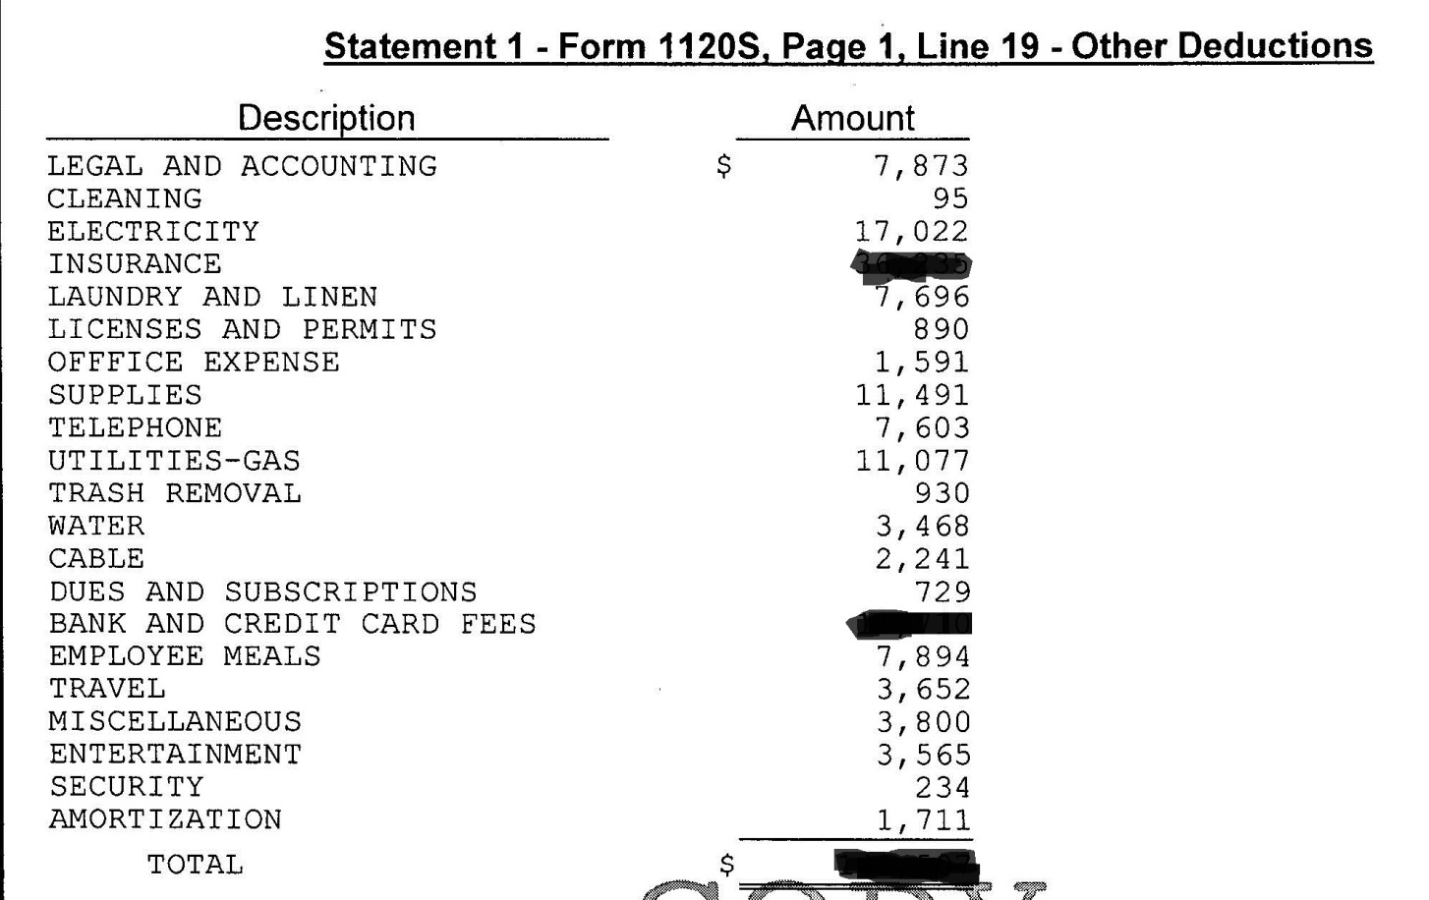
Other Deductions
Meals
Travel
Entertainment
Other?

Slide 34
Farm Income (Loss) Line 18 & Schedule F

Slide 35
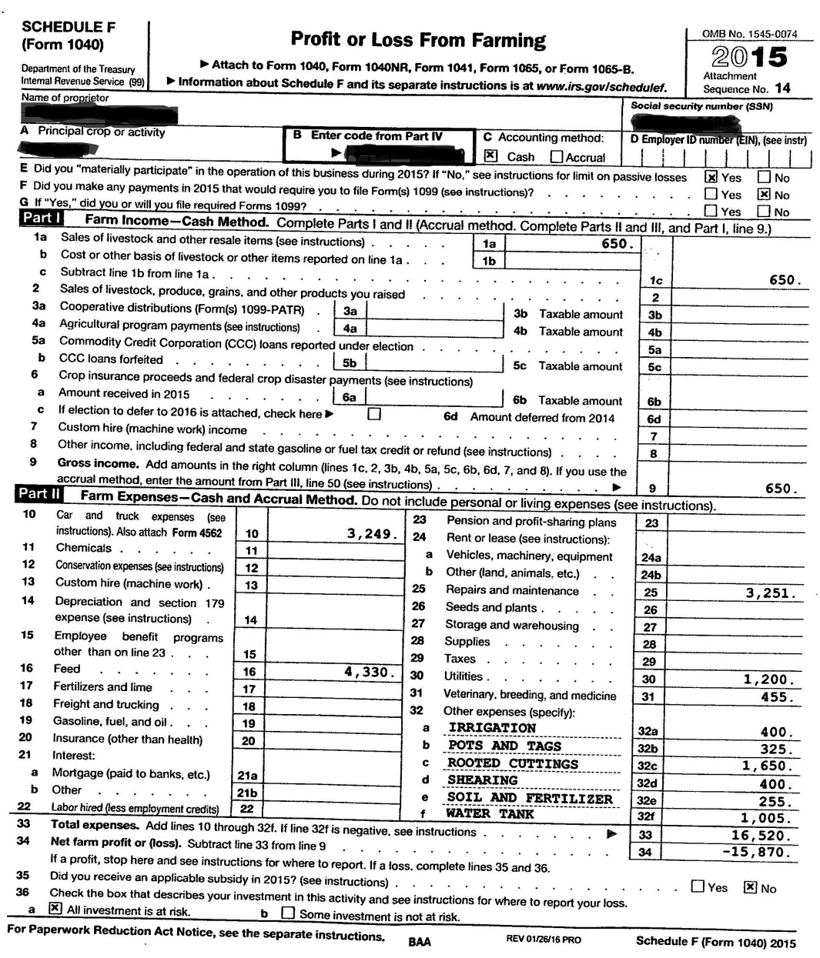
Farm Income (Loss) - Line 18 & Schedule F Appears to be HOBBY FARM
Sale of livestock and other resale items
Car and truck expenses

Slide 36
Farm Income (Loss) Line 18 & Schedule F

Slide 37
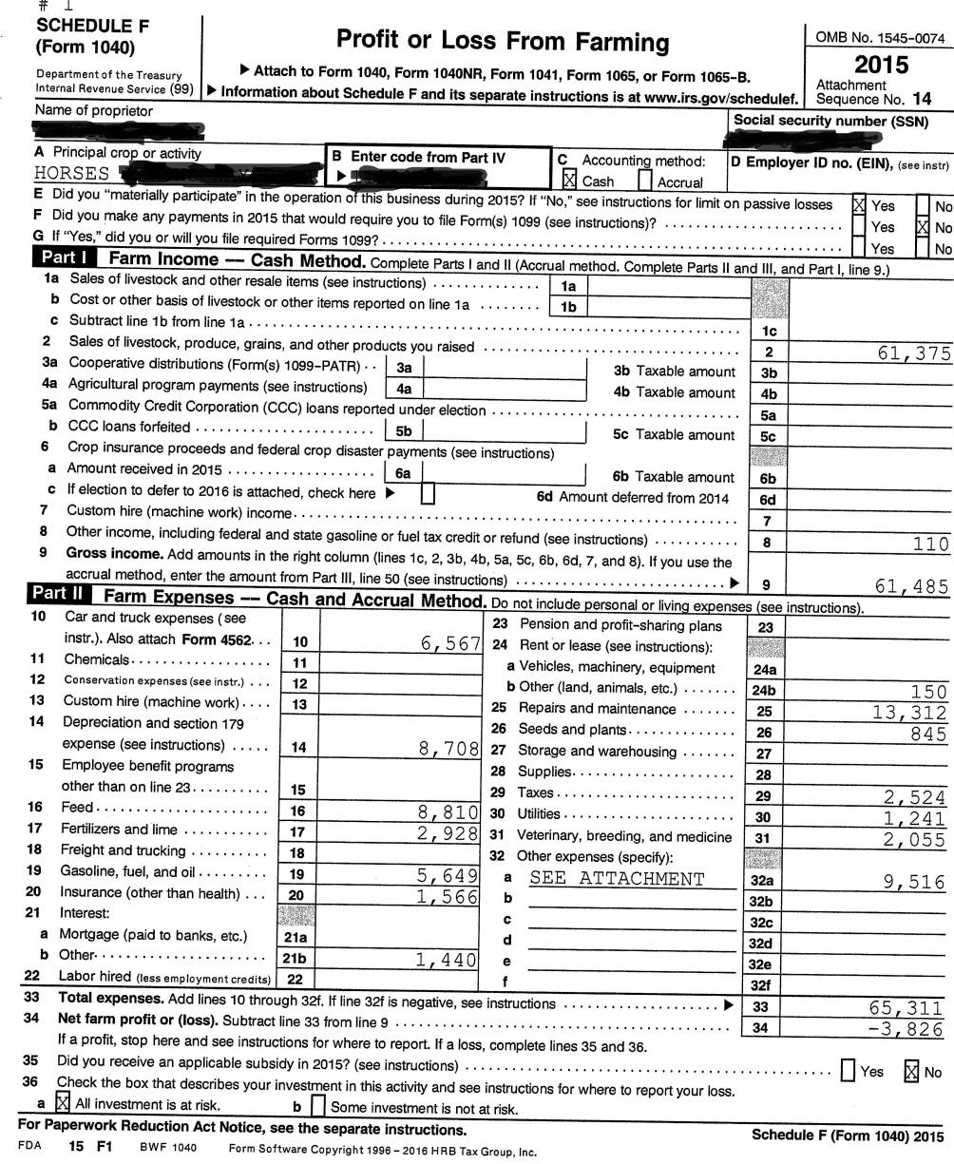
Farm Income (Loss) - Line 18 & Schedule F Appears to be PRIMARY INCOME FARM
Sale of livestock, produce, grains, and other products YOU raised
Car and truck expenses
DEPRECIATION
OTHER

Slide 38
OTHER

Slide 39
Farm Income (Loss) - Line 18 & Schedule F DEPRECIATION

Slide 40
Social Security Benefits Lines 20a, 20b and Form SSA-1099
Be sure only to count the untaxed amount since taxable amount is already counted in AGI
Are there younger siblings (under 18)?

Slide 41
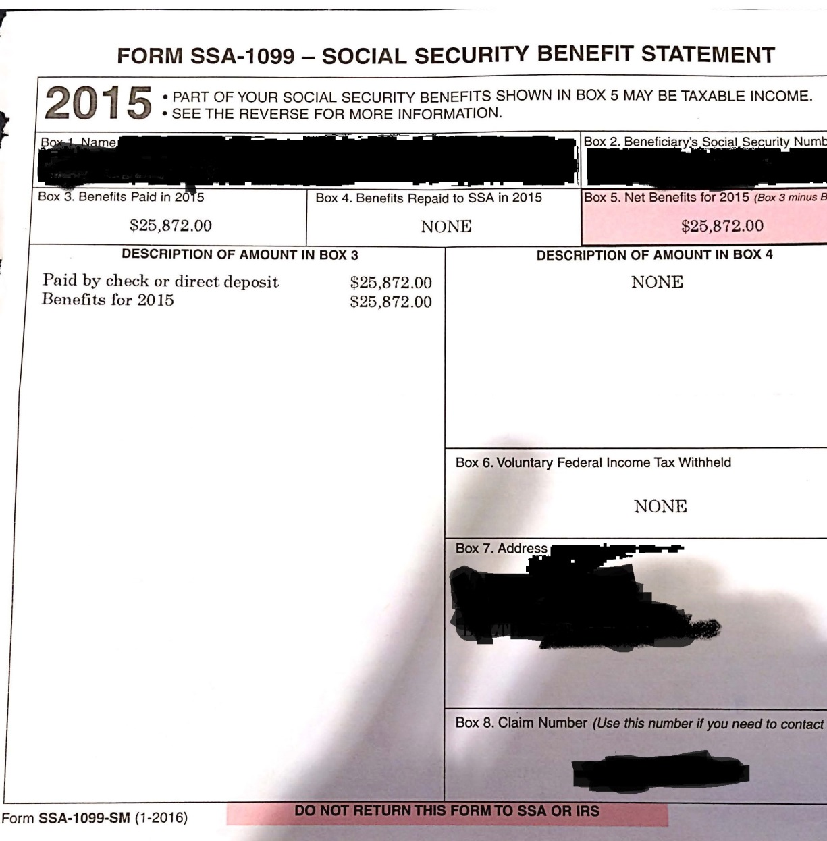
SSA-1099
Only the parents SSA will be taxable on their own tax return – not the children’s SSA-1099

Slide 42
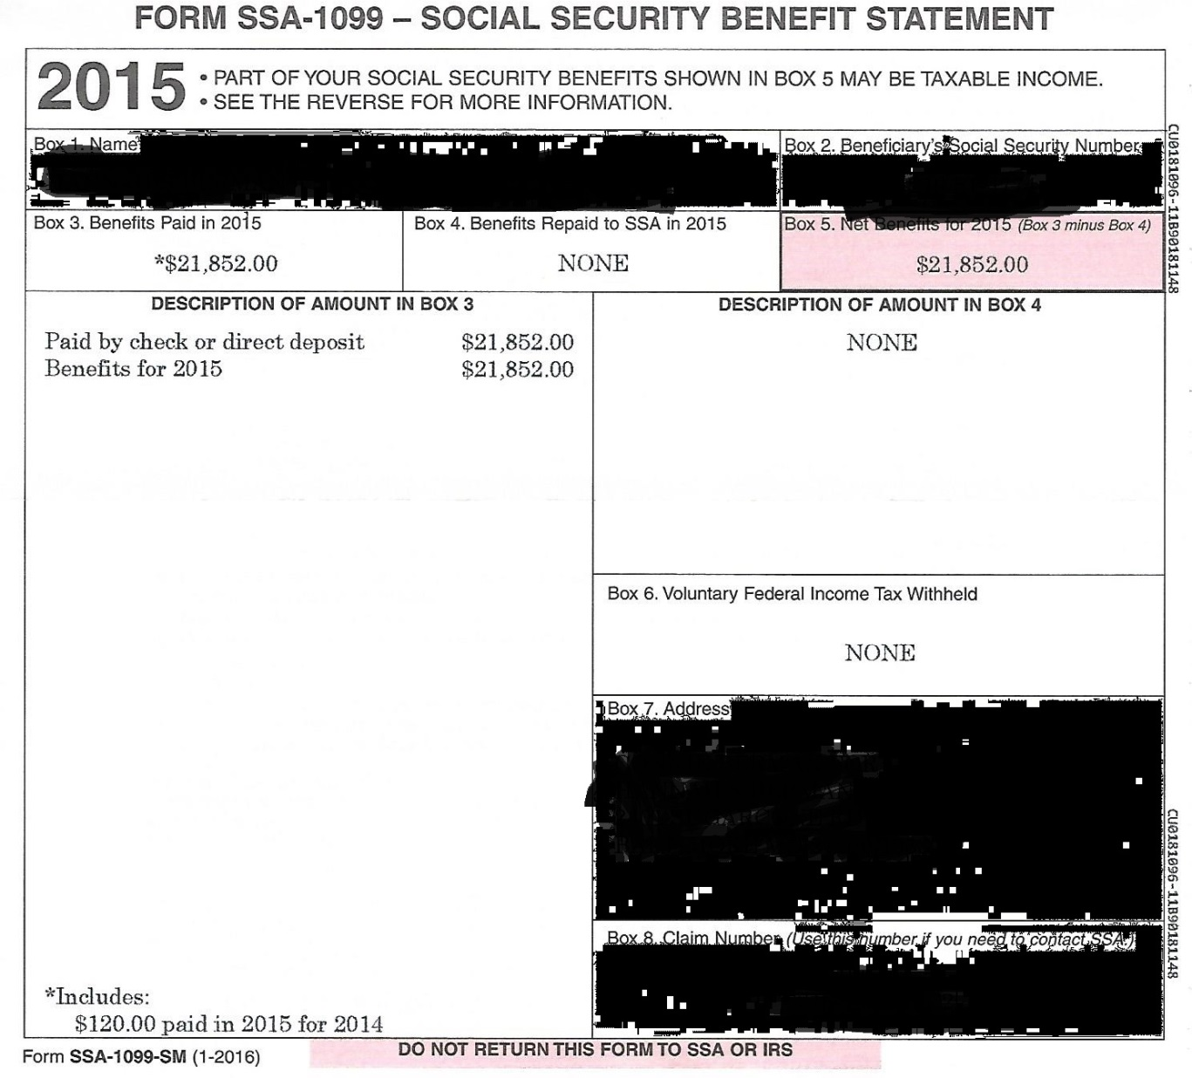
SSA-1099 - student
Watch for previous year payouts
PJ – benefits stop when student turns 18

Slide 43
SSA-1099 - Sibling
Be sure to collect for all siblings
Watch for previous year payouts
PJ – benefits stop when student turns 18 – especially important now with PPY

Slide 44
Questions
No Questions and I’m bored…
Questions are too hard and I’m stumped…

Slide 45
Contact Information
Tonya R. Hsiung
Assistant Director of Financial Aid
Franklin & Marshall College
717-358-4395
tonya.hsiung@fandm.edu

