Slide 1
2017-18 Verification
Amber Johnson
U.S. Department of Education
October 25, 2016

Slide 2
Agenda
Background
2017-18 Verification Changes Overview
2017-18 Verification Tracking Groups & Documentation
Verification Reminders
Conflicting 2015 Tax/Income Information
Resources

Slide 3

Background

Slide 4
Verification – History
Last comprehensive look in 1985
Program Integrity regulations (October 29, 2010)
  Move toward more customized verification
  Effective for the 2012-2013 award year
For the 2012-2013 award year
  Retained the long-standing five items and added SNAP and child support paid, if reported on the ISIR

Slide 5
Verification – History
For the 2013-2014 award year
  Introduced the concept of verification groups
  Added high school completion and identity/statement of educational purpose as verification items
For the 2014-2015 award year
  Eliminated SNAP (V2) as a separate verification group
  Added household resources group (V6)
  Added other untaxed income and benefits as a verification item

Slide 6
Verification – History
For the 2015-2016 award year
  No changes to verification items and tracking groups
For the 2016-2017 award year
  Eliminated Child Support Paid (V3) as a separate
  verification group
  In limited circumstances, an applicant’s Verification Tracking Group could change

Slide 7
2017-18 Verification Changes Overview

Slide 8

Tracking Groups and Data Elements
  Verification Tracking Group V6 was eliminated
  for 2017-18
    Schools still have authority to select additional students and items of their choosing for verification
  SNAP and Child Support Paid removed as individual verification items under V1, V4 or V5
  FR: April 1, 2016
  DCL GEN-16-07

Slide 9
Verification of Non-Filing
  Individual selected for V1/V5 verification required to file a 2015 IRS income tax return and granted a filing extension by the IRS, or any nontax filer selected for V1/V5 verification (parent, student, etc.) regardless if they earned any income from work, MUST provide:
    Confirmation of non-filing from the IRS or other relevant taxing authority dated on or after October 1, 2016
    If individual never filed a tax return before, can get letter of nonfiling from the IRS through form 4506-T (box 7)

Slide 10
Use of Documents from 2016-17
  School can use verification documents from 2016-2017 to meet 2017-2018 requirements for the following items:
    Adjusted Gross Income (AGI); U.S. Income Tax Paid ; Untaxed Portions of IRA Distributions; Untaxed Portions of Pensions; IRA Deductions and Payments; Tax Exempt Interest Income; Education Credits; Income Earned from Work
  Documentation of high school completion obtained prior to the 2017–2018 award year is acceptable
  Must obtain new documentation for:
    Number of Household Members
    Number in College
    Identity/Statement of Educational Purpose
GEN-16-07

Slide 11

2017-18 Verification Tracking Groups:
Data Elements & Documentation

Slide 12
Which Students to Verify?
Schools only need verify students who are selected for verification
Applicants can be selected in two ways:
Department Selects
School must verify all students the Department selects
ISIR will include verification flag and an asterisk (*) next to EFC
School Selects
Schools may select students not selected by the Dept.
May use the same data elements and documents as the Dept., or something else
Written policy must address how school selects students and what they will verify
Student will be assigned to a verification group, which determines the items to verify

Slide 13

Verification Selection Groups
V1 – Standard Verification Group
V2 – Reserved
V3 – Reserved
V4 – Custom Verification Group
V5 – Aggregate Verification Group
V6 – Reserved

Slide 14
V1– Tax Filers
  Adjusted Gross Income
  U.S. Income Tax Paid
  Untaxed Portions of IRA Distributions
  Untaxed Portions of Pensions
  IRA Deductions and Payments
  Tax Exempt Interest Income
  Education Credits
Documentation:
IRS DRT;
Tax Return Transcripts;
Alternate documentation
where allowed (e.g. amended
returns, foreign returns, etc.)

Slide 15
IRS Data Retrieval Tool
IRS Request Flag | Description
Blank | IRS Data Retrieval Tool not available
00 | Student/Parent was ineligible to use the IRS Data Retrieval Tool
01 | Student/Parent was presented with the IRS Data Retrieval Tool and elected to use it, but did not transfer IRS data into the FAFSA
02 | IRS data was transferred and was not changed
03 | IRS data was transferred and changed
04 | IRS data was transferred and then changed on a subsequent transaction
05 | Student/Parent was presented with the IRS Data Retrieval Tool and elected not to use it
06 | IRS data was transferred, but a subsequent change made the student/parent ineligible to use the IRS Data Retrieval Tool

Slide 16
V1 – Tax Non-Filers
Income earned from work
Documentation
Signed statement certifying the following:
  Individual has not filed and not required to file 2015 tax return;
  Sources of income earned from work and amounts of income from each source for tax year 2015; and
Copy of IRS Form W–2 for each source of employment income received for tax year 2015, and
Verification of Non-Filing Letter from the IRS

Slide 17
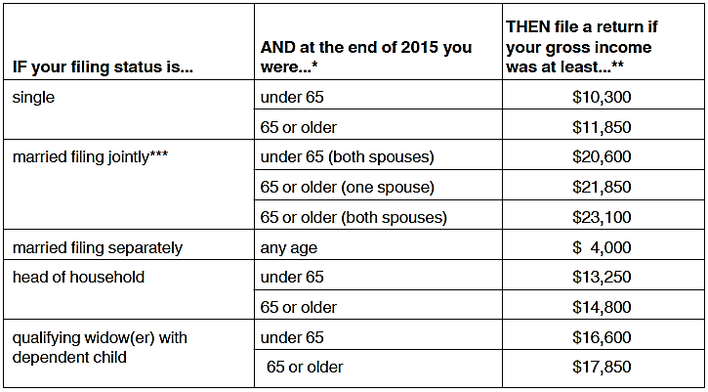
V1 - Tax Non-Filers
Schools are required to know whether an applicant was required to file a tax return
IRS Publication 17 gives guidance

Slide 18
V1 – Tax Non-Filers
      Institution must require applicant to submit a “Verification of Nonfiling Letter” for 2015 tax year
        Can be obtained from IRS.gov online
        Form 4506-T and checking box 7 if never filed taxes before
        Must be dated October 1 or later
        Non-Filing letter is also required documentation for those granted filing extension by the IRS

Slide 19
Tax Filers - Extensions
Person is required to file, but obtained extension, must submit:
School may request transcript/IRS DRT when taxes are filed; must then re-verify income information
Tax Filers Extension Documentation:
IRS Form 4868 or copy of the IRS’s approval to extend beyond October 15 deadline;
W-2 for each source of employment income; and
If self employed, a signed statement certifying the amount of AGI and U.S. income tax paid; and
Non-Filing Letter from the IRS
When above documentation reviewed, verification is considered complete (disbursements are valid)

Slide 20
Amended Tax Returns
Individuals who filed an amended tax return must submit the following documents to
the institution:
an IRS Tax Return Transcript, or any other IRS tax transcript(s) that include all of the income and tax information required to be verified; and
a signed copy of the IRS Form 1040X that was filed with the IRS
Guidance effective 8/13/15 for 15/16 and subsequent years
Posted on Program Integrity Q & A website

Slide 21
Non-IRS Tax Filers
Income Information for Non-IRS Tax Filers
Tax filers who filed an income tax return with a taxing authority in a U.S. territory (Guam, American Samoa, the U.S. Virgin Islands) or commonwealth (Puerto Rico and the Northern Mariana Islands) or with a foreign central government, must submit a copy of a transcript of their tax information
  A signed copy of the applicable 2015 income tax return that was filed with the taxing authority is only acceptable if tax filers are unable to obtain a free copy of a transcript of their tax information

Slide 22
Non-IRS Nontax Filers
Income Information for Non-IRS Nontax Filers
Residents of the Freely Associated States (Republic of the Marshall Islands, the Republic of Palau, the Federated States of Micronesia), or a
U.S. territory or commonwealth or a foreign central government who are not required to file an income tax return under that taxing authority’s rules must submit the following:
  a copy of their Wage and Tax Statement (or equivalent documentation) for each source of employment income and
  a signed statement identifying all of the individual’s income and taxes

Slide 23
V1– All Applicants
  Number in Household & Number in College
Documentation:
Household size – signed statement (name, age, relationship)
  - Not required for certain logical assumptions:
    Dependent student household size reported is 2 and parent is unmarried or 3 if the parents are married or unmarried and living together
    Independent student household reported is one and applicant is unmarried or two if the applicant is married
Number in College – signed statement (name of household member attending at least half-time and eligible institution name)
    Not required if reported number is one (student)

Slide 24


V4—Custom
High School Completion Status
Identity/Statement of Educational Purpose

Slide 25
High School Completion Status
High school completion status
Documentation
High school diploma; or
Final official high school transcript showing date diploma awarded, or
Secondary leaving certificate (for students who completed secondary education in a foreign country and are unable to get a copy of high school diploma/transcript), or
DD-214 (if it specifically states that student is a high school graduate or equivalent)
Note: If prior to student being selected for verification, an institution already obtained HS completion status records for other purposes, the institution may rely on those records as long as it meets ED HS completion criteria

Slide 26
High School Completion Status
Recognized equivalent of a HS diploma
Documentation
Copy of student’s General Educational Development (GED) certificate, an official GED transcript that indicates the student passed the exam, or a state-authorized HS equivalent certificate, or
Academic transcript of a student who has successfully completed at least a two-year program that is acceptable for full credit toward a bachelor’s degree, or
Student excelled academically in HS and has met all the criteria to be admitted to a 2-year degree program or higher

Slide 27
High School Completion Status
Test transcripts of State-authorized examinations
Documentation
Official test transcripts of state-authorized examinations (e.g., GED test, HiSET, TASC, or other state-authorized high school equivalency examinations) are acceptable documentation of high school completion only if:
    The official test transcript specifically indicates that a State has determined that the test results are considered by the state to meet its requirements of a high school equivalency, or
    The official test transcript includes language that the final score is a passing score

Slide 28
High School Completion Status
Homeschooled
Documentation
Credential, transcript, or the equivalent, signed by the parent or guardian, that lists the secondary school courses completed by the applicant and documents the successful completion of a secondary school education, or
A secondary school credential for homeschool provided for under state law

Slide 29
High School Completion Status - Updates
If the school successfully verified and documented applicant’s high school completion status for a prior award year, verification of high school completion status is not required for subsequent years
A school may not accept as alternative documentation an applicant’s self-certification

Slide 30
Identity/Statement of Educational Purpose
Students that appear in-person
Clarified that the valid photo ID must not have expired
Documentation
Present to an institutionally-authorized individual
  A valid (unexpired) government-issued photo identification, and
  A signed statement of educational purpose provided by ED, text cannot
  be modified
Maintain an annotated copy of the identification:
  The date documentation was received, and
  The name of the institutionally-authorized individual that obtained the documentation

Slide 31
Identity/Statement of Educational Purpose
Student unable to appear in-person
Documentation
Must provide the institution:
  A copy of a valid (unexpired) government-issued photo identification
  AND
  An original, notarized statement of educational purpose signed by the applicant (cannot be faxed or scanned)
    Maintain a copy in the file
    After examining the original Statement of Educational Purpose for accuracy and completeness, the institution may convert it into an electronic record

Slide 32
V5 – Aggregate
High School Completion Status
Identity/Statement of Educational Purpose
AND
All items indicated-Tax Filer (V1)
All items indicated-Non-Tax Filer (V1)

Slide 33

Verification Reminders

Slide 34
October 18, 2016 Electronic Announcement
  Alternative documentation allowed when tax filer RECENTLY requested but unable to obtain an IRS Tax Return Transcript using the IRS paper or on-line request process
    No alternative documents for telephone requests
    Exception not permitted for transcripts unable to be obtained simply because the IRS has not had time to process the data due to a recent filing
For 2016-2017 award year only!

Slide 35
October 18, 2016 Electronic Announcement
In instances where tax filer recently requested a tax transcript from the IRS but was unsuccessful in obtaining the tax transcript:
  1. Signed copy of relevant 2015 IRS tax return
  AND
  2. A statement from the tax filer (on or attached to the tax return) which certifies that the tax return submitted to the institution includes the same information that was submitted to the IRS
  AND
  3. Documentation from IRS of unsuccessful tax transcript request
      Screen shot print (SIGNED AND DATED BY TAX FILER) or
      Letter from IRS (SIGNED AND DATED BY TAX FILER); or
      AND
  4. Completed and signed IRS Form 4506 T-EZ or 4506-T listing institution as third party
    - Send to IRS only if doubt paper tax return accuracy

Slide 36

Transcript Requests – 2017-18
“Get Transcript Online” at IRS.gov website
Online Get Transcript by Mail
Automated phone tool (1-800-908-9946)
Paper Form 4506-T or 4506T-EZ generate a paper transcript

Slide 37
Tax Identity Theft
Victims of IRS tax-related identity theft must submit
Statement signed and dated by tax filer indicating they were victims of IRS tax-related identity theft and the IRS has been made aware of the tax-related identity theft; and
A Tax Return DataBase View (TRDBV) transcript obtained from the IRS (1-800-908-4490)
  Tax filers who cannot obtain a TRDBV transcript may instead submit another official IRS transcript or equivalent document provided by the IRS if it includes all of the income and tax information required to be verified
Guidance applies to 15/16 and subsequent years
Posted in 6/26/15 Federal Register Notice

Slide 38
Tracking Group Changes
Applicants may be moved from previously assigned Groups V1 or V4 to Verification Tracking Group V5
  Applicant is only required to verify any additional items in V5 that were not previously verified
  If the applicant is moved to Verification Tracking Group V5, no additional disbursements of any Title IV aid may be made until verification is satisfactorily completed

Slide 39
Tracking Group Changes
Applicants moved to Verification Tracking Group V5:
  If student was previously verified and Title IV aid had been disbursed prior to receiving an ISIR with updated code V5, and the applicant does not complete V5 verification, the applicant is liable for the full amount of TIV aid disbursed for 2017-2018
  The school is not liable
    Exception: if an R2T4 is required for the student, school would return funds as per normal

Slide 40
FAA Access – Identity Verification Results
In 2014-15 an Identity Verification Results reporting function was added to FAA Access
Schools report the verification results for identity and high school completion for students who have been selected for verification under V4 or V5

Slide 41
FAA Access – Identity Verification Results
Whom to report: student for whom school received an ISIR with a Verification Tracking Group of V4 or V5 AND for whom school requested verification documentation
  Do NOT include students the school selected for verification of identity or high school completion status
When to report: 60 days following the institution's first
request to the student to submit the required V4 or V5 identity and high school completion documentation
  Changes to previously submitted identity verification results must be updated within 30 days

Slide 42
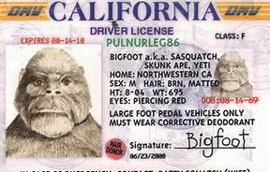

FAA Access – Identity Verification Results
New Value #6 added to drop-down options for 2017-18:
  Verification completed in person, no issues found
  Verification completed remotely, no issues found
  Verification attempted, issues found with identity
  Verification attempted, issues found with HS completion
  No response from applicant or unable to locate
  Verification attempted, issues found with both identity and HS completion

Slide 43
Verification & PJ
  For applicants selected for verification (by ED or school), must complete verification before PJ adjustments made [HEA section 479A(a)]
  But…all PJ adjustments do NOT require verification
    Does school require?
  Must mark ISIR as PJ!
    An ISIR with PJ coded correctly will not be subject to ED’s verification selection

Slide 44
“Non-Verification” Reminders
Regardless of verification status
  Must resolve any and all “C-Codes”
    Citizenship, Selective Service, Loan Default, etc.
  Must resolve conflicting information
    Separate process from verification
    Includes any information of which the school has knowledge

Slide 45

Early FAFSA: Identification and Resolution of Conflicting 2015 Income and Tax Information
DCL GEN-16-14

Slide 46
Early FAFSA Conflicting Information
New FOTW edits warn if one or more income or tax amounts reported for 2017-18 differs from amount reported on 2016-17 FAFSA
  Edits not triggered if
    2016-17 FAFSA transaction was based on estimated income/taxes,
    There has been a change in dependency status between
    two years, or
    There has been a change in either student’s or parents’ marital status between two years

Slide 47
Early FAFSA Conflicting Information
CPS will identify conflicting information between the two years that once resolved would have significant impact on the applicant’s EFC
CPS will not flag if
  Student is not expected to be Pell-eligible,
  Change in dependency status between two years,
  Change in student’s or parents’ marital status between two years, or
  PJ was performed in either year

Slide 48
Early FAFSA Conflicting Information
Institutionally required resolution
  Student’s 2017-18 ISIR and SAR will be flagged with ‘C’ code and comment code 399
  If comment code 399 not included on 2017-18 ISIR, school is not required to determine if there are any differences in income or tax information between two ISIRs
    However, any other conflicting information (e.g., citizenship status or HS completion status) must be resolved

Slide 49
Early FAFSA Conflicting Information
Resolving potential conflicting information
  School must compare all of the 2015 income and tax-related items from both years’ ISIRs to determine which are in conflict
  If, for either year, school had verified the information that conflicts, or student/parent used IRS DRT and did not change any of the transferred data, school can assume the verified values are correct and submit changes to other ISIR’s data
  Exception: If school is aware that subsequent to verification an amended tax return was filed, school must ensure both years’ ISIRs are based on the amended tax data

Slide 50
Early FAFSA Conflicting Information
Conflicts must be resolved if the information
  Was not verified,
  Was not transferred using IRS DRT,
  Was transferred and then changed, or
  If school is aware that an amended tax return was filed with IRS
May need to reach out to the student for reasons why data is different between years

Slide 51
Early FAFSA Conflicting Information
Unable to resolve
  Until conflicting information is resolved, school may not disburse any additional 2016-17 or 2017-18 Title IV aid
  If unable to resolve, either because student didn’t respond or adequately clarify reasons for conflicting information, school must consider student in an overaward status for any need-based 2016-17 Title IV aid that was disbursed

Slide 52
Early FAFSA Conflicting Information
Additional disbursements and overpayments
  2017-18 FAFSA/ISIR – if required correction is for 2017-18 year, school must use EFC from corrected ISIR to award/disburse
  2016-17 FAFSA/ISIR – if required correction is for 2016-17 year, school must ensure that all awards/disbursements for 2016-17 are adjusted to use corrected 2016-17 EFC
    Lower 2016-17 EFC: school must disburse any additional 2016-17 aid that it determines student is eligible to receive, consistent with late disbursement rules at
    34 C.F.R. § 668.164(g)
    Higher 2016-17 EFC: school must determine student’s 2016-2017 Title IV eligibility based on corrected EFC and may not make any additional 2016-17 disbursements for which the student is no longer eligible

Slide 53
Early FAFSA Conflicting Information
Resolving overawards and overpayments
  Title IV Grants and Perkins Loans
    Adjust subsequent disbursements if possible
    If not resolved by adjusting subsequent disbursements, student must repay portion disbursed for which he or she is no
    longer eligible
    School is not liable
    Follow normal overpayment rules and procedures
  Direct Subsidized Loans
    Does not need to be immediately repaid but instead will be repaid under terms of promissory note
    No action school must take except to record its determination

Slide 54

Resources

Slide 55
Resources
Federal Student Aid Handbook
Application and Verification Guide – Chapter 4
  2017-18 AVG is coming soon!
Federal Register
April 1, 2016 (2017-18 verification items & documentation)
  https://ifap.ed.gov/fregisters/FR040116FAFSA20172018BeVerified.html
Dear Colleague Letters
GEN-16-07 published on April 5, 2016 (2017-18 verification items and documentation)
  https://ifap.ed.gov/dpcletters/GEN1607.html
GEN-16-14 published on August 3, 2016 (conflicting 2015 tax and income information)
  https://ifap.ed.gov/dpcletters/GEN1614.html
Electronic Announcement
July 29, 2016 (2017-18 suggested verification text)
  https://ifap.ed.gov/eannouncements/072916VerificationSuggestedTextPackageFor20172018.html

Slide 56

Resources
Program Integrity Q & A Website (Verification)
http://www2.ed.gov/policy/highered/reg/hearulemaking/2009/integrity-qa.html
FSA Assessments
http://ifap.ed.gov/qahome/qaassessments/fsaverification.html
  Activity 3 – Verification Codes
Federal Regulations
34 C.F.R. § 668 Subpart E (668.51 – 668.61)
34 C.F.R. § 668.16(f)

Slide 57

Review
Background
2016-17 Verification Changes Overview
2016-17 Verification Tracking Groups & Documentation
Verification Reminders
Conflicting 2015 Tax/Income Information
Resources

Slide 58
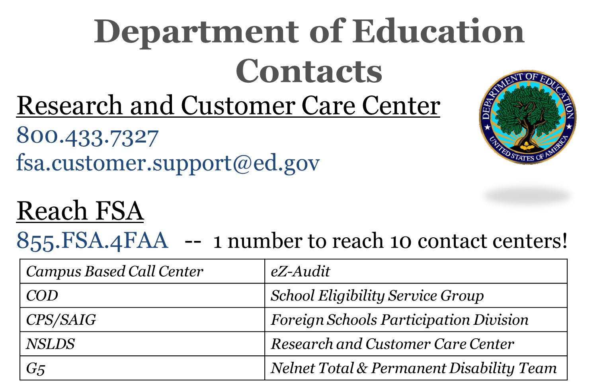

Slide 59

Regional Contacts
Philadelphia School Participation Team
  Main Number – 215-656-6442
  Joe Kern (IIS) – Joe.Kern@ed.gov; 215-656-8566
Philadelphia Training Officers
  Amber Johnson – Amber.Johnson@ed.gov; 202-377-3369
  Craig Rorie – Craig.Rorie@ed.gov; 215-656-5916

Slide 60
Training Feedback
To ensure quality training, we ask all participants to please fill out an online session evaluation.
Go to https://www.surveymonkey.com/s/AmberJohnson
  Evaluation form is specific to Amber Johnson
Additional feedback about training can be directed to JoAnn.Borel@ed.gov; 409-579-3776

Slide 61
Thank You!

