Slide 1

This is Why It’s So Interesting to Work in Financial Aid
Presented by
Joan Holleran and Other Members of
NextPAGE Committee

Slide 3


Where it all begins…….

Slide 4
FERPA
The Family Educational Rights and Privacy Act (FERPA) determines what information is public and what is confidential in a student’s record.
Which of the following individuals have access to a dependent student’s financial aid information?

Slide 5
FERPA
Noncustodial parent
Older sibling
Donors of a scholarship that the student receives
Landlord
None of the above

Slide 6
FERPA
When a student matriculates into postsecondary education, all rights under FERPA transfer from the parent to the student.

Slide 7
FERPA
How would the noncustodial parent, older sibling, scholarship donors, or landlord get permission to have student information?
How and where do you document that permission?
Is there a time limit on release of student info?

Slide 8
Verification
The dependent student V1 verification form is returned. The question says, “List the people in your parents’ household…” The parents with whom the student resides are mother, 49, and stepfather, 52.
Which of the following family members should be included?

Slide 9
Verification
Stepfather, 52. Says he’s not paying for college for children that aren’t his
Younger sister, 6, child of mother & bio father, splits time between them, claimed by mother on taxes
Older brother, 26, child of mother & bio father, floats between mother and bio father, works more or less full-time
Grandmother, 77, mother’s mother, in declining health, receives SS and pension

Slide 10
Verification
Must include stepparent if remarried regardless of support they contribute.
Deciding factor to determine number in household: If parents/stepparents provide more than half of support for school year being verified.
What if the dependent student in this scenario says she moved out when she was 18 because she doesn’t get along with stepfather and supports herself?

Slide 11
Identity Theft
A parent of one of your students tells you he is the victim of IRS tax-related identity theft and cannot provide you with the requested tax information for you to verify the file.
Which of the following is true?

Slide 12
Identity Theft
Unable to use IRS Date Retrieval Tool
Cannot request a tax transcript until issue is resolved
Request that IRS Identity Protection Specialized Unit provide “alternate paper tax return transcript” known as Transcript DataBase View (TRDB)
School must collect signed and dated statement from tax filer indicating they are victim of IRS tax-related identity theft and that IRS has been made aware of tax-related identity theft
All of the above

Slide 13
Identity Theft
School could develop its own form that taxpayer signs and dates acknowledging tax-related identity theft and that IRS has been made aware.

Slide 14
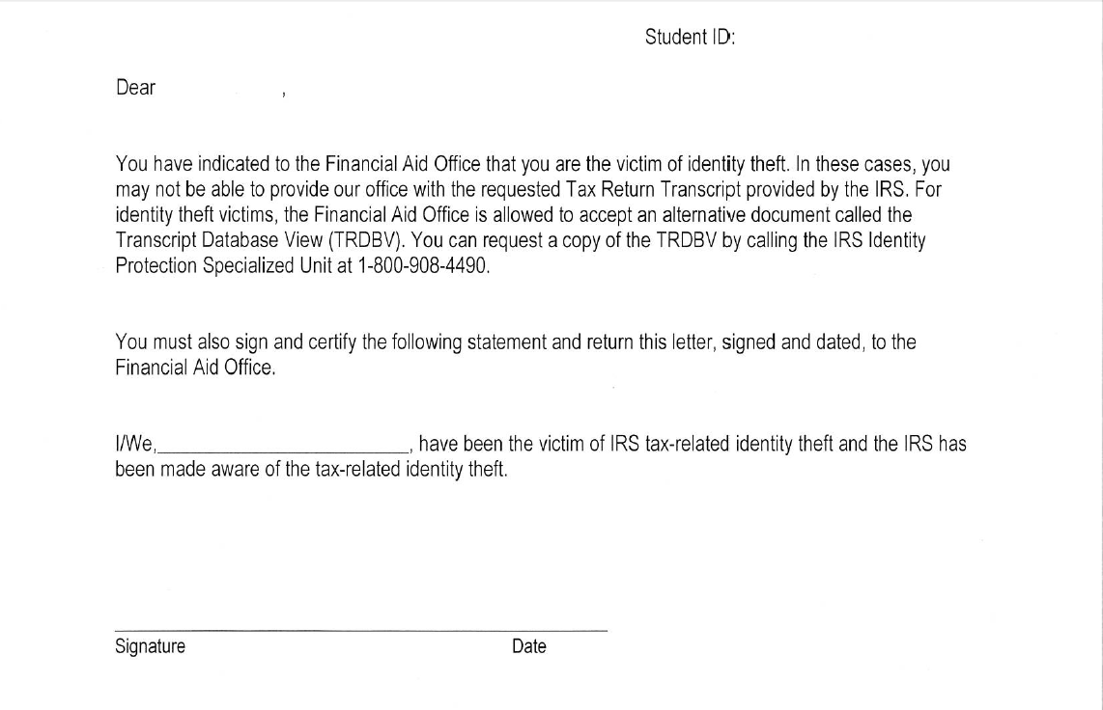
Identity Theft – Sample Form for School Use

Slide 15
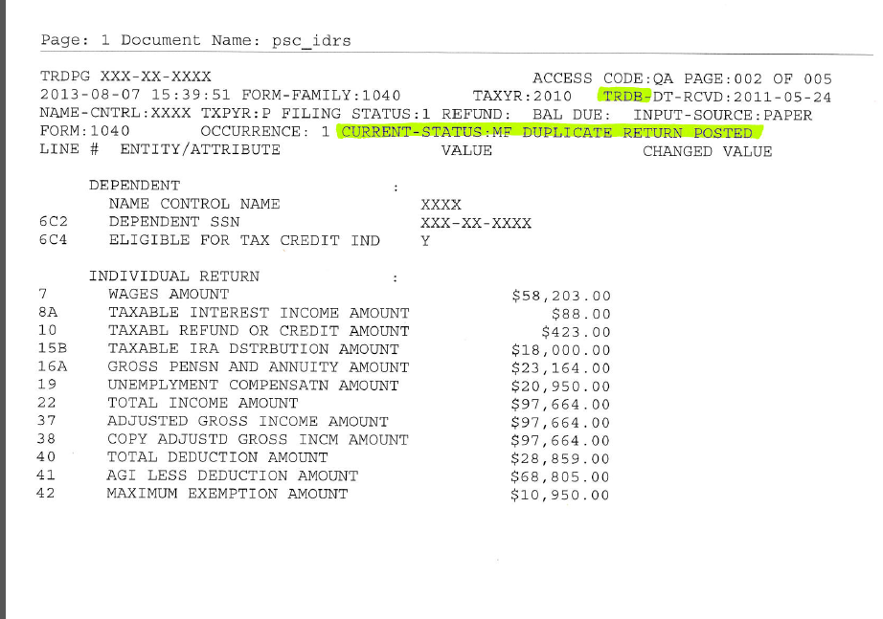
Sample TRDB

Slide 16
C-Flag – Social Security
Luis Montero-Rodriguez applied for financial aid at your school. His FAFSA record comes back with a C-Flag discrepancy, “The name you reported on your FAFSA does not match the name in the Social Security Administration’s (SSA) records for your Social Security Number (SSN). Therefore, you must correct your SSN (Item 8) or name (Items 1 and 2). If you confirm your name, you should also contact the SSA to make sure that they correct it in their records…”
The student tells you there is no error.

Slide 17
C-Flag – Social Security
This is SAR comment code 061. SSN Match Flag = 3 (SSN match, no name match)
Student’s SSN matches but name does not match.
What documentation will you request?

Slide 18
C-Flag – Social Security
Birth certificate
Social Security card
Final high school transcript
A letter from high school guidance office
Driver’s license

Slide 19

C-Flag – Social Security
123-45-6789
LUIS MONTERO RODRIGUEZ
Luis Montero Rodriguez

Slide 20
C-Flag – Social Security
Must match SS card exactly!
Latinos often combine surname of father first and mother second (with or without hyphens but not always).
  Montero Rodriguez
  Montero
  Rodriguez

Slide 21
C-Flag – Selective Service
The student indicates on the FAFSA that their first name is Ryan and DOB is 7/2/94. Student did not answer question, “Are you male or female?” Selective Service match says that student is not registered. You ask the student to come to the office to help them resolve the discrepancy. When the student arrives, she introduces herself as Rachel.
How do you proceed?

Slide 22
C-Flag – Selective Service with Transgender Issue
For Selective Service to be a match, student must list gender on birth certificate.
Females who don’t answer question will be told they must register.
We don’t deal with “preferred” names.
It is not our intention to “out” a student but we need to use their legal name.
You can say, “What pronouns do you identify with?” but if student chooses not to register, we stop there.

Slide 23
C-Flag – Citizenship
Student completed FAFSA but rejects due to failed citizenship match
Undocumented student produces Employment Authorization Card
Is student eligible for federal aid?
How can you assist this student?

Slide 24
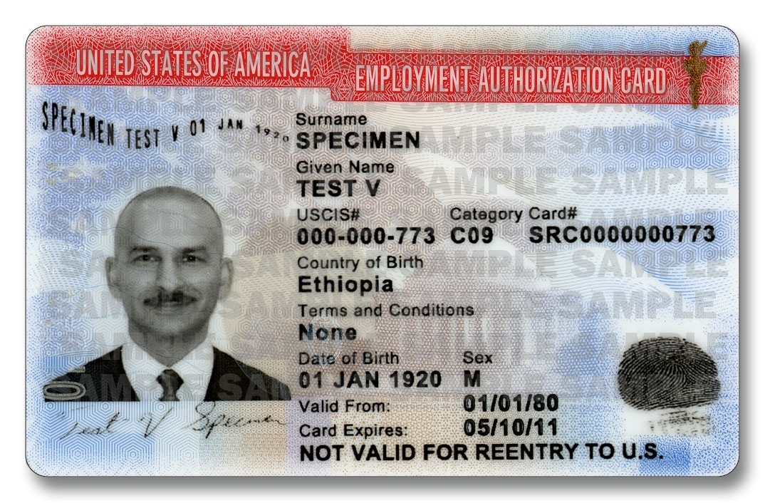
C-Flag – Citizenship

Slide 25

C-Flag – Citizenship

Slide 26
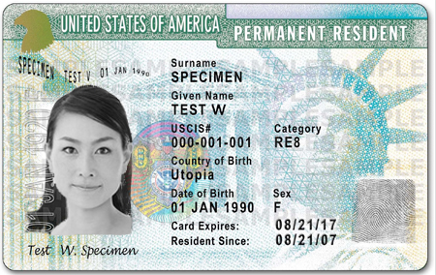
C-Flag – Citizenship

Slide 27
C-Flag – Citizenship
Deferred Action for Childhood Arrivals (DACA) is an American immigration policy (June 15, 2012) that allows certain illegal alien youth who entered the country before their 16th birthday and before June 2007 to receive a renewable two-year work permit and exemption from deportation.

Slide 28
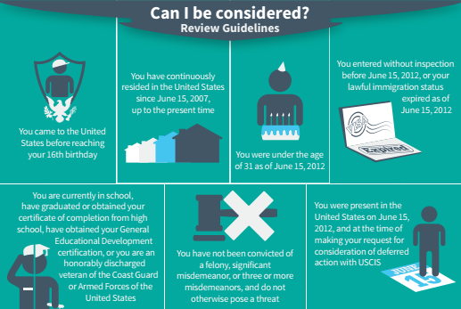
Credit: United States Citizenship and Immigration Services (USCIS)

Slide 29

Credit: beforeitsnews.com

Slide 30
C-Flag – Citizenship
Illegal alien parents bring illegal alien child to USA
Child attends, graduates from US high school – qualifies for Employment Authorization Card
Child cannot become U.S. citizen or permanent resident – no passport
Social Security number/card for work only
No federal or state aid. Alternative loan with co-signer who is citizen or permanent resident
May qualify for institutional aid

Slide 31
C-Flag – Unusual Enrollment
History (UEH)
Sabrina applies for financial aid at your school for 2016-17. Her ISIR comes back with SAR comment code 359 – NSLDS Unusual Enrollment History
She says she attended Blackjack University (2015-16) and Muddy Swamp CC (2014-15) before transferring to your school.
What does financial aid have to do?

Slide 32
C-Flag – Unusual Enrollment
History (UEH)
Must review student’s enrollment and financial aid records to determine if received Pell Grant (or other federal aid) at your school in 3 most recent prior years
If not, use NSLDS and COD to determine where student received federal aid in 3 most recent prior years.
AND was academic credit earned at each school during the award year?

Slide 33
C-Flag – Unusual Enrollment
History (UEH)
What is UEH about?
Alerts FAO to students who go from school to school receiving aid to ensure they are progressing toward a degree.
Student attends 3 different schools and gets federal aid at all 3.
When 4th school’s federal aid award appears, they are flagged as UEH.

Slide 34
C-Flag – Unusual Enrollment
History (UEH)
You check with Admissions/Records Office and on NSLDS and COD
Sabrina’s college enrollment and aid history:
  2015-16 - Blackjack Univ - Pell F15, Sp16 - 9cr F15 + 6 cr Sp16 = 15 cr
  2014-15 - Muddy Swamp CC - Pell F14, Sp15 - 12 cr F14 + 12 cr Sp15 = 24 cr
  2013-14 - Neverland CC - Pell F13 - no acad transcript, not reported on your school’s admission app
What action does the FAO need to take?

Slide 35
C-Flag – Unusual Enrollment
History (UEH)
Contact student to find out about Neverland CC enrollment.
Give the student a break and request that NSLDS delete the Neverland CC file from its record.
Tell the student that if she pays back the Pell grant she got at Neverland CC, all is forgiven.
You don’t need to take any action except pay the aid at your school.

Slide 36
C-Flag – Unusual Enrollment
History (UEH)
Student says she didn’t earn any credits at Neverland CC. Walked away due to “personal issues.”
Since student did not earn credits at Neverland, is the student eligible to have federal aid at your school for the upcoming year?

Slide 37
C-Flag – Unusual Enrollment
History (UEH)
No, student not eligible to receive future federal aid since didn’t earn any credits at Neverland CC.
Student has right to appeal to you.
If appeal is approved, student will continue to qualify for aid as long as meeting your school’s SAP policy.

Slide 38
C-Flag – Unusual Enrollment
History (UEH)
Often student owes money and can’t get missing transcript - letter from other school acceptable - did student earn credits?
If student withdrew due to medical reasons, acceptable documentation will permit student to qualify for continued aid.

Slide 39
Satisfactory Academic Progress
According to federal regulations, all schools participating in Title IV programs must establish, publish, and apply reasonable satisfactory academic progress (SAP) standards.
An SAP policy ensures that students are moving toward successfully completing program of study for which they are receiving aid.
Measurement of SAP must encompass the student’s entire attendance at the institution regardless of receipt of Title IV aid.

Slide 40
Satisfactory Academic Progress
Must have a quantitative (pace within a maximum timeframe) component
Must have a qualitative (GPA or equivalent) component
Must be as strict or stricter than the school’s standards for students not on financial aid
Must be applied consistently within categories of students

Slide 41
Satisfactory Academic Progress
Qualitative standard
  Regs do not state what GPA (or other assessment measure against a norm) must be.
  Regs do say at end of second year of attendance, must have a “C” or equivalent consistent with graduation requirements for programs longer than two years.
  All attended periods count.

Slide 42
Satisfactory Academic Progress
Quantitative standard
  Must specify the pace by which a student should progress through his academic program within the maximum time frame.
  Undergrad should graduate within 150% of published time frame of program.
  120 credits to graduate X 150% = ok to pay aid until 180 credits

Slide 43
Satisfactory Academic Progress
Calculate completion rate (pace):
Cumulative # of credits earned divided by cumulative # of credits attempted
Withdrawals, incompletes, F grades, and repeated courses all count as attempted credits

Slide 44
Satisfactory Academic Progress
Progress policy must also include:
  Frequency of SAP evaluation (end of each payment period or annually)
  Notification of not meeting SAP
  Effect of incompletes, withdrawals, course repeats, transfer credits
  ESL, remedial, enrichment courses
  Change of major, double major or two degrees
  Appeals and procedure to appeal
  Re-establishing eligibility

Slide 45
Satisfactory Academic Progress
Evaluating SAP at end of each payment period
  Allows school to pay one semester of Title IV aid (Financial Aid Warning) when not meeting SAP
Evaluating SAP annually
  No Financial Aid Warning semester

Slide 46
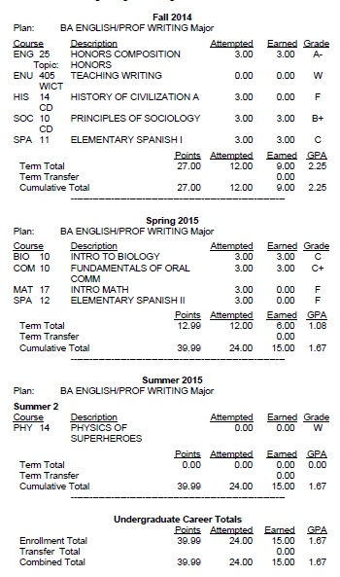
M e a s u r
I n g
S
A
P

Slide 47
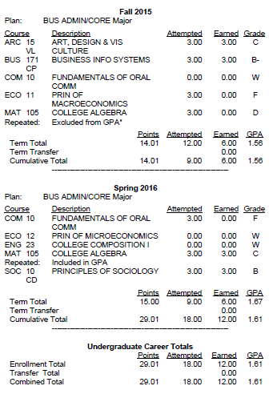
M e a s u r
I n g
S
A
P

Slide 48


Questions?
Need more information?
To learn more about the nextPAGE (PASFAA’s Advancement of Generations Exchange) Committee, ask any member here today or go to the PASFAA website.

