Slide 1
Communicating with the Next Generation of College Students
A Roundtable Discussion
with Rebecca Schreiber-Reis, Dickinson College
Notes:
Do your students tend not to read your emails? Have you considered new methods of communication to reach your student body? Did last year’s Summer Melt session inspire you? This roundtable is a chance to discuss text messaging, social media, and other electronic methods of communication that step beyond email. Rebecca discovered great interest in text “nudging” on the FINAID Listserv, but schools were hesitant to try new methods of communication. Join this roundtable if you would like to share experiences, hear what other schools have tried, or learn what others hope to try.

Slide 2
Ten Texts to College Chapter 5, Summer Melt by Benjamin L. Castleman and Lindsay C. Page
Texting is the primary method of communication for today’s teens and young adults (Lenhardt, A.)
Texts provide manageable bursts of information- “nudges” to complete tasks
Behavioral economists have observed that long lists- such as missing items emails- cause us to procrastinate (Madrian, B.C. & Shea, D.F)
“Nudges” have been used successfully to encourage personal savings, and as reminders for vaccinations. (Thaler, R. & Sunstein, C.; Karlan, D. McConnell, M., Mullainathan, S., & Zinman, J.; Stockwell, M.S., Kharbanda, E.O., Martinez, R.A., Vargas,
C.Y., Vawdrey, D.K., & Camargo, S.)

Slide 3
Research Findings Summer Melt
uAspire (Boston, MA) found that students who did not respond to emails and phone calls, responded rapidly to text messages
Responses were especially high for texts related to financial aid and billing
Fewer than 4% of students opted out of text messaging
Minnesota Office of Higher Education noted that students who chose to receive emails were less responsive, and responded later, than those who selected text-based communications

Slide 4
Follow-up survey of student responses to text message campaign
The text messages… | Percentage of respondents who felt that each statement was “somewhat true” or “very true”
Got me to complete a task I hadn’t yet done | 86%
Informed me about something I hadn’t realized I needed to do | 86%
Helped me manage my time better | 75%
Got me to reach out to a uAspire advisor for help | 72%
Helped make the summer tasks less overwhelming | 70%
(Castleman, B.L. & Page, L.C., p. 115)

Slide 5
Communicating with Students: Reframing our Goal
We can provide services to support diverse or non-traditional populations
Adjusting communication strategies can help students solidify skills and graduate successfully
For some populations, this just levels the playing field
Nudging “fills in for what middle-class parents do with their children every day.” (Castleman, B.L. & Page, L.C.)

Slide 6
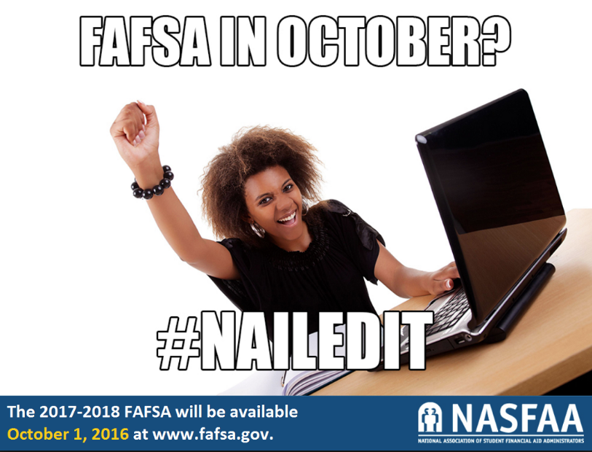
Communicating with Students: Why Try Something New?
Alert student to outstanding requirements
Advise student of deadlines
Assist student through complex steps

Slide 7
Beyond Email
Facebook messaging
Free
No phone number collection
Must use personal accounts for custom messaging
Group messaging with general information
Possible institutional limitations on social media use to contact students
Google chat
Free
Size of student body may prohibit this method
May create professional email contact for messaging
Campus-based platforms
Cost varies
Streamlined process
May offer back-and-forth discussions

Slide 8
Text Nudging
Challenges
Collecting phone numbers
Legal considerations
Who incurs the cost?
Solutions
Surveys and sign-up drives
Ask counsel to review;
use opt-in model with immediate opt-out capability
Absorb cost within communication budget; place 10-text cap
(apx. $1) if student incurs cost

Slide 9
Nudging – Getting Started
Researchers focused on:
1. Method
2. Timing
3. Personalization
Counsel at some test sites said schools were within their rights to text without prior consent, if phone numbers had been provided
Sent an introductory message so future texts would not be ignored

Slide 10
The Messages
Templates with fillable fields allow for simple initial contact
160-character max
Personalization yields higher rate of engagement
Sample introductory text, with personalization:
"Hi Alex, this is Brendan W. from uAspire. We want to help you w/ college! Stay tuned for key summer To Dos. Save this #, you can txt us for help!"

Slide 11
Dickinson's Effort
Using OrgSync, which offers ability to send (but not receive) text messages
Preparing pilot program through fall semester, planning to use nudges with larger population in spring semester
Requiring double-layered opt-in through OrgSync portal
Will test with a greeting from a counselor to increase the feeling of personalization
Using nudges to direct students toward more substantial emails
Nudges based primarily on outstanding items emails, though some specific reminders may be sent
For example, we may send one FAFSA completion nudge to anyone who has not submitted the application by a specific date
Primary goal: to decrease the number of applications that are incomplete after our May 1st deadline

Slide 12
Roundtable
Which new communication methods have your institutions tried or considered?
Are there reservations in your office, or across campus?
What aspect of potential new communication opportunities seems promising or exciting?
Have you identified particular challenges for your student body, which would impact your efforts?

Slide 13
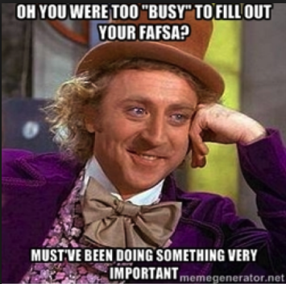
Discussion-
How often is it appropriate to adjust our method of communication to meet student needs?
Do we have a responsibility to meet students where they are, or to teach them to adapt to the professional world?

Slide 14
Sources
Castleman, B.L. & Page, L.C., Summer Melt: Supporting Low-Income Students Through the Transition to College, Cambridge, MA: Harvard Education Press (2014).
Karlan, D. McConnell, M., Mullainathan, S., & Zinman, J., “Getting to the Top of Mind: How Reminders Increase Saving,” National Bureau of Economic Research Working Paper No. 16205, Cambridge, MA (2010).
Lenhardt, A., “Teens, Smart Phones, and Texting,” unpublished report, Pew Research Center, Washington, DC (2012).
Madrian, B.C. & Shea, D.F., “The Power of Sugestion: Inertia in 401(k) Participation and Savings Behavior,” Quarterly
Journal of Economics 116, no. 4 (2001): 1149-1187.
Stockwell, M.S., Kharbanda, E.O., Martinez, R.A., Vargas, C.Y., Vawdrey, D.K., & Camargo, S., “Effects of a Text Messaging Intervention on Influenze Vaccination in an Urban, Low-Income Pediatric and Adolescent Population,” Journal of the American Medical Association 307, no. 16 (2012): 1702-1708.
Thaler, R. & Sunstein, C., Nudge: Improving Decisions About Health, Walth, and Happiness, New Haven, CT: Yale University Press (2008).

