Slide 1
Program Review Essentials
&
The Top 10 Compliance Findings
Amber Johnson
October 25, 2016
U.S. Department of Education

Slide 2
Program Review Process Overview
Analyze school data and records to identify procedural weaknesses
Examine consumer information to ensure accuracy and compliance
Frame required actions and recommendations to strengthen future compliance
Quantify harm and identify liabilities
Refer institutions for administrative action if necessary

Slide 3
Program Review Overview
Program reviews are usually conducted on-site
240 program reviews conducted nationwide in 2015-16 fiscal year
For more information, see The Program Review Guide for Institutions 2009 which can be found under publications tab on IFAP
  http://www.ifap.ed.gov/ifap/byYear.jsp?type=programrevguide

Slide 4
Review of Institutional Processes and Data
Institutional and program eligibility
Administrative capability
  Required policies and procedures
Refund and withdrawal procedures
Packaging, awarding and disbursing procedures
Campus security
Verification policies and procedures

Slide 5
Review of Institutional Processes and Data
Fiscal records and procedures
Cash management and reconciliation procedures
FISAP (if applicable)
Consumer information
Satisfactory Academic Progress
Staff/Student interviews may be conducted

Slide 6
FSA Review of Student-level Information
Sample of student files reviewed
Review multiple sources of student records
  Admission records
  Academic records, including current transcript
  Financial Aid records
  Student account record (ledger)
Student interviews may be conducted

Slide 7
Program Review Report
Preliminary report of non-compliance findings
Describes required actions, including file reviews if necessary
Establishes timeframe for institutional response
  School can request an extension
List of student files reviewed attached as appendix
May also include recommendations or comments

Slide 8
School Response to Program Review Report
Contact reviewer with any and all questions
Submit all information required in the requested format by the established deadline
Complete required actions
Request extension of time to respond if necessary

Slide 9
Final Program Review Determination Letter
Final Program Review Determination (FPRD) will be issued after school’s response is received and reviewed by the Department
May require further action from the school
If no further action required:
  Notifies the institution of the Department’s final determination for each finding
  FPRD closes the review
  Includes copy of Program Review Report and school response(s) to report

Slide 10
FPRD – School Action Required
Contains original finding, summary of school response, Department’s final determination
Identifies liabilities, if any, and instructions for payment
Describes appeal rights for monetary liabilities
Proof of repayment of liabilities to loan holders may be required

Slide 11
Appeal of Monetary Liabilities
Monetary liabilities may be appealed within 45 days
Appeal filed with FSA’s Administrative Actions and Appeals Services Group (AAASG)
Collection of liabilities deferred for appealed amounts during the appeal process
Appeal may be referred to Office of Hearings and Appeals (OHA) for review by an Administrative Law Judge
Either party can appeal OHA decision to the Secretary of Education within 30 days

Slide 12
Expedited Determination Letter (EDL)
Serves as both preliminary report and final determination letter
School is not required to respond
Usage limited
  No findings, or only minor and non-systematic findings
  Any identified findings corrected prior to EDL issuance
  Any liabilities identified were paid/collected prior to issuance of EDL

Slide 13
Top 10 Program Review Findings
Crime Awareness Requirements Not Met
Verification Violations
Return to Title IV (R2T4) Calculation Errors
Student Credit Balance Deficiencies
Drug Abuse Prevention Program Requirements Not Met

Slide 14
Top 10 Program Review Findings
Student Status – Inaccurate/Untimely Reporting
Entrance/Exit Counseling Deficiencies
Consumer Information Requirements Not Met
SAP Policy Not Adequately Developed/Monitored
Inaccurate Recordkeeping

Slide 15
Top 10 Audit Findings
Repeat Finding – Failure to Take Corrective Action
Student Status – Inaccurate/Untimely Reporting
R2T4 Calculation Errors
R2T4 Funds Made Late
Verification Violations

Slide 16
Top 10 Audit Findings
Pell – Overpayment/Underpayment
Qualified Auditor’s Opinion Cited in Audit
Entrance/Exit Counseling Deficiencies
Student Credit Balance Deficiencies
Improper Origination of DL

Slide 17
Reasons for Institutional Self-Evaluation
Assessment of staff training needs
Quality control
  Test automated systems
Ensure compliance
  Preparation for audit or program review
    Reduce potential liabilities
    Demonstrate administrative capability
  Self-disclosure of compliance issues is encouraged

Slide 18
Self-Evaluation Tools
FSA Assessments
  http://www.ifap.ed.gov/qahome/fsaassessment.html
    Develop/Update policies and procedures
    Self-assess with file review worksheets
Peer review
  State and national associations
Independent financial aid management consultant
Internal review
  Internal peer review/cross-training

Slide 19
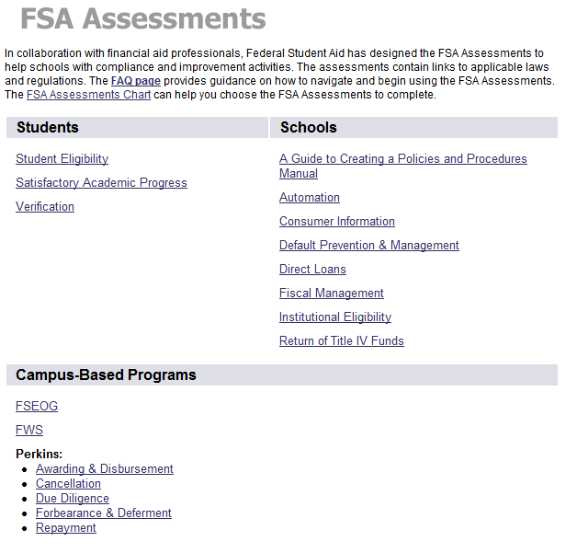

Slide 20
Top 10 Clery Mistakes
Failure to properly report crimes based on geography
Improper classification and under-reporting of crimes
Lack of adequate policy statements
Failure to publish and distribute the annual security report as a comprehensive document
Inadequate systems for collecting statistics from required sources

Slide 21
Top 10 Clery Mistakes
Incorrect reporting of referrals for disciplinary action for liquor law and drug violations
Inaccurate reporting of crime statistics to the Department
Deficient crime log
Inaccurate reporting of hate crimes
Failure to develop, implement and adhere to established policy

Slide 22
Campus Security Information Resources
OPE Campus Security webpage (http://www2.ed.gov/admins/lead/safety/campus.html)
Handbook for Campus Crime Reporting (http://rems.ed.gov/docs/ED_CampusSafetyAndSecurityReportingHandbook.pdf)
Online tutorial for use after reading Handbook
Variety of other resources:
  Statute
  Regulations
  Statistics
FSA Assessments: Consumer Information (http://www.ifap.ed.gov/qahome/qaassessments/consumerinformation.html)

Slide 23
Resolving Verification Findings
Develop internal checklist
Update policies and procedures and ensure they are implemented
Monitor processing of ISIR corrections and verification status codes
Perform monthly file reviews and/or develop quality control review process

Slide 24
Causes of R2T4 Findings
Late refunds
  School policies and procedures not followed
  Inadequate system in place to identify/track unofficial withdrawals
  No system in place to track number of days remaining to return funds
  Regulation 668.22(j)(1) requires return of funds “as soon as possible but no later than 45 days after” the date of determination

Slide 25

Causes of R2T4 Findings
R2T4 calculation errors
  Incorrect number of days used in term (vacations)
  Actual clock hours used instead of scheduled hours
  Incorrect aid used as aid that could have been disbursed
  Incorrect amounts used for institutional charges
  Mathematical and/or rounding errors

Slide 26
Resolving R2T4 Findings
Develop and implement system to track and monitor deadlines
Use R2T4 on the Web for calculations
  Can set up term calendar profiles
Make sure you have accurate information about scheduled breaks of five or more consecutive days
Use accurate information for scheduled hours for each day for clock hour programs (and document it)
Implement peer review of calculation
Perform monthly self-assessment

Slide 27
Student Credit Balance Deficiency Causes
Credit balances not released within 14 days
Non-compliant authorization to retain Title IV credit balances
Inadequate process in place to determine when Title IV credit balance exists
Credit balances not released by end of loan period or award year
Failure to maintain required credit balance ledger

Slide 28
Causes of Enrollment Status Findings
Roster file not timely submitted to NSLDS
Untimely reporting of specific student information
Conflicting enrollment status dates and types (G vs. W)
Failure to report enrollment status changes to less than half-time
Failure to report accurate enrollment types and effective dates

Slide 29
Resolving Enrollment Status Findings
Implement process to track and monitor enrollment status changes
Maintain accurate enrollment records
Train staff on requirements, including definitions of different status codes
Ensure effective communication among all staff and offices with enrollment reporting responsibilities

Slide 30
Resolving Exit Counseling Deficiencies
Exit counseling not conducted/documented for withdrawn students or graduates
  Upload results of counseling conducted outside of Studentloans.gov to NSLDS
Exit counseling materials not sent to students who failed to complete online counseling
  Maintain copy of cover letter or e-mail to non-school address for sent materials

Slide 31
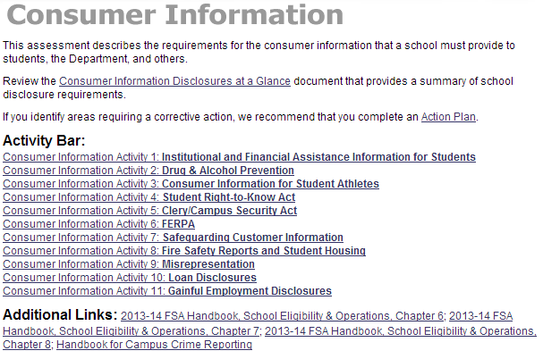
Consumer Information Resources

Slide 32
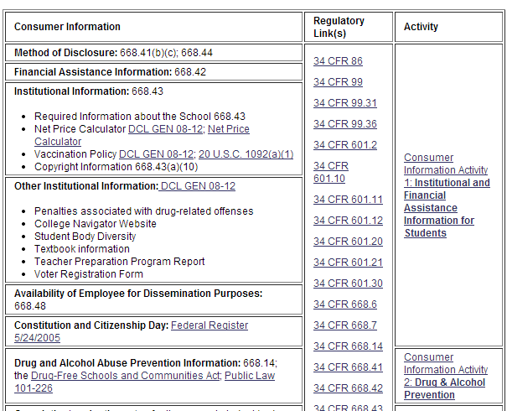
Consumer Information Resources

Slide 33
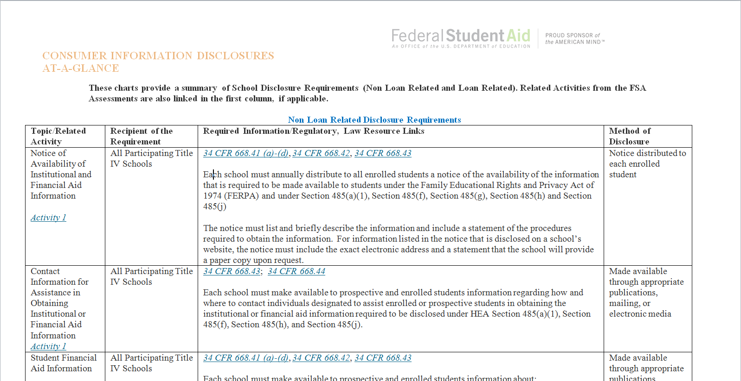
Consumer Info Disclosures at a Glance

Slide 34
Causes of SAP Deficiencies
Policy does not contain all required components
  Does not address effects of remedial courses, course incompletes, withdrawals, changes of major or program, and/or transfer credits
Improper use of financial aid Warning, Appeals, Probation and Academic Plans in SAP policy
  Insufficient documentation for appeals
Failure to consistently apply policy
Aid disbursed to students not making progress

Slide 35
Inaccurate Recordkeeping Examples
Conflicting last dates of attendance (LDAs)
Inadequate or mismatched attendance records for schools required to take attendance
Disbursement dates reported to COD do not match date of actual disbursements to student account
Failure to determine unofficial withdrawals
Academic records do not support disbursements
Lack of documentation for COA adjustments
Inadequate leave of absence (LOA) documentation

Slide 36
Accounting Records Deficiencies Example
Failure to clearly show Title IV disbursements on individual student account records
Disbursement dates reported to COD do not match actual date of disbursement to student accounts
Failure to reconcile school records with G5 and COD (and FISAP, if applicable)
No method to track Title IV credit balances due to failure to maintain running balance on student accounts

Slide 37
Inconsistent/Missing Information
Causes
  No system in place to coordinate information collected in different offices
  Insufficient or missing documentation to support professional judgment or dependency override
Solutions
  File/Scan documents timely
  Keep organized and consistent files
  Ensure all documents are received and reviewed
  Establish procedures to communicate information with other offices

Slide 38
Repeat Audit Findings
Causes:
Failure to implement Corrective Action Plan (CAP)
CAP did not remedy the compliance problem
Ineffective CAP from previous year used again
Internal controls not established to ensure CAP is successfully implemented
Solutions:
Periodically review results of CAP to ensure it is working as intended
Revise CAP as necessary

Slide 39
Causes of Pell Over- and Underpayments
Clock hour programs
  Incorrect proration for weeks or hours
  Incorrect handling of crossover payment periods
Credit hour programs
  Failure to follow census date policy
  Failure to adjust for enrollment status changes between terms
  Failure to document student established attendance

Slide 40
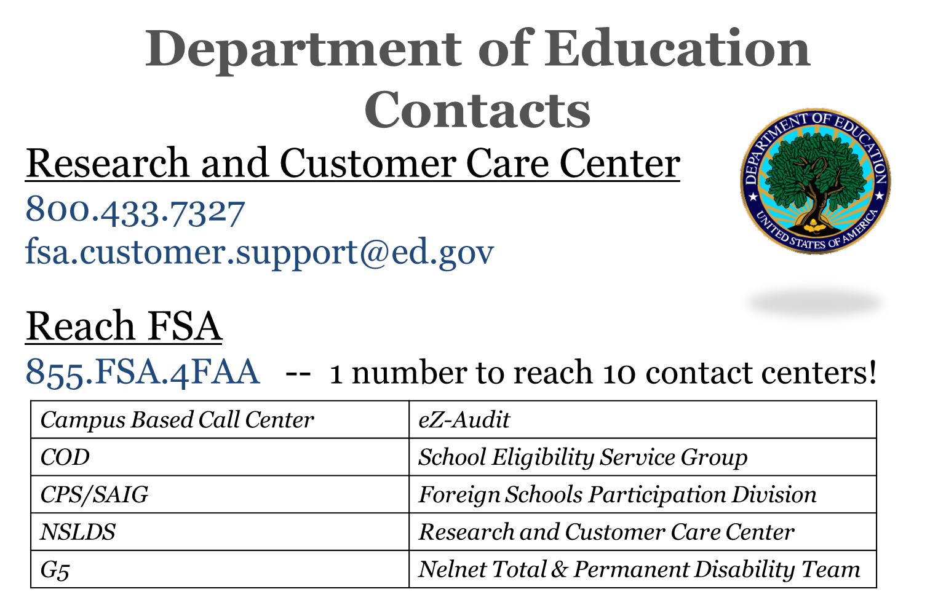

Slide 41

Regional Contacts
Philadelphia School Participation Team
  Main Number – 215-656-6442
  Joe Kern (IIS) – Joe.Kern@ed.gov; 215-656-8566
Philadelphia Training Officers
  Amber Johnson – Amber.Johnson@ed.gov; 202-377-3369
  Craig Rorie – Craig.Rorie@ed.gov; 215-656-5916

Slide 42
Training Feedback
To ensure quality training, we ask all participants to please fill out an online session evaluation.
Go to https://www.surveymonkey.com/s/AmberJohnson
  Evaluation form is specific to Amber Johnson
Additional feedback about training can be directed to JoAnn.Borel@ed.gov; 409-579-3776

Slide 43
Thank You!

