Slide 1

PASFAA 101/ First Timers Reception
NextPAGE: What PASFAA Can do for You
Presenter: PASFAA President Stacy Schenk
Director of Financial Aid
Mt. Aloysius College

Slide 2

PASFAA
The Pennsylvania Association of Student Financial Aid Administrators (PASFAA) is a dynamic, service association whose mission is:
- To provide for the professional development of members and other constituencies,
- To advocate for access to post-secondary education, and
- To educate the public on financial aid and funding opportunities.

Slide 3

We Are: an all-volunteer organization comprised of
861 members, affiliated with 224 different institutions
Membership Categories
  550 Regular Members
  291 Associate Members
  2 Retired Members
  0 Student Members
  18 Life Members
Sector Categories
  72 Business, Trade & Technical
  59 Inst’l Support Services
  17 Nursing
  360 Private
  94 Public Two-Year
  72 PASSHE
  147 State Related
  10 Graduate School

Slide 4
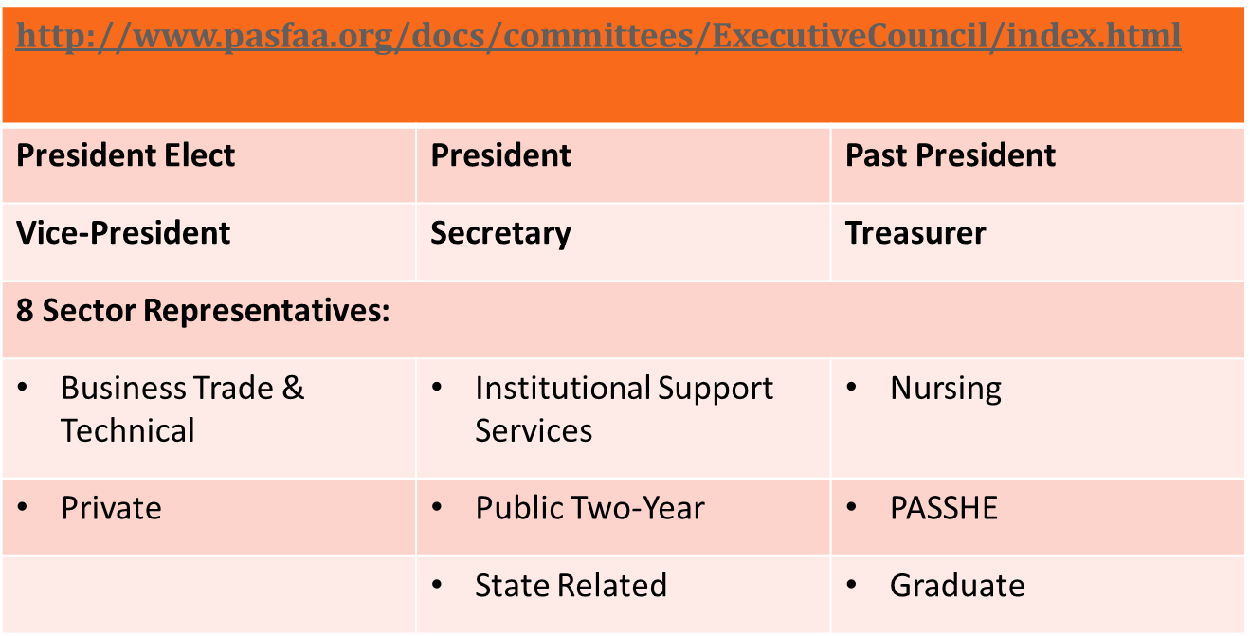
PASFAA Council
Our Elected Leadership

Slide 5
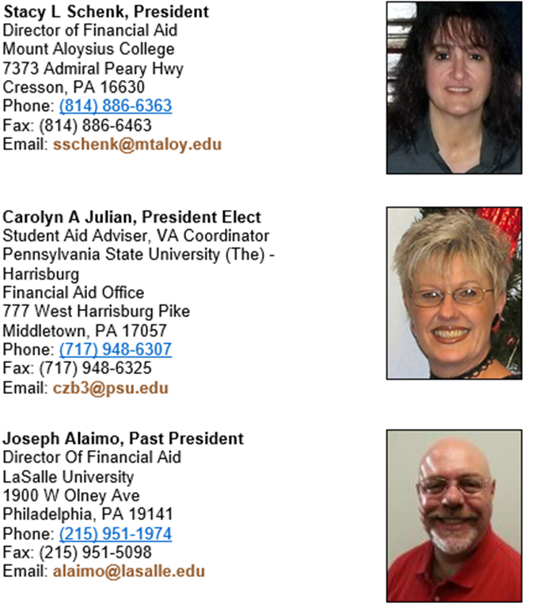
PASFAA Council
Our Elected Leadership

Slide 6
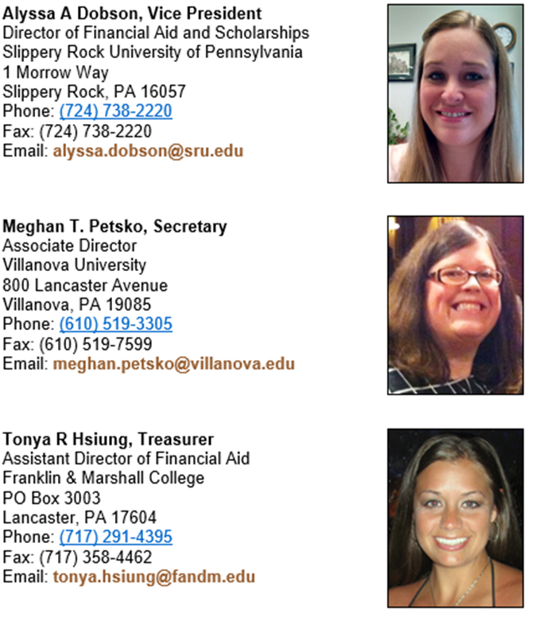
PASFAA Council
Our Elected Leadership

Slide 7

PASFAA Council
Our Elected Leadership

Slide 8
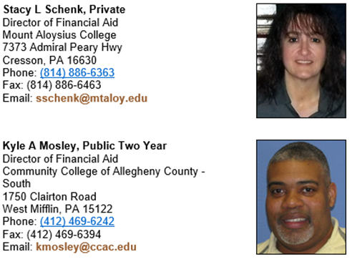
PASFAA Council
Our Elected Leadership

Slide 9
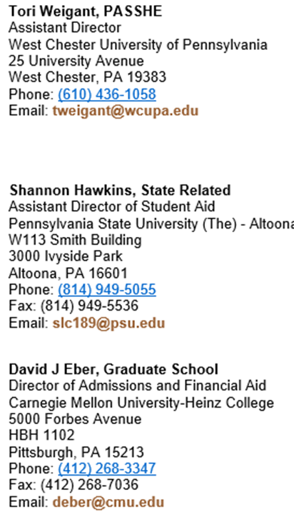
PASFAA Council
Our Elected Leadership

Slide 10
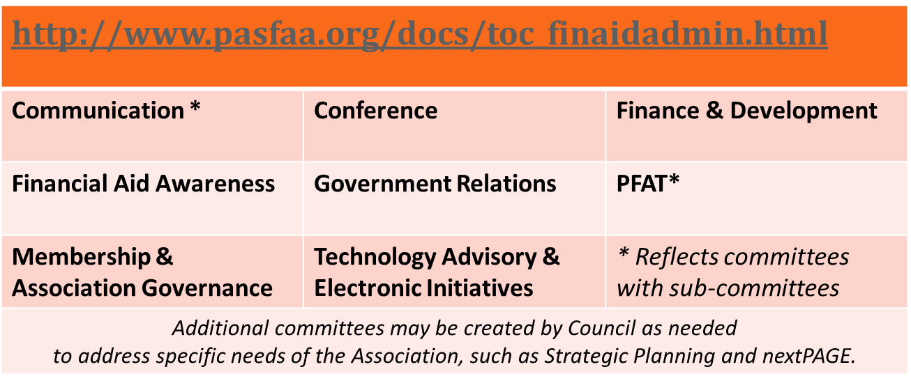
PASFAA
Standing Committees
The Life Blood of PASFAA

Slide 11
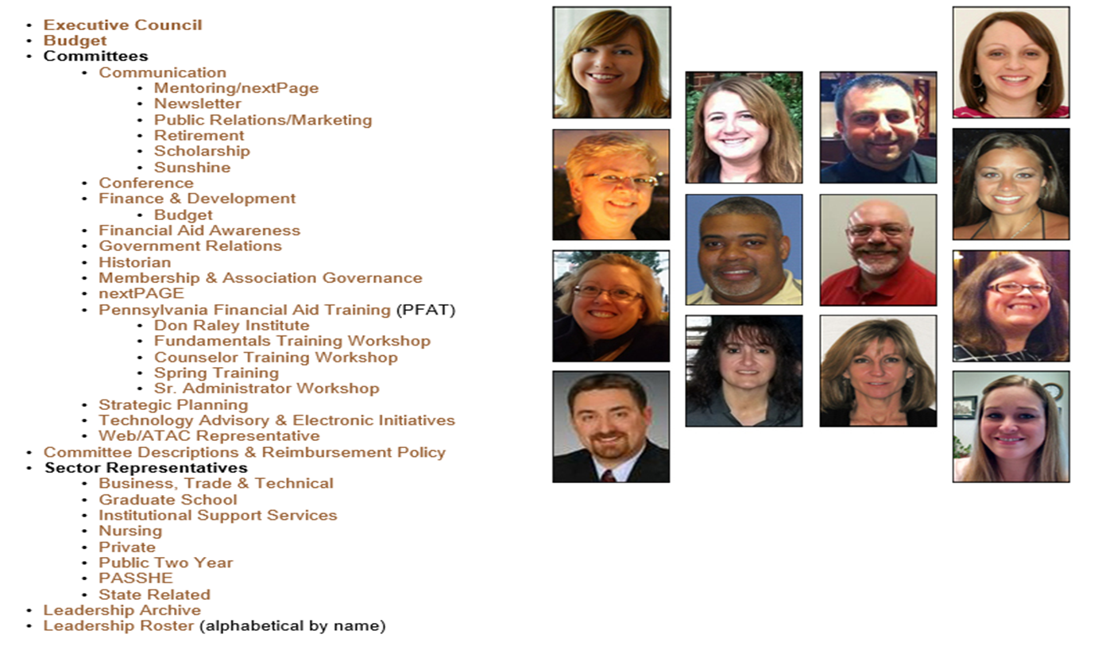
PASFAA
Standing Committees
The Lifeblood of PASFAA

Slide 12
How Can PASFAA
Help You and Your Career?
Leadership Opportunities through Elected Office and Committee Membership, Conferences, Training, Outreach lead to:
  Professional Networking
  Increased technical expertise
  Improved office operations and student service
  Development of legislative awareness

Slide 13
A Sample of our Stories
A favorite committee experience
Why I chose to run for a PASFAA office
One of my most influential experiences in PASFAA
I didn’t know I could do that; but I did it
A PASFAA colleague who made a difference in my career
A benefit I received through networking with peers
How PASFAA connected me to EASFAA and NASFAA

Slide 14
PASFAA 101/ First Timers Reception
NextPAGE: What PASFAA Can do for You
PASFAA and YOU …
What questions can we answer for you about getting more involved?

