Slide 1

Federal Update
Stephen Payne
PASFAA – October 2016

Slide 2
Agenda
Federal Budget and Funding
HEA Reauthorization
Prior-Prior Year
ED Update
ED Rulemaking Update
NASFAA Research Update
Advocacy & You!

Slide 3
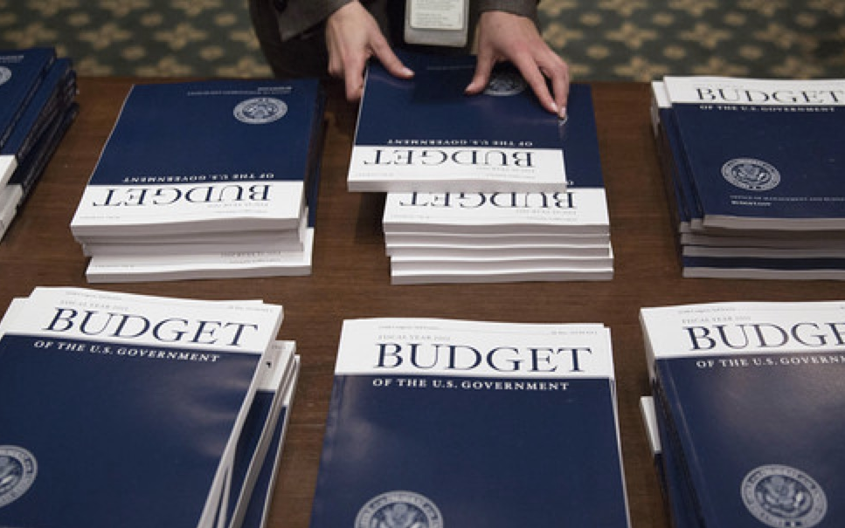
Federal Budget & Funding Update

Slide 4
How the Process Should Work…
President Proposes Budget
Congress Passes Budget Resolutions
Appropriations Subcommittees Draft Spending Bills
Full Appropriations Committee Approves Draft Bills
Appropriations Bills Pass House and Senate
President Signs Appropriations Bills Into Law by October 1

Slide 5
How the Process Should Work…
President Proposes Budget
Congress Passes Budget Resolutions
Appropriations Subcommittees Draft Spending Bills
Full Appropriations Committee Approves Draft Bills
Appropriations Bills Pass House and Senate
President Signs Appropriations Bills Into Law by October 1
But…Congress rarely follows this process.
  Politics jam the gears, no punishment for not following order
  Instead, we more often than not see mechanisms that help to patch the inability to pass separate appropriations bills
    Continuing Resolution (CR)
    Omnibus
Notes:
Does not allow for committee experts to thoughtfully and carefully debate spending levels for the issues they are most well versed in—cuts against democratic process

Slide 6
Student Aid, Congress, & the Budget
Funding for student aid falls into the Labor, Health, Human Services, and Education Appropriations Subcommittee (Labor-H), one of 12 subcommittees
The Labor-H bill is sometimes the most controversial and complex, which often makes it the last bill to see action
  Many important programs share the same pot of funds
  Several contentious programs land in the bill, including funding for Obamacare and certain labor programs
Most student aid funds are “forward funded” meaning they fund the following award year
  Ex: FY 2017 funds the 2017–18 award year
Notes:
- Its kind of crazy to think about how important we know our programs are and how they have to compete with programs in health and labor (two other very important areas)

Slide 7
October 2015 Budget Agreement
2-year deal that raised domestic spending caps imposed under sequestration
Suspends debt ceiling until March 2017
Without budget agreement, some student aid programs would likely see cuts
Compromised top-level spending numbers cleared the way for negotiations over a FY16 funding bill

Slide 8
FY16 Omnibus
$1.1 trillion agreement
Flat funds most student aid programs
Increases for TRIO and GEAR UP
Pell Grant maximum increases to $5,815, a $40 increase over FY15
No $370 million cut to Pell discretionary fund, as proposed in original House Labor-H bill
No cuts to FWS or FSEOG, as proposed in original Senate Labor-H bill

Slide 9
Where are we now for FY17?
President Proposes Budget
Congress Passes Budget Resolutions
Appropriations Subcommittees Draft Spending Bills
Full Appropriations Committee Approves Draft Bills
Appropriations Bills Pass House and Senate
President Signs Appropriations Bills Into Law by October 1
President Obama’s final Budget released in February.
House passes Budget Resolution in March; Senate skips Budget Resolution.
Internal disagreement among Republicans about spending levels.
Speaker Ryan intends to push all bills through House under “regular order”
Continuing Resolution (CR) through 12/9

Slide 10
Obama’s FY2017 (AY 17-18) Budget
Grants
  Maximum Pell Grant of $5,935 (+$120)
  Year-Round Pell, a “Super Pell” ($150/semester bonus), and Second-Chance Pell
  Continue to index Pell to inflation beyond FY17
Campus-Based Aid
  Level fund FSEOG and FWS (FY 2015 levels)
  Revise allocation formula to direct dollars to schools that enroll and graduate high number of Pell Grant students
  Expand/Reform the Perkins Loan Program

Slide 11
Obama’s FY2017 (AY 17-18) Budget
Loans and Repayment
  REPAYE would be only IDR option for all borrowers
  PSLF cap at $57,500
  Simplification of tax credits
  Consolidation of teacher grant and forgiveness programs (including TEACH Grants) into a single loan forgiveness program with a cap of $25,000 beginning in 2021

Slide 12
Obama’s FY2017 (AY 17-18) Budget
Access and Affordability Proposals
  America’s College Promise ($60 billion/10 yrs)
  College Opportunity Bonus Program ($5.7 billion/10 yrs)
    Rewards colleges that enroll and graduate low-income students
Other Items of Note
  “Student Aid Enforcement Unit”
  Return to 85/15 ratio from current 90/10 Rule for proprietary schools

Slide 13
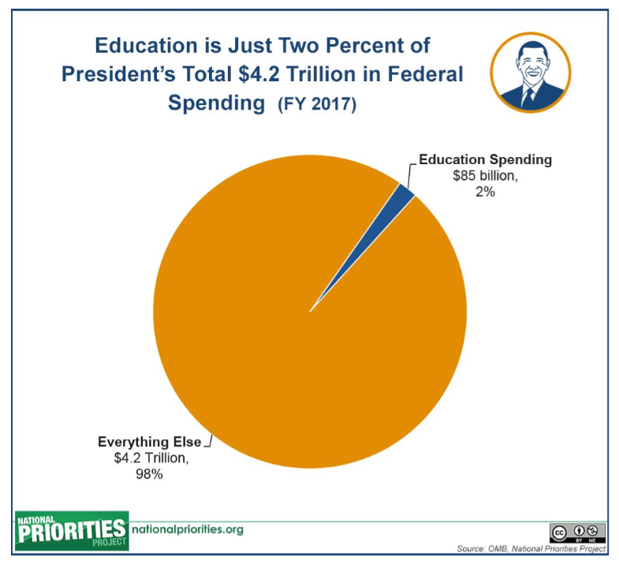
Education in Context

Slide 14
House Budget Resolution
$6.5 trillion in spending cuts over 10 years
Freeze Pell maximum for 10 years and eliminate mandatory inflation add-on
Eliminate Administrative Cost Allowance (ACA)
Switch to “fair value scoring” of federal student loans
Eliminate in-school interest subsidy
Phase out TEACH Grants
Ultimately, House Republican leadership could not get the votes to pass
Senate skips work on budget resolution

Slide 15
Senate Appropriations Bill
Return of Year-Round Pell
Use of Pell Surplus for other programs
Flat funding for FWS, FSEOG, TRIO, GEAR UP

Slide 16
House Appropriations Bill
No Year-Round Pell
Cut to Pell Appropriation
Flat funding for FWS, FSEOG, TRIO, GEAR UP

Slide 17
What’s Next?
Continuing Resolution (CR) funds the federal government through Dec. 9.
Following the election, the winning (or most winning) party will hold some leverage over the other in negotiations on a funding package for the rest of FY17.
To avoid a vote on a large spending package, spending bills could be moved in smaller “mini-buses” (as opposed to one “omnibus”).

Slide 18
What’s Next? (cont.)
Considerations as negotiations begin again…
  Bipartisan interest in increasing NIH funding, which will impact student aid programs because that money will have to be found within the Labor-H pool
  Pell Grant Program surplus tempting for appropriators
  Year-Round Pell could return, but a procedural hurdle to overcome first between House and Senate
  Best Case Scenario: Flat-funding to student aid and other higher education programs.

Slide 19
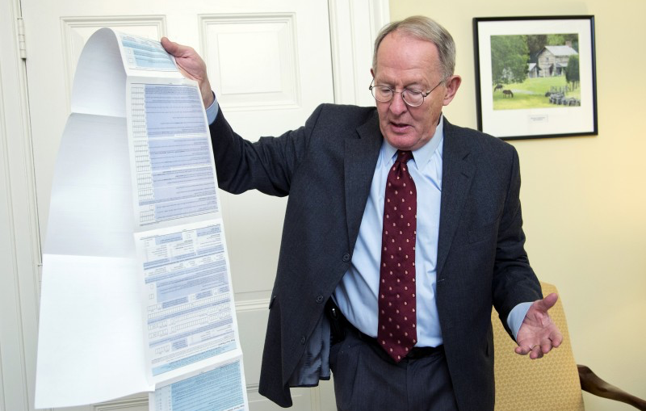
HEA Reauthorization Update

Slide 20
Reauthorization
Theme: Hurry Up and Wait!
Technically supposed to occur in 2014
NASFAA's Reauthorization Task Force submitted recommendations to House and Senate Eucation Committees in 2013
Movement beyond committee work not happening until 2017 at the earliest.

Slide 21
Reauthorization: Emerging Themes
Broad Themes: Simplification; Affordability; Accountability; Transparency
Specific Proposals:
Year-Round Pell
Simplification (Application & Repayment)
Improvement of loan counseling
Authority to limit loans
One grant/one loan

Slide 22
Reauthorization: What’s Next?
Election results will have a significant impact on the prospects of an HEA reauthorization in the 115th Congress (2017-2018).
There are many unanswered questions…
  Who will take the White House?
  Will Democrats take back the Senate? House?
  Who will be the new House education committee chair? Rep. Foxx?
  Who will be the Senate Democratic education committee leader? Sen. Murray? Sen. Sanders?
  If Clinton/Kaine win, will Rep. Scott take Sen. Kaine’s seat? If so, who will be the new House Democratic education committee leader?

Slide 23
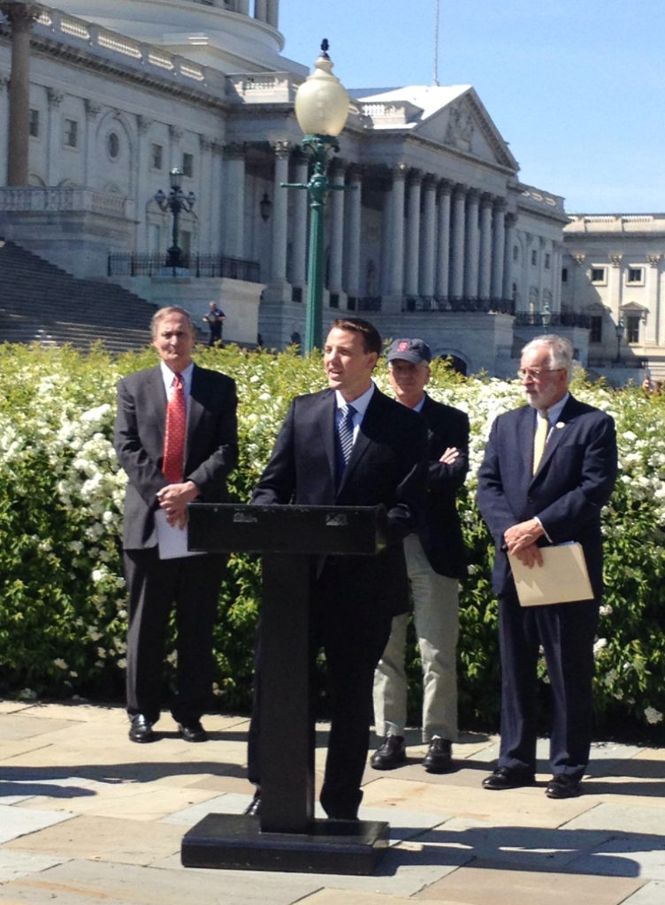
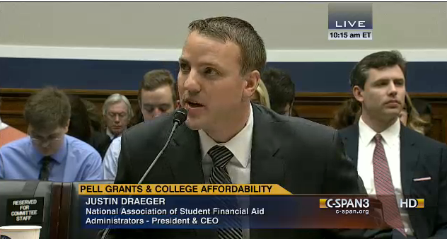
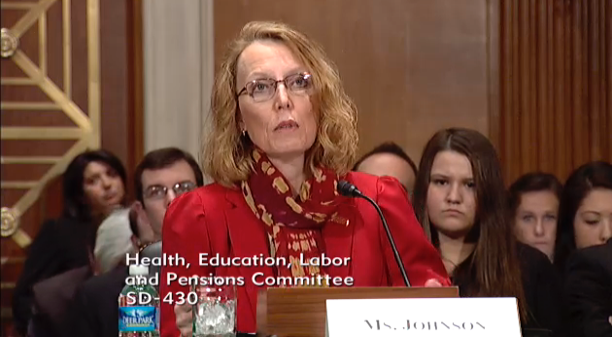
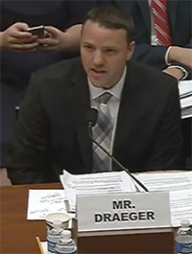
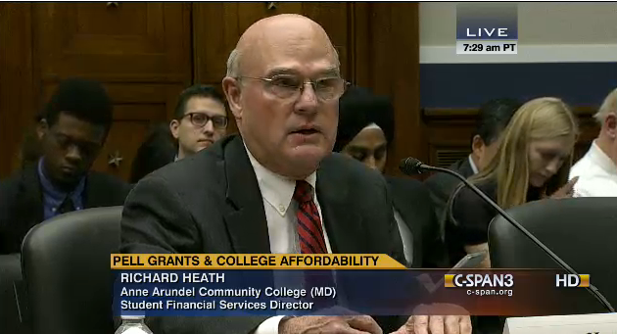
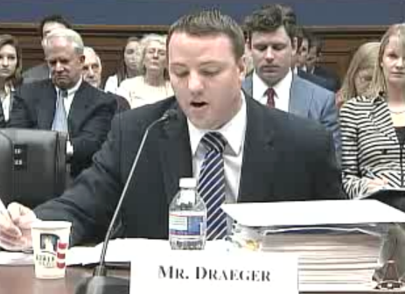
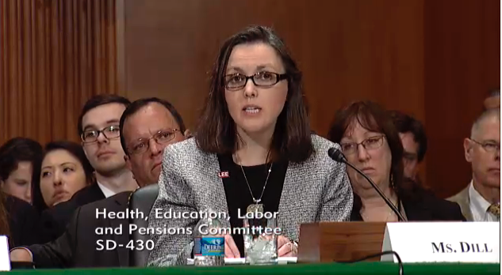
NASFAA Influence

Slide 24
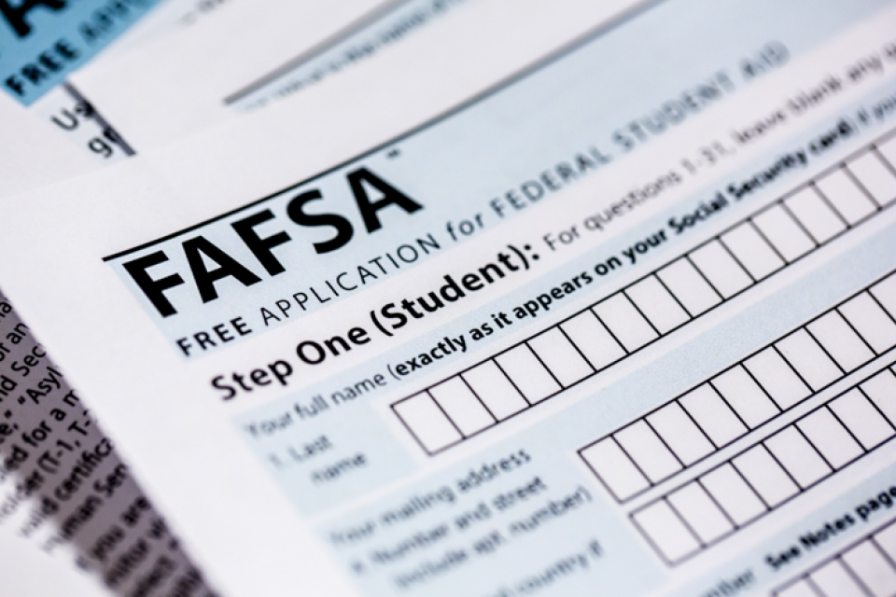
Prior-Prior Year (PPY) Update

Slide 25
NASFAA and PPY Background
NASFAA advocacy for PPY
  Reduced verification burden
  More time to make college going decisions
After much research NASFAA discovered…
  Most students did not see significant change in Pell Awards
  About 16-18% would see large changes in their Pell Grants (more than $1,000 in either direction)
  Shift to PPY appears to work best for students from lowest-income families
President Obama announced change to Early FAFSA and PPY in October 2015

Slide 26

NASFAA and PPY
Immediate formation of PPY Implementation Task Force following President’s Announcement
PPY Task Force working to identify implementation issues, solicit feedback, identify best practices, facilitate collaboration, develop resources, and evaluate implementation
PPY Toolkit on NASFAA website www.nasfaa.org/ppy_toolkit
Send feedback to policy@nasfaa.org.

Slide 27
Early FAFSA/PPY News
THIS JUST IN: Full 2017-2018 Pell Grant Payment Schedules posted on IFAP last week (10/18)
  Maximum award rises to $5,920, a $105 increase from $5,815
NASFAA sent a letter on 10/13 congratulating Department of Education for a successful roll-out of Early FAFSA
Priority Deadline concerns

Slide 28
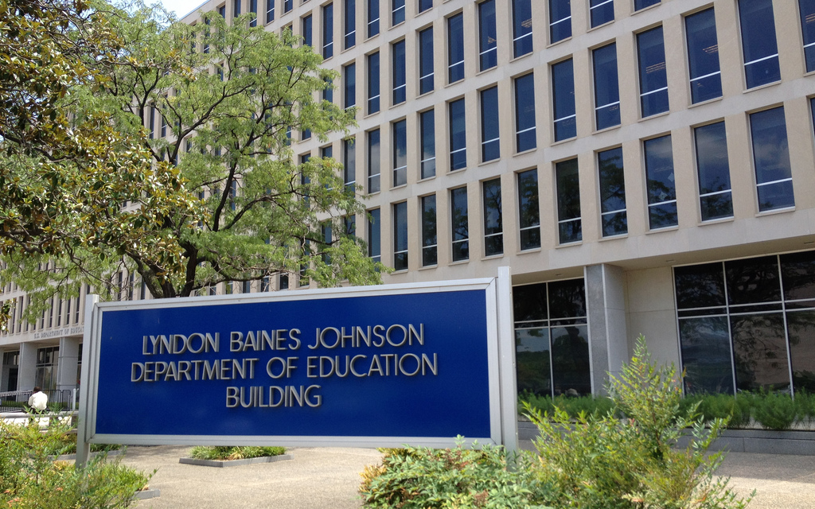
ED Update

Slide 29
NASFAA and FSA
In November 2015, NASFAA testified in a hearing before both the House Oversight and Education Committees on the Department of Education’s Office of Federal Student Aid (FSA)
  The hearing reviewed FSA’s status as a Performance-Based Organization (PBO)
  NASFAA focused on complications in the GE reporting process, the strained relationship between FAAs and FSA, and the lack of accountability at FSA
In April, NASFAA surveyed institutions about their operational experiences with FSA in response to a request from the House of Representatives.
In May, NASFAA replied to the committee leaders with the results of the survey.

Slide 30
NASFAA and FSA: FSA Survey
789 respondents; representative of membership
Looked at processing time, outstanding items, impact of processing time, and areas in which ED and FSA provide high level of service
Included 5 recommendations
Full report available on the NASFAA website

Slide 31
ED, Accreditation, and ACICS
ED terminated recognition of ACICS on September 22.
ACICS indicated intent to appeal.
Institutions will have 18 months to find a new accreditor following appeal.
  243 institutions
  $4.76 billion of Title IV aid

Slide 32

NASFAA Updates

Slide 33
NASFAA Research Update
Task Force Reports:
Consumer Information and Law Student Indebtedness Second Task Force Report= (September, 2016)
  Set out to identify through consumer testing what information on the award letter and ED’s shopping sheet could be modified to create a document that would better assist current or prospective law students
  Recommendations included:
    G/P schools should move towards standardizing financial aid terminology and ED should develop a portal through which all information is shared with students
    Additional consumer testing is needed to determine if G/P students understand basic financial aid terminology and concepts
    G/P institution should list Graduate PLUS Loan eligibility on a student’s award letter
Graduate-Specific Data Task Force Report (August, 2016)
  Examined current data being collected and what new data the community would like to see collected in the future.
  Recommendations included:
    Enhancing NSLDS reporting capabilities
    Streamlining and adding consistency to CIP codes
    Conducting additional consumer testing to better understand the needs of graduate/professional students
    Working with the National Center for Education Statistics to organize training for the G/P community on how to use federal data sets that contain information on G/P students

Slide 34
NASFAA Research Update (cont.)
Recently released studies:
Study on College Presidents (August, 2016)
  A research study focused on gaining a greater understanding of college presidents' perceptions of their financial aid offices, administrators, and the profession at large.
  Key Findings included: College presidents felt that the most important function of a financial aid administrator is to act as "a technical partner that administers financial aid and ensures compliance with regulations” are satisfied with their financial aid administrators' ability to perform their expected job functions.
  Based on the findings it was recommended that NASFAA develop an email series targeted at presidents and explore programming jointly focused on presidents and financial aid directors.
Study on Federal Work Study (FWS) (June, 2016)
  Funded by a grant from the Bill & Melinda Gates Foundation to study the components needed to efficiently and effectively administer FWS and ways in which schools can strengthen their FWS programs.
  Research was conducted in conjunction with Public Agenda, and included members from the National Student Employment Association.
  Research included a literature review and policy scan, national survey, and in-person focus groups.
  Based on this work NASFAA put forth 17 recommendations for policymakers, NASFAA and/or the ED, and future research.
  NASFAA also created a step-by-step framework for the seven components needed to develop a robust FWS program, and included promising practices in each component.
Notes:
FWS notes:
Components include:
Area #1: Identify Function Locations
Area #2: Address Award/Employment Disconnect
Area #3: Advertise
Area #4: Match Students with Jobs
Area #5: Monitor Award Usage
Area #6: Address Logistical Obstacles
Area #7: Measure Program Effectiveness

Slide 35
NASFAA Research Update (cont.)
Current Research Collaborations:
Federal Reserve Board study on Loan Counseling
The Institute for College Access and Success study on verification
  Funded by a grant from HCM Strategists
Tyton Partners study on financial aid software market
  Funded by a grant from the Bill & Melinda Gates Foundation
  Collaboration with Tyton Partners, NACAC, AACRAO, and NASFAA
Notes:
Federal Reserve Board study on Loan Counseling: Focus groups at National Conference, membership survey in late 2016
The Institute for College Access and Success study on verification: Focus groups at National Conference, membership survey in September, 2016, report released in late 2016/early 2017.
Tyton Partners study on financial aid software market – membership survey later in 2016. Report TBD

Slide 36
NASFAA Research Update (cont.)
Forthcoming projects:
2017 NASFAA Benchmarking Report
  Also updates NASFAA’s Staffing Model and Salary Model
  Serves as update to our 2016, 2012, 2006, 1999, and 1995 reports
  Benchmarking Survey distributed in October, 2016, report to be released in early 2017
Living Annotated Bibliography (New)
  Based on a findings from our Research Meets Practice study
  Will included brief synopsis and links to research studies on the five topics for use by financial aid practitioners
    Topics identified in our Research Meets Practice survey
    Continuously updated
    Topics included will be reevaluated annually
Journal of Student Financial Aid, Special Edition
  Focus: Financial Aid Practitioner – Researcher Partners
  Call for proposals is until through 10/14/16 with Anticipated Publication in November, 2017

Slide 37
Volunteer to Assist Displaced Students
With the closing of ITT, NASFAA has renewed its partnership with Beyond12 to assist displaced students.
  NASFAA previously partnered with Beyond12 after the closing of Corinthian.
NASFAA is seeking volunteers to assist students. Volunteer at:
www.nasfaa.org/volunteer_signup

Slide 38
Policy Task Forces
Past
Reauthorization Task Force
Reimagining Aid Design and Delivery (RADD) Task Force
Task Force on Student Loan Indebtedness
Task Force on Public Service Loan Forgiveness
Task Force on Campus-Based Allocations
Task Force on Consumer Information
Task Force on Loan Servicing
Task Force on R2T4
Task Force on Innovative Learning Models
Task Force on Benchmarking
Dynamic Loan Limit Working Group
One Grant/One Loan Task Force
Task Force on Graduate-Specific Financial Aid Data
Consumer Information and Law Student Indebtedness Task Force
Existing
PPY Implementation Task Force
Tuition- and Debt-Free College Proposals Task Force
Prerequisite Working Group
Future
Graduate/Professional Loan Limits
COA Construction Working Group

Slide 39
One Grant/One Loan Task Force
Report released in August 2016
Offered 12 considerations and 11 recommendations should Congress decide to pursue a “one grant, one loan” model
  Key consideration: Will federal program consolidation truly make the financial aid process simpler for students and families, given the existence of other sources of financial aid?”

Slide 40
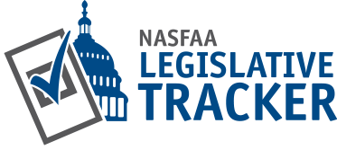
Advocacy and You!
How can you get involved?
Volunteer to join a task force or for the Advocacy Pipeline!
Visit with or write to your member of Congress, either locally or in DC!
Monitor new legislation with the NASFAA Legislative Tracker!

