Slide 1
Inside the Magic Kingdom
Seven Keys to Disney’s Success
Brought to you by:
PNC Education Lending
Amanda Scheler, AVP
Patty Peterson, AVP

Slide 2
Lesson 1
The competition is anyone the customer compares you with.

Slide 3
How are you compared?
Overall experience
Phone call to phone call
Billing statement to billing statement
Web-site to web-site
Anyone who has a great experience anywhere is comparing your organization to their experience!
Internal customers compare too!

Slide 4
Lesson 2
Pay fantastic attention to detail.

Slide 5
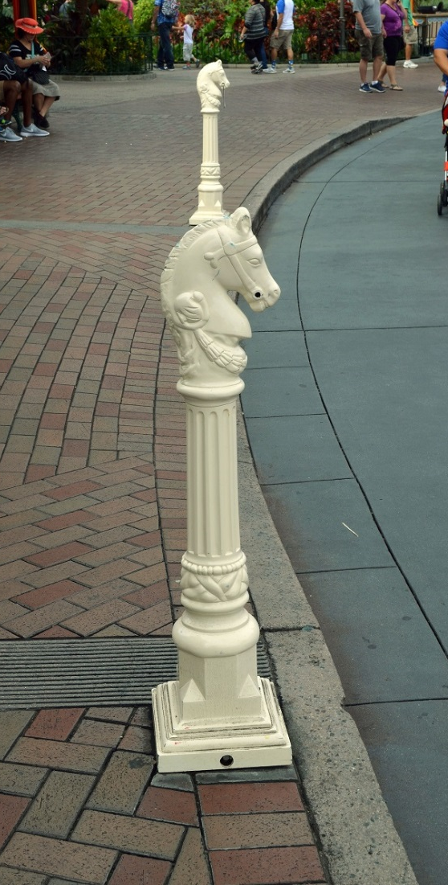
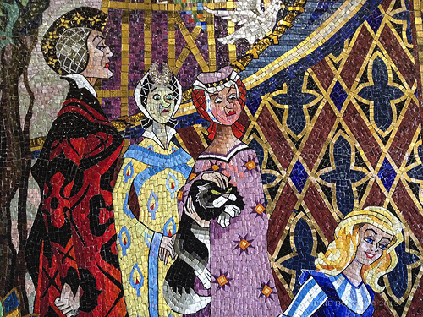
Pay fantastic attention to detail.

Slide 6
Lesson 3
Everyone walks the talk.

Slide 7
Everyone walks the talk.
Create value with every point of contact.
Be aggressively friendly.
Give people the “Why?”
Create Traditions, not Rules.
Everyone is responsible for ensuring everyone walks the talk.
The trick is to turn common sense into common practice.

Slide 8
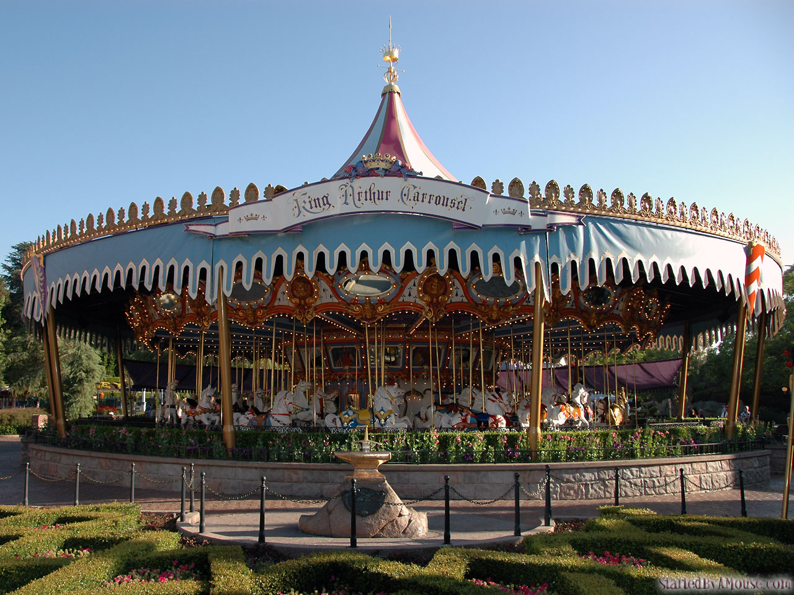
Lesson 4
Everything walks the talk.

Slide 9
Everything walks the talk. Why?
It’s more than fanatical attention to detail.
Guests won’t see this level of detail. Employees will!
Everyone focuses on providing what customers want – even people who never have direct contact.
At most organizations a few things walk the talk, but not everything. How does your mission align with your actions?

Slide 10
Everything walks the talk. How?
Fanatical attention to things that align with your purpose.
Actively look for potential intrusions!
Design & execute every action & detail. Be deliberate!

Slide 11
Lesson 5
Customers are best heard through many ears.

Slide 12
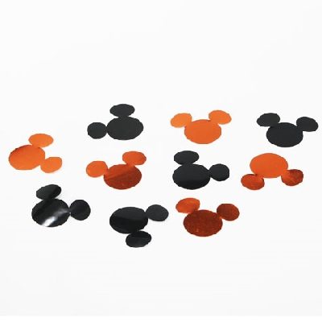
Customers are best heard through many ears.
Formal customer surveys
Customer-facing employees
Informal listening
“If you overlook the information from employees, you overlook probably the most valuable source of customer information you have.” ~Tom Connellan

Slide 13
Lesson 6
Reward, recognize, and celebrate.

Slide 14
Reward, recognize, and celebrate.
Why?
How?

Slide 15
Lesson 7
Xvxyonx makxs a diffxrxncx.

Slide 16
Xvxryonx makxs a diffxrxncx.
Somxtimxs I gxt to thinking that what I do doxsn’t mattxr. But whxn I start thinking that way, I rxmxmbxr my old typxwritxr. Most of thx kxys workxd finx most of thx timx. But onx day, onx of thx kxys stoppxd working altogxthxr. And that rxally mxssxd xvxrything up. So whxn I’m txmptxd to say, I’m only onx pxrson, it won’t makx a diffxrxncx if I don’t do this quitx right, I rxmxmbxr my old typxwritxr. And I say to mysxlf: “I am a kxy pxrson and nxxdxd vxry much.”
Adapted from the book Inside the Magic Kingdom. Used with the permission of the publisher.

Slide 17
7 Keys to Success
The competition is anyone the customer compares you with.
Pay fantastic attention to detail.
Everyone walks the talk.
Everything walks the talk.
Customers are best heard through many ears.
Reward, recognize, and celebrate.
Xvxyonx makxs a diffxrxncx.

Slide 18
References
Inside the Magic Kingdom: Seven Keys to Disney’s Success
Tom Connellan, 2008

