Slide 1
Federal Update
Amber Johnson
October 26, 2016
U.S. Department of Education

Slide 2
Agenda
Early FAFSA Prior Prior Year Conflicting Information | 2017-18 Verification
Gainful Employment | Regulatory Activity
Dear Colleague Letters & Electronic Announcements | Training
1

Slide 3
2017-2018
Early FAFSA
Prior Prior Year
Conflicting Info
2

Slide 4
2017-2018 Application Changes
2017-2018 Major Processing Announcements
Early FAFSA Launch
Beginning with 2017-2018, the FAFSA cycle will begin October 1 instead of January 1
2017–18 FAFSA available Oct. 1, 2016, at fafsa.gov
Change to October 1 launch will be permanent
Prior-Prior Year Income
Beginning with 2017-2018, FAFSA income information will come from the “prior-prior year”
2017-2018 FAFSA will collect tax year 2015 income information
IRS Data Retrieval Tool available at time of launch
3

Slide 5
Early FAFSA/Prior-Prior Year: Issues
We’ve heard your concerns about….
Outreach
Early FAFSA Webpage (right-hand side of IFAP)
http://ifap.ed.gov/EarlyFAFSA/indexV1.html
Periodic EAs, DCLs, training, Resources on IFAP
Q & As recently added
Student websites, publications, communications will be updated appropriately and as timely as possible
"Early FAFSA" mailbox for the community to contribute thoughts, ideas, and concerns on the implementation of the 2017-2018 Early FAFSA
"Early FAFSA" mailbox - EarlyFAFSAFeedback@ed.gov
4

Slide 6
2017–18 FAFSA Changes
5

Slide 7
Early FAFSA/Prior-Prior Year: Issues
Materials and Resources for Outreach
FAFSA: FinancialAidToolkit.ed.gov/fafsa
Resources: FinancialAidToolkit.ed.gov/resources
FAFSA Changes: FinancialAidToolkit.ed.gov/fafsa-changes
Talking points
Table of FAFSA launch dates and tax years
Fact sheets for counselors and parents & college students
Outreach calendar
PowerPoint presentations
Information about upcoming webinars
6

Slide 8
Enhanced FAFSA Instructions
Which FAFSA should you complete?
For which tax year should you report income and tax information?
What should you do when your current marital status doesn’t match the way you filed your tax return?
Why should you use the IRS Data Retrieval Tool?
7

Slide 9
Early FAFSA/Prior-Prior Year: Issues
We’ve heard your concerns about….
Professional Judgement (GEN-16-03)
Reminded schools of their ability to use PJ and encourages schools to use PJ when appropriate (and properly document)
ED acknowledges likely increase in use of PJ
ED will modify risk-based compliance models to account for PJ increase
Reminded schools to set Professional Judgment Flag to 1 (EFC Adjustment Processed) to indicate that the CPS submission was the result of a PJ determination
8

Slide 10
Early FAFSA/Prior-Prior Year: Issues
We’ve heard your concerns about….
Verification
May be some changes but overall process will be the same
In most cases financial data processed by IRS
Conflicting information (16/17 vs. 17/18 data)
2/18/16 EA - most effective way to reduce likelihood of conflicting information is to encourage use of IRS DRT in 16/17 and 17/18
GEN-16-14 – resolving conflicting information for 2015 income and tax information
9

Slide 11
GEN-16-14: Conflicting Information
ED will identify possible conflicting information resulting from the use of 2015 income and tax information for 2016-2017 and 2017-2018 FAFSAs
Limit the burden and minimize instances of conflicting information related to 2015 income and tax information
Normal conflicting information rules apply for non-income and tax related information
10

Slide 12
GEN-16-14: Conflicting Information
FOTW new edits warn if one or more income or tax amounts reported for 2017-18 differs from amount reported on 2016-17 FAFSA
If corrections not entered, comments included on SAR and ISIR
Edits NOT triggered if:
2016-17 FAFSA transaction was based on estimated income/taxes
Change in dependency status between two years
There has been a change in either student’s or parents’ marital status between two years
11

Slide 13
GEN-16-14: Conflicting Information
CPS will identify conflicting information between two years that once resolved would have significant impact on EFC
CPS will NOT flag if:
Student is not expected to be Pell-eligible
Change in dependency status between two years
Change in student’s or parents’ marital status between two years
PJ was performed in either year
12

Slide 14
GEN-16-14: Conflicting Information
Institutionally required resolution
Student’s 2017-18 ISIR and SAR will be flagged with ‘C’ code and comment code 399
Will NOT be included on the 2016-17 ISIR
Regardless if selected for verification
If comment code 399 not included on 2017-18 ISIR, school is not required to determine if there are any differences in income or tax information between two ISIRs
However, any other conflicting information (e.g., citizenship status or HS completion status) must be resolved
13

Slide 15
GEN-16-14: Conflicting Information
Applicability of ISIRs
School does NOT have to resolve comment code 399 if:
School never received a 2016-2017 ISIR
School received a 2016-2017 ISIR but did not and will not disburse TIV aid in either year
School does have to resolve comment code 399 if:
School received 2016-2017 ISIR and disbursed or may disburse TIV aid
Unless no longer enrolled in 2016-17 and not expected to enroll in 2017-18
School received 2016-2017 ISIR but did not review or process a 2016-2017 ISIR

Slide 16
GEN-16-14: Conflicting Information
Resolving potential conflicting information
School must compare 2015 income and tax-related ISIR items from both years’ ISIRs to determine conflict
Compare 17/18 ISIR with 399 code and 16/17 ISIR that was, or will be, used for awarding and disbursing Title IV aid
If, in any year, school had verified conflicting information or IRS DRT was used and no data was changed, school can assume verified or DRT values are correct and submit changes to other ISIR’s year’s values
Exception
If school is aware that subsequent to verification, amended tax return was filed, school must ensure both years’ ISIRs based on amended tax data

Slide 17
GEN-16-14: Conflicting Information
Conflicts must be resolved if information:
Was not verified
Was not transferred using IRS DRT
Was transferred and then changed or
If school is aware amended tax return was filed with IRS
May need to reach out to student for reasons why data is different between years

Slide 18
GEN-16-14: Conflicting Information
Additional disbursements and overpayments
2017-18 FAFSA/ISIR – if required correction is for 2017-18 year, school must use EFC from corrected ISIR to award/disburse
2016-17 FAFSA/ISIR – if required correction is for 2016-17 year, school must ensure that all awards/disbursements for 2016-17 are using corrected 2016-17 ISIR
Exception – not required to submit corrections to 2016-2017 ISIR if published deadline September 9, 2017 for making corrections has passed

Slide 19
GEN-16-14: Conflicting Information
Unable to resolve
Until conflicting information is resolved, school may not disburse any additional 2016-17 or 2017-18 Title IV aid
If unable to resolve, either because student didn’t respond or adequately clarify reasons for conflicting information, school must consider student in an overaward status for any need-based 2016-17 Title IV aid that was disbursed
except FWS – though no more FWS can be earned

Slide 20
GEN-16-14: Conflicting Information
Additional disbursements and overpayments
Lower EFC: when correction results in lower official 2016-17 EFC, school must disburse any additional 2016-17 aid that it determines student is eligible to receive, consistent with late disbursement rules at 34 CFR 668.164(g)
Higher EFC: when correction results in a higher official 2016-17 EFC, school must determine student’s 2016-2017 Title IV eligibility based on corrected EFC and may not make any additional 2016-17 disbursements for which the student is no longer eligible
Overaward may occur

Slide 21
GEN-16-14: Conflicting Information
Resolving overawards and overpayments
Title IV Grants and Perkins Loans
Adjust subsequent disbursements
If not resolved by adjusting subsequent disbursements, student must repay portion disbursed no longer eligible for
School is not liable
Follow normal overpayment rules and procedures
Direct Subsidized Loans
Does not need to be immediately repaid but instead will be repaid under terms of promissory note
No action school must take except to record its determination

Slide 22
2017-2018 Important Dates
August 2016
EFC Formula Guide (7/14/16)
SAR Comments Code and Text Guide (8/10/16)
ISIR Guide (8/10/16)
September 2016
CPS Web Applications Demo System availability (9/26/16)
October 2016
FAFSA on the Web available (10/1/16)
FAA Access to CPS Online availability (10/1/16)
IRS Data Retrieval Tool available (10/1/16)
Student Aid Report distribution begins (10/3/16)
May 6, 2016 Electronic Announcement
21

Slide 23
Early FAFSA/Prior-Prior Year: Items
Electronic Announcement #4 - March 18, 2016
Outlines income related items on FAFSA that will be based on 2015 data (prior-prior year)
Tax filing status, tax return status, type of return, return eligibility, AGI, taxes paid, exemptions, income earned from work, income exclusions, untaxed income
FAFSA items current at time FAFSA completed or for current award year (Not prior-prior year data)
Dislocated worker, household size, number in college, assets, certain means-tested benefits
22

Slide 24
2017-18 Pell Grant
The White House announced the maximum Pell Grant for the 2017-18 award year
https://www.whitehouse.gov/the-press-office/2016/09/28/fact-sheet-providing-students-and-families-comprehensive-support-and
23

Slide 25
2017-18 Pell Grant
DCL GEN-16-19
Provides the 2017-18 award year Federal Pell Grant Program payment and disbursement schedules
Provided earlier than prior year in support of the President’s “Early FAFSA” initiative
Maximum Pell Grant for 2017-18 is $5920
Maximum Pell Grant EFC for 2017-18 is 5328
Minimum Pell Grant for 2017-18 is $596
Future EAs will provide information about 2017-18 changes to CPS, CPS Online, FAA Access, FOTW, COD, and Ed Express
24

Slide 26
Priority Deadlines
“…to provide your prospective students and their families more time to explore their postsecondary education options as well as to preserve the ability for those students to receive institutional and campus-based aid, I ask you not to move any priority financial aid deadlines earlier than your deadlines for recent years.”
Letter form Under Secretary Ted Mitchell – August 8, 2016
25

Slide 27
2017-2018 Verification
Resources
Federal Register Notice – April 1, 2016
GEN-16-07 – April 5, 2016
26

Slide 28
4/1/16 Federal Register
Updates
DD Form 214 Certificate of Release or Discharge From Active Duty that indicates an individual is a high school graduate/equivalent can be used as alternative documentation to verify high school completion status
27

Slide 29
4/1/16 Federal Register
Updates
Individual selected for verification required to file a 2015 IRS income tax return and granted a filing extension by the IRS or any nontax filer selected for verification (parent, student, etc.) regardless if they earned any income from work, MUST provide:
Confirmation of non-filing from the IRS or other relevant taxing authority dated on or after October 1, 2016
If person never filed a tax return before, can get letter of nonfiling from the IRS through 4506-T document (box 7)
28

Slide 30
2017-2018 Verification
GEN-16-07
Verification Tracking Group V6 is eliminated
Schools reminded they can still select items of their choosing for verification
SNAP and Child Support Paid removed as individual verification items under V1, V4 or V5
29

Slide 31
2017-2018 Verification
GEN-16-07
School can use verification documents from 2016-2017 for following items if meet 2017-2018 requirements:
Adjusted Gross Income (AGI); U.S. Income Tax Paid ; Untaxed Portions of IRA Distributions; Untaxed Portions of Pensions; IRA Deductions and Payments; Tax Exempt Interest Income; Education Credits; Income Earned from Work
Documentation of high school completion obtained prior to the 2017–2018 award year is acceptable
Must obtain new documentation each award year for:
Number of Household Members
Number in College
Identity/Statement of Educational Purpose
30

Slide 32
Suggested Text – EA 7/29/16
Contains 3 appendices to assist with crafting school verification documents to gather verification data
Appendix A – Suggested Text
Not required to use ED’s suggested text and formats
ONE EXCEPTION – institutions must use the exact language provided in the “Statement of Educational Purpose” (Groups V4 & V5)
Appendix B – Table of verification items
Appendix C – Verification tracking groups and FAFSA verifiable information
31

Slide 33
V4/V5 Tracking Results
2016-2017 & 2017-2018
The V4 and V5 tracking process in FAA Access that began in the 2014-15 processing year WILL CONTINUE for 2016-17 AND 2017-2018
Schools need to select the proper award year for which they are providing results
2015-16, 2016-17, 2017-18, etc.
https://faaaccess.ed.gov
32
Elec. Ann. – 8/19/16

Slide 34
NEW V4/V5 Tracking Results – 2017-18
New Value #6 added to drop down options for 2017-18:
Dropdown options for 2017-18 will now be:
Verification completed in person, no issues found
Verification completed remotely, no issues found
Verification attempted, issues found with identity
Verification attempted, issues found with HS completion
No response from applicant or unable to locate
Verification attempted, issues found with both identity and HS completion
33
Elec. Ann. – 8/23/16

Slide 35
IRS “Get Transcript Online”
Allows the user to immediately receive an online PDF version of their IRS Tax Return Transcript or, if appropriate, a verification of non-filing
New enhanced two-step, multi-factor authentication process requires:
access to a valid email address,
a text-enabled mobile phone in the user’s name, and
specific financial account numbers (credit card number, etc.)
During the new Get Transcript Online registration process, the IRS will send the user a one-time confirmation code via email and an authentication code via text that the user will use to finalize the Get Transcript Online registration
34
July 26, 2016 EA

Slide 36
Gainful Employment
35

Slide 37
Important Dates
REPORTING
JUL 31, 2015
(For 2008-09 to 2013/2014 Data)
OCT 01, 2015
(For 2014-15 Data)
COMPLETERS LIST FOR SCHOOLS
JUNE 2016
COMPLETERS LIST CORRECTIONS DUE FROM SCHOOLS
Due July 28, 2016
DRAFT DEBT-TO-EARNINGS RATES TO SCHOOLS
October 19, 2016
DRAFT DEBT-TO-EARNINGS RATES CHALLENGES DUE FROM SCHOOLS
45-Day Challenge Period
RELEASE FINAL DEBT-TO-EARNINGS RATES TO SCHOOLS
WINTER 2016
36

Slide 38
GE Completers List Webinars
Title: Reading Your Draft GE Debt-to-Earnings (D/E) Rates Files
Tuesday, October 18, 2016 and again on Tuesday, October 25, 2016 from 1:30 P.M. to 3:00 P.M. (ET)
Title: Submitting Draft GE Debt-to-Earnings (D/E) Challenges
Thursday, October 20, 2016 and again on Thursday, October 27, 2016 from 1:30 , both from 1:30 P.M. to 3:00 P.M. (ET)
Registration Details: EA September 26, 2016
37

Slide 39
Important Dates
DISCLOSURES (UPDATES)
JANUARY 2016
DISCLOSURES
(NEW REGULATORY REQUIREMENTS)
JANUARY 31, 2017
PROGRAM
CERTIFICATIONS
DECEMBER 2015 & Ongoing
38

Slide 40
Other Possible Disclosures
Beginning in 2017, disclosures could include
D/E rates | Percent borrowing
Program cohort default rates | Completion rates
Loan repayment rates | Withdrawal rates
Median loan debt | Placement rates
39

Slide 41
GE Electronic Announcements
#93 – Draft GE Debt-to-Earnings (D/E) Rates and Viewer Tool Now Available
#90 – Updated NSLDS GE User Guide
#89 – Additional Information for Accurate GE Reporting by October 1, 2016 Deadline
#88 – Distribution of Final GE Completers Lists and Draft GE Completers Lists Correction Results
#87 – Updated NSLDS GE User Guide and GE Program Tracking Information
#86 – Upcoming October 1, 2016 GE Reporting Deadline for the 2015-16 Award Year
40

Slide 42
GE Electronic Announcements
#85 – Alternative Earnings Survey Resources Now Available
#79 – GE Completers List Viewer Tool and Import Tool Available
#78 – Draft GE Completers List files
#77 – Fulfilling GE certification requirements when updating the E-App
#75 – NSLDS Enrollment Update Access Required for Draft GE Completers List Corrections

Slide 43
RegulatoryActivity
42

Slide 44
Borrower Defense - PROPOSED
Notice of Proposed Rulemaking – June 16, 2016
Borrower defense to repayment regulations
Establish new Federal standard and process for determining whether borrower has a defense to repayment on a loan based on an act/omission of school
Amend DL by prohibiting schools from using certain contract provisions with dispute resolution processes
Provide for remedial actions that may be taken to collect losses arising out of claims for which a school is liable
Revise the financial responsibility standards and add disclosure requirements for schools
Final regulations expected to be posted by 11/1/16
43

Slide 45
NPRM – 7/25/16 (PROPOSED)
Distance Education and State Authorization
Require an institution offering distance education or correspondence courses to be authorized by each State in which the institution enrolls students, if such authorization is required by the State
Define the term ‘‘State authorization reciprocity agreement’’ as an agreement between 2 or more States
Require an institution to document the State process for resolving complaints from students enrolled in programs offered through distance education
Require that an institution provide public and individualized disclosures to enrolled and prospective students regarding its programs offered solely through distance education
44

Slide 46
Additional DCLs
&
Electronic Announcements
45

Slide 47
Dear Colleague Letters
GEN-16-17 – Campus Policing
Provides information and resources to ensure schools are properly policing campuses, adhering to Cleary Act requirements and meeting all Civil Rights obligations
Contains links to the updated Department’s Handbook for Campus Safety and Security Reporting, the President’s Task Force Report, plus several other websites and contact information
The Department’s Campus Security webpage is:
http://www2.ed.gov/admins/lead/safety/campus.html
46

Slide 48
Dear Colleague Letters
GEN-16-16 – Cost Disclosures (T1or T2)
No later than September 1, 2017, an institution with a T1 or a T2 arrangement that meets or exceeds the credit balance thresholds must post certain data prominently on the same website where the institution posts its full contract with a financial account provider
The institution must disclose:
total paid or received by parties under the contract
any year students open 30 or more financial accounts
number of students who had accounts any time under the contract during the most recently completed award year
mean & median costs incurred by student accountholders
47

Slide 49
Dear Colleague Letters
GEN-16-16 – Reporting Fee data (T1or T2)
If school does not have efficient or cost-effective way of calculating cost disclosure information, the school may:
Provide student directory information (name, DOB, attendance dates) to account provider and use to determine account holders
School must list required data as part of the directory information and students will have option to opt out
Students that opt out will not be included in cost disclosure
Review accounts linked to a student ID which can be readily identified by the account provider
Review the number of accounts opened under a revenue sharing contract
48

Slide 50
Dear Colleague Letters
GEN-16-15 – 3rd Party Servicer Q & As
Over 20 Q & As on 3rd Party Servicers including:
Key definitions, including a chart with examples of functions and services that are or are not considered to be 3rd party servicing
Servicers cannot be located outside the U.S. or owned by non-U.S. citizens/nationals or permanent residents
What constitutes working on behalf of an institution
Compensation not required to be a 3rd party servicer
49

Slide 51
Electronic Announcements
10/18/2016 – Acceptable Documentation Update for 2016-17 Award Year Verification
Alternative documentation allowed when tax filer RECENTLY requested but unable to obtain an IRS Tax Return Transcript using the IRS paper or on-line request process
No alternative documents for telephone requests
Exception not permitted for transcripts unable to be obtained simply because the IRS has not had time to process the data due to a recent filing
For 2016-2017 award year only!

Slide 52
Electronic Announcements
In instances where tax filer recently requested a tax transcript from the IRS but was unsuccessful in obtaining the tax transcript :
1. Signed copy of relevant 2015 IRS tax return
AND
2. A statement from the tax filer (on or attached to the tax return) which certifies that the tax return submitted to the institution includes the same information that was submitted to the IRS
AND
3. Documentation from IRS of unsuccessful tax transcript request
Screen shot print (SIGNED AND DATED BY TAX FILER) or
Letter from IRS (SIGNED AND DATED BY TAX FILER); or
AND
4. Completed and signed IRS Form 4506T-EZ or 4506-T listing institution as third party
- Send to IRS only if doubt paper tax return accuracy

Slide 53
Electronic Announcements
10/18/2016 – Additional COD System Implementation Planned for October 28-30, 2016
During October 28-30, 2016, additional COD System functionality will be implemented
Includes an attachment that highlights the processing function enhancements and modifications that will be implemented
52

Slide 54
Electronic Announcements
9/26/2016 – Official Cohort Default Rates – FY2013
On September 26, 2016, the Department distributed electronically distributed FY 2013 3-Year official cohort default rates to all eligible schools
Please don’t forget to review your CDR data and appeal as appropriate within the required time frames
Questions about default rates - contact fsa.schools.default.management@ed.gov or call the Operations Performance Division Hotline at (202) 377-4259
53

Slide 55
Electronic Announcements
9/6/16 – Pell Grant Overpayments
Reminder when to report Pell Grant overpayments to NSLDS and when to make adjustments to Pell Grant information in the COD System
Indicate different requirements between school and student errors
Provide a table summarizing Pell Grant overpayment reporting requirements to NSLDS, the COD System, and G5
54

Slide 56
Electronic Announcements
7/19/16 – G-845 submissions
Verification of eligible non-citizenship statuses must be submitted to the Los Angeles field office:
U.S. Citizenship and Immigration Services (USCIS) Attn: USCIS SAVE Program Status Verification Office 300 N. Los Angeles Blvd., Room 3204 Los Angeles, CA 90012
Exception for Battered Immigrant-Qualified Aliens with a Status Under VAWA must still be sent to the Buffalo field office
55

Slide 57
Electronic Announcements
7/1/16 – Posting Contract Information and Providing Contract URL to ED
Schools with either a Tier One (T1) or Tier Two (T2) arrangement must post to their website any contracts or agreements establishing the T1 or T2 arrangements no later than September 1, 2016
Updates to the posting must occur within a reasonable time if there are substantive changes
In addition, the school must also provide to ED the URL for their contract/agreement through https://studentaid.ed.gov/sa/about/data-center/school/cash-management
56

Slide 58
Training
57

Slide 59
Upcoming Training
2016 FSA Training Conference
November 29 – December 2
Georgia World Congress Center – Atlanta, GA
58

Slide 60
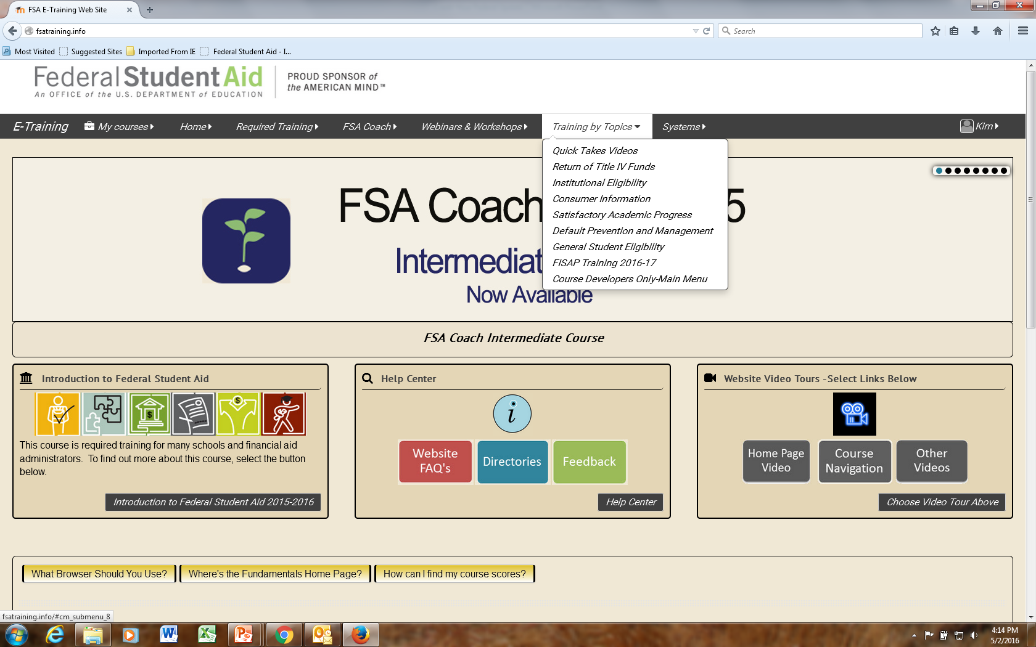
FSA Training
Modules
fsatraining.info

Slide 61
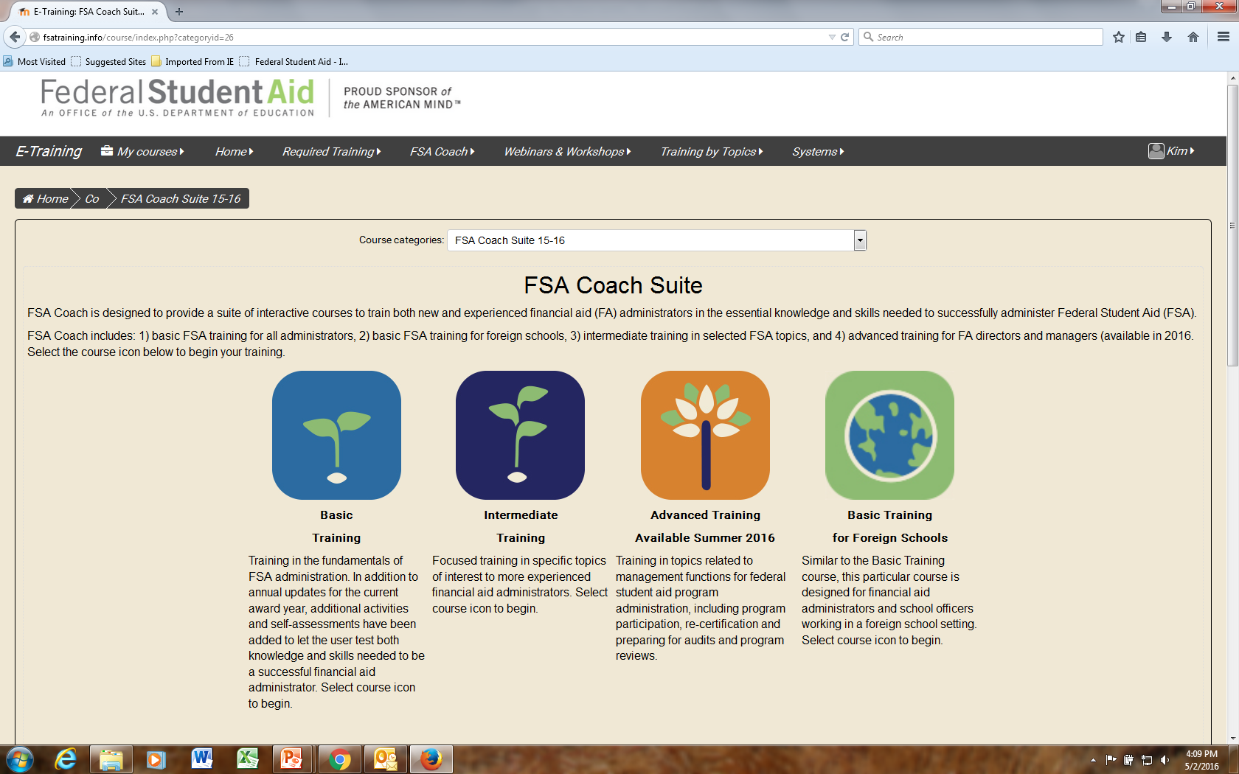

Slide 62
Quick Takes Videos
FSA-related topics that can be completed in about 15 minutes
Several topics now available
Finding Federal training resources
Conflicting information
Paper secondary confirmation
Professional judgment
Basics in FSA Parts I, II and III
Available now on fsatraining.info
61

Slide 63
ED Contacts
Research and Customer Care Center
800.433.7327
fsa.customer.support@ed.gov
Reach FSA
855.FSA.4FAA – 1 number to reach 10 contact centers!
Campus-Based Call Center | eZ-Audit
COD | School Eligibility Services Group
CPS/SAIG | Foreign Schools Participation Division
NSLDS | Research and Customer Care Center
G5 | Nelnet Total & Permanent Disability
62

Slide 64
Regional Contacts
Philadelphia School Participation Team
Main Number – 215-656-6442
Joe Kern (IIS) – Joe.Kern@ed.gov; 215-656-8566
Philadelphia Training Officers
Amber Johnson – Amber.Johnson@ed.gov; 202-377-3369
Craig Rorie – Craig.Rorie@ed.gov; 215-656-5916
63

Slide 65
Training Feedback
To improve our training, we ask all participants to complete an online session evaluation
Go to https://www.surveymonkey.com/s/AmberJohnson
Additional feedback about training can be directed to JoAnn.Borel@ed.gov; 409-579-3776
64

Slide 66
Thank You
65

