Slide 2
What Is the Right
Type of Loan?
Comparing Private Loan and PLUS Loan Options
Allyson Bentz
Assistant Dir. of Financial Aid
Accredited Financial Counselor
Geneva College
Ben Brudnock
Assistant Vice President
EFS Account Executive
Wells Fargo

Slide 3
Agenda
Funding the gap
Recent statistics and trends
Comparison of PLUS & Private loans
Eligibility
Cost
Repayment
Understanding APR and rate shopping
Strategies & school communication examples
Resources for schools and families
3
Notes:
Overview of what will be covered during presentation.

Slide 4
Common Ways to Pay
After the “free money” and savings run out….. some wise, some not so much…..!
Google
PLUS
Credit Cards
Powerball Lottery 1 in 146,107,962
Direct Loan
Educational Private Loans
Retirement Accounts
Perkins
Hold Out Until Your Kid Gets to the 11th Grade then Start Up a 529 Plan
Payment Plans
Home Equity
Education Loan Resource Continuum
Source: Adapted from 2012 PASFAA Fall Conference Presentation
4

Slide 5
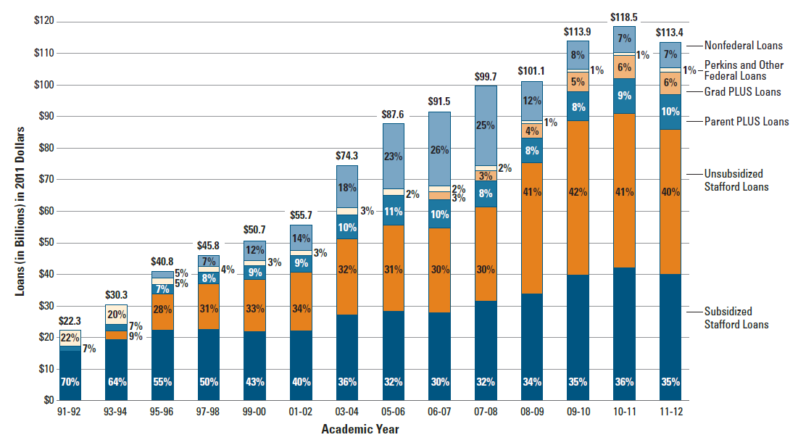
PLUS & Private Loan Volume Trends
SOURCE: The College Board, Trends in Student Aid 2012
5
Notes:
Federal loans = $105.2 in 2011-12; private loans = $8.1billion

Slide 6
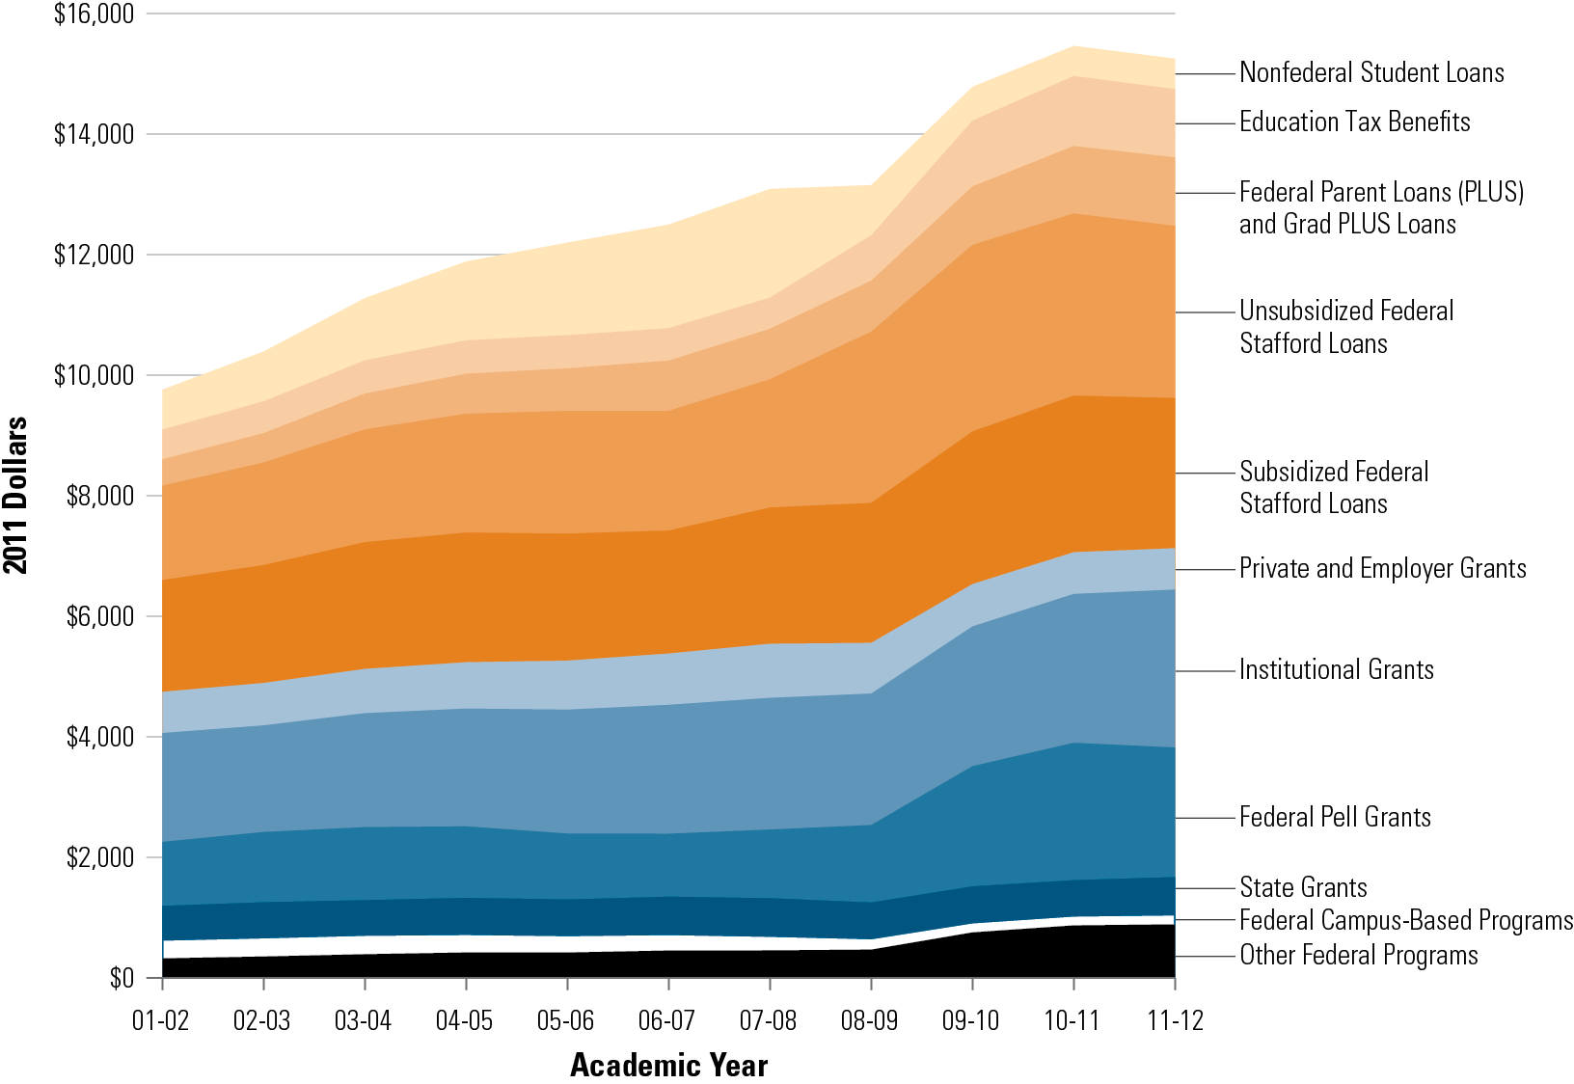
Ten Year Trend in average aid per FTE
SOURCE: The College Board, Trends in Student Aid 2012, Figure 1
Notes:
In 2011-12, average undergrad aid award included 51% grants & 40% loans
Ten-Year Trend in Student Aid and Nonfederal Loans per Full-Time Equivalent (FTE) Student Used to Finance Postsecondary Education Expenses in 2011 Dollars, 2001-02 to 2011-12

Slide 7
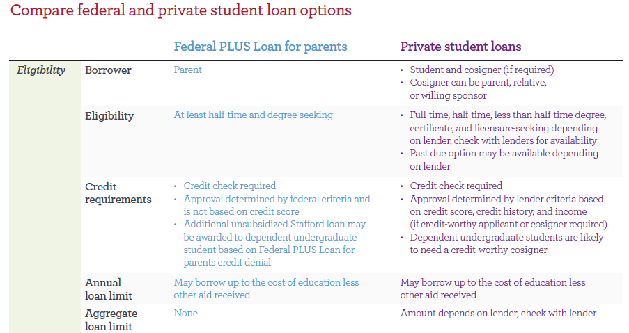
Credit Factoid:
19.6% of the population has a credit score of 750-799
18.1% of the population has a credit score of 800-850
Source: MyFico.com
7

Slide 8
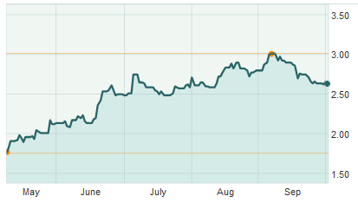
Federal and Private Comparison, continued
New Direct Loan formulas, per H.R. 1911, for 2013-14:
10-yr T note (1.81%)
+ 2.05% undergrad = 3.86% (8.25% cap)
+ 3.60% graduate = 5.41% (9.50% cap)
+ 4.60% PLUS = 6.41% (10.50% cap)
10-year Treasury note from 5/8 to 10/2
3.01% (52-week high)
2.61%
8

Slide 9
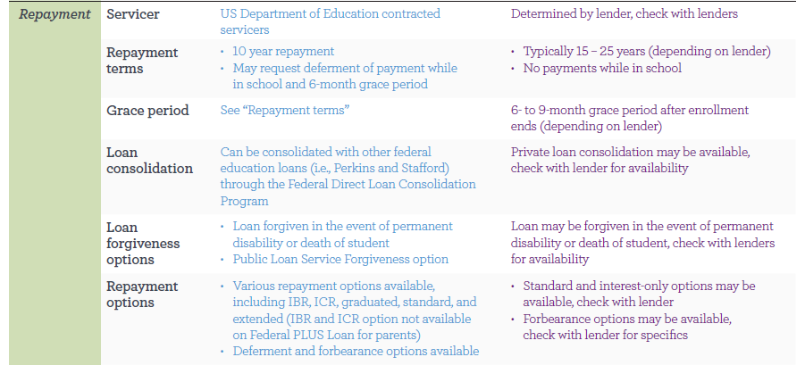
Federal and Private Comparison, continued
9

Slide 10
Understanding APR & Rate Shopping
To fee, or not to fee…that is the question
Direct PLUS in 2013-14
Loan amount $10,000
4.204% fees ($420.60)
Interest rate 6.41%
Term 120 months
Monthly payment $118.05
Cumulative payment $14,165.77
Interest paid $4,165.77
Private Education Loan
Loan amount $10,000
Zero fees ($0)
Interest rate 7.38%
Term 120 months
Monthly payment $118.08
Cumulative payment $14,168,96
Interest paid $4,168,96
The up-front fees on Direct PLUS pushes the actual Annual Percentage Rate (APR) to 7.33%
The example above shows a “break-even” point on a $10,000 loan between PLUS and a zero-fee Private Education Loan
Calculator used: FinAid.org

Slide 11
School Communication Strategies
Is your school “Pro-PLUS?” Here’s a website example:
“Before applying for a private or alternative education loan, you may qualify for grants and/or other assistance under Title IV of the Higher Education Act. Loans under Title IV include the Federal Stafford and the Federal PLUS loan. These Title IV loans may have terms and conditions that may be more favorable than the terms and conditions of private education loans.”
Is your school “neutral” Here’s a website example:
Private Educational Loans and Direct PLUS Loans should be considered as a last resort, but may be necessary to finance a college education. To learn more about these options, please review the comparison chart and the suggestions below. If you have good credit history, a private loan may cost less than a federal student loan- be sure to consider all of your options and compare carefully!

Slide 12
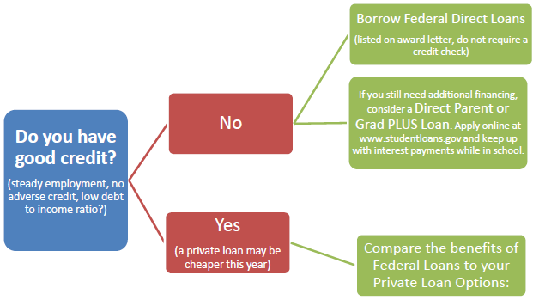
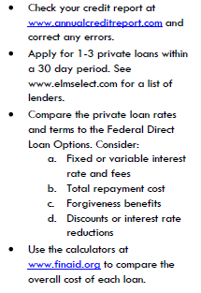
School Communication Strategies, continued
SOURCE: Geneva College

Slide 13
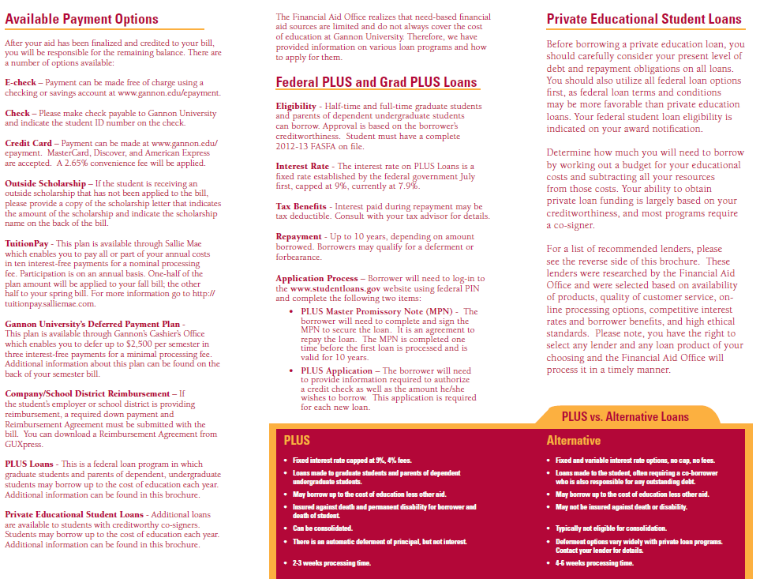

Slide 14
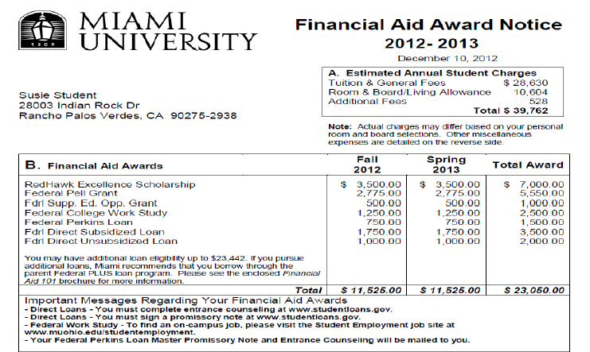
School Award Letter Strategies
14
Notes:
NPC as legislated must be called NPC – but do families understand what that means?

Slide 15
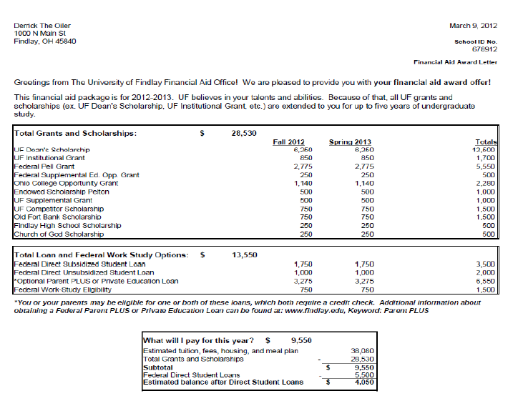
School Award Letter Strategies, continued

Slide 16
School Award Letter Strategies, continued
Enroll in Payment Plan | Details on all plans and payment options can be found at www.geneva.edu/studentaccounts or by calling the Business Office (724.847.6875). Enrollment in the interest free monthly payment plan begins in March (for 12 month plan) and ends in August (for 6 month plan), so please sign up early! You must sign up for an amount that will cover both the fall and spring semester balances. If you are unsure of the annual balance due, feel free to estimate – you can always change the plan amount at a later date. | Enroll as soon as possible
Apply for Additional Loans | If you are interested in borrowing additional loans, there are two options for those who qualify: Direct Parent PLUS Loans (apply online at www.studentloans.gov) Private Student Loans (get more details at www.geneva.edu/privateloans) Our website also has a comparison chart of these two options, suggestions on how to get the best interest rate, and additional details: www.geneva.edu/fa. Please be sure to apply early and for the amount needed for the entire year. If loan changes need to be made after approval, please notify the financial aid office in writing. | Apply as early as possible
Notes:
Geneva Financial Aid Checklist

Slide 17
Staff Training
Is everyone aware of interest rates and…
How they are determined?
When they change?
Future predictions?
Business Office
Admissions Counselors
Support Staff

Slide 18
Federal Student Loan Interest Rates
Undergraduate
For loans first disbursed between July 1 and June 30 of…
Year | Subsidized | Unsubsidized | PLUS
06-07 and 07-08 | 6.80% | 6.80% | 7.9% Direct 8.5% FFEL
08-09 | 6.00%
09-10 | 5.60%
10-11 | 4.50%
11-12 and 12-13 | 3.40%
13-14 | 3.86% | 3.86% | 6.41%
Graduate
Year | Subsidized | Unsubsidized | PLUS
2006-2013 | 6.80% | 6.80% | 7.9% Direct 8.5% FFEL
13-14 | N/A | 5.41% | 6.41%
Perkins Loan: 5% fixed rate
Notes:
Sample Interest Rate Chart

Slide 19
What’s the bottom line?
All consumers should make an informed decision before deciding on a loan. There is no down side to shopping around.
Each family’s situation is unique
Applying for multiple credit-based student loans (rate shopping) in a 30-day window is treated as one inquiry when determining a credit score*
Applying for a private student loan does not impact ones eligibility for a Direct PLUS Loan for parents or graduate and professional students
All approved borrowers get the same PLUS deal: 6.41% with 4.2+% up-front fees. While PLUS may be a good option for those with less than excellent credit, private loans may offer those with above average credit a better rate, zero fees and more repayment discounts.
*Source: myFICO.com

Slide 20
Resources for Schools and Families
FastWeb’s “Quick Reference Guide on Choosing a Student or Parent Loan
Studentloans.gov Federal v. Private Loan comparison chart
FinAid.org’s Private Loan Comparison
PA Marketplace
ELM Select
Fast Choice/Fast Alt Loan Choice by Great Lakes
Choice wrap from Wells Fargo
Other lender publications/comparison tools

Slide 21
Questions/Discussion?
Notes:
Address any additional questions your school contact may have.

