Slide 1



Slide 2
MoneyCounts: a financial literacy series
The Pennsylvania State University
  The Commission for Adult Learners
  &
  The Office of Student Aid
  April 2013
  Workshops Budgeting
  Webinars Credit Cards
  Seminars Student Loans
  Presentations Other Topics

Slide 3

MoneyCounts: A Financial Literacy Series
What Should Every Adult Know About Finances?
Dr. Daad Rizk
The Pennsylvania State University
301 Outreach Building
University Park, PA 16802
dar39@psu.edu

Slide 4
Description
Returning to school as an adult has its challenges and often involves financial sacrifices, but there are ways to lessen the impact.
In this workshop, we will:
Explore the financial challenges and options faced by Adult Students
Discuss how financial literacy creates a balance between school demands and the rest of adult responsibilities

Slide 5
Definition of Financial Literacy
Financial Literacy is acquiring the knowledge and skills to make informed financial decisions and take effective actions regarding money management.

Slide 6
Are you an Adult Learner?
24 years of age or older; or
a veteran or actively serving member of the armed services; or
returning to school after four or more years of employment, homemaking, or other activity; or
assuming multiple adult roles such as parent, spouse/partner, employee and student.

Slide 7
Challenges?
Where will I find the money?
Where will I find the time?
What would I study? What would I want to accomplish?
How do I balance school demands and the rest of my adult responsibilities?
Discussing finances is a personal and an emotional topic

Slide 8
Options?
Finding the money?
  Ask your employer for tuition reimbursement
    There may be strings attached
      Working for the company for extended number of years
        Job security ( win-win situation)
        Passing grades tied to reimbursement (win-win-situation)
    Good news:
      Up to $5,250 of employer-provided educational assistance is tax free.
      Classes do NOT have to be related to your current position

Slide 9
Options?
Student/Financial Aid Office is your FRIEND!
  File the FAFSA (Free Application for Federal Student Aid) meet application deadlines!
    You may qualify for grants and scholarships
      Search for free money first!
    You will be classified as independent student
      You file based on your income (you & your spouse if married)
      You can get loans (be careful not to extend yourself on loans, remind yourself that loans will have to be paid back)

Slide 10
Options?
Military Aid?
  Educational benefits for Veterans and their dependents – Federal Government
    GI Bill Benefits – Education, Self, Spouse, Children
    Yellow Ribbon Scholarships
    Contact your local Veteran’s Office – financial aid office

Slide 11
Options
Child Subsidy Program
  Child care subsidy program for qualifying low-income undergraduate student parents enrolled in a degreed program.
  Funding for graduate student families could also be available.

Slide 12
Options?
Use Personal Assets?
  Saving
  Home equity – LOC – Interest rate
  Other assets

Slide 13
Options?
Investigate education tax credits and deductions
  American Opportunity Credit (Hope credit)
    $2,500 in 2011 for tuition and related expenses for the first four years of undergraduate education (income $80,000 single or $160,000 M/J)
  Lifetime Learning Credit
    $2,000 in 2011 for tuition and related expenses for higher education courses taken throughout your lifetime (income $51,000 single or $102,000 M/J)
  Student Loan Interest Deduction
    $2,500 of the interest you pay on student loans each year (income $60,000 single or $120,000 M/J)

Slide 14
Set Yourself up for Success!
Make your educational experience an Affair to Remember!
Acquire financial literacy knowledge
  Earning, Saving and Investing, spending, borrowing, protecting
Catch up on new technology – computer skills
Take action and make one change at a time

Slide 15
Get the family & friends on Board!
Develop a Financial Plan
Engage family and friends
Ask for support and constructive feedback
  Evaluate progress each step of the way
  Keep your focus, stay positive

Slide 16
Need Versus Want
A very simple concept, but a very difficult one to get control of
  Want can disguise as Need
  I must have - I would like to have
  Make need directly related to your budget
    I need a pair of shoes ($300 or $30)?

Slide 17
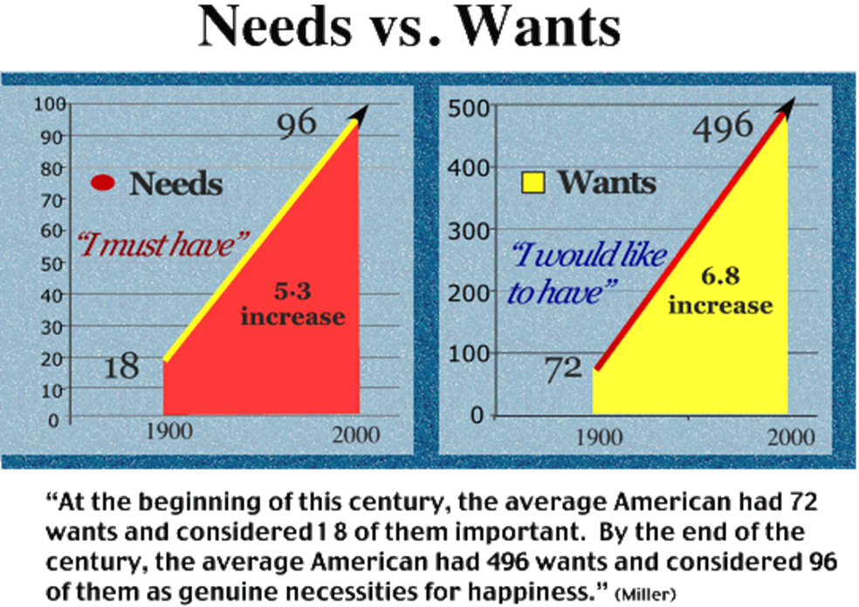
I Need/I must have/I would like to have

Slide 18
Skepticism in financial matters
Buyer beware – Caveat Emptor
  Adults must learn skepticism in financial matters
    Understand the motivation of the counterparty
    Look at anyone you do business with skepticism
    Watch for lenders who make too easy for you to borrow (housing market collapse)
    Ask more questions and do comparison-shop
    Get verbal promises in writing and check out investments, and those pitching them, before you buy

Slide 19
Know What You Spend
Many Adults do not adopt a Budget
  Budgeting or tracking where money is going helps you figure out what expenses can be cut to free up dollars to meet your goals
  If you always end up short at the end of each month, budgeting is a must to get back on track
  Use of credit cards can make you feel like you are not spending money
  Use cash for day-to-day expenses to become more aware of your spending habits
  Budgeting can give you a higher standard of living as time passes by – you will be able to meet your goals through saving and reducing waste

Slide 20
Live Below Your Means
Easy credit a few years ago made it possible for most of us to borrow and live a lifestyle beyond what our paycheck could support
  Aim to live on less than what you make so that you are able to save, invest, and finish school

Slide 21
Debt Limits Choices
Big purchases with borrowed money are big commitments of your future income (house, car, education, etc.,)
  The decision to take on debt today could leave you unable to take advantage of opportunities later
  Limit student loans to tuition cost and borrow only what you can afford to pay after graduation

Slide 22
Pay Yourself First
Most Adults have this concept backward
  Set aside at least 10% of your net income each month before you pay your bills
  Establish an emergency fund
  Save for retirement
  Save for major purchases

Slide 23
Time Value of Money
Getting a dollar today is worth more than receiving it in the future
  You can invest the dollar today and in time, it grows to be worth more than a dollar
  The earlier you start investing, the faster you reach your goals

Slide 24
Compounding Interest
When interest you earn is added to the principal, you increase the value of that principal and you earn interest on the total value
The effect of earning interest on interest makes your money grow faster

Slide 25
School, Career and Life?
Map out your life goals - your plan?
Establish a support system
  family/friends/tutoring programs/academic advisors and counselors
Make it a family decision
  Include children and spouse
Consider attending part-time, night classes or online education
  Focus on future rewards!

Slide 26

MoneyCounts: A Financial Literacy Series
Share a TIP!
Things do not change, WE CHANGE!
      Henry David Thoreau

Slide 27
Contact Information
Questions & Comments
Thank you!
Dr. Daad Rizk
The Pennsylvania State University
MoneyCounts: A Financial Literacy Series
301 Outreach Building
University Park, PA 16802
dar39@psu.edu
1-(814)-863-0214

