Slide 1


Verification
2013-14 and 2014-15

Slide 2

Verification for 2013-2014

Slide 3
2013-2014 Verification
No sample verification worksheets
Sample text and format for individual data elements
Institutions are able to develop a customized worksheet for individual students or groups of students

Slide 4
2013-2014 Verification items
Retained all items subject to verification in 2012-2013
All applicants—
  Household size
  Number in college
  SNAP benefits (formerly food stamps)—if receipt indicated on ISIR
  Child support paid—if amount indicated on ISIR

Slide 5
2013-2014 verification
Tax filers—
  Adjusted gross income
  U.S. income tax paid
  Education credits
  Specific untaxed income items
    Untaxed IRA distributions
    Untaxed Pensions
    IRA deductions
    Tax Exempt Interest

Slide 6
Verification Items
Non-tax filers
  Income earned from work

Slide 7
2013-2014 verification
Added two new items—
  High school completion status
  Identity/Statement of Educational Purpose

Slide 8
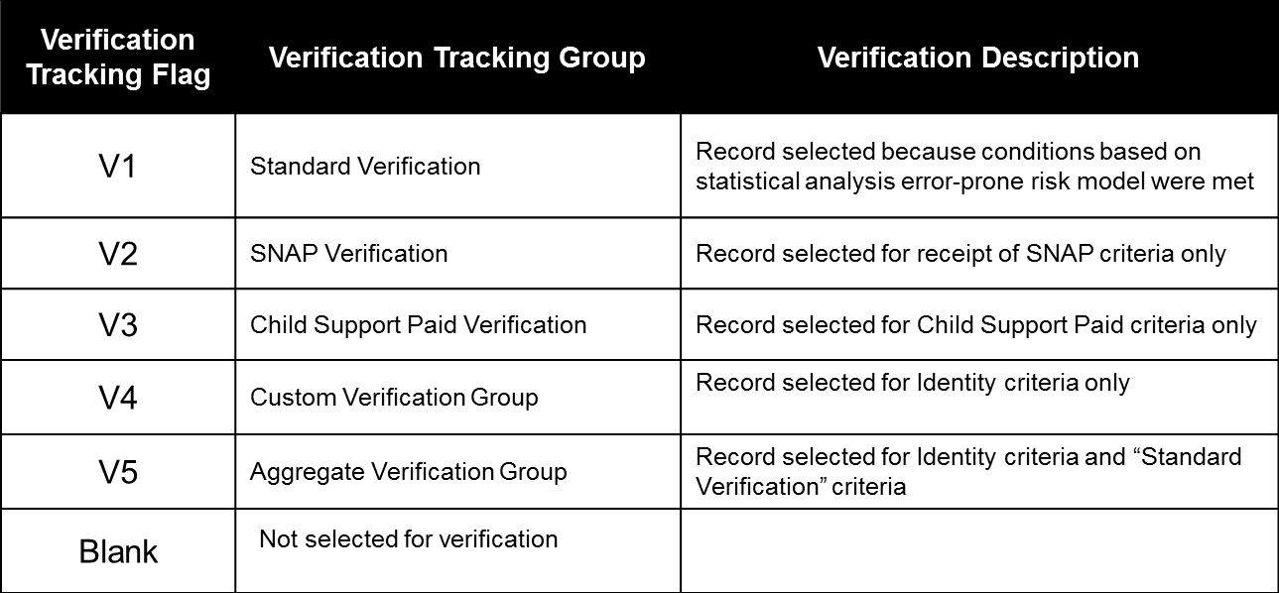
Verification Tracking Groups
5 Verification Tracking Groups

Slide 9
Verification Exclusions
There are times when you don’t need to verify a student’s application.
Except in the case of the student’s death, however, none of the exemptions excuse you from the requirement to resolve conflicting information.
You should document the basis for an exclusion.
Other information not excluded must still be verified according to all other requirements.

Slide 10
Verification Exclusions
You don’t have to verify FAFSA information of a student in the following situations:
  Death of the student. You don’t have to continue verification if you made an interim disbursement and the student died before verification was completed.
  Not an aid recipient. The student won’t receive Title IV aid for reasons other than a failure to complete verification. This includes being ineligible for that aid and withdrawing without receiving it.
Notes:
Death of a Student: You cannot make any additional disbursements, except for FWS funds already earned, to any of the student’s beneficiaries. You cannot originate or disburse his Direct Subsidized Loan or consider any interim disbursement you made of Pell, Perkins, or FSEOG funds or provisional FWS employment to be an overpayment.

Slide 11
Verification Exclusions
Applicant verified by another school. The student completed verification for the current award year at another school before transferring.
  Her FAFSA data must be the same as it was at the previous school
  You must get a letter from that school stating that it verified her application and the letter must include the transaction number of the pertinent valid ISIR.
Post enrollment. The student was selected for verification after ceasing to be enrolled at your school and all (including late) disbursements were made.

Slide 12
Additional Verification exlcusions
The spouse, if applicable, of an independent student is deceased.
Both of the parents (or spouse, if applicable, in the case of an independent student) are mentally incapacitated.

Slide 13
Additional Verification Exclusions
The parents (or spouse, if applicable, in the case of an independent student) are residing in a country other than the United States and can’t be contacted by normal means.
The parents (or spouse, if applicable, in the case of an independent student) cannot be located because the student does not have and cannot get their contact information.

Slide 14
2013-2014 Verification
Documentation of high school completion status: high school diploma—
High school diploma; or
Final high school transcript that shows the date the high school diploma was awarded
  Note: If a copy of an applicant’s high school diploma or final high school transcript is unavailable, the institution may accept alternative documentation.

Slide 15
Alternative Documentation High school diploma
Limited Cases, Examples may include:
  Student’s high school closed and the student is having a difficult time obtaining the information
  Non-traditional student out of high school for several years and high school is having a difficult time finding the information
Little information provided by ED regarding acceptable “alternative documentation”
Cannot be self-certified by the student

Slide 16
2013-2014 verification
Documentation of high school completion status: recognized equivalent of a high school diploma—
General Educational Development (GED) Certificate;
State certificate received by a student after the student has passed a State-authorized examination that the State recognizes as the equivalent of a high school diploma;
Academic transcript of a student who has successfully completed at least a two-year program that is acceptable for full credit toward a bachelor's degree; or

Slide 17
2013-2014 verification
Documentation of high school completion status: recognized equivalent of a high school diploma—
For a person who is seeking enrollment in an educational program that leads to at least an associate degree or its equivalent and has not completed high school but has excelled academically in high school, documentation from the high school that the student excelled academically in high school and documentation from the postsecondary institution that the student has met the formalized, written policies of the postsecondary institution for admitting such students.

Slide 18
2013-2014 verification
Documentation of high school completion status: homeschooled—
Transcript or the equivalent, signed by the parent or guardian, that lists the secondary school courses completed by the applicant and documents the successful completion of a secondary school education; or
A secondary school completion credential for home school (other than a high school diploma or its recognized equivalent) provided for under State law

Slide 19
2013-2014 verification
Documentation of identity/statement of educational purpose—
Appear in person and present to an institutionally authorized individual—
  A valid government-issued photo identification (driver’s license, non-driver’s license, or passport); and
  A signed statement of educational purpose

Slide 20
Statement of educational purpose
2013-2014 Required Verification Text
(Note: Institutions must use the exact language in the Statement of Educational Purpose as provided below)
Identity and Statement of Educational Purpose (To Be Signed at the Institution)
The student must appear in person at _________________ (Name of Postsecondary Educational Institution) to verify his or her identity by presenting a valid government-issued photo identification (ID), such as but not limited to a driver’s license, other state-issued ID, or passport. The institution will maintain a copy of the student’s photo ID that is annotated with the date it was received and the name of the official at the institution authorized to collect the student’s ID.

Slide 21
Statement of educational purpose
In addition, the student must sign, in the presence of the institutional official, the following:
Statement of Educational Purpose
I certify that I, _______________________(Print student’s name), am the individual signing this Statement of Educational Purpose and that the federal student financial assistance I may receive will only be used for educational purposes and to pay the cost of attending __________________________ (Name of Postsecondary Educational Institution) for 2013-2014.
________________________________________
(Student’s Signature) (Date)
______________________
(Student’s ID Number)

Slide 22
2013-2014 verification
Documentation of identity/statement of educational purpose (cont.)—
Must maintain, an annotated copy of the identification submitted by the applicant that includes—
  The date documentation was received; and
  The name of the institutionally-authorized individual that obtained the documentation

Slide 23
2013-2014 verification
Documentation of identity/statement of educational purpose (cont.)—
If unable to appear in person, the student must provide the institution—
  A copy of a valid government-issued photo identification (driver’s license, non-driver’s license, or passport); and
  An original notarized statement of educational purpose signed by the applicant

Slide 24
Hot Topics

Slide 25
Amended tax returns
If the institution is aware that an amended tax return was filed, to complete verification, the applicant must submit—
  Signed copy of the relevant tax return or IRS Tax Return Transcript
AND
  Signed copy of the 1040X that was filed with the IRS

Slide 26
Identity theft
To complete verification for victims of identity theft—
  Signed copy of IRS income tax return
AND
  One of the following—
    IRS Form 14039, “Identity Theft Affidavit”
    Signed, dated statement indicating victim of identity theft and IRS is investigating
    Copy of the police report filed by the tax filer

Slide 27
High school completion status
Previously obtained documentation
  May rely on documentation previously obtained as long as it meets the criteria
High School Completion Abroad
  If unable to obtain a copy of their high school diploma, may document high school completion status by obtaining a copy of the “secondary school leaving certificate” (or equivalent) through the appropriate central government agency

Slide 28
2014-2015
Verification

Slide 29
2014-2015 verification
Federal Register Notice, published June 13, 2013, Free Application for Federal Student Aid (FAFSA) Information To Be Verified for the 2014-2015 Award Year
Dear Colleague Letter GEN-13-16, Published June 13, 2013, 2014-15 Award Year: FAFSA Information to be Verified and Acceptable Documentation

Slide 30
Verification 2014-2015
Retained all items subject to verification in 2013-2014
Added one new item
  Other untaxed income and benefits

Slide 31
2014-2015 verification
Documentation of untaxed income and benefits
Untaxed income information reported in Question 45 for the student and spouse and Question 94 for the dependent student’s parents
If the verified income does not appear to provide sufficient financial support, the student or parents must explain how the family was supported during the 2013 calendar year

Slide 32
2014-2015 verification
Other new requirements for 2014-15
Pell ineligible graduates will be excluded from random selection
Pell eligible graduate students should be added to targeted selection

Slide 33
2014-2015
Verification Tracking Flag Groups:
Verification Tracking Flag | Verification Tracking Group | Verification Description
V1 | Standard Verification | Record selected because conditions based on statistical analysis error-prone risk model were met
V2 | Reserved for FSA Use Only | N/A
V3 | Child Support Paid Verification | Record selected for Child Support Paid criteria only
V4 | Custom Verification Group | Record selected for Identity criteria and SNAP/Child Support Paid
V5 | Aggregate Verification Group | Record selected for Identity criteria, “Standard Verification” criteria and SNAP/Child Support Paid
V6 | Household Resources Verification Group | Record selected for Other untaxed income, “Standard Verification” and SNAP/Child Support Paid

Slide 34
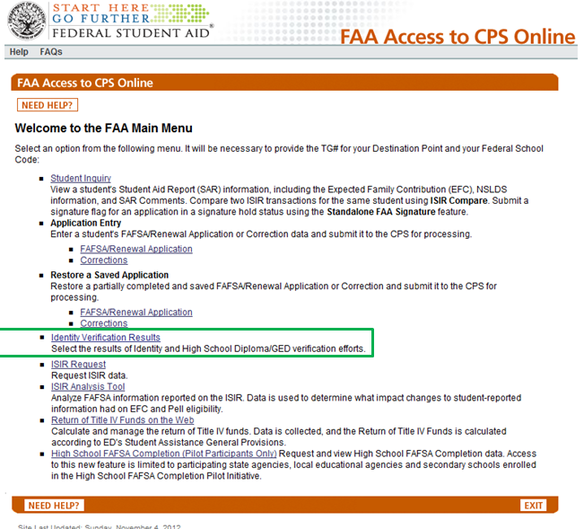
FAA Access Updates 2014-2015
FAA Access will be updated to add required Identity Verification Results to the home page.

Slide 35
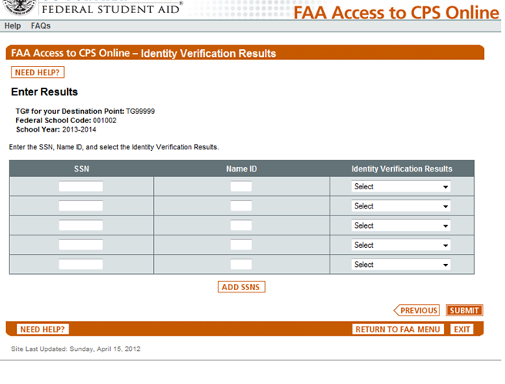
FAA Access Updates for 2014-2015
FAAs will be able to enter SSNs/Name ID/ Verification Results from a dropdown menu on this page
Click “Add SSNs” and enter additional ones

Slide 36
Faa access updates 2014-2015
Dropdown options will be
  Verification completed in person, no issues found
  Verification completed remotely, no issues found
  Verification attempted, issues found with identity
  Verification attempted, issues found with HS completion
  No response from applicant or unable to locate

Slide 37
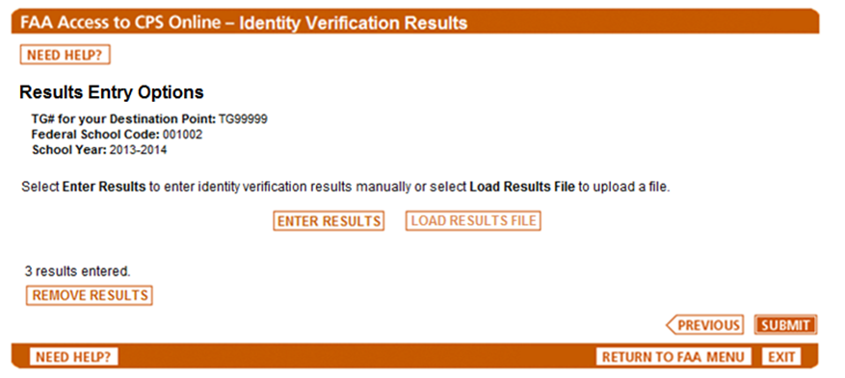

FAA Access Updates 2014-2015
FAAs will be able to select the Option of Required Results Entry.

Slide 38
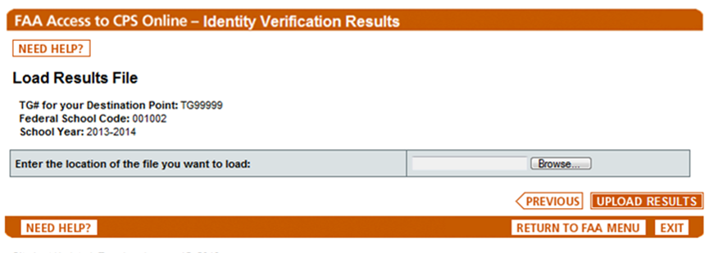
FAA Access Updates 2014-2015
Available after April, 2014
FAAs will be able to create and upload a flat file to report required results.

Slide 39
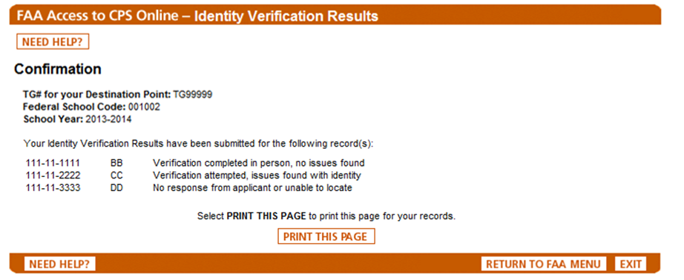
FAA Access Updates 2014-2015
FAAs will get a confirmation page with the results submitted. FAAs can print the page for their records.

Slide 40

Additional verification resources
Please see the slides following the Contact Information for a wide variety of resources regarding Verification

Slide 41
Resources
Resources used to develop this presentation include:
  2012-2013 Federal Student Aid Handbook, Application and Verification Guide
  *ED 2013 NASFAA Presentation: Verification 2013-2014 and 2014-2015
  *Some of the slides used in this presentation were copied directly from the slides used in ED’s NASFAA Presentation.

Slide 42
questions

Slide 43
Contact information
Cindy Davis
Compliance Services
PHEAA
717.720.2182
cdavis@pheaa.org
cmpolicy@pheaa.org

Slide 44
Verification resources
6/18/10 NPRM (Pages 34825 – 34834)
  http://ifap.ed.gov/fregisters/FR061810ProgramInterityIssuesNPRM.html
10/29/10 Final Rule (Pages 66902 – 66913 and 66954 – 66958)
  http://www.ifap.ed.gov/fregisters/FR102910Final.html
Federal Register Notice of Information To Be Verified for the 2012–2013 Award Year
  http://www.ifap.ed.gov/fregisters/FR071311FAFSAInformation.html

Slide 45
Verification resources
GEN-11-13 and GEN-11-03
  http://www.ifap.ed.gov/dpcletters/GEN1113.html http://www.ifap.ed.gov/dpcletters/GEN1103.html
Q&A on Program Integrity website:
  http://www2.ed.gov/policy/highered/reg/hearulemaking/2009/verification.html
Sample 2012-2013 Verification Worksheets
  http://www.ifap.ed.gov/eannouncements/020312SampleVerificationWorksheets1213.html

Slide 46
Verification resources
2012-2013 FAFSA-IRS Tax Return Transcript Matrix
  http://www.ifap.ed.gov/eannouncements/031612FAFSA1213VerificationIRSTaxReturnMatrix.html
2012-2013 Application and Verification Guide
  http://www.ifap.ed.gov/fsahandbook/attachments/1213AVG.pdf
  http://ifap.ed.gov/fsahandbook/1213FSAHandbookErrata.html
GEN-12-07—Acceptable Documentation for Income and Taxes
  http://www.ifap.ed.gov/dpcletters/attachments/GEN1207.pdf

Slide 47
Verification resources
2012-2013 Electronic Data Exchange (EDE) Technical Reference
  http://www.ifap.ed.gov/ifap/byAwardYear.jsp?type=edetechref
2012-2013 ISIR Guide
  http://ifap.ed.gov/isirguide/attachments/1213ISIRGuideDec2011.pdf
Acceptable Documentation Update for 2012-2013 Award Year Verification
  http://ifap.ed.gov/eannouncements/110212AwardYrVerAcceptDocs.html

Slide 48
Verification resources
Acceptable Documentation for Verification of 2011 IRS Information
  http://ifap.ed.gov/eannouncements/072012AcceptableDocumentation4Verification2011IRSInfo.html
Limited Circumstances When a Signed Copy of a Tax Return or Other Documentation is Acceptable for Completing Verification
  http://www.ifap.ed.gov/eannouncements/082112LimitedCircumstancesWhenSignedCopyofTaxReturnisAcceptable.html

Slide 49
Verification resources
2012-2013 Verification Reporting and Verification Status Code "W" Warning Message (Updated April 10, 2013)
  http://ifap.ed.gov/eannouncements/040913FirstVerificationWWarning1213.html

Slide 50
Verification resources
Federal Register Notice of Information To Be Verified for the 2013–2014 Award Year
  http://www.ifap.ed.gov/fregisters/FR071212FASFA.html
Dear Colleague Letter GEN-12-11
  http://www.ifap.ed.gov/dpcletters/GEN1211.html
Plans for 2013-2014 Verification Worksheets
  http://ifap.ed.gov/eannouncements/110112Plansfor1314VerificationWorksheets.html

Slide 51
Verification resources
2012-2013 Verification Reporting and Verification Status Code "W" Warning Message (Updated April 10, 2013)
  http://ifap.ed.gov/eannouncements/040913FirstVerificationWWarning1213.html

Slide 52
2013-14 verification resources
2013-2014 Verification Suggested Text
  http://ifap.ed.gov/eannouncements/011813VerificationSuggestedText1314.html
2013-2014 Electronic Data Exchange (EDE) Technical Reference
  http://www.ifap.ed.gov/ifap/byAwardYear.jsp?type=edetechref
  http://ifap.ed.gov/eannouncements/010913IssueAlertIncorrectFieldJustififorVerifiTrackFlag20132014EDETechRef.html

Slide 53
2013-2014 verification resources
2013-2014 ISIR Guide
  http://www.ifap.ed.gov/ifap/byAwardYear.jsp?type=isirguide
2013-2014 Application and Verification Guide
  http://ifap.ed.gov/fsahandbook/1314FSAHandbookAVG.html
  http://ifap.ed.gov/eannouncements/022813ErrataandUpdatesfor20132014FSAHandbook.html
2013-2014 FAFSA Verification-IRS Tax Return Transcript Matrix
  http://ifap.ed.gov/eannouncements/031513FAFSAVerification1314IRSTaxReturnTranscriptMatrix.html

Slide 54
2013-2014 verification resources
FAFSA Applicants Impacted by a Tax Filing Software Issue Related to IRS Form 8863
  http://ifap.ed.gov/eannouncements/031813FAFSAAppWhoMayHaveBeenImpactedbyaTaxFilingSoftwareIssueRelatedtoIRSForm88.html
Availability of 2012 IRS Information for IRS DRT and for Requesting IRS Tax Return Transcripts
  http://ifap.ed.gov/eannouncements/030113AcceptableIRSDocumentation20132014AYVerification.html

Slide 55
2014-2015 verification resources
Federal Register Notice, published June 13, 2013
  http://ifap.ed.gov/dpcletters/GEN1316.html
Dear Colleague Letter, posted June 13, 2013,
  GEN-13-16: 2014-2015 Award Year: FAFSA Information to be Verified and Acceptable Documentation in PDF Format, 313KB, 8 Pages
Attachment to GEN-13-16, posted June 13, 2013,
  Attachment to GEN-13-16: IRS Tax Return Transcript and IRS Record of Account Transcript Request Process in PDF Format, 127KB, 4 Pages

