Slide 1
Verification 101
Tonya R. Hsiung
Assistant Director of Financial Aid
Franklin & Marshall College

Slide 2
What is Verification
Because students sometimes make error on their application, there is a process for verifying applications and making corrections. The Central Processing System (CPS) selects which applications are to be verified, but you also have the authority to verify additional students.

Slide 3
Regulations define…
Whose application MUST be verified
FAFSA information to be verified (will vary beginning with 2013-2014)
Documentation used to verify data elements
Regardless of whether a student is selected for verification or not, you MUST always resolve discrepancies and conflicting information.

Slide 4
Who Must Be Verified?
You must verify applications selected by the CPS of students who will receive (or have received) SUBSIDIZED student financial assistance - Title IV programs for which eligibility is determined by the EFC:
Federal Pell grant
FSEOG
Federal Work Study
Federal Perkins Loan
Direct Subsidized Loan Program
Verification is not required if the student will only receive UNSUBSIDIZED student financial assistance – Title IV programs for which eligibility is NOT based on the EFC:
TEACH Grant
Direct Unsubsidized Loan Program
Direct PLUS Loan Program
Iraq and Afghanistan Service Grant (this is a non-need based grant and not subject to verification)

Slide 5
Customized Verification (started in 2013-2014)
The FAFSA information that must be verified:
Will vary from applicant-to-applicant
May be information that is not used in calculating the applicant’s EFC
May change from award year-to-award year

Slide 6
Verification Tracking Groups
V1 – Standard
V2 – SNAP – NOT USED IN 2014-2015
V3 – Child Support Paid
V4 – Custom
V5 – Aggregate
V6 – Household Resources

Slide 7
Items To Be Verified – Tax Filer
Adjusted Gross Income
US Income Tax Paid
Untaxed Portions of IRA distributions (exclude Rollovers)
Untaxed Portions of Pensions (exclude rollovers)
Tax-Exempt Interest Income
Education Credits
Number of Household Members
Number in College
Supplemental Nutrition Assistance Program (SNAP – Food Stamps)
Child Support Paid
Other Untaxed Income*
Payments to Tax-Deferred Pension and Savings
Child Support Received
Housing, food, and other living allowances paid to members of the military, clergy, and others
Veterans Noneducation Benefits
Other untaxed income
Money received or paid on the applicant’s behalf*

Slide 8
Items To Be Verified – Tax Filer
 | VERIFICATION GROUP
Verification Data Item | Standard | NOT USED in 2014-2015 | Child Support Paid | Custom | Aggregate | Household Resources
 | V1 | V2 | V3 | V4 | V5 | V6
Adjusted Gross Income | X |  |  |  | X | X
US income tax paid | X |  |  |  | X | X
Untaxed portions of IRA distributions | X |  |  |  | X | X
Untaxed portions of pensions | X |  |  |  | X | X
IRA deductions and payments | X |  |  |  | X | X
Tax-exempt interest income | X |  |  |  | X | X
Education credits | X |  |  |  | X | X
Other Untaxed Income |  |  |  |  |  | X
Household Size | X |  |  |  | X | X
Number in College | X |  |  |  | X | X
SNAP benefits | X |  |  | X | X | X
Child Support Paid | X |  | X | X | X | X
High School Completion |  |  |  | X | X
Identity/Educational Purpose |  |  |  | X | X

Slide 9
Items To Be Verified – Non-Tax Filer
Income Earned from Work
Number of Household Members
Number in College
Supplemental Nutrition Assistance Program (SNAP – Food Stamps)
Child Support Paid
Other Untaxed Income*
Payments to Tax-Deferred Pension and Savings
Child Support Received
Housing, food, and other living allowances paid to members of the military, clergy, and others
Veterans Noneducation Benefits
Other untaxed income
Money received or paid on the applicant’s behalf*

Slide 10
Items To Be Verified – Non-Tax Filer
 | VERIFICATION GROUP
Verification Data Item | Standard | NOT USED in 2014-2015 | Child Support Paid | Custom | Aggregate | Household Resources
 | V1 | V2 | V3 | V4 | V5 | V6
Income earned from work | X |  |  |  | X | X
Household Size | X |  |  |  | X | X
Number in College | X |  |  |  | X | X
SNAP benefits | X |  |  | X | X | X
Child Support Paid | X |  | X | X | X | X
High School Completion |  |  |  | X | X
Identity/Educational Purpose |  |  |  | X | X
Other Untaxed Income* |  |  |  |  |  | X

Slide 11
*Untaxed Income
For the 2014-2015 award year, certain applicants (V6 Verification Group) will be required to verify the untaxed income information they provided on the FAFSA for the student and for the dependent student’s parents
If the financial aid administrator determines that the amounts provided and verified from the untaxed income question and from income information (e.g. AGI, income earned from work, untaxed income not included on the FAFSA) do not appear to provide sufficient financial support for the number of household family members reported, the applicant and, if appropriate, the applicant’s parents or spouse must explain how the family was financially supported during the 2013 calendar year.
You could use the poverty Guidelines as a guide if additional information is needed: http://aspe.hhs.gov/poverty/index.cfm (see handout)

Slide 12
POVERTY GUIDELINES
2013 POVERTY GUIDELINES FOR THE 48 CONTIGUOUS STATES AND THE DISTRICT OF COLUMBIA
.
SOURCE: Federal Register, Vol. 78, No. 16, January 24, 2013, pp. 5182-5183
Persons in family/household | Poverty guideline
1 | $11,490
2 | 15,510
3 | 19,530
4 | 23,550
5 | 27,570
6 | 31,590
7 | 35,610
8 | 39,630
For families/households with more than 8 persons, add $4,020 for each additional person.

Slide 13
Documents Required
For taxable income, base year tax information (i.e. for 2014-2015, need 2013)
For untaxed income and benefits, examples include:
Verification Worksheet
Official agency documentation
Signed statement

Slide 14
Tax Documents
IRS tax data can be obtained using one of two methods:
IRS Data Retrieval Tool (through the FAFSA)
This is the BEST METHOD!
Information must NOT be altered once transferred in order to be acceptable (code of 02)
IRS Tax RETURN Transcript (from the IRS)
Via web, phone, IRS Form 4506T-EZ

Slide 15
IRS Data Retrieval Tool

Slide 16
IRS Data Retrieval Tool

Slide 17
IRS Data Retrieval Tool

Slide 18
IRS Tax Return Transcript via www.irs.gov

Slide 19
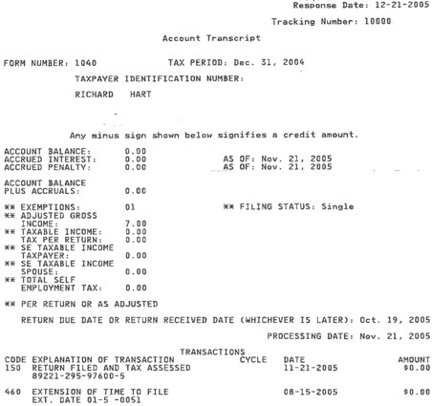
IRS Tax Return Transcript
INCORRECT FORM

Slide 20
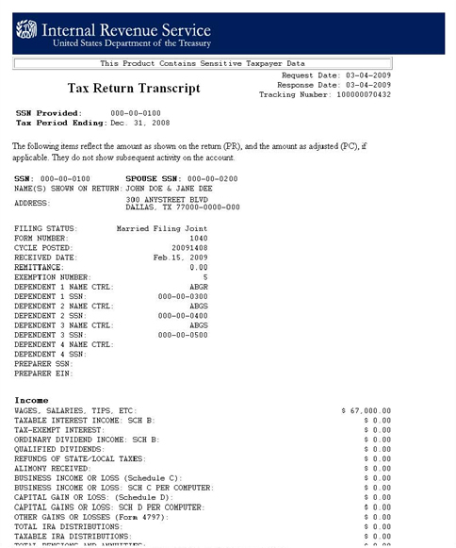
IRS Tax Return Transcript
CORRECT FORM

Slide 21
Reasons the IRS DRT cannot be used
The person did not indicate on the FAFSA that the tax return has been completed (indicated “will complete” or “not required to file”)
The marriage date is January 2014 or later
The first three digits of the SSN are 666
The tax return was amended
The person filed a Puerto Rican or foreign tax return
The person is married and filed the tax return as Head of Household (HOH) or Married, filing Separately (MFS)
Neither married parent entered a valid SSN
A non-married parent or both parents entered all zeroes for the SSN

Slide 22
IRS Tax Transcript Required
When the applicant or parent did not use the IRS DRT – either at initial FAFSA filing or through the FOTW correction process.
When information obtained by using the IRS DRT was changed before or after submission of the FAFSA or the FAFSA correction.
When a married independent applicant and spouse filed separate returns.
When the married parents of a dependent student filed separate returns
In all instances, when the dependent student’s legal parents are unmarried and living together.

Slide 23
IRS Tax Transcript Required
When an applicant or applicant’s parents had a change in marital status after the end of the 2013 IRS tax year on December 31, 2013.
When the applicant or parent or spouse file an amended tax return. Under this condition, the institution must obtain the documents below to complete verification:
A signed copy of the original tax return that was filed with IRS, an IRS Tax Return Transcript, or any IRS tax transcript that includes all of the income and tax information required to be verified, and
A signed copy of the IRS Form 1040X that was filed with the IRS.

Slide 24
IRS DRT or Tax Transcript Items
Adjusted Gross Income
US Income Tax Paid
Untaxed Portions of IRA distributions*
Untaxed Portions of Pensions*
IRA Deductions and Payments
Tax-Exempt Interest Income
Education Credits
*IRS DRT & Tax Return Transcript cannot identify rollovers – may need 1099-R to verify if IRA or Pension distribution is a rollover

Slide 25
Other Information Regarding Taxes
IRS Tax Return Transcripts submitted to the institution for verification do not need to be signed by the tax filer, unless the institution has reason to doubt the authenticity of the document.
Paper Tax Returns – in very limited circumstances, an institution may accept a signed paper copy of a 2013 income tax return for verification purposes through guidance provided by the US Department of Education and must document the limited circumstances that allowed the applicant to submit a copy of the income tax return

Slide 26
Other Information Regarding Taxes
On 8/21/12, the US Department of Education issued guidance in an Electronic Announcement on the limited circumstances when a signed copy of an income tax return or other documentation is acceptable for completing verification for individuals who:
Filed an amended IRS income tax return
Were victims of IRS identity theft
File non-IRS income tax returns
This guidance continues to be in effect for the 2014-2015 award year and subsequent award years until further notice.

Slide 27
Documents to Verify Untaxed Income and Benefits
The US Department of Education no longer has a Verification Form for school use. They have a example forms in the Federal Student Aid Handbook with suggested or required text. Each institution will need to create a form or forms to verify information, based on the customized verification groups.
If one form is used, you will need to determine how you will notify the student of what sections to complete based on their verification selection group.

Slide 28
Verifying SNAP Benefits & Child Support Paid
SNAP Benefits
If the ISIR shows that someone in the parents’ or student’s household received SNAP benefits in 2012 or 2013, the student must provide a signed statement indicating receipt of the benefit (this can be done on your customized verification form)
Child Support Paid
If the ISIR shows that the student or parent paid child support in 2013, the student must provide a statement signed by him/her or, if she is dependent, either parent and giving the annual amount of the support, the names of those who paid it and whom it was paid to, and the name(s) of the child(ren) for whom it was paid(this can be done on your customized verification form)
You may request documentation to verify receipt of SNAP or Child Support Paid if you believe the information to be inaccurate.

Slide 29
Verifying High School Completion Acceptable Documentation
A copy of high school diploma
A copy of final, official high school transcript that shows the date when the diploma was awarded
A copy of a General Education Development (GED) certificate or GED transcript
An academic transcript that indicates the student successfully completed at least a two-year program that is acceptable for full credit toward a bachelor’s degree
A copy of a secondary school completion credential for homeschool (other than a high school diploma or its recognized equivalent) if state law requires homeschooled students to obtain that credential
A transcript or the equivalent, signed by the parent or guardian of a homeschooled student, that lists the secondary school courses the student completed and documents the successful completion of a secondary school education in a homeschool setting.
If your school has already received one of the documents above as part of the admission process, you do not need to ask for another. Students who are unable to get one of these documents must contact your financial aid office.

Slide 30
Verifying Identity and Statement of Educational Purpose
Students must appear IN PERSON at the school and present a valid, government-issued photo identification (ID) such as a passport, drivers license, etc.
You must maintain an annotated copy of the ID. The annotation must include the date it was received and the name of the person your school authorized to receive it.
Students must also sign a statement of educational purpose (you create the form, but must use the Department of Education’s wording on the form).
If they are unable to appear in person, they must sign and submit the statement of educational purpose and must submit a copy of his/her ID with the statement signed by a notary public confirming that the student appeared before him/her and presented the ID confirming his/her identity.

Slide 31
Updating Information
Generally, a student cannot update information on the FAFSA because it is considered a “snapshot” of the family’s financial situation as of the date it was signed.
Only certain items can be updated under the following conditions:
All applicants whose dependency status changes must update that status and the associated FAFSA information throughout the award year except when the update is caused by a change in the student’s marital status.
All applicants selected by the Department of a school for verification of household size or number in college must update those numbers to be correct as of the date of verification unless the update is due to a change in the student’s marital status.
At your discretion, you can update either situation even when the update is due to a change in the student’s marital status (if you deem it necessary to address an inequity or to reflect more accurately the applicant’s ability to pay – must be on a case-by-case basis and must be documented).
Documenting household size or number in college is not required in a subsequent verification in the same year if the information has not changed.

Slide 32
Correcting Errors
For students who are selected for verification and receiving subsidized student aid, the following changes must be submitted for processing:
Changes to any non-dollar items
Changes to any dollar item of $25 or more

Slide 33
Verification Policies and Procedures
Must:
Be written
Address school options where flexibility exists
Be made clear to all students
Be consistently applied

Slide 34
Verification Status Codes
V – Verified
You have verified the student. This includes students selected by the CPS and those your school chose to verify based on its own criteria.
W – Without Documentation
The student was selected for verification by the CPS or your school, and you chose to pay a first disbursement of Pell without documentation. You must update this status once verification is complete or COD will reduce the Pell Grant to zero.
S – Selected, But Not Verified
The CPS selected the student for verification, but you did not verify because the student met the criteria to not be verified or because your school participates in the Quality Assurance (QA) Program and the student’s application did not meet your school’s verification criteria.
Blank
Used in verification was not performed because the student was not selected by the CPS or your school or because the student was selected after ceasing enrollment at your school and all disbursements were already made.

Slide 35
Data Sources
2013-2014 Federal Student Aid Handbook – Application and Verification Guide (AVG) – Chapter 4
2013-2014 NASFAA Core Module 4 – Verification
US Department of Education GEN-13-16

Slide 36
Questions???
Tonya R. Hsiung
Assistant Director of Financial Aid
Franklin & Marshall College
717-291-4395
tonya.hsiung@fandm.edu

