Slide 1


Program Reviews & Audits

Slide 2

Audits and Program Reviews
It is helpful to understand the difference between audits and program reviews
Audits and program reviews are required for schools participating in any federal student aid program.
These external review processes ensure schools are in compliance with policies and procedures governing student aid programs.

Slide 3
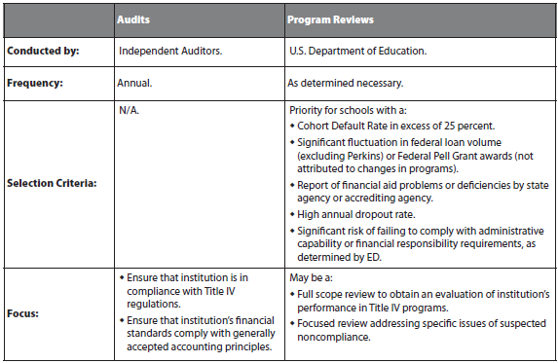
Audits and Program Reviews

Slide 4
Compliance Audits
ED requires annual compliance audits for all schools that participate in any federal student aid program.
Independent auditors perform the audits to review schools’ compliance practices and financial statements

Slide 5
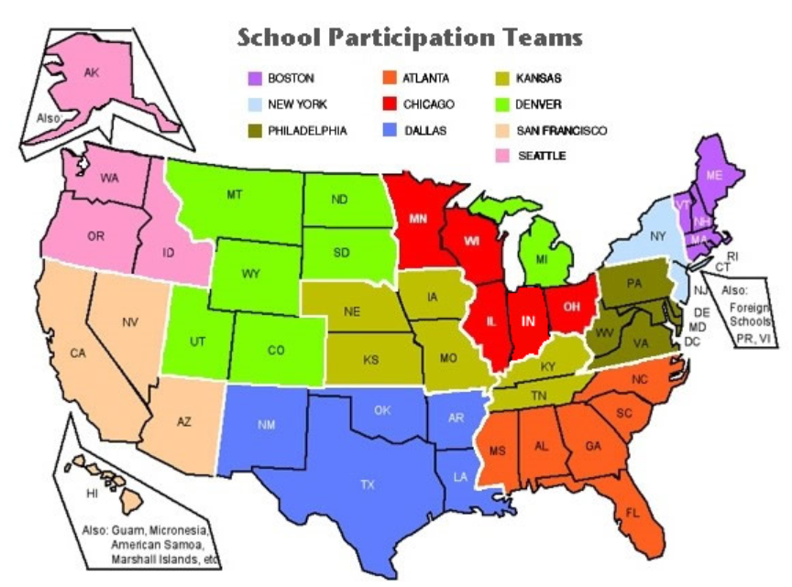
ED Program Reviews
ED conducts program reviews to ensure schools are in compliance
with federal student aid administration requirements.
www.ed.gov/offices/OSFAP/services/casemanagement.html#review

Slide 6
Top 10 AUDIT Findings
(Provided from the 2013 NASFAA Conference):
1. Repeat finding —failure to take corrective
action.
2. Return to Title IV (R2T4) calculation
errors.
3. Return to Title IV funds made late.
4. Student status —inaccurate/untimely
reporting.
5. Federal Pell Grant –
overpayments/underpayments.

Slide 7
Top 10 AUDIT findings CONTINUED
6. Verification violations.
7. Student credit balance deficiencies.
8. Qualified auditor's opinion cited in audit.
9. Entrance/Exit counseling deficiencies.
10. Overaward — financial need exceeded

Slide 8
Top 10 PROGRAM REVIEW Findings
(Provided from the 2013 NASFAA Conference):
1. R2T4 calculation errors.
2. Verification violations.
3. Entrance/Exit counseling deficiencies.
4. Two-way tie:
− Crime awareness requirements not met.
− Student credit balance deficiencies.
5. Satisfactory academic progress policy
not adequately developed/monitored.

Slide 9
Top 10 PROGRAM REVIEW findings Continued
6. R2T4 funds made late.
7. Federal Pell Grant –
Overpayments/underpayments.
8. Account records inadequate/
not reconciled.
9. Inaccurate record keeping.
10. Two way tie:
  Lack of administrative capability.
  Information in student files missing/inconsistent.

Slide 10
Findings Common to Both
1. R2T4 calculation errors
2. R2T4 funds made late
3. Federal Pell Grant –
overpayments/underpayments
4. Verification violations
5. Student credit balance deficiencies
6. Entrance/Exit counseling deficiency

Slide 11
Student Credit Balance Deficiencies
(Both)
Credit balance not released to student within 14 days.
No process in place to determine when a credit balance has been created.
Non-compliant authorization to hold
Title IV credit balances.
Regulations: 34 C.F.R. §§ 668.164(e) and 668.165(b)

Slide 12
Title IV Credit Balances
An institution must refund a credit balance to the student, or parent as applicable, as soon as possible but no later than 14 days from one of the following:
  The first day of classes of a payment period if the credit balance occurred on or before the first day of the payment period.
  The date the balance occurs, if the credit balance occurs after the first day of the payment period.
  The date the student rescinds authorization for the school to hold funds for budgeting or to use the funds for other institutional charges.

Slide 13
Compliance Solutions
Develop and implement or increase procedures and internal controls so that credit balances can be identified and released in a timely fashion.
Provide training for staff.
Conduct a self-audit of credit balance disbursements
Ensure credit balance authorization is compliant with Title IV requirements
  - See example in FSA Handbook, Volume 4

Slide 14
Entrance/exit Counseling deficiencies
(Both)
Entrance counseling not conducted/ documented for first-time borrowers.
Exit counseling not conducted/documented for withdrawn students or graduates (official/unofficial).
Exit counseling materials not mailed/ emailed to students who failed to complete counseling.
Untimely exit counseling
Regulation: 34 C.F.R. § 685.304

Slide 15
Compliance Solutions
Assign responsibility for monitoring the entrance/exit interview process
Develop and implement procedures to ensure entrance/exit counseling is completed; automate tracking, monitoring; post links on school’s web page: www.studentloans.gov for entrance and exit counseling.

Slide 16
Additional Compliance Solutions continued
Develop procedures for ensuring communication among registrar, business, and financial aid offices
Provide training for staff
  FSA COACH: Module 4-03: Loan Counseling Requirements
  FSA Assessments: Schools
    Default Prevention & Management

Slide 17
R2T4 Calculation Errors (both)
Ineligible funds were counted as aid that could have been disbursed.
Grant overpayments were treated improperly.
The withdrawal date used was incorrect.
Mathematical and/or rounding errors were made.
Incorrect number of days used for term/payment period.
Regulation: 34 C.F.R. § 668.22(e)

Slide 18
Compliance Solutions
Work with registrar to receive accurate information regarding enrollment periods, including weekends; be sure to exclude all class breaks of five days or more.
Pay attention to new regulations; revise procedures as needed
Perform self-assessment by reviewing random sample of student files
Provide training for staff

Slide 19
Compliance Solutions Continued
FSA Assessment: Schools
  R2T4 module
Use R2T4 Worksheets
  www.ifap.ed.gov

Slide 20
Verification Violations (Both)
Verification worksheet missing/incomplete
Income tax transcripts missing
Conflicting data not resolved
Untaxed income not verified
Disbursement of entire Title IV award before verification completed
Regulations: 34 C.F.R. Subpart E: § § 668.51 ̶ 668.61

Slide 21
Compliance Solutions
Develop and implement procedures for resolving conflicting data, and submitting ISIR corrections following completion of verification
Develop appropriate verification procedures to ensure timely submission of all required documents

Slide 22
Compliance Solutions Continued
Monitor verification process
Create a verification checklist
Review Federal Student Aid Handbook, Application & Verification Guide, Chapter 4
Review verification regulations
  Published October 29, 2010
  Effective July 1, 2012
Provide training for staff

Slide 23
Return of Title iv Funds Made Late (Both)
School’s policy and procedures not followed
Returns not made within allowable timeframe (45 days)
Inadequate system in place to identify/track official and unofficial withdrawals
No system in place to track number of days remaining to return funds
Regulations: 34 C.F.R. §§ 668.22(j) and 668.173(b)

Slide 24
Compliance Solutions
Develop and implement procedures to ensure that R2T4 calculations are completed and funds returned to the appropriate Title IV program within the regulatory timeframe of 45 days
Periodically review processes and procedures to ensure compliance
  Tracking/monitoring deadlines
  Ensuring timely communication between offices and/or systems
R2T4 on the Web
FSA Assessments: Schools
  + R2T4 module
Provide training for staff

Slide 25
Pell Grant Overpayment/Underpayment
(Both)
Incorrect Pell Grant formula
Inaccurate calculations
  - Proration
  - Incorrect EFC
  - Adjustments between terms
  - Incorrect number of weeks/hours
Regulations: 34 C.F.R. §§ 690.62; 690.63; 690.75; 690.79 & 690.80

Slide 26
Compliance Solutions
Establish internal controls and procedures to verify enrollment status before disbursing aid; adjust aid accordingly; develop procedures for resolving over/underpayments
Prorate when needed
Use correct enrollment status
Use correct Pell Grant formula/schedule

Slide 27
Compliance Solutions - Continued
Assign responsibility for monitoring to ensure Pell Grant disbursements are accurate and timely (reconcile regularly)
Ensure understanding of staff and provide training as needed
Conduct random file reviews

Slide 28
Repeat Findings – Failure to take Corrective Action (Audit)
Failure to implement Corrective Action Plan (CAP)
CAP did not remedy the instances of noncompliance
Internal controls not sufficient to ensure compliance with FSA guidelines
Regulations: 34 C.F.R. § § 668.16 and 668.174(a)

Slide 29
Compliance Solutions
Ensure all staff are properly trained
Perform quality assurance checks to
ensure new policies & procedures are
strictly followed
Review results of CAP (Corrective Action Plan)
-- Is it working?
-- Are changes needed to improve process?
Accountability – assign staff to monitor the CAP

Slide 30
Student Status – Inaccurate/untimely
Reported (Audit)
Roster file (formerly called Student Status Confirmation Report [SSCR]) not submitted timely to NSLDS
Failure to provide notification of last date of attendance/changes in student enrollment status
Conflicting status change types and dates
Regulation: 34 C.F.R. § 685.309(b)

Slide 31
Compliance Solutions
Maintain accurate enrollment records
Automate enrollment reporting
−Batch uploads or individual online updates
−Update frequently
Designate responsibility for monitoring the reporting deadlines
Review NSLDS newsletters for updates
Use the correct status codes

Slide 32
Qualified Auditor’s Opinion Cited in Audit (Audit)
Anything other than an unqualified
opinion
Serious deficiencies/areas of concern in
the compliance audit/financial statements
− R2T4 violations
− Inadequate accounting systems and/or
procedures
− Lack of internal controls
Regulation: 34 C.F.R. § 668.171(d)(1)

Slide 33
Compliance Solutions
Assessment of entire financial aid/fiscal
process
− Design an institution-wide plan of action
Adequate and qualified staff
Appropriate internal controls
Training
– FSA COACH
– FSA Assessments
– FSA Online and In-Person trainings
Implement appropriate CAP timely and
effectively

Slide 34
Overaward – Financial Need Exceeded (Audit)
x Failure to factor in outside
scholarships that result in overawards
Failure to calculate tuition or fee waivers
Enrollment status changes
Incorrect EFC from an earlier ISIR
transaction
Regulations: 34 C.F.R. § § 668.35; 673.5; 690.79; & 685.303(e)

Slide 35
Compliance Solutions
Establish procedures to ensure consistent handling of outside scholarships and tuition/fee waivers
Determine if student’s costs exceed original cost of attendance (professional judgment)
Routinely monitor FWS earnings to ensure students do not exceed allowable tolerance
Determine if any aid can replace EFC, such as TEACH, PLUS or Unsubsidized Direct Loan

Slide 36
Crime awareness requirements not met (PR)
Campus security policies and procedures not adequately developed
Annual report not published and/or distributed
Failure to develop a system to track and/or log all required categories of crimes for all campus locations
Regulations: 34 C.F.R. § § 668.41; 668.46(c); & 668.49

Slide 37
Compliance Solutions
Post a link for security reports to school’s webpage
Review The Handbook for Campus Safety and Security Reporting
−http://www2.ed.gov/admins/lead/safety/ campus.html
FSA Handbook: Volume 2, Chapters 6 & 8
FSA Assessments: Schools - Consumer Information Module
−Activity 5: Clery/Campus Security Act

Slide 38
SAP Policy not adequately
Developed/Monitored (PR)
One or more missing required components in school’s policy
- Qualitative, quantitative, completion rate, maximum timeframe, remedial/repeat coursework, warning, probation, appeals
Failure to consistently or adequately apply SAP policy
Aid disbursed to students not meeting the standards
Regulations: 34 C.F.R. §§ 668.16(e); 668.32(f) & 668.34

Slide 39
Compliance Solutions
FSA Assessments: Students - Satisfactory Academic Progress (SAP) Module
FSA Handbook, Volume 1, Chapter 1
Staff training on new regulatory requirements for SAP
− Published October 29, 2010
− Effective July 1, 2011

Slide 40
Account records inadequately /not
Reconciled (PR)
Failure to provide appropriate documentation of disbursements to reviewers
Failure to balance school’s program accounts with G5 and COD
Failure to identify Federal funds in institutional bank accounts
Regulations: 34 C.F.R. §§ 668.24 and 668.161-668.167

Slide 41
Compliance Solutions
Perform routine reconciliation of all program accounts with COD and G5
Establish internal reporting procedure
FSA Assessments: Schools
− Fiscal Management
FSA COACH
− School Responsibilities: Fiscal and Records Management
The Blue Book
Direct Loan School Guide

Slide 42
Inaccurate Recordkeeping
Inadequate or mismatched attendance records for schools that are required to take attendance
Failure to maintain consistent disbursement records
Regulations: 34 C.F.R. §§ 668.24(a),(d) and 668.161-668.167

Slide 43
Compliance Solutions
Communicate the importance of accuracy of all FSA records with all staff members
Establish procedures to routinely check documents for accuracy
Take advantage of FSA Assessments and IFAP training options to ensure that all staff members are well-informed

Slide 44
Lack of administrative capability (pr)
Significant findings that indicate a failure to administer aid programs in accordance with Title IV statutes and regulations
Regulation: 34 C.F.R. § 668.16

Slide 45
Lack of administrative capability (pr)
continued
−R2T4 refunds not made or calculation errors
−No policies and procedures
−Unreported additional locations and programs
No Title IV fund reconciliation process; Excess Cash
No separation of duties
Regulation: 34 C.F.R. § 668.16

Slide 46
Compliance Solutions
Training
− Fundamentals of Title IV administration
− FSA Coach
− Attend FSA training opportunities
− FSA Assessments
− FSA Handbook, Volume 2
Establish fiscal policies and procedures to ensure that reconciliations are done monthly

Slide 47
Information In Student Files
Missing /Inconsistent (PR)
No system in place to coordinate information collected in different offices at the school
Data on ISIR conflicts with institutional data or other data in student’s file
Insufficient or missing documentation needed to support professional judgment or dependency override
Regulations: 34 C.F.R. §§ 668.16(f) and 668.24(a),(c)

Slide 48
Compliance Solutions
Establish communication with other offices to identify and address inconsistent information
Perform periodic ‘review’ of student files
Develop process to monitor and verify that all documents are received and reviewed
Where possible, automate requests for and receipt of documents
File documents and/or scan to student files in
a timely manner.

Slide 49
Resources
FSA Assessments
Self Evaluation Tools
NASFAA Standards of Excellence Review

Slide 50
FSA Assessments
Self-assessment tool designed to assist schools in evaluating their financial aid policies, processes, and procedures
Includes assessment modules regarding Students, Schools, and Campus-Based Programs
http://ifap.ed.gov/qahome/fsaassessment.html

Slide 51
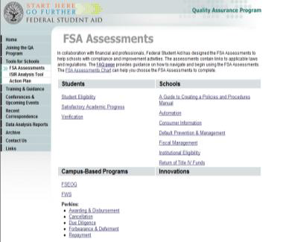
FSA Assessments - Continued

Slide 52
Self-Evaluation Tools
Self-evaluation tools may help institutions prepare for audits and reviews. Federal Student Aid works in cooperation with financial aid professionals to design a series of assessment modules to help schools enhance their services and ensure compliance with current federal regulations. Access FSA Assessments at
www.ifap.ed.gov/qahome/fsaassessment.html

Slide 53
Standards of excellence Review
Standard of Excellence Review is an objective, confidential peer review that will help your school provide students and their families with quality customer service, deliver financial aid funds in a cost-effective manner, maximize resources, and ensure regulatory compliance. When you choose a NASFAA Standards of Excellence Review, you receive a confidential assessment of your operations by qualified, experienced financial aid peer reviewers; unbiased reports highlighting your program’s strengths and weaknesses – without penalties or fines; and strategic recommendations of achieving excellence.

Slide 54
Thank You for
your Attention

