Slide 1



Slide 2

Take control of your cdr
With help from your servicers
October 2013

Slide 3
What We’re Going to Discuss Today
Define Cohort Default Rate (CDR)
  How it is calculated
  Why it matters
  How you can impact it at your institution
Explain Servicer Role
  Your servicers are your partners in default prevention
  How servicers communicate with borrowers
Explore Opportunities
  How you can take control of your own default management

Slide 4
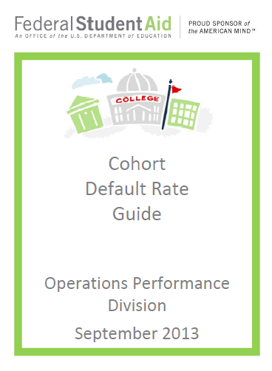
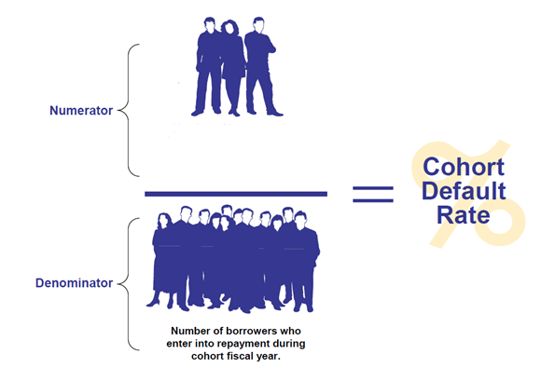
What is a Cohort Default Rate?
Number of borrowers in
denominator who defaulted
or met other specified
conditions during the applicable
cohort default period
applicable
Visit the Department of Education’s Default Prevention and Management webpage including the Cohort Default Rate Guide and FAQs at http://www.ifap.ed.gov/DefaultManagement/DefaultManagement.html
Notes:
For purposes of this presentation, we are going to discuss the Non-Average Formula that the Dept. uses for a school with 30 or more borrowers entering repayment during a cohort fiscal year.
A school’s cohort default rate is the percentage of a school’s federal student loan
borrowers who enter repayment within the cohort fiscal year (denominator) and default (or
met other specified condition) (numerator) within the cohort default period.
The link that is provided on this slide is for the Department’s Default Prevention and Management webpage. It has a link to the Cohort Default Rate Guide that contains detailed information on CDRs and I would encourage you to visit this site and bookmark or save it to your favorites.

Slide 5
When is a Federal Loan in Default?
02/25/11 FSA electronic announcement subject: Definition of Default for Student Eligibility and Cohort Default Rate Calculations
  http://ifap.ed.gov/eannouncements/022511DefiDefaultEligiCDR.html
If the loan is a... | The holder is the... | The loan is included as a defaulted loan in the school’s Cohort Default Rate (CDR) calculation when the...
FFEL Loan | FFEL Lender | Default Claim is Paid by the Guaranty Agency
FFEL Loan | Department of Education | Loan is 360 Days Past Due
Direct Loan | Department of Education | Loan is 360 Days Past Due
Notes:
When does a federal student loan default? This is a common question and in fact the Dept of ED published an electronic announcement in Feb 2011 to clarify the definition of default as it applies for the purposes of student eligibility vs. cohort default rate calculations.
For Student Eligibility - a borrower who is 270 or more days past due in repaying a FFELP loan or a Direct Loan is considered to be in default.
For Cohort Default Rate Calculations – a FFELP loan held by a lender is considered in default on the date the default claim is paid by the guaranty agency to the lender (Claim Paid Date). For a Direct Loan or a FFELP loan held by the Department of Education, the date of default is when the loan is 360 days past due.

Slide 6
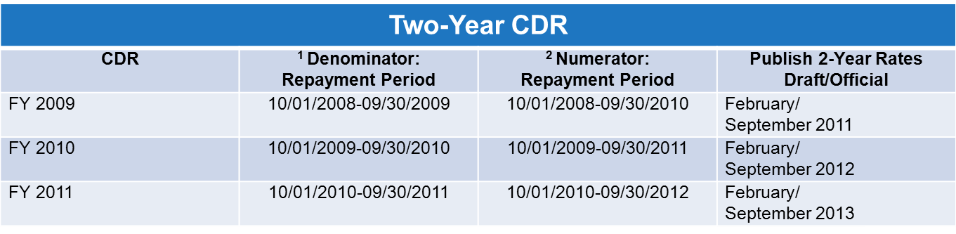
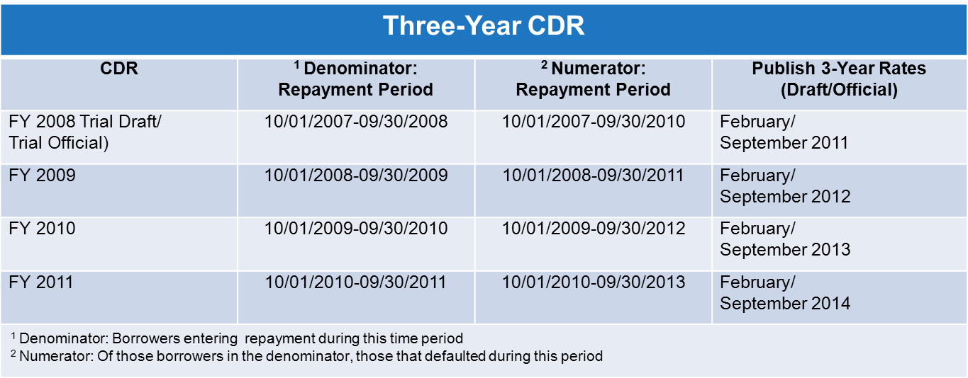
Timeframes for Two-year and Three-year CDRs
Transition period from using the official 2-year rates to using the official 3-year rates:
Notes:
We are in a transition period from using the official 2-year rates to using the official 3-year rates.
The draft cycle begins in February of each year when draft cohort default rates are
released.
The official cycle begins in September of each year when official cohort default rates are released and made available to the general public.
Transition Period
Beginning in calendar year 2014, the only rates the Department officially publishes will be the 3-year rates.

Slide 7
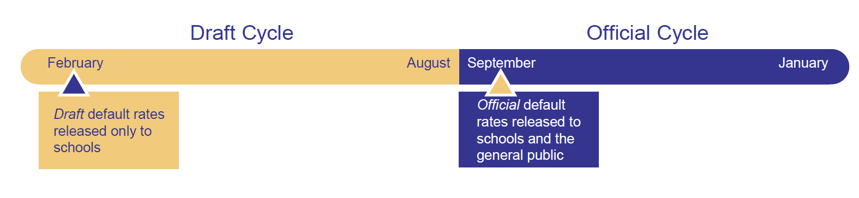
Why CDR Matters and How the Rate Impacts Your School
Why are cohort default rates important?
Defaulted federal student loans hurt borrowers and cost taxpayers money.
Benefits for schools with low rates
Requirements and Sanctions for schools with high rates
Notes:
Draft rates are published in February and official rates in September.
There are no sanctions or benefits associated with the draft cohort default rate. However, it is important to review and verify the accuracy of the draft data because unless it is corrected, the draft cohort default rate data will be used to calculate the official cohort default rates.
For the official rates - There are sanctions for schools with high rates and benefits for schools with low rates. Again, it is important to review and validate the data. If you find any errors, you may be eligible to file an uncorrected data adjustment, new data adjustment, and/or erroneous data appeal.

Slide 8
Benefits for Schools with Low CDR
If the official 2 or 3 year CDR is less than 15% for the three most recent consecutive years:
Multiple Disbursement and Delivery Benefits:
  Deliver loan funds in a single installment for a single term loan for standard term-based programs. Also applies to nonstandard term-based programs when the term is not longer than four months.
  Deliver the first disbursement of loan funds to first-year students who are first-time borrowers without the 30-day delay.
Notes:
Benefits for schools with low rates have an impact on multiple disbursements and delayed delivery exemptions. School with a three-year official CDR less than 15% for the three most recent years for which rates are published may:
Deliver loan funds in a single installment for a single term loan for standard term-based programs. The same applies to nonstandard term-based programs when the term is not longer than four months.
Deliver the first disbursement of loan funds to first-year students who are first-time borrowers without the 30-day delay.

Slide 9
School Requirements and Sanctions for High 3-Year CDR
3-Year CDR School Required Activity and Sanctions - Schools with a single-year CDR of 30% or greater must:
Establish a default prevention task force.
Develop a default prevention/reduction plan with measurable objectives for lowering the CDR.
Submit the default reduction plan directly to ED.
School with two consecutive years of CDRs of 30% or greater must revise the default reduction plan and implement additional measures to prevent and reduce defaults and may be subject to provisional certification.
3-Year CDR Loss of Eligibility
The first time that schools may lose program eligibility as a result of the 3-year CDR calculations will be in calendar year 2014 --- after three consecutive years of official 3-year CDR rates have been published.
Notes:
Today, schools remain subject to current regulations and existing threshold rates associated with the 2-year measurement. Currently the CDR rate for sanctions begins at 25% for the 2-Year measurement.
However, since we’re in a transition period to the new 3-year official CDR methodology, we’d thought it would be helpful to share information about the potential impact. Again, the information on this slide is for the 3-year rates ONLY.
Loss of eligibility. The first time that schools may lose program eligibility as a result of the 3-year CDR calculations will be in calendar year 2014 --- after three consecutive years of official 3-year CDR rates have been published
Loss of eligibility would occur under the following conditions:
The official CDR was 30% or greater for three consecutive years. Without a successful appeal, the school would lose eligibility to participate in the Federal Direct Loan Program and the Federal Pell Grant Program.
The official 2011 three-year rate (published in calendar year 2014), or any succeeding year’s rate exceeds 40 percent. Without a successful appeal, the school would lose eligibility to participate in the Direct Loan Program. However, the school would retain eligibility for the Federal Pell Grant Program.

Slide 10
Your servicers are your partners
Know your servicers’ websites, school-specific support channels, training opportunities and other available resources
  In order to provide the best service to schools and borrowers, FSA’s servicing contracts are structured to allow for servicers’ creativity and innovation.
  What follows are some examples of what one servicer offers. Please check with your other TIVAS to make sure you know what they offer as well.
Notes:
How many of you have been asked to take the CFI survey, which rates your satisfaction with your federal servicers? You don’t have to raise your hand if you’re not comfortable, don’t worry. I’m not writing down names.
You probably already know that your federal servicers are responsible for and graded on certain aspects of your experience as a school. These aspects include customer service, our websites, the information and communication we provide, our systems and tools, our training sessions, the working relationship you have with us, and your overall satisfaction.
Think of this like that Lending Tree commercial – when banks compete, you win. What you have here is opportunity for creativity and innovation. This healthy competition means a better experience for you and ultimately for your students and former students.

Slide 11
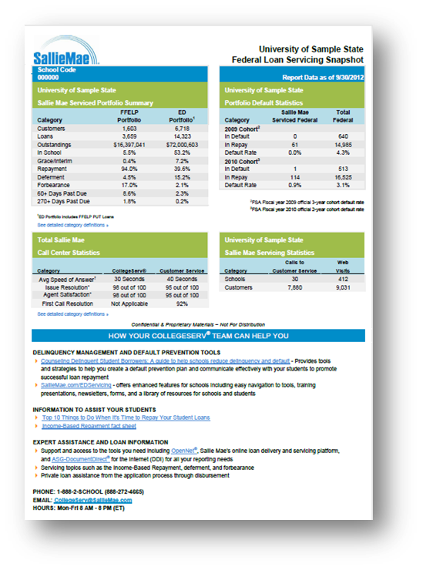
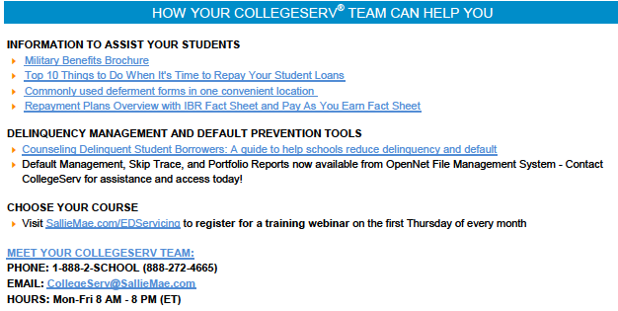
Federal Loan Servicing Snapshot Report
Quarterly report sent via email
  Serviced Portfolio Summary
  Portfolio Default Statistics
  Total Call Center Statistics
  Sallie Mae Servicing Statistics
  How Your CollegeServ® Team Can Help You
Notes:
Most, if not all, TIVAS provide some sort of report to our school partners on the performance of the loans we service for your school. This is what Sallie Mae’s looks like. Without getting into too much detail here, this is a quarterly report that provides data that will tell you how your Sallie Mae-serviced loans are performing. In Sallie Mae’s case, this is a federal loan report only – you may receive a similar report that shows how your private student loan portfolio is performing.
We also take the liberty of showing you how Sallie Mae’s bit of your portfolio is comparing to the total federal student loan portfolio serviced for your institution. We’re incredibly proud of our success in the area of default prevention, and love when these reports indicate that we’re doing a good job for you here.
This customized report also contains a bit about our customer service levels, including things like average speed of answer on the phone, and how often we’re able to resolve the borrower’s concern on the first call – we call it first call resolution, and it’s a biggie for us. We know that these borrowers want to get what they need and get on with their life, and when we’re able to see that they didn’t need to call us back for up to five days following their call, we’re pleased to say they got what they needed the first time.
I’m sure I speak for all the TIVAS when I say that the intent here is to give you something you can share internally, either with those who monitor portfolio metrics or those who counsel students on repayment options. Or, share it with your boss, to simply show how your partnership with your servicers is helping students. We all want to make you look good.

Slide 12
How (and When) We Communicate
with Federal Student Loan Borrowers with ED-owned Loans

Slide 13
Borrower Communication and the Loan Life Cycle
We understand. Students are busy. They’re focused on classes, they’re planning for life after college. That’s why we communicate with them throughout their loan’s “life cycle.”
Welcome
In School
Grace
Repayment
Notes:
Judy:
As you know, the time to talk to students about managing their student loans isn’t when they’re putting on their cap and gown.
It’s now, while they’re still on campus and earning their degree. [While they’re still directly benefitting from those loans.]
Today, we’re going to talk about many resources Sallie Mae-Ed Servicing Department and the Department of ED itself make available – to you and to your students.
These are free tools, available to you at the click of a button. We’re committed to making sure your students are equipped with the information they need to be successful.
You need tools to share with your students, so they have what they need to be successful.
We have those tools for you.
You need information about federal student loan repayment programs to make sure your students know about the options available to them.
We have the answers to your questions.
We are Going to show you examples of some of the materials available at SallieMae.com/EDServicing. All of these documents are available in the Library section of our website.
Transitional emails – include – In School –Grace – Nearing Repayment – Repayment
These have been VERY successful with open rates close to 50% for some. Note – slide 4 has a slide-in animation feature to show off the customization. Each email has the borrower’s name in the subject line – which we believe has contributed to the high ope

Slide 14


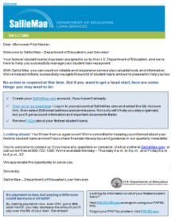
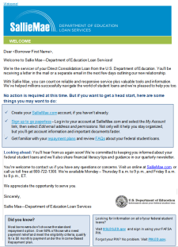
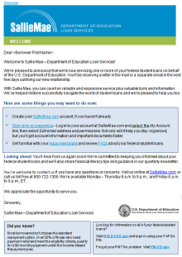
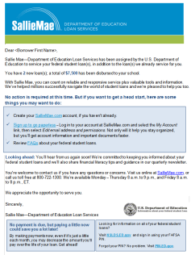
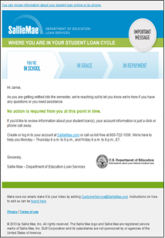
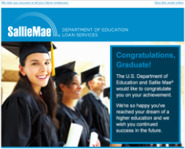
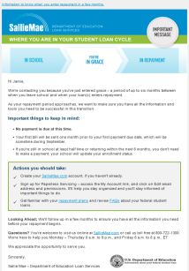
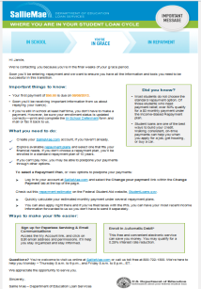
Loan Life Cycle Touch Points
Student Begins College
or Is Converted to SLMA
Welcome
New Loan
In School
Grace
Staff/Grad Plus
Congrats on Graduating
Consolidation
New Loan Acknwldgmnt
Early
In School
Mid
In School
Late
In School
Entering
Grace
Exiting
Grace
Conversion
Withdrawn / Less Than Half Time`
Qtrly Nwsltr & Thank You
(Rcv 8-16 x’s
Thru Grace)
School Deferment
(Enrollment Change – In dev)
Within 30 days
To Be Developed
To Be Developed
Within 30 days of
new relationship
Targeted Borr Populations
Within 30 days of
1st Disb of new loan
Within 6 months of status begin date
½ way btwn status begin and end date
Within 6 months of status end date
Within 0-90 days of Sep Date
Within 30 days of
Entering Grace
Within 50 days of
Rpmt Begin Dt
Welcome
No Action Rqr’d
We appreciate the opp to serve you
Early In School
No Action Rqr’d
½ Way Thru Schl
Just Touching Base
End of School
What to Expect
Status Change
Congrats or Guidance on Next Steps
Changes are coming
Payment Info & Repay Options

Slide 15


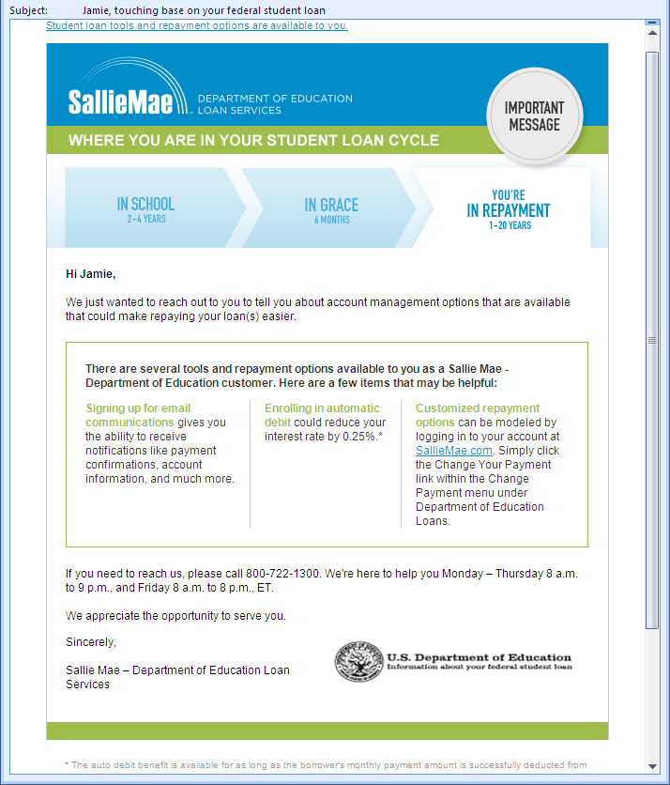
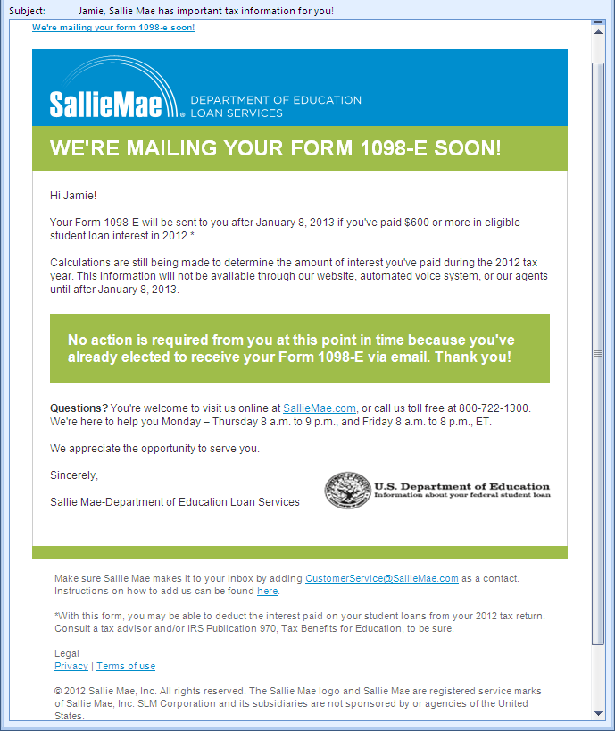
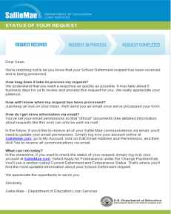
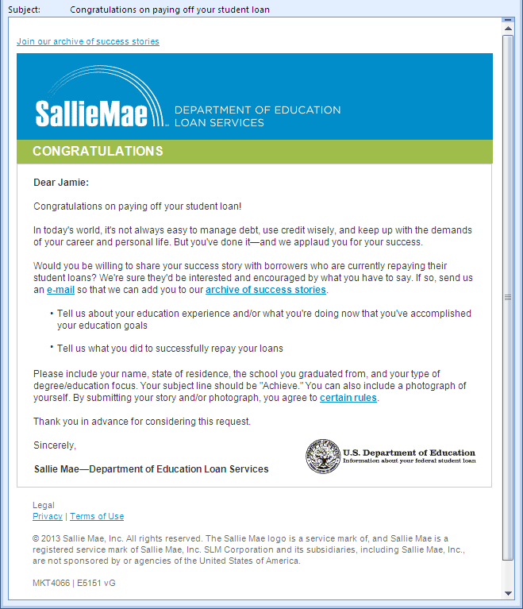
Loan Life Cycle Touch Points (Cont.)
In Repayment
PIF
In Repayment
Annually - If Eligible
Possibly Multiple
(As Applicable)
Within a year of all loans PIFB
Paid-In-Full
Congrats
1 year of
on-time pmts
Re-enroll in IDR Program
Graduated Repayment Reminder
1098-E
Close the Loop
Payment
Confirmation
Exiting
Deferment/
Forbearance
Disaster Relief
10 Day Late Payment Reminder
Qtrly Nwsltr & Thank You
(4x# yrs in rpmt)
Web Enhancements
Go
Paperless
Borrower Surveys
Special Promotions
Quarterly
Thank You
To Be Developed
To Be Developed
To Be Developed
To Be Developed
6 months after
entering repayment
Within 1 year of
Entering PIFB
Within 30 days of
Entering PIFB
We’re here to help if you need us
1098-E Expectations
Here’s the status of your request
You’re Almost There
Congratulations!

Slide 16

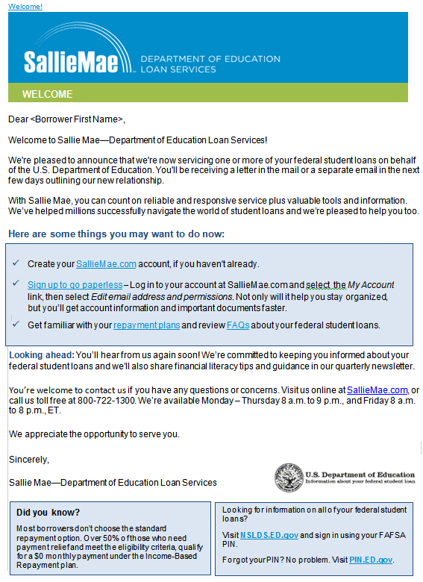

Welcome – New Borrower Relationship
Welcome – New Relationship
Start production mid-August
New COD Borrower
Conversion / Acquisition Borrower
New Consolidation
Transferred Borrower

Slide 17
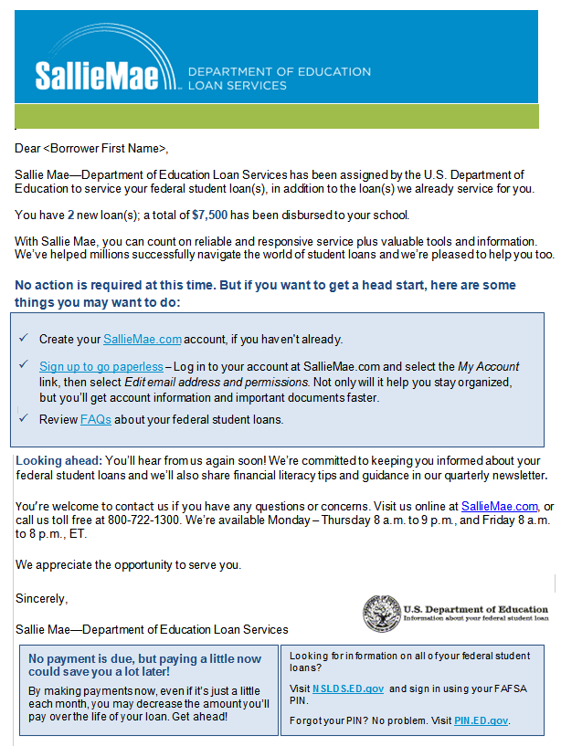
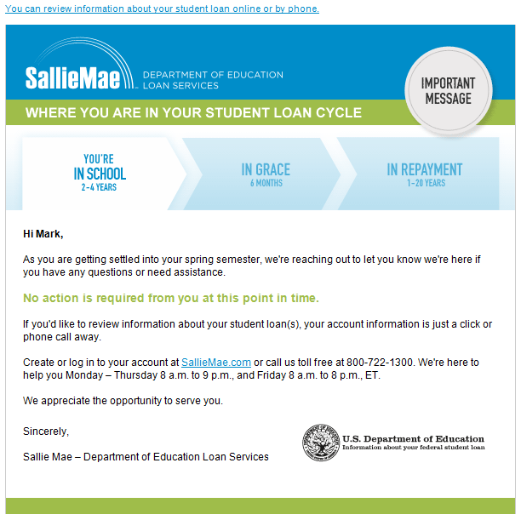
New Loan Acknowledgement and In School
New Loan Acknowledgement
In School
Starts production mid-August
46% YTD Open Rate

Slide 18
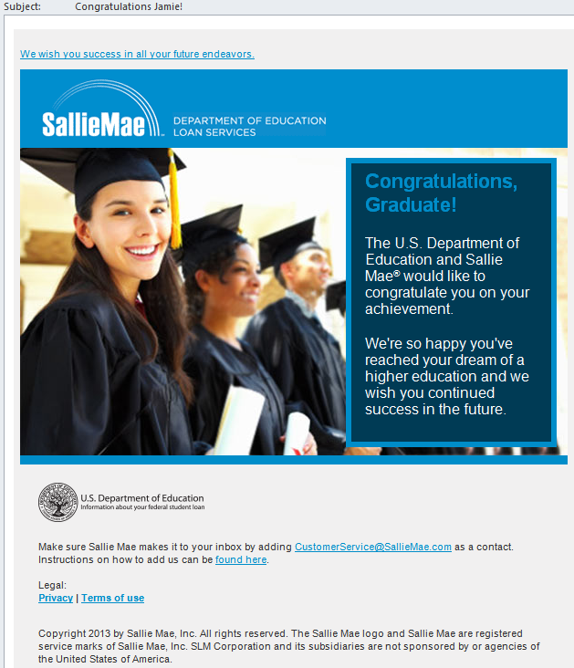
Graduation Congratulations
Congratulations on Graduating
56% YTD Open Rate

Slide 19
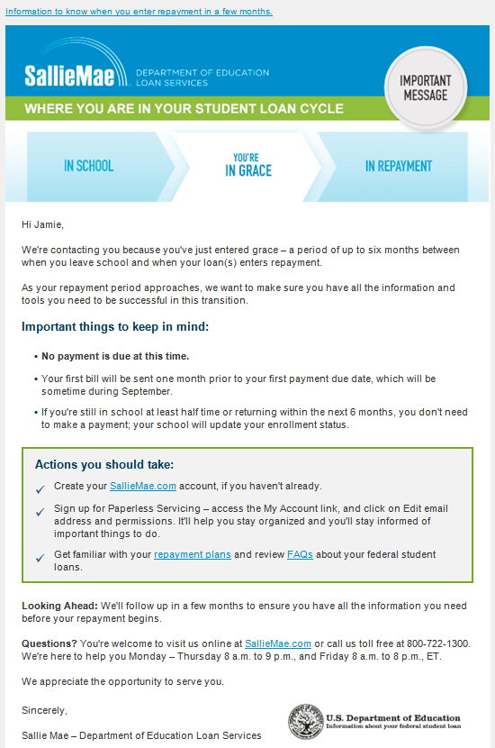

Entering and Exiting Grace
Entering Grace
(Monthly)
Exiting Grace (Weekly)
43% YTD Open Rate
39% YTD Open Rate

Slide 20
In Repayment and Paid-in-Full
In Repayment
(Generated Monthly)
Paid-in-Full
(Generated Monthly)
44% YTD Open Rate
52% YTD Open Rate

Slide 21
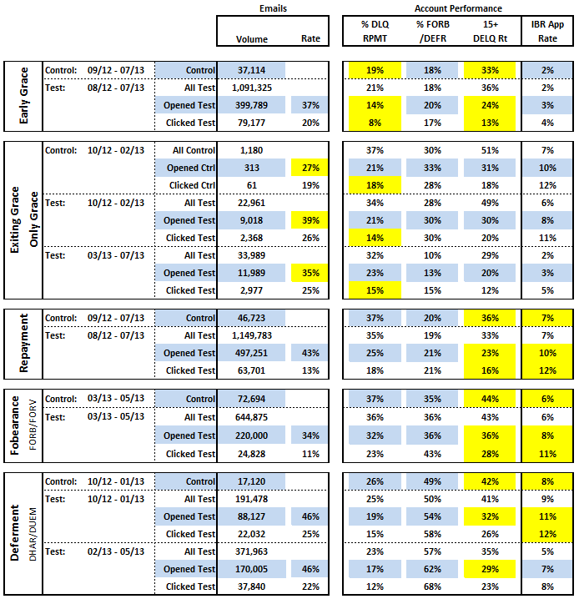
New Email Communication Performance
Key Findings:
All test emails have very high open and click rates
Early Grace: the test population has a lower 15+ day delinquency rate and overall delinquency rate
Exiting Grace: the performance metrics are in line with the control group (the control group received a very similar email). The test group however does have significantly higher open and click rates
Repay: the test population has a lower 15+ day delinquency rate and higher IBR enrollment rates
Exiting Forbearance: the test population has a lower 15+ day delinquency rate and higher IBR enrollment rates
Exiting Hardship or Unemployment Deferment: the test population has a lower 15+ day delinquency rate, higher IBR enrollment rates, and higher rates back into forbearance or deferment

Slide 22
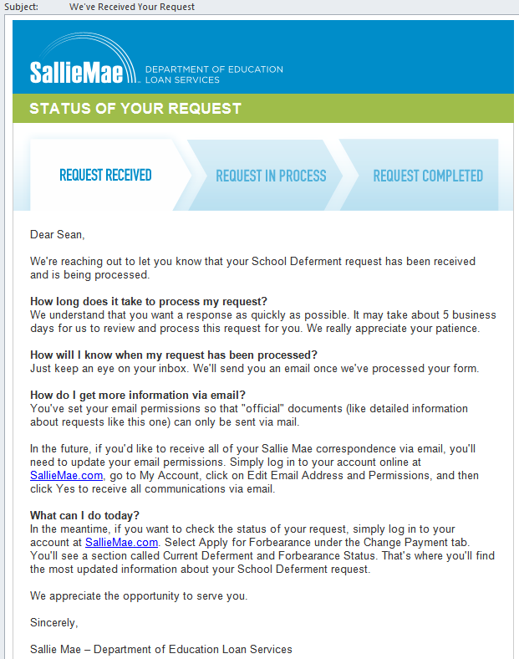
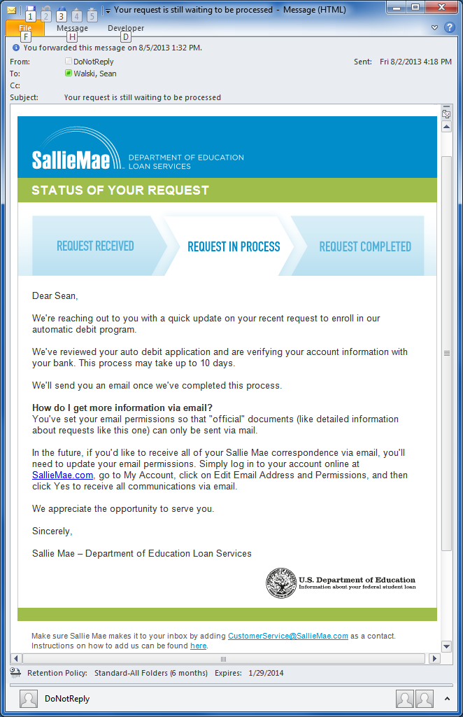
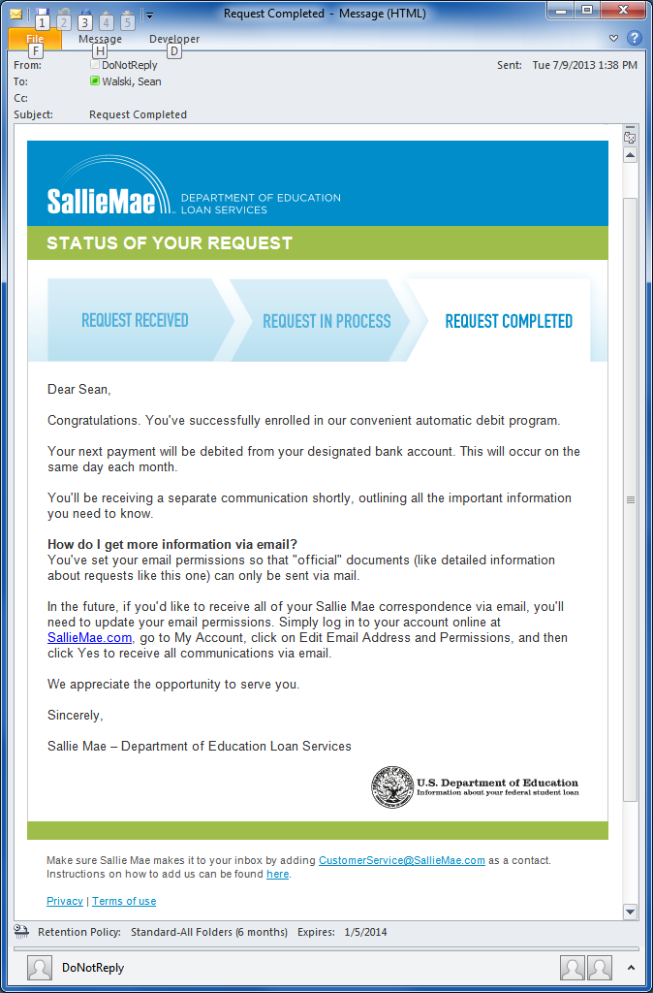
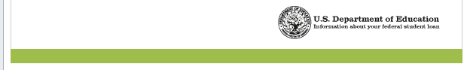
“Close The Loop” Series
“Close The Loop”
57% YTD Open Rate

Slide 23
The Default Prevention Challenge
Understanding the Data
Creating Strategies Based on the Data
Leveraging Multiple Resolution Channels
Focusing Efforts in Certain Stages
Test, Test, Test!

Slide 24
Create Strategies Associated to the Data
Center on ‘who’ and ‘why’
Create data sets based on risk
Consider ‘best practices’
Don’t be afraid to be innovative
Get ready to test!

Slide 25
Leverage Multiple Channels
Traditional Telephone Outreach
Self Service
Mobile & Video
Direct Mail

Slide 26
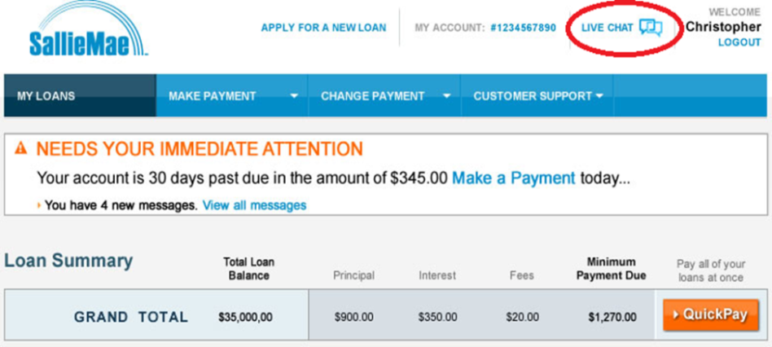
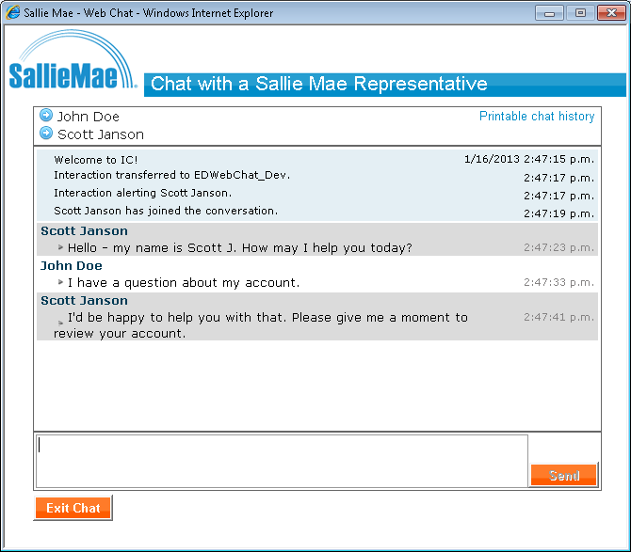
Web Chat Channel
  6,900+ customers have initiated chat
  Over $115 million resolved
  7% in a skip status
  Over 50% of the resolves in the mid stage
  31+ attempts prior to chat
  85% stay within channel

Slide 27

Web Chat Customer Feedback
“Direct and to the point, very helpful. A lot of people like me that are behind on payments don't have the guts to talk to someone in the phone out of fear to be yelled at like it often happens. Making the Chat option available removes all emotions and allows to address what is really important.”
“I appreciate the willingness to work with me on my difficulties in paying back my loan. Connie was willing to help me and made sure that I was able to come up with a good payback plan. Thanks.”
Ranked chat 4.6 on a 5 pt. scale
89% were able to resolve their question or issue
91% would use chat again
“I like the fact that the live chat is an available option. It’s hard to conduct business during the workday, and confidential information may be overheard by those around you. I appreciate the option.”

Slide 28
Focusing Default Prevention Efforts at Certain Stages
Critical Stage
- spend increases with risk
Late Stage
- Assignment
Mid Stage
- Multi channel
Early Stage
- Tactics focused on risk
In School - Grace - Repay
- Educate on Income-Driven Repayment Plans

Slide 29
Test, Test, Test!
An example of a recent test: The “Warm & Fuzzy” Messaging
“This is Sallie Mae Department of Education calling with good news for <borrower>. At Sallie Mae we understand that times are tough for a lot of people and we are here to help. Did you know that half of our borrowers that are in income based repayment plans have a monthly payment of $0? That's right, zero! If you contact us today, one of our agents can assist you with the many options we offer that could provide a solution for your account today. Give us a call at XXX-XXX-XXXX. Thank you!”
Our borrowers hear the same “debt collection” messaging from us as soon as they become delinquent.
By mixing up the wording and tone, we try to understand any lifts we can gain from making those changes.
Identify Requirements
Gain Consensus on Criteria
Strategy & Design
Planning
Executing
Review & Audit
Accept, Reject, or Modify?

Slide 30
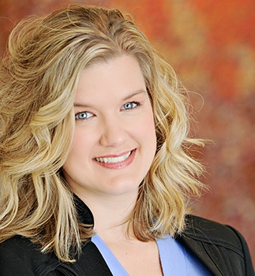
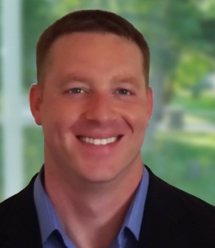
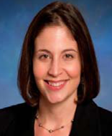
Contact information
Amanda Holt
Director, Client Communications
Sallie Mae – Dept of ED Loan Services
Amanda.Holt@SallieMae.com
302-283-4077
CollegeServ (School Services):
Email: CollegeServ@SallieMae.com
Web: SallieMae.com/EDServicing
Phone Number: 888.2.SCHOOL (888.272.4665)
8:00 a.m. – 8:00 p.m. (Monday-Friday)
Borrower Customer Service:
Web: SallieMae.com/FederalLoans
Toll-Free: 800.722.1300
8:00 a.m. – 9:00 p.m. (Monday-Thursday)
8:00 a.m. – 8:00 p.m. (Friday)
Steve Adams
Director, Operations Strategies
Sallie Mae – Dept of ED Loan Services
Steven.Adams@SallieMae.com
302-283-8121
Keri Neidig
Senior Account Executive
Sallie Mae
Keri.Neidig@SallieMae.com
610-216-2807

Slide 31

QUESTIONS

