Slide 1
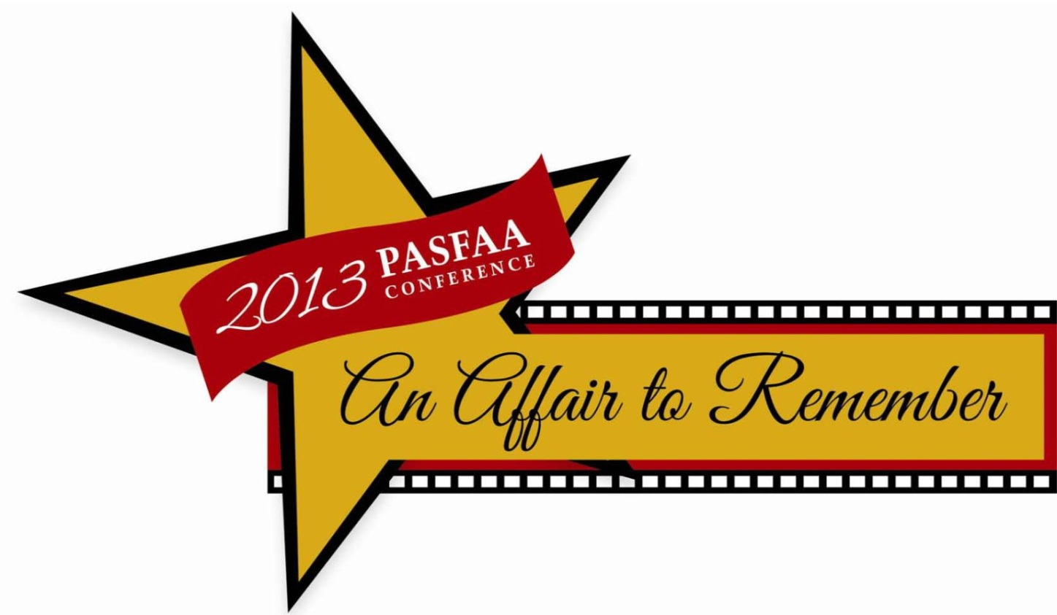
Student Advocacy in action Linda M. Anderson October 14, 2013

Slide 2
Student Advocacy: Discussion Agenda
The Goals of the Government Relations Committee.
Our committee members.
PASFAA’s role in Student Advocacy.
Student Advocacy within PASFAA’s Mission Statement.
The importance of Student Advocacy.
Our projects during the 1213 AY; topics we have addressed.
Preparing for a Lobbying Visit.
Successful Meetings and Points to Remember.
Our accomplishments during the 1213 AY.
Encouraging You to Be an Advocate.

Slide 3
Goals of the GRC
To gain an understanding of the impact of leadership changes in the House and Senate: to understand the impact on federal aid and state grant program funding.
To identify ways to keep PASFAA membership informed and involved.
To understand legislative issues, in order to appropriately inform and influence members of Congress in support of our federal and state financial aid programs.
To understand the impact of any deficit reduction proposals on our students, programs, on access, affordability, retention and program completion to graduation.
To articulate the value and impact of our financial aid programs: Student access, affordability, progress to degree completion, and the minimization of overall student debt burden, are critical initiatives and justifications to retain programs which continue to help our students and our schools achieve these objectives.

Slide 4
GRC Members 1213
Linda Anderson, PASFAA Vice President and Chair, Government Relations Committee; Director of Student Financial Aid, Carnegie Mellon University.
Scott Miller, Director of Federal Relations, PHEAA.
John Falleroni, Associate Director of Financial Aid, Duquesne University.
Evan Weiler, Assistant Director of Financial Aid, Kutztown University.
Michael Nuccio, Graduate Financial Aid Counselor, Arcadia University.
Kim Uphold, Assistant Director of Financial Aid, Reading Area Community College.
Shelby Smith, Assistant Director of Financial Aid, Moravian College.
Alyssa Dobson, Director of Financial Aid, Edinboro University

Slide 5
PASFAA’s Role in Advocacy
Government Relations Committee
Advises PASFAA leadership.
Arranges annual D.C. Capitol Hill visits.
Maintains Government Relations Resource Center on PASFAA website.
Alerts membership to key issues.
Communicates with Congress on specific issues.

Slide 6
Student Advocacy in our Mission Statement and in our Strategic Plan
The Pennsylvania Association of Student Financial Aid Administrators (PASFAA) is a dynamic service association whose mission is to provide training, mentoring and career support to members and other constituencies within a changing environment; to advocate for access to post-secondary education, and to educate the public on financial aid opportunities.
Objective A: Educate and inform Members and Legislators on Issues Related to Post-Secondary Education Funding.
Offer training opportunities and information related to advocacy to members and to external constituents.
Enhance the PASFAA website to include resources and links for communicating with legislators.
Objective B: Collaborate with peer associations and legislators.
Enhance relationships with other aid associations in support of advocacy.
Provide information to support communications to legislators by the Government Relations Committee.
Objective C: Promote the involvement of students and parents in advocacy.
Provide information to support communications to legislators by parents and students through post-secondary institutions and secondary school avenues.

Slide 7
The Importance of student advocacy
For Students:
We advocate daily for students in our roles within our schools. It is an integral part of our positions and what our profession represents. Our continuing goal is to make sure that students obtain all that the funding formulas and legislation permits, as they complete their college educations. Advocacy at the federal level is a logical part of our positions.
For our Financial Aid Profession:
It acknowledges to our Congressmen the fundamental role we play as a student advisor, educator, and expert in the administration of financial aid; it acknowledges that we understand the strategic and tactical concepts needed to deliver our programs and services.
For Congressmen and Legislative Staff:
They need to know that we are here to partner with them as they seek to serve their constituencies and understand complex higher education issues.

Slide 8
Topics we have addressed in 1213: During Capitol Hill visits and in response to the CFPB request for Information
Access, and affordability.
Federal student loan interest rates and the sustainability of a student loan model.
Educating the student: transparency and consumer disclosures.
The Know Before you Owe Act.
Financial literacy initiatives.
Student loan indebtedness.
Private loans & financing.
ROI metrics.
Reauthorization.

Slide 9
Preparing for a Hill Visit
Do your research.
Identify key Congressional Staff members, Senators and their Legislative Aides, key staff members on the House and Senate Education Committees, and Appropriations Committee, and the Consumer Financial Protection Bureau (CFPB).
Understand the current political climate: currently budget politics and deficit reduction are driving policy.

Slide 10
Successful Meetings and Points to Remember
Do your research on the staff members’ backgrounds: Which legislation have they endorsed; which committees have they served on; do they have liberal or conservative perspectives; are they experienced or new in their positions?
Be ready to respond to any of their inquiries: Issue specific or broad based.
Create a template of talking points and leave it for them to use as reference material.
Make vivid the consequences of legislation.
Present a balanced approach if you are representing multiple constituencies.
Come prepared to talk about the key issues.
Use data when relevant; relay student stories/testimonials.
Be prepared to cover topics in 15 minutes with a clear and concise summary.

Slide 11
Successful Meetings and Points to Remember
Well-articulated discussions and exchanges which enable the Congress member or legislative aide to gain a more in-depth understanding of the impact of legislation on students and families; exchanges which enable us to understand more about the legislative and appropriations processes on Capitol Hill, and their roles and challenges.
Follow-up from Congressional staff members after your visit to ask you more questions.
The request for your feedback about legislation they are proposing.

Slide 12
GRC Accomplishments 1213
March 2013: responded to the CFPB’s request for information about ways to increase the availability of affordable loan repayment plans for private loans, with a focus on the student experience, increased delivery requirements for financial literacy programs, and the enactment of legislation to support a fiscally responsive approach to private student loan borrowing such as the Durbin-Harkin Know Before you Owe Act of 2012.
May 2013: we made our annual 2 day visit to Capitol Hill, visiting with members of the PA Congressional delegation as well as staff from the House and Senate Education Committees and the Senate Appropriations Subcommittee on labor, HHS, and ED with discussions on the student loan interest rate proposals, the importance of Financial Literacy Initiatives, Loan repayment plans, Parent PLUS Loans, Private Loans, Transparent Consumer Information.
We strengthened our PA Advocacy efforts, including enhancing the advocacy portion of the PASFAA website and making plans to increase PASFAA’s role in state advocacy.
September 2013: Provided membership with a summary email on Gainful Employment and Negotiated Rulemaking.
September 2013: Responded to NASFAA’s request for feedback on the impact of sequestration on schools.

Slide 14
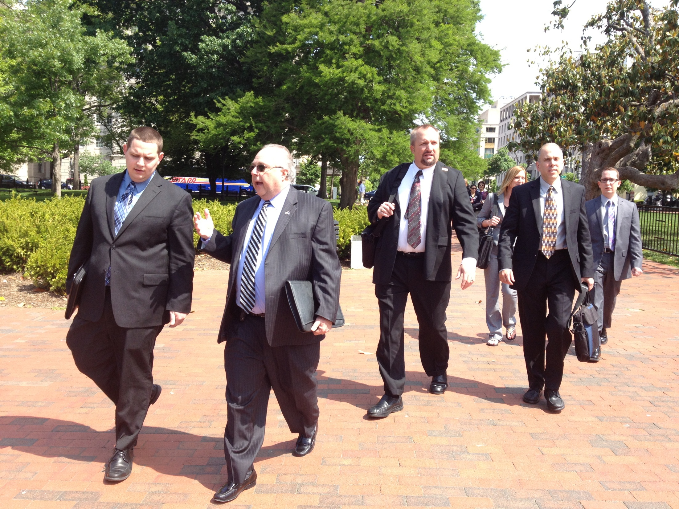

Slide 15
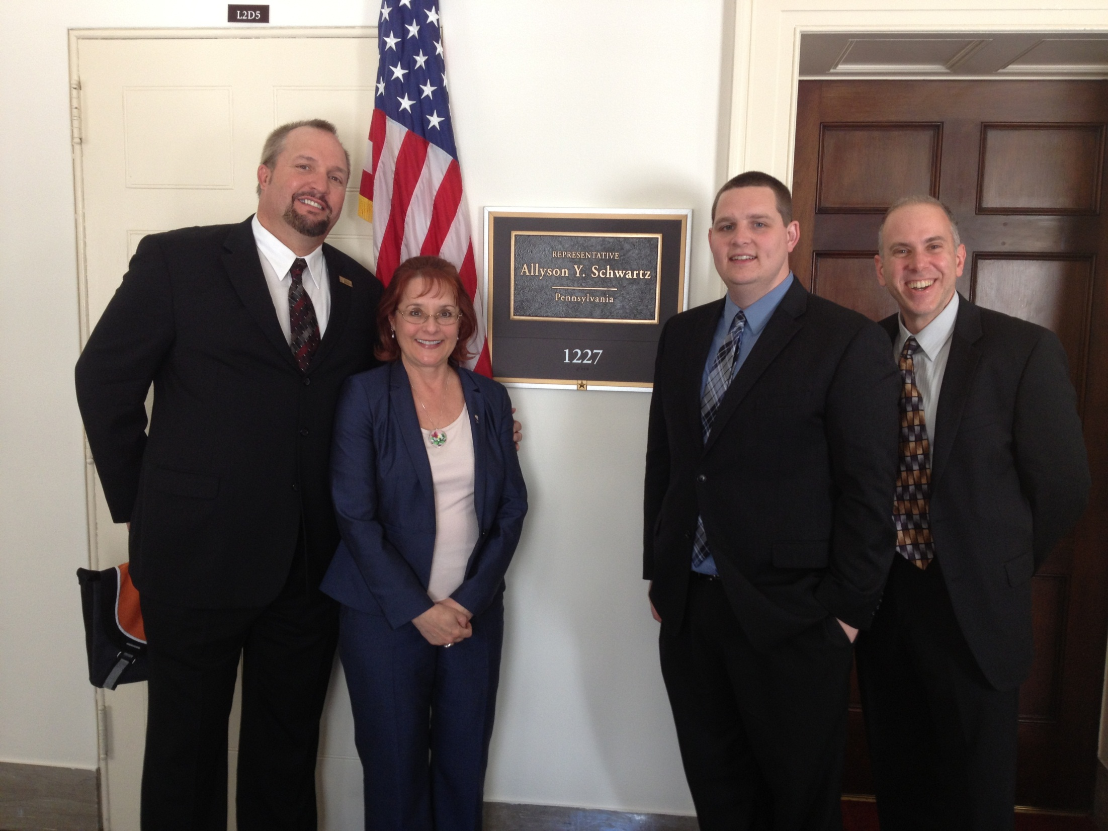

Slide 16
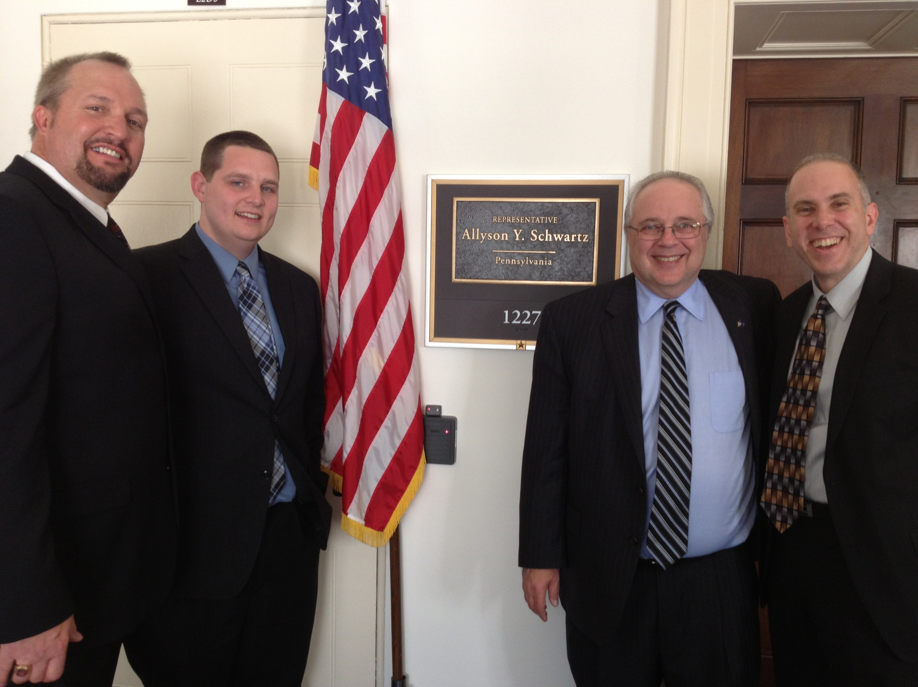

Slide 17
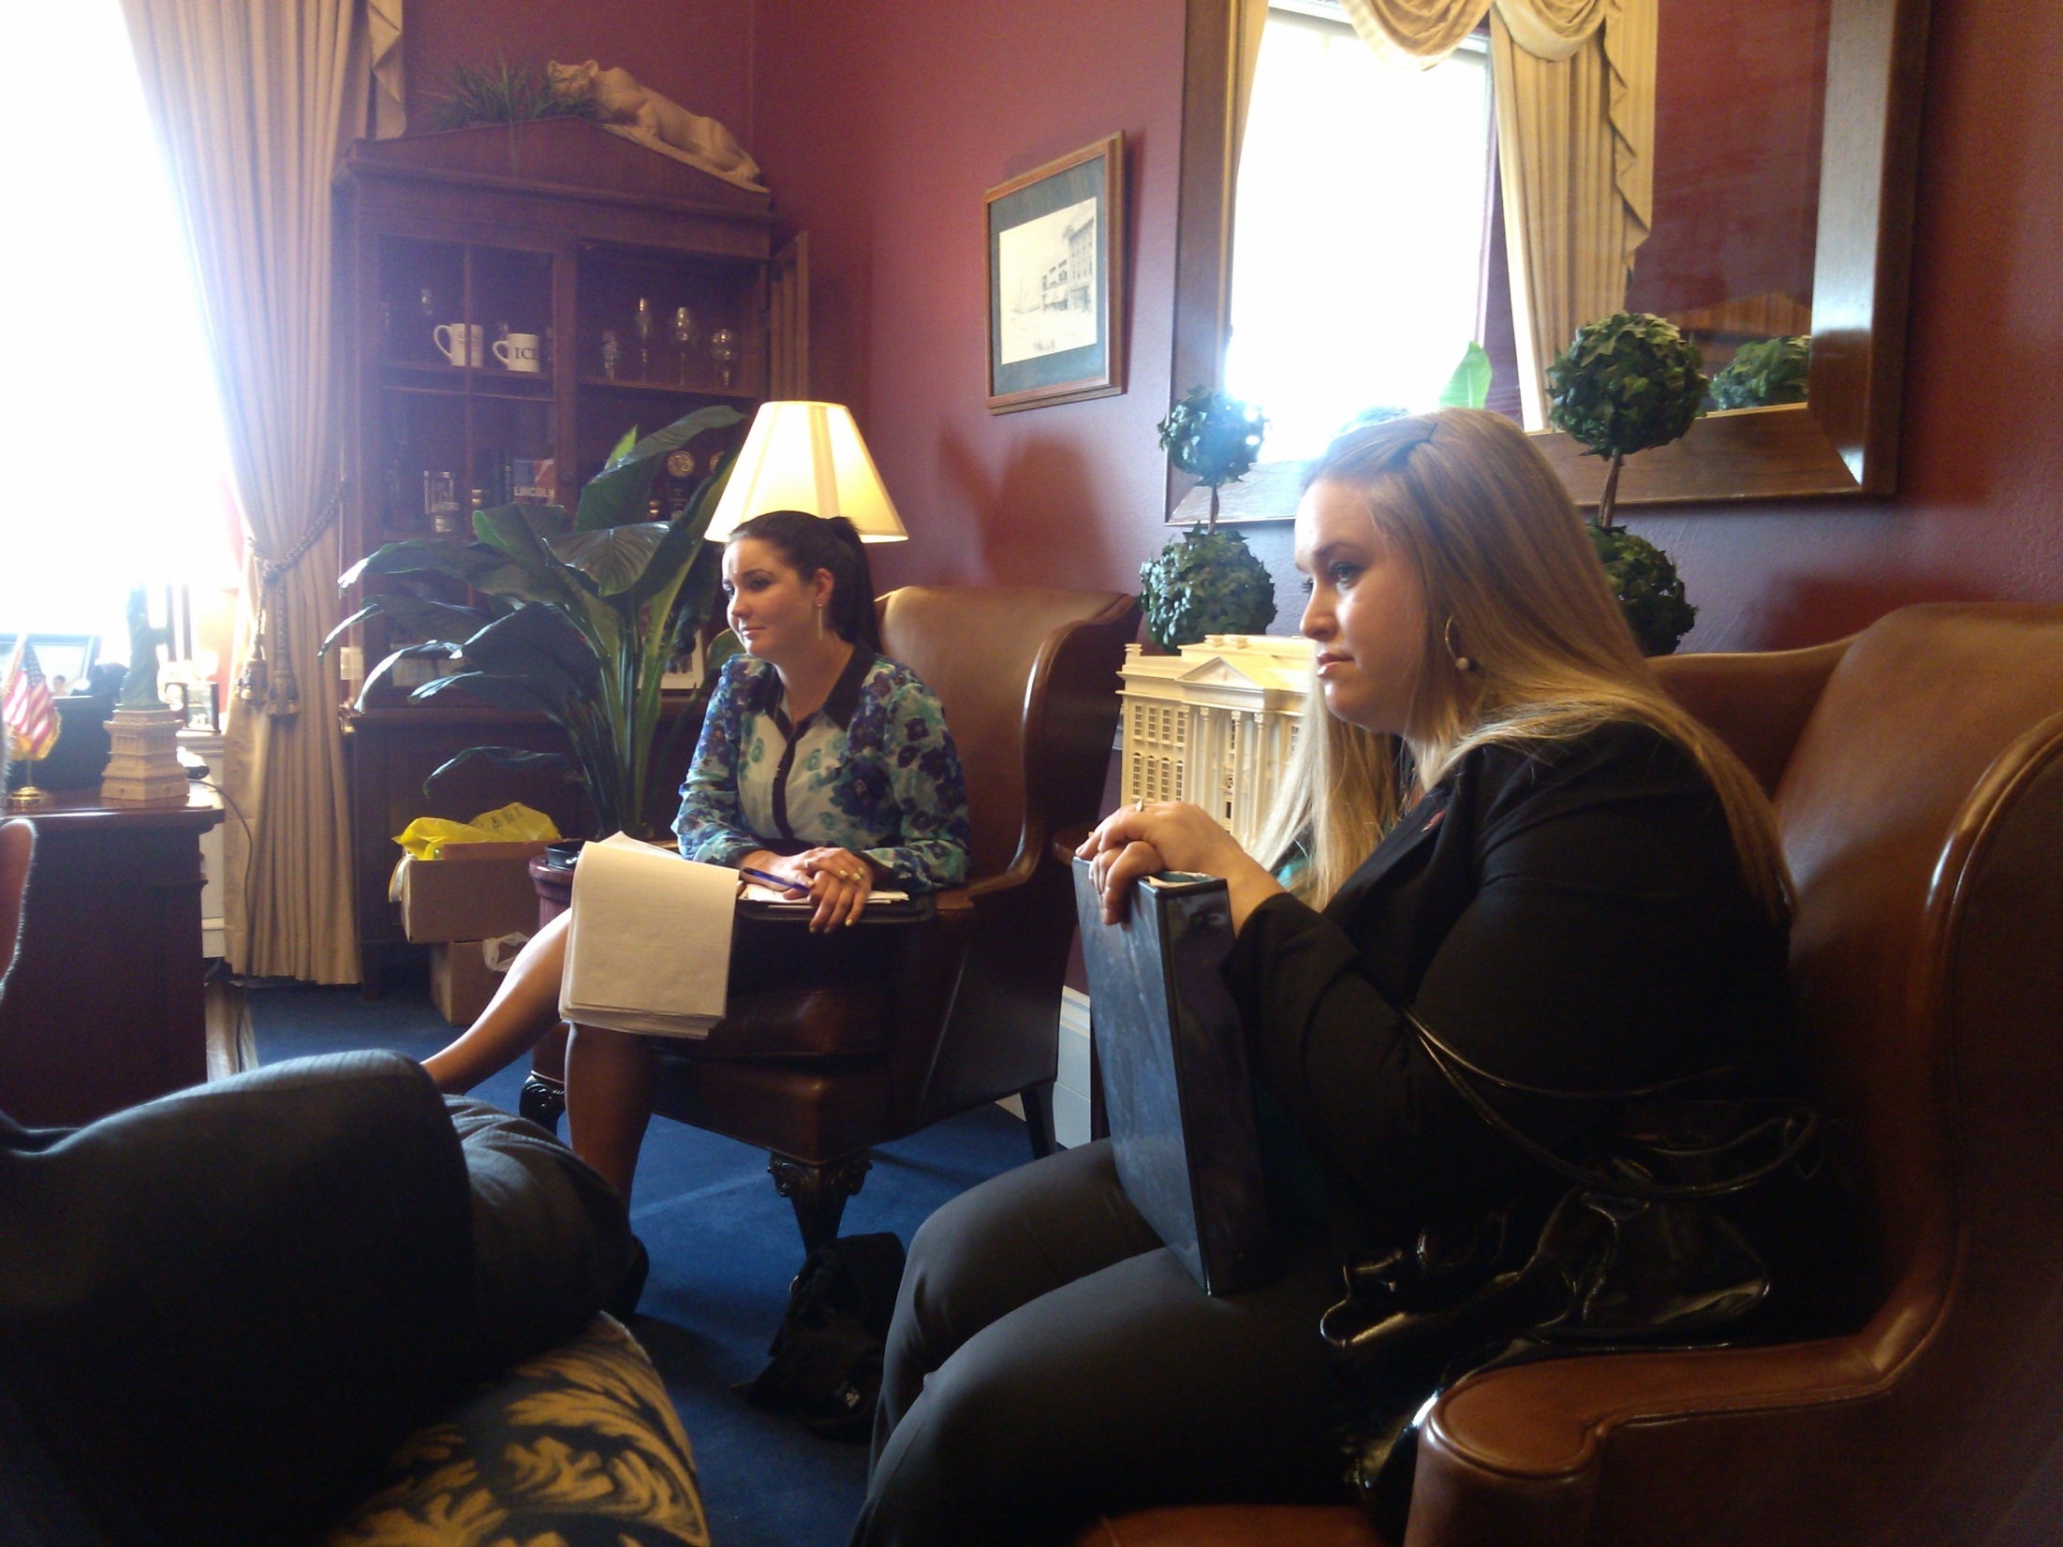

Slide 18
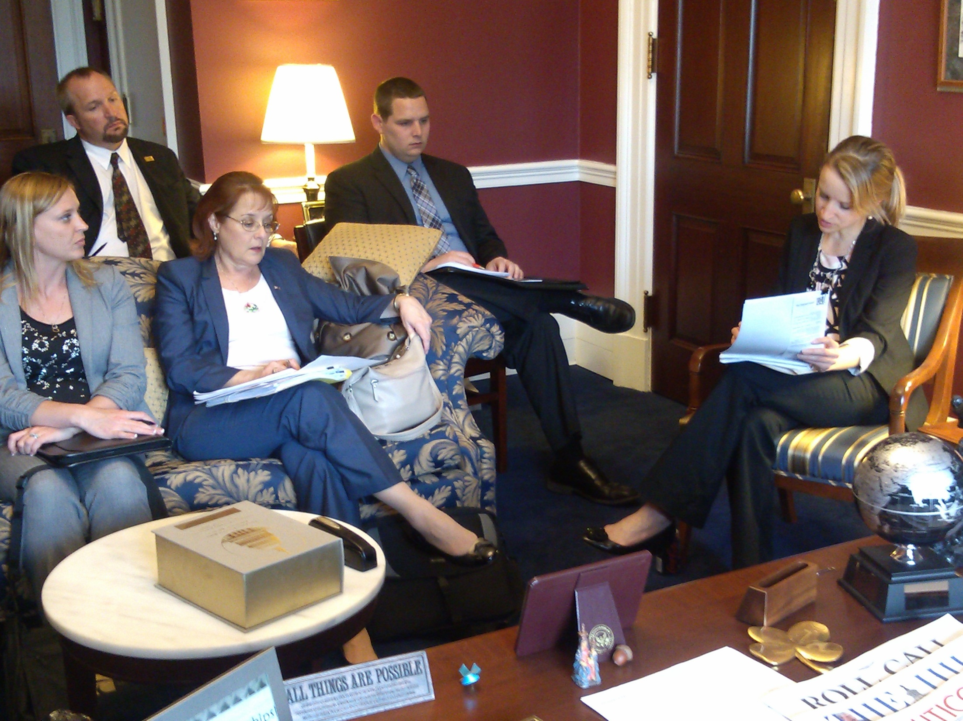

Slide 19
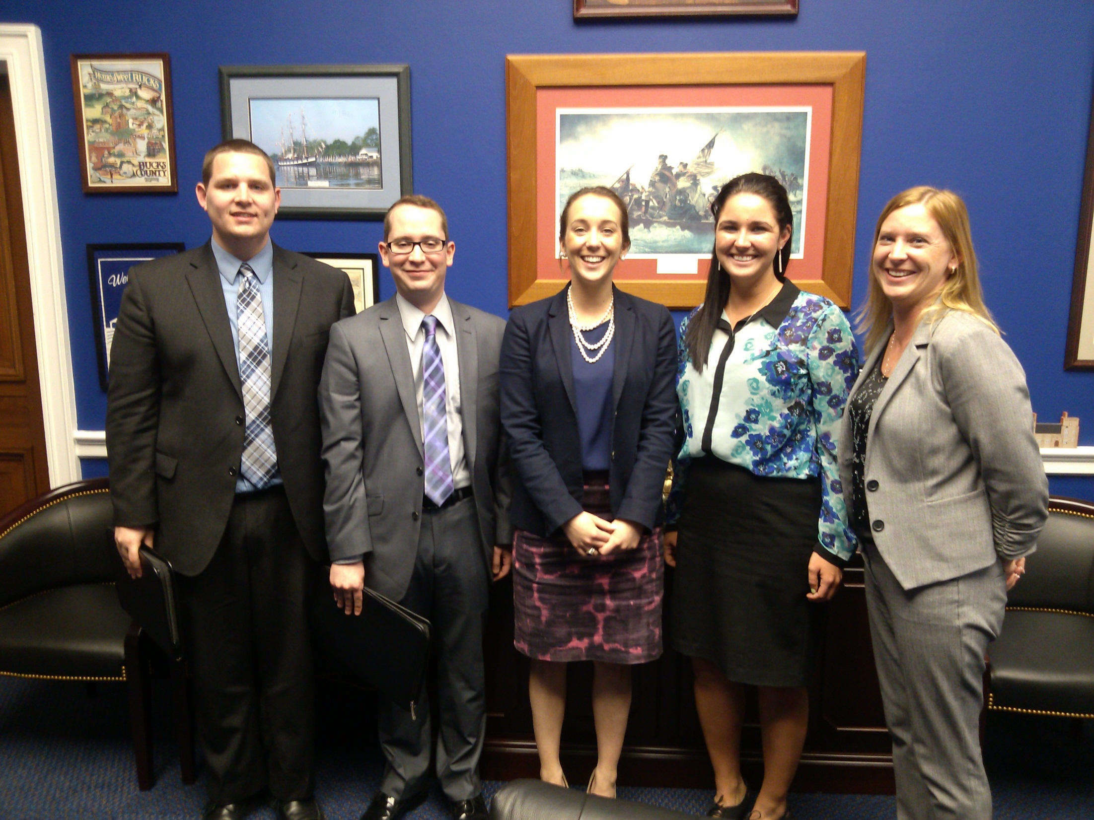

Slide 20
