Slide 1
Five Simple Steps to Managing Stress
Tami Gilbeaux, CPFM
Strategic Business Director
Notes:
Everyone is here because they want to better handle stress in their life – right? What causes stress in your life? (Get the group talking and sharing about stressors they experience). Based on answers relate how everyone experiences stress.

Slide 2
Agenda
What is stress
Steps to handle stress
Summary
Notes:
What we are going to talk about today is – what exactly is stress? We all know we have it, but can we define it? As promised I will cover 5 tips to handling stress in your life. And then we will sum it up and maybe do an exercise or two to help you relieve any stress you are feeling right now. Are you worried about what is happening back at the office? At home? With loved ones?

Slide 3
Definition
Stress is the body’s reaction to a change that requires a physical, mental or emotional adjustment or response.
Notes:
Here is a clear and simple definition of stress. It is a normal body reaction to something going on – internal or external.

Slide 4
Stress
Negative stress is referred to as distress
Caused by losing, failing, overworking and not coping properly
Can be harmful if not handled, but is perfectly normal
Notes:
Negative stress is often called “distress”. It can be caused by a number of things and it can be very harmful is not handled properly. We will talk more about that in a minute. The important thing to remember is that it is perfectly “normal”. Everyone experiences stress! Who is experiencing stress right now? Anyone willing to share?

Slide 5
Stress
Not all stress is negative
Positive stress results from exhilarating experiences
Winning the lottery
Unexpected promotion
Recognitions/awards
Notes:
It is important to note that not all stress is negative. We all experience positive stress – happy things – like winning the lottery, getting that promotion, receiving an award – some people here are going to experience that at the banquet this week! So we don’t want to remove stress from our life – how boring would that be!

Slide 6
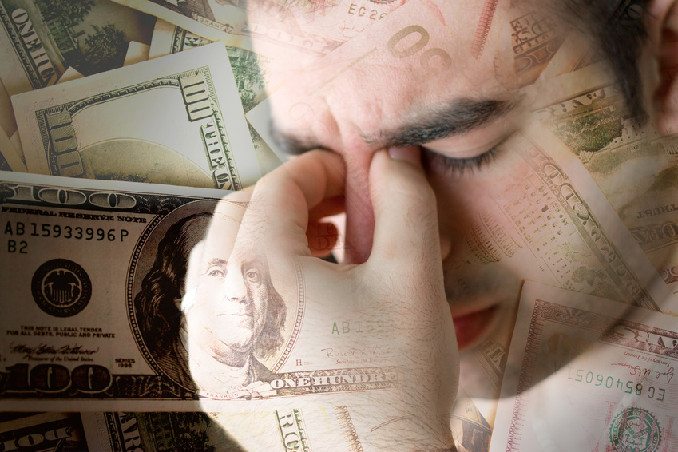
Stress
Stress is a part of everyday life
Time, money and relationships ensure that stress will ALWAYS be with us
Notes:
Stress is a part of every day life. Since we have to deal with issues of time, money and relationships – I can guarantee you that stress will always be with us.

Slide 7
Five Steps to Handle Stress
1.
Awareness
2.
Attitude
3.
Action
4.
Control
5.
Commitment
Notes:
I promised you 5 easy steps to gain control of stress in your life. Here they are and I will spend a couple of minutes talking about each.

Slide 8
Step 1
Awareness
Notes:
The first step is awareness. What do we mean by awareness? How will that help me cope with stress?

Slide 9
Awareness
We must know our own body so we can recognize stress
Increase heart rate
Blood pressure rises
Breathing speeds up
Others???
Notes:
We need to be aware of what is going on in our own bodies. Have you ever gone to the doctor because you KNOW something is not right? You don’t need a doctor to tell you when something is wrong with your health – you may not have a name for it, but you know when something is not right. Are you having difficulty sleeping, overeating or no appetite? Are you catching more colds or minor illnesses? I know when I am stressed because I start having back problems – I have learned to recognize this in myself and take actions to relieve stress. I always said I was the least stressed person in the world – I roll with the punches – not true – that was denial. We all experience stress and we need to watch for the signs.

Slide 10
Step 2
Attitude
Notes:
Step 2 – Attitude.

Slide 11
Attitude
Positive Attitude
Believing you can handle the situation
Positive thinking and negative thinking are attitudes – they show the way you handle your life (points of view)
Train your mind to think in terms of 'possible' and 'can be done'
Notes:
Having a positive attitude about life goes a long way in dealing with stress. Believing in yourself and your ability to handle whatever life throws at you is a great stress reliever. View problems as opportunities in disguise – another way to be successful. Train my mind to think in terms of it is possible or it can be done – we just need to figure out how.

Slide 12
“The pessimist sees the difficulty in every opportunity; an optimist sees the opportunity in every difficulty.”
~Winston Churchill
Notes:
I have always tried to be a half full glass person rather than half full – maintain that positive outlook. It is a life changing thing.

Slide 13
Attitude
View life as a series of opportunities
Do not view life as a threat or endless group of problems
Seek out challenges
Believe you will learn from the challenges you will face
Notes:
Your attitude is so important. Start viewing life and its challenges as opportunities not threats or mountains to block your way. Rise up to the challenges – begin to actually seek them out – deliberately choose the hard way instead of the easy route – you will be amazed at what you can accomplish it you set your mind to it. Most of all believe you will learn from every challenge you face. Reflect on everything you experience and pull the good from it – it is in there – we just forget sometimes to look for it.

Slide 14
Attitude
Change your self talk
Watch and monitor what you say
Switch your inner voice from “I can’t” to “I can!”
Notes:
Change your self talk – what do I mean by self talk. It’s that inner voice that has a tendency to pull you down or lift you up. Fostering that positive attitude will help you change your self talk – focus on the positive – not the negative. We are what we say – be careful about speaking negatively – about anything. Negativity has a way of spreading – like wild fire! Have you ever been around a negative person – that person that always sees the glass half empty – always talking about all that is wrong in their life??? Hearing that day in and day out will impact your attitude – limit your exposure to negativity. Lastly, switch that inner voice from a I can’t do it to I can do it!!!! I recently had to adopt that attitude about changes in my job – I was being very negative – thought I could not do that!!! Now I am practicing what I am telling you – focusing on the positive – I CAN DO THIS!!!!

Slide 15
“A man is but the product of his thoughts; what he thinks, he becomes.”
~Mahatma Gandhi
Notes:
Simply said – we are what we think.

Slide 16
Step 3
Action
Notes:
Step 3 – Action – what do I mean by that?

Slide 17
Action
Action is attitude in motion!
Embrace stressful situations
Learn from others
Alter your perspective
Manage what you can
Let go of the rest!
Laugh!!!!
Notes:
Remember our previous step? Action is attitude in motion. Practicing what you preach. Embrace the stressful situations in your life – beat them down. Turn them into the positive – what did you learn from that. Learn from the stress others experience. Why re-invent the wheel. Surround yourself with positive people – it makes life a lot easier. Alter your perspective of situations. Manage what you can and don’t fret about the rest. I am sure everyone here has heard of the Serenity Prayer – it is used by Alcoholics Anonymous groups – God, grant me the serenity to accept the things I cannot change, The courage to change the things I can, And the wisdom to know the difference.
Let go of the things you can’t control – why invite stress into your life – if you can’t effect the outcome – don’t waste time on it. And most of all – LAUGH – everyday – it is the best medicine in the world.

Slide 18
Action
Learn to say “No”
Practice relaxation techniques
Muscle relaxation
Breathing techniques
Imagery/Visualization
Exercise
Meditation/Prayer
Massages
Notes:
On a more practical note when it comes to action – learn to say “NO”. This has been very hard for me to do – I hate to refuse, but I learned not too long ago that we all have our limits. When I found myself stretched so thin that I was not doing my best at anything – I had to learn to say NO.
Practice relaxation techniques – Meditation is awesome for relieving stress – but definitely not easy. To really excel at meditation you need to prepare and do it consistently. Choose the perfect time of day for you – no distractions. Close your eyes. Sit in a relaxed position, take slow deep breaths, slowly relax every muscle in your body. Movements should be small and slow. The most difficult part of meditation is clearing your mind – no thoughts allowed – good or bad – they are distractions. This has been a difficult process for me – I have a great deal of time shutting off my mind. My husband can blank out in a minute. I have begun to use meditation to help me fall asleep at night – I am a terrible sleeper – always have been. It really does work!

Slide 19
“The time to relax is when you don’t have time for it!”
~Sydney Harris
Notes:
Isn’t this the truth?? It is the same with training – we don’t have time NOT to do it. Make time! Enough said.

Slide 20
“Don’t Sweat the Small Stuff! It’s Almost All Small Stuff!”
~Dr. Richard Carlson
Notes:
This man made a fortune off this phrase. He is highly in demand as a motivational speaker – such a simple concept!

Slide 21
Step 4
Control
Notes:
Step 4 – Control – control what????

Slide 22
Control
You must believe you have control of your life
You must believe you can manage any problem you face
You must develop a positive outlook on life
Feeling in control helps decrease stress
Notes:
Control your life. You must believe you are in control of your life – even when it seems you are not – because in reality you should always be in control of your life – don’t relinquish control to anyone – that is called slavery and we did away with that a long time ago. You must believe you have control and manage any problem with the view that you can control the outcome – remember if you can’t influence the outcome – don’t worry about it. Develop that positive outlook on life. Just feeling/believing you are in control helps to decrease stress. Then when you take action – you do control it.

Slide 23
Control
Respond appropriately to any given situation
Minimize effects of stress by exploring possible consequences of action or inaction
Remove fear of the unknown
Deal with it rationally
Notes:
It is important to remember to respond appropriately in any given situation. Act – don’t react! I was watching a ball game in late September and saw the coach go ballistic over what he perceived to be a bad call. He was yelling and screaming at the umpire, using foul language, got right up in his face – and what was the result – he was ejected from the game. The team suffered because of his actions. His negativity spread and before long 3 people were involved and all 3 were ejected from the game. They ended up losing the game and I am sure that the negativity spread throughout the team has something to do with that loss. He certainly had NO control over that call – what did he accomplish????
One of the ways to minimize stress is to examine all the possible consequences of a situation – look at the best case scenario and the worst case scenario – when you do this it may not be as bad as you think. Fear of the unknown is a great stressor – examining situations is a great way to alleviate that fear. And most of all deal with the situation rationally. If more people did this we would have less rioting, civic discord, road rage – you name it.

Slide 24
Step 5
Commitment
Notes:
Last but not least is step 5 – commitment. What commitment?

Slide 25
Commitment
Have a mission or purpose for your life
Be committed to whatever you do
Believe what you do is meaningful, purposeful and right
Notes:
Your commitment to live your life with purpose. Determine what your mission or purpose in life it and deal with surrounding stressors in light of that purpose. If you determine your purpose is to raise the best children you can and leave the world a better place – then the way you deal with situations should reflect that. If you want to be the best financial aid administrator in the world – or at least New York – then the decisions you make and the way you deal with daily stress should reflect that. Determining your ultimate purpose will help you gain perspective on what is important and what is the “small stuff” – remember, don’t sweat the small stuff. Be committee to what you deem is your purpose or mission in life. Always believe that what you do is meaningful and right. It says a lot about your value system. I am not making judgments here – only you can know what your ultimate purpose in life is. There is no right or wrong – you just need to be clear about it and make decisions accordingly – establish your priorities.

Slide 26
Commitment
Commit to learn from EVERY experience
By experiencing stress, we learn to deal with stress
We actually train ourselves to better handle stress
Notes:
Above all, make a commitment to learn from every situation you experience. Nothing in life is without value – learn from everything – that takes reflection. I think this is a lost art today – we live in a word that is so filled with “things” that we don’t take time to think about anything. No one experiences quiet time any more – people have cell phones glued to their ear wherever they are, or earbuds in their ears . We check our email every 10 minutes like the world will end if we don’t. We survived before all this technology and the world will go on in spite of it – but what quality of life are we experiencing. We don’t interact with people any more. As fast as technology is today, we add stress to our life when our computers don’t download fast enough. The fast we go, the more we try to cram in. stop and smell the roses – enjoy life- de-stress!

Slide 27
Notes:
Tonight while you are trying to de-stress – remember, one of the most important stress relievers is rest or sleep. Doctors still recommend 8 full hours of sleep a night – probably most of you don’t get that, but while you are here at the conference, give it a try – rest and rejuvenate.
Thank you for coming to this session. I hope you have learned a few tips on how to better handle stress in your life.

Slide 28
Contact Information
Tami Gilbeaux, CPFM
Strategic Business Director
tamig@inceptia.org
315.692.2063

