Slide 1
Resolving Cases of Inadvertent Overborrowing
David Racculia
PHEAA Compliance Services

Slide 2
Agenda
Loan Origination Basics
Aggregate Loan Limits
Annual Loan Limits
Annual Loan Limit Progression
Annual Loan Limit Proration
Transfer or Change of Program
Understanding NSLDS
Identifying an Overborrowing Situation
Resolving an Overborrowing Situation
Examples
Resources
Questions?

Slide 3
Loan Origination Basics
The School is responsible for determining a student’s eligibility for a Stafford loan.
School’s must confirm that each student meets the definition of an eligible borrower…
Enrolled at least half time;
Making Satisfactory Academic Progress;
Does not owe a grant overpayment;
Not in Default; and
Has not exceeded an annual or aggregate loan limit.

Slide 4
Loan Origination Basics
Inadvertent Overborrowing
Occurs when a student “inadvertently” exceeds an annual or aggregate Stafford loan limit.
Such a student is ineligible for additional Title IV aid of any kind until the situation is resolved.

Slide 5
Aggregate Loan Limits

Slide 6
Annual Loan Limits
This category excludes those dependent students whose parents cannot secure a PLUS loan.
This category includes independent students and those dependent students whose parents cannot secure a PLUS loan. This figure includes the $2,000 available to a dependent student.

Slide 7
Annual Loan Limits – Special Cases
**This category includes independent students and those dependent students whose parents cannot secure a PLUS loan. No additional unsubsidized amount is available to a dependent student whose parents are eligible for PLUS funds.

Slide 8
Increased limits – Certain health professions

Slide 9
Annual Loan limit progression
Academic years come in 2 flavors
Scheduled Academic Year (SAY)
Borrower Based Academic Year (BBAY)

Slide 10
Annual Loan limit progression
Borrower Based Academic Years – continued:
Clock Hour Program Example:

Slide 11
Annual Loan limit progression
Loan limits “reset” when a new academic year begins - However…
A student can become eligible for a higher loan limit during an academic year if he or she advances to a higher grade level.
this does not apply in clock hour programs.

Slide 12
Annual loan limit proration
Annual loan limits are prorated when:
The student is enrolled in a program that is shorter than a full academic year;
-- or --
The student is enrolled in a program that is one academic year or more in length, but is in a remaining period of study that is shorter than a full academic year.

Slide 13
Annual loan limit proration
For programs shorter than a full academic year:
Multiply the applicable loan limit by the lesser of:
hours enrolled in program
hours in academic year
- or -
Weeks enrolled in program
Weeks in academic year

Slide 14
Annual Loan limit proration
For a final period of study less than a full academic year:
hours enrolled in program
hours in academic year
With a final period of study there is no comparison to weeks of instructional time.

Slide 15
Transfer or change of program
Special consideration must be given to the annual loan limits when a student transfers between schools - or changes programs within the same school - where the academic years between the two schools or programs overlap.
Transfers are handled differently depending on the type of program – Clock Hour vs. Standard Term.

Slide 16
Transfer or change of program
Standard Term Program
A student may not receive more than the annual loan limit minus the amount received at the other school.
However, he or she may borrow again for a subsequent term at the new school provided that term begins after the end of the academic year at the prior school.
The same principles apply for students who transfer between programs at the same school.

Slide 17
Transfer or change of program
Standard Term Program Example
Amber was enrolled as a dependent undergraduate history major at A Long Time Ago College. As a dependent undergraduate student, she received $2,750 in subsidized funds and $1,000 in unsubsidized for the period August 1, 2011 to December 15, 2011. In January 2012, She decides to transfer to a new program at Integrity University and is accepted as a grade level 3 student majoring in criminal justice.
IU determines that the academic year at the previous school ends on February 24, 2012 (30 weeks from the begin date of the prior loan period.) The academic years between the two schools overlap since IU’s academic year is August to May.
In this instance, IU can originate a loan for the spring semester representing the remaining amount based on the annual loan limit for a grade level 3 student minus the amount Amber already received at the prior school:
($7,500 loan limit)
$5,500 sub and $2,000 unsub
– $2,750 sub and $1,000 unsub (from prior school)
$2,750 sub and $1,000 unsub

Slide 18
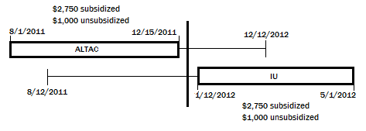
Transfer or change of program

Slide 19
Transfer or change of program
Clock Hour Program
The student is limited to the original annual loan limit until the completion of the first academic year at the new school unless the new school accepted clock hours from the first school.
If transfer hours are accepted, the new school can originate a new loan for the remaining portion of the loan period from the prior school. After this period is completed, the student progresses to a new loan period and annual limit.

Slide 20
Transfer or change of program
Clock Hour Program (cont.)
Changing programs within the same school is more involved for clock hour institutions.
Two options:
student remains in the same payment period; or
the student begins a new payment period in the new program.

Slide 21
Transfer or change of program
Clock Hour Program (cont.)
A student can be considered in the same payment period if:
The student is continuously enrolled;
The coursework of the prior program is substantially similar to the coursework in the new program;
The payment periods are substantially equal in length (clock hours and weeks of instructional time);
Little or no changes in school charges associated with the payment period;
The clock hours from the prior program are accepted in the new.

Slide 22
Transfer or change of program
Clock Hour Program (cont.)
If a new payment period is necessary:
As appropriate, perform a Return of Title IV Funds (R2T4) calculation to “close out” the old payment period;
The student can then begin a new payment period for the new program using the remaining annual loan limit eligibility from the prior loan period.
Note – the new loan period can use the remaining annual loan limit provided that the new program is at least an academic year in length. If the new program is less than an academic year in length the loan limit is the lesser of the remaining annual loan limit or the prorated annual loan limit based upon the hours to be completed in the new program.

Slide 23
Transfer or change of program
Clock Hour Program Example
Hank enrolled as a dependent undergraduate to study nursing at McCoy Medical College. As a dependent undergraduate student, he received $1,750 subsidized loan and a $1,000 unsubsidized for the period from January 1, 2011 to August 1, 2011. In May, He decides to transfer to what he believes is a better program offered at Enterprise University. This new program is 1800 clock hours.
EU accepts clock hours from McCoy Medical and originates a new loan in the amount of $1,750 subsidized and $1,000 unsubsidized for a loan period of May 1 to August 1, 2011. August 1 represents the end of the loan period at MMC. After this period, Hank will progress to a new annual loan limit.
Had EU not accepted transfer hours from MMC, Hank would have been limited to a maximum loan amount of $1,750 subsidized and $1,000 unsubsidized for the first academic year at EU (900 clock hours and 30 weeks).
$3,500 sub and $2,000 unsub (Annual loan limit for grade level 1)
- $1,750 sub and $1,000 unsub (amount already received at MMC)

Slide 24
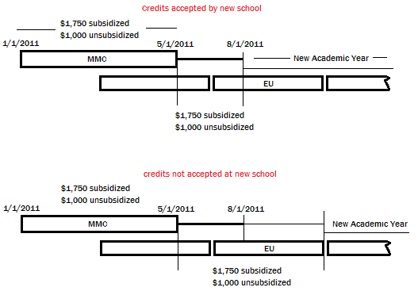
Transfer or change of program

Slide 25
Understanding nslds
Warning flags indicate that a student’s loan totals may already have exceeded
– or be close to –
the aggregate loan limits.

Slide 26
Understanding nslds

Slide 27
Understanding NSLDS

Slide 28
Understanding NSLDS

Slide 29
Identifying an overborrowing Situation
Check for a “C” code on the ISIR
Evaluate the loan history on NSLDS
Separate loans into academic years
Look out for additional unsubsidized codes (“P” or “H” indicators)
Compare against the applicable loan limits
If an overaward is discovered…
Identify the loan(s) that caused the overborrowing
Contact the appropriate servicer for assistance.

Slide 30
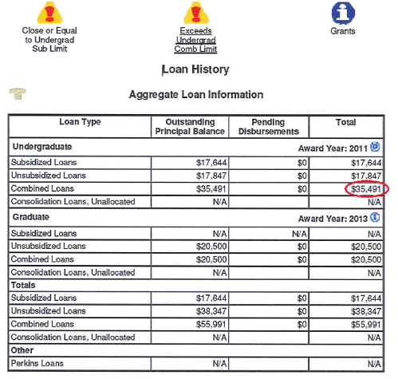
Example #1 – aggregate limits

Slide 31
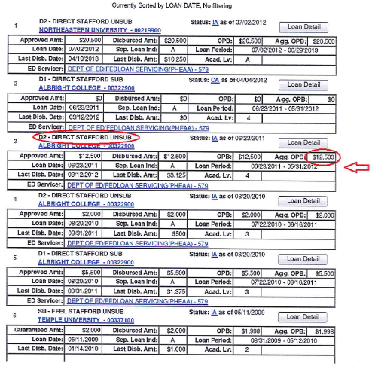
Example #1 – aggregate limits

Slide 32
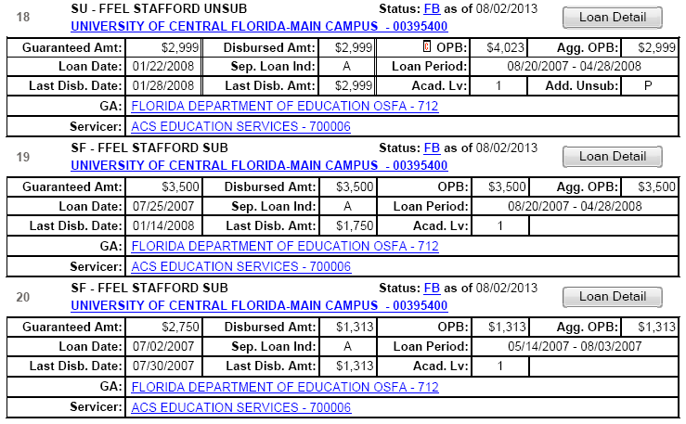
Example #1 – annual limits

Slide 33
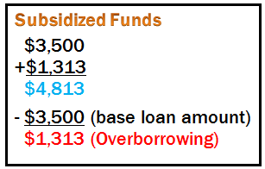
Example #1 – annual limits

Slide 34
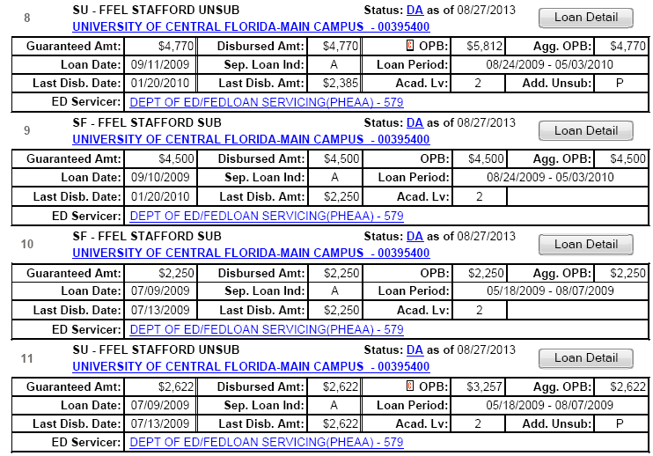
Example 3 – Annual Limits

Slide 35
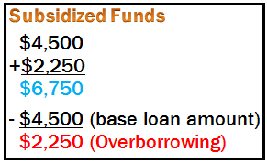
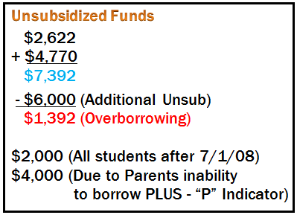
Example 3 – Annual Limits

Slide 36
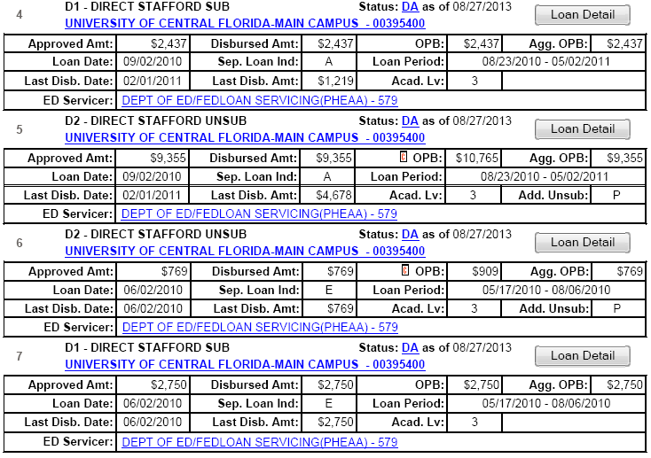
Example 4 – Annual Limits

Slide 37
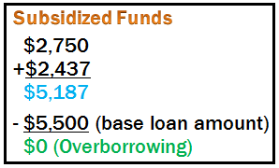
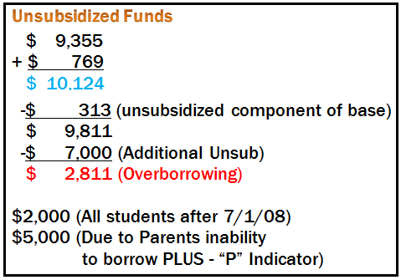
Example 4 – Annual Limits

Slide 38
Resolving an overborrowing situation
A student who has exceeded an annual or aggregate loan limit can restore their eligibility in one of two ways:
Repay the over-borrowed amount in full; or
Establish “satisfactory arrangements” with the loan holder to repay the excess amount.
“Satisfactory arrangements” are at the discretion of the loan holder; however, they typically involve the borrower “reaffirming” his or her intent to repay the excess amount in accordance with the terms and conditions of the original promissory note.
This document might be referred to as a “reaffirmation” letter.

Slide 39
Resolving an overborrowing situation
Repaying the excess loan amount
The student must contact the servicer for repayment instructions.
The school may assist the borrower in contacting the servicer; however, the student –not the school – must make the necessary payment.
The servicer must provide confirmation that the payment was properly credited.

Slide 40
Resolving an overborrowing situation
Making Satisfactory Arrangements
Either the school or the student may contact the servicer and request the “reaffirmation.”
The servicer will confirm the amount of excess loan funds received and will send the borrower a reaffirmation agreement to sign.
The student – or the school – returns the signed reaffirmation to the servicer.
The servicer sends the student (and possibly the school) an acknowledgement that the signed reaffirmation has been received.
The student’s eligibility is restored as of the date the servicer receives the signed reaffirmation paperwork.

Slide 41
Resources
Dear Colleague Letter (DCL) GEN-13-02 (http://ifap.ed.gov/dpcletters/GEN1302.html)
34 CFR 668.32(g)(2)
34 CFR 668.35(d)
Federal Student Aid Handbook, Volume 3 (http://ifap.ed.gov/fsahandbook/1314FSAHbkVol3.html)
NSLDS Newsletter #11 (http://ifap.ed.gov/nsldsmaterials/NSLDSNewsletter11.html)
NSLDS Newsletter #23 (http://ifap.ed.gov/nsldsmaterials/Newsletter23.html)

Slide 42
Resources
For Policy Assistance…
David Racculia
Tarah Seroskie
(Compliance Specialists)
E-mail – CMPolicy@aesSuccess.org
Phone – (717) 720-3460

Slide 43
Questions

