Slide 1
unpacking the art of public speaking
Cory Geraths
Assistant director of cas 100 (effective speech)
The Pennsylvania State university
Department of communication arts & Sciences

Slide 2
from then to now: a three minute history of the discipline
the teaching of public speaking—as it has evolved today—began thousands of years ago
Aristotle
Isocrates
Cicero
Quintilian
a lot has changed—but a lot has stayed fairly consistent

Slide 3
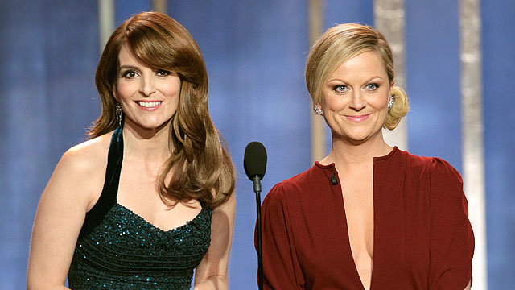
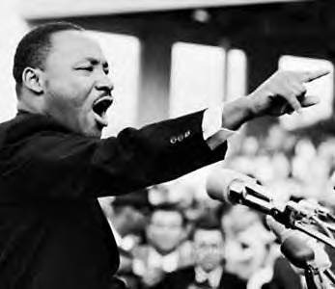
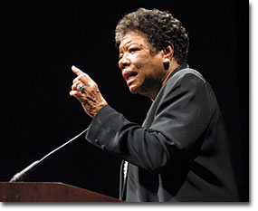
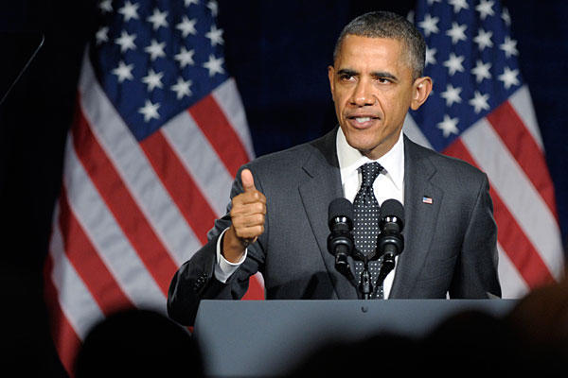
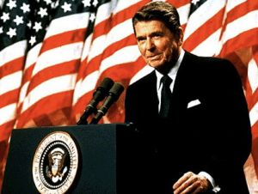
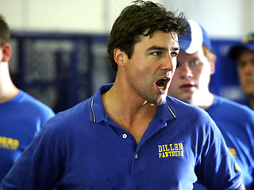
what makes a great speaker?
when you think of a good speaker—or a good speech—who and what come to mind?

Slide 4
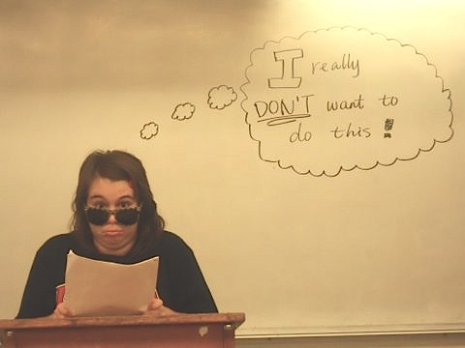
overcoming anxiety

Slide 5
overcoming anxiety
reflection
creation
preparation
completion
C.U.R.E.

Slide 6
speech construction
five steps
invention
arrangement
style
memory
delivery

Slide 7
the goal …
to avoid this!
and to aim for this!

Slide 8
invention
brainstorming
discovery
research
writing/rewriting

Slide 9
arrangement
patterns
introductions
“the body”
conclusions
transitions

Slide 10
style
language
word choice
imagery/rhythm

Slide 11
memory
how to learn your speech or presentation?
practice
practice
practice
… and then practice again!

Slide 12
delivery
what matters when you deliver?
your body and your voice
eye contact
gestures
movement
posture
verbal fillers
tone
pace

Slide 13
visual aids: the good, the bad, and the ugly!
PowerPoint/Keynote
handouts
demonstrations

