Slide 1
NSLDS Basics
Presented by Douglas Vore
Montgomery County Community College
Resource: 2012 FSA Conference

Slide 2
NSLDS Basics
Using NSLDS for daily activities
Checking Aggregates
Enrollment Reporting
Transfer Student Monitoring
Requesting and Receiving Reports

Slide 3
Checking Aggregates
Aggregates are calculated in real-time when you retrieve a student on the NSLDS Professional Access Site (NSLDSFAP)
May be different from the last ISIR or last time student/borrower data was retrieved
Aggregate loan information is separated into undergraduate and graduate loan totals
The undergraduate aggregate section will display only if the student has undergraduate loans and the graduate aggregate section will display only if the student has graduate loans

Slide 4
Checking Aggregates
Undergraduate/Graduate Award Year is determined based on the “loan period begin date” from the most recently reported undergraduate/graduate loan for the student
The Dependency Status Indicator identifies the dependency status used in the student’s undergraduate/graduate loan limits determination

Slide 5
Checking Aggregates

Slide 6
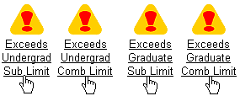
Checking Aggregates
Exceeds Loan Limits warning symbols for graduate and undergraduate borrowers
Click the link for the Exceeds Loan Limit warning symbol to display those loans that were attributed to the applicable loan limit overage

Slide 7
Checking Aggregates Example
Click the Link

Slide 8
Aggregate Example Click Result

Slide 9
Aggregate Example Click Result

Slide 10
Enhancements for Enrollment Reporting
New Enrollment Reporting File Format
Enrollment Reporting Profile with options to:
Establish reporting file preferences
Set up a location as the Administrator
Change schedule
Request ad hoc roster
See Quarterly Certification report
For more information see NSLDS Newsletter 39 and NSLDS Newsletter 40 on IFAP

Slide 11
New Enrollment Reporting File Format Options
New Enrollment Reporting File Format
Enhanced Fixed Width flat file
Enhanced Comma Separated Values (CSV) file
Enhanced eXtensible Markup Language (XML) file
Layouts posted to NSLDS Record Layouts section on the IFAP Web site on 4/6/12

Slide 12
New Enrollment Reporting File Format Options
Transition to new format by March 31, 2013
Indicate file type choice on NSLDS new Enrollment Reporting Profile page
Current file format will be used until a new format is selected on the NSLDS Professional Access Web site

Slide 13
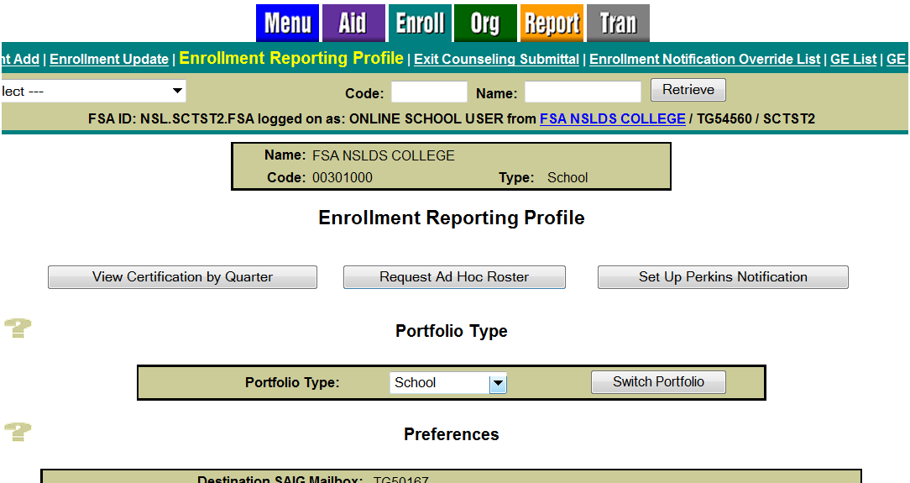
Enrollment Reporting Profile

Slide 14
Use Profile Page for Preferences

Slide 15
Update File Preferences by March 31, 2013

Slide 16
Enrollment Spreadsheet Submittal
The Enrollment Spreadsheet Submittal Format, will be posted in early December 2012 to the "Software and Associated Documents" section of the Federal Student Aid Download (FSAdownload) Web site
It will include:
Enrollment Spreadsheet Submittal Instructions Guide
Enrollment Spreadsheet Submittal Format
There is also information in the NSLDS Enrollment Reporting Guide posted on IFAP November 20, 2012

Slide 17
Using Spreadsheet Submittal
Create a file
You can create your own
You can import a file to a spreadsheet, such as the Enrollment Roster file in CSV sent via SAIG
Make sure the first tab is named “upload file”
Save as a spreadsheet file with an extension of .xls or .xlsx (Excel format)
Open the Enrollment Submittal link under the Enroll Tab

Slide 18
Enrollment Submittal Page

Slide 19
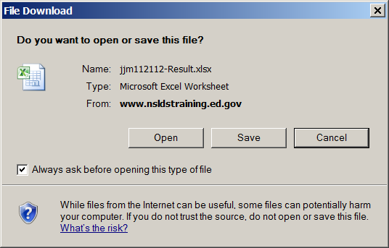
Error Count and Pop Up Box to View Results

Slide 20
Results Spreadsheet

Slide 21
Transfer Student Monitoring (TSM) Profile
Tells NSLDS:
Who is responsible
Mailbox that will be used to send Inform files
How long to monitor
How/where alerts are to be received

Slide 22
TSM Profile

Slide 23
TSM Time Period
Monitoring Period can be set by school
Default period is 90 days
It can be changed to a value from 30 to 120 days
Designated number of days all the students are monitored beyond the Enrollment Begin Date

Slide 24
TSM Profile Update

Slide 25
TSM Re-Populate
Re-populate the TSM list page of those students previously added to the Inform process and used during a prior monitoring period
Allows schools to select and update students from a Web page
FAA can continuously add from one monitoring time period to another

Slide 26
TSM Re-Populate

Slide 27
NSLDS Reports
NSLDS has 3 types of reports:
On-demand reports sent to the requestor’s SAIG TG Mailbox
Web reports that provide an immediate PDF or Excel file
Scheduled reports that are created at specific intervals and delivered to a designated SAIG TG Mailbox

Slide 28
NSLDS Report list

Slide 29
NSLDS Web Report List

Slide 30
NSLDS Scheduled Reports
Set up under the Org tab, School Profile page
Define the profile for the report
Reporting Type includes options for Comma Delimited, Fixed Width, or Report (pre-formatted)
For some Exit Counseling reports, when selecting Comma Delimited or Fixed Width Reporting Types, a user may also indicate an Extract Format of either NSLDS or Direct Loan
Frequency includes the following schedule options for report delivery:
Daily (generated and distributed Monday through Friday)
Weekly (generated and distributed every Thursday)
Monthly (generated and distributed every 8th day of the month)
Quarterly (generated and distributed every 8th day of the first month of each calendar quarter—January, April, July, and October)
Cancel (to stop report delivery)

Slide 31
NSLDS Scheduled Reports
Set up under the Org tab, School Profile page, continued
Define the profile for the report
Frequency includes the following schedule options for report delivery:
Daily (generated and distributed Monday through Friday)
Weekly (generated and distributed every Thursday)
Monthly (generated and distributed every 8th day of the month)
Quarterly (generated and distributed every 8th day of the first month of each calendar quarter—January, April, July, and October)
Cancel (to stop report delivery)

Slide 32
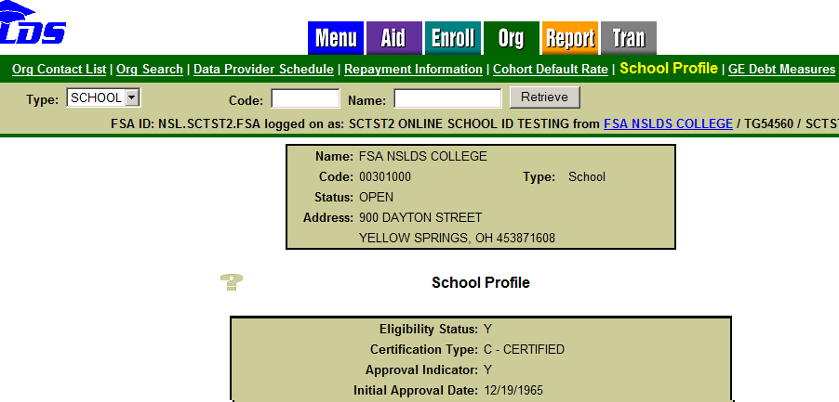

Slide 33
NEED MORE HELP
CONTACT:
NSLDS Customer Support Center
Phone: 800-999-8219
Toll: 785-838-2141
Fax: 785-838-2154
Web: www.nsldsfap.ed.gov
E-mail: nslds@ed.gov

