Slide 1


Managing an Effective Debt Management Program for Graduate Students
October 2013
Catherine Demchak
Dave Eber
Heinz College, Carnegie Mellon University

Slide 2
Evolution of Communication
One-on-One Appointments
Group Sessions
Website Information and Group Sessions
Webinars and Group Sessions

Slide 3

Getting Started
Choose a web conference company
  How much does it cost?
  What features will you need?
  How is the audio handled?
  Do you want to record the webinar for later viewing?

Slide 4
How to Run the Webinar
Preparation for your webinar should begin 2-3 weeks in advance
Reserve your meeting time with other users of the webinar software
Present by yourself or with a support team
  Chat box option usually necessitates a 2nd person to manage the questions
Send the announcement
Send invitations to participants

Slide 5
How to Run the Webinar
The day of your webinar
Do a practice run
Log on
  15 minutes early is a GOOD idea, especially with multiple presenters
Take charge of Q&A period by answering questions quickly
End by thanking your participants

Slide 6
Goals of Debt Management Education
Be Efficient
  Staff time
Be Effective
  Clear message
Be Educational
  Give students the tools they need to prepare for life after graduation
Be Enthusiastic
  This may be a difficult time for some students, be attentive to their questions and concerns

Slide 7

Organize your Thoughts
What do you want to bring to the forefront?
What do you want to show the students?
What do you want them to take away from the webinar?
What resources do you want them to reference once the webinar is over?
Know your loans, grace period, lender/servicer.
Pay-off plans, consolidation, public service loan forgiveness.
Options if they can’t make a payment, where to turn for help.
NSLDS, Tax Benefits, US Department of Education.

Slide 8
How many Slides?
How much time do you have
Allow time for participants to log-in
Allow about 2 minutes per slide
  Some slides may take more or less time
Allow for Q&A time at the end of the webinar

Slide 9
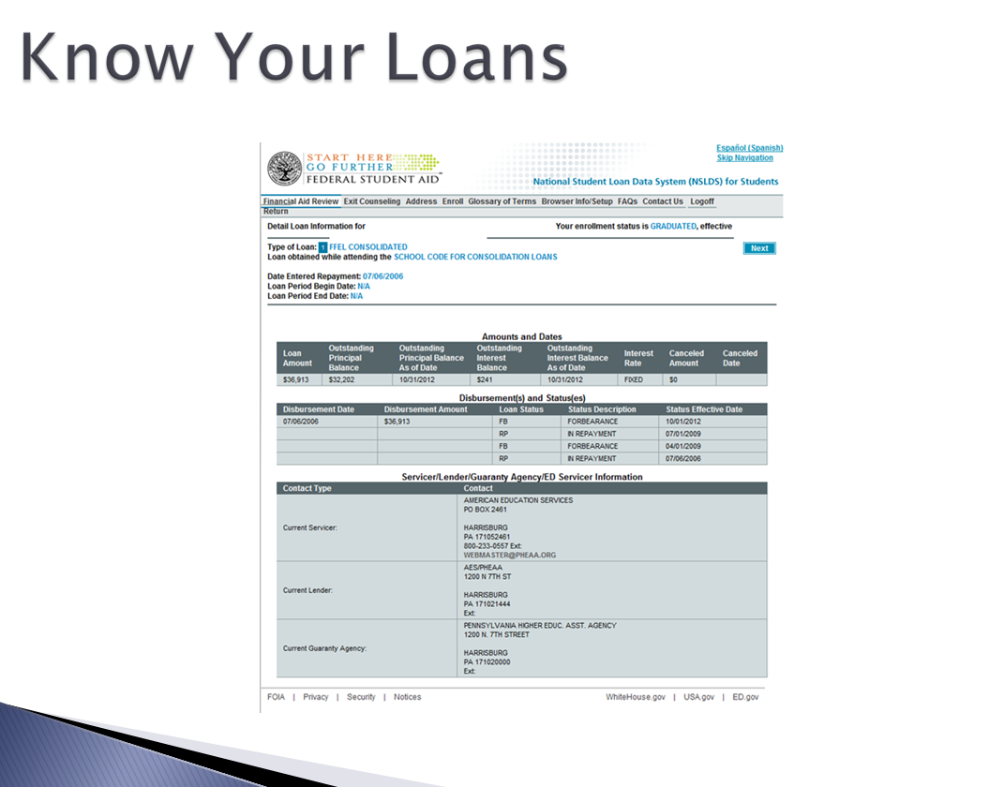
Slide Layout
Use…
Bullet Points
Graphics
Screen Shots
Vary the Layout
Keep in mind…students may request an electronic version of the presentation…keep it simple.

Slide 10

Proofread!!!
Proofread several times
Check for spelling, punctuation and grammar,
Check the order of information
Have you colleagues proofread
Have a student proofread

Slide 11
Proofread!!!
Proofread several times
Check for spelling, punctuation and grammar,
Check the order of information
Have you colleagues proofread
Have a student proofread

Slide 12
Proofread!!!
Proofread several times
Check for spelling, punctuation and grammar
Check the order of information
Have your colleagues proofread
Have a student proofread

Slide 13
Content
What topics should you include?
How much detail do you want to provide?
  Slides shouldn’t have too much information
  Use notes to provide details
Will the webinar be archived for viewing at a later date?
  Easy format to read by someone not attending the live webinar
  No industry terminology (jargon)
  Use hyperlinks to guide viewers to websites with additional information

Slide 14
Resources
Provide a slide or two of resources for your viewers to reference at a later date
  Your website
  Department of Education
    Repayment calculators
    Consolidation
  NSLDS
  Tax benefits (publication 970)
  Cost of Living Calculator

Slide 15
Challenges/Successes
Challenges
Can’t gauge the level of students’ understanding
Interaction is limited
Participant distractions
Successes
Can reach more students in remote locations
Can be saved and played back at a later date

Slide 16
Questions?
Thank You

Slide 17
Contacts
Catherine Demchak
  cdemchak@andrew.cmu.edu
David Eber
  deber@andrew.cmu.edu
Heinz College Office of Financial Aid
Carnegie Mellon University
Pittsburgh, PA

