Slide 1
Leadership Lessons of a Sheep Farmer
Patty Peterson
Campus Relations Manager, AVP
PNC

Slide 2
STUDENTS
PARENTS
OTHER DEPARTMENTS, AGENCIES, ETC.
STAFF
FUNCTIONAL
EMOTIONAL

Slide 3
Sheep?

Slide 4
Engage & Care
Engage your people on a regular basis.
People don’t care how much you know until they know how much you care!

Slide 5
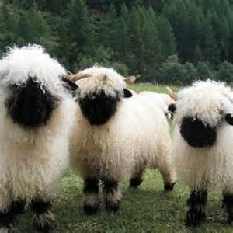
Start Healthy
Discover the Shape of Your Sheep

Slide 6
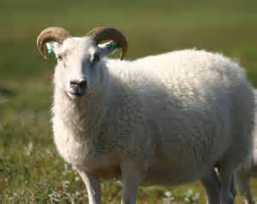
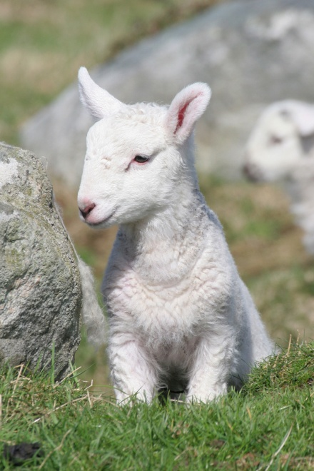
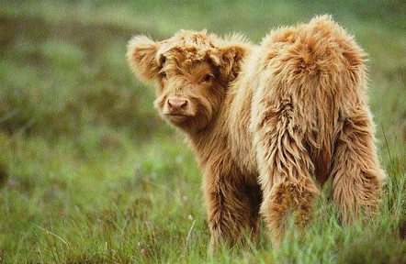
SHAPE
Strengths
Heart
Attitude
Personality
Experiences

Slide 7
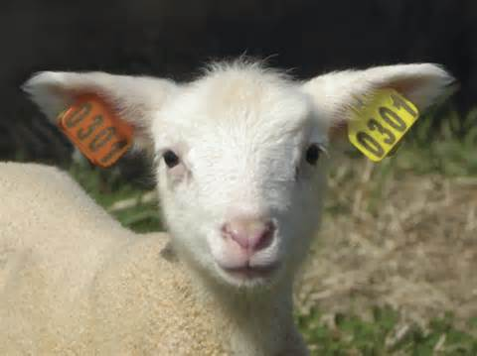
CONNECT
Be personal
Build trust
Aim high
Communicate relentlessly
Define the cause

Slide 8
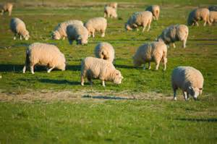
Care 101
Make Your Pasture a Safe Place

Slide 9
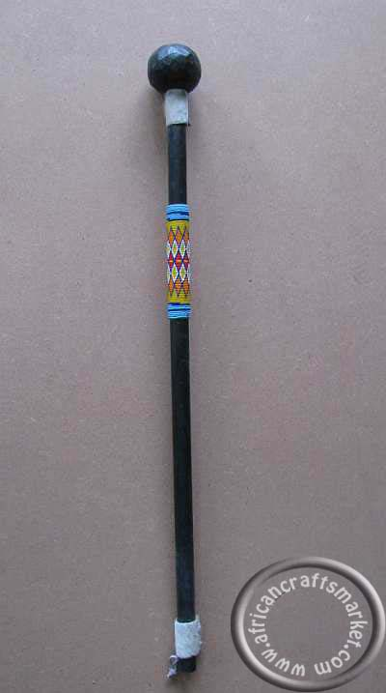
Tools of the Trade

Slide 10
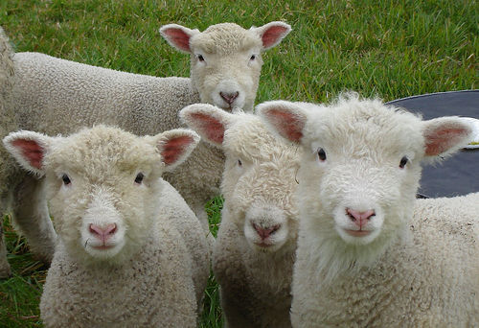
The Heart of the Shepherd
Who will pay the price for your leadership?
How can you get your flock where it needs to go?
Great leadership is a lifestyle, not a technique.

Slide 11
7 Secrets of a Shepherd
Know the condition of your flock
Discover the SHAPE of your sheep
Help your sheep identify with you
Make your pasture a safe place
The staff of direction
The rod of correction
The heart of the shepherd

Slide 12
NEXT STEP
The Way of the Shepherd – Seven Secrets to Managing Productive People, Dr. Kevin Leman & William Pentak, 2004

