Slide 2
agenda
Types of Direct Loans
Interest Rates, Fees, Loan Limits
Direct Loan Processing Cycle
Default
COD Overview
What’s coming…

Slide 3
Types of direct loans
Direct Subsidized
Direct Unsubsidized
Direct PLUS
Direct Consolidation

Slide 4
Direct Subsidized and unsubsidized loans
Subsidized
Need-based
No interest accrues while enrolled at least half-time
Unsubsidized
Non-need based
Interest accrues from date of disbursement
Additional amount available
Independent
Parent PLUS loan denials

Slide 5
Direct Sub and unsub loan Eligibility
Complete FAFSA and meet the “eligible student” definition (34 CFR 668.32), including:
Citizenship, selective service registration, matriculation, etc.
Not in default on Title IV loans or owe a repayment on any federal grant,
Complete Master Promissory Note (MPN) at www.studentloans.gov
Complete Entrance Counseling
Be registered for at least 6 credits

Slide 6
Packaging student loans
Package loans after:
Pell
SEOG
PHEAA
Work-study
Scholarships

Slide 7
Direct PLUS Loans
Types of Direct PLUS Loans
Graduate PLUS Loans
Parent PLUS Loans
Credit based loan (complete application at www.studentloans.gov)
Repayment begins 60 days after last disbursement
Graduate students qualify for in-school deferment

Slide 8
Direct plus loan Eligibility
To receive a Parent PLUS or Graduate PLUS Loan, the STUDENT must meet the “eligible student” definition (34 CFR 668.32), including:
Citizenship, selective service registration, matriculation, etc.
Not in default on Title IV loans or owe a repayment on any federal grant,
And be enrolled at least half-time

Slide 9
Additional Direct parent plus loan Eligibility
To receive a Parent PLUS Loan, the Parent must meet the following criteria:
Must be the student's biological or adoptive parent or the student's stepparent, if the biological or adoptive parent has remarried at the time of application
Student must be a dependent student
Student must be enrolled at least half-time
Must be a U.S. citizen or eligible non-citizen
Not be in default on any federal education loans or owe an overpayment on a federal education grant

Slide 10
What if plus loan is approved?
If Parent PLUS is approved:
Parent must complete a PLUS MPN at www.studentloans.gov
Parent must login using their SSN and PIN
No Entrance Counseling is required
If Grad PLUS is approved:
Student must complete PLUS MPN
Student must complete PLUS Entrance Counseling

Slide 11
What if plus loan is denied?
If Parent PLUS is denied:
Undergraduate student can have additional unsubsidized Stafford, or
Parent borrower can add endorser
If Grad PLUS is denied:
Student can add endorser

Slide 12
Direct consolidation loan
Allow borrowers to combine one or more federal education loans into a new loan that offers several advantages
One lender and one monthly payment
Flexible Repayment Plans
No minimum or maximum loan amounts or fees
Reduced monthly payments
Retention of subsidy benefits

Slide 13
Direct consolidation loan
To qualify for Direct Consolidation Loans:
Must have at least one Direct Loan or Federal Family Education Loan (FFEL)
Loans must be in grace or repayment status
Includes loans that are in a deferment or forbearance
Loans that are in an in-school status cannot be included
Borrowers can consolidate most defaulted federal education loans, if:
Make satisfactory repayment arrangements with their current loan holder(s)
Agree to repay their new Direct Consolidation Loan under the Income Contingent Repayment Plan or Income Based Repayment Plan
Complete Application & MPN online www.loanconsolidation.ed.gov

Slide 14
agenda
Types of Direct Loans
Interest Rates, Fees, Loan Limits
Direct Loan Processing Cycle
Default
COD Overview

Slide 15
Interest rates
LOAN TYPE | FIRST DISBURSED BETWEEN JULY 1, 2013 AND JUNE 30, 2014
Direct Subsidized Loans (Undergraduate Students) | Fixed at 3.86%
Direct Unsubsidized Loans (Undergraduate Students) | Fixed at 3.86%
Direct Unsubsidized Loans (Graduate or Professional Students) | Fixed at 5.41%
Direct PLUS Loans (Parents & Graduate/Professional Students) | Fixed at 6.41%
*Due to the Bipartisan Student Loan Certainty Act of 2013, DL interest rates will be tied to the
financial market. Under the new interest rate structure, rates will be determined each year for new
loans & will be fixed for the life of the loan. The rates are calculated using a 10-year Treasury Note
Index plus an add-on amount for each loan program & include interest rate caps.

Slide 16
Fees to borrowers
LOAN TYPE | FIRST DISBURSED ON OR AFTER JULY 1, 2013
Direct Subsidized/Unsubsidized Loans | 1.051%
Direct PLUS Loans (Parents & Graduate/Professional Students) | 4.204%

Slide 17
Annual loan limits
Year | Dependent Undergraduate | Independent Undergraduate And Dep. Undergrad whose parent can’t borrow PLUS | Graduate/ Professional Students
1st Year | $5,500 (maximum $3,500 subsidized) | $9,500 (maximum $3,500 subsidized) | Up to $20,500 each academic year (maximum $8,500 subsidized)
2nd Year | $6,500 (maximum $4,500 subsidized) | $10,500 (maximum $4,500 subsidized)
3rd Year and Above | $7,500 (maximum $5,500 subsidized) | $12,500 (maximum $5,500 subsidized)

Slide 18
Aggregate loan limits
Dependent Undergraduate | Independent Undergraduate And Dep. Undergrad whose parent can’t borrow PLUS | Graduate/ Professional Students
$31,000 No more than $23,000 of this amount may be in subsidized | $57,500 No more than $23,000 of this amount may be in subsidized | $138,500 No more than $65,500 of this amount may be in subsidized *The graduate aggregate limit includes all federal loans received for undergraduate study.
*Cannot award loan funds if:
1. Student is over aggregate loan amount
2. Student is over aggregate subsidized loan amount

Slide 19
agenda
Types of Direct Loans
Interest Rates, Fees, Loan Limits
Direct Loan Processing Cycle
Default
COD Overview

Slide 20
Direct loan processing cycle
Originate
Disburse
Reconcile
Repayment/
Servicing
Promissory Note/
Entrance Counseling

Slide 21
origination
School originates a Direct Loan when it creates Direct Loan Award and Disbursement data on its system
Loan origination record
Person Data
DL Award
DL Disbursement Data
School then sends this origination and disbursement data to the COD system

Slide 22
DL AWARD ID
Sequence # of loan
at this school
for this borrower
during award year
21 characters
123456789S14G99999001
Award year
Trailing (1314)
Social
Security
Number
Loan Type
Sub, Unsub,
Plus
Direct Loan
School code

Slide 23
Direct loan servicers
ACS
AES / PHEAA (Fedloan Servicing)
Great Lakes Education Loan Services
Nelnet
Sallie Mae Corporation

Slide 24
Direct loan processing cycle
Originate
Disburse
Reconcile
Repayment/
Servicing
Promissory Note/
Entrance Counseling

Slide 25
MPN Options
School sets up profile
Multi-year vs. Single-year
Electronic vs. Paper
COD Print vs. School Print
School specific message
May use eMPN from another school

Slide 26
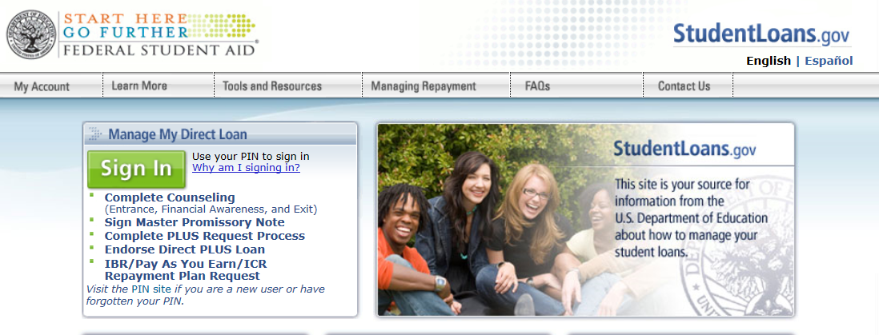
MPN and Entrance Counseling
Must complete Master Promissory Note (MPN) at www.studentloans.gov
Must complete Entrance Counseling at www.studentloans.gov

Slide 27
Direct loan processing cycle
Originate
Disburse
Reconcile
Repayment/
Servicing
Promissory Note/
Entrance Counseling

Slide 28
disbursement
May request funds from G5 before/after disbursing aid
School submits Actual Disbursement Records to COD to substantiate drawdown within 30 days
Accepted actual disbursements at COD:
Result in Current Funding Level (CFL) increase for Advance Funded schools
COD screens provide current funding and disbursement status

Slide 29
Direct loan processing cycle
Originate
Disburse
Reconcile
Repayment/
Servicing
Promissory Note/
Entrance Counseling

Slide 30
Reconciliation and Closeout
Schools must reconcile each month
Like balancing the checkbook, but at the school level
Use reports and SAS to research and determine timing differences
School reconciles internally, FAA and Business offices
School reconciles externally with COD
Schools must complete closeout and the balance confirmation process each year
Total Net Drawdowns – total net disbursements = $0 Ending Cash Balance

Slide 31
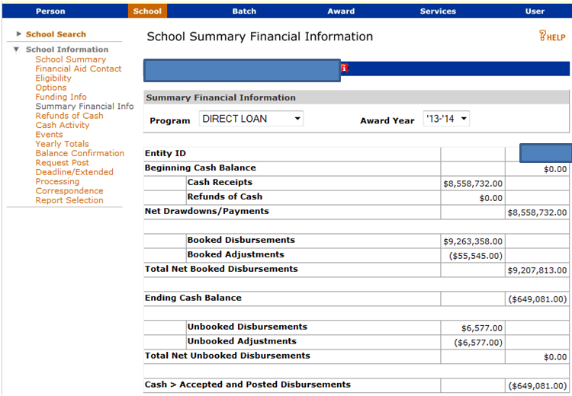
Summary Financial Information

Slide 32
Direct loan processing cycle
Originate
Disburse
Reconcile
Student Repayment
Promissory Note/
Entrance Counseling

Slide 33
Exit counseling
Complete online at www.studentloans.gov
Student uses PIN to access
Student should complete when:
Graduate
Drop below half-time enrollment status
Withdraw from institution

Slide 34
repayment
Stafford loan
Enters at end of grace period (6 months after student graduates or drops below half-time)
Parent PLUS loan
Enters 60 days after full disbursement (parent can request deferment while student is enrolled at least half-time and during six months following that)
Grad PLUS loan
Enters when borrower falls below half-time enrollment

Slide 35
Repayment plan options
Standard Plan
Repayment period up to 10 years
Monthly payment remains consistent
Extended Plan
Monthly payments over a 25 year plan
Must have a debt greater than $30,000.
Two payment options: fixed or graduated
Graduate Plan
Repayment period up to 10 years
Monthly payments start out low and increase every two years

Slide 36
Repayment plan options
Income Contingent Plan
Maximum repayment period is 25 years (any unpaid portion will be discharged, may have to pay taxes on discharged amount)
Not available on Parent PLUS
Each year monthly payments are calculated on the basis of student’s (and spouse’s if married) AGI, family size, and total amount of Direct Loans
Income Based Plan
Maximum repayment period may exceed 10 years
Each year monthly payments will be based on income during any period when you have a partial financial hardship
Pay As You Earn Plan
Payment amount may increase or decrease each year based on income and family size
Must have a partial financial hardship
Be a new borrower as of 10/1/07
Received a disbursement of a Direct Loan on or after Oct. 1, 2011

Slide 37
deferment
Temporary stop making payments
Federal government will pay interest for the borrower on Subsidized Stafford
Some possible reasons for deferments:
Enrolled at least half time at an eligible postsecondary school
Unemployed or unable to find full-time employment (for a maximum of three years)
Economic hardship

Slide 38
Forbearance
Another method of temporarily postponing or reducing loan payments
Student is responsible for interest that accrues
Some possible reasons for forbearance:
Financial hardship or illness
Called to active duty in the U.S. Armed Forces
The total amount you owe each month for all of the Title IV student loans you received is 20% or more of your total monthly gross income (for a maximum of three years)

Slide 39
agenda
Types of Direct Loans
Interest Rates, Fees, Loan Limits
Direct Loan Processing Cycle
Default
COD Overview

Slide 40
default
Failure to pay back student loan
Student is considered in default after being delinquent for 270 days
Student is susceptible to wage garnishment, seizure of income tax refunds, lottery winnings, license non-renewal, sued by DOE
Student not eligible for fed. financial aid

Slide 41
Cohort default rate (CDR)
Includes Stafford loans, and Stafford loans underlying consolidation loans (no Perkins or PLUS)
CDR = % of borrowers who enter repayment in a given year who then default within that year or the next year (soon to be the next two years)
High rate has consequences for schools

Slide 42
Smart borrowing
Never borrow more than needed
Budget carefully: the cost of attendance can be reduced
Consider working more during summer months or school year, but do not over-commit

Slide 43
agenda
Types of Direct Loans
Interest Rates, Fees, Loan Limits
Direct Loan Processing Cycle
Default
COD Overview

Slide 44
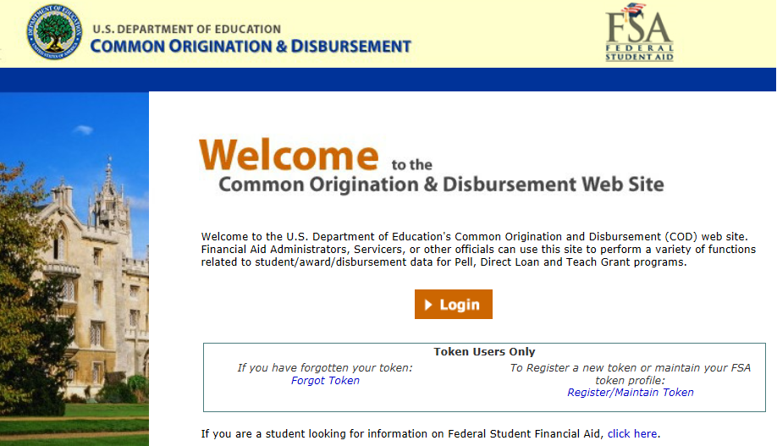
Common origination disbursement (COD)

Slide 45
Cod – PERSON SEARCH

Slide 46
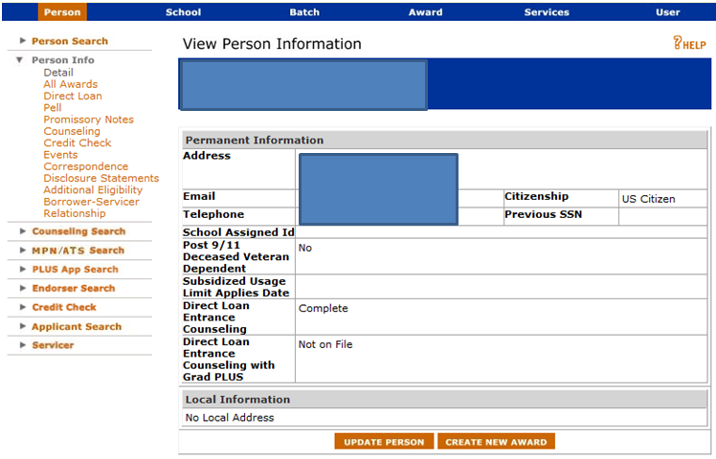
Person detail

Slide 47
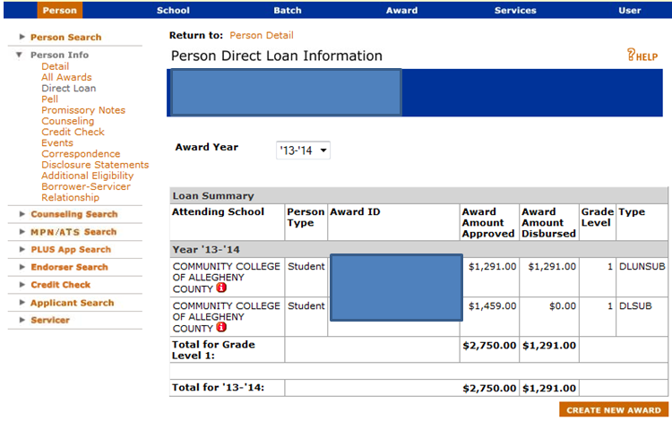
Person Direct loan information

Slide 48
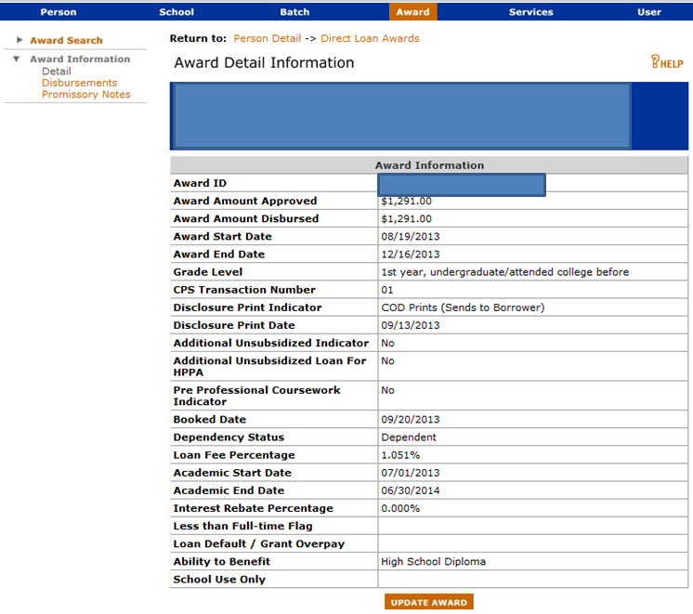
Award detail information

Slide 49
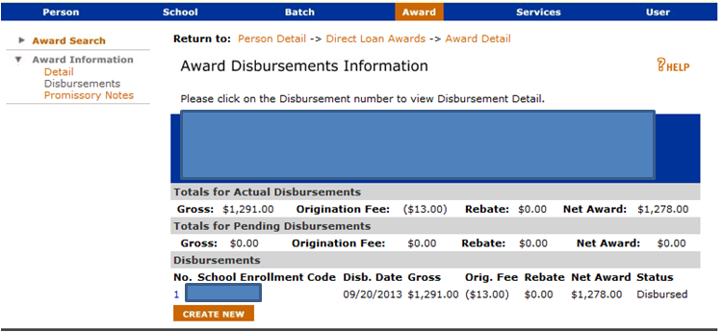
Award disbursement information

Slide 50
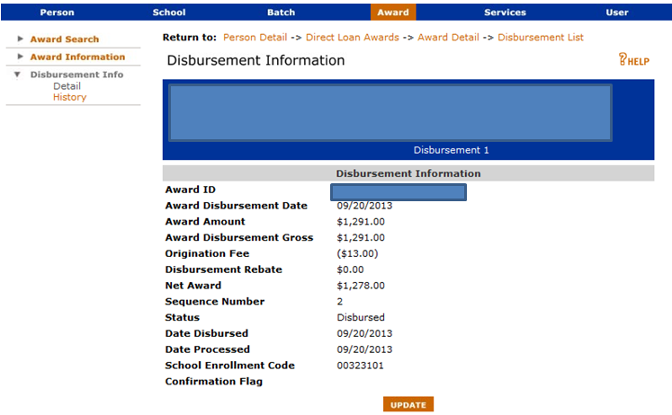
Disbursement information

Slide 51
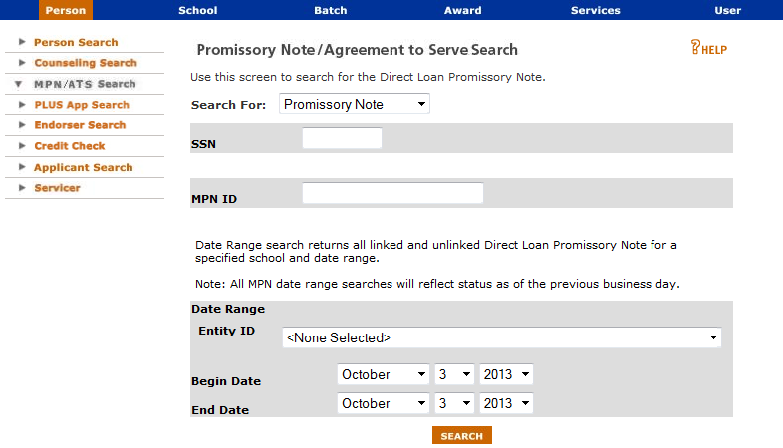
Mpn search

Slide 52
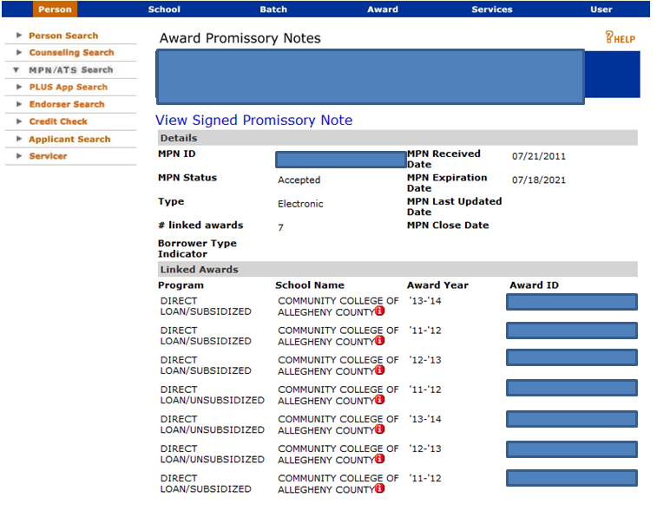
Award promissory notes

Slide 53
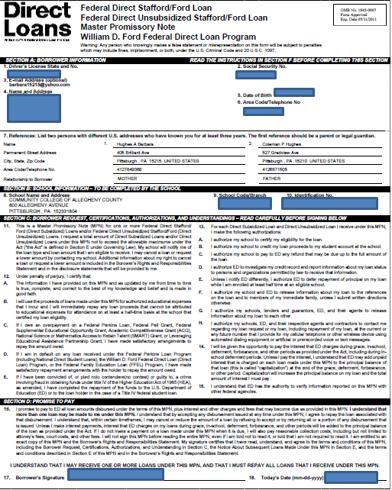
Master promissory note (mpn)

Slide 54
PLUS Search

Slide 55
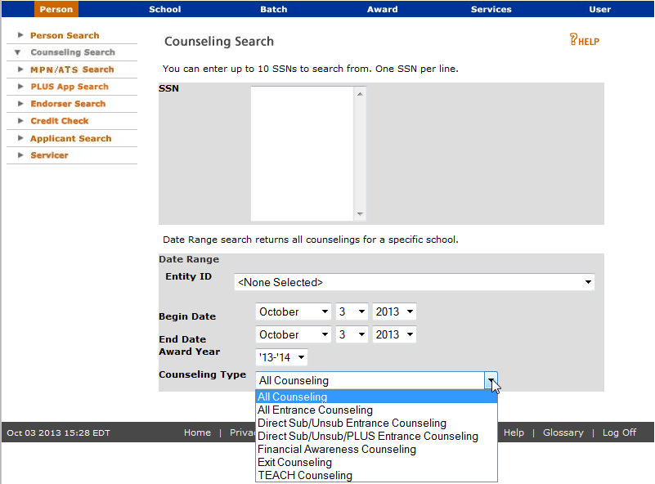
Counseling search

Slide 56
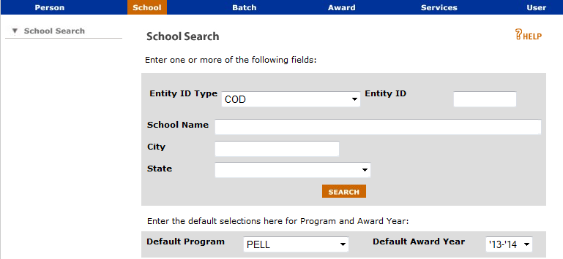
School search

Slide 57
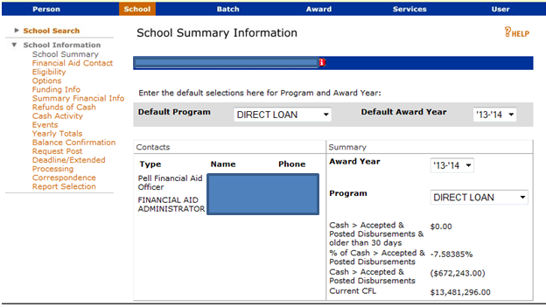
School summary

Slide 58
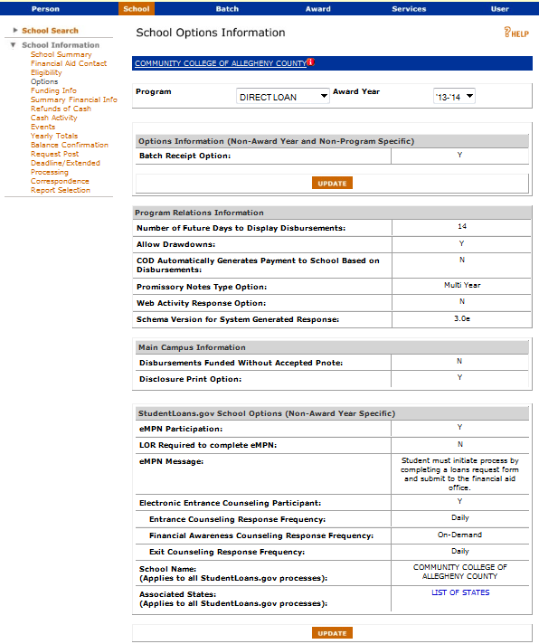
School options

Slide 59
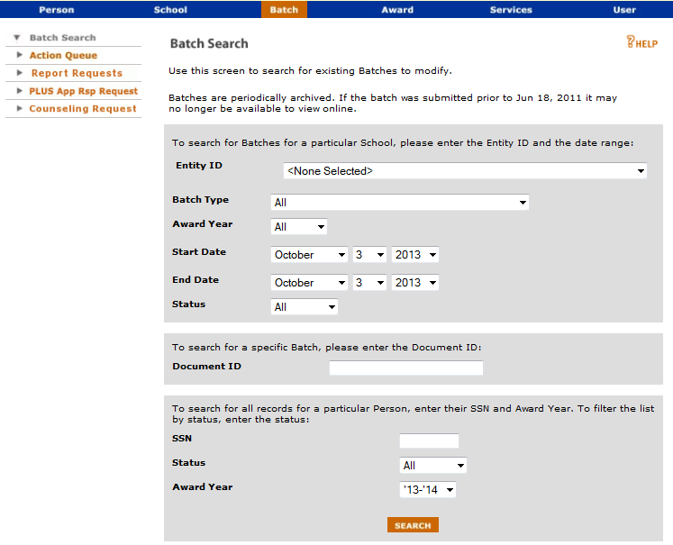
Batch search

Slide 60
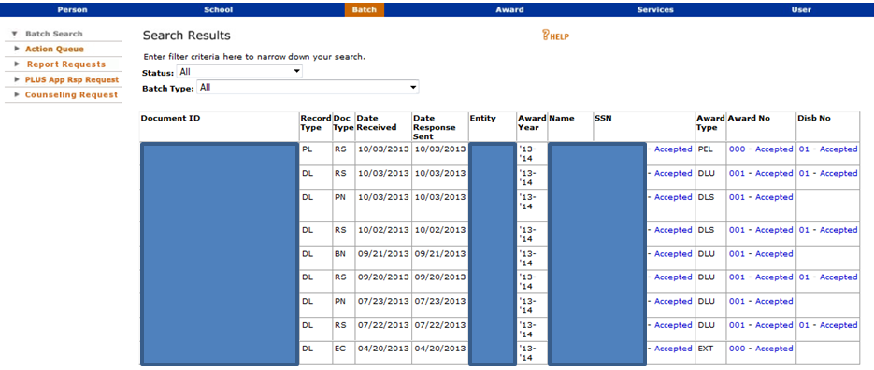
Batch search results

Slide 61
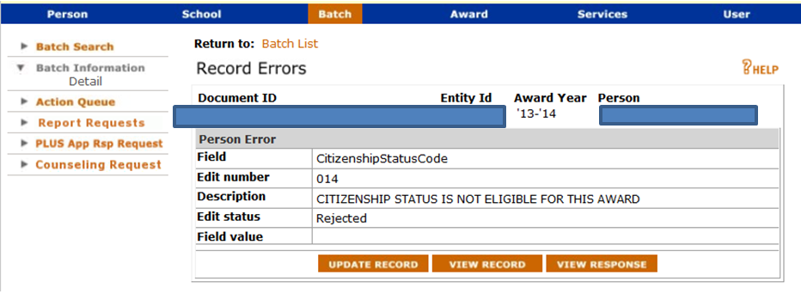
Record error example

Slide 62
cod Reports

Slide 63
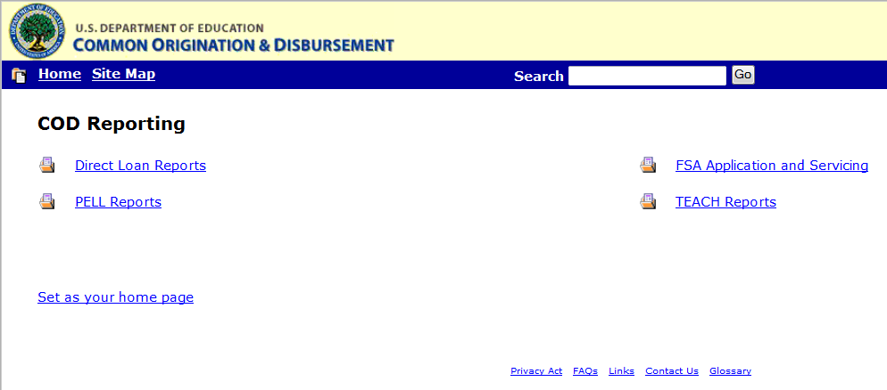
COD Reports

Slide 64
COD dl Reports

Slide 65
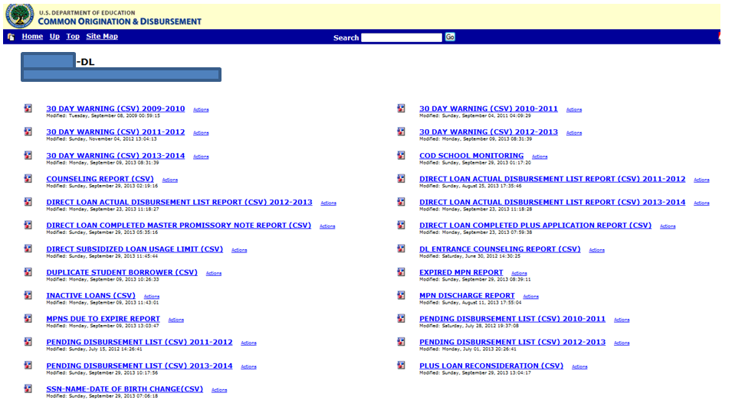
COD dl Reports

Slide 66
What’s coming…
150% Direct Subsidized Loan Limit
Limits a first-time borrower’s eligibility for Direct Subsidized Loans to a period not to exceed 150 percent of the length of the borrower’s educational program.
Only first-time borrowers on or after July 1, 2013 are subject to the new provision
A first-time borrower is one who did not have an outstanding balance of principal or interest on a Direct Loan or on a FFEL Program Loan on July 1, 2013
Under certain conditions, the provision also causes first-time borrowers who have exceeded the 150 percent limit to lose the interest subsidy on their Direct Subsidized Loans.

Slide 67
150% Direct Subsidized Loan Limit
Entrance Counseling has been updated to include this information
Awaiting on Department of Education guidance

Slide 68
websites
COD
www.cod.ed.gov
Direct Loan
http://direct.ed.gov
FSA Download
http://fsadownload.ed.gov
Information for Financial Aid Professionals
http://ifap.ed.gov

Slide 69
questions

