Slide 1
Common Sense and Financial Aid:
Understanding the Student Loan Debt Burden and Strategies to Help Un-burden Students

Slide 2
The Big Picture

Slide 3
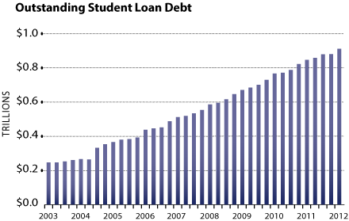
Outstanding student loan debt
Notes:
Source: Federal Reserve Bank of NY

Slide 4
Federal student loan debt
Reached $1 Trillion milestone on May 8, 2012.
$1,000,000,000,000
About $878 Billion in FFEL loans
About $292 Billion in Direct loans
Average borrower has about $27k in Federal Debt (4-year graduate); $300 per month/120 months (10 years)
Outpacing Credit Card Debt.
The clock continues to count.
www.finaid.org/loans/studentloandebtclock.phtml
Total outstanding Private Student Loan Debt (2009) was approximately $157.8 Billion (this is in addition to Federal debt)

Slide 5
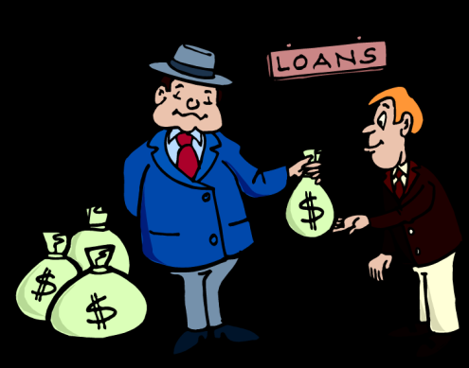
Obtaining a student loan
Have we made student borrowing too easy?
Do students understand and actively confirm what they are borrowing?
Do students sign their own documents?
Do graduates know how much they have borrowed for 2, 4, 6 years – or even longer?
What barriers do you have in place to prevent maximum borrowing? Any?

Slide 6
Debt Picture
Number of student loan borrowers in the US: 37 million
Percentage of borrowers who owe less than $6000: 25%
Average starting salary for 2012 college graduates: $44,482
Unemployment rate for college graduates: 4.6%
Percentage of 2010 college graduates working jobs that require less than a high school diploma: 38%

Slide 7
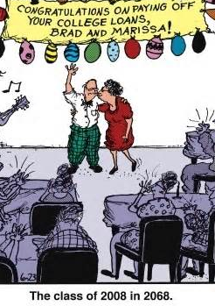
Debt picture
National average default rate on student loans: 13.4%
FLS/YCDWI Default Plan Builder
Student borrowers under the age of 30: 14 million
Number of Americans age 60 or older who owe money on student loans: 2.2 million

Slide 8
Rising costs
Notes:
Source: Coursesmart.com

Slide 9
From the Gallup student poll: Do you (as a student) have a plan?
Notes:
Source: Coursesmart.com

Slide 10
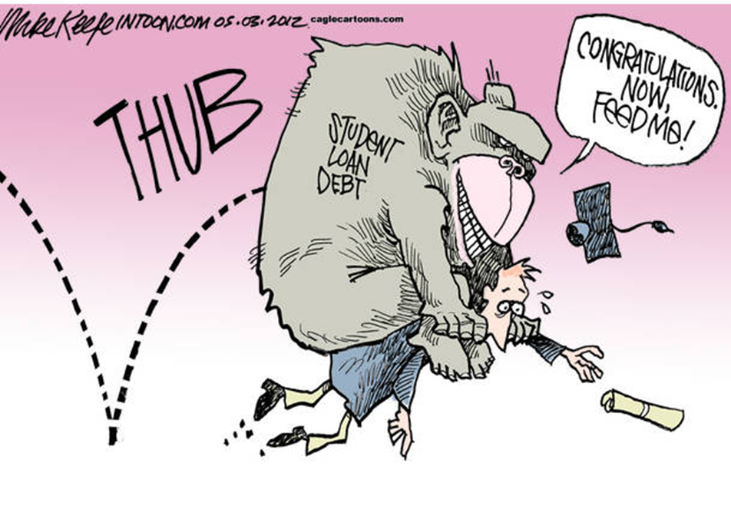
The debt monkey

Slide 11
$0 EFC isn’t what it used to be

Slide 12
Impacts on student benefits
Sequestration cuts institutional aid (SEOG by $37M, Federal Work Study by $49M)
Increased loan borrowing fees
From 1% to 1.051% for Direct Stafford
From 4% to 4.204% for PLUS
Increased Interest Rates
Subsidized loans from 3.4% to 3.86% on July 1, 2013
Subsidy during 6-month grace period was removed last year
No interest subsidy for Graduate Students as of last year
Students can only borrow subsidized loans up to 150% of program length (if they would qualify)

Slide 13
Student choices
Undeclared majors
Changing majors
5 or 6-year plan
Working the system
Buy Now, Pay Later mentality
It’s not real money
According to a recent survey released by the Credit Union National Association (CUNA), nearly half of those 17 and 18 year olds surveyed can’t predict how much college will cost them. The survey also said, “A lack of knowledge of student loan terms is compounded by optimism. Seventy percent of students surveyed feel confident they’ll land a high-paying job after graduation.”

Slide 14
Practical advise; smart decisions

Slide 15
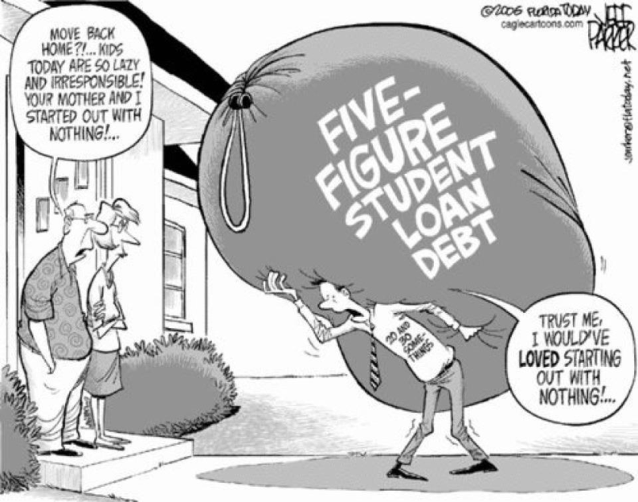
Is there a student loan debt bubble?
Deferred loans represent 43.5% of all student loan balances. (no payments are being made on them at all – interest is still accruing) – Transunion study 2007-2012

Slide 16
No, but…
Impact on housing and the broader economy.
Grads return home to live with parents
Jobless or Underpaid
Home ownership rates among young people at lowest point in decades
Heavy student loan debt may hurt their ability to qualify for a mortgage or save for a down payment.
62% of workers in their 30s will not have resources to retire
May be unable to save for retirement or rely on their parents, who are nearing retirement, to pay their debt.
Rural areas are struggling to attract and retain young professionals
Students cannot afford the housing or the required car to travel there.

Slide 17
“I have to pay back
my student loans?”
Remedies and Best Practices

Slide 19
Who does not repay?
Graduates v. Non Completers
GPA is most important predictor
Students who work full time while in school
At risk groups
Different majors have different default rates
“Jobs pay student loans immediately.
Careers pay them for life.”
Notes:
The further a student persists in their program of study, the less likely it is that they will default. Likewise, students who successfully complete their program are more likely to repay their student loans. Graduating borrowers have a default rate of 1.8%; Borrowers who do not graduate have a 14% default rate. TG study, NASFAA Transcript volume 22.
The default rate for borrowers with a GPA below 2.0 is about 18%. The default rate for ALL other borrowers is 2.6%. From TG study, NASFAA Transcript volume 22.
Students who work full time tend to take reduced loads (costs more overall), tend to struggle to balance work and grades (lower gpa = higher probability of default).
At Risk - Black students default on loans at a rate 4 times higher than white students (and a higher percentage of blacks attend proprietary schools) – Institute of Higher Education Policy 2011.
Quote from Bankrate.com regarding the connection between employability and the probability of repaying student loans. The National Center for Educational Statistics showed in a longitudinal study that borrowers don’t default right away. Most who default do so after 4-5 years of graduating. This indicates most graduates can find an acceptable/entry level position but then are unable to sustain repaying loans as life situations become increasingly costly and they are unable to keep up.

Slide 20
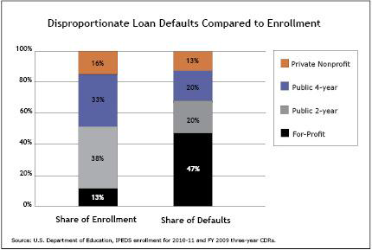
Loan default by school type

Slide 21
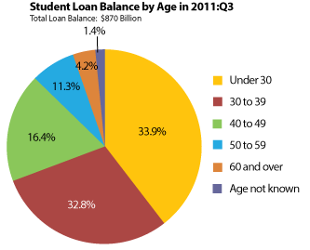
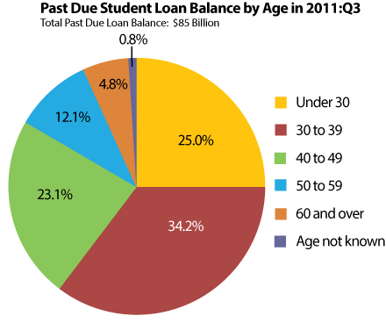
Student loans by age

Slide 22
PennsylvaniA by the numbers
National 2-year FY 2010 Cohort Default Rate is 9.1%
PA 2-year FY 2010 CDR is 7.4%
Is your school’s rate higher or lower?
http://www2.ed.gov/offices/OSFAP/defaultmanagement/cdr2yr.html
National 3-year FY 2009 CDR is 13.4%
PA 3-year FY 2009 CDR is 10.1%
http://www2.ed.gov/offices/OSFAP/defaultmanagement/cdr.html

Slide 23
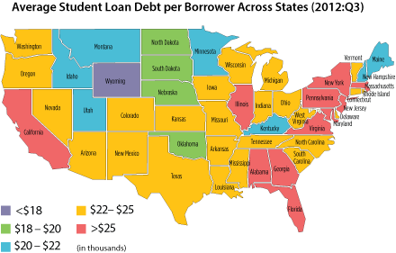
Pennsylvania by the numbers

Slide 24
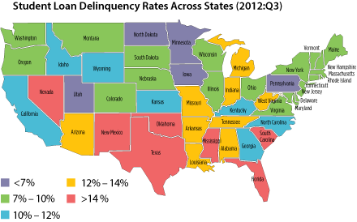
Pennsylvania by the numbers

Slide 25
Why worry about default aversion?
Default rates correlate to graduates’ ability to face the job market
It’s not just about default!
Consequences on Enrollment & Public Image
High CDR = Low Institutional Quality

Slide 26
CASE STUDIES
What have we been hearing?
What have you been hearing?
What does the dialogue sound like with incoming students and parents, your student workers, alumni?
How do you reach students at a younger age?

Slide 27
Remedies/Best Practices

Slide 28
The big fix
Not just one solution or approach
Starts with financial literacy
Realistic decisions – post secondary education and career choices
Default prevention
Active involvement of parents, counselors, schools and…wait for it…
Students!
How do you involve students and make sure they are the ones completing the paperwork?

Slide 29
Financial literacy
Parents –
41% save for college, 46% save for vacation
14% discourage talking about money
How bank accounts work
Pros and cons of credit cards
How to save
Importance of solid credit

Slide 30
A developmental perspective
Financial literacy education curriculum is implemented at multiple points in childhood and adulthood
Frequent and relevant information during correct developmental periods
For example, a college freshman may benefit most from education around school loans, budgeting while in school, credit card behavior, but seniors need education about budgeting for living on their own, mortgages, and retirement planning.
What does your school do? Mandatory Freshman Seminar?

Slide 31
Financial literacy tools
www.mymoney.gov
www.jumpstart.org
www.youcandealwithit.com
www.federalstudentaid.ed.gov
www.studentloans.gov
www.educationplanner.org
www.mysmartborrowing.org
www.nefe.org (National Endowment for Financial Education)

Slide 32
Engaging students
Entrance / Exit Counseling
At risk students
On campus: residence halls, in class, heavy traffic areas
Collaboration on campus: Financial Aid, President’s Office, Deans, Admissions, Student Affairs, Residence Life, Alumni Association, Athletics, Career Center

Slide 33
Repayment options
Income-Driven Repayment Plans
Pay As You Earn Plan
Income-Based Repayment Plan
Income-Contingent Repayment Plan
Income Sensitive Repayment Plan
Other Repayment Plans
Standard
Graduated
Extended (fixed or graduated)
Public Service Loan Forgiveness (myfedloan.org)

Slide 34
Effects of increased regular payments
$10000 loan at 8% interest, $100 per month

Slide 35
Pheaa tools and references
www.pheaa.org
www.edplanner.org
www.mysmartborrowing.org
www.youcandealwithit.com
www.myfedloan.org
Higher Education Access Partners
http://www.pheaa.org/about/contact-us/pa-school-services.shtml

Slide 36
Contact Information:

