Slide 1
Active Shooter Survival
The Pennsylvania State University Police Department
Sgt. Frances McClellan
Crime Prevention and Community Education

Slide 2
Objectives
Define an Active Shooter
Identify Indicators
How to Respond
What will help look like?
Active Shooter Survival

Slide 3
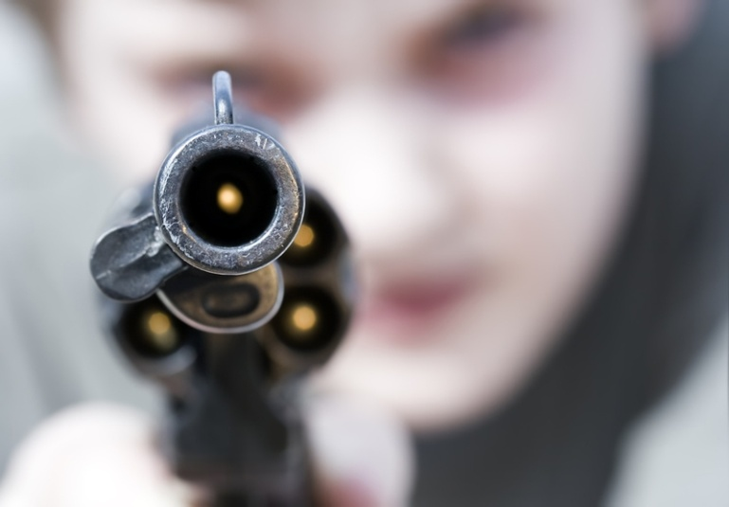
Active Shooter
Defined as one or more subjects who participate in a random or systematic shooting spree demonstrating their intent to continuously harm or kill others.
Active Shooter Survival
Notes:
Most active shooter situations are over in a matter of minutes. It is imperative to contact law enforcement as soon as possible to end the violence.
How you respond will be determined by the situation and how it unfolds. Remember, there could be more than one shooter involved. If you are involved in an active shooter situation, remain calm
and use these tips to help you plan a strategy for survival.

Slide 4
Indicators
Typically people do not just “snap”. There are indicators of potentially violent behavior that can be observed over time.
Active Shooter Survival
Notes:
Infrequent attendance at class or work with little or no work completed
Excessive procrastination and very poorly prepared work, especially if inconsistent with previous work
Lack of energy or frequently falling asleep in class or at work
Repeated requests for special considerations (eg. Deadline extensions, vacation time, tardiness, etc.)
Dependency (e.g the student who hangs around or makes excessive appointments during office hours)
Behavior which regularly interferes with effective class management or established norms and protocols at work
Students or employees who appear overly nervous, tense or fearful
Unable to make decisions despite your repeated efforts to clarify or encourage
Marked changes in personal hygiene
Impaired speech and disjointed thoughts
Bizarre behavior that is obviously inappropriate for the situation (e.g., talking to something/someone that is not present)
Frequent or high levels of irritable, unruly, abrasive, or aggressive behavior
Threats to others or self

Slide 5
Your Response
What can you do?
What should you do?
Active Shooter Survival
Notes:
Develop a survival mindset
Know your surroundings before an emergency happens
Ask yourself What if? And develop a plan
Leave the area
Notify authorities
Find a safe place
Fight back

Slide 6
Leave the Area
If it’s safe to do so, leave the area and find a safe place
Active Shooter Survival
Notes:
If you can and you feel it is safe, leave the area and get to a safe place
Rely on your senses and react quickly
Leave belongings behind but take your cell phone if it is nearby
If outside when shooting begins, drop to the ground and lay as flat as possible.
Find a safe place to hide
When you reach a safe place, stay down and don’t move
Wait and listen for instructions from law enforcement

Slide 7
Notify Authorities
Call 911
Active Shooter Survival
Notes:
After you are in a safe place, call 911
Be prepared to provide the following information:
Name
Telephone number that you are calling from
Location that you calling from
Location of the actor
Suspects description
Type of weapons that he/she had
Number of actors
Direction of travel
Any known injured people
Any vehicle information if applicable
Do not assume someone has already called the police. You may be able to provide additional information that someone has not told the police. Police can then use the information that you provide to track the shooter(s).

Slide 8
Find a safe place
Find a safe and secure place to hide
Active Shooter Survival
Notes:
If you can not escape, find a safe place to hide
Hallways should be avoided
Try to stay as quiet as possible
Try not to hide in groups; the more people, the more potential victims
Turn out the lights
Close and Lock the door
Keep Away from the door frames and windows
If the shooter believes the room is vacant, they are less likely to enter that room.
Lock all the doors and windows
Utilize furniture or heavy items to block the door
If the door opens in toward you, utilize a door stop or 3 ring binder to wedge under the door.
Using your body as a barrier is NOT a good option; you want to put obstacles between you and the armed shooter.
Develop a plan about what you will do if the shooter enters your immediate vicinity.

Slide 9
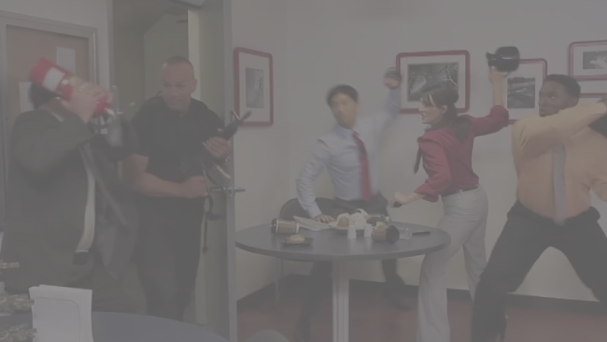
Fight Back
Fight for your life
Active Shooter Survival
Notes:
This is a last resort – you have exhausted all other options.
This is a life and death situation.
If you decide to take out the assailant, you must be prepared to disrupt his/her actions to stop the threat.
Realize you could get hurt or killed.
Do not hesitate. Be decisive.
These methods of action may or may not be implemented in sequential order.

Slide 10
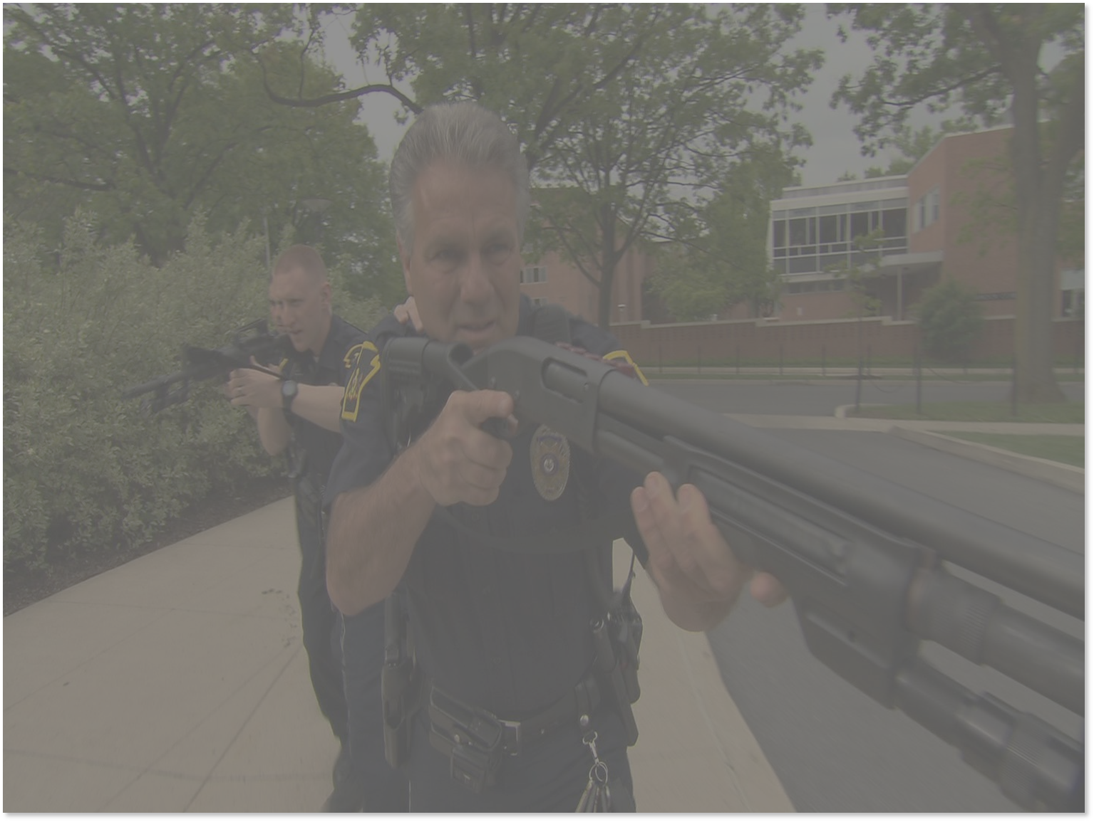
When help arrives
Follow instructions from Law Enforcement
Active Shooter Survival
Notes:
Law enforcement will immediately respond to the area.
It is important for you to convey to others that help is on the way. Remain inside the secure area.
Law enforcement’s top priority is to locate, contain, and stop the shooter.
The shooter may choose not flee when law enforcement enters the building. Remember the shooter’s mindset is not escape. Their goal is to kill and injure.
Do not run at or make sudden movements towards law enforcement
Follow instructions given by the officer: Law Enforcement officers do not know who you are or who the shooter is.
Show them your hands over your head with palms open (demonstrate)
Officers might have weapons pointed in your direction. This is not intended to scare you. Police do not know who you are or who the shooter is.
Injured persons
Initial responding officers will not treat the injured or begin evacuation until the threat is neutralized.
You may need to explain this to others in an attempt to calm them.
Once the shooter is contained, officers will begin treatment and evacuation.
Evacuation
Safety corridors will be established. This may be time consuming.
Remain in secure areas until instructed otherwise.
You may be instructed to keep your hands on your head.
You may be searched.
You will be escorted out of the building by law enforcement personnel.

Slide 11
How will you know?
Emergency Notification Systems
Active Shooter Survival
Notes:
Emergency Notification Systems
Media

Slide 12
Questions?
Active Shooter Survival

