Slide 1
PASFAA Conference October 31, 2012
Federal Tax
Individual Returns
Forms 1040/1040EZ/1040A
Partnership Returns Form 1065
Corporate Returns Sub-chapter S Form 1120S
Presenter
Joseph Pugliese, CPA, MBA
pugliese56@aol.com

Slide 2
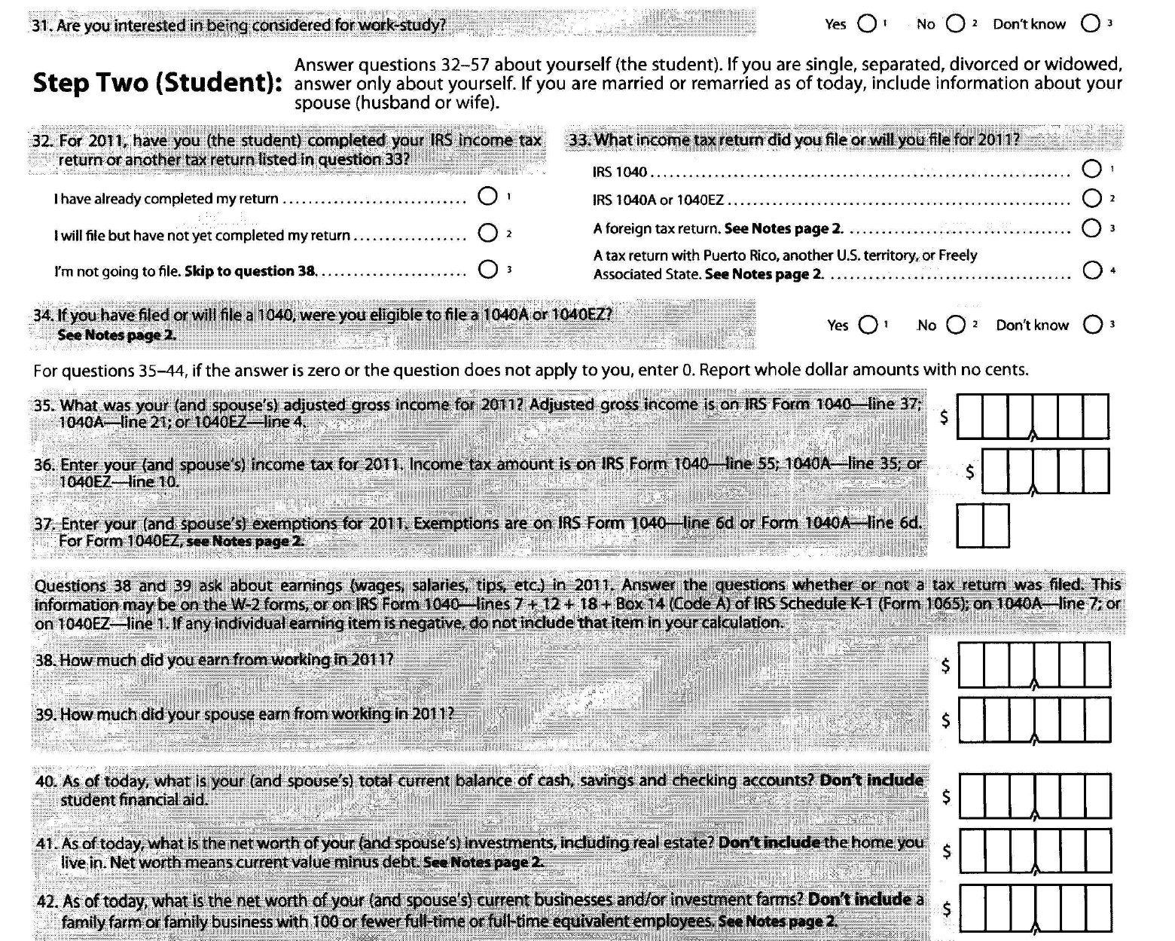
FAFSA Form Page 4

Slide 3
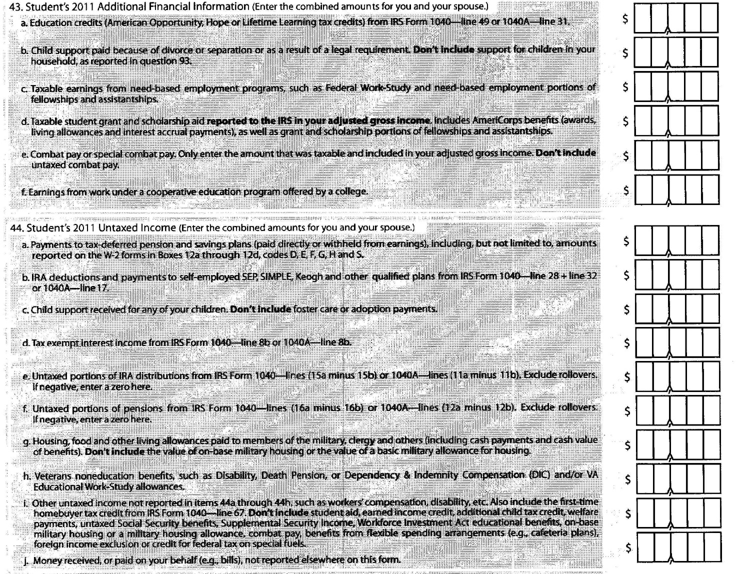
FAFSA Form Page 5

Slide 4
Individual taxpayers file:
Form 1040 EZ
Form 1040A
Form 1040
Partnerships file:
Form 1065
Schedule K-1 issued
Corporation file:
Form 1120S
Schedule K-1 issued
Form 1120
Dividends declarations

Slide 5
Form 1040EZ
US Individual Income Tax Return
Requirements for filing Form 1040EZ
Your filing status is single or married filing jointly
You do not claim any dependents
You do not claim any adjustments to income
You claim only the earned income credit
You (and your spouse if filing a joint return) were under age 65 and not blind at the end of 2011
Your taxable income (line 6 of Form 1040EZ) is less than $100,000
You had only wages, salaries, tips, taxable scholarship or fellowship grants, unemployment compensation, or Alaska Permanent Fund dividends, and your taxable interest was not over $1,500
You do not owe any household employment taxes on wages you paid to a household employee
You are not a debtor in a chapter 11 bankruptcy case filed after October 16, 2005

Slide 6
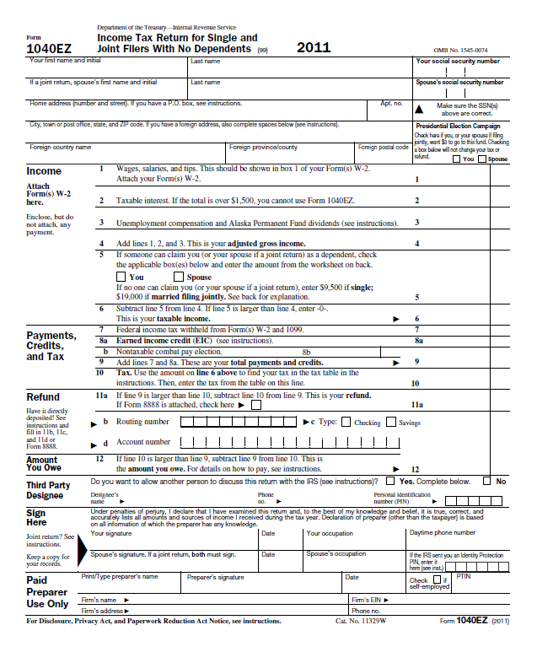

Slide 7
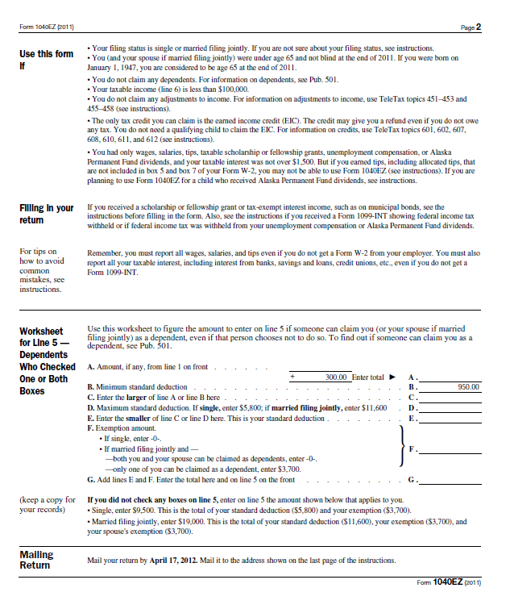

Slide 8
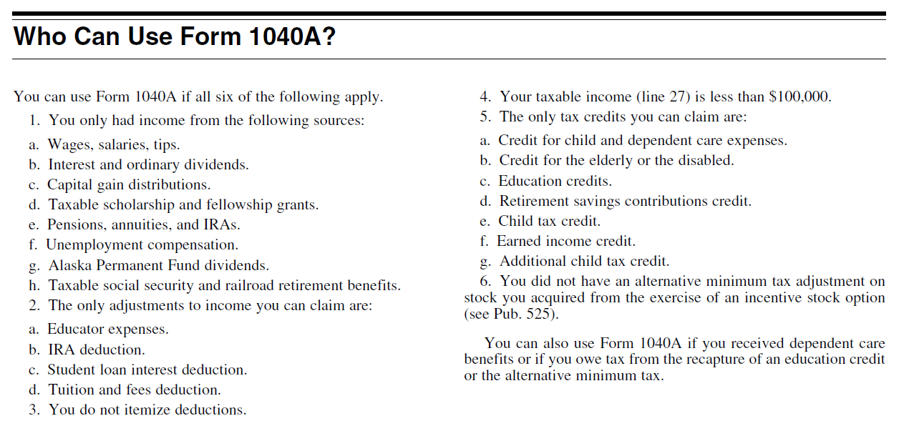
Form 1040A

Slide 9
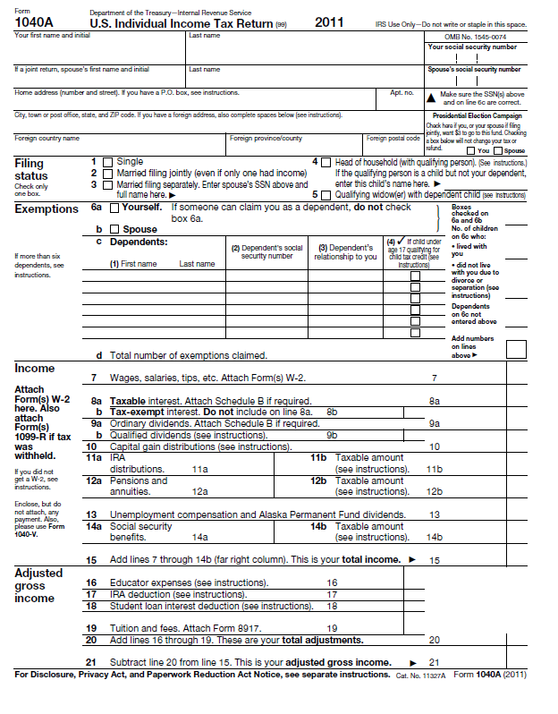

Slide 10
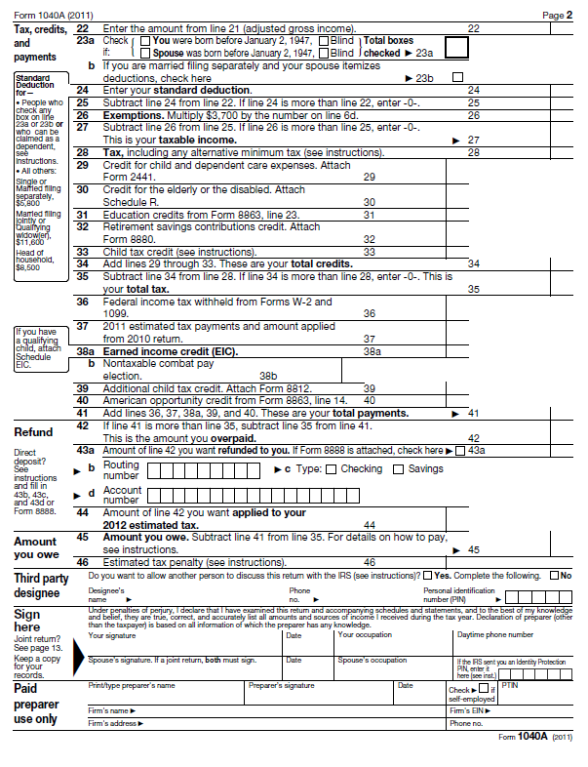

Slide 11
If you don’t meet requirements for 1040EZ or 1040A then you file Form 1040

Slide 12
Who Must File

Slide 13
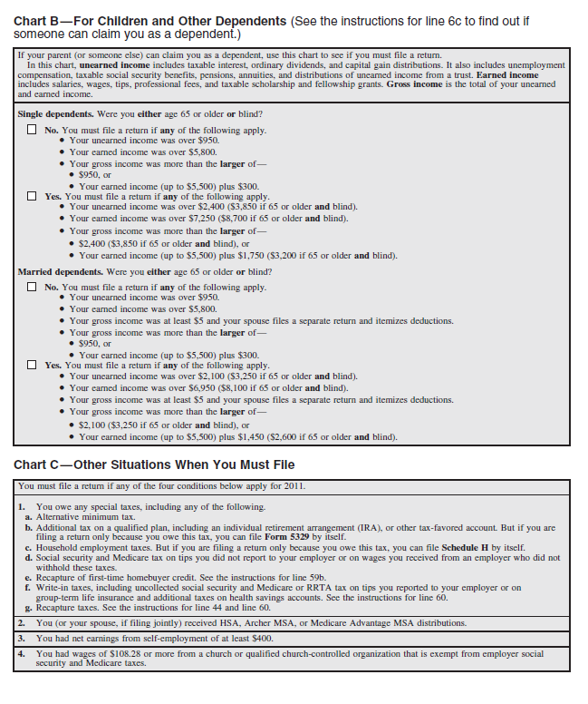

Slide 14
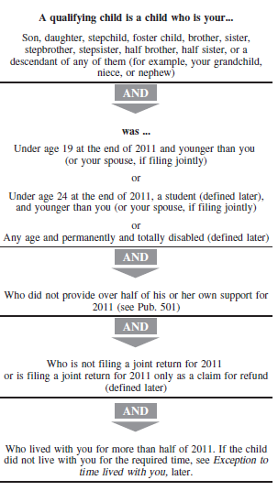
Dependent?

Slide 15
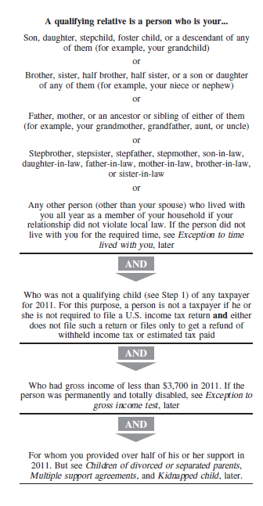
Dependent?

Slide 16
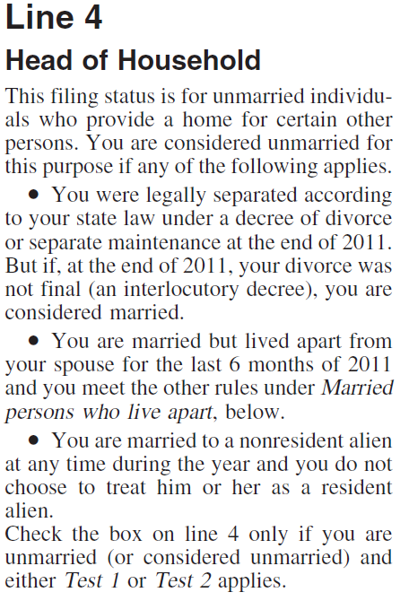
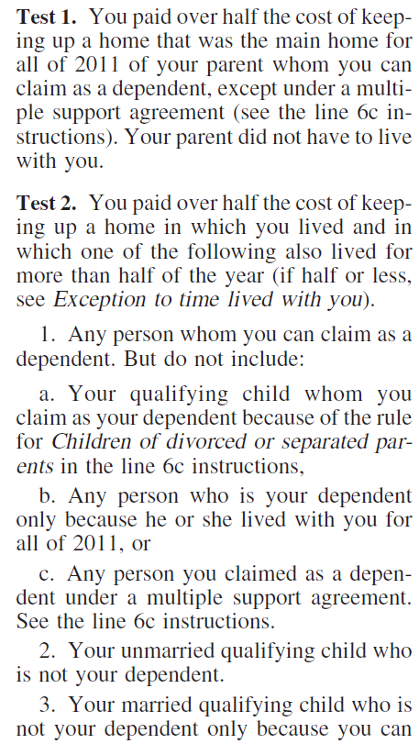
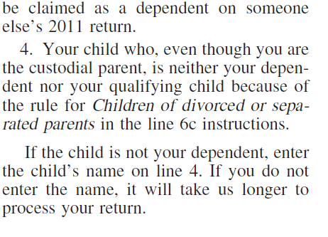

Slide 17
Form 1040 Information of Value
Form 1040
Schedule A – Itemized Deductions
Medical Expenses
Taxes
Interest
Contributions

Slide 18
Form 1040 Information of Value
Form 1040
Schedule B - Interest income
Bank Accounts
Number of accounts
Brokerage Accounts
Bonds
Private Mortgages
Schedule B - Dividend Income
Stock Ownership
Mutual Funds
Schedule C – business income
Schedule E
Rental income – Property ownership
Royalty income
Schedule K-1 Partnership or Sub-S Corp income

Slide 19
Form 1040 Information of Value
Contributions to Retirement Plans (Info on 1040, W-2 or Form 5498)
Pensions
IRA
401k
403b
408
409
457

Slide 20
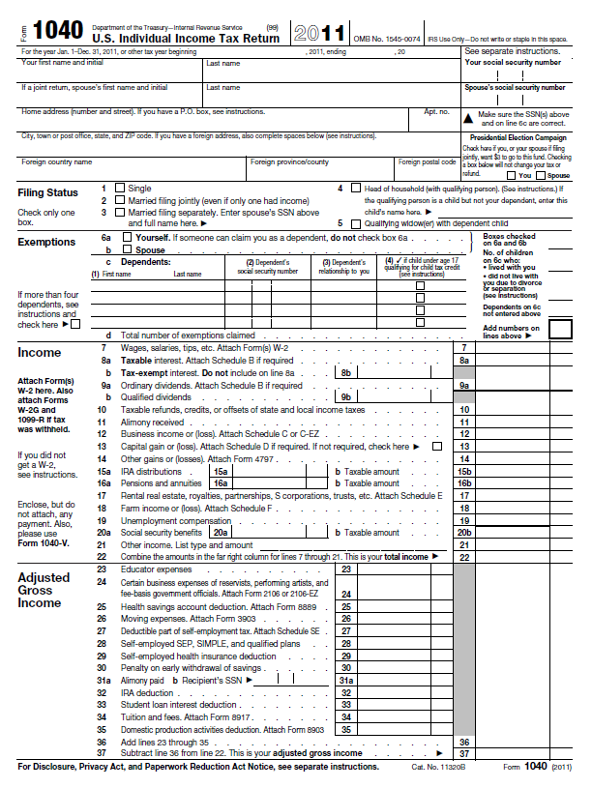
W-2
1099 – INT
1099 – INT
1099 - DiV
1099 – DIV
1099-G
1099-R 1099-R
1099-R 1099-R
1099-G
1099-G
1098-E
1098-T

Slide 21
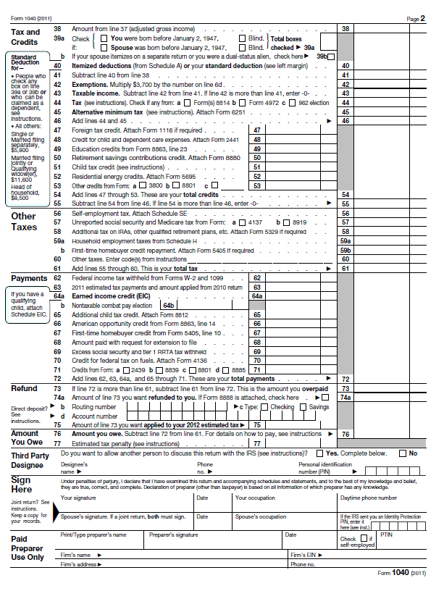

Slide 22
Reportable Income or Deductions
Income reported on Form W-2
Wages
Salary
Bonus
Commission
Tips
Vacation Days/Sick Days not taken
Other income/payments or deductions reported on Form 1099 or 1098

Slide 23
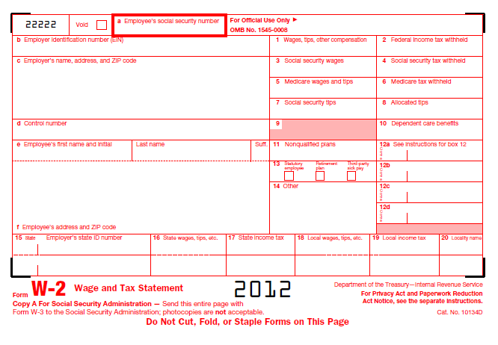
Form W-2 Wage and Tax Statement

Slide 24
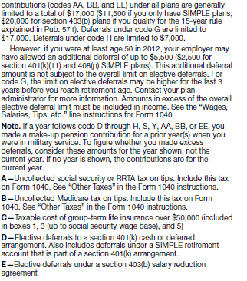

Slide 25
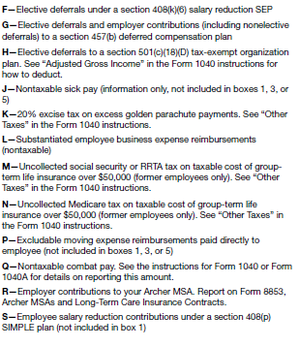

Slide 26
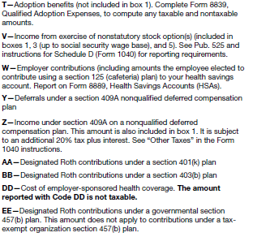

Slide 27
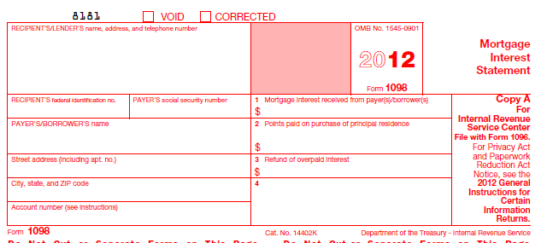
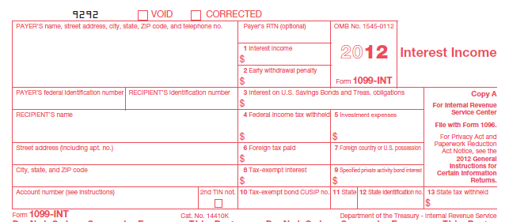
Form 1098 Mortgage Interest Statement
Form 1099 Interest Income

Slide 29
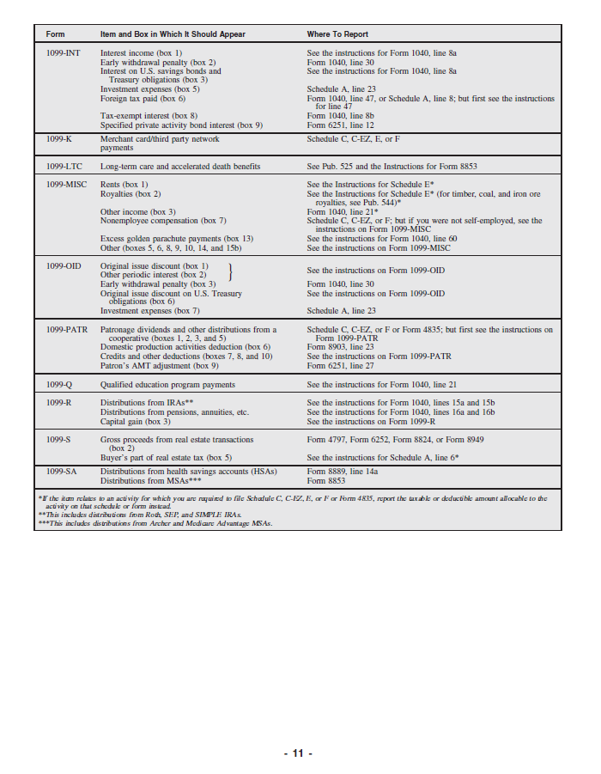

Slide 30
Form 1040 Schedule A
Schedule A – Itemized Deductions

Slide 31
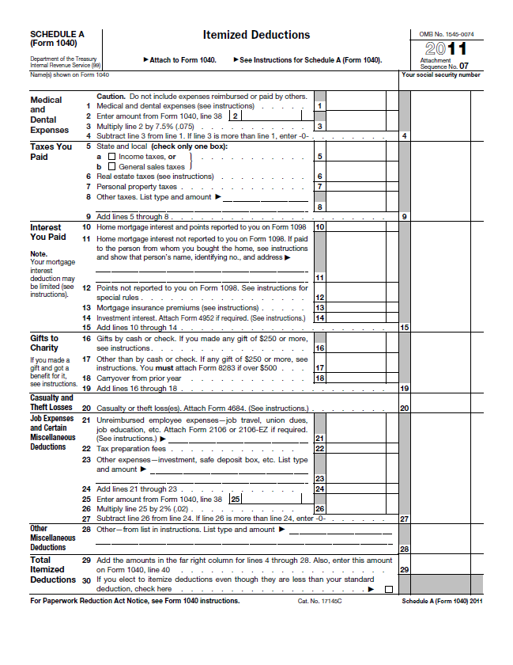

Slide 32
Form 1040 Schedule B
Schedule B – Interest and Ordinary Dividends

Slide 33
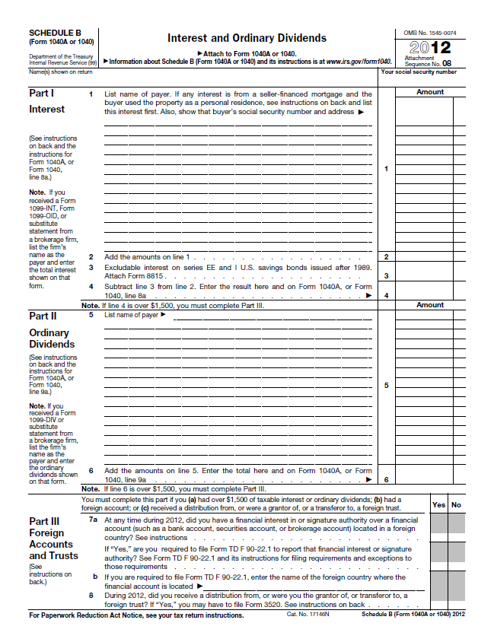

Slide 34
Form 1040 Schedule C
Schedule C
Used to report Profit or Loss from a business
Used primarily by individuals
Used by unincorporated businesses
Depreciation is a non-cash expense
Other Non-cash expenses
Any income must pay Social Security tax at 15.3% as well as federal income tax

Slide 36
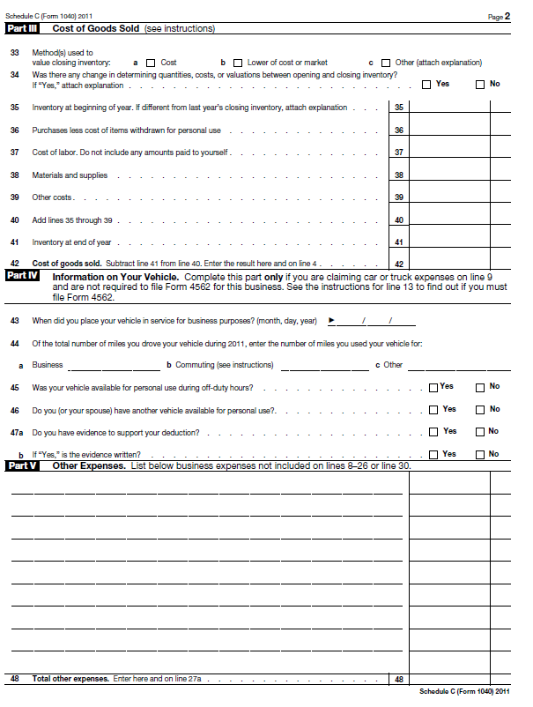

Slide 37
Form 1040 Schedule D
Schedule D
Used to report short term capital gains – assets held one year or less
Used to report long term capital gains – assets held more than one year
ST gains taxed as ordinary income
LT gains taxed at 15%
Gains on sale
Stocks
Bonds
Properties
Equipment
Business

Slide 38
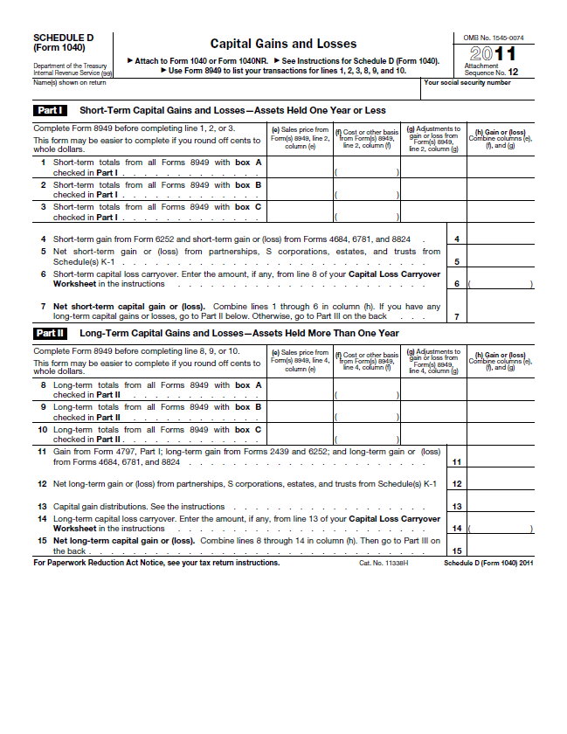

Slide 39
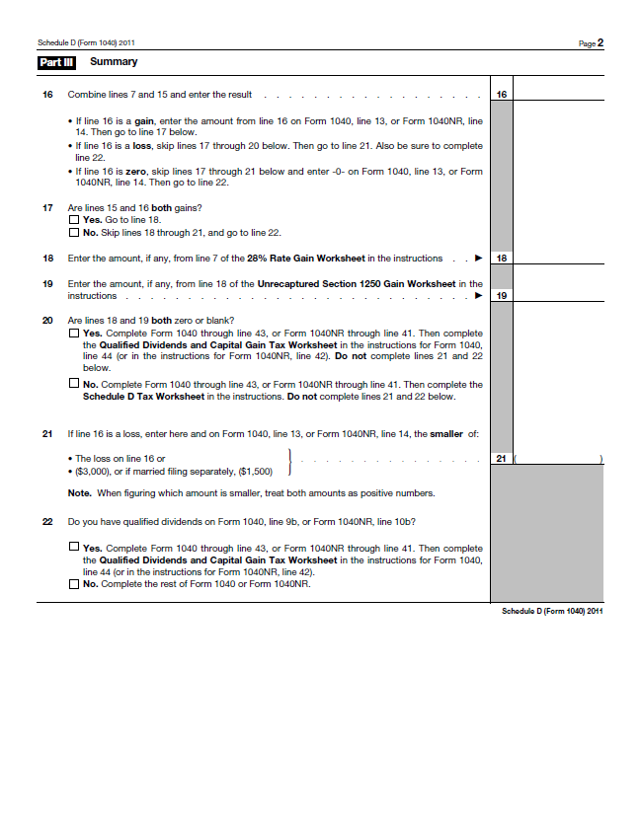

Slide 40
Form 1040 Schedule E
Schedule E
Used to report income and loss on rental properties
Used to report royalty income
Used to report income from Schedule K-1 for Sub – S Corporations
Used to report income from Schedule K-1 for Partnerships
Depreciation expense on properties – a non-cash exp

Slide 41
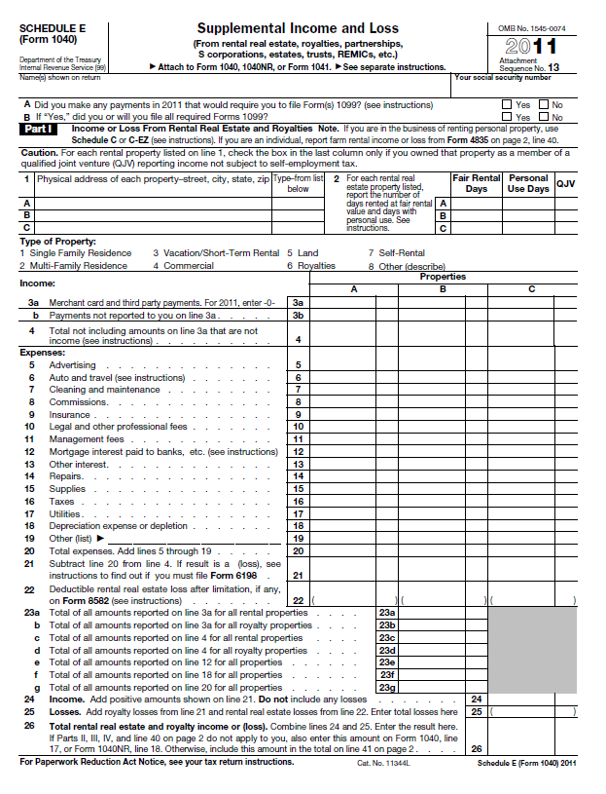

Slide 42
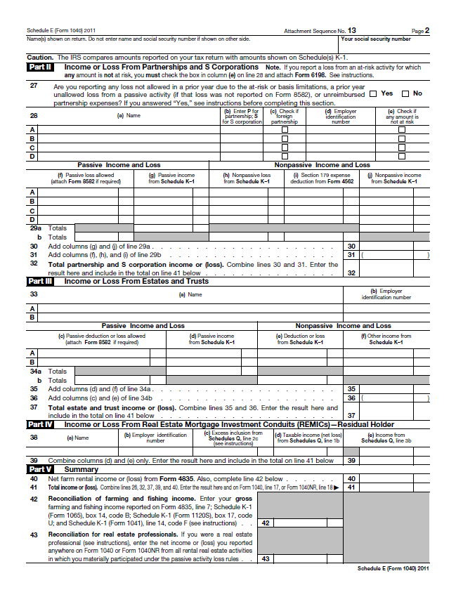

Slide 43
Partnership Return Form 1065
Form 1065
Used to report income or loss from partnership
Schedule K-1 reports individual partners’ share of income to report on Form 1040 Schedule E

Slide 44
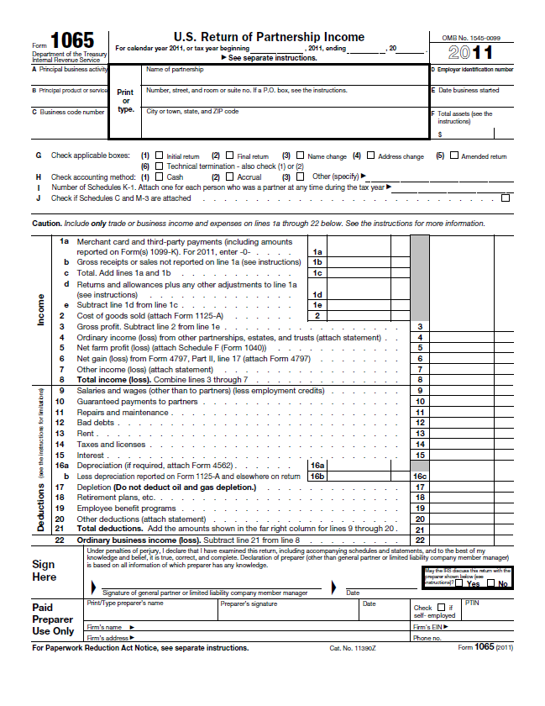

Slide 45
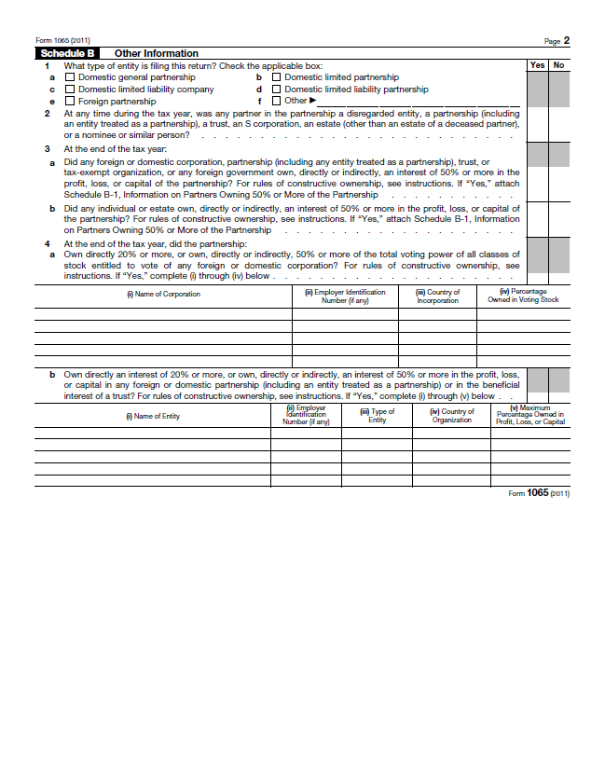

Slide 46
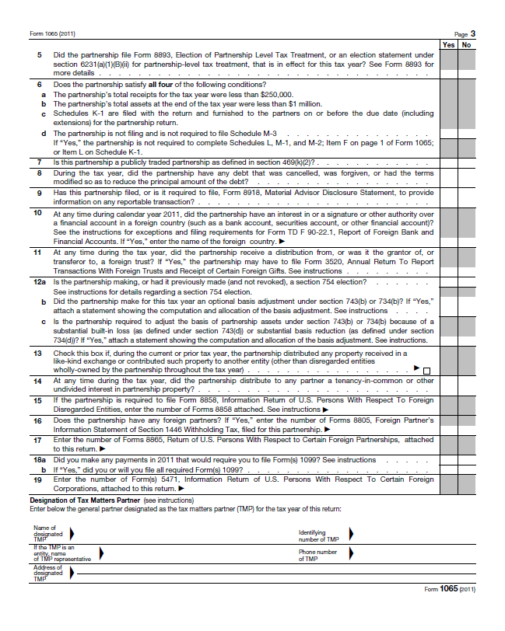

Slide 47
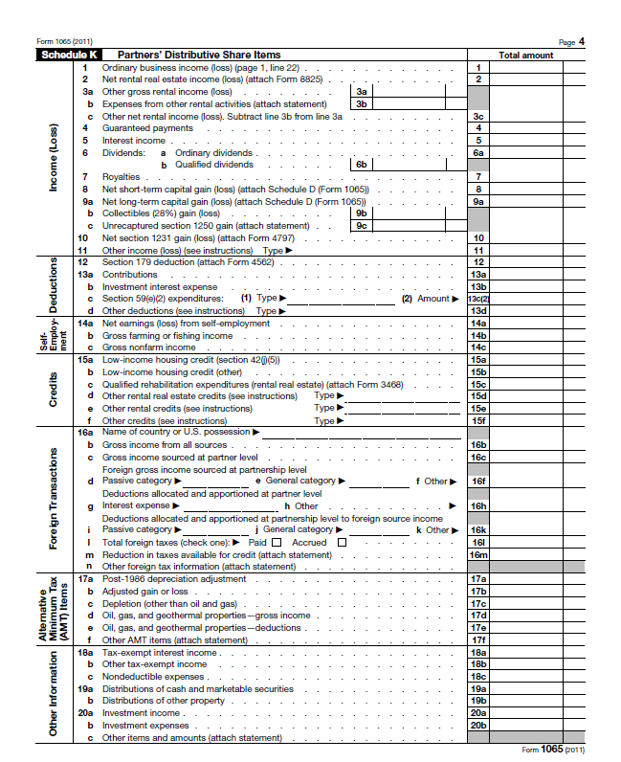

Slide 48
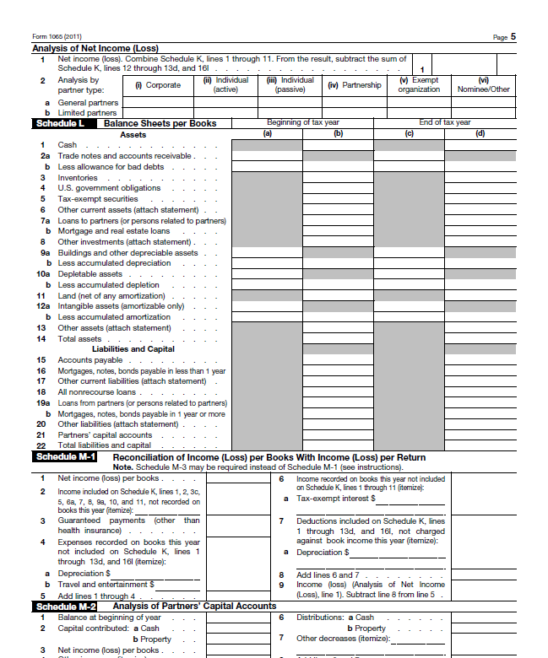

Slide 49
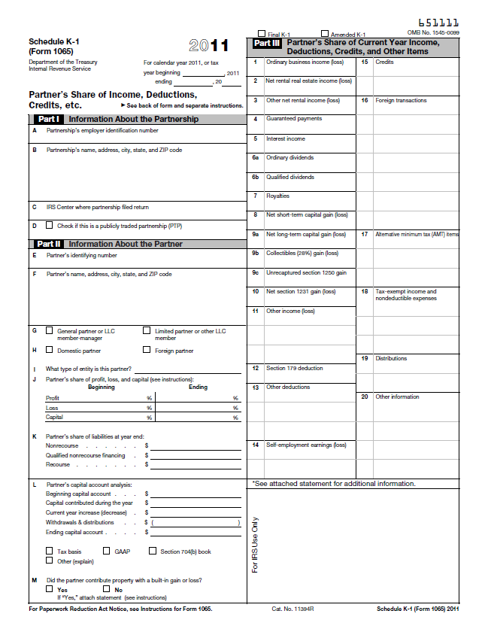

Slide 50
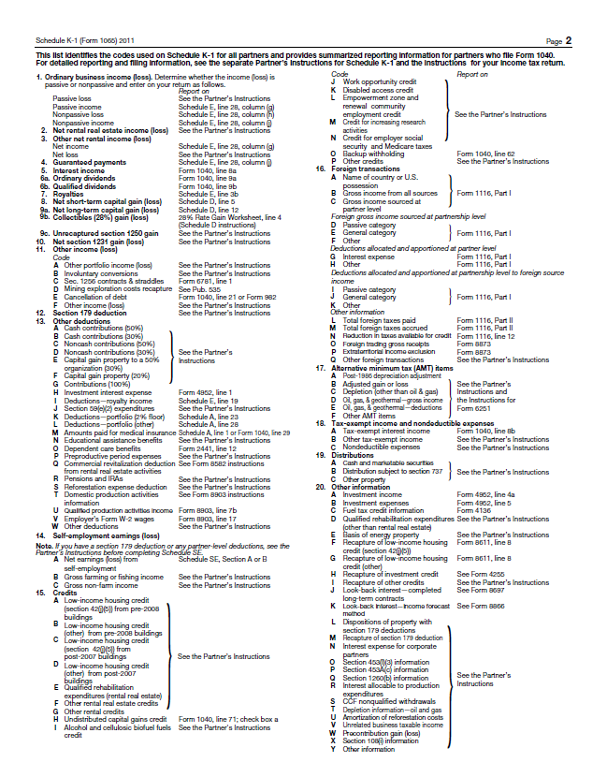

Slide 51
Partnership Return Form 1120S
Form 1120S
Used to report income or loss from Sub-chapter S Corporation
Schedule K-1 reports individual partners’ share of income to report on Form 1040 Schedule E

Slide 52
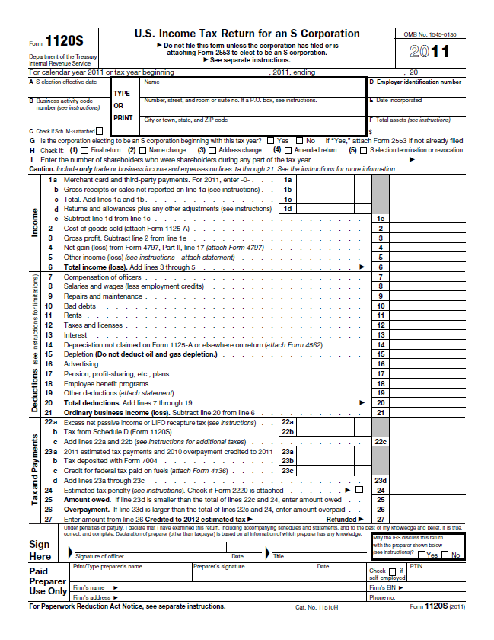

Slide 53
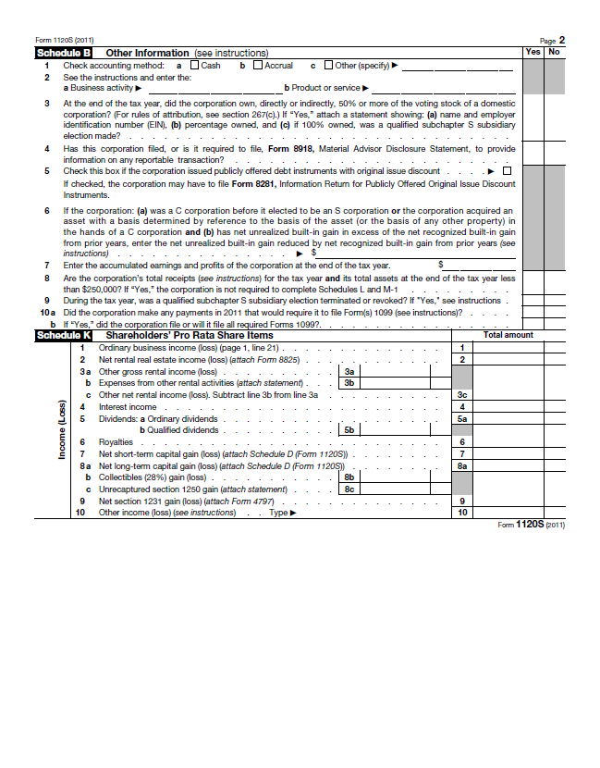

Slide 54
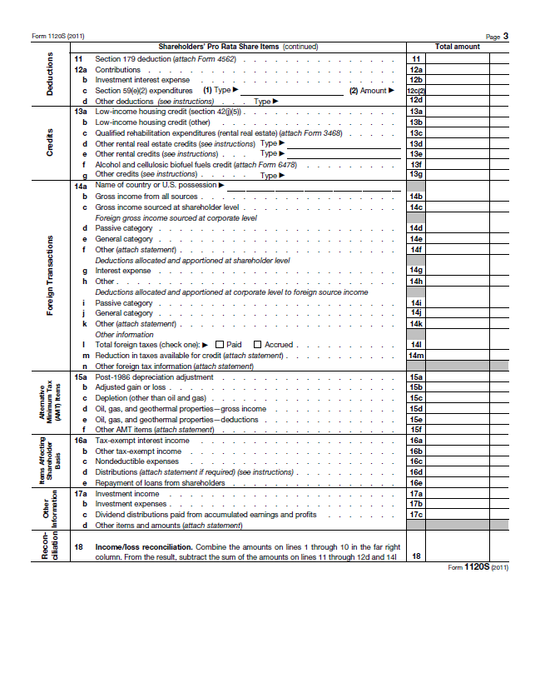

Slide 55
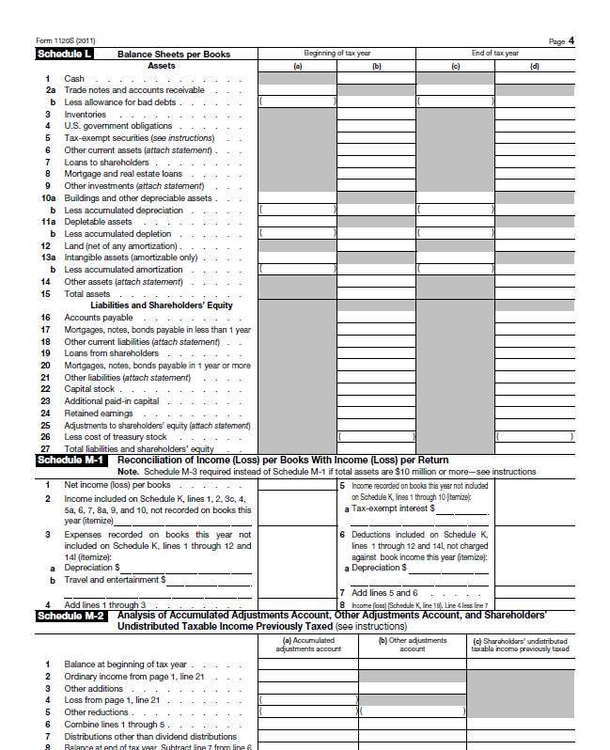

Slide 56
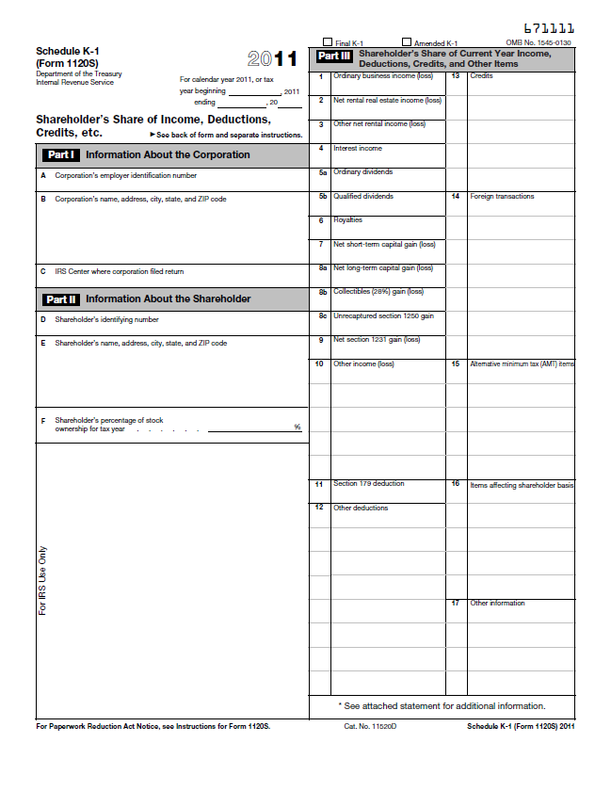

Slide 57
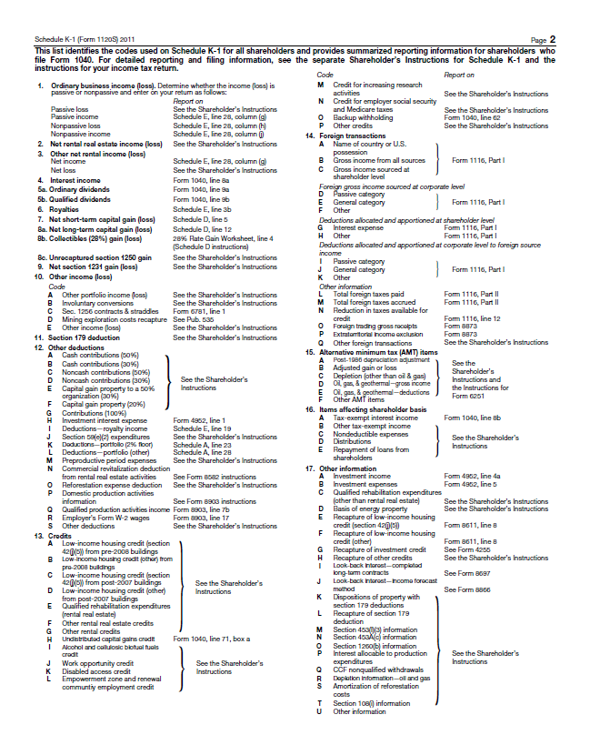

Slide 58
Thank you

