Slide 1
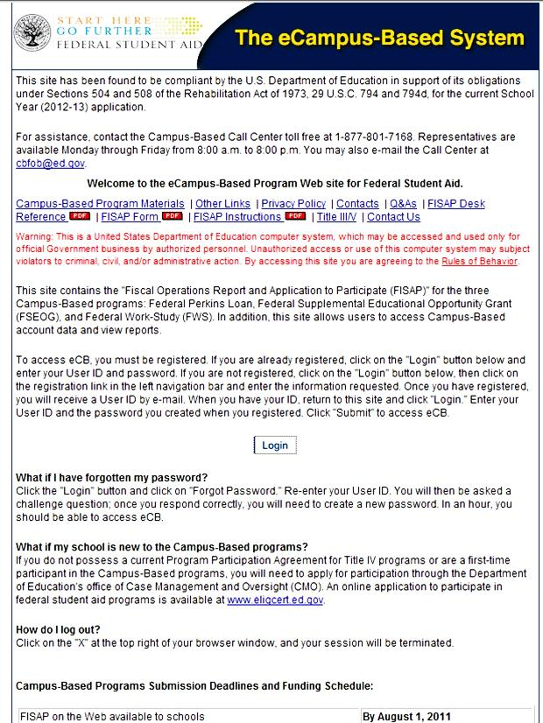
Attaining an Error Free FISAP
PASFAA Annual Conference
Harrisburg, PA
October 2012
Greg Martin

Slide 2
Fiscal Operations Report and Application to Participate (FISAP) –What is it?
The FISAP is the school’s operations report on how Campus-Based Program funds were spent for the reporting year that has just ended
and
The FISAP is the school’s application to participate in the Campus-Based Programs and request funds for the upcoming year

Slide 3
When is the FISAP Due?
By October 1 of each year
If October 1 falls on a weekend, the due date would be the Friday before. For example, the 2011 due date was September 30
Revisions to the initial FISAP submission may be made through December 15
December 16 the FISAP form is locked

Slide 4
FISAP on IFAP
http://ifap.ed.gov/eannouncements/062011FinalFormInstruandTechRefforFISAPDue093011.html
Form, Instructions and Technical Reference published by August 1
Tentative Awards made by February 1
Final Awards made by April 1

Slide 5
FISAP
Part I – Identifying Information, Certification, and Warning Instructions
Part II – Application to Participate, Request for Funds, and the Eligible Applicant Grid
Part III – Federal Perkins Loan Program Report (cumulative and award year data)
Part IV – FSEOG Program Report
Part V - FWS Program Report
Part VI – Program Summary

Slide 6
FISAP Corrections Due by December 15
Initial submission due by October 1 (or the Friday before if October 1 falls on the weekend)
Schools have until December 15 to make revisions to FISAP data after the initial submission
After December 15, revisions must be requested through Campus-Based Programs staff via the FISAP change request process within eCB

Slide 7
Failure to Make Required Revisions
Impacts tentative and final awards; there are limited funds appropriated annually
School may receive less than what they are eligible for or be over-awarded and required to repay after an audit
Base guarantee affected if request is less
Fair share may also be affected
Annual funding amount may be reduced in G5 by ED
No reinstatement of funds for reporting errors

Slide 8
Failure to Make Required Revisions (cont.)
Amount expended on FISAP is official statement
Funds in G5 will be adjusted to match and a negative balance may result

Slide 9
Accurate FISAP Data
Schools are requested to make necessary revisions after the December 15 deadline to ensure FISAP historical data is accurate
A-133 audit findings
Award cancellations
Ineligible students
Errors in reporting

Slide 10
FISAP Change Request after December 15
FISAP revisions are made in the “working copy” of the FISAP by the school
Cannot submit the revisions until Campus- Based staff approves and “unlocks” the FISAP for submission
School has five days after the FISAP change request approval to submit the revisions

Slide 11
FISAP Change Request after December 15
Campus-Based staff work with the school to ensure revisions are made correctly and that the school understands the possible impact of the revisions made

Slide 12
FISAP Changes after December 15
Examples of changes not permitted:
Increase/decrease in requested FSEOG, FWS, Perkins LOE
Increase/addition of administrative cost allowance for any Campus-Based Program

Slide 13
FISAP Changes after December 15
Items that have the most impact on funding levels:
Number of enrolled students
Total tuition and fees
Total grant funding expended
Eligible applicant grid changes

Slide 14
Common Errors in FISAP Filing
Schools do not coordinate with other offices on campus in collecting and reconciling program information
Schools do not validate FISAP information provided by third party servicers

Slide 15
Examples of Offices Involved in Collection/Reporting of FISAP Data
Financial Aid Office – awards/disbursements
Registration – enrollment/program of study
Business Office – disbursements/drawdown
Admissions – eligible program of study/admission status (guest student vs. regular student

Slide 16
FISAP Errors
Mergers/Splits
Schools combine or separate FISAP reporting data too soon
Schools do not request funding for all involved schools
Schools need to work with school compliance staff, FSA’s internal controls, and campus-based staff to ensure proper reporting

Slide 17
Part II, Section A – Request for Funds for the Award Year
Schools request more than what they can reasonably expend resulting in unexpended funds for the year
Schools request less than what they can reasonably expend resulting in inadequate funds for students

Slide 18
Part II, Section A – Request for Funds for the Award Year
Schools participating in the Perkins Loan Program do not request a Perkins Level of Expenditure (LOE) to obtain authority to advance funds to students
Schools participating in the Perkins Loan Program do request a Perkins LOE and do not advance funds to students

Slide 19
Part II, Section B – Federal Perkins Loan Liquidation Request
Schools wishing to liquidate their Perkins Loans portfolio do not indicate “YES”
Schools not wishing to liquidate their Perkins Loans portfolio indicate “YES” every year which will trigger the liquidation process

Slide 20
Part II, Section C – Waiver Request for the Underuse of Funds
Schools with unexpended Campus-Based funds do not request a waiver for the underuse of funds, resulting in a funding penalty for the following year

Slide 21
Part II, Section D – Information on Enrollment
Schools misreport the number of enrolled students
Report students enrolled only in audit courses
Report students not enrolled in an eligible program of study

Slide 22
Part II, Section E – Assessments and Expenditures
Schools misreport total tuition and fees (Question # 22)
Identified through audit or program review
Revising student account records
Lack of coordination between campus offices (Registration, Business Office, Financial Aid)

Slide 23
Part II, Section E – Assessments and Expenditures
Total Title IV, Part A, Subpart I, Grants (Total Federal Pell Grant expenditures (#23a), Total ACG expenditures (#23b), Total Smart expenditures (#23c)
Identified through an audit or program review
Revisions as a result of R2T4 calculations
Lack of coordination between the business office and the financial aid office

Slide 24
Pell and ACG/Smart Grants for 2013-14 FISAP Reporting
Pell Grant expenditures may be significantly less due to the cancellation of two Pell Grants in an award year
ACG/SMART Grants – 2010-11 last year funded, reporting not required beginning with the 2013-14 FISAP

Slide 25
Part III, Section A – Federal Perkins Loan Program
Discovery of Perkins Loan Identity Theft
Report this information on line 26 – Loan Principal Adjustments and on line 55 – Other Costs or Losses

Slide 26
Part III, Section C - Cumulative Repayment Information as of June 30
Schools misreport the number of accepted assigned Perkins Loans and the dollar amount of accepted assigned loans
Servicer reports to the schools are not reviewed to determine assigned loans not accepted by the Department

Slide 27
Part IV, Section A - Federal Funds Authorized for FSEOG
Amount is adjusted (downward) by the school to eliminate unexpended funds
Should only be adjusted if funds were returned to the Department through the reallocation process
Adjustments to the final award as a result of the reallocation process (returning funds/receiving supplemental funding) will be reflected in the Statement of Account (SOA)

Slide 28
Part IV, Section B – Federal Funds Available for FSEOG Expenditures
Schools neglect to move FSEOG funds to a prior year or to the next year
Results in unexpended funds for the program if not reported fully expended for the reporting year

Slide 29
Part IV, Section D – Federal Funds Spent for FSEOG Program
FSEOG Administrative Cost Allowance (ACA) claimed
Schools fail to claim enough ACA to expend full authorization resulting in unexpended funds
Cannot make FISAP change to this data element after December 15

Slide 30
Part V, Section A – Federal Funds Authorized for FWS
Amount is adjusted by the school to eliminate unexpended funds
Should only be adjusted if funds were returned to the Department through the August reallocation process
Adjustments to the final award as a result of the reallocation process (returning funds/receiving supplemental funding) will be reflected in the SOA

Slide 31
Part V, Section B – Federal Funds Available for FWS Expenditures
Schools neglect to move FWS funds to a prior year or to the next year
Results in unexpended funds for the program if not reported fully expended for the reporting year

Slide 32
Part V, Section C – Total Compensation for FWS
School misreports on-campus vs. off-campus compensation
School misreports institutional share of earned compensation
Must coordinate with office(s) that handle student employment and payroll

Slide 33
Part V, Section D – Funds Spent from Federal Share of FWS
FWS Administrative Cost Allowance (ACA) claimed
Schools fail to claim enough ACA to expend full authorization resulting in unexpended funds
Cannot make FISAP change to this data element after December 15

Slide 34
Part V, Section E – Use of FWS Authorization
Errors made in prior sections of Part V result in reporting errors in Expended and Unexpended FWS funds

Slide 35
Part V, Section G – Information About FWS Students Employed in Community Service Activities
Required 7% of authorized funding to be spent in community service (7% is based on the total of the Final Award, minus reallocated funds, plus all supplemental funds)
Require at least one reading tutor

Slide 36
Part V, Section F – Job Location and Development (JDL) Program
Schools neglect to use funds for JDL program

Slide 37
Part V, Section G – Information About FWS Students Employed in Community Service Activities
Schools who choose not to participate in community service employment and/or tutor requirement may have penalty imposed
Can apply for community service waiver (information posted on IFAP in electronic announcement annually)

Slide 38
Part VI, Section A – Program Summary for Award Year
Unduplicated student count is misreported
This amount is often reported to be more than total Campus-Based recipients
Most financial aid software vendors provide ability to pull this data
School must resolve error or edit records from system report
Errors typically due to R2T4 calculations

Slide 39
Why are FISAP Filing Errors Made?
Waiting too late to file – not having all information needed
Changes in staffing
Mergers/Acquisitions/Splits
Lack of understanding of the program and reporting requirements
Lack of coordination among campus offices related to Campus-Based Program reconciliation

Slide 40
Transferring Campus-Based Funds from One Year to Another
Misconception that Campus-Based funds must also be moved in G5 if funds reported moved to the next year on the FISAP
Funding should remain in the year it was authorized and drawn from that year for expenditures in a subsequent or prior year
Funds can be carried forward/backward for one year, not year after year
Funds are available in G5 for drawdown for five years

Slide 41
Transferring Campus-Based Funds from One CB Program to Another
Schools may transfer up to 25% of a Campus-Based program’s annual authorization between the following programs:
FWS to FSEOG
FSEOG to FWS
FWS to Perkins Loans only if the school received a LOE for the award year

Slide 42
Transferring Campus-Based Funds To/From the Perkins Loan Program
The transfer of funds from Perkins Loans is only allowable in years when Federal Capital Contribution is allocated to schools or if the school received a LOE
The LOE is the authority from ED for the school to participate and spend monies from the Perkins Loan funds for that award year

Slide 43
Campus-Based Program Funds Transferred and G5
Funds transferred to another Campus-Based Program must be reported on the FISAP and drawn in G5 from the program initially authorized

Slide 44
Problems Viewing a PDF File from within the eCB System
Some schools are reporting seeing lines of code or other illegible data when attempting to open a .pdf document in the eCB system when accessing the system using a computer with Windows 7 operating system

Slide 45
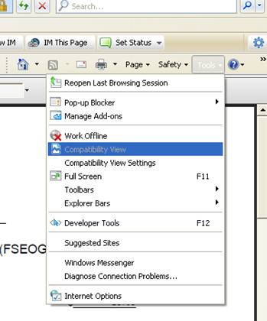
Problems Viewing a PDF File from within the eCB System
When the .pdf window opens, select “Tools” from the right side of the screen and select “Compatibility View”

Slide 46
Problems Viewing a PDF File from within the eCB System
If “Compatibility View” is not available:
Select “Compatibility View Settings” and press the “Add” button to add the website
This is similar to the previous issue, but can be encountered with any version of the Windows operating system

Slide 47
eCB PDF Security Issue
Some schools are receiving the form in “code” or receiving the “Security Certificate” issue

Slide 48
eCB PDF Security Issue Fix
While in Internet Explorer, go to “Tools,” then Internet Options
Select the “Security Tab,” and then click “Trusted Sites,” which should take you to a screen that shows your current web address in a box with “Add” beside it (You need to be logged in to eCB at the time)
Then select “Sites”
Select “Add,” and it will add the FISAP site to your trusted sites to resolve the issue

Slide 49
eCB PDF/Printing Issues
The PDF won’t print or won’t print properly
If you get the following message, “there is a problem with this websites security,” select the option, “continue to use this website,” and you should be able to print

Slide 50
eCB PDF/Printing Issues
However, if that doesn’t work:
While logged in eCB, go to Self-Service page
Press/hold the ALT button down, and then select “Submitted Version” or “Working Version All Parts” link
When the system loads the FISAP, a security window should appear and ask if you want to “accept data from this site this one time only or add it to approved sites”
Release the ALT button and select “add to trusted/approved sites”

Slide 51
Contact Information
We appreciate your feedback & comments.
Perkins Loan liquidation team e-mail
PerkinsLiquid@ed.gov – for schools in the
Perkins Loan liquidation process or have
questions about the process
Phone: eCampus-Based Call Center
877-801-7168 for all other questions
regarding grants and Campus-Based Programs

Slide 52
Thank you
Greg Martin
gregory.martin@Ed.gov
215-656-6452
Comments about this presentation or my performance
Should be directed to :
Jo Ann Borel
Joann.borel@ed.gov
202-595-4385

