Slide 1

Understanding IM
Presented by
Karen Hanley and Brian Lemma
Georgetown University

Slide 2
Why IM?
Institutional Methodology (IM) was created by The College Board as an alternative to the Federal Methodology, with the goal of determining a family’s true financial strength through a more in depth analysis of their income and assets.

Slide 3
Institutional Methodology
Two variations:
  Dependent Students
  Independent Students
No simplified needs test or auto zero formula
  All assets considered
  Assets evaluated separately from income
  Minimizes “cliff effect” results
Notes:
The IM does not include a SNT or bypass formula. Institutions using the IM believe that these formula variations result in a possible cliff effect since an applicant with a dollar more of AGI can have an EFC significantly higher than a family whose income falls below the $50,000 or $ 30,000 levels.
The IM does include 3 different formulas with two variations:
Dependent students (same basic defining criteria as FM). Dependent students are deemed to be the primary beneficiaries of the education and are assessed accordingly in the IM need analysis. Parents of dependent students are deemed to have a primary responsibility for paying for education to the extent they are able but as you will see when you look at the tables, the income and asset assessment rates are lower than for dependent students and they also have greater income and asset allowances.
Independent students are defined the same was as in the FM.

Slide 4
Income in Need Analysis

Slide 5
Types of Taxable Income
Adjusted Gross Income (IM & FM)
Wages (earnings) (IM & FM)
Interest and dividends (IM)
Unemployment compensation (IM)
Alimony received (IM)
Capital gains (IM)
Business income (IM)
Taxable IRA, pension and annuity distributions (IM)
Rental income, royalties (IM)
Income from partnerships & S Corporations (IM)
Notes:
Those with IM designation are itemized on PROFILE - all are factored into AGI

Slide 6
Types of Untaxed Income
Untaxed interest and dividends (FM & IM)
Tax deferred pension plan contributions (FM & IM)
IRA contributions (FM & IM)
Social Security benefits (IM)
Pension income (FM & IM)
Foreign income exclusion (IM)
Earned income credit (IM)
Additional child tax credit (IM)
IM adds back “losses” (business/real estate/ and other)
Notes:
IM asks for SS benefits of siblings or parents, but not student, assuming benefits will end at age 18

Slide 7
Protecting Family Income
FM and IM protect a portion of family income for necessities
Allowances protect a base level of income
  Not designed to provide an allowance for a family’s standard of living
  Choice cannot be part of equation
Protect income at “point of zero contribution”
  Point at which a family has no discretion on allocating income
  All money is needed to maintain family
Notes:
Just as it is the job of the aid administrator to identify annual recurring income, it is of equal importance to accurately identify nondiscretionary expenses against the income to be included in the analysis. Need analysis acknowledges these expenses & provides a systematic method for protecting income.
Both the FM and IM need analysis systems provide a basis upon which to consistently allow for those expenses which are not discretionary. These include basic living expenses and taxes.
After allowances have been applied, assuming a family has some discretionary financial resources, it is reasonable to expect that a percentage of those resources will be available for college expenses.

Slide 8
Allowances against income
U.S. Income Tax (IM & FM)
State and other taxes
  IM tables include sales tax
  FM tables do not include sales or property tax
F.I.C.A. Tax (IM & FM)
Medical/Dental Expense Allowance
  IM: Percent of total income
  FM: Included only by professional judgment

Slide 9
Allowances against income
Employment Allowance
  IM: % of lowest wage, capped
  FM: % of lowest wage, capped
Annual Education Savings Allowance (AESA)
  IM: Recognizes need to save for younger children
  FM: No comparable allowance
Income Protection Allowance
  IM: Based on most current consumer expenditure data
    Updated annually
  FM: Based on “market basket” defined in 1967
    Updated annually by CPI
Notes:
The IM employment allowance is % of lesser income, capped. The FM is 35% of lesser income earned to a maximum of $3,500. Only if both parents (or single parent) works
The IM offers an additional protection: the annual education savings allowance. This allowance protects a portion of income for future higher education expenses for younger siblings. The AESA assumes that a family should be able to save from annual family income for future educational costs. If saved, this amount would equal one third of the total EFC for a private four year college at the time their student enrolls in college (see IM: What is It? For more information.
Schools using IM may also include an optional private school expense allowance which helps offset the private secondary school costs for younger siblings.

Slide 10
Adding up the assets

Slide 11
Why Include Assets ?
Concept of financial strength
  Deferred purchasing power
  Supplement to income
  Planning for retirement
Liquid vs. non-liquid assets
  An asset is an asset
  Valuation presents challenges
Philosophy about assets drives data collection
  FM
  IM
Notes:
The underlying assumption of need analysis is that parents and students have an obligation to finance postsecondary education to the extent they are able. Income and assets together are used to produce a comprehensive measure of a family’s financial strength.
One could also say that assets represent deferred purchasing power. Families accumulate assets by deferring spending on goods and services from past income. If they choose to do so, this “unspent” or “accumulated” income is available to supplement the purchase of goods from current and future income.
Need analysis looks at what additional financial capacity a family with assets may have. Additional capacity is considered a supplement to income. Assets permit families to discharge debt and to avoid new debt.
Assets are “accumulated.” Assets are “savings.” Assets can be thought of as unspent or accumulated income.
Even assets that are derived from the most frugal approach to spending represent some excess funds that were not used to purchase basic necessities.
It is generally easier for families with high assets to free up current income for educational expenses. They can use their assets rather than their income for their contribution. If they decide to borrow, they are more likely to be approved for a private loan than a family who depends on income alone.
Valuation of assets can present a problem. Liquid assets are easier to quantify. Non-liquid assets are more difficult for the family to set a realistic value and more difficult for the FAA to verify and to weigh in assessing financial strength.

Slide 12
Assets in the Methodology
Inclusions
  Current balances in cash, savings & checking accounts (IM; FM maybe)
  Investments (IM; FM maybe)
    Other real estate, vacation homes, mutual funds, trust funds, stocks, bonds, etc.
    529 savings plans, Coverdell savings accounts, prepaid tuition plans
  Parental assets held in the names of younger siblings(IM)
  Value of business (IM; FM maybe)
  Value of farm (IM; FM maybe)
  Home Equity (IM)
Exclusions
  Retirement funds
    Collected on Profile, but not included in IM
    Not collected on FAFSA

Slide 13
Asset Allowances
FM:
Education Savings and Asset Protection Allowance
IM:
  Protection for savings for future education costs
    Cumulative Education Savings Allowance (CESA)
  Protection for savings for unforeseen expenses
    Emergency Reserve Allowance (ERA)
  Protection for low income families who may rely on assets to supplement income
    Low income protection allowance
      Absolute value of any negative Available Income
Notes:
The APA was originally developed to recognize the need for families to save for retirement. As a result there was a need to protect a portion of family assets for these future retirement needs. The APA varied depending on the age of the older parent and the marital status. Today this allowance continues to exist in the FM but has been re-named the education and asset protection allowance. The derivation of the allowance remains the same:
The education and asset protection allowance is defined in the context of an annuity. This is a sum of money paid at regular intervals over the expected life of the person covered by the annuity. The formula assumes that the parents will retire at age 65 and receive an average amount of Social Security Benefits. The actual values of the ESAPA are calculated as the amount that would be needed to purchase an annuity in today’s dollars that would provide lifelong payments that, when added to expected Social Security payments, would produce the amount of income needed to maintain a moderate standard of living. BLS data are used to determine this moderate standa

Slide 14
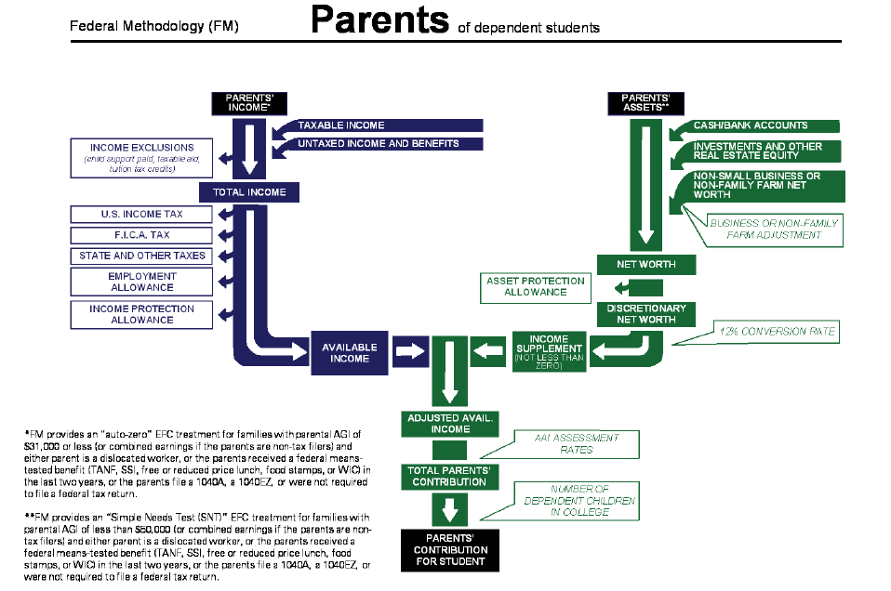
FM Pipe Chart

Slide 15
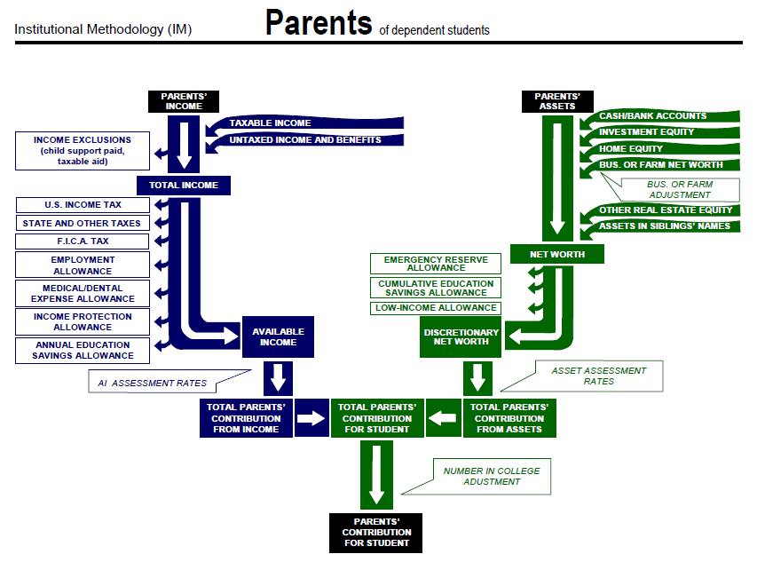
IM Pipe Chart

Slide 16
IM Options
Standard IM treatment disallows losses
  Long term capital losses
  Depreciation on business, rental property
Option to allow losses to reduce income
  If true out of pocket expense
  Should be documented
Notes:
CSS Standard rules disallow losses, option is to allow all or some to be allowed if legitimate cash flow impact

Slide 17
IM income options
Allow elementary/secondary tuition expenses
  Represents cost of one year of public education
  Institution can opt to use different amount
Rationale
  Medically/developmentally necessary
  To prepare students for highly selective colleges

Slide 18
Cost of living
Cost of living (COLA) adjustments (IPA & ERA)
  Reflects regional variances in living expenses
  Manhattan, NY vs. Manhattan, KS
  Based on zip code of parent’s residence

Slide 19
Imputing Assets
Impute assets from interest & dividend income
  Multiplication factor (representative of current interest/dividend rates) used to estimate amount of asset necessary to generate reported interest and dividend income.
  Schools may choose to use this practice when reported assets are not in line with interest & dividend income

Slide 20
Home equity in IM
Alternate treatments of home equity
  Use reported value & debt to calculate equity
  Apply housing multiplier to calculate value
  Cap home equity at % of income
  Exclude home from calculation

Slide 21
568 Presidents’ Working Group
In response to Section 568 of the Improving America’s Schools Act, the presidents of a number of leading colleges and universities reaffirmed their commitment to need-based financial aid by endorsing a comprehensive set of principles for the fair determination of a family’s contribution to the cost of an undergraduate education.

Slide 22
568 Presidents’ Working Group
Principles
  to award financial aid only on the basis of need
  to use common principles of analysis for determining need
  to use a common aid application form
  to engage in a one-time exchange of certain pre-award data of commonly admitted financial aid students

Slide 23
Case Studies

Slide 24
Case Study #1
George Town is a current student who lives with his divorced mother. He lives in Virginia Beach, VA. Mom is a wage earner and has a side business. George has no siblings.
AGI $92,362
Wages $83,831
Interest Income $20
Business loss ($15,657)
IRA distribution $24,168
Tax-deferred pension $15,902
Child support received $10,164
US taxes paid $9,063

Slide 25
Town Family
FM IM
Total income $118,428 $134,085
Allowances $41,387 $51,041
Available income $77,041 $83,044
Total Assets $8,200 $169,102
Asset Protection Allowance $16,000 $43,110
Parent Contribution $30,304 $34,459
Notes:
Home value $300,000, home debt $284,373
Year Purchased 2004
Purchase price $375,000
Home equity in calculation: $160,902
GUID G00480785

Slide 26
Case Study #2
Hoya Saxa is a current student with five in his family and a sibling in college. He lives in Garden City, NY. Both parents are wage earners. They pay $8,000 private school tuition for Hoya’s sibling and they have $20,000 in out of pocket medical expenses.
AGI $131,659
Wages $128,091
Interest and Dividend Income $398
Capital Gain $260
Business Income $2,950
Education Credits $3,000
Tax-deferred pension $2,000
US taxes paid $4,666

Slide 27
Saxa Family
FM IM
Total income $130,659 $133,659
Allowances $56,757 $96,770
Available income $73,902 $36,889
Total Assets $10,000 $174,290
Asset Protection Allowance $49,200 $110,355
Parent Contribution $14,415 $7,096
Notes:
Allowances
$8000 private school tuition
$20,000 medical expenses
Difference in asset values – home equity of $160,390 and student assets of $3900 that are counted as a parent asset.

Slide 28
Acknowledgements
The College Board
The Presidents’ 568 Working Group

Slide 29
Contact Information
Brian Lemma
bl23@georgetown.edu
Karen Hanley
ksa8@georgetown.edu

